Slide 1
CSE/STAT 416
Precision/Recall k-Nearest Neighbors
Pre-Class Video
Tanmay Shah
Paul G. Allen School of Computer Science & Engineering
University of Washington
May 8, 2024

Slide 2
Pre-Lecture Video

Slide 3
Detecting Spam
Imagine I made a “Dummy Classifier” for detecting spam
The classifier ignores the input, and always predicts spam.
This actually results in 90% accuracy! Why?
  Most emails are spam…
This is called the majority class classifier.
A classifier as simple as the majority class classifier can have a high accuracy if there is a class imbalance.
A class imbalance is when one class appears much more frequently than another in the dataset
This might suggest that accuracy isn’t enough to tell us if a model is a good model.

Slide 4
Assessing Accuracy
Always digging in and ask critical questions of your accuracy.
Is there a class imbalance?
How does it compare to a baseline approach?
  Random guessing
  Majority class
  …
Most important: What does my application need?
  What’s good enough for user experience?
  What is the impact of a mistake we make?

Slide 5

Confusion Matrix
For binary classification, there are only two types of mistakes
$\hat{y}=+1, y=−1$
$\hat{y}=−1, y=+1$
Generally we make a confusion matrix to understand mistakes.
Predicted Label
 | True Positive (TP) | False Negative (FN)
 | False Positive (FP) | True Negative (TN)
True Label

Slide 6

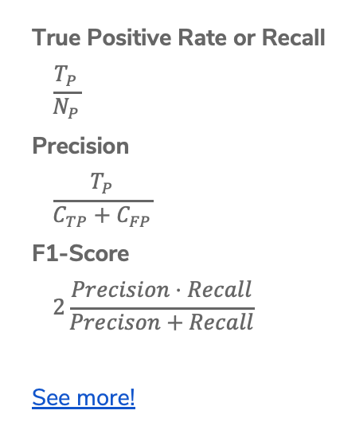
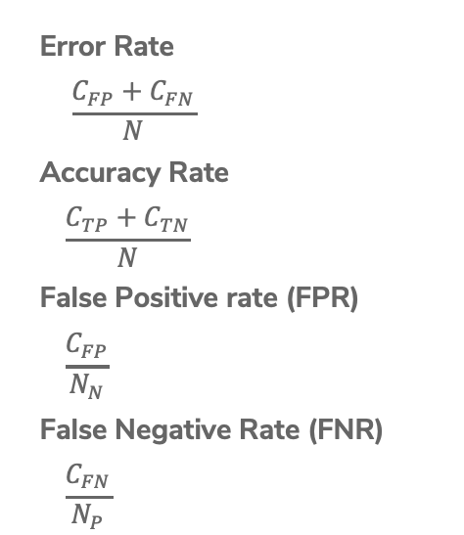
Binary Classification Measures
Notation
$C_{TP}=\#TP, C_{FP}=\#FP, C_{TN}=\#TN, C_{FN}=\#FN$
$N=C_{TP}+C_{FP}+C_{TN}+C_{FN}$
$N_{P}=C_{TP}+C_{FN}, N_{N}=C_{FP}+C_{TN}$
Error Rate
$$\frac{C_{FP}+C_{FN}}{N}$$
Accuracy Rate
$$\frac{C_{TP}+C_{TN}}{N}$$
False Positive rate (FPR)
$$\frac{C_{FP}}{N_{N}}$$
False Negative Rate (FNR)
$$\frac{C_{FN}}{N_{P}}$$
True Positive Rate or Recall
$$\frac{T_{P}}{N_{P}}$$
Precision
$$\frac{T_{P}}{C_{TP}+C_{FP}}$$
F1-Score
$$2\frac{Precision⋅Recall}{Precison+Recall}$$
See more!

Slide 7
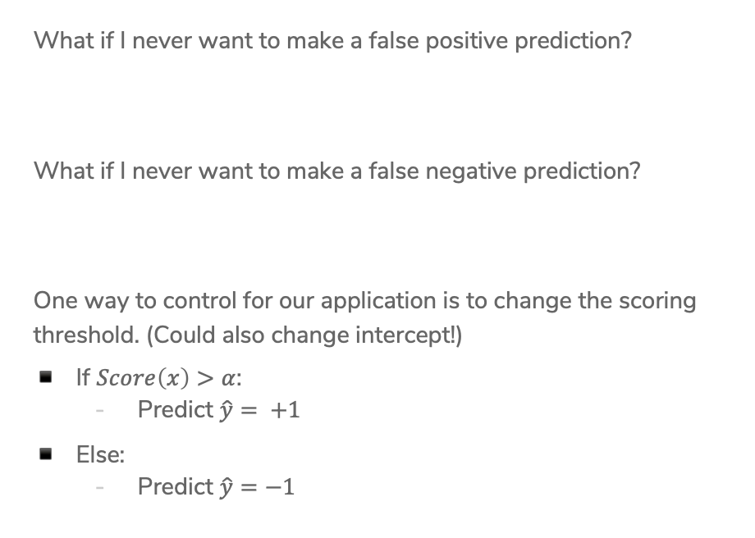
Change Threshold
What if I never want to make a false positive prediction?
What if I never want to make a false negative prediction?
One way to control for our application is to change the scoring threshold. (Could also change intercept!)
If $Score\left(x\right)>α$:
  Predict $\hat{y}= +1$
Else:
  Predict $\hat{y}=−1$

Slide 8
ROC Curve
What happens to our TPR and FPR as we increase the threshold?
TPR
1
0
FPR
0
1

Slide 9
Assessing Accuracy
Often with binary classification, we treat the positive label as being the more important of the two. We then often then focus on these metrics:
Precision: Of the ones I predicted positive, how many of them were actually positive?
Recall: Of all the things that are truly positive, how many of them did I correctly predict as positive?
Notes:
Together, these can tell a more complete story about the models accuracy

Slide 10
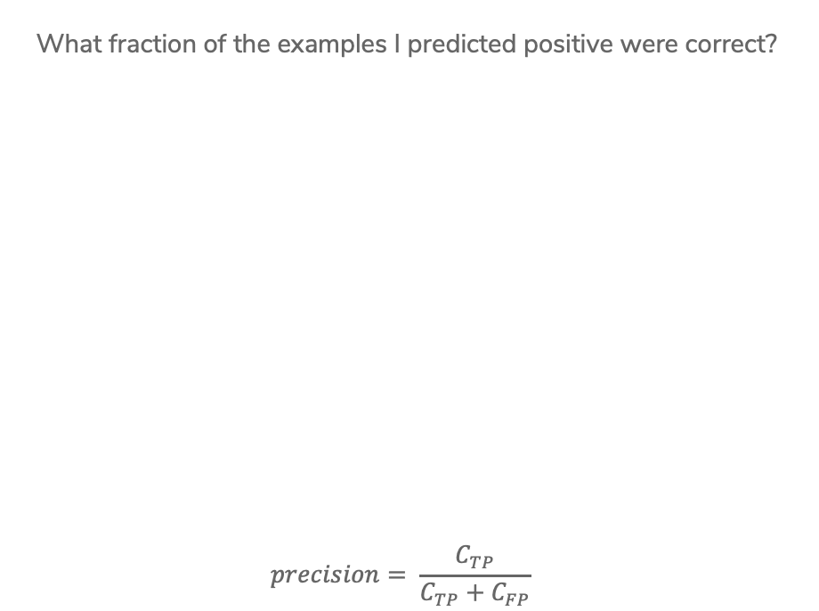

Precision
What fraction of the examples I predicted positive were correct?
$$precision= \frac{C_{TP}}{C_{TP}+C_{FP}}$$
Sentences predicted to be positive:
${\hat{y}}_{i}=+1$
Notes:
Calculate precision (4/ (2 + 4) = 2/3)
High precision means your positive predictions are trustworthy

Slide 11
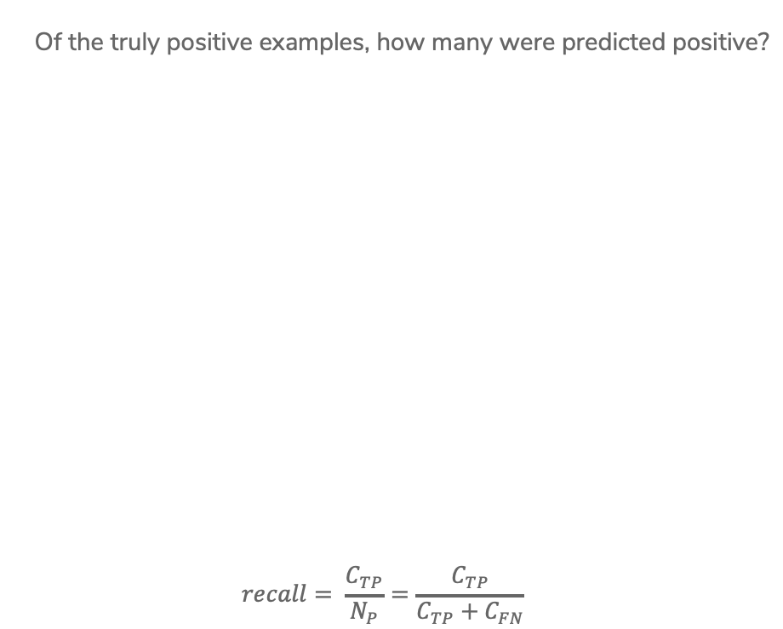
Recall
Of the truly positive examples, how many were predicted positive?
$$recall= \frac{C_{TP}}{N_{P}}=\frac{C_{TP}}{C_{TP}+C_{FN}}$$
Notes:
Calculate recall (4 / (4 + 2) = 2/3)
2 positive examples not shown
High recall means we are likely to “discover” all the positive examples

Slide 12


Precision & Recall
An optimistic model will predict almost everything as positive
High recall, low precision
A pessimistic model will predict almost everything as negative
High precision, low recall

Slide 13
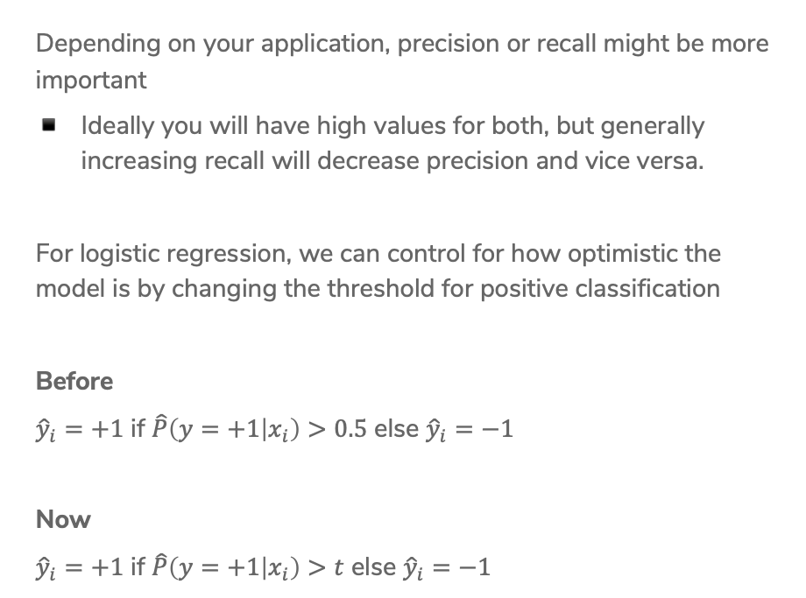
Controlling Precision/Recall
Depending on your application, precision or recall might be more important
Ideally you will have high values for both, but generally increasing recall will decrease precision and vice versa.
For logistic regression, we can control for how optimistic the model is by changing the threshold for positive classification
Before
${\hat{y}}_{i}=+1$ if $\hat{P}\left(y=+1 | x_{i}\right)>0.5$ else ${\hat{y}}_{i}=−1$
Now
${\hat{y}}_{i}=+1$ if $\hat{P}\left(y=+1 | x_{i}\right)>t$ else ${\hat{y}}_{i}=−1$

Slide 14
Precision-Recall Curve
Precision
1
0
Recall
0
1
Notes:
Draw in point for (1, 0) w/ smiley face
Draw in point for (0, 1) w/ frowny face
These are extremes, lets see how we can trade off between them

Slide 15
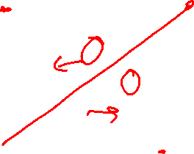
Precision-Recall Curve
Can try every threshold to get a curve like below

Slide 16
Precision-Recall Curve
Sometimes, Classifier B is strictly better than Classifier A

Slide 17
Precision-Recall Curve
Most times, the classifiers are incomparable

Slide 18
Compare Classifiers
Often come up with a single number to describe it
F1-score, AUC, etc.
Remember, what your application needs is most important
Also common to use precision at k
If you show the top k most likely positive examples, how many of them are true positives

Slide 19
CSE/STAT 416
Precision/Recall k-Nearest Neighbors
Tanmay Shah
Paul G. Allen School of Computer Science & Engineering
University of Washington
May 8, 2024
❓ Questions? Raise hand or sli.do #cs416
🎵 Listening to:

Slide 20
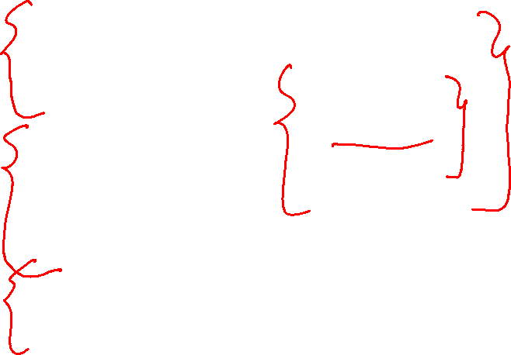
Roadmap
Housing Prices - Regression
  Regression Model
  Assessing Performance
  Ridge Regression
  LASSO
Sentiment Analysis – Classification
  Classification Overview
  Logistic Regression
  Bias / Fairness
  Decision Trees
  Ensemble Methods
Deep Learning
  Neural Networks
  Convolutional Neural
Document Retrieval – Clustering and Similarity
  Precision / Recall
  k-Nearest Neighbor
  Kernel Methods
  Locality Sensitive Hashing
  Clustering
  Hierarchical Clustering

Slide 21
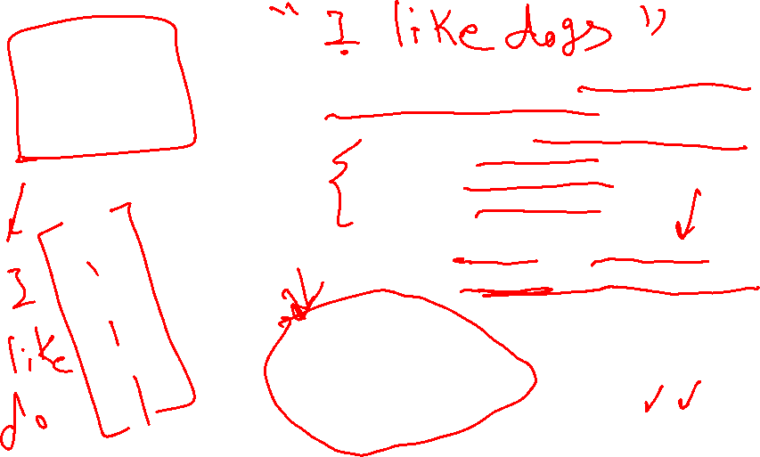
Document Retrieval
Consider you had some time to read a book and wanted to find other books similar to that one.
If we wanted to write an system to recommend books
  How do we measure similarity?
  How do we search over books?
  How do we measure accuracy?
Big Idea: Define an embedding and a similarity metric for the books, and find the “nearest neighbor” to some query book.
Notes:
Could also return set of nearest neighbors (draw circle)

Slide 22
Nearest Neighbors

Slide 23
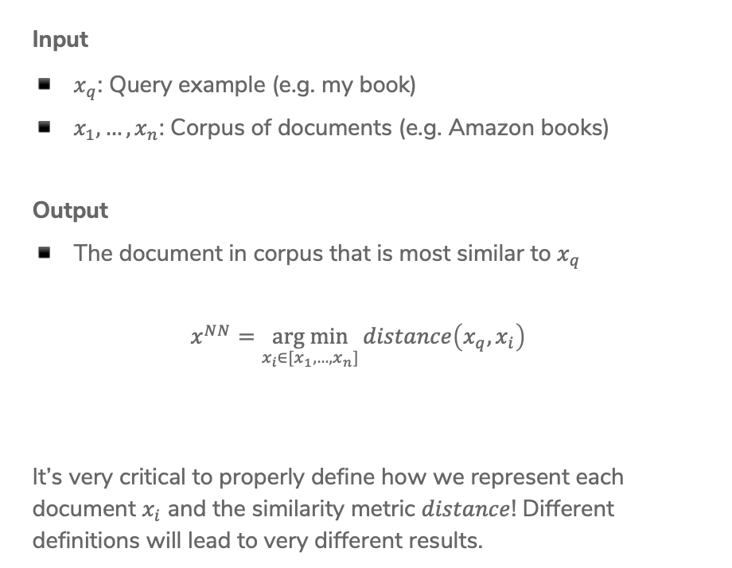
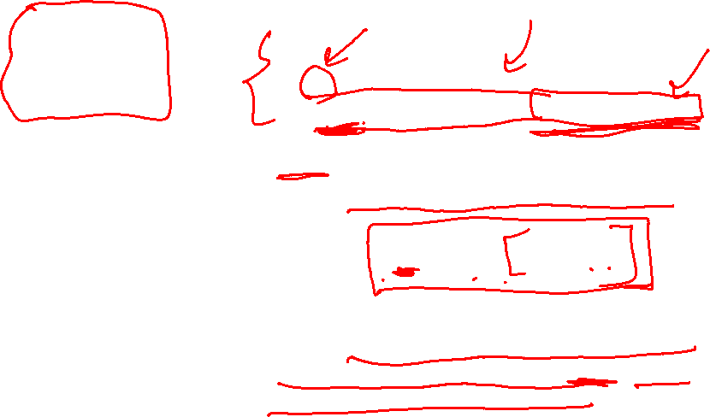
1-Nearest Neighbor
Input
$x_{q}$: Query example (e.g. my book)
$x_{1},…,x_{n}$: Corpus of documents (e.g. Amazon books)
Output
The document in corpus that is most similar to $x_{q}$
$$x^{NN}=\underset{x_{i}∈[x_{1},…,x_{n}]}{arg min}{distance\left(x_{q}, x_{i}\right)}$$
It’s very critical to properly define how we represent each document $x_{i}$ and the similarity metric $distance$! Different definitions will lead to very different results.
Notes:
Note about argmin vs min
Right now, we will use a hand-wavey notion of these documents and similarity, will dive in to how to represent them in a bit

Slide 24



1-Nearest Neighbor
How long does it take to find the 1-NN? About $n$ operations
Input: $x_{q}$
$x^{NN}=∅$
$nn_dist=∞$
$for x_{i}∈\left[x_{1}, …, x_{n}\right]:$
$dist=distance\left(x_{q}, x_{i}\right)$
$if dist<nn_dist:$
$x^{NN}=x_{i}$
$nn_dist=dist$
Output: $x^{NN}$
Notes:
Write O(n) above slide

Slide 25

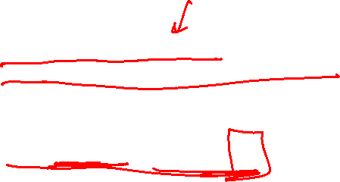
k-Nearest Neighbors
Input
$x_{q}$: Query example (e.g. my book)
$x_{1},…,x_{n}$: Corpus of documents (e.g. Amazon books)
Output
List of $k$ documents most similar to $x_{q}$
Formally
Notes:
Write
X^k-NN = {x^(NN_1), x^(NN_2), …, x^(NN_k) }
For all x_i not in X^NN, distance(x_i, x_q) >= max_{j in [1,..k]} distance(x_q, x^NN_j)

Slide 26

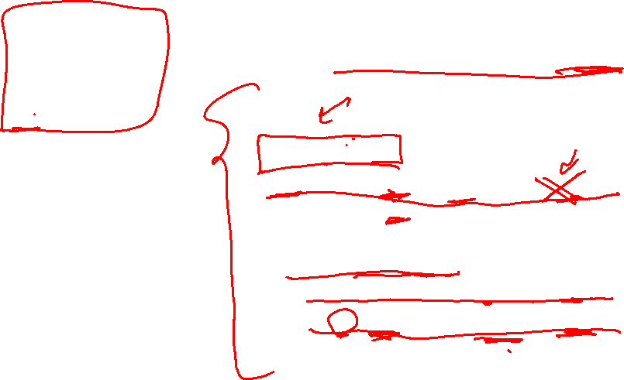
k-Nearest Neighbors
Same idea as 1-NN algorithm, but maintain list of k-NN
Input: $x_{q}$
$X^{kNN}=[x_{1},…, x_{k}]$
$nn_dists=[dist\left(x_{1}, x_{q}\right), dist\left(x_{2},x_{q}\right), …, dist\left(x_{k}, x_{q}\right)]$
$for x_{i}∈\left[x_{k+1 }, …, x_{n}\right]:$
$dist=distance\left(x_{q}, x_{i}\right)$
$if dist<\max\left(nn_dists\right):$ $remove largest dist from X^{kNN} and nn_dists$
$add x_{i} to X^{kNN}and distance\left(x_{q}, x_{i}\right) to nn_dists$
Output: $X^{kNN}$

Slide 27

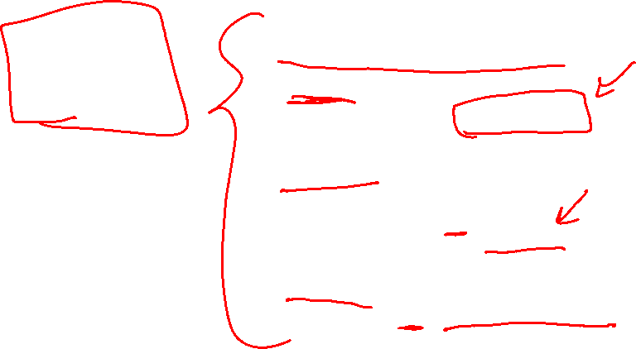
k-Nearest Neighbors
Can be used in many circumstances!
Retrieval
Return $X^{k−NN}$
Regression
$${\hat{y}}_{i}=\frac{1}{k}\sum_{j=1}^{k}{x^{NN_{j}}}$$
Classification
$${\hat{y}}_{i}=majority_class(X^{k−NN})$$
Notes:
Wednesday we will talk about classification/regression a bit more in depth

Slide 28
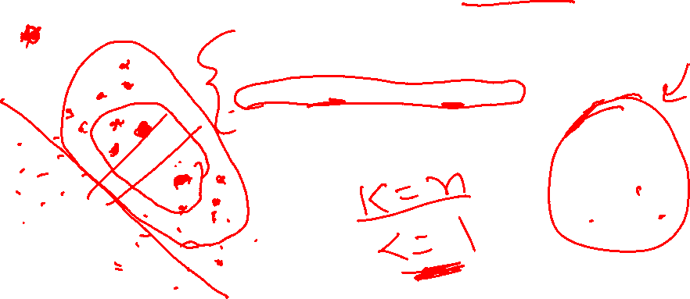
1.5 min
In the regression/classification settings, what is the relationship between k for k-NN and the bias/variance of the model? Each option completes the sentence “As k increases …”
Bias increases, Variance increases
Bias decreases, Variance increases
Bias increases, Variance decreases
Bias decreases, Variance decreases

Slide 29



Slide 30
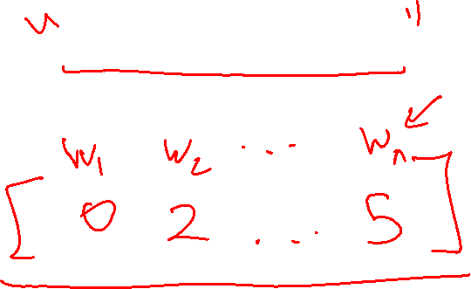
Embeddings

Slide 31
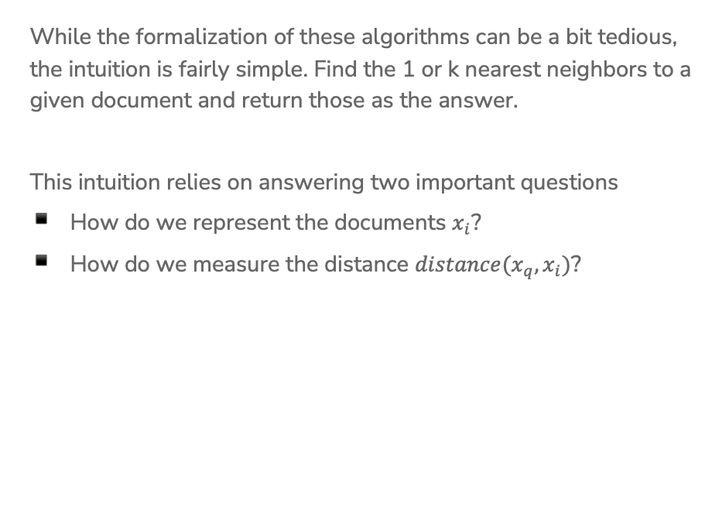
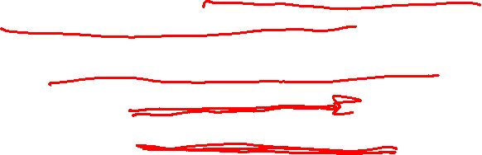
Important Points
While the formalization of these algorithms can be a bit tedious, the intuition is fairly simple. Find the 1 or k nearest neighbors to a given document and return those as the answer.
This intuition relies on answering two important questions
How do we represent the documents $x_{i}$?
How do we measure the distance $distance(x_{q}, x_{i})$?
Notes:
Write “embedding/representation” for first point
Write “distance metric” for second

Slide 32
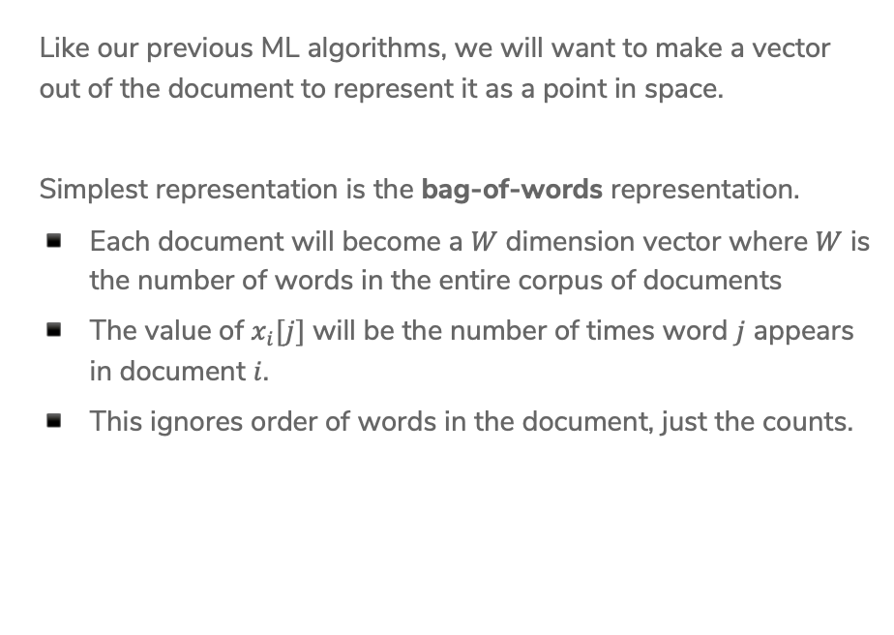
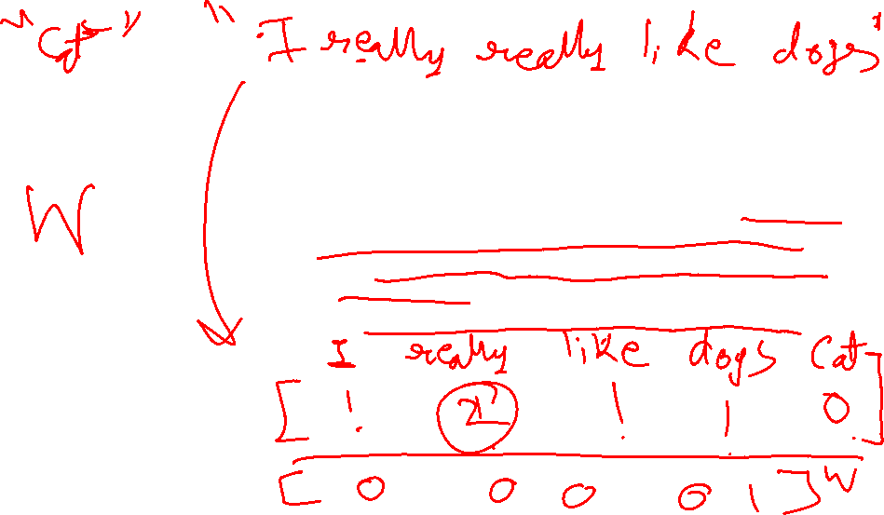
Document Representation
Like our previous ML algorithms, we will want to make a vector out of the document to represent it as a point in space.
Simplest representation is the bag-of-words representation.
Each document will become a $W$ dimension vector where $W$ is the number of words in the entire corpus of documents
The value of $x_{i}[j]$ will be the number of times word $j$ appears in document $i$.
This ignores order of words in the document, just the counts.
Notes:
Example Corpus
“I like dogs” => [1, 1, 1, 0]
“I like cats” => [1, 1, 0, 1]

Slide 33

Bag of Words
Pros
Very simple to describe
Very simple to compute
Cons
Common words like “the” and “a” dominate counts of uncommon words
Often it’s the uncommon words that uniquely define a doc.

Slide 34
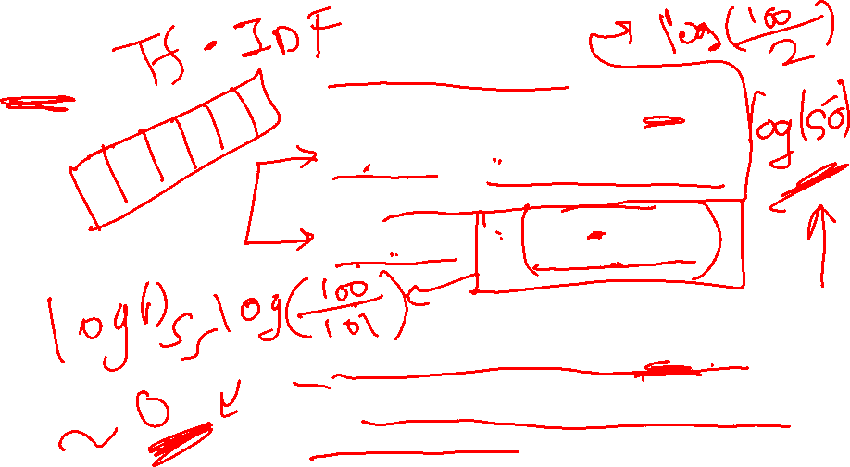
TF-IDF
Goal: Emphasize important words
Appear frequently in the document (common locally)
Appears rarely in the corpus (rare globally)
Do a pair-wise multiplication to compute the TF-IDF for each word
Words that appear in every document will have a small IDF making the TF-IDF small!

Slide 35

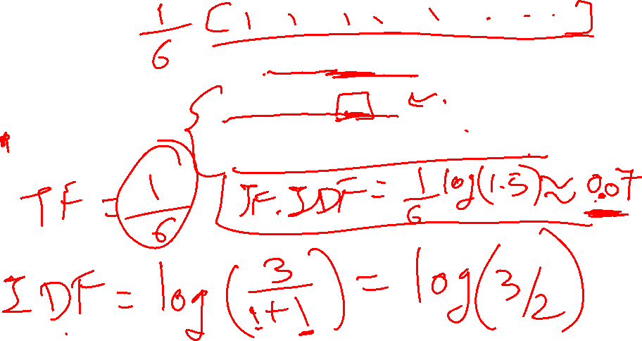
1.5 min
What is the $TF−IDF(“rain”, Doc_{1})$ with the following documents (assume standard pre-processing)
Doc 1: It is going to rain today.
Doc 2: Today I am not going outside.
Doc 3: I am going to watch the season premiere.
Notes:
Full example: https://medium.com/analytics-vidhya/tf-idf-term-frequency-technique-easiest-explanation-for-text-classification-in-nlp-with-code-8ca3912e58c3
Answer: (1/6) * log(3/2) = 0.07

Slide 36
Distance

Slide 37
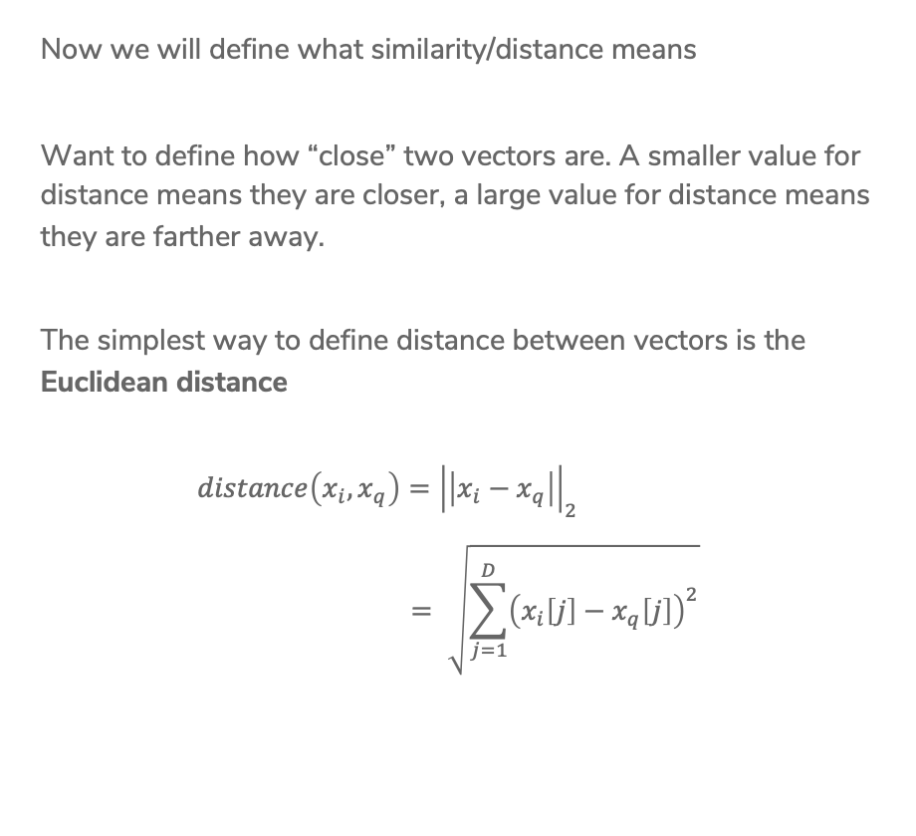

Euclidian Distance
Now we will define what similarity/distance means
Want to define how “close” two vectors are. A smaller value for distance means they are closer, a large value for distance means they are farther away.
The simplest way to define distance between vectors is the Euclidean distance
$$distance\left(x_{i}, x_{q}\right)={\left|\left|x_{i}−x_{q}\right|\right|}_{2} \\ = \sqrt{\sum_{j=1}^{D}{{\left(x_{i}\left[j\right]−x_{q}\left[j\right]\right)}^{2}}}$$
Notes:
Draw picture of this distance metric

Slide 38

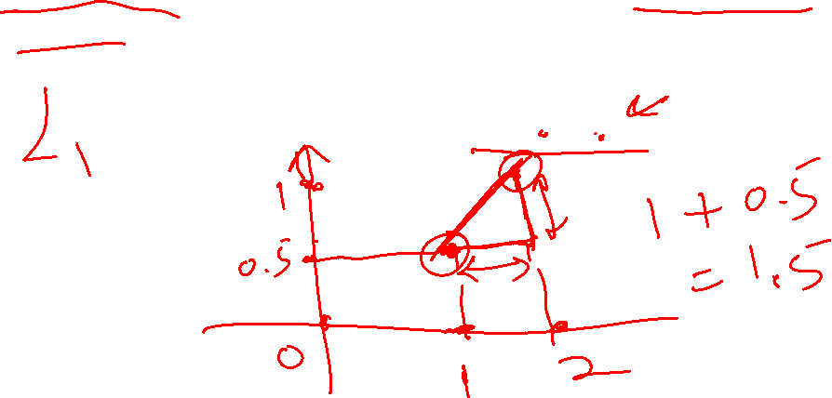
Manhattan Distance
Another common choice of distance is the Manhattan Distance
$$distance\left(x_{i}, x_{q}\right)={\left|\left|x_{i}−x_{q}\right|\right|}_{1}$$
$$=\sum_{j=1}^{D}{\left|x_{i}\left[j\right]−x_{q}[j]\right|}$$

Slide 39

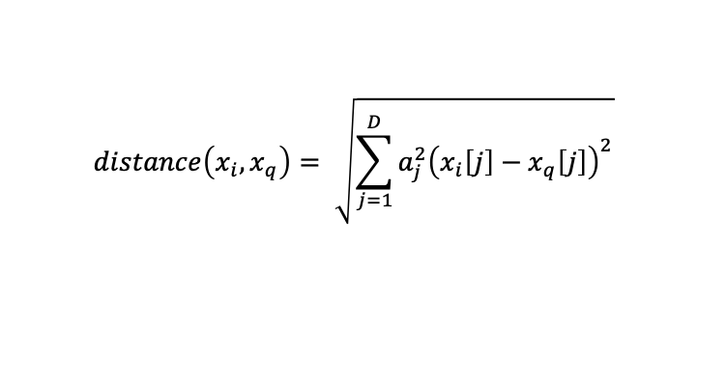
Weighted Distances
Some features vary more than others or are measured in different units. We can weight different dimensions differently to make the distance metric more reasonable.
Weighted Euclidean distance
$$distance\left(x_{i}, x_{q}\right)= \sqrt{\sum_{j=1}^{D}{{a_{j}^{2}\left(x_{i}\left[j\right]−x_{q}\left[j\right]\right)}^{2}}}$$
Notes:
Makes all units cancel out and on the same scale, so we don’t have to worry about one dimension affecting distance too much

Slide 40

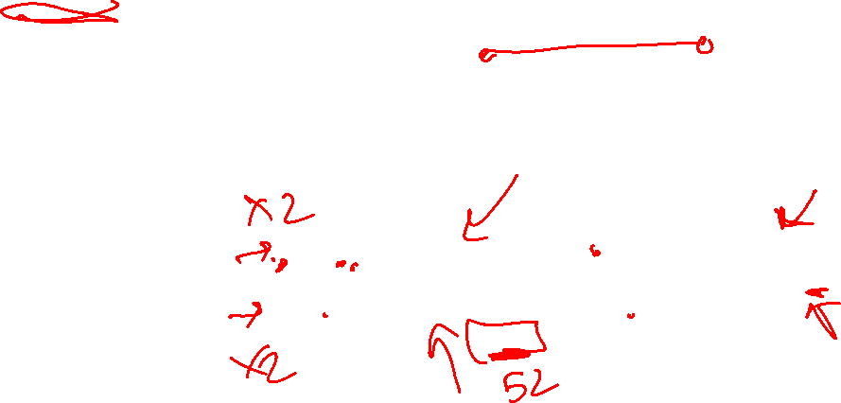
Similarity
Another natural similarity measure would use
$x_{i}^{T}x_{q}=\sum_{j=1}^{D}{x_{i}\left[j\right]x_{q}[j]}$
Notice this is a measure of similarity, not distance
This means a bigger number is better

Slide 41
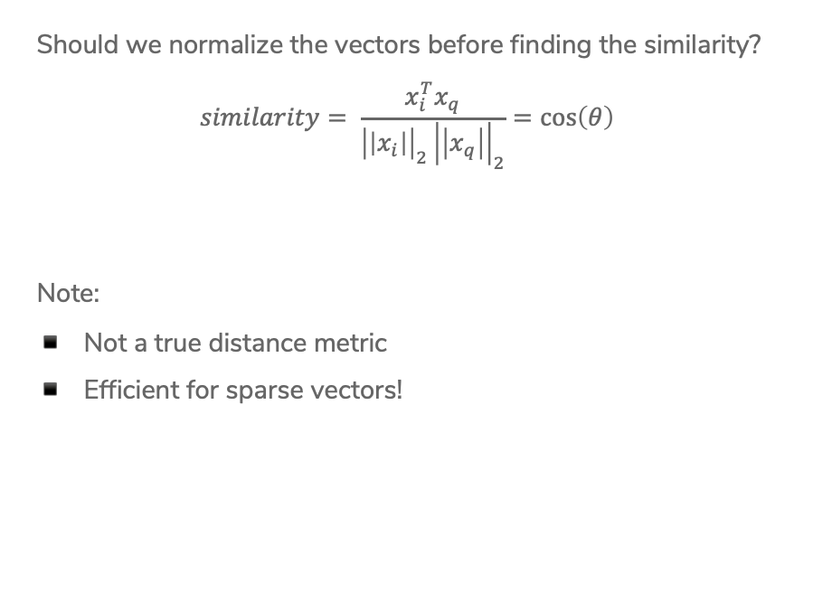
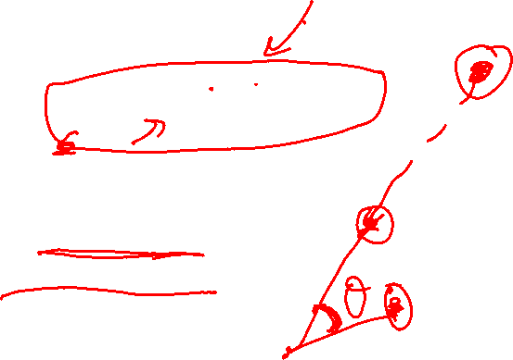
Cosine Similarity
Should we normalize the vectors before finding the similarity?
$$similarity= \frac{x_{i}^{T}x_{q}}{{\left|\left|x_{i}\right|\right|}_{2}{\left|\left|x_{q}\right|\right|}_{2}}=\cos\left(θ\right)$$
Note:
Not a true distance metric
Efficient for sparse vectors!
Notes:
Draw lines with theta

Slide 42

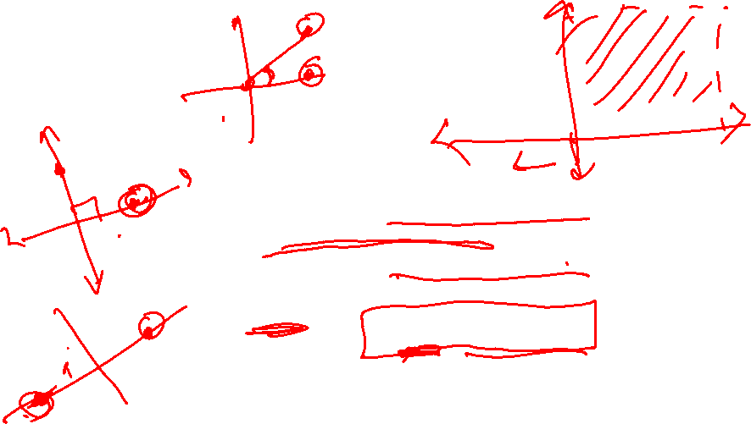
Cosine Similarity
In general
$$−1≤cosine similarity≤1$$
For positive features (like TF-IDF)
$$0≤cosine similarity≤1$$
Define
$$distance=1 −similarity$$
Notes:
Draw three graphs
Two points right next to each other, cos(theta) ~ 1
Two points at 10 and 2, cos(theta) ~ 0
Two points at 2 and 7 , cos(theta) ~-1

Slide 43
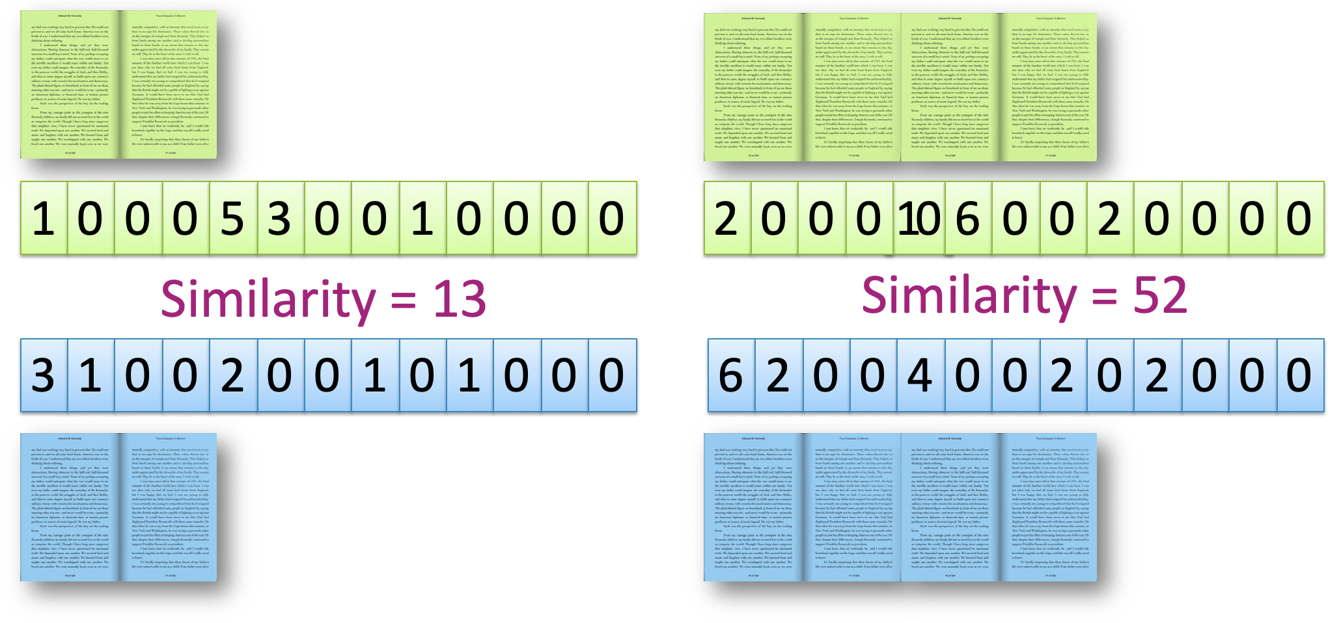
To Normalize or
Not To Normalize?
Not normalized

Slide 44
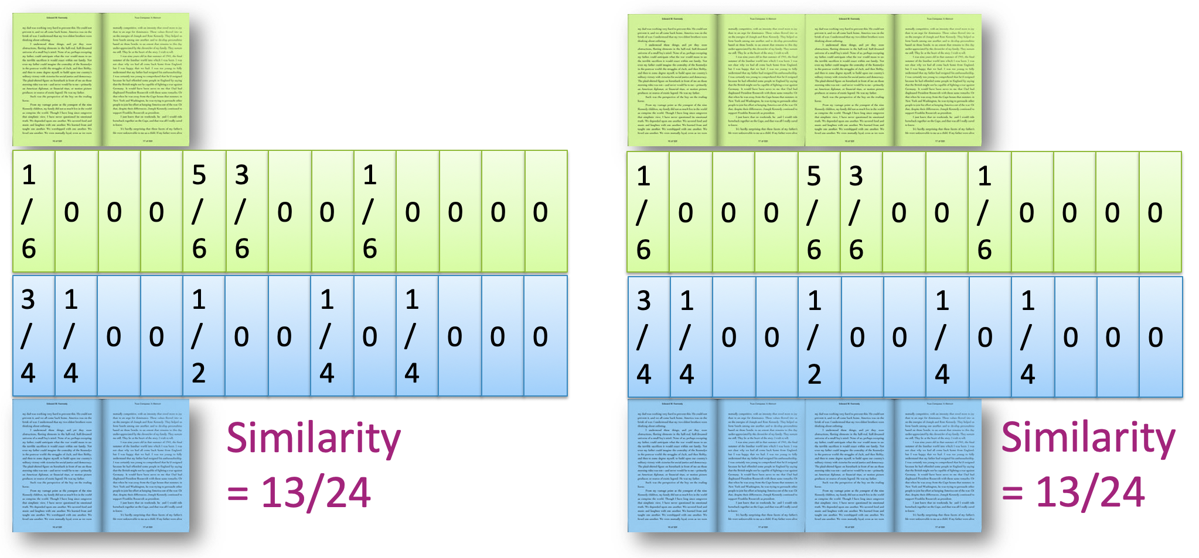
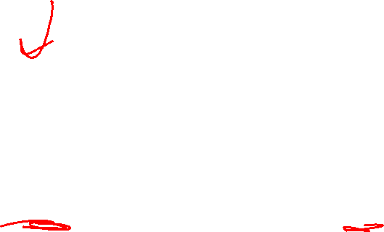
To Normalize or
Not To Normalize?
Normalized

Slide 45
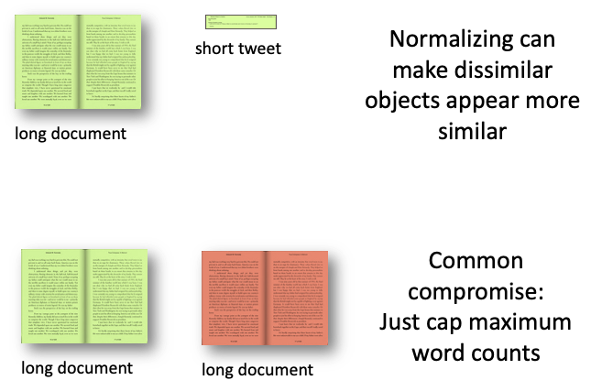
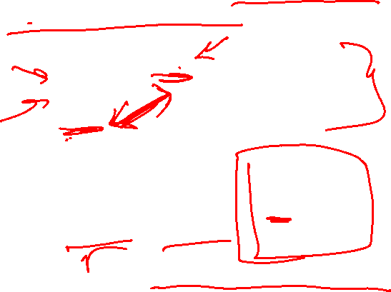
To Normalize or
Not To Normalize?
Normalization is not desired when comparing documents of different sizes since it ignores length.
In practice, can use multiple distance metrics and combine them using some defined weights

Slide 46


3 min
Not a real Poll Everywhere question, just time to work!
For the given documents, what are their Euclidean Distance and Cosine Similarity?
Assume we are using a bag of words representation
Document 1: “I really like dogs”
Document 2: “dogs are really really awesome”
Steps:
Write out bag of words vectors
Compute Euclidean distance
Compute Cosine similarity

Slide 47
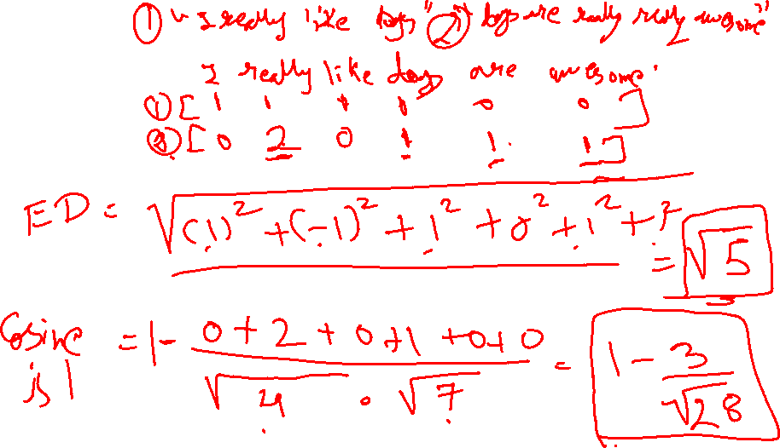


Slide 48
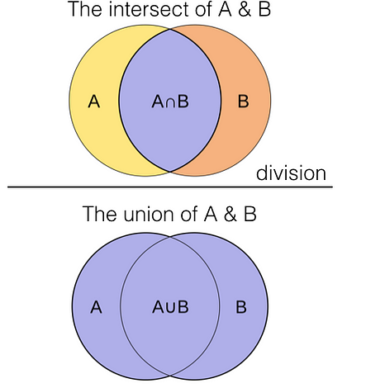
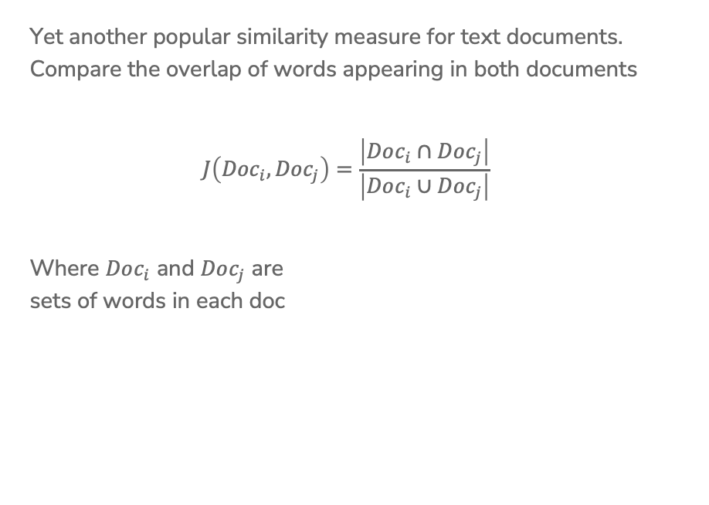
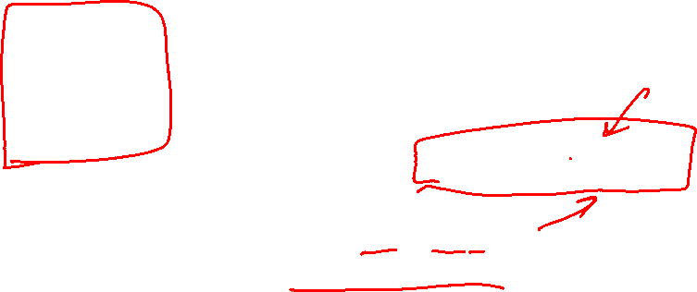
Jaccard Similarity
Yet another popular similarity measure for text documents. Compare the overlap of words appearing in both documents
$$J\left({Doc}_{i}, {Doc}_{j}\right)=\frac{\left|Doc_{i}∩Doc_{j}\right|}{\left|Doc_{i}∪Doc_{j}\right|}$$
Where $Doc_{i}$ and $Doc_{j}$ are
sets of words in each doc
Source: Uniqtech - Medium

Slide 49
Recap
Theme: Use nearest neighbors to recommend documents.
Ideas:
Precision and Recall Curves
Implement a nearest neighbor algorithm
Compare and contrast different document representations
  Emphasize important words with TF-IDF
Compare and contrast different measurements of similarity
  Euclidean and weighted Euclidean
  Cosine similarity and inner-product similarity

