Slide 1
CSE/STAT 416
Convolutional Neural Networks
Pre-Lecture Videos
Tanmay Shah
Paul G. Allen School of Computer Science & Engineering
University of Washington
May 3 , 2024

Slide 2
Video 1
Recap Neural Networks

Slide 3
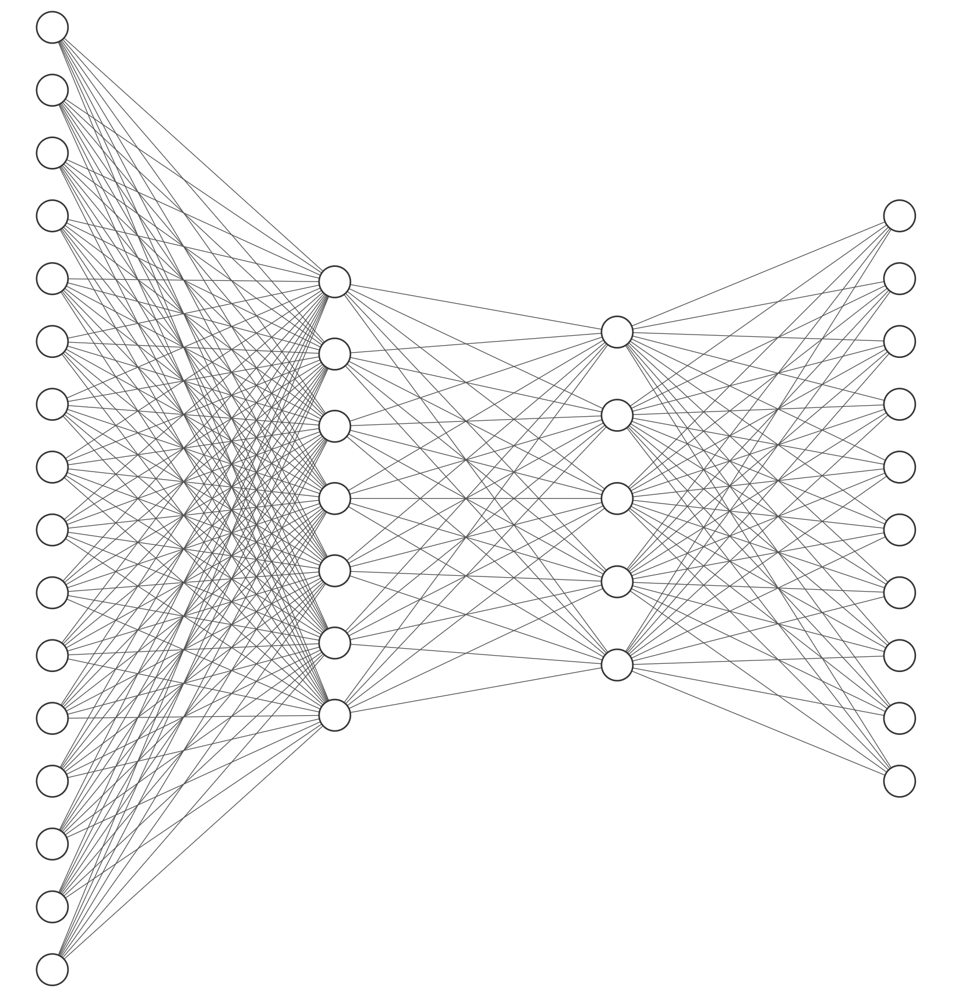
Deep Learning
A lot of the buzz about ML recently has come from recent advancements in deep learning.
When people talk about “deep learning” they are generally talking about a class of models called neural networks that are a loose approximation of how our brains work.
Notes:
WOS:
Input Layer
Hidden Layers
Output Layer

Slide 4
2 mins
Compute the output for input (0, 1). There is a sign activation function on the hidden layers and output layer.
2
2
2
3
-1
1
3
1
-2
Notes:
First hidden: sign(2*0+3*1+2) = sign(5) = 1
Second hidden: sign(1*0-2*1+1) = sign(-1) = 0
Output: sign(2*1+3*0-1) = sign(1) = 1

Slide 5
NNs to the Rescue
Neural Networks implicitly find these low level features for us!
Each layer learns more and more complex features

Slide 6
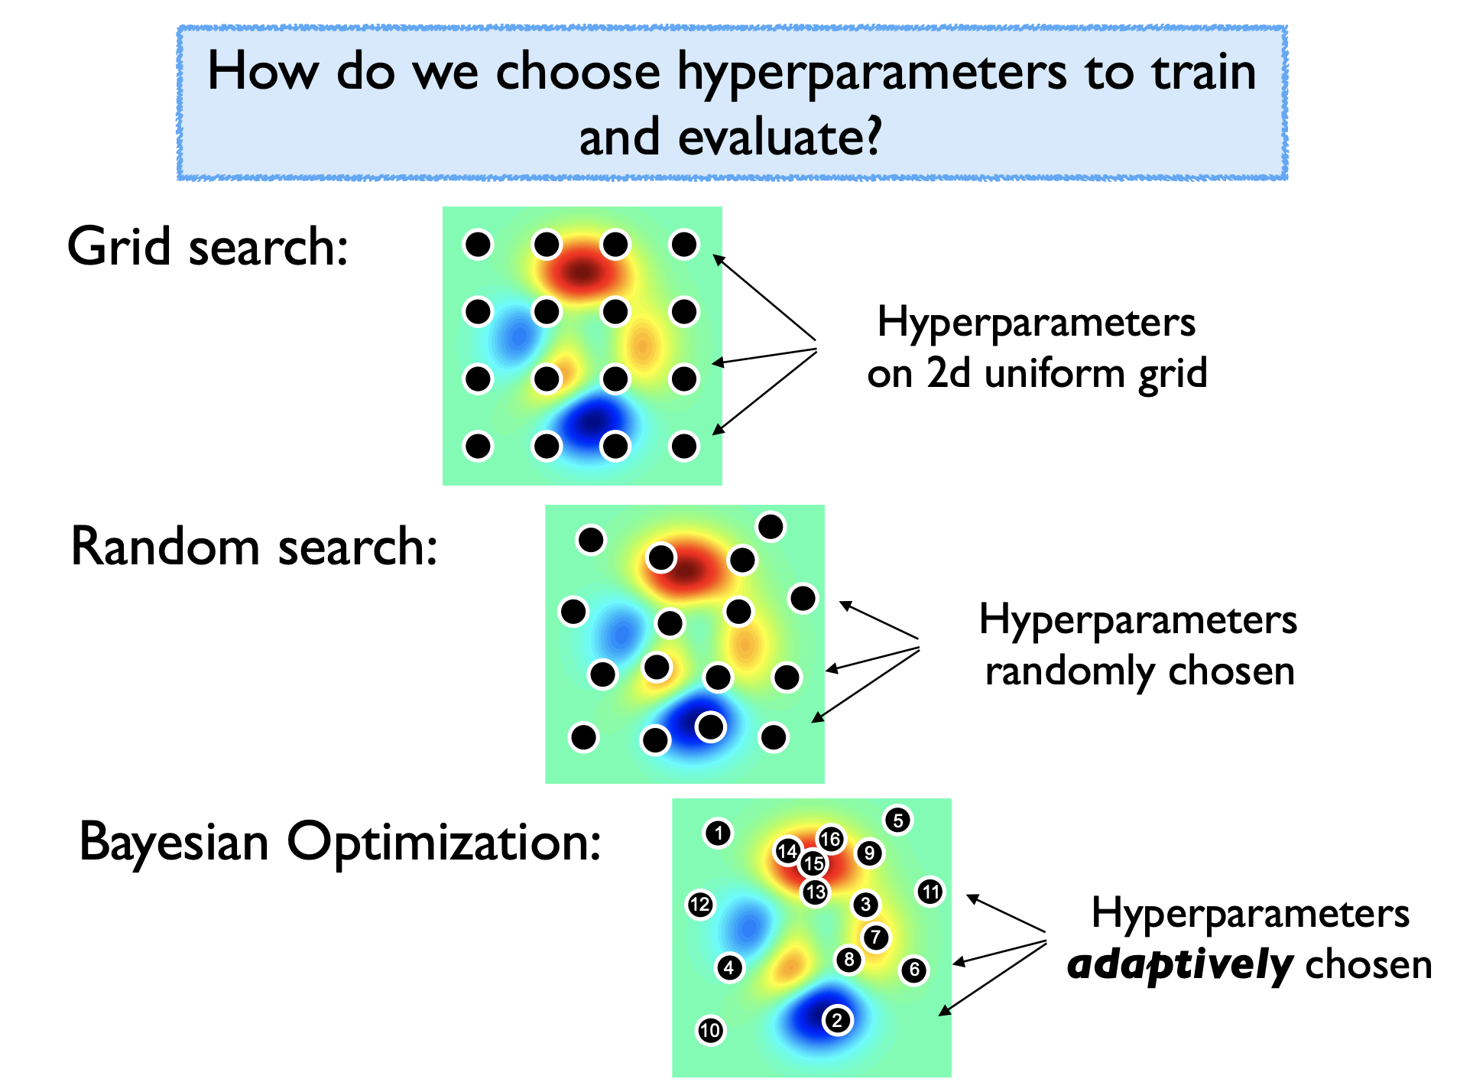
Hyperparameter Optimization
Notes:
Bayesian optimization tries to model the function that maps hyperparameter choices to validation error. It uses the model to predict which hyperparameter is likely to have the best performance, when you try that and get the validation error, it improves its performance.

Slide 7
Video 2
Convolutions

Slide 8
Image Challenges
Images are extremely high dimensional
CIFAR-10 dataset are very small: 3@32x32
  # inputs:
For moderate sized images: 3@200x200
  # inputs:
Images are structured, we should leverage this
Notes:
Draw RGB above 3
# inputs: 3 * 32 * 32 + 1 =3072
Means if you want 4 hidden neurons, that’s over 12000 weights to learn!
For 3@200x200 => 120,000

Slide 9
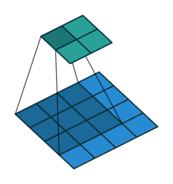
Convolutional Neural Networks
Idea: Reduce the number of weights that need to be learned by looking at local neighborhoods of image.
Use the idea of a convolution to reduce the number of inputs by combing information about local pixels.

Slide 10
Convolution
Use a kernel that slides across the image, computing the sum of the element-wise product between the kernel and the overlapping part of the image
Image Kernel
3 | 3 | 2 | 1 | 0
0 | 0 | 1 | 3 | 1
3 | 1 | 2 | 2 | 3
2 | 0 | 0 | 2 | 2
2 | 0 | 0 | 0 | 1
0 | 1 | 2
2 | 2 | 0
0 | 1 | 2
Notes:
Different use of the word kernel :/

Slide 11
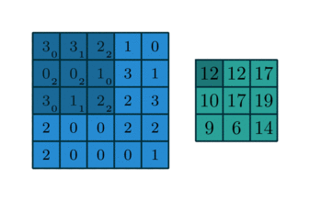
Convolution
The input image (blue), the kernel (dark blue, numbers lower right) slide over the image to produce a result (green)

Slide 12
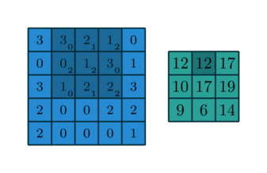
Convolution
The input image (blue), the kernel (dark blue, numbers lower right) slide over the image to produce a result (green)

Slide 13
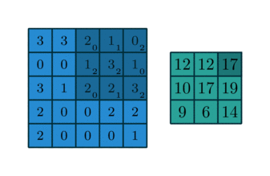
Convolution
The input image (blue), the kernel (dark blue, numbers lower right) slide over the image to produce a result (green)

Slide 14
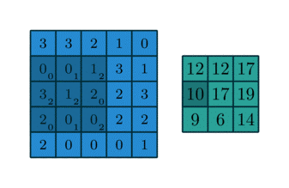
Convolution
The input image (blue), the kernel (dark blue, numbers lower right) slide over the image to produce a result (green)

Slide 15
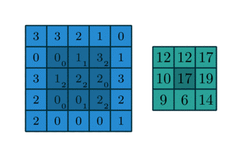
Convolution
The input image (blue), the kernel (dark blue, numbers lower right) slide over the image to produce a result (green)

Slide 16
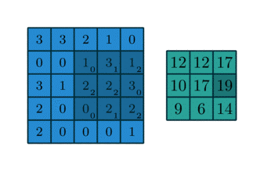
Convolution
The input image (blue), the kernel (dark blue, numbers lower right) slide over the image to produce a result (green)

Slide 17
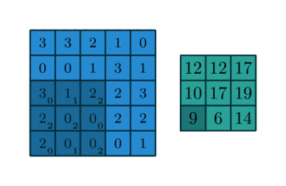
Convolution
The input image (blue), the kernel (dark blue, numbers lower right) slide over the image to produce a result (green)

Slide 18
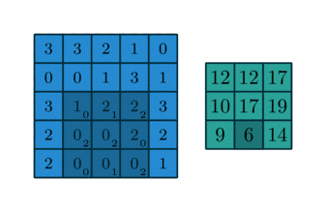
Convolution
The input image (blue), the kernel (dark blue, numbers lower right) slide over the image to produce a result (green)

Slide 19
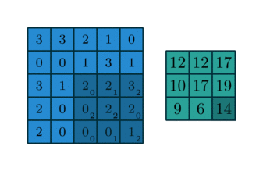
Convolution
The input image (blue), the kernel (dark blue, numbers lower right) slide over the image to produce a result (green)

Slide 20
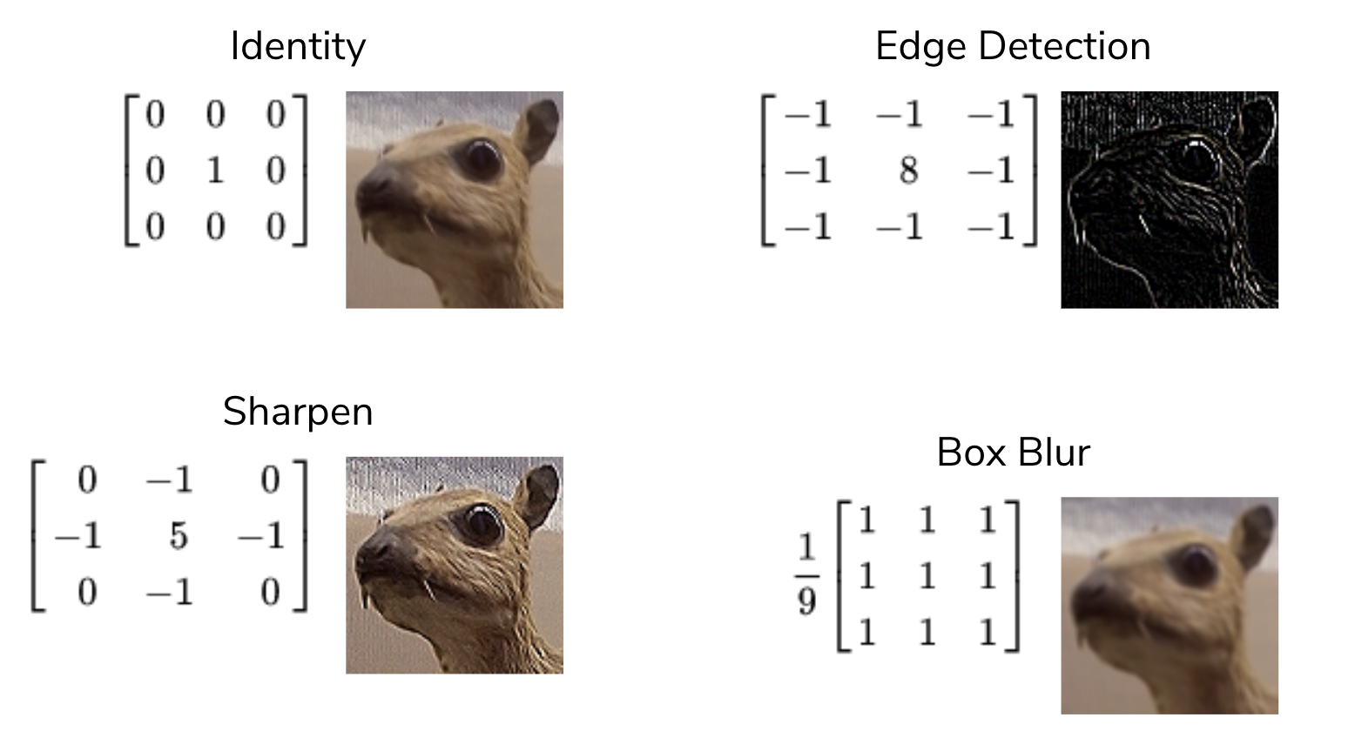
Special Kernels
The numbers in the kernels determine special properties
Convolutional Neural Networks (CNNs) learn the right weights for each kernel they use! Generally not interpretable!

Slide 21
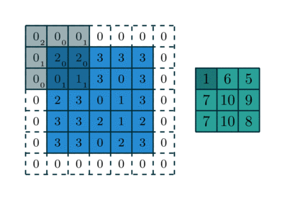
Hyper-parameters of a Single Convolution
You can specify a few more things about a kernel
Kernel dimensions
Padding size and padding values
Stride (how far to jump) values
For example, a 3x3 kernel applied to a 5x5 image with 1x1 zero padding and a 2x2 stride

Slide 22
CSE/STAT 416
Convolutional Neural Networks
Tanmay Shah
Paul G. Allen School of Computer Science & Engineering
University of Washington
May 3 , 2024

Slide 23
HW4 Walkthrough

Slide 24
Deep Learning
A lot of the buzz about ML recently has come from recent advancements in deep learning.
When people talk about “deep learning” they are generally talking about a class of models called neural networks that are a loose approximation of how our brains work.
Notes:
WOS:
Input Layer
Hidden Layers
Output Layer

Slide 25
Image Features
Features in computer vision are local detectors
Combine features to make prediction
In reality, these features are much more low level (e.g. Corner?)

Slide 26
The Past
A popular approach to computer vision was to make hand-crafted features for object detection
Relies on coming up with these features by hand (yuck!)

Slide 27
NNs to the Rescue
Neural Networks implicitly find these low level features for us!
Each layer learns more and more complex features

Slide 28
Convolutional Neural Networks
Idea: Reduce the number of weights that need to be learned by looking at local neighborhoods of image.
Use the idea of a convolution to reduce the number of inputs by combing information about local pixels.

Slide 29
Hyper-parameters of a Single Convolution
You can specify a few more things about a kernel
Kernel dimensions
Padding size and padding values
Stride (how far to jump) values
For example, a 3x3 kernel applied to a 5x5 image with 1x1 zero padding and a 2x2 stride

Slide 30
3 min
What is the result of applying a convolution using this kernel on this input image?
Use 1x1 zero padding and a 2x2 stride
Image Kernel
1 | 2 | 3 | 4
5 | 6 | 7 | 8
9 | 10 | 11 | 12
13 | 14 | 15 | 16
1 | 1
0 | 2

Slide 31
Convolutional Neural Networks

Slide 32
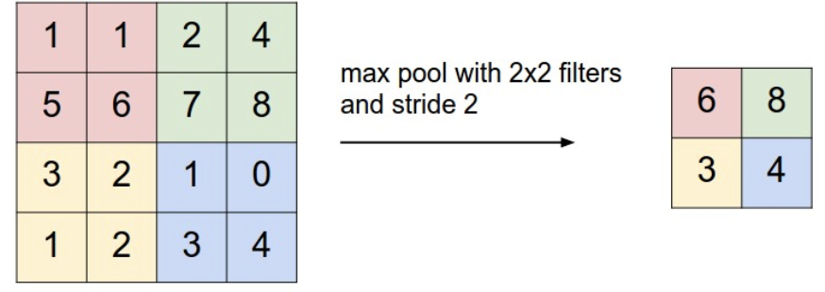
Pooling
Another core operation that is similar to a convolution is a pool.
Idea is to down sample an image using some operation
Combine local pixels using some operation (e.g. max, min, average, median, etc.)
Typical to use max pool with 2x2 filter and stride 2
Tends to work better than average pool

Slide 33
Convolutional Neural Network
Combine convolutions and pools into pre-processing layers on image to learn a smaller, information dense representation.
Example architecture for hand-written digit recognition
Each convolution section uses many different kernels (increasing depth of channels)
Pooling layers downsample each channel separately
Usually ends with fully connected neural network

Slide 34
Convolutional Neural Network
Why does this help?
Only need to learn a small number of values (kernel weights) that get applied to the entire image region by region
  This is called weight-sharing
  Gives efficiency + shift invariance
Pooling lets us focus on features from larger and larger regions of the original image.

Slide 35
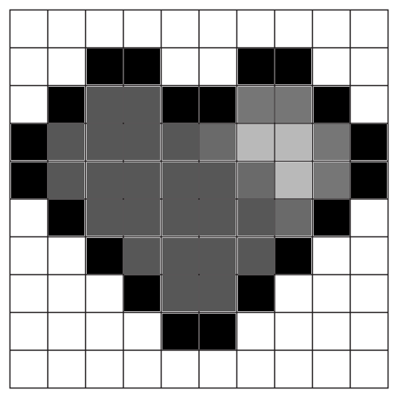
2 min
Input: 10x10x1 image (grayscale image of 10x10 pixels)
Convolution: 5x5 kernel, stride 1
MaxPool: 2x2, stride 2
What is the size of the resulting image?

Slide 36
2 min
Input: 10x10x1 image (grayscale image of 10x10 pixels)
Convolution: 5x5 kernel, stride 1
MaxPool: 2x2, stride 2
What is the size of the resulting image?

Slide 37
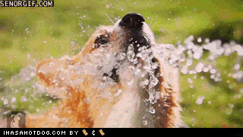

Slide 38
Number of Weights / Parameters

Slide 39
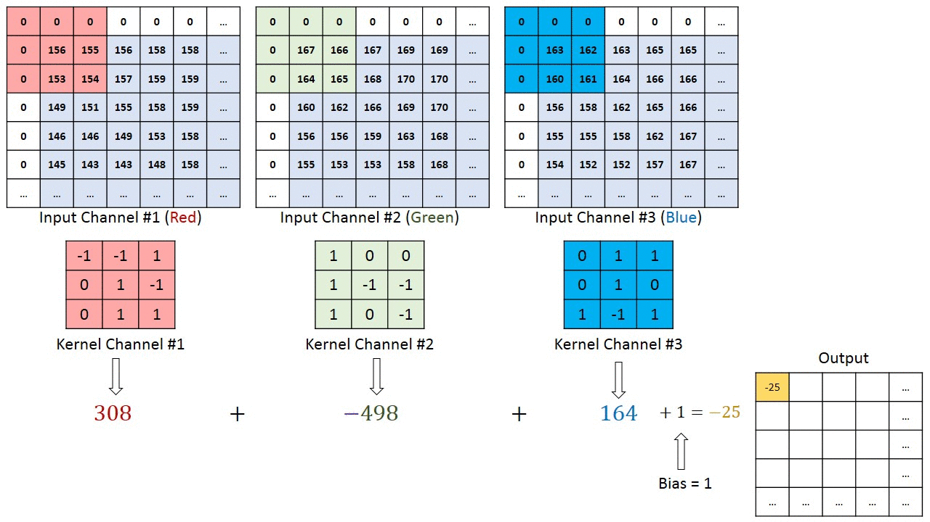
CNN with Color Images
How does this work if there is more than one input channel?
Usually, use a 3-dimensional tensor as the kernel to combine information from each input channel

Slide 40
CNN with Color Images
Another way of thinking about this process is each kernel is a (hidden-layer) neuron that looks at the kernel-size pixels in a neighborhood
If there are 5 output channels in a conv layer, only need to learn the weights for the 5 neurons
These neurons are a bit different since they look at the pixels that overlap with the window at each position.

Slide 41
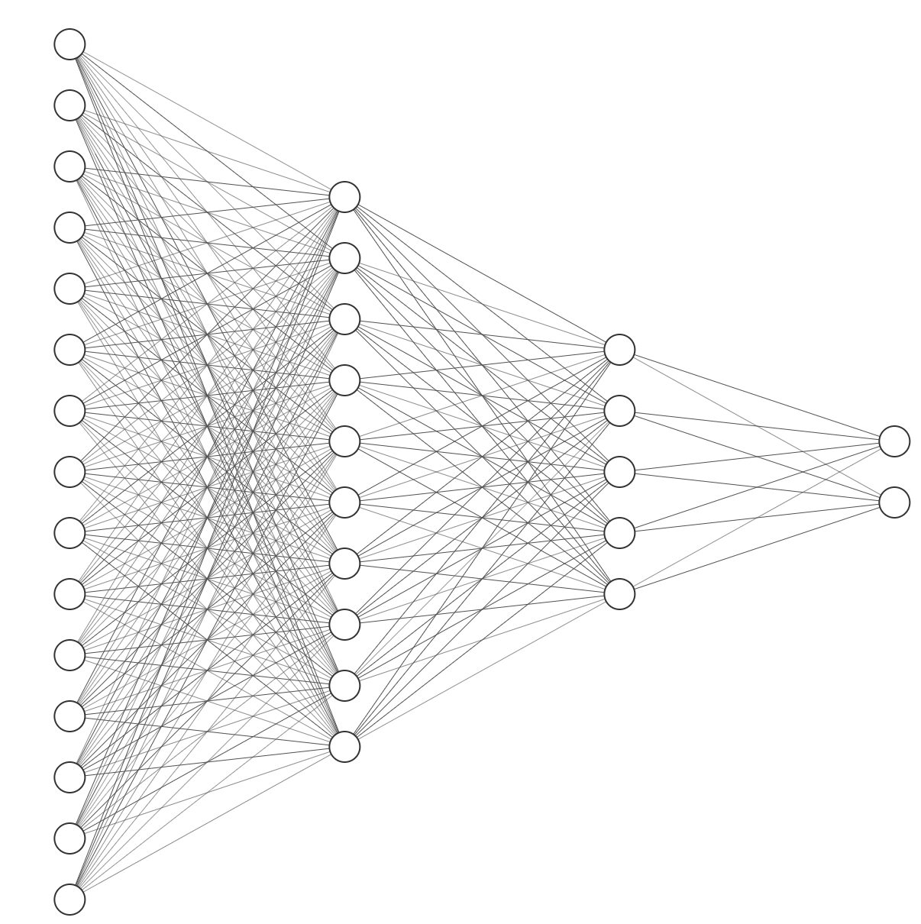
2 min
Consider a plain neural network below, how many weights need to be learned?
Completely ignore intercept terms
15 10 5 2
Notes:
✍️ 15x10 + 5x10 + 2x2 = 210
✍️ With Intercept: 210 + (10 + 5 + 2) = 227

Slide 42
Weight Sharing
Consider solving a digit recognition task on 28x28 grayscale images. Suppose I wanted to use a fully connected hidden layer with 84 neurons
Without Convolutions:
Notes:
Draw a large fully connected NN
✍️ 28x28 = 784
✍️ 784x84 + 84x10 = 66,696

Slide 43
Weight Sharing
Consider solving a digit recognition task on 28x28 images. Suppose I wanted to use a fully connected hidden layer with 84 neurons
With Convolutions (assume n1=10, n2=20) (not counting intercepts)
Notes:
✍️ Conv1: 5 * 5 * 1 * 10 = 250
✍️ MaxPool: 0 weights
✍️ Conv2: 5 * 5 * 10 * 20 = 5000
✍️ MaxPool: 0 weights
✍️ # Inputs Flattened: 4*4*20 = 320
✍️ Weights in FC: 320*84 + 84*10 = 27,720
✍️ Total Weights Learned: 250 + 5000 + 27,720 = 32,970

Slide 44
CNN Applications & Transfer Learning

Slide 45
General CNN Architecture
CNNs usually* have architectures that look like the following
A series of Convolution + Activation Functions and Pooling layers. It’s very common to do a pool after each convolution.
Each set of operations lowers the size of the image but increases the number of features.
Then after some number of these operations, flatten the image to work with the final neural network

Slide 46
Features
The learned kernels are exactly the “features” for computer vision!
They start simple (corners, edges) and get more complex after more layers

Slide 47
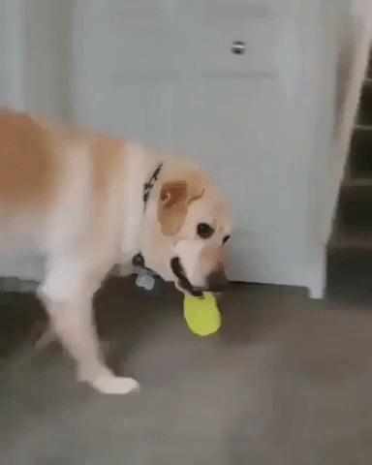

Slide 48
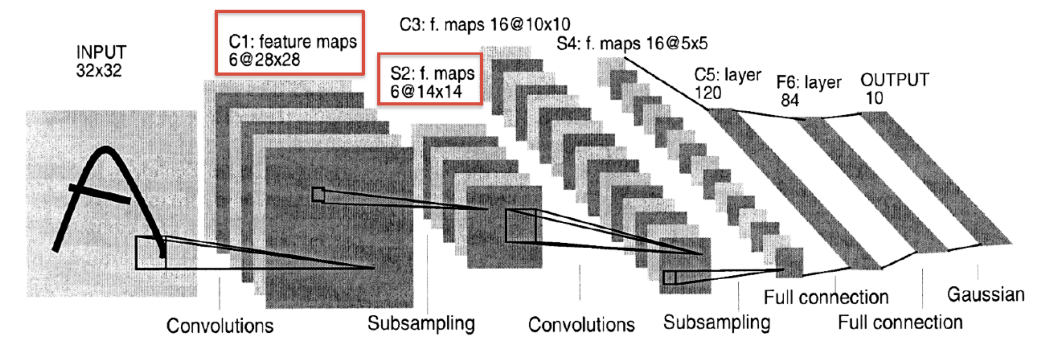
CNN Success
CNNs have had remarkable success in practice
LeNet, 1990s

Slide 49
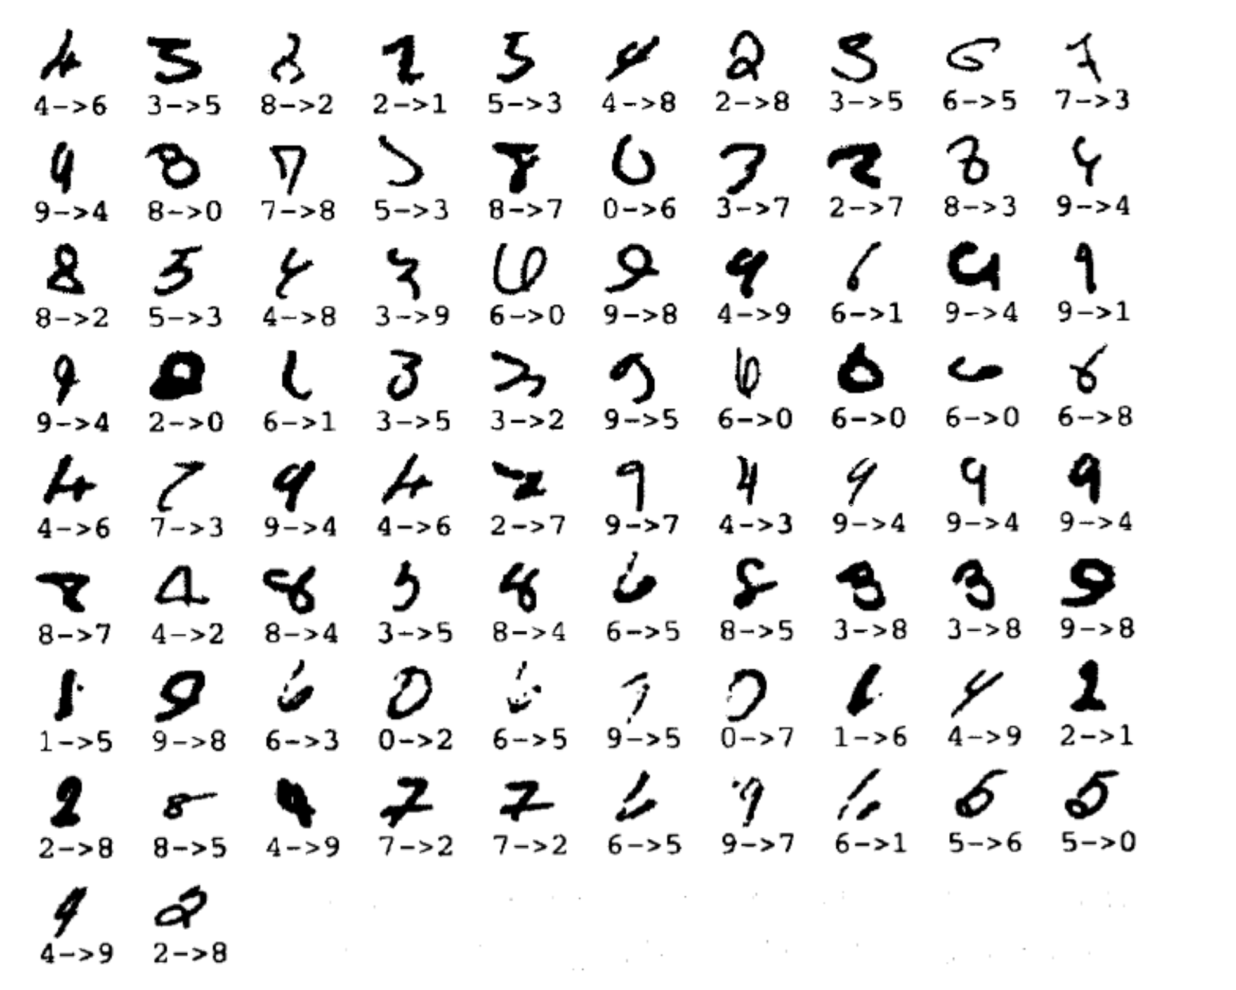
CNN Success
LeNet made 82 errors on MNIST (popular hand-written digit dataset of size 60K). 99.86% accuracy
Notes:
MNIST

Slide 50
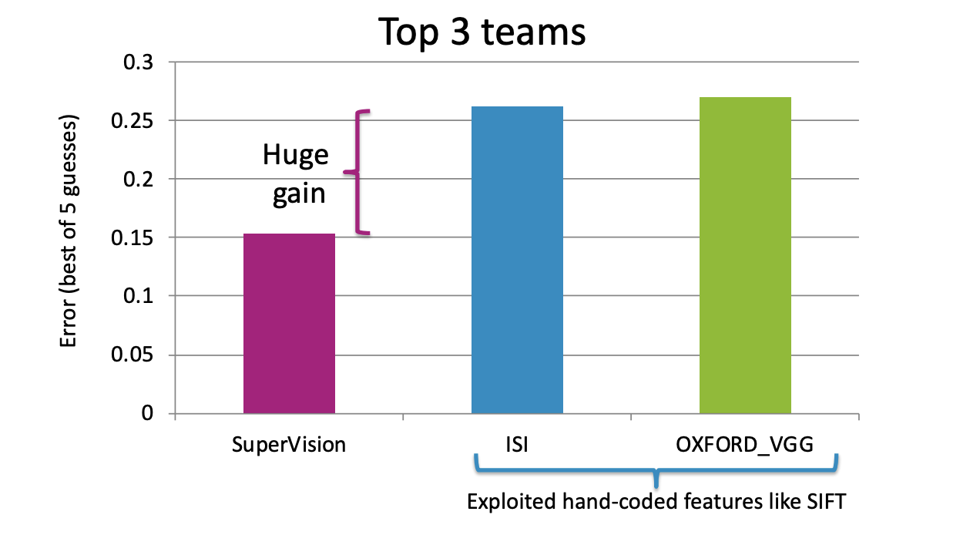
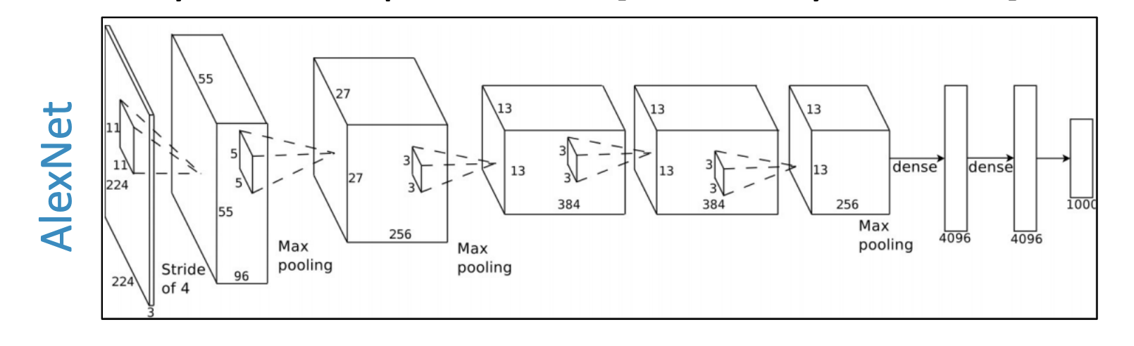
CNN Success
ImageNet 2012 competition:
1.2M training images
1000 categories
Winner: SuperVision
8 layers, 60M parameters [Krizhevsky et al. ‘12]
Top-5 Error: 17%

Slide 51
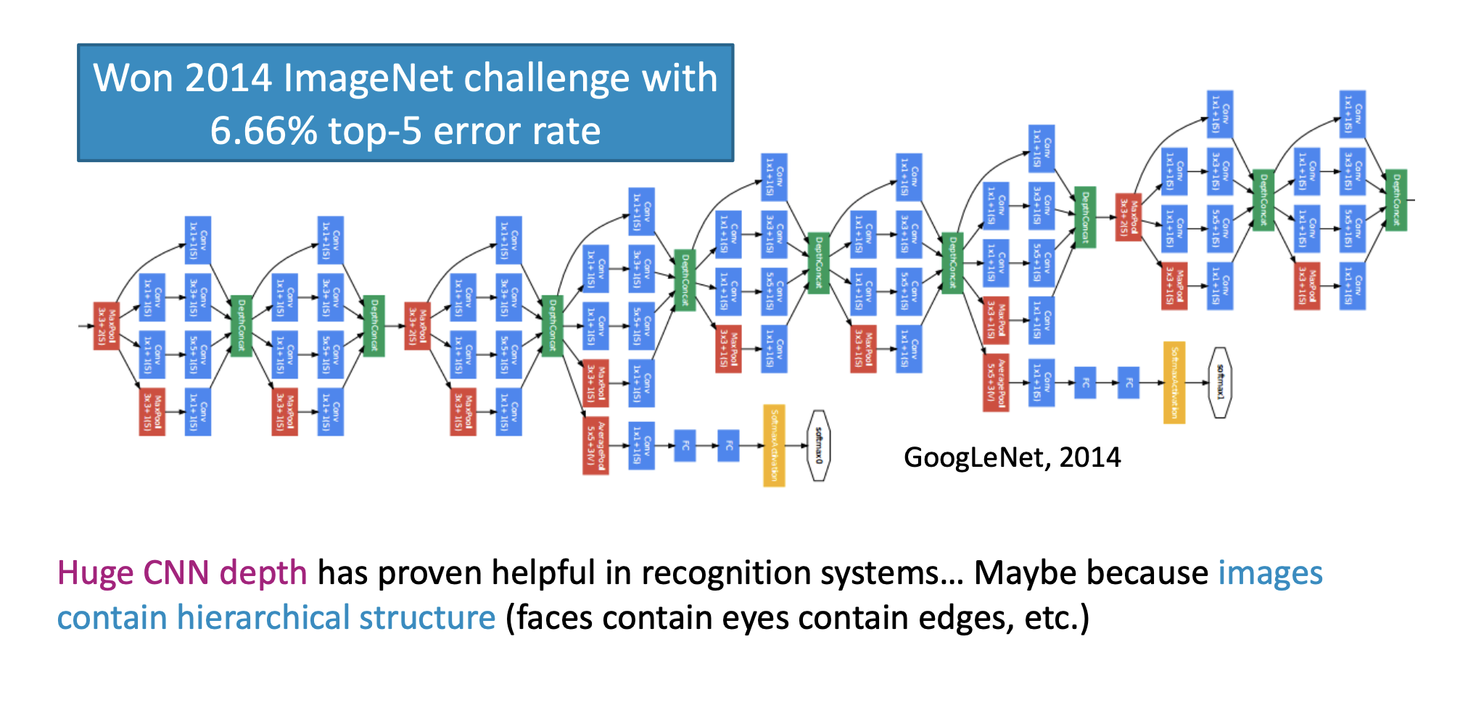
CNN Success

Slide 52
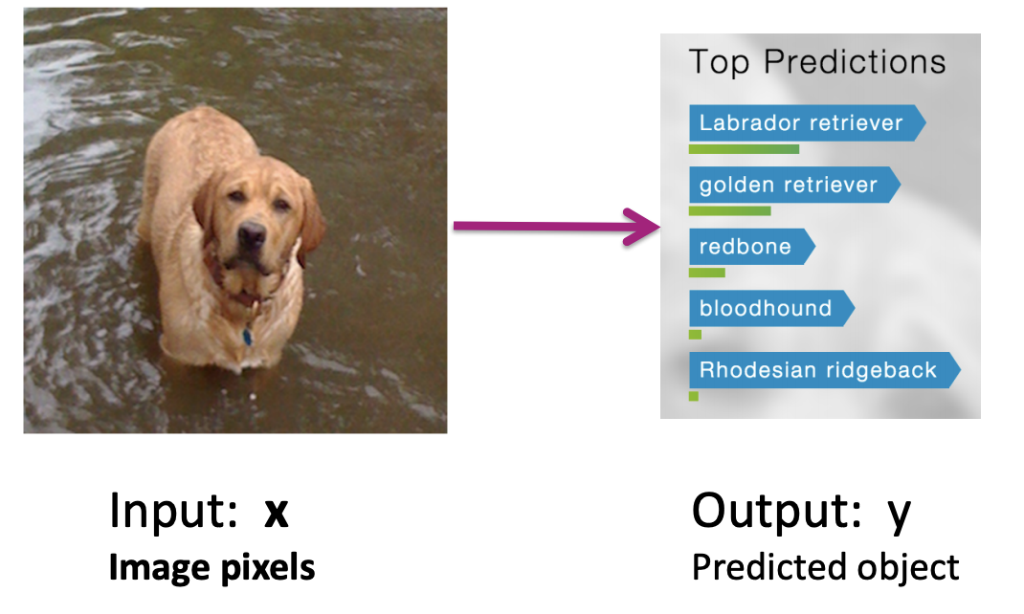
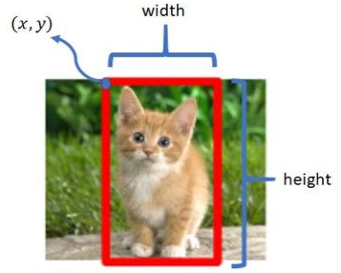
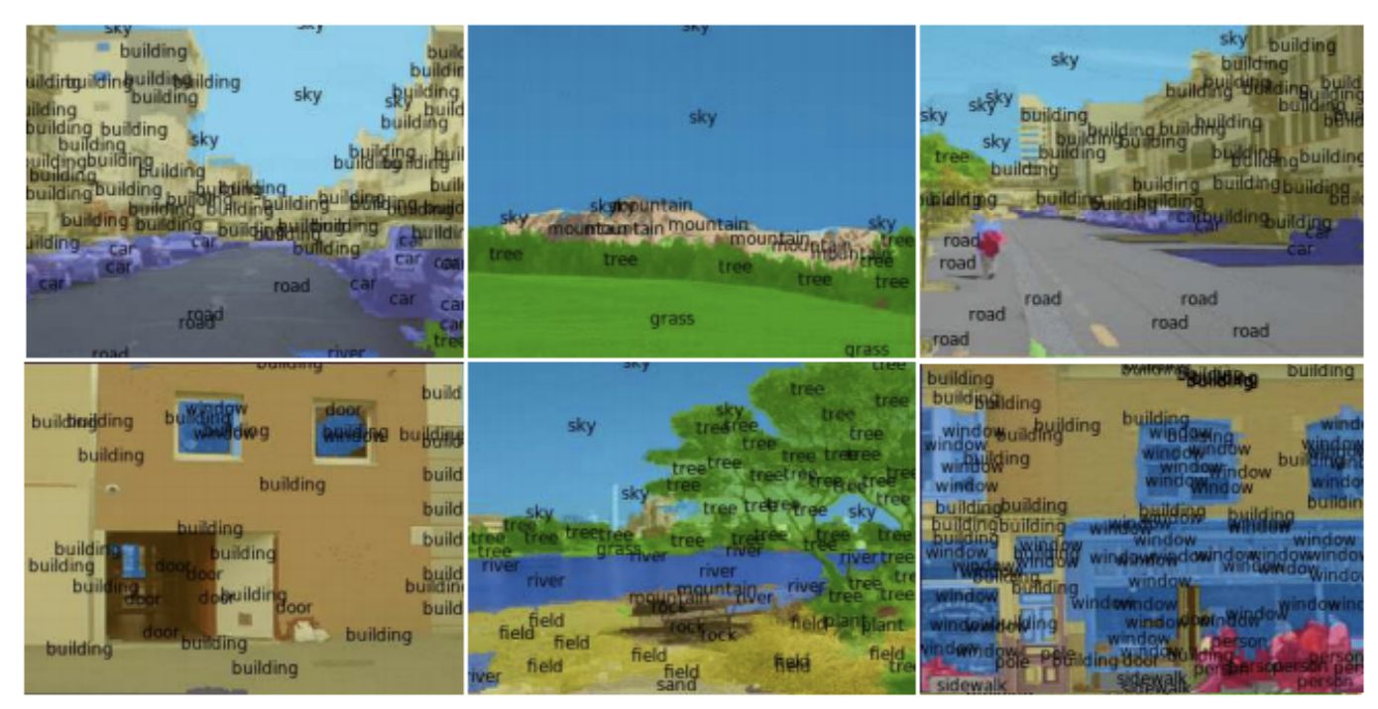
Applications
Image Classification
Object Localization
Scene Parsing [Farabet et al. ‘13]

Slide 53
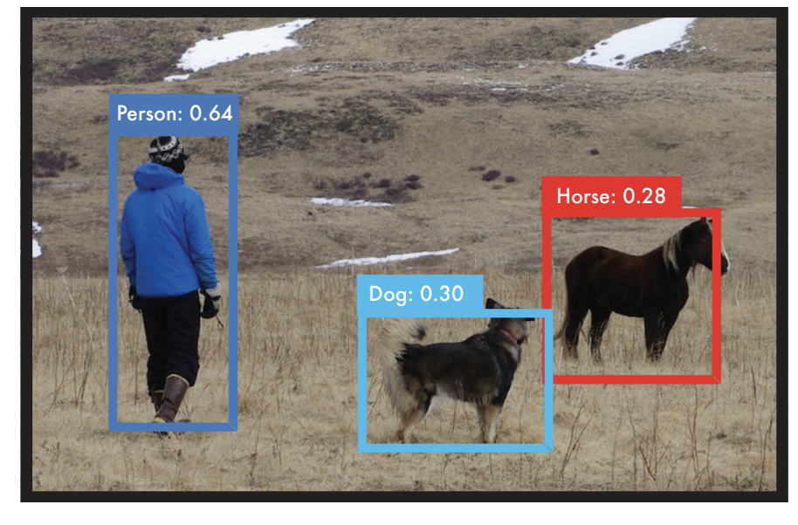
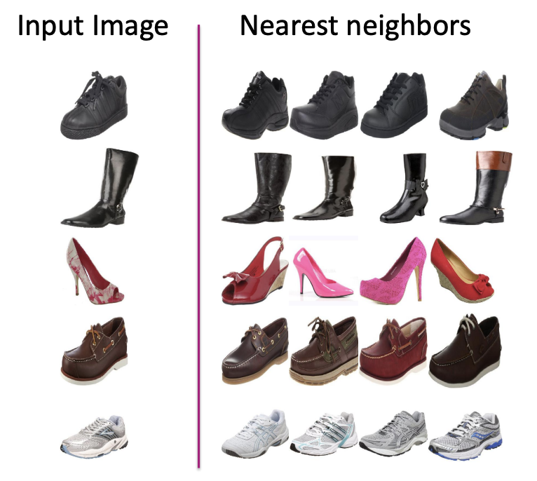
Applications
Object Detection [Redmon et al. 2015] (http://pjreddie.com/yolo/)
Product Recommendation

Slide 54
3 min
For each of the Computer Vision Tasks below, what do you think the output layer of the neural network would look like? What would each output neuron represent?
Image Classification: Given an image with a single object, output the class of the object.
Object Localization: Given an image with a single object, output the class and bounding box (x,y,w,h) of the object.
Object Detection: Given an image with possibly multiple objects, output the bounding box and class for each object.

Slide 55
Image Classification: Given an image with a single object, output the class of the object.
Object Localization: Given an image with a single object, output the class and bounding box (x,y,w,h) of the object.
Object Detection: Given an image with possibly multiple objects, output the bounding box and class for each object.

Slide 56
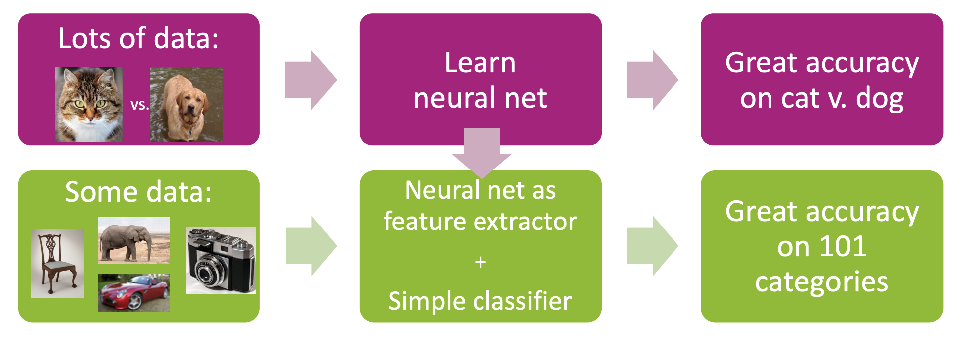
A Tale of 2 Tasks
If we don’t have a lot of data for Task 2, what can we do?
Idea: Use a model that was trained for one task to help learn another task.
An old idea, explored for deep learning by Donahue et al. ‘14 & others

Slide 57
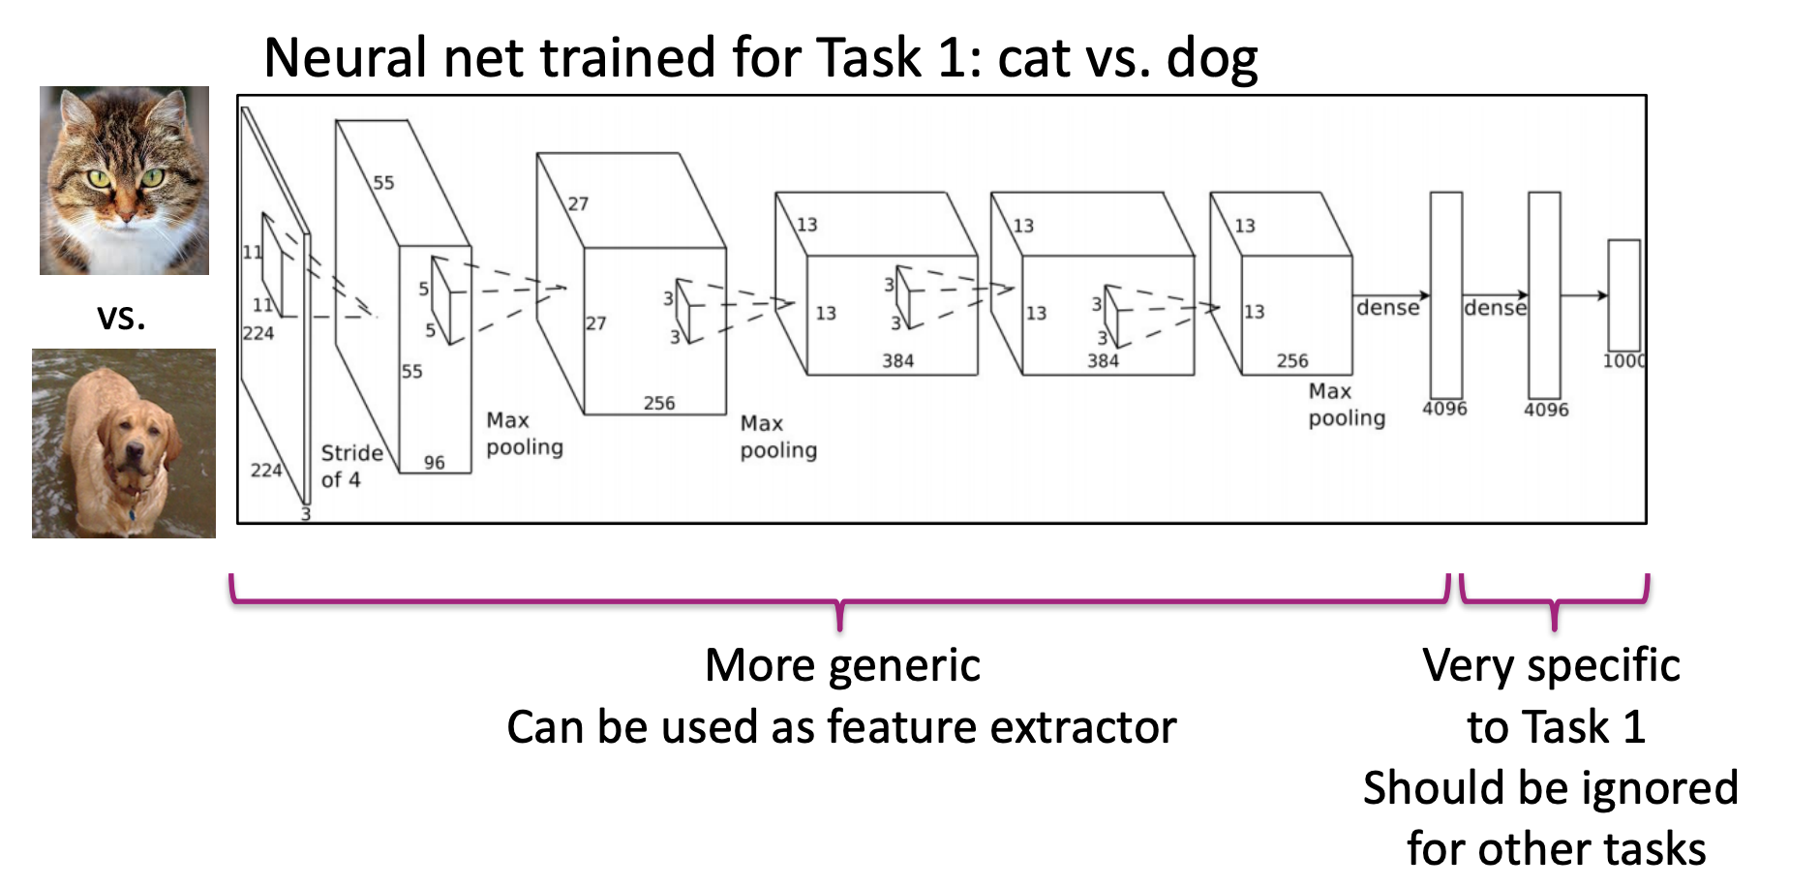
CNNs
What is learned in a neural network?
Initial layers are low-level and very general.
Usually not sensitive/specific to the task at hand

Slide 58
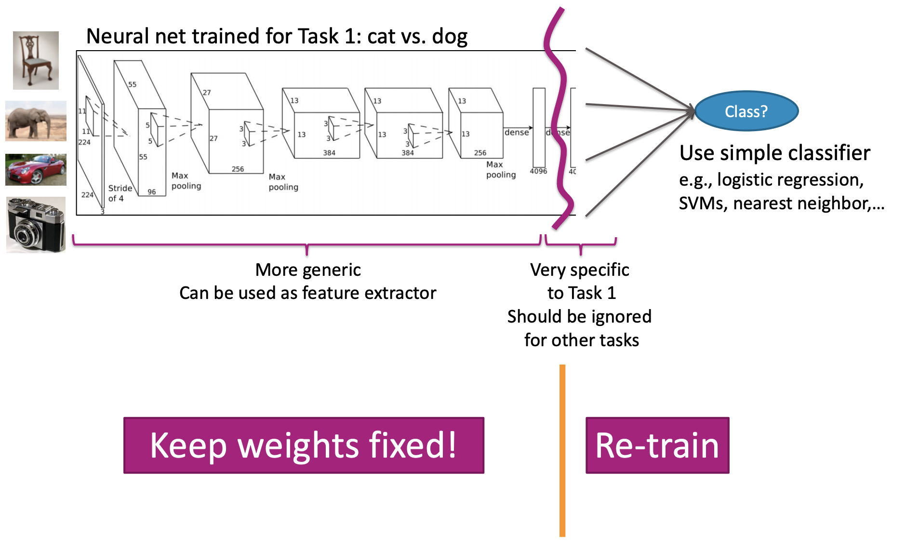
Transfer Learning
Share the weights for the general part of the network

Slide 59
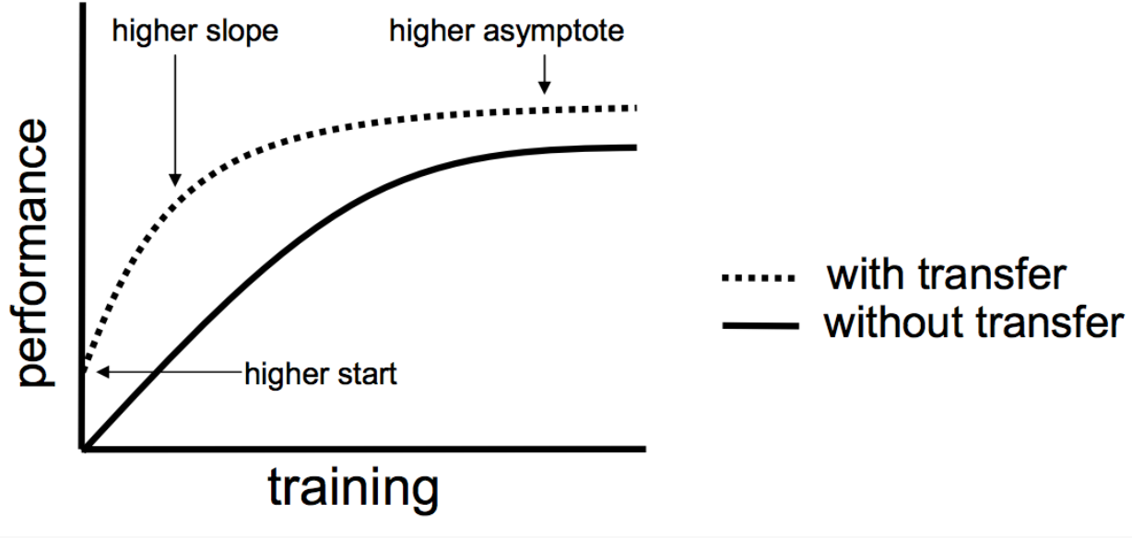
Transfer Learning
If done successfully, transfer learning can really help. Can give you
A higher start
A higher slope
A higher asymptote

Slide 60
Deep Learning in Practice

Slide 61
Pros
No need to manually engineer features, enable automated learning of features
Impressive performance gains
Image processing
Natural Language Processing
Speech recognition
Making huge impacts in most fields

Slide 62
Cons
Requires a LOT of data
Computationally really expensive
Environmentally, extremely expensive (Green AI)
Hard to tune hyper-parameters
Choice of architecture (we’ve added even more hyper-parameters)
  Size of kernels, stride, 0 padding, number of conv layers, depth of outputs of conv layers,
Learning algorithm
Still not very interpretable

Slide 63
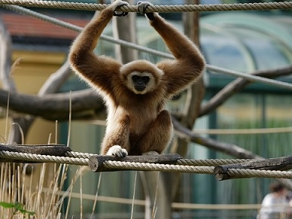
NN Failures
While NNs have had amazing success, they also have some baffling failures.
“No one adds noise to things in real applications”
Not true!
Hackers will hack
Sensors (cameras) are noisy!

Slide 64
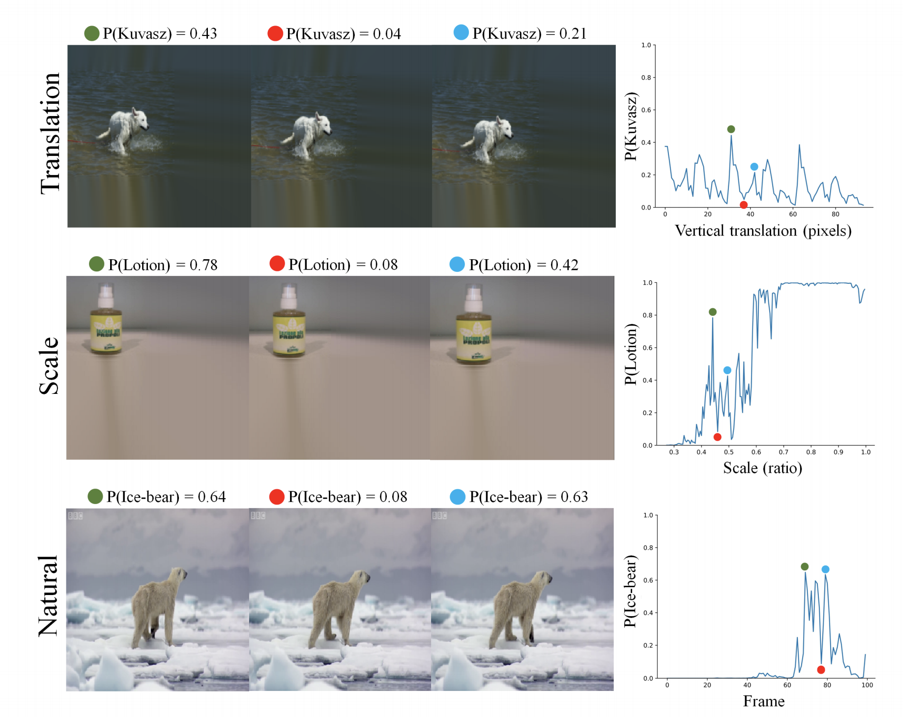
NN Failures
They even fail with “natural” transformations of images
[Azulay, Weiss https://arxiv.org/abs/1805.12177]

Slide 65
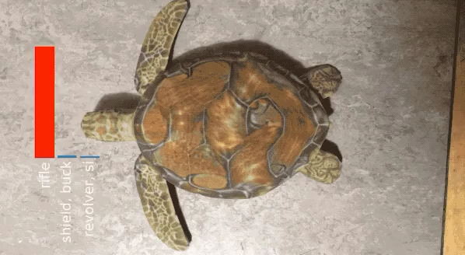
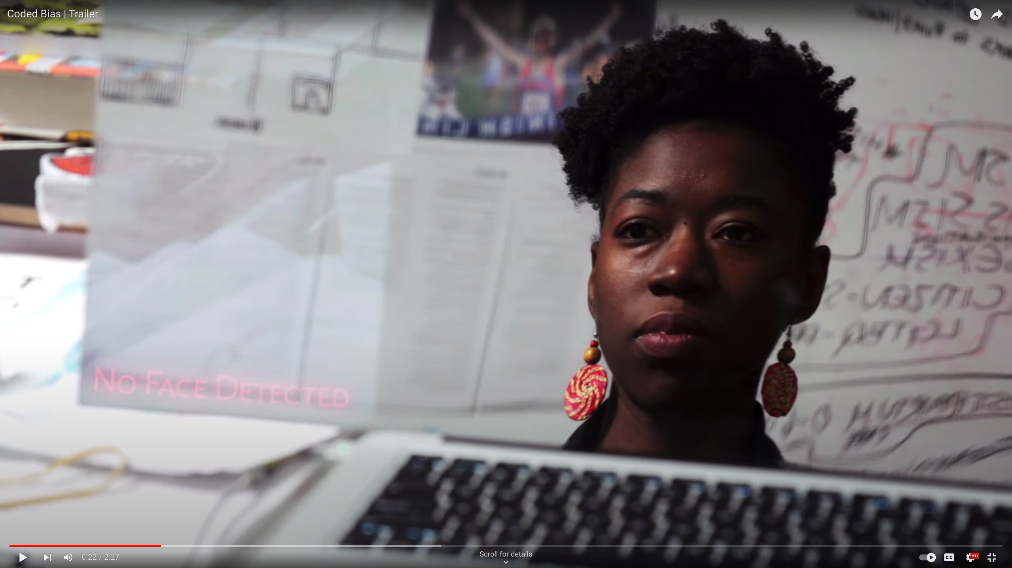
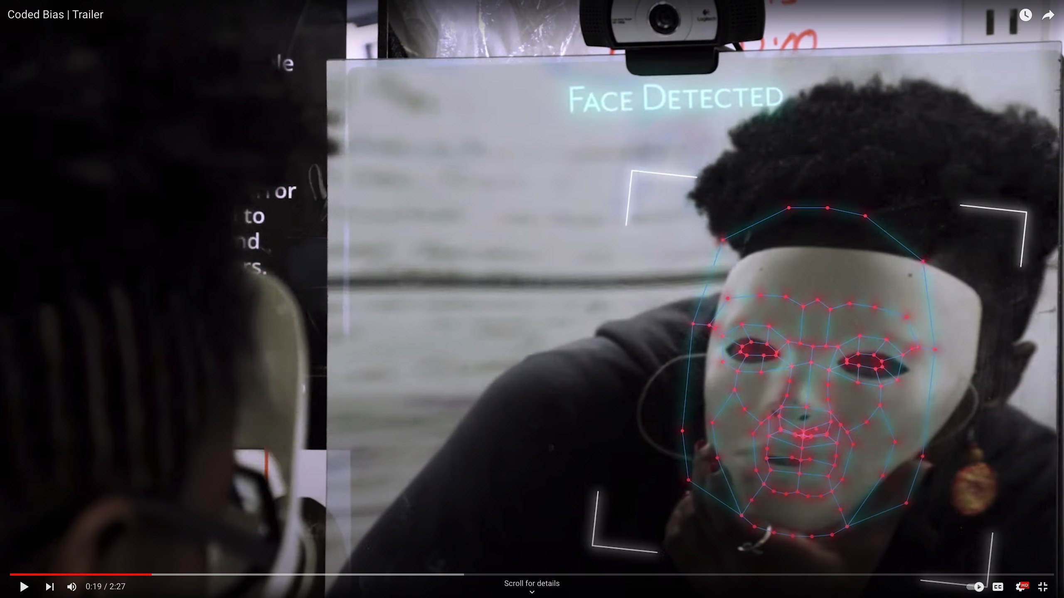
NN Failures
Objects can be created to trick neural networks!

Slide 66
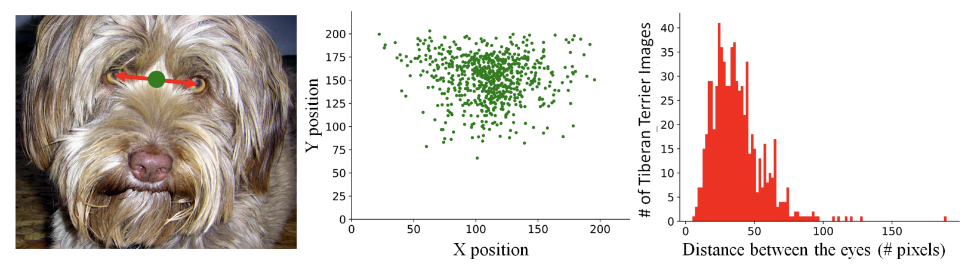
Dataset Bias
Datasets, like ImageNet, are generally biased
One approach is to augment your dataset to add random permutations of data to avoid bias.

Slide 67
Demo: Adversarial Neural Networks to Promote Fairness
https://godatadriven.com/blog/towards-fairness-in-ml-with-adversarial-networks/
Dataset: Adult UCI
Predict whether a person’s income will be > $50K or ≤ $50K based on factors like:
  Age
  Education level
  Marital status
  Served in Armed Services?
  Hours per week worked
  Occupation sector
  Etc.

Slide 68
Further Readings on Deep Learning
Dealing with Variable Length Sequences (e.g. language)
Recurrent Neural Networks (RNNs)
Long Short Term Memory Nets (LSTMs)
http://colah.github.io/posts/2015-08-Understanding-LSTMs/
Reinforcement Learning
Google DeepMind AlphaGo Zero
Generative Adversarial Networks
How to learn synthetic data
Green AI

Slide 69
Recap
Theme: Details of convolutional neural networks
Ideas:
Convolutions
MaxPool
Number of Parameters in a (C)NN
Weight Sharing
CNN Applications
Transfer Learning
NN Failures
Using NNs to promote algorithmic fairness

