Slide 1
CSE/STAT 416
Assessing Performance
Tanmay Shah
University of Washington
March 29, 2024
❓ Questions? Raise hand or sli.do #cs416
💬 Before Class: Did you get to do anything fun during the (short) spring break?
🎵 Listening to: grentperez

Slide 2
Logistics
Check EdStem for announcements and clarifications
Section tomorrow will focus on writing code for HW1
Module 0 assignments out!
  Learning Reflection due Monday
  HW0 released and due Thursday night

Slide 3
Pre-Class Video 1
Feature Extraction

Slide 4

ML Pipeline
- Deployment Bias
Training
Data
Pre-
Processing
x
ML
model
ŷ
⌃
- Historical Bias
- Representation Bias
- Measurement Bias
f
y
Optimization
algorithm
Quality
metric
4

Slide 5

Higher Order Features
This data doesn’t look exactly linear, why are we fitting a line instead of some higher-degree polynomial?
We can! We just have to use a slightly different model!
$$y_{i}=w_{0}+w_{1}x_{i}+w_{2}x_{i}^{2}+w_{3}x_{i}^{3}+ε_{i}$$

Slide 6
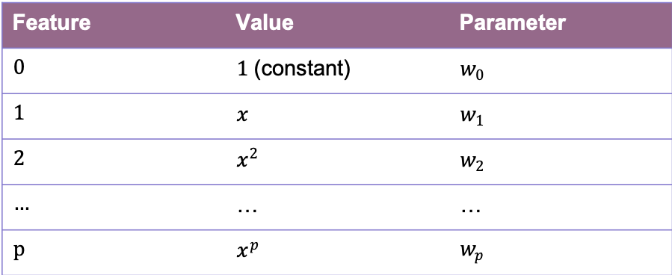
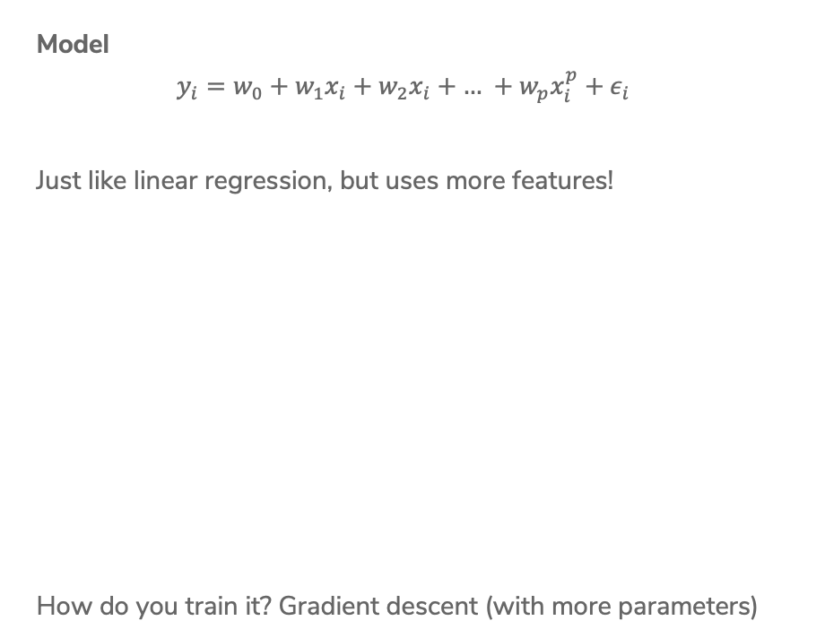
Polynomial Regression
Model
$$y_{i}=w_{0}+w_{1}x_{i}+w_{2}x_{i}+\text{…} +w_{p}x_{i}^{p}+ε_{i}$$
Just like linear regression, but uses more features!
How do you train it? Gradient descent (with more parameters)
Feature | Value | Parameter
0 | $1$ (constant) | $w_{0}$
1 | $x$ | $w_{1}$
2 | $x^{2}$ | $w_{2}$
… | … | …
p | $x^{p}$ | $w_{p}$

Slide 7
Polynomial Regression
How to decide what the right degree? Come back Wednesday!
Notes:
Draw different values of p in different colors
Max p = 32

Slide 8
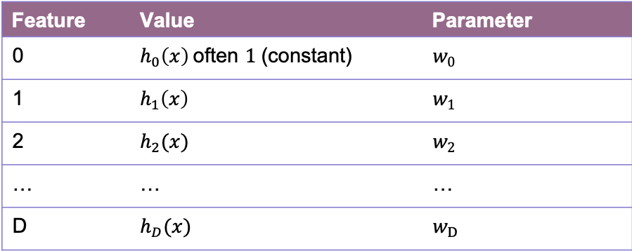

Features
Features are the values we select or compute from the data inputs to put into our model. Feature extraction is the process of turning the data into features.
Model
$$y_{i}=w_{0}h_{0}\left(x_{i}\right)+w_{1}h_{1}\left(x_{i}\right)+\text{…}+w_{D}h_{D}\left(x_{i}\right)+ε_{i} \\ = \sum_{j=0}^{D}{w_{j}h_{j}\left(x_{i}\right)+ε_{i}}$$
Feature | Value | Parameter
0 | $h_{0}\left(x\right)$often $1$ (constant) | $w_{0}$
1 | $h_{1}\left(x\right)$ | $w_{1}$
2 | $h_{2}(x)$ | $w_{2}$
… | … | …
D | $h_{D}(x)$ | $w_{D}$

Slide 9
Adding Other Inputs
Generally we are given a data table of values we might look at that include more than one value per house.
Each row is a single house.
Each column (except Value) is a data input.
sq. ft. | # bathrooms | owner’s age | … | value
1400 | 3 | 47 | … | 70,800
700 | 3 | 19 | … | 65,000
… | … | … | … | …
1250 | 2 | 36 | … | 100,000

Slide 10
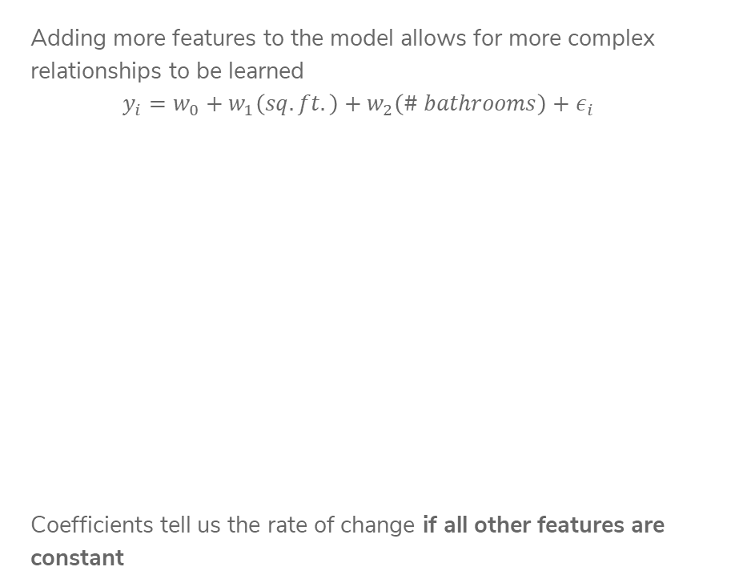
More Inputs - Visually
Adding more features to the model allows for more complex relationships to be learned
$$y_{i}=w_{0}+w_{1}\left(sq. ft.\right)+w_{2}\left(\# bathrooms\right)+ε_{i}$$
Coefficients tell us the rate of change if all other features are constant

Slide 11
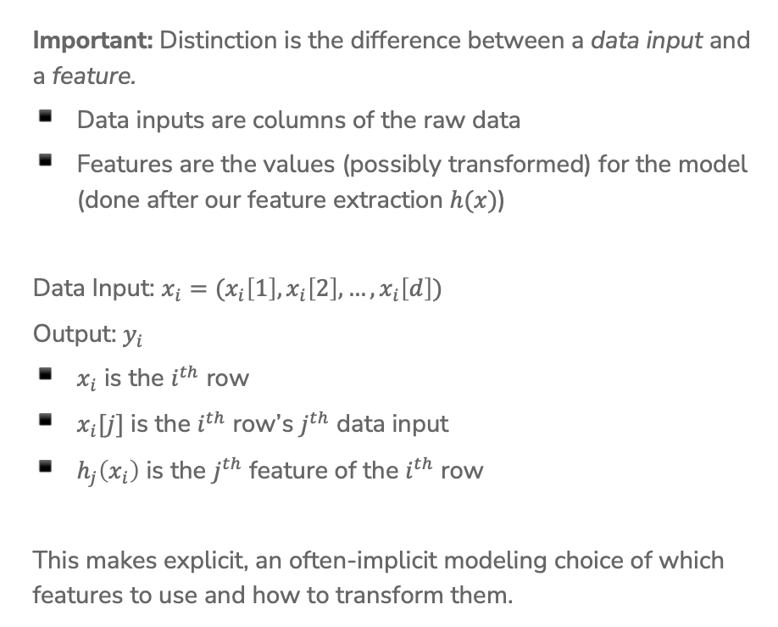
Notation
Important: Distinction is the difference between a data input and a feature.
Data inputs are columns of the raw data
Features are the values (possibly transformed) for the model (done after our feature extraction $h(x)$)
Data Input: $x_{i}=(x_{i}\left[1\right], x_{i}\left[2\right], …, x_{i}\left[d\right])$
Output: $y_{i}$
$x_{i}$ is the $i^{th}$ row
$x_{i}[j]$ is the $i^{th}$ row’s $j^{th}$ data input
$h_{j}\left(x_{i}\right)$ is the $j^{th}$ feature of the $i^{th}$ row
This makes explicit, an often-implicit modeling choice of which features to use and how to transform them.

Slide 12
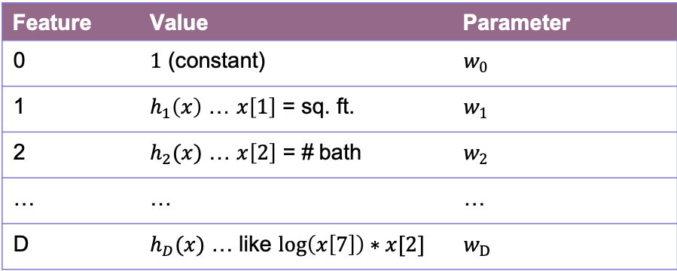
Features
You can use anything you want as features and include as many of them as you want!
Generally, more features means a more complex model. This might not always be a good thing!
Choosing good features is a bit of an art.
Feature | Value | Parameter
0 | $1$ (constant) | $w_{0}$
1 | $h_{1}\left(x\right)$ … $x\left[1\right]$ = sq. ft. | $w_{1}$
2 | $h_{2}(x)$ … $x\left[2\right]$ = # bath | $w_{2}$
… | … | …
D | $h_{D}(x)$ … like $\log\left(x\left[7\right]\right)∗x[2]$ | $w_{D}$

Slide 13
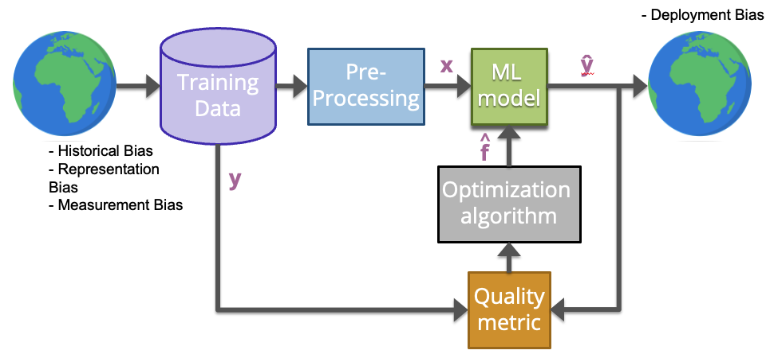

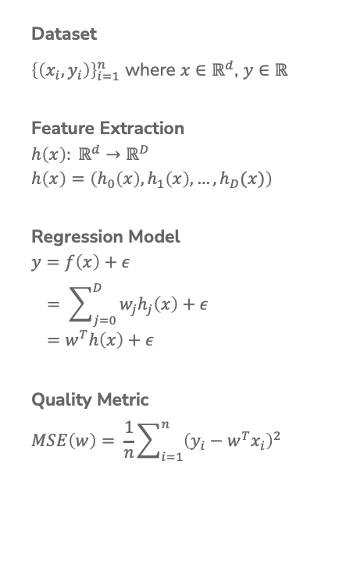
Linear Regression Recap
Dataset
${\left\{\left(x_{i}, y_{i}\right)\right\}}_{i=1}^{n}$ where $x∈ℝ^{d}$, $y∈ℝ$
Feature Extraction
$$h\left(x\right): ℝ^{d}→ℝ^{D}$$
$$h\left(x\right)=\left(h_{0}\left(x\right), h_{1}\left(x\right), …, h_{D}(x)\right)$$
Regression Model
$$y=f\left(x\right)+ε \\ = \sum_{j=0}^{D}{w_{j}h_{j}\left(x\right)+ε} \\ =w^{T}h\left(x\right)+ε$$
Quality Metric
$$MSE\left(w\right)= \frac{1}{n}\sum_{i=1}^{n}{{\left(y_{i}−w^{T}x_{i}\right)}^{2}}$$
Predictor
$$\hat{w}= \underset{w}{argmin}{MSE(w)}$$
ML Algorithm
Optimized using Gradient Descent
Prediction
$$\hat{y}={\hat{w}}^{T}h(x)$$

Slide 14
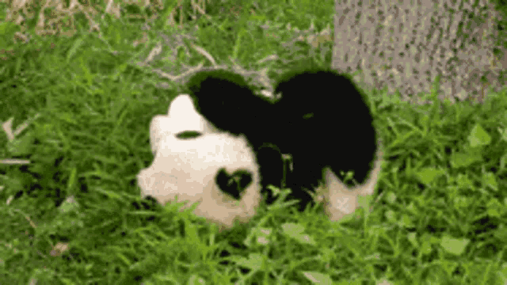

Slide 15
Pre-Class Video 2
Assessing Performance

Slide 16
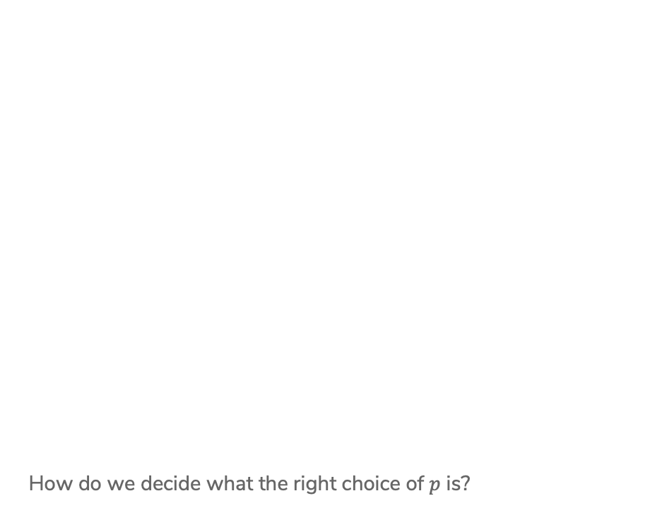
Polynomial Regression
How do we decide what the right choice of $p$ is?
Notes:
Draw different values of p in different colors, p=0, 1, 2, 3, 31
Max p = 31

Slide 17
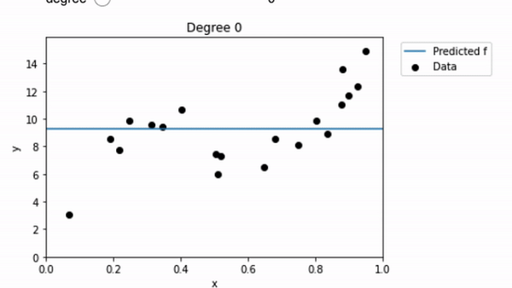
Polynomial Regression
Consider using different degree polynomials on the same training set.
From estimating with your eyes, which one seems to have the lowest MSE on this dataset?
It seems like minimizing the MSE on the training set is not the whole story here …
(animation by Pemi Nguyen)

Slide 18
Performance
Why do we train ML models?
We generally want them to do well on unseen data.
If we choose the model that minimizes MSE on the data it learned from, we are just choosing the model that can memorize, not the one that generalizes well.
Analogy: Just because you can get 100% on a practice exam you’ve studied for hours, it doesn’t mean you will also get 100% on the real test that you haven’t seen before.
Key Idea: Assessing yourself based on something you learned from generally overestimates how well you will do in the future!

Slide 19
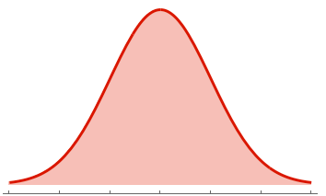
Future Performance
What we care about is how well the model will do on unseen data.
How do we measure this? True error
To do this, we need to understand uncertainty in the world
True Error
Sq. Ft.
Price | Sq. Ft.
Notes:
Explain the high-level of a probability density function (PDF)
$$E_{xy}[L(y, f_w(x))]$$
Show that this is just the weighted average over all pairs of x,y
This is where the true function we mentioned last time comes in. It is a theoretical construct – it doesn’t actually exist – but it helps us define the true error and analyze it. WOS $$y=f(x)+epsilon$$

Slide 20
Model Assessment
How can we figure out how well a model will do on future data if we don’t have any future data?
Estimate it! We can hide data from the model to test it later as an estimate how it will do on future data
We will randomly split our dataset into a train set and a test set
The train set is to train the model
The test set is to estimate the performance in the future

Slide 21
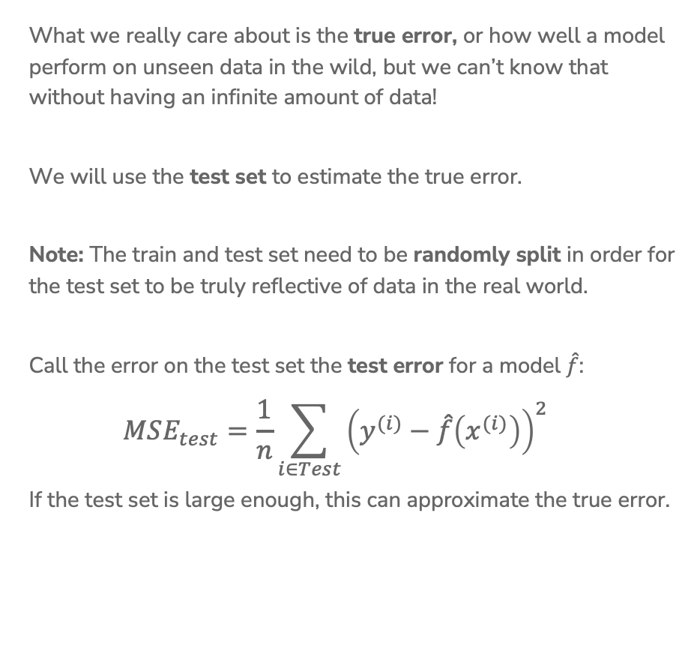
Test Error
What we really care about is the true error, or how well a model perform on unseen data in the wild, but we can’t know that without having an infinite amount of data!
We will use the test set to estimate the true error.
Note: The train and test set need to be randomly split in order for the test set to be truly reflective of data in the real world.
Call the error on the test set the test error for a model $\hat{f}$:
$$MSE_{test}=\frac{1}{n}\sum_{i∈Test}{{\left(y^{(i)}−\hat{f}\left(x^{(i)}\right)\right)}^{2}}$$
If the test set is large enough, this can approximate the true error.

Slide 22
Train/Test Split
If we use the test set to estimate future, how big should it be?
This comes at a cost of reducing the size of the training set though (in the absence of being able to just get more data)
In practice people generally do train:test as either
80:20
90:10
Important: Never train your model on data in the test set!
Notes:
WOS “More test data => better estimate of true error”
WOS “What happens if training set is too small? Extreme example of two points”

Slide 23
Regression Recap

Slide 24
Linear Regression Model
Assume we have a simple model with one feature, where we establish a linear relationship between the area of a house $i$ and its price:
$$y_{i}={ w}_{0}+w_{1}x_{i}+ε_{i}$$
$w_{0},w_{1}$are the parameters of our model that need to be learned
$w_{0}$ is the intercept / bias, representing the starting price of a house
$w_{1}$ is the slope / weight associated with feature ”area of a house”
Learn estimates of these
parameters ${\hat{w}}_{1}$ , ${\hat{w}}_{0}$ and use
them to predict new value
for any input $x$!
$\hat{y}={\hat{w}}_{1}x+{\hat{w}}_{0}$
Why don’t we add $ε$?
$$y$$
Price
Area of a house
$$x$$
Notes:
Talk about what happens if w_1 is 0

Slide 25
ML Pipeline
- Deployment Bias
Training
Data
Pre-
Processing
x
ML
model
ŷ
⌃
- Historical Bias
- Representation Bias
- Measurement Bias
f
y
Optimization
algorithm
Quality
metric
25
Notes:
Write these on the slide
Training data: Raw data about houses
Feature extraction: Extract / transform/ compute relevant features
X: SQ. FT
Y: Actual house prices
Quality Metric: Errors in predicted values
Optimization Algorithm: Adjust the parameters of the model
\hat{Y}: predicted sales

Slide 26
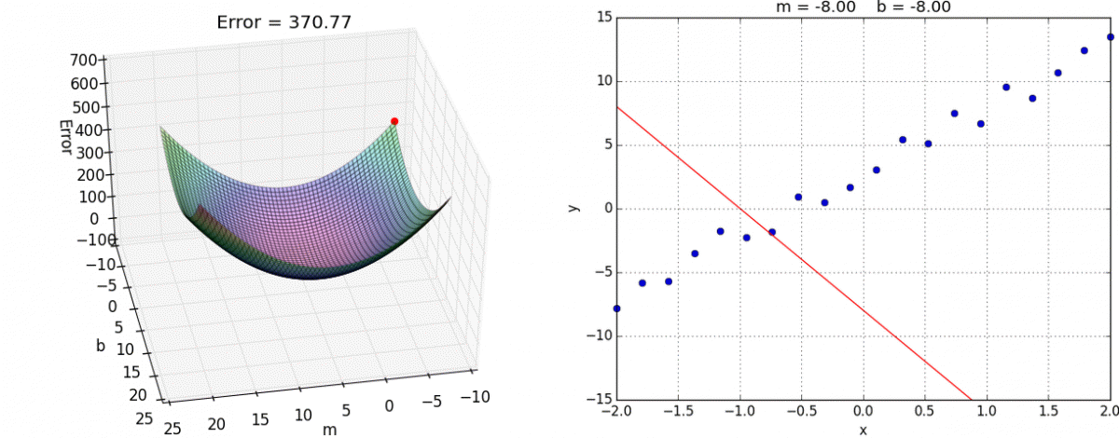

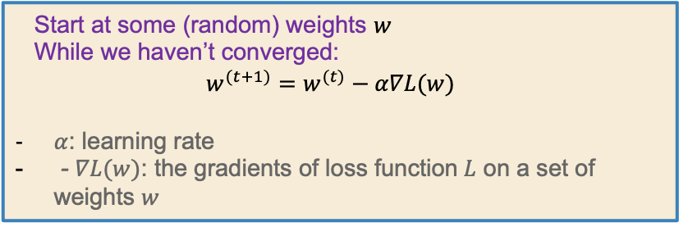
Gradient Descent
Instead of computing all possible points to find the minimum,
just start at one point and “roll” down the hill. Use the gradient (slope) to determine which direction is down.
Start at some (random) weights $w$
While we haven’t converged:
$$w^{(t+1)}=w^{(t)}−α∇L(w)$$
$α$: learning rate
- $∇L(w)$: the gradients of loss function$L$ on a set of weights $w$

Slide 27
Pre-Class 1 Recap:
Features
You can use anything you want as features and include as many of them as you want!
Generally, more features means a more complex model. This might not always be a good thing!
Choosing good features is a bit of an art.
Feature | Value | Parameter
0 | $1$ (constant) | $w_{0}$
1 | $h_{1}\left(x\right)$ … $x\left[1\right]$ = sq. ft. | $w_{1}$
2 | $h_{2}(x)$ … $x\left[2\right]$ = # bath | $w_{2}$
… | … | …
D | $h_{D}(x)$ … like $\log\left(x\left[7\right]\right)∗x[2]$ | $w_{D}$

Slide 28
Linear Regression Recap
Dataset
${\left\{\left(x_{i}, y_{i}\right)\right\}}_{i=1}^{n}$ where $x∈ℝ^{d}$, $y∈ℝ$
Feature Extraction
$$h\left(x\right): ℝ^{d}→ℝ^{D}$$
$$h\left(x\right)=\left(h_{0}\left(x\right), h_{1}\left(x\right), …, h_{D}(x)\right)$$
Regression Model
$$y=f\left(x\right)+ε \\ = \sum_{j=0}^{D}{w_{j}h_{j}\left(x\right)+ε} \\ =w^{T}h\left(x\right)+ε$$
Quality Metric
$$MSE\left(w\right)= \frac{1}{n}\sum_{i=1}^{n}{{\left(y_{i}−w^{T}x_{i}\right)}^{2}}$$
Predictor
$$\hat{w}= \underset{w}{argmin}{MSE(w)}$$
ML Algorithm
Optimized using Gradient Descent
Prediction
$$\hat{y}={\hat{w}}^{T}h(x)$$

Slide 29
Term recap
Supervised learning: The machine learning task of learning a function that maps an input to an output based on example input-output pairs.
Regression: A supervised learning task where the outputs are continuous values.
Feature:
  An attribute that we’re selecting for our model
  Can come from the original dataset, or through some transformations (feature extraction)
Parameter: The weight or bias associated with a feature. The goal of machine learning is to adjust the weights to optimize the loss functions on training data.
Loss function: A function that computes the distance between the predicted output from a machine learning model and the actual output.
Machine learning model: An algorithm that combs through an amount of data to find patterns, make predictions, or generate insights
Optimization algorithm: An algorithm used to minimize the loss during training. The most common one is Gradient Descent.

Slide 30
Pre-Class 2 Recap:
Model Evaluation
Low training error != a good model
To avoid memorizing, need to test on data we didn’t train on
Training set to train on and a test set for evaluation
  Test set is a stand-in for all future data

Slide 31
1 min
Goal: Get you actively participating in your learning
Typical Activity
  Question is posed
  Think (1 min): Think about the question on your own
  Pair (2 min): Talk with your neighbor to discuss question
    If you arrive at different conclusions, discuss your logic and figure out why you differ!
    If you arrived at the same conclusion, discuss why the other answers might be wrong!
  Share (1 min): We discuss the conclusions as a class
During each of the Think and Pair stages, you will respond to the question via a sli.do poll
  Not worth any points, just here to help you learn!

Slide 32
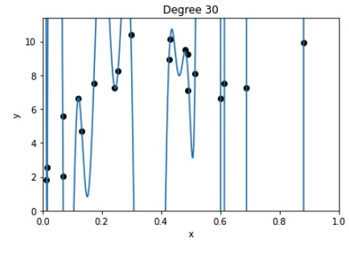
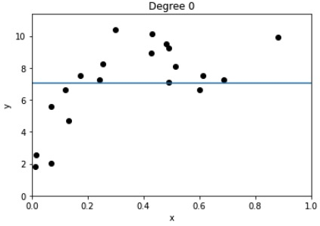
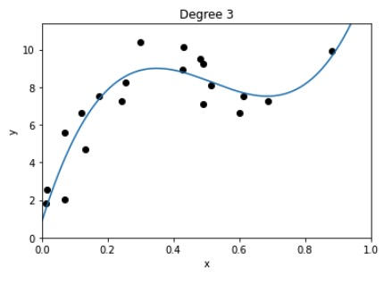
1 minute
Which of the models do you expect to have the:
Highest Train Error
Highest Test Error
Lowest Train Error
Lowest Test Error
Notes:
Displayed points are the train set. Assume the test set is not shown, but generally along the same distribution.

Slide 33
2 minute
Which of the models do you expect to have the:
Highest Train Error
Highest Test Error
Lowest Train Error
Lowest Test Error
Notes:
Displayed points are the train set. Assume the test set is not shown, but generally along the same distribution.
WOS: Depends on dataset!

Slide 34
Model Complexity

Slide 35
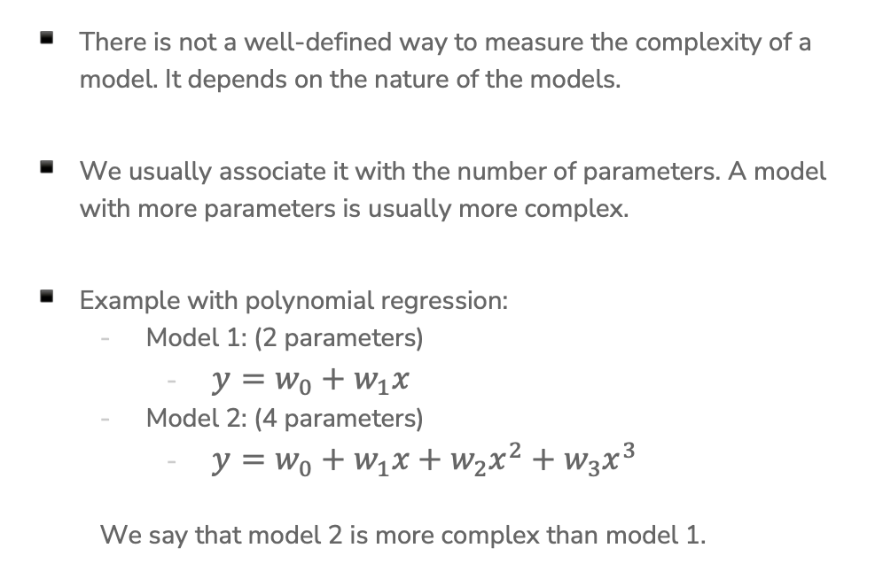
Model Complexity
There is not a well-defined way to measure the complexity of a model. It depends on the nature of the models.
We usually associate it with the number of parameters. A model with more parameters is usually more complex.
Example with polynomial regression:
  Model 1: (2 parameters)
    $y=w_{0}+w_{1}x$
  Model 2: (4 parameters)
    $y=w_{0}+w_{1}x+w_{2}x^{2}+w_{3}x^{3}$
  We say that model 2 is more complex than model 1.

Slide 36
Training Error
What happens to training error as we increase model complexity?
Start with the simplest model (a constant function)
End with a very high degree polynomial

Slide 37
True Error
What happens to true error as we increase model complexity?
Start with the simplest model (a constant function)
End with a very high degree polynomial

Slide 38
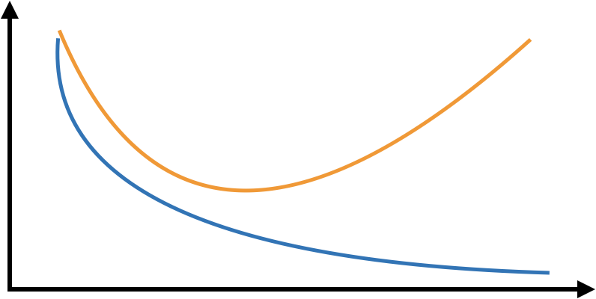
Train/True Error
Compare what happens to train and true error as a function of model complexity
Error
True error
Train error
Complexity
Notes:
Draw a squiggly line for test error
Draw the just right zone
Draw the overfitting zone
Draw the underfitting zone

Slide 39
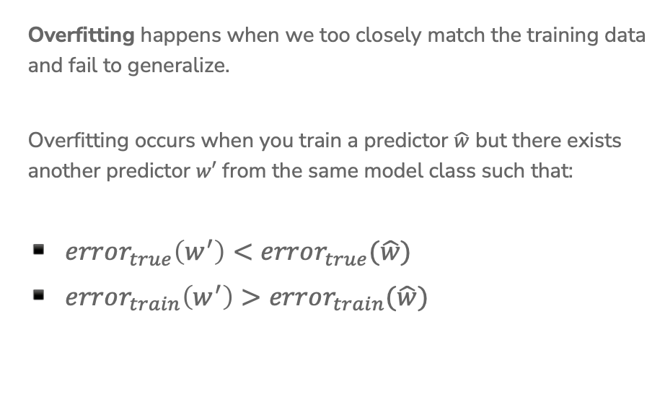
Overfitting
Overfitting happens when we too closely match the training data and fail to generalize.
Overfitting occurs when you train a predictor $\hat{w}$ but there exists another predictor $w′$ from the same model class such that:
$error_{true}\left(w^{′}\right)<error_{true}(\hat{w})$
$error_{train}\left(w^{′}\right)>error_{train}(\hat{w})$
Error
Complexity
Notes:
Remind them that test error is a heuristic for true error.

Slide 40
1 min
Consider the learning task of predicting the price of a house based on its features. Evaluate the statement: “To make the model more accurate, we should include as many features as possible (e.g., square footage, # bathrooms, location, etc.).
True
False
Unsure

Slide 41
1 min
Consider the learning task of predicting the price of a house based on its features. Evaluate the statement: “To make the model more accurate, we should include as many features as possible (e.g., square footage, # bathrooms, location, etc.).
True
False
Unsure

Slide 43
Bias-Variance Tradeoff

Slide 44
Underfitting / Overfitting
The ability to overfit/underfit is a knob we can turn based on the model complexity.
More complex => easier to overfit
Less complex => easier to underfit
In a bit, we will talk about how to chose the “just right”, but now we want to look at this phenomena of overfitting/underfitting from another perspective.
Underfitting
Optimal
Overfitting

Slide 45
Signal vs.
Noise
Learning from data relies on balancing two aspects of our data
Signal
Noise
Complex models make it easier to fit too closely to the noise
Simple models have trouble picking up the signal
Notes:
Nate Silver founded fivethirtyeight, a statistical blog that became famous for correctly predicting the outcomes of all 50 states in the 2012 election

Slide 46
Source of errors in a model
Total errors for a machine learning model comes from 3 types:
Bias
Variance
Irreducible Error
Irreducible error is the one that we can’t avoid or possibly eliminate. They are caused by elements outside of our control, such as noise from observations.

Slide 47
Bias
A model that is too simple fails to fit the signal. In some sense, this signifies a fundamental limitation of the model we are using to fail to fit the signal. We call this type of error bias.
Bias is the difference between the average prediction of our model and the expected value which we are trying to predict.
Low complexity (simple) models tend to have high bias.
Notes:
WOS: Bias: $$f(x) – E_D[\hat{f}(x | D)]$$
WOS: y = f(x) + epsilon, defines a distribution to draw values.
What you’re doing: randomly sampling a bunch of points from the generator, training a model, repeating that and taking the average of them. Then computing the difference between the average model and the true function.
Can’t compute bias of a real-world dataset, don’t have the true function.

Slide 48
Variance
A model that is too complicated for the task overly fits to small fluctuations. The flexibility of the complicated model makes it capable of memorizing answers rather than learning general patterns. This contributes to the error as variance.
Variance is the variability in the model prediction, meaning how much the predictions will change if a different training dataset is used.
High complexity models tend to have high variance.
Notes:
WOS: Variance: $E_D[(\hat{f}(x | D) - E_D[\hat{f}(x | D)])^2]$
What you’re doing: randomly sampling a bunch of points from the generator, training a model, repeating that and taking the average of them. Then you are looking at the difference between each trained model and the average trained model. How much did the model vary, how much is it jumping around.
Can compute variance of a real-world dataset, by taking different random samples of the data.

Slide 49
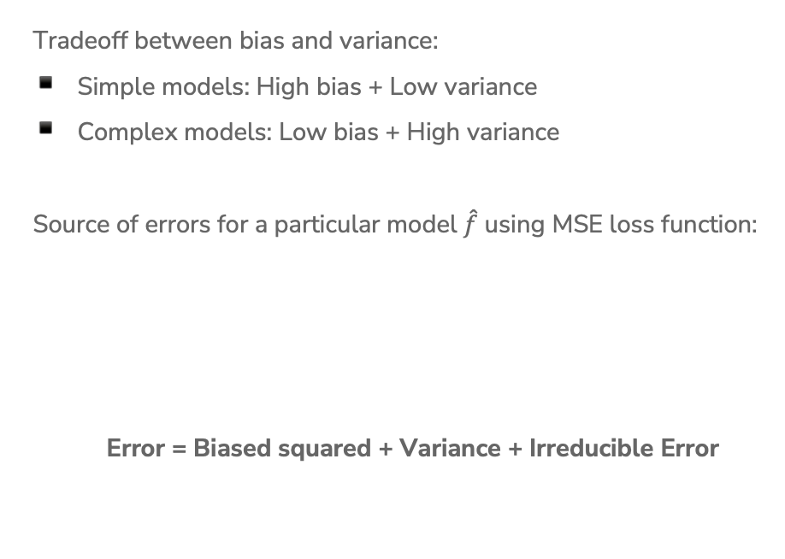
Bias-Variance Tradeoff
Tradeoff between bias and variance:
Simple models: High bias + Low variance
Complex models: Low bias + High variance
Source of errors for a particular model $\hat{f}$ using MSE loss function:
Error = Biased squared + Variance + Irreducible Error

Slide 50

Bias-Variance Tradeoff
Visually, this looks like the following!
$$Error=Bias^{2}+Variance+Irredicible Error$$
Error
Complexity
Notes:
WOS: true error curve, variance, bias, noise

Slide 51
Bias – Variance Tradeoff
Optimal model complexity
True error
Error
Underfitting
Overfitting
Variance
Biased squared
Complexity

Slide 52
Dataset Size
So far our entire discussion of error assumes a fixed amount of data. What happens to our error (true error and training error) as we get more data?
Error
Size of train set
Notes:
WOS: true error, train error

Slide 53
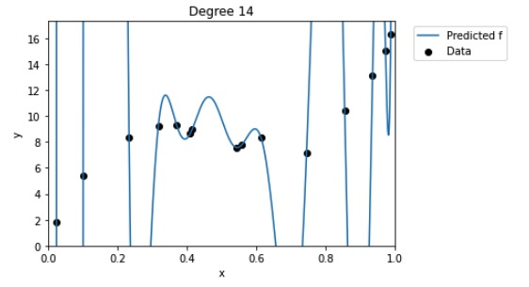
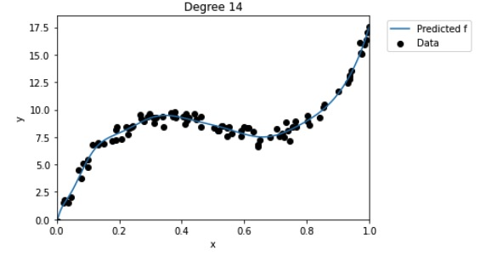
Dataset Size
Model complexity doesn’t depend on the size of the training set
The larger the training set, the lower the variance of the model, thus less overfitting
Notes:
Bias is not impacted by training set size, because in bias calculations we average across several sampled datasets, we don’t consider individual models trained on particular datasets. https://stats.stackexchange.com/a/406782

Slide 54
Demo
Bias-Variance Tradeoff
Training a linear regression model in Python
Observing the effect of the bias-variance tradeoff as compared to model complexity

Slide 55


Slide 56
Choosing Complexity

Slide 57
Choosing Complexity
So far we have talked about the affect of using different complexities on our error. Now, how do we choose the right one?

Slide 58
1 min
Suppose I wanted to figure out the right degree polynomial for my dataset (we’ll try p from 1 to 20). What procedure should I use to do this? Pick the best option
For each possible degree polynomial p:
Train a model with degree p on the training set, pick p that has the lowest test error
Train a model with degree p on the training set, pick p that has the highest test error
Train a model with degree p on the test set, pick p that has the lowest test error
Train a model with degree p on the test set, pick p that has the highest test error
None of the above

Slide 59
2 min
Suppose I wanted to figure out the right degree polynomial for my dataset (we’ll try p from 1 to 20). What procedure should I use to do this? Pick the best option
For each possible degree polynomial p:
Train a model with degree p on the training set, pick p that has the lowest test error
Train a model with degree p on the training set, pick p that has the highest test error
Train a model with degree p on the test set, pick p that has the lowest test error
Train a model with degree p on the test set, pick p that has the highest test error
None of the above

Slide 60
Choosing Complexity
We can’t just choose the model that has the lowest train error because that will favor models that overfit!
It then seems like our only other choice is to choose the model that has the lowest test error (since that is our approximation of the true error)
This is almost right. However, the test set has been tampered, thus is no longer is an unbiased estimate of the true error.
We didn’t technically train the model on the test set (that’s good), but we chose which model to use based on the performance of the test set.
  It’s no longer a stand in for “the unknown” since we probed it many times to figure out which model would be best.
NEVER EVER EVER touch the test set until the end. You only use it ONCE to evaluate the performance of the best model you have selected during training.

Slide 61
Choosing Complexity
We will talk about two ways to pick the model complexity without ruining our test set.
Using a validation set
Doing (k-fold) cross validation

Slide 62
Validation Set
So far we have divided our dataset into train and test
We can’t use Test to choose our model complexity, so instead, break up Train into ANOTHER dataset
We will pick the model that does best on validation. Note that this now makes the validation error of the “best” model a biased estimate of true error. The test error will be an unbiased estimate though since we never looked at it!
Train | Test
Train | Validation | Test

Slide 63
Validation Set
The process generally goes
train, validation, test = random_split(dataset)
for each model complexity p:
model = train_model(model_p, train)
val_err = error(model, validation)
keep track of p and model with smallest val_err
return best p & error(model, test)

Slide 64
Validation Set
Pros
Easy to describe and implement
Pretty fast
Only requires training a model and predicting on the validation set for each complexity of interest
Cons
Have to sacrifice even more training data
Prone to overfitting*

Slide 65
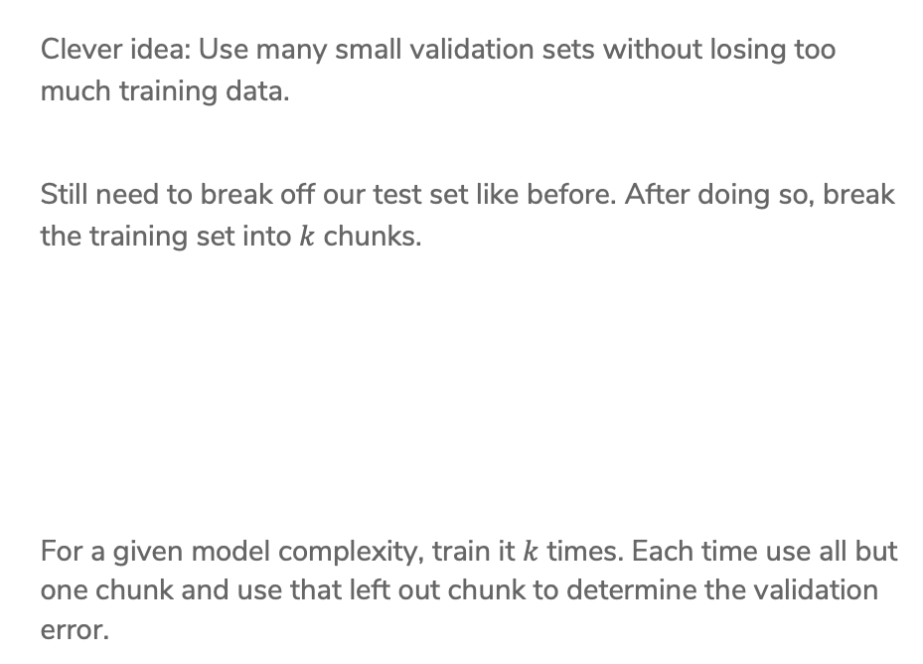
Cross-Validation
Clever idea: Use many small validation sets without losing too much training data.
Still need to break off our test set like before. After doing so, break the training set into $k$ chunks.
For a given model complexity, train it $k$ times. Each time use all but one chunk and use that left out chunk to determine the validation error.
Train | Test
Chunk1 | Chunk2 | Chunk3 | Chunk4 | Test

Slide 66
Cross Validation
For a set of hyperparameters, perform Cross Validation on k folds
Validation
Training
. . .
Error 1
. . .
Error 2
Average
all validation errors
. . .
Error 3
.
.
. . .
Error k
k folds

Slide 67
Cross-Validation
The process generally goes
chunk_1, …, chunk_k, test = random_split(dataset)
for each model complexity p:
for i in [1, k]:
model = train_model(model_p, chunks - i)
val_err = error(model, chunk_i)
avg_val_err = average val_err over chunks
keep track of p with smallest avg_val_err
return model trained on train (all chunks) with best p & error(model, test)

Slide 68
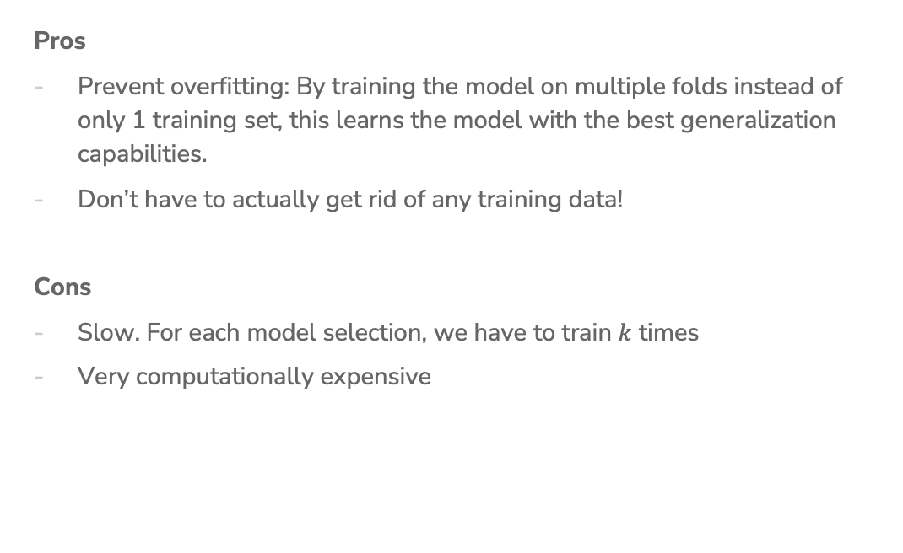
Cross-Validation
Pros
Prevent overfitting: By training the model on multiple folds instead of only 1 training set, this learns the model with the best generalization capabilities.
Don’t have to actually get rid of any training data!
Cons
Slow. For each model selection, we have to train $k$ times
Very computationally expensive

Slide 69

Cross-Validation
Generally, the more folds you use the better as you aren’t relying on the specifics of a single validation fold.
Theoretical best estimator* is to use $k=n$
  Called "Leave One Out Cross Validation” (LOOCV)
In practice, people use $k=5$ to $10$ for computational simplicity

Slide 70
Recap
Theme: Assess the performance of our models
Ideas:
Model complexity
Train vs. Test vs. True error
Overfitting and Underfitting
Bias-Variance Tradeoff
Error as a function of train set size
Choosing best model complexity
  Validation set
  Cross Validation

