Slide 1
CSE/STAT 416
Ensemble Methods
Amal Nanavati
University of Washington
July 20, 2022
Adapted from Hunter Schafer’s slides

Slide 2
Roadmap
So Far
Housing Prices - Regression
  Regression Model
  Assessing Performance
  Ridge Regression
  LASSO
Sentiment Analysis – Classification
  Classification Overview
  Logistic Regression
  K-Nearest Neighbors
  Decision Trees
  Ensemble Methods

Slide 3
Administrivia
Timeline:
  Last lecture in Classification
  Next Week: Neural Networks, Deep Learning
Deadlines:
  HW3 late deadline tomorrow, 7/21 11:59PM
    Uses two late days
  HW4 released TODAY, due Tues 7/26 11:59PM
    Programming component is on Kaggle, groups of ≤ 2
    Concept is still individual
  Learning Reflection 5 due Fri, 7/22 11:59PM

Slide 4
HW4 Walkthrough

Slide 5
Recap: Decision Trees
Picking Up From Where We Left Off

Slide 6
Types of Features
Numeric: data described by a number (quantitative)
  Discrete: cannot be subdivided
    e.g., number of bedrooms
  Continuous: can be subdivided
    e.g., area of the house
  Tricky Case: house price? (don’t divide further than penny)
    Rule of Thumb: if the discreteness is caused by units of measurement, as opposed to the quantity being measured, treat it as continuous!
Categorical: data described by a category (qualitative)
  Ordinal: has an order
    e.g., school quality (good / okay / poor)
    e.g., survey response (agree / neutral / disagree)
  Nominal: doesn’t have an order
    e.g., nearest school type (public / private / charter)
Notes:
Before we discuss how to define distance, it’s important to discuss the different types of features we might have in a machine learning task.

Slide 7

Making Categorical Features Quantitative
All ML models we’ve learnt so far require input features to be numbers!
Ordinal: Assign each value to a number:
  e.g., good = 1, okay = 0, poor = -1
Nominal: One-hot encoding, make each value its own binary feature!
  In section, you saw a one-hot encoding of “County”
School | House Price
Public | $500K
Private | $750K
Charter | $600K
Public | $700K
School - Public | School - Private | School - Charter | House Price
1 | 0 | 0 | $500K
0 | 1 | 0 | $750K
0 | 0 | 1 | $600K
1 | 0 | 0 | $700K

Slide 8


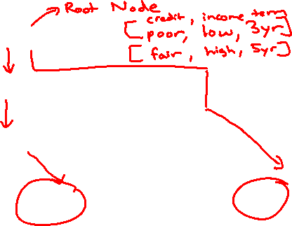
Decision Trees
Start
excellent
Credit?
poor
fair
Income?
Safe
Term?
high
Low
3 years
5 years
Risky
Safe
Term?
Risky
3 years
5 years
Risky
Safe
Branch/Internal node: splits into possible values of a feature
Leaf node: final decision (the class value)
Notes:
WOS:
An example, have students classify it.

Slide 9
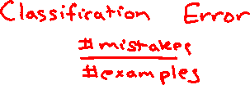
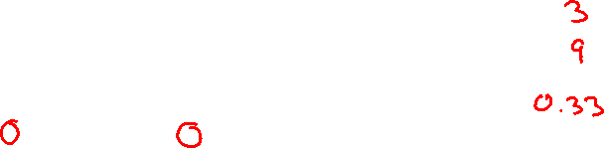
Evaluating the split on Term
Choice 2: Split on Term
Loan status:
Safe Risky
Root
6 3
Error = .
=
Term?
3 years
4 1
5 years
2 2
Tree | Classification error
(root) | 0.33
Split on credit | 0.22
Split on term | 0.33
Safe
Risky
1 mistake
2 mistakes

Slide 10
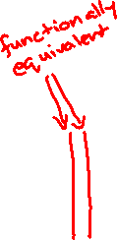
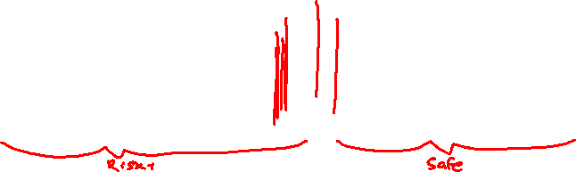

Best threshold?
Infinite possible values of t
Income = t*
Income < t*
Income >= t*
Safe
Risky
Income
$10K
$120K
Notes:
WOS:
Predict=Risky, Num risky Num safe
Predict = Safe, num risky num safe

Slide 11
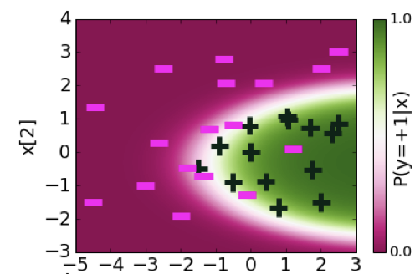
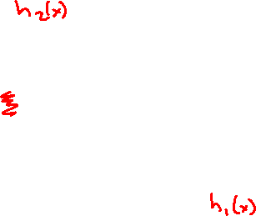
Recall This Example From Logistic Regression

Slide 12
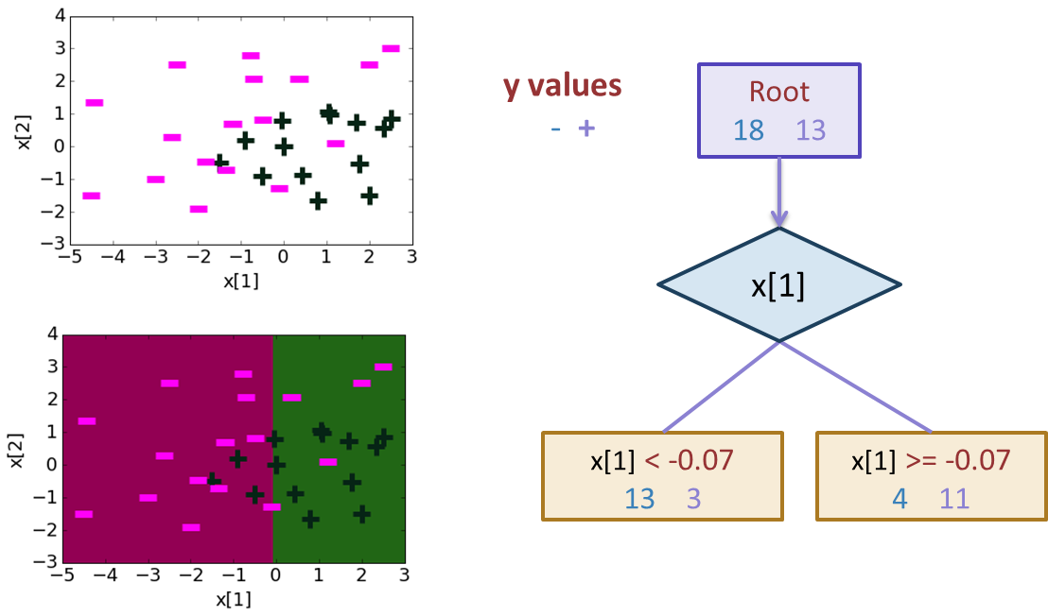

Depth 1: Split on x[1]
Notes:
0.22542207904 + 1.12 x[1] -1.07 x[2]

Slide 13
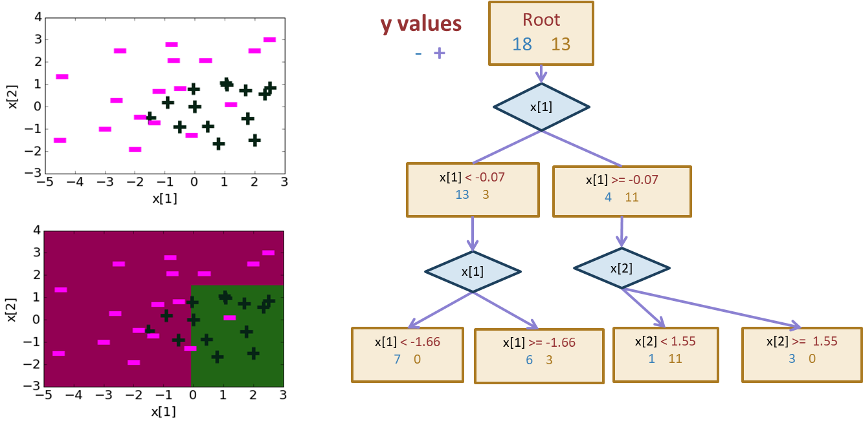

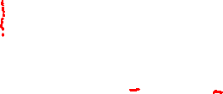
Depth 2
Notes:
0.22542207904 + 1.12 x[1] -1.07 x[2]

Slide 14
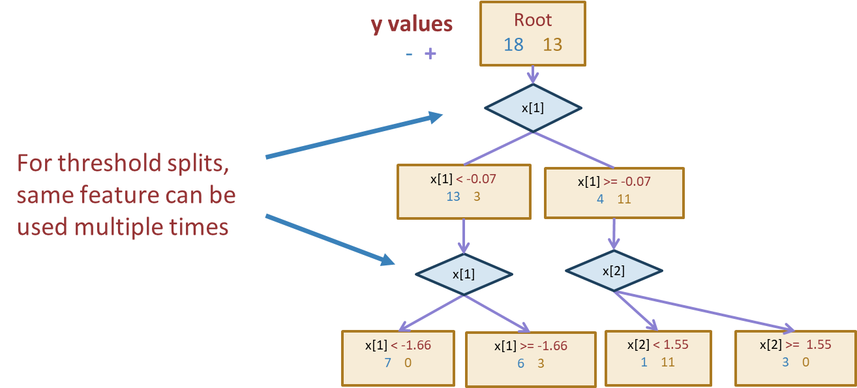
Same feature can be used to split multiple times
Notes:
0.22542207904 + 1.12 x[1] -1.07 x[2]

Slide 15
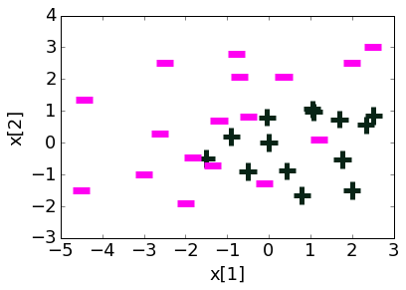
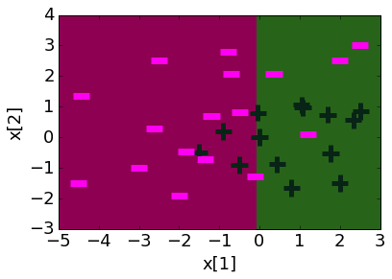
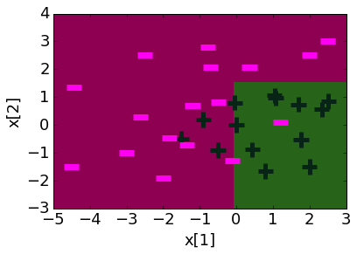
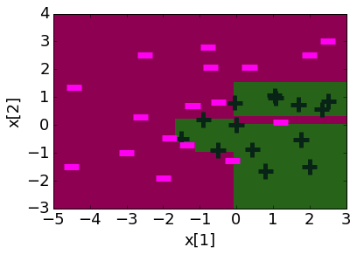
Decision boundaries at different depths
Decision boundaries can be complex!
Depth 1 Depth 2 Depth 10
Notes:
0.22542207904 + 1.12 x[1] -1.07 x[2]

Slide 16
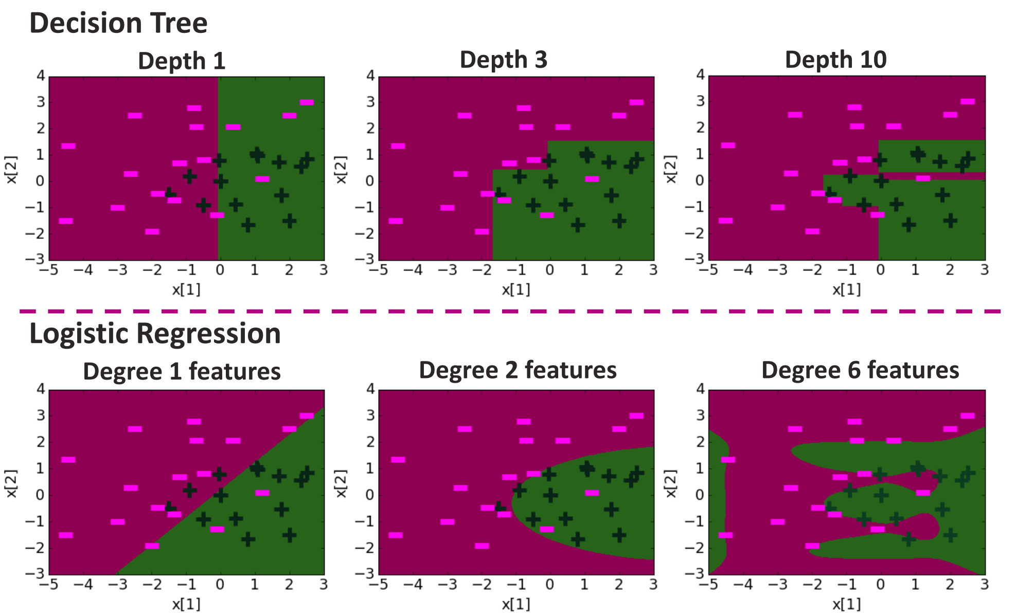
1 min
Which of these two is a possible Decision Tree decision boundary?
(A)
(B)
Notes:
WOS:
Depth 1, 3, 10
Degree 1, 2, 6

Slide 17
2 min
Which of these two is a possible Decision Tree decision boundary?
(A)
(B)
Notes:
WOS:
Depth 1, 3, 10
Degree 1, 2, 6

Slide 18
Compare Decision Boundaries

Slide 19
Overfitting Prevention (Termination Criteria Revisited)
Deep decision trees are prone to overfitting.
  Decision boundaries are interpretable but not stable ().
  Small changes in the dataset leads to big differences in the outcome.
Overcome overfitting by stopping early:
  Stop when the tree reaches a certain depth (e.g., 4 levels)
  Stop when a leaf has ≤ some number of points (e.g., 20 pts)
    Will use on HW
  Stop if a split won’t decrease the classification error by more than some amount (e.g., 10%)
Fine-tune hyperparameters using a validation set.
Can also prune after growing a full-length tree

Slide 20
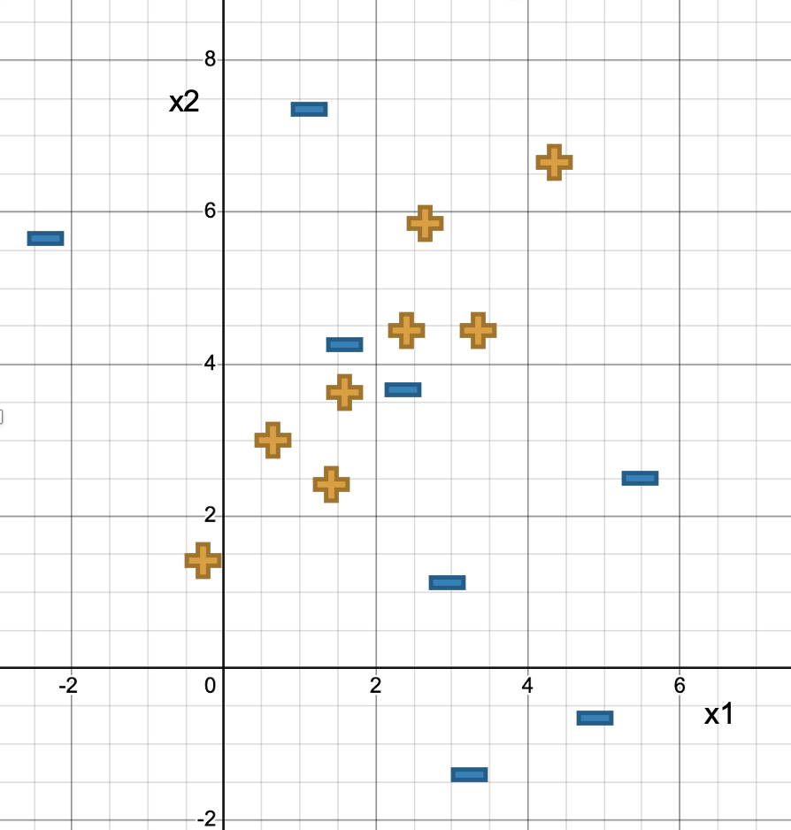
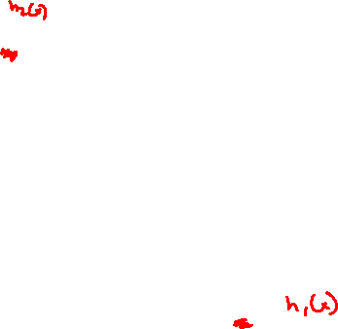
1 mins
Which of the following decision boundaries will the algorithm we learnt output, if we stop growing the tree at a depth of two?
Hint: compute classification errors for the “first-level” split.
Option A
Option B
Notes:
One of these boundaries will get outputted by the algorithm we learnt.

Slide 21
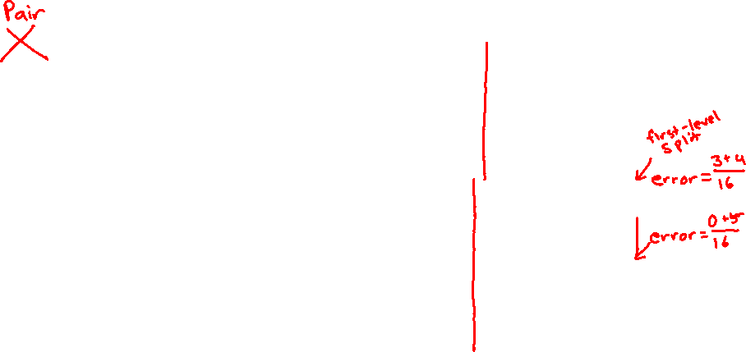
2 mins
Which of the following decision boundaries will the algorithm we learnt output, if we stop growing the tree at a depth of two?
Hint: compute classification errors.
Option A
Option B
Notes:
One of these boundaries will get outputted by the algorithm we learnt.

Slide 22
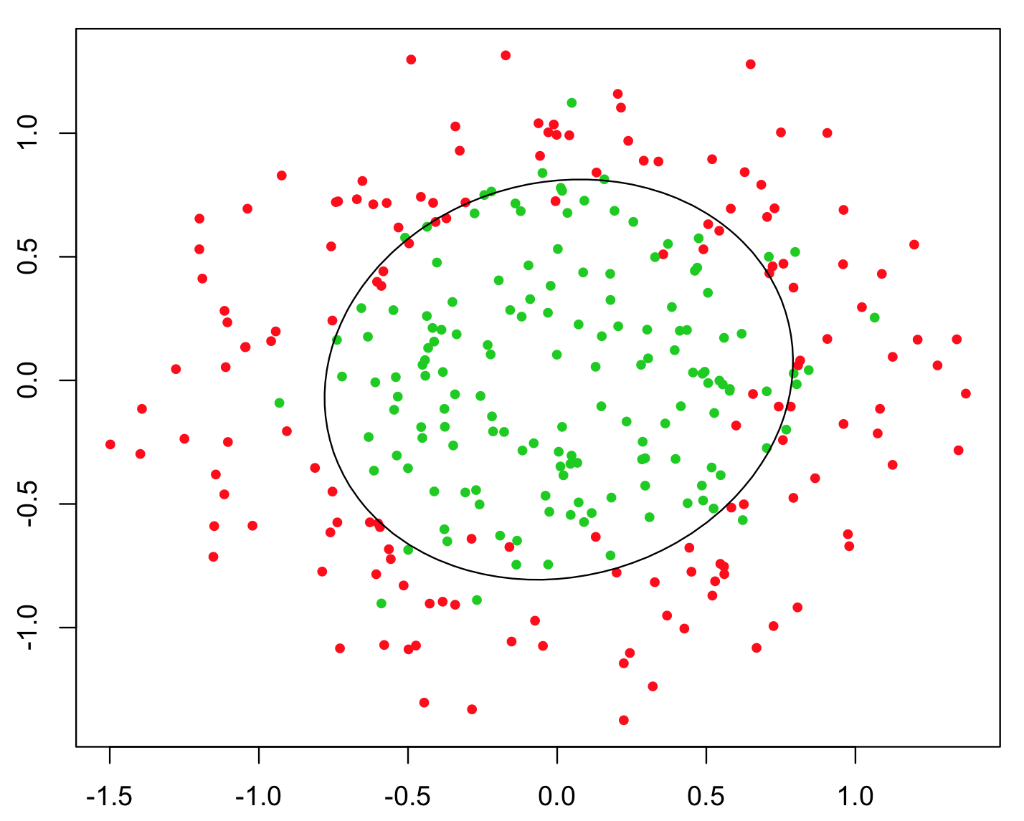
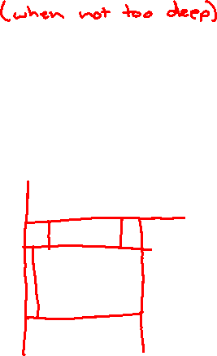
Pros/Cons
Decision Tree
Pros:
  Easy to interpret
  Handles numeric and categorical variables without preprocessing
  No normalization required as it uses rule-based approach
  Can create non-linear decision boundaries
  Can readily do multi-class classification (unlike Logistic Regression)
Cons:
  Deep decision trees are prone to overfitting
  Only allows axis-parallel decision boundaries

Slide 23
Ensemble Methods
Bagging –
Random Forest

Slide 24
Ensemble Method
Instead of switching to a brand-new type of model that is more powerful than trees, what if we instead tried to make the tree into a more powerful model.
What if we could combine many weaker models in such a way to make a more powerful model?
A model ensemble is a collection of (generally weak) models that are combined in such a way to create a more powerful model.
There are two common ways this is done with trees
Random Forest (Bagging)
AdaBoost (Boosting)

Slide 25

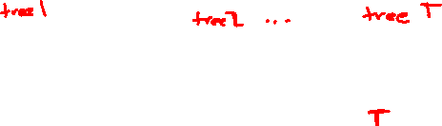
Random Forest Overview
A Random Forest is a collection of $T$ Decision Trees. Each decision tree casts a “vote” for a prediction and the ensemble predicts the majority vote of all of its trees.
Notes:
Will first explain how we learn each tree, and then I’ll try to explain why this works!

Slide 26
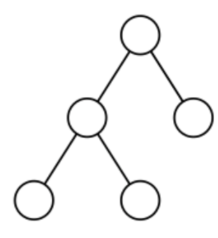
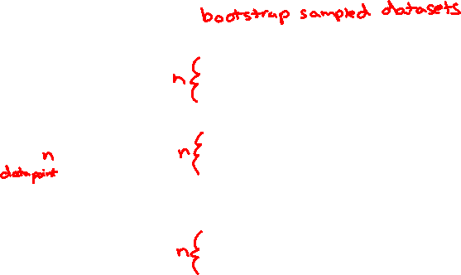
Training Trees
If I just have one dataset, how could I learn more than one tree?
Solve this with bootstrap sampling! Can create many similar datasets by randomly sampling with replacement.
Technically, you also randomly select features too!

Slide 27
Details
The Random Forest model is a specific type of ensemble model that uses bagging (bootstrapped aggregation).
When training the trees on the bootstrapped samples, we actually want to use very deep trees that overfit!
That sounds bad at first, but we are trying to take advantage of what it means to have a high variance model (low bias).
Remember that high variance models have low bias because if you “average out” over all the models you could learn, they will not have bias.
That is exactly what we are doing here! If we average over a bunch of high variance (overfit) models, to get an ensemble that has low bias and lower variance (if we add more trees)!

Slide 28
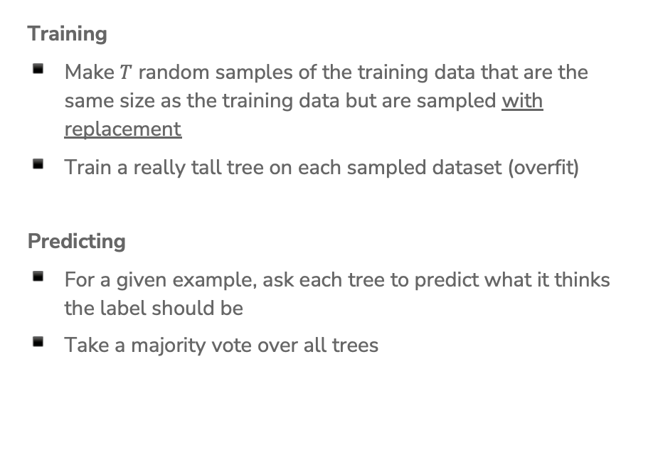
Random Forest Algorithm
Training
Make $T$ random samples of the training data that are the same size as the training data but are sampled with replacement
Train a really tall tree on each sampled dataset (overfit)
Predicting
For a given example, ask each tree to predict what it thinks the label should be
Take a majority vote over all trees

Slide 29

1 min
Say you have a random forest with 3 decision trees. What would this random forest predict on a person with excellent credit, $50K income, and a loan term of 5 years?
Start
Term?
3 years
5 years
Safe
excellent
Credit?
poor
fair
Start
Start
Risky
Risky
Safe
excellent
poor
Income
Credit?
< $50K
≥ $50K
fair
Income
Safe
Term
< $30K
≥ $30K
Income
Term?
3 year
5 year
< $70K
≥ $70K
3 years
5 years
Risky
Safe
Safe
Risky
Risky
Safe
Risky
Safe

Slide 30

2 min
Say you have a random forest with 3 decision trees. What would this random forest predict on a person with excellent credit, $50K income, and a loan term of 5 years?
Start
Term?
3 years
5 years
Safe
excellent
Credit?
poor
fair
Start
Start
Risky
Risky
Safe
excellent
poor
Income
Credit?
< $50K
≥ $50K
fair
Income
Safe
Term
< $30K
≥ $30K
Income
Term?
3 year
5 year
< $70K
≥ $70K
3 years
5 years
Risky
Safe
Safe
Risky
Risky
Safe
Risky
Safe

Slide 31
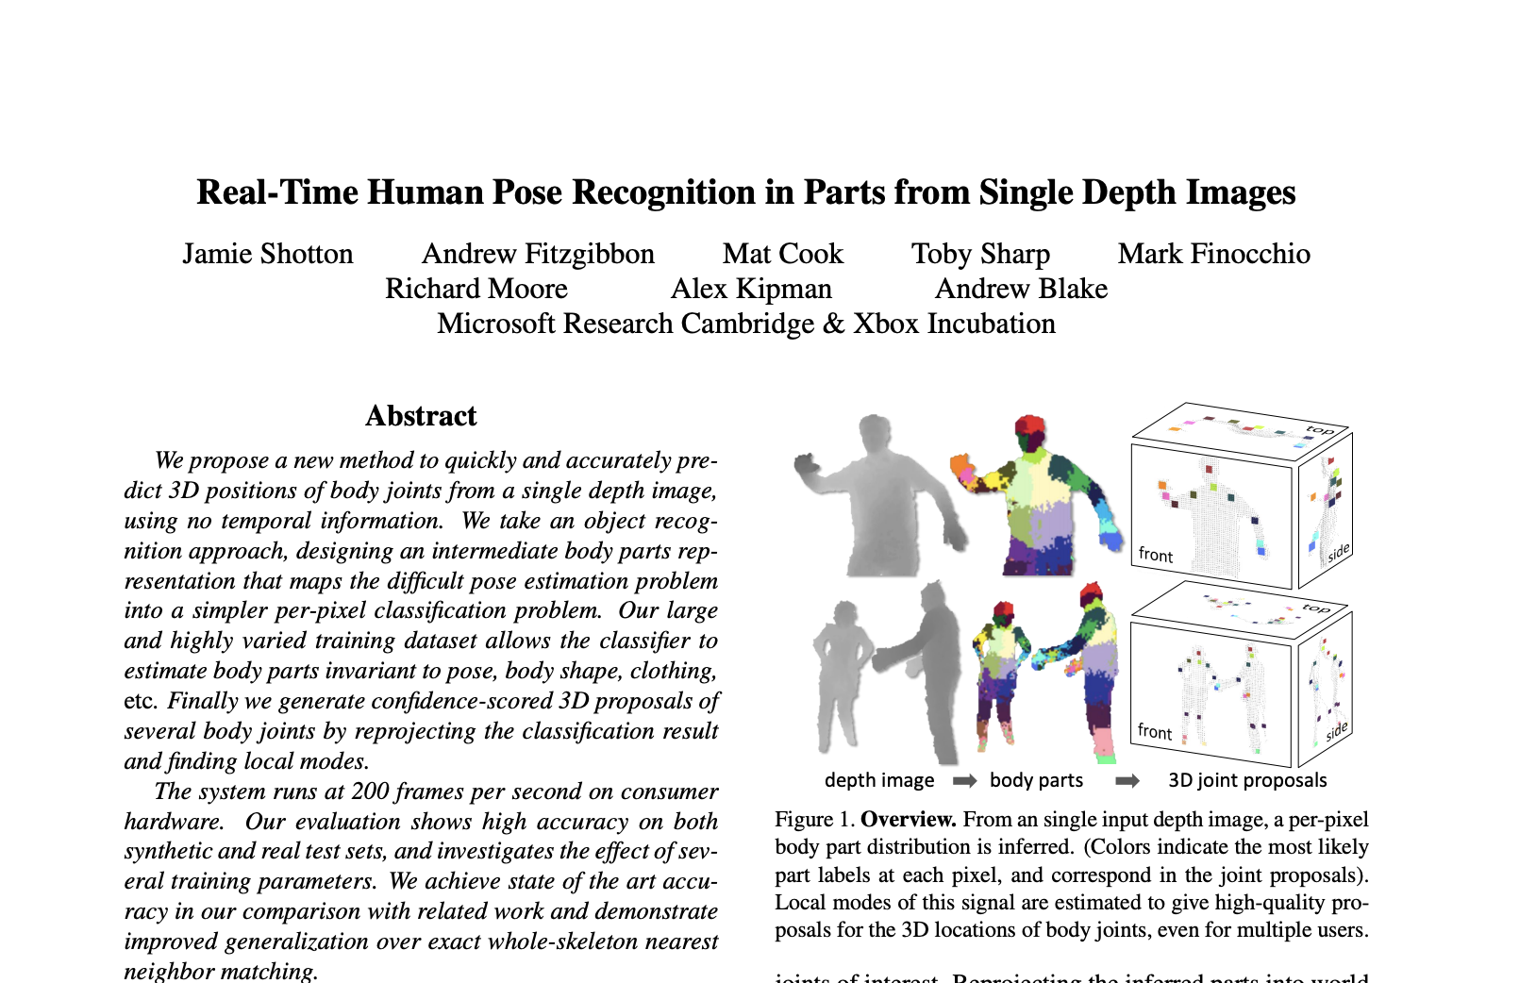
Application
Microsoft used Random Forests in their Kinect system to identify the “pose” of a person from the depth camera.

Slide 32
Random Forest Overview
Use overfitting to our advantage! Averaging overfit models can help make a strong model.
Versatile: Works pretty well in a lot of cases and can serve many different purposes.
  Classification, regression, clustering, feature importance
Low Maintenance: Tends to require less hyper-parameter tuning. Good “out of the box” model.
  More trees is always better here (but takes longer).
  Some other hyperparameters, but they tend to have a small affect on performance.
Efficient: Trees can be learned in parallel!

Slide 33



Slide 34
AdaBoost
Boosting
Notes:
We are going to talk about another ensemble model (a model that combines many weaker models), but that does it in a completely different way

Slide 35
Background
A weak learner is a model that only does slightly better than random guessing.
Kearns and Valiant (1988, 1989):
“Can a set of weak learners create a single strong learner?”
Schapire (1990)
“Yes!”

Slide 36
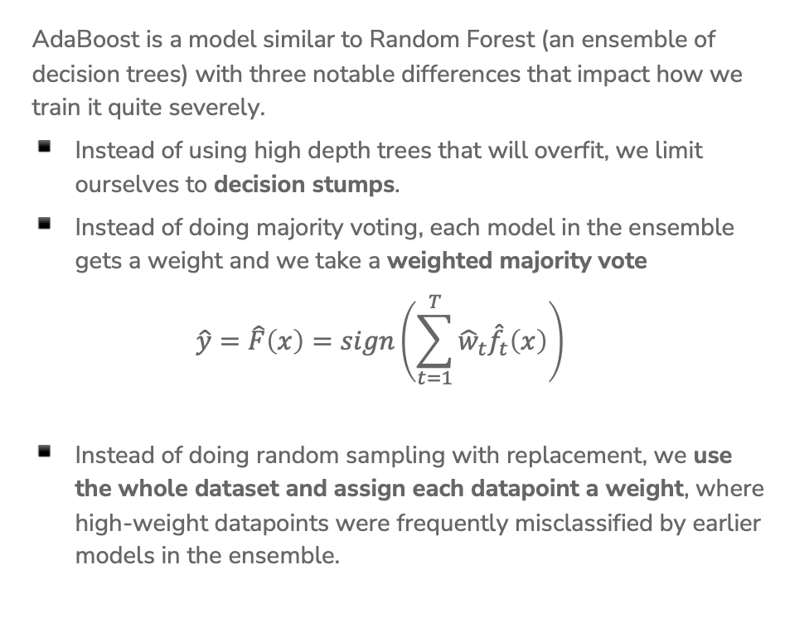
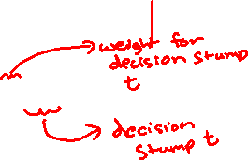
AdaBoost Overview
AdaBoost is a model similar to Random Forest (an ensemble of decision trees) with three notable differences that impact how we train it quite severely.
Instead of using high depth trees that will overfit, we limit ourselves to decision stumps.
Instead of doing majority voting, each model in the ensemble gets a weight and we take a weighted majority vote
$$\hat{y}=\hat{F}\left(x\right)=sign\left(\sum_{t=1}^{T}{{\hat{w}}_{t}{\hat{f}}_{t}\left(x\right)}\right)$$
Instead of doing random sampling with replacement, we use the whole dataset and assign each datapoint a weight, where high-weight datapoints were frequently misclassified by earlier models in the ensemble.
Notes:
Write where hat{f_t} is the t^th tree trained and it predicts +1 or -1 and hat{w} is some weight for that model’s predictions (also learned)

Slide 37
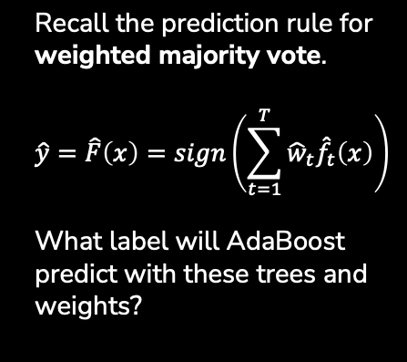

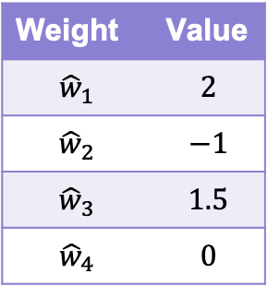



1 min
Yes
Income >= 1000
No
Weight | Value
$${\hat{w}}_{1}$$ | $$2$$
$${\hat{w}}_{2}$$ | $$−1$$
$${\hat{w}}_{3}$$ | $$1.5$$
$${\hat{w}}_{4}$$ | $$0$$
SAFE
RISKY
$${\hat{f}}_{1}\left(x\right)= +1$$
Good
Credit History?
Bad
RISKY
SAFE
$${\hat{f}}_{2}\left(x\right)=−1$$
3 Years
Savings >= 100k
5 Years
Recall the prediction rule for weighted majority vote.
$$\hat{y}=\hat{F}\left(x\right)=sign\left(\sum_{t=1}^{T}{{\hat{w}}_{t}{\hat{f}}_{t}\left(x\right)}\right)$$
What label will AdaBoost predict with these trees and weights?
SAFE
RISKY
$${\hat{f}}_{3}\left(x\right)=−1$$
Bad
Good
Market Cond.
RISKY
SAFE
$${\hat{f}}_{4}\left(x\right)= +1$$
Notes:
WOS:
\hat{F}(x) equation
sign(2*1+-1*-1+1.5*-1+0*1)
sign(1.5)
+1
It is possible to have zero weights, that means the ensemble disregards that stump’s predictions
It is possible to have negative weights, that means that whatever the stump votes for, the ensemble will effectively take that to be a vote in the opposite direction

Slide 38
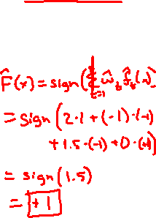
2 min
Yes
Income >= 1000
No
Weight | Value
$${\hat{w}}_{1}$$ | $$2$$
$${\hat{w}}_{2}$$ | $$−1$$
$${\hat{w}}_{3}$$ | $$1.5$$
$${\hat{w}}_{4}$$ | $$0$$
SAFE
RISKY
$${\hat{f}}_{1}\left(x\right)= +1$$
Good
Credit History?
Bad
RISKY
SAFE
$${\hat{f}}_{2}\left(x\right)=−1$$
3 Years
Savings >= 100k
5 Years
Recall the prediction rule for weighted majority vote.
$$\hat{y}=\hat{F}\left(x\right)=sign\left(\sum_{t=1}^{T}{{\hat{w}}_{t}{\hat{f}}_{t}\left(x\right)}\right)$$
What label will AdaBoost predict with these trees and weights?
SAFE
RISKY
$${\hat{f}}_{3}\left(x\right)=−1$$
Bad
Good
Market Cond.
RISKY
SAFE
$${\hat{f}}_{4}\left(x\right)= +1$$
Notes:
WOS:
\hat{F}(x) equation
sign(2*1+-1*-1+1.5*-1+0*1)
sign(1.5)
+1
It is possible to have zero weights, that means the ensemble disregards that stump’s predictions
It is possible to have negative weights, that means that whatever the stump votes for, the ensemble will effectively take that to be a vote in the opposite direction

Slide 39
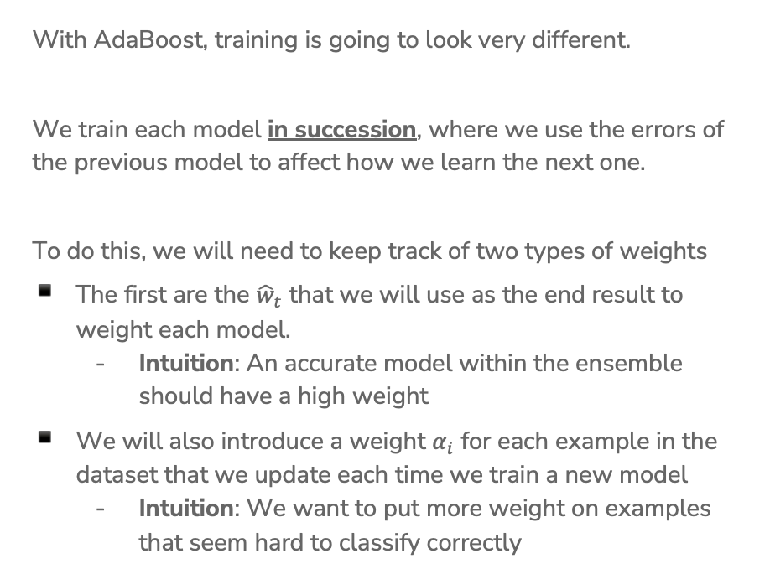
Training AdaBoost
With AdaBoost, training is going to look very different.
We train each model in succession, where we use the errors of the previous model to affect how we learn the next one.
To do this, we will need to keep track of two types of weights
The first are the ${\hat{w}}_{t}$ that we will use as the end result to weight each model.
  Intuition: An accurate model within the ensemble should have a high weight
We will also introduce a weight $α_{i}$ for each example in the dataset that we update each time we train a new model
  Intuition: We want to put more weight on examples that seem hard to classify correctly
Notes:
This is in contrast to random forests, where we trained each model in parallel. Each model was trained on an independently randomly sampled dataset. In AdaBoost, we use the errors from previous models to impact how we train the next model, so we need to train models one at a time.

Slide 40
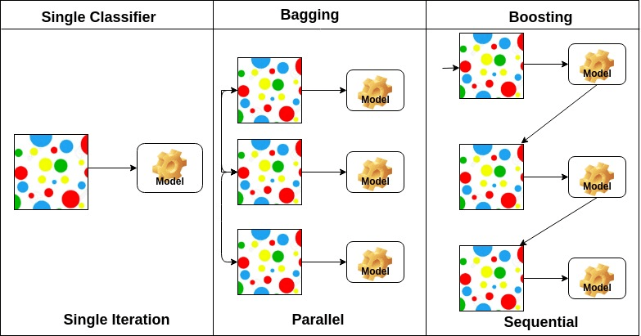
Boosting (AdaBoost) vs. Bagging (Random Forrest)
Notes:
Bagging = Bootstrap aggregation

Slide 41
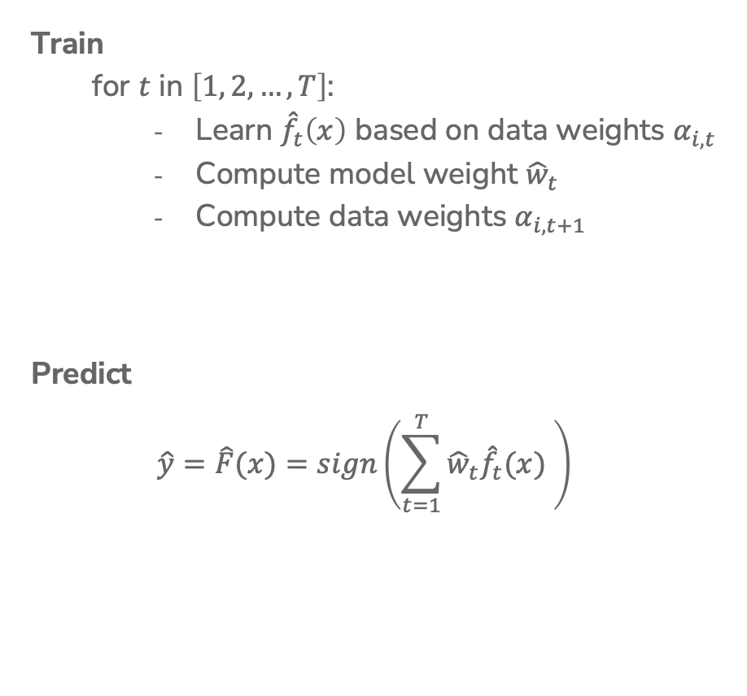
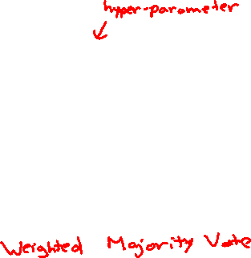
AdaBoost
Ada Glance
Train
  for $t$ in $\left[1, 2, …, T\right]$:
    Learn ${\hat{f}}_{t}\left(x\right)$ based on data weights $α_{i,t}$
    Compute model weight ${\hat{w}}_{t}$
    Compute data weights $α_{i,t+1}$
Predict
$$\hat{y}=\hat{F}(x)=sign\left(\sum_{t=1}^{T}{{\hat{w}}_{t}{\hat{f}}_{t}(x) }\right)$$
Notes:
Write “How much we trust hat{f}_t next to compute hat{w}_t
Write “Pay more attention to examples we got wrong” next to recompute alpha_i
Write “Only used in training” near alpha

Slide 42
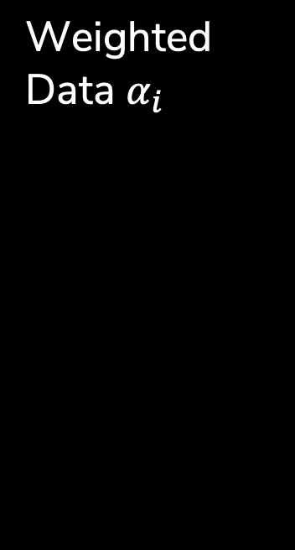
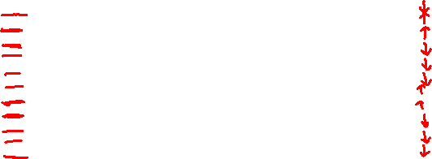
Weighted Data $α_{i}$
Start with a dataset and train our first model (a decision stump)
For all the things it gets wrong, increase the weight of that example. For each one that’s right, decrease its weight.
Notes:
WOS:
Point out which ones were correct (underline with one color)
Point out which were wront (underline with another color)
“Reduce weights of correct examples, increase weights of incorrect examples.”

Slide 43
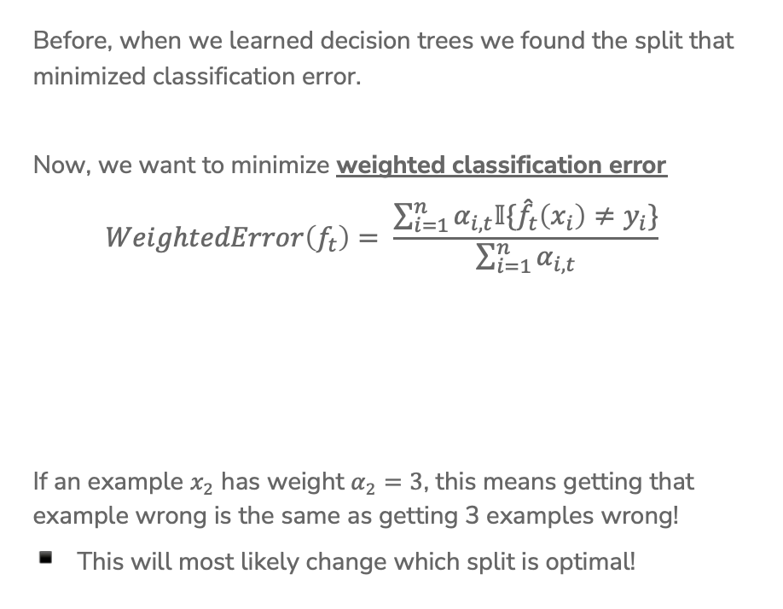
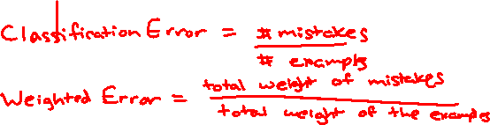
Learning w/ Weighted Data
Before, when we learned decision trees we found the split that minimized classification error.
Now, we want to minimize weighted classification error
$$WeightedError\left(f_{t}\right)= \frac{\sum_{i=1}^{n}{α_{i,t}𝕀\{{\hat{f}}_{t}\left(x_{i}\right)≠y_{i}\}}}{\sum_{i=1}^{n}{α_{i,t}}}$$
If an example $x_{2}$ has weight $α_{2}=3$, this means getting that example wrong is the same as getting 3 examples wrong!
This will most likely change which split is optimal!
Notes:
WOS:
Classification error: # mistakes / # total
Weighted classification error: sum weights of mistakes / total sum weights

Slide 44

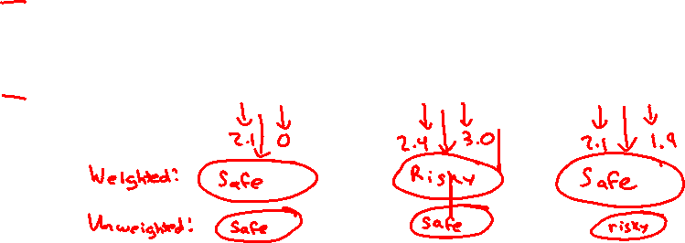
Learning w/ Weighted Data
We also set leaf node predictions to be the class with larger total weight, not the class with more instances.
Loan status:
Safe Risky
Root
6 3
Credit | y | weight
excellent | safe | 1.2
fair | risky | 3.0
fair | safe | 0.5
poor | risky | 0.9
excellent | safe | 0.9
fair | safe | 0.7
poor | risky | 1.0
poor | safe | 2.1
fair | safe | 1.2
Credit?
excellent
2 0
fair
3 1
poor
1 2
Notes:
WOS:
Compute weighted predictions (safe, risky, safe)
Write unweighted predictions: (safe, safe, risky)

Slide 45

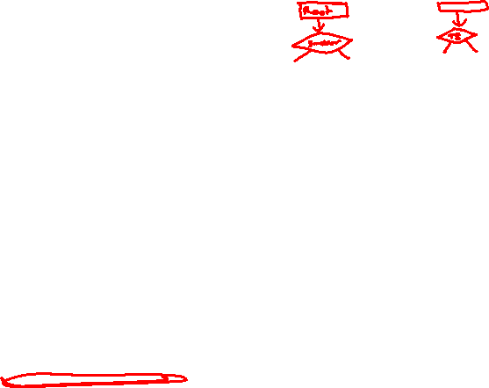
2 min
Consider the following weighted dataset, what is the weighted classification error of the optimal decision stump (just one split)?
We want to use the TumorSize and IsSmoker to predict if a patient’s tumor is malignant.
TumorSize | IsSmoker | Malignant | Weight
Small | No | No | 0.5
Small | Yes | Yes | 1.2
Large | No | No | 0.3
Large | Yes | Yes | 0.5
Small | Yes | No | 3.3
Notes:
Options
IsSmoker, 3.3
IsSmoker, 1.7
IsSmoker, 2 (just count)
TumorSize, 1.2 + .3 = 1.5
TumorSize, 1+1 (just count)

Slide 46
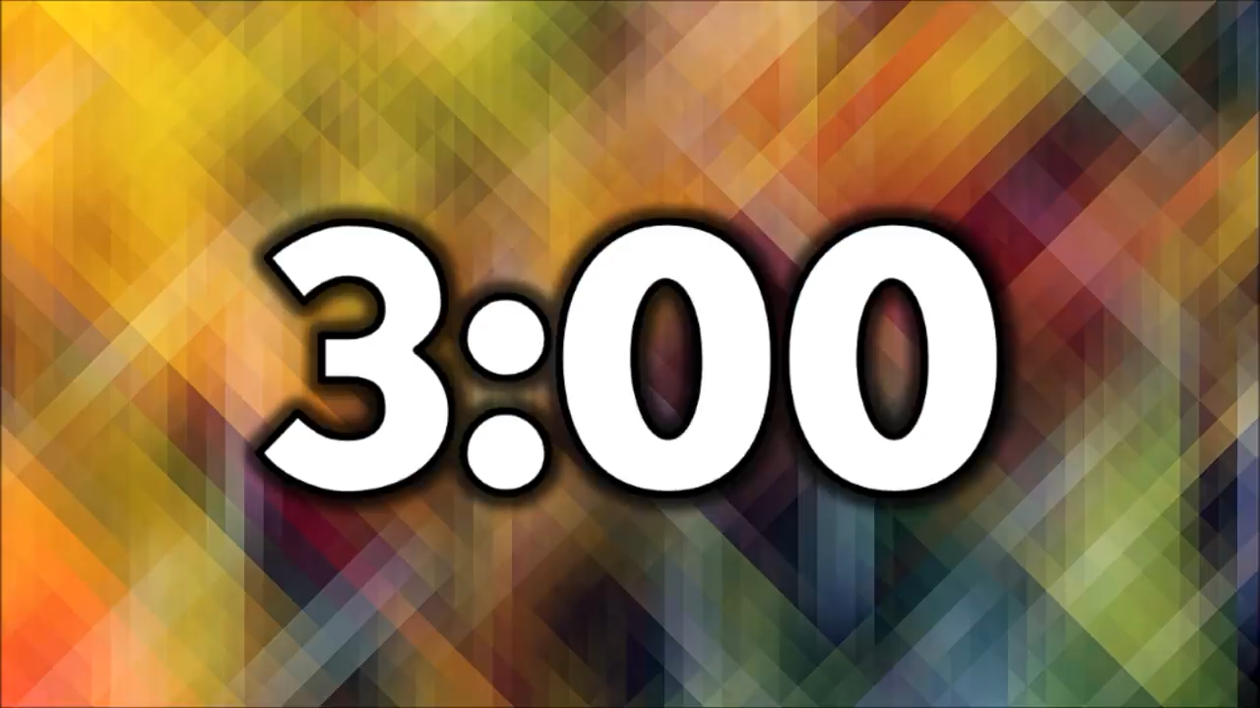
3 min
Consider the following weighted dataset, what is the weighted classification error of the optimal decision stump (just one split)?
We want to use the TumorSize and IsSmoker to predict if a patient’s tumor is malignant.
TumorSize | IsSmoker | Malignant | Weight
Small | No | No | 0.5
Small | Yes | Yes | 1.2
Large | No | No | 0.3
Large | Yes | Yes | 0.5
Small | Yes | No | 3.3
Notes:
Options
IsSmoker, 3.3
IsSmoker, 1.7
IsSmoker, 2 (just count)
TumorSize, 1.2 + .3 = 1.5
TumorSize, 1+1 (just count)

Slide 47
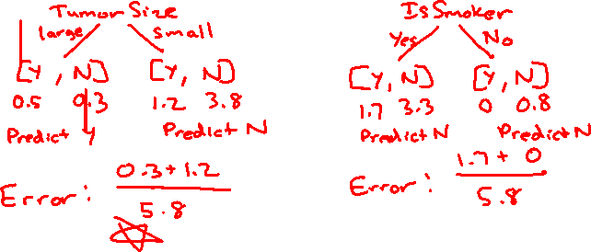
0 min
TumorSize | IsSmoker | Malignant | Weight
Small | No | No | 0.5
Small | Yes | Yes | 1.2
Large | No | No | 0.3
Large | Yes | Yes | 0.5
Small | Yes | No | 3.3
Notes:
WOS
Tumor Size, Large / Small, 0.5 0.3 / 1.2 3.8, Yes / No, Weighted Error (0.3+1.2)/5.8 ~= 0.26
IsSmoker, Y / N, 1.7 3.3 / 0.0 0.8, No / No, Weighted Error (1.7+0)/5.8 ~= 0.29

Slide 48
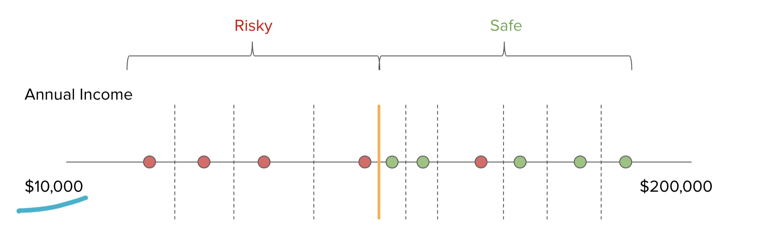
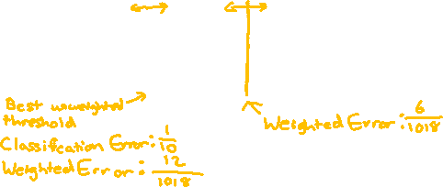
Real Valued Features
The algorithm is more or less the same, but now we need to account for weights
2
5
1
3
2
1
1
2
1
1000
Notes:
WOS:
Best split unweighted
Best split weighted (between 1000 and 3)

Slide 49
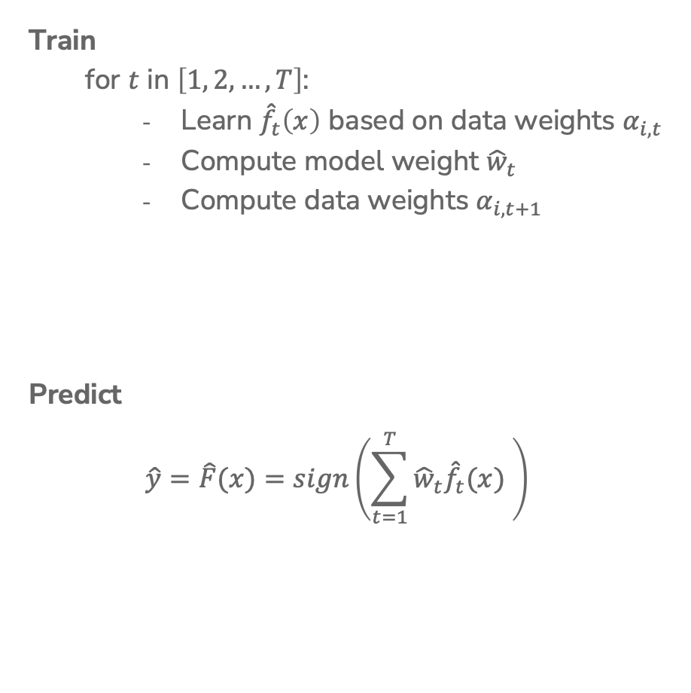
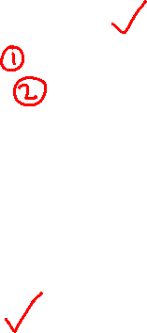
AdaBoost
Ada Glance
Train
  for $t$ in $\left[1, 2, …, T\right]$:
    Learn ${\hat{f}}_{t}\left(x\right)$ based on data weights $α_{i,t}$
    Compute model weight ${\hat{w}}_{t}$
    Compute data weights $α_{i,t+1}$
Predict
$$\hat{y}=\hat{F}(x)=sign\left(\sum_{t=1}^{T}{{\hat{w}}_{t}{\hat{f}}_{t}(x) }\right)$$
Notes:
We’ve learnt how to learn a decision stump based on weights, and we’ve learnt how to make the final AdaBoost prediction by taking the weighted average of trees. Now, let’s discuss how to compute the model weights and the datapoint weights.

Slide 50
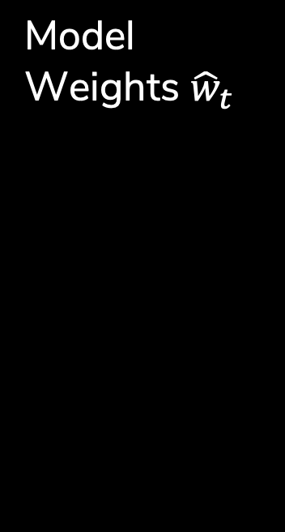


Model Weights ${\hat{w}}_{t}$
Goal: Want to have high weight for models that are very accurate, and low weight for models that are not.
The specific formula used for AdaBoost
$${\hat{w}}_{t}=\frac{1}{2}\ln\left(\frac{1−WeightedError\left({\hat{f}}_{t}\right)}{WeightedError({\hat{f}}_{t})}\right)$$
Notes:
WOS:
Great Classifier: If WeightedError(f_t) = 0.01 => 1-0.01 / 0.01 = 99 => \hat{w}_t = 2.3
Okay Classifier: If WeightedError(f_t) = 0.5 => 0.5/0.5 = 1 => \hat{w}_t = 0
Awful Classifier: If WeightedError(f_t) = 0.99 => 1-0.99 / 0.99 = 0.01 => \hat{w}_t = -2.3
You can have negative weights. In that case, your ensemble is effectively learning to do the opposite of what that stump predicts.

Slide 51



Computing $α_{i,t+1}$
Goal: Increase the weights of data examples that were hard to classify. If we got it wrong, increase the weight, otherwise decrease it.
$$α_{i,t+1}←\left\{\begin{aligned}α_{i,t}e^{−{\hat{w}}_{t}}, if {\hat{f}}_{t}\left(x_{i}\right)=y_{i} \\ α_{i,t}e^{{\hat{w}}_{t}}, if {\hat{f}}_{t}\left(x_{i}\right)≠y_{i} \end{aligned}\right.$$
Notes:
WOS:
Start with old weight
Downweight if tree t correctly predicts
Upweight if tree t wrongly predicts
e^{-1} < 1, e^{0} = 1, e^1 > 1
How much to up- or down-weight depends on how important that tree is for our ensemble.

Slide 52



AdaBoost
Ada Glance
$${\hat{w}}_{t}=\frac{1}{2}\ln\left(\frac{1−WeightedError\left({\hat{f}}_{t}\right)}{WeightedError({\hat{f}}_{t})}\right)$$
Train
  for $t$ in $\left[1, 2, …, T\right]$:
    Learn ${\hat{f}}_{t}\left(x\right)$ based on data weights $α_{i,t}$
    Compute model weight ${\hat{w}}_{t}$
    Compute data weights $α_{i,t+1}$
Predict
$$\hat{y}=\hat{F}(x)=sign\left(\sum_{t=1}^{T}{{\hat{w}}_{t}{\hat{f}}_{t}(x) }\right)$$
$$α_{i,t+1}←\left\{\begin{aligned}α_{i,t}e^{−{\hat{w}}_{t}}, if {\hat{f}}_{t}\left(x_{i}\right)=y_{i} \\ α_{i,t}e^{{\hat{w}}_{t}}, if {\hat{f}}_{t}\left(x_{i}\right)≠y_{i} \end{aligned}\right.$$

Slide 53


Normalizing $α_{i,t}$
Generally, the weights for some points get really large/small in magnitude due to how the data is laid out.
Numbers in wildly different scales can often cause problems due to finite precision of computers when it comes to real numbers.
Generally, we normalize the data weights so they sum to 1 to prevent them from getting too small or too big.
$$α_{i,t+1}←\frac{α_{i,1+1}}{\sum_{j=1}^{n}{α_{j,t+1}}}$$

Slide 54






AdaBoost
Ada Glance
$${\hat{w}}_{t}=\frac{1}{2}\ln\left(\frac{1−WeightedError\left({\hat{f}}_{t}\right)}{WeightedError({\hat{f}}_{t})}\right)$$
Train
  for $t$ in $\left[1, 2, …, T\right]$:
    Learn ${\hat{f}}_{t}\left(x\right)$ based on data weights $α_{i,t}$
    Compute model weight ${\hat{w}}_{t}$
    Compute data weights $α_{i,t+1}$
Predict
$$\hat{y}=\hat{F}(x)=sign\left(\sum_{t=1}^{T}{{\hat{w}}_{t}{\hat{f}}_{t}(x) }\right)$$
$$α_{i,t+1}←\left\{\begin{aligned}α_{i,t}e^{−{\hat{w}}_{t}}, if {\hat{f}}_{t}\left(x_{i}\right)=y_{i} \\ α_{i,t}e^{{\hat{w}}_{t}}, if {\hat{f}}_{t}\left(x_{i}\right)≠y_{i} \end{aligned}\right.$$
$$α_{i,t+1}←\frac{α_{i,t+1}}{\sum_{j=1}^{n}{α_{j,t+1}}}$$

Slide 55
Visualizing AdaBoost

Slide 56




$t=1$
Learn a Classifier
Start with all data having same weight. $α_{i,1}=1/n$
Learn a decision stump that minimizes weighted error
With all the same weights, this is the same as before!
${\hat{f}}_{ 1}\left(x\right)=…$
Calculate ${\hat{w}}_{1}≈0.61$
Notes:
WOS:
Circle misclassified points

Slide 57




$t=1$
Update Data Weights
Compute new weights $α_{i,2}$ based on the errors of ${\hat{f}}_{1}$
The points with more weight are drawn larger
$$α_{i,2}$$
$$α_{i,2}$$
Notes:
Circle ones that are incorrect

Slide 58




$t=2$
Learn a Classifier
Now use new weights to learn best stump that minimizes weighted classification error.
${\hat{f}}_{ 2}\left(x\right)=…$
Calculate ${\hat{w}}_{2}≈0.53$
Then update weights based on errors.
$$α_{i,2}$$
Notes:
WOS:
Circle misclassified points

Slide 59


AdaBoost Ensemble
If we plot what the predictions would be for each point, we get something that looks like this:
Notes:
Write out \hat{y}_i = sign(\hat{w}_1\hat{f}_1(x) +\hat{w}_1\hat{f}_1(x) )
Where the thing inside the sign is Score(x)
Graph is showing the score/confidence
Right now the first classifier outweighs the second one, but with more you get a much more interesting picture

Slide 60




1 min
Say AdaBoost learned the below classifier at time $t=1$.
Which of the following images represent the reweighted points for time $t=2$?
(A)
(B)
(C)
Notes:
WOS:
\alpha_1 = 1/N , all equal
Source: https://nycdatascience.com/blog/student-works/capstone/a-closer-look-at-tree-boosting-methods/

Slide 61

2 min
Say AdaBoost learned the below classifier at time $t=1$.
Which of the following images represent the reweighted points for time $t=2$?
(A)
(B)
(C)
Notes:
WOS:
Circle incorrect examples
Source: https://nycdatascience.com/blog/student-works/capstone/a-closer-look-at-tree-boosting-methods/

Slide 62


1 min
Say AdaBoost learned the below classifier at time $t=2$.
Which of the following images represent the reweighted points for time $t=3$?
(A)
(B)
(C)
Notes:
Source: https://nycdatascience.com/blog/student-works/capstone/a-closer-look-at-tree-boosting-methods/

Slide 63
2 min
Say AdaBoost learned the below classifier at time $t=2$.
Which of the following images represent the reweighted points for time $t=3$?
(A)
(B)
(C)
Notes:
WOS:
Circle incorrect examples
Correctly classified points got smaller
Source: https://nycdatascience.com/blog/student-works/capstone/a-closer-look-at-tree-boosting-methods/

Slide 64


1 min
Say AdaBoost learned the below classifier at time $t=3$.
Which of the following images represent the reweighted points for time $t=4$?
(A)
(B)
(C)
Notes:
Source: https://nycdatascience.com/blog/student-works/capstone/a-closer-look-at-tree-boosting-methods/

Slide 65




0 min
You have now worked through a complete example of training AdaBoost!
What about predicting?
$${\hat{w}}_{1}=0.42$$
$$α_{i,2}=…$$
$${\hat{w}}_{2}=0.65$$
$$α_{i,3}=…$$
$${\hat{w}}_{3}=0.92$$
$$α_{i,4}=…$$

Slide 66






1 min
Consider the following ensemble and weights from the AdaBoost example we’ve been working through.
Which of the following is the final decision boundary?
(B)
(C)
(D)
(A)

Slide 67
2 min
Consider the following ensemble and weights from the AdaBoost example we’ve been working through.
Which of the following is the final decision boundary?
(B)
(C)
(D)
(A)

Slide 68






$${\hat{w}}_{1}=0.42$$
$$α_{i,2}=…$$
$${\hat{w}}_{2}=0.65$$
$$α_{i,3}=…$$
$${\hat{w}}_{3}=0.92$$
$$α_{i,4}=…$$

Slide 69
AdaBoost Overfitting

Slide 70

AdaBoost
Ada Glance
$${\hat{w}}_{t}=\frac{1}{2}\ln\left(\frac{1−WeightedError\left({\hat{f}}_{t}\right)}{WeightedError({\hat{f}}_{t})}\right)$$
Train
  for $t$ in $\left[1, 2, …, T\right]$:
    Learn ${\hat{f}}_{t}\left(x\right)$ based on data weights $α_{i,t}$
    Compute model weight ${\hat{w}}_{t}$
    Compute data weights $α_{i,t+1}$
Predict
$$\hat{y}=\hat{F}(x)=sign\left(\sum_{t=1}^{T}{{\hat{w}}_{t}{\hat{f}}_{t}(x) }\right)$$
$$α_{i,t+1}←\left\{\begin{aligned}α_{i,t}e^{−{\hat{w}}_{t}}, if {\hat{f}}_{t}\left(x_{i}\right)=y_{i} \\ α_{i,t}e^{{\hat{w}}_{t}}, if {\hat{f}}_{t}\left(x_{i}\right)≠y_{i} \end{aligned}\right.$$
$$α_{i,t+!}←\frac{α_{i,t+1}}{\sum_{j=1}^{n}{α_{j,t+1}}}$$
Notes:
For other models, we saw that increasing the complexity of the model increases the likelihood of overfitting. However, AdaBoost is just a collection of really weak learners – is there really a chance of it overfitting?

Slide 71

AdaBoost when $t=30$
Can eventually get 0 training error with a set of weak learners!
This is most likely overfit

Slide 72
AdaBoost Theorem
Technical condition: The weak learner can do at least slightly better than complete random guessing

Slide 73

Compare
Decision Tree
AdaBoost
Notes:
Best test error is around 34% which is worse than the best test error for boosting

Slide 74

Overfitting?
Boosting tends to be robust to overfitting
But will eventually overfit
Notes:
Choose with cross validation

Slide 75


Choose $T$?
How do you end up choosing the number of trees $T$ for boosting?
Like always
Find $T$ that minimizes validation error
Do cross validation
You can’t
Find $T$ that minimizes training error
Find $T$ that minimizes test error

Slide 76
Application
Boosting, AdaBoost and other variants like gradient boosting, are some of the most successful models to date.
They are extremely useful in computer vision
  The standard for face detection
Used by most winners of ML competitions (Kaggle, KDD Cup, …)
Most industry ML systems use a model ensembles
  Some with boosting, some with bagging
  Many times just use 6 different types of models and hand specify their weights.

Slide 77
AdaBoost Overview
Powerful! One of the most powerful set of models for many real world datasets.
  Typically does better than random forest with the same number of trees.
Higher Maintenance: You do have to tune hyper-parameters
  AdaBoost: Number of trees is technically important, but the model tends to be robust to overfitting in practice.
  Gradient Boosting: MANY hyper-parameters (all important)
Expensive: Boosting is inherently sequential which means its slow to learn ensembles with many trees.
  Can be made faster with optimized software like XGBoost (UW)

Slide 78
Activity: Ideating on Preventing Potential Bias in ML Applications

Slide 79
Recap
Theme: Compare two different ways of making ensembles
Ideas:
Describe what an ensemble model is
Explain what a random forest is and why adding trees improves accuracy.
Formalize how AdaBoost combines weighted votes from simple classifiers (weak learners) and how those classifiers are learned.
Compare/contrast bagging and boosting.
Describe the steps of the AdaBoost algorithm.

