Slide 1
CSE/STAT 416
Recommender Systems:
Matrix Factorization
Amal Nanavati
University of Washington
Aug 10, 2022
Adapted from Hunter Schafer’s slides

Slide 2
Administrivia
Next Week: Course Wrap-Up, Guest Panel, Final
Deadlines:
  HW6 late deadline TOMORROW, Thurs 8/11 11:59PM
    Submit Concept on Gradescope
    Submit Programming on EdSTEM
  HW7 (final HW) released TODAY
    Due Tues 8/16 11:59PM, NO LATE DAYS
  LR 8 due Fri 8/12 11:59PM
  Extra Credit Guest Panel Mon 8/15 during lecture.
  Take-Home Final Exam:
    Wed 8/17 9AM – Thurs 8/18 11:59PM

Slide 3
HW7 (Last Homework) Walkthrough

Slide 4
Recap

Slide 5
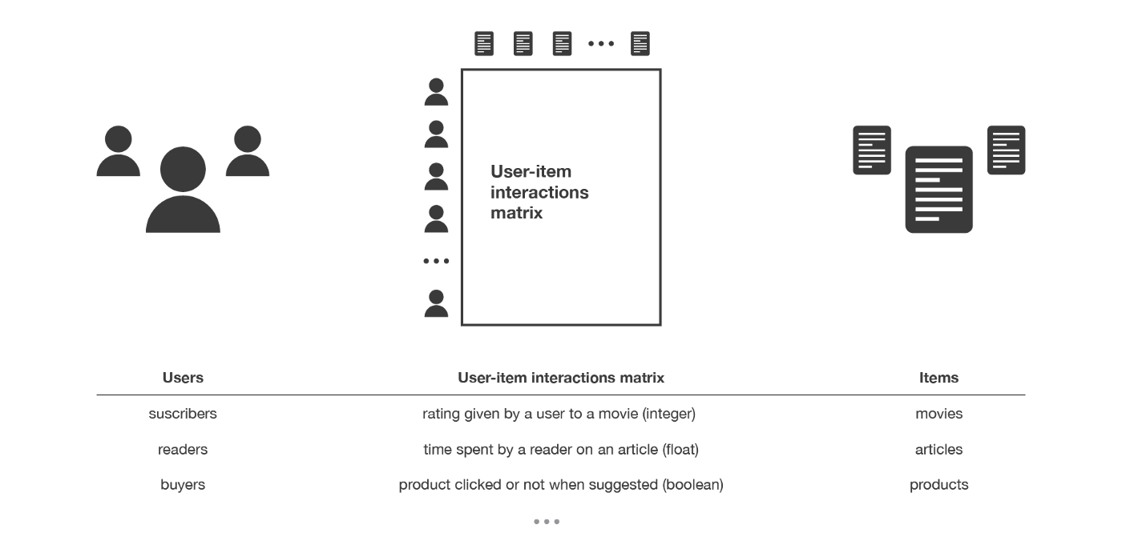
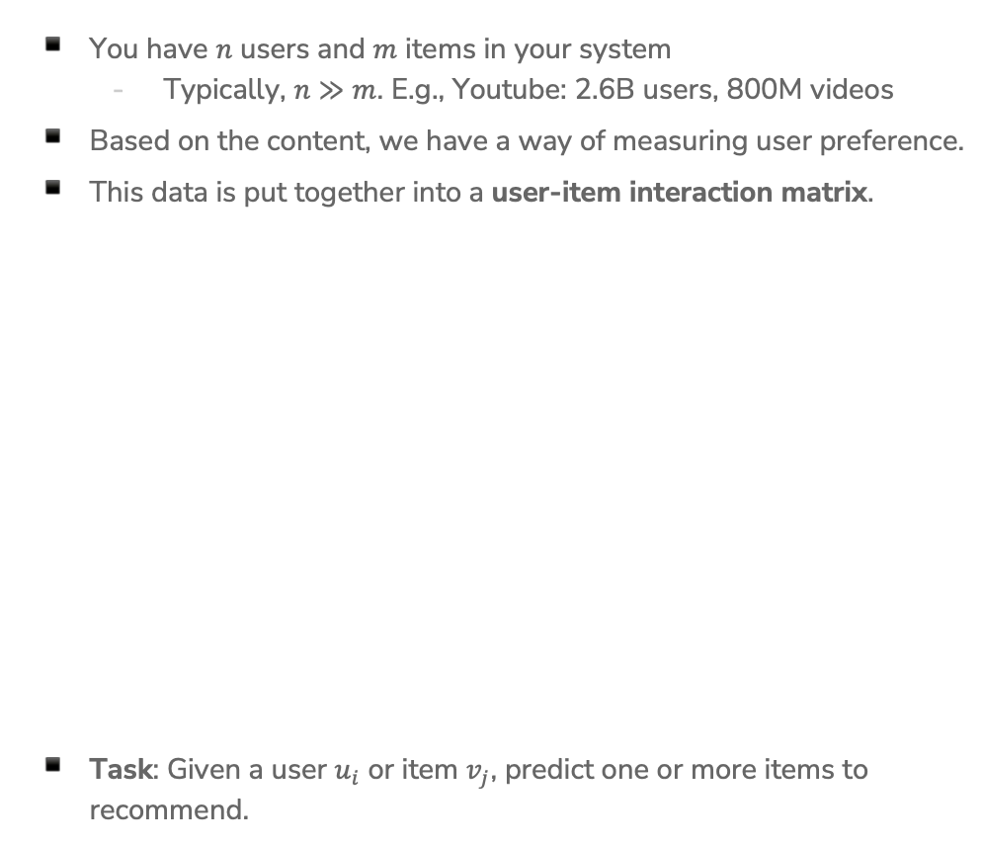
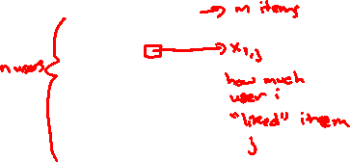
Recommender Systems Setup
You have $n$ users and $m$ items in your system
  Typically, $n≫m$. E.g., Youtube: 2.6B users, 800M videos
Based on the content, we have a way of measuring user preference.
This data is put together into a user-item interaction matrix.
Task: Given a user $u_{i}$ or item $v_{j}$, predict one or more items to recommend.
Notes:
WOS: n, m near rows/columns
Say: Note that sometimes the feedback is explicit, other times its implicit
Sources:
https://www.globalmediainsight.com/blog/youtube-users-statistics/#:~:text=YouTube%20has%20more%20than%202.6,population%20use%20YouTube%20every%20month.
https://earthweb.com/how-many-videos-are-on-youtube/#:~:text=There%20are%20800%20million%20videos,are%20on%20YouTube%20in%202022%3F
https://towardsdatascience.com/introduction-to-recommender-systems-6c66cf15ada

Slide 6
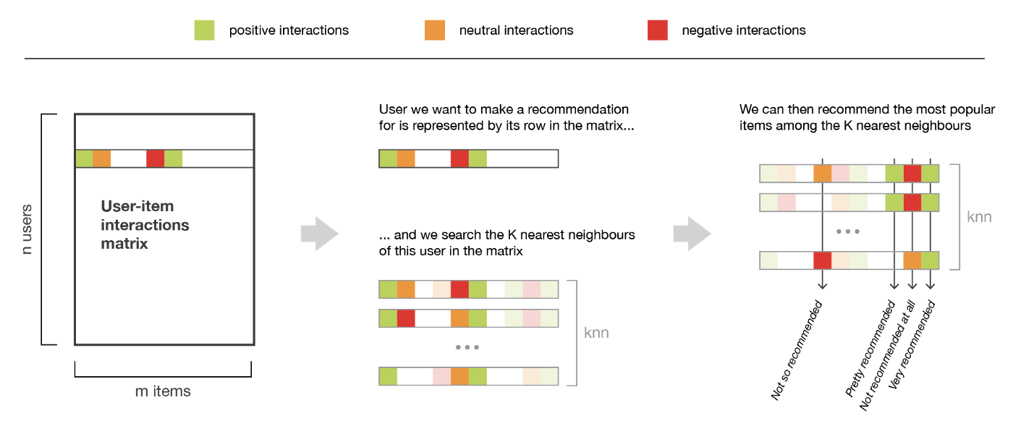

Solution 0: Popularity
Simplest Approach: Recommend whatever is popular
Rank by global popularity (i.e., Squid Game)
Sum Across Users
Recommend Top-K

Slide 7
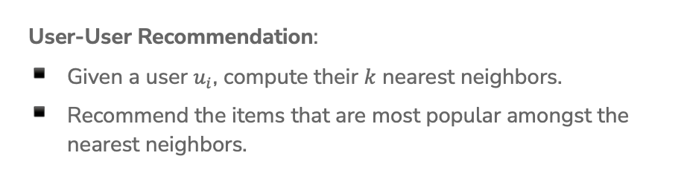

Solution 1: Nearest User (User-User)
User-User Recommendation:
Given a user $u_{i}$, compute their $k$ nearest neighbors.
Recommend the items that are most popular amongst the nearest neighbors.

Slide 8
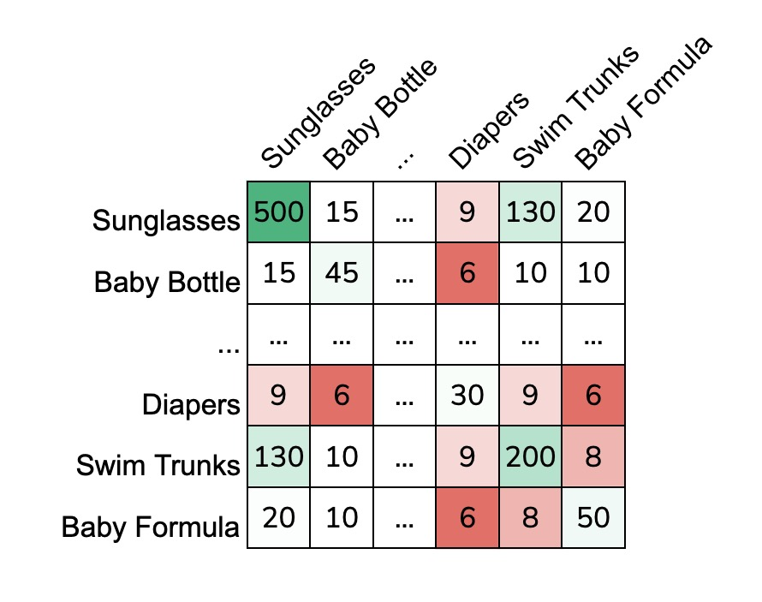
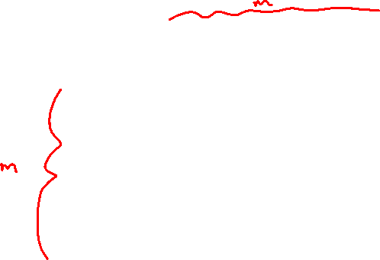
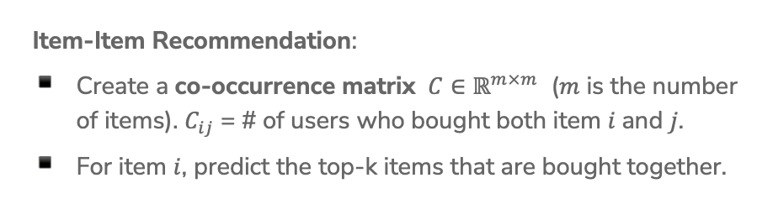
Solution 2: “People Who Bought This Also Bought…” (Item-Item)
Item-Item Recommendation:
Create a co-occurrence matrix $C∈ℝ^{m×m}$ ($m$ is the number of items). $C_{ij}$ = # of users who bought both item $i$and $j$.
For item $i$, predict the top-k items that are bought together.
Notes:
WOS:
Symmetric matrix
Select a cell, write what it means
Select diaper, show that the most similar are sunglasses and swim trunks
Anything wrong with this?

Slide 9
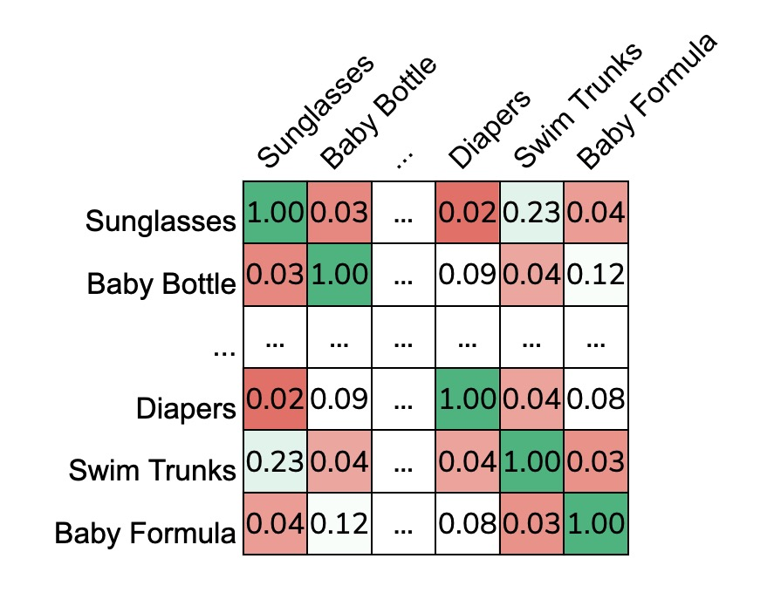

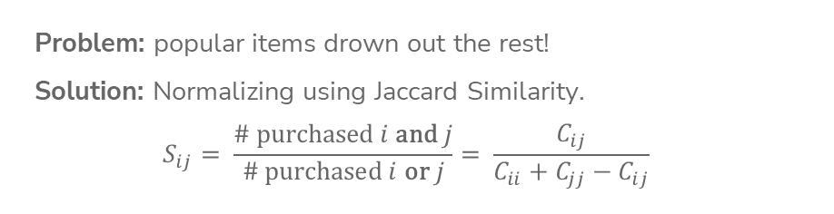
Normalizing Co-Occurence Matrices
Problem: popular items drown out the rest!
Solution: Normalizing using Jaccard Similarity.
$$S_{ij}= \frac{\# \text{purchased} i \text{and} j}{\# \text{purchased} i \text{or} j}= \frac{C_{ij}}{C_{ii}+C_{jj}−C_{ij}}$$
Notes:
WOS:
Select diaper, show that the most similar are baby bottle and baby formula
Anything wrong with this?

Slide 10
Solution 3: Feature-Based

Slide 11

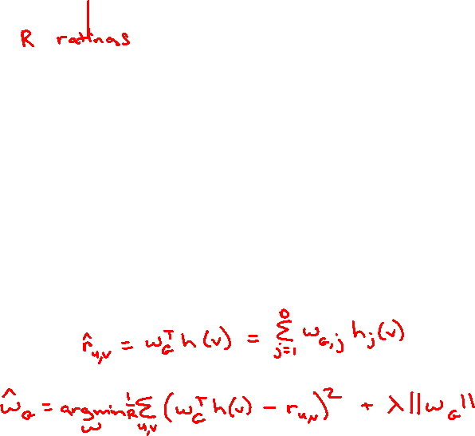
Solution 3: Feature-Based
What if we know what factors lead users to like an item?
Idea: Create a feature vector for each item. Learn a regression model!
Define weights on these features for all users (global)
$$w_{G}∈ℝ^{d}$$
Fit linear model
Genre | Year | Director | …
Action | 1994 | Quentin Tarantino | …
Sci-Fi | 1977 | George Lucas | …
Notes:
Write h(v) = (genre: ‘action’, year: 1994, director: Tarantino, …) with dimensions
For all users, r_uv \approx w\cdot h(v)
Write OLS over movie ratings, with regularization

Slide 12
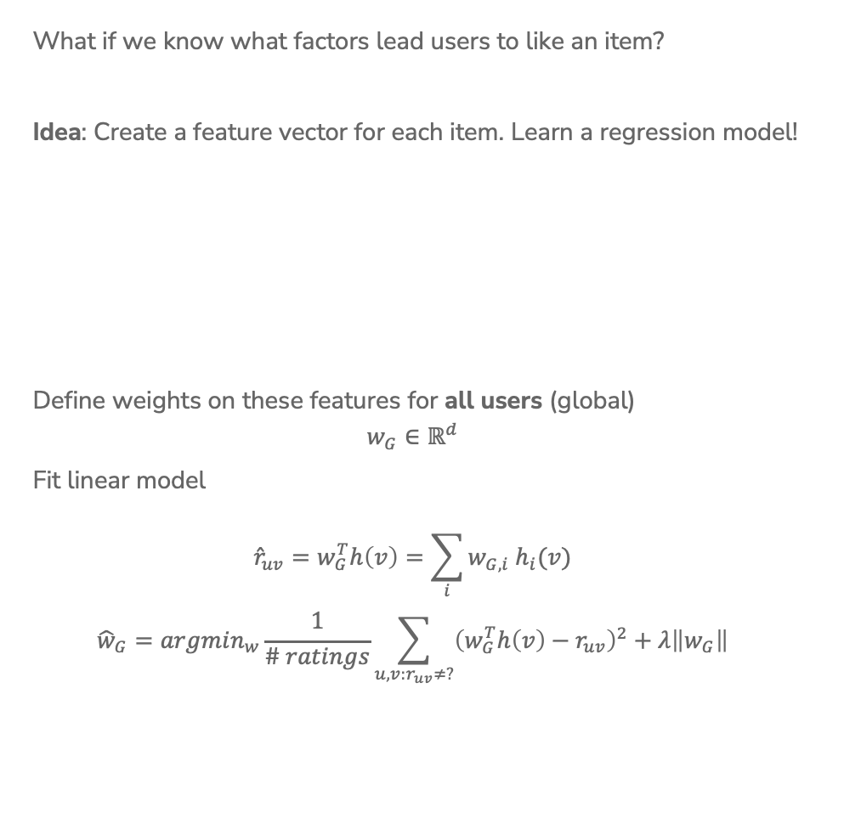
Solution 3: Feature-Based
What if we know what factors lead users to like an item?
Idea: Create a feature vector for each item. Learn a regression model!
Define weights on these features for all users (global)
$$w_{G}∈ℝ^{d}$$
Fit linear model
$${\hat{r}}_{uv}=w_{G}^{T}h\left(v\right)=\sum_{i}{w_{G,i} h_{i}(v)}$$
$${\hat{w}}_{G}=argmin_{w}\frac{1}{\# ratings}\sum_{u,v:r_{uv}≠?}{{\left(w_{G}^{T}h\left(v\right)−r_{uv}\right)}^{2}+λ\left\|w_{G}\right\|}$$
Genre | Year | Director | …
Action | 1994 | Quentin Tarantino | …
Sci-Fi | 1977 | George Lucas | …
Notes:
Write h(v) = (genre: ‘action’, year: 1994, director: Tarantino, …) with dimensions
For all users, r_uv \approx w\cdot h(v)
Write OLS over movie ratings, with regularization

Slide 13
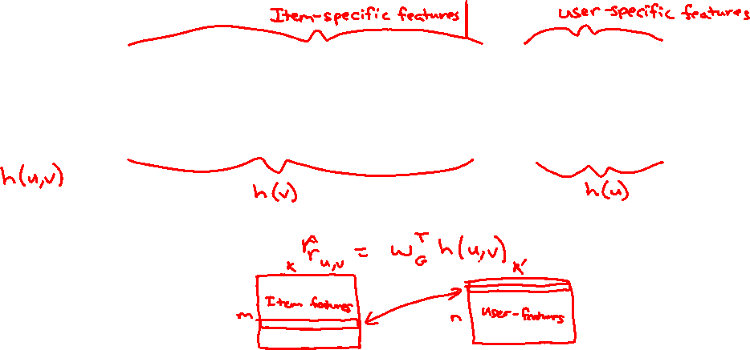
Personalization: Option A
Add user-specific features to the feature vector!
Genre | Year | Director | … | Gender | Age | …
Action | 1994 | Quentin Tarantino | … | F | 25 | …
Sci-Fi | 1977 | George Lucas | … | M | 42 | …
Notes:
h(u) = (gender: F, age: 25, education: MSc, …)
h(u,v) = (…, h(v), …, …, h(u),…append features)

Slide 14
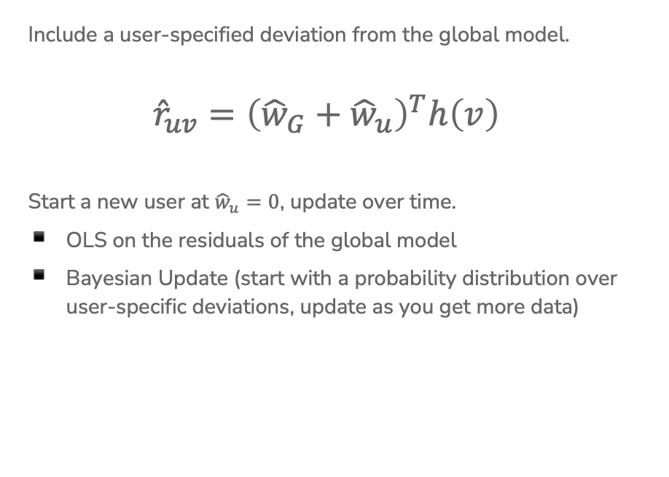

Personalization: Option B
Include a user-specified deviation from the global model.
$${\hat{r}}_{uv}={\left({\hat{w}}_{G}+{\hat{w}}_{u}\right)}^{T}h\left(v\right)$$
Start a new user at ${\hat{w}}_{u}=0$, update over time.
OLS on the residuals of the global model
Bayesian Update (start with a probability distribution over user-specific deviations, update as you get more data)
Notes:
r_uv = (w_g + w_u )h(v)
Start w_u = 0, As we gain more information about user w_u becomes more information
WOS: Linear Mixed Models

Slide 15
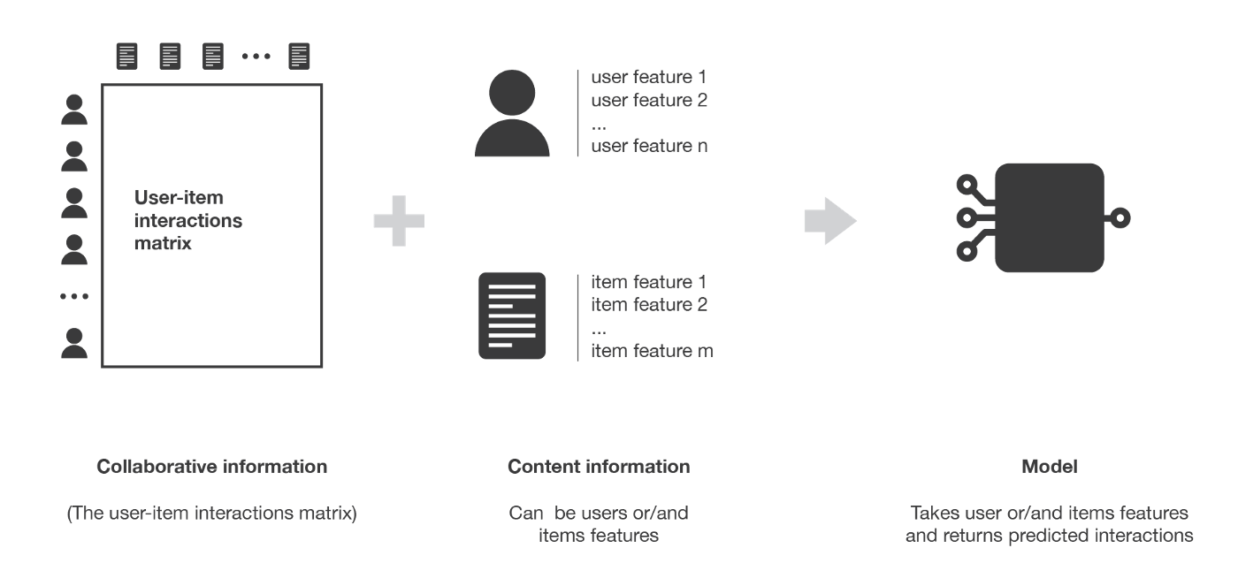
1 min
Will feature-based recommender systems suffer from the cold start problem? Why or why not?
What about other pros/cons of feature-based?

Slide 16
2 min
Will feature-based recommender systems suffer from the cold start problem? Why or why not?
What about other pros/cons of feature-based?

Slide 17
Solution 3 (Feature-Based) Pros / Cons
Pros:
No cold-start issue!
  Even if a new user/item has no purchase history, you know features about them.
Personalizes to the user and item.
Scalable (only need to store weights per feature)
Can add arbitrary features (e.g., time of day)
Cons:
Hand-crafting features is very tedious and unscalable ☹

Slide 18
Solution 4: Matrix Factorization
Can we learn the features of items?

Slide 19
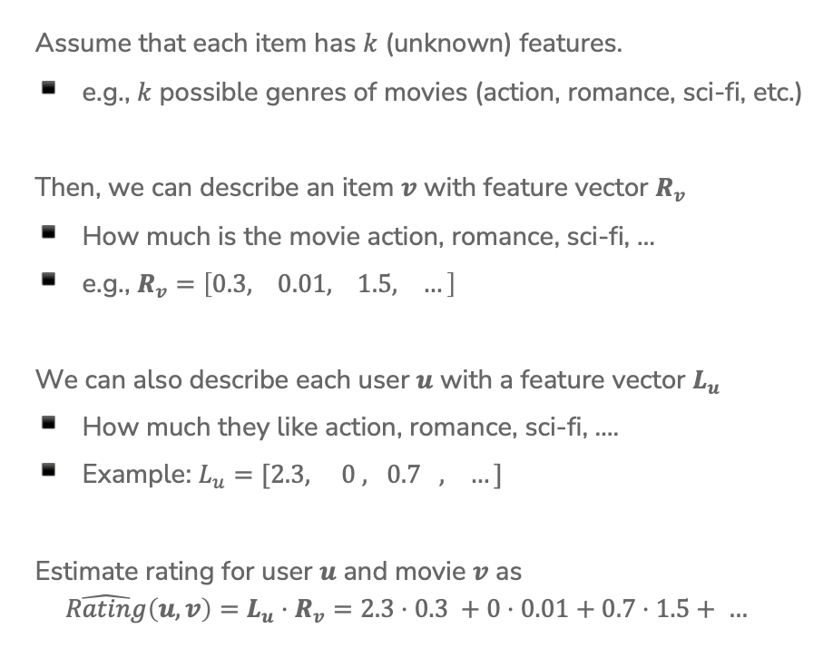
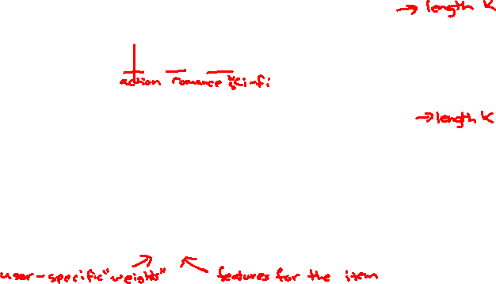
Matrix Factorization Assumptions
Assume that each item has $k$ (unknown) features.
e.g., $k$ possible genres of movies (action, romance, sci-fi, etc.)
Then, we can describe an item $v$ with feature vector $R_{v}$
How much is the movie action, romance, sci-fi, …
e.g., $R_{v}=\left[0.3, 0.01, 1.5, …\right]$
We can also describe each user $u$ with a feature vector $L_{u}$
How much they like action, romance, sci-fi, ….
Example: $L_{u}=[2.3, 0 , 0.7 , …]$
Estimate rating for user $u$ and movie $v$ as
$$\hat{Rating}\left(u,v\right)=L_{u}⋅R_{v}=2.3⋅0.3 +0⋅0.01+0.7⋅1.5+ …$$

Slide 20
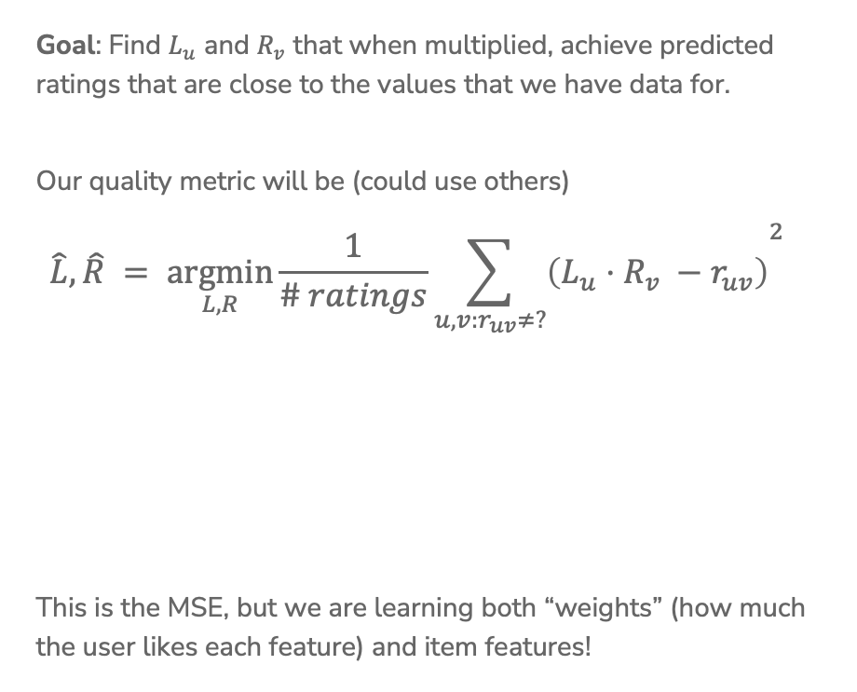
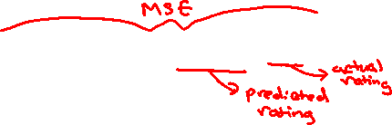
Matrix Factorization Learning
Goal: Find $L_{u}$ and $R_{v}$ that when multiplied, achieve predicted ratings that are close to the values that we have data for.
Our quality metric will be (could use others)
$${\hat{L}, \hat{R} = \underset{L, R}{argmin}{\frac{1}{\# ratings}\sum_{u, v:r_{uv}≠?}{\left(L_{u}⋅R_{v} −r_{uv}\right)}}}^{2}$$
This is the MSE, but we are learning both “weights” (how much the user likes each feature) and item features!
Notes:
WOS:
Entries we have ratings for
Predicted rating
Actual rating

Slide 21
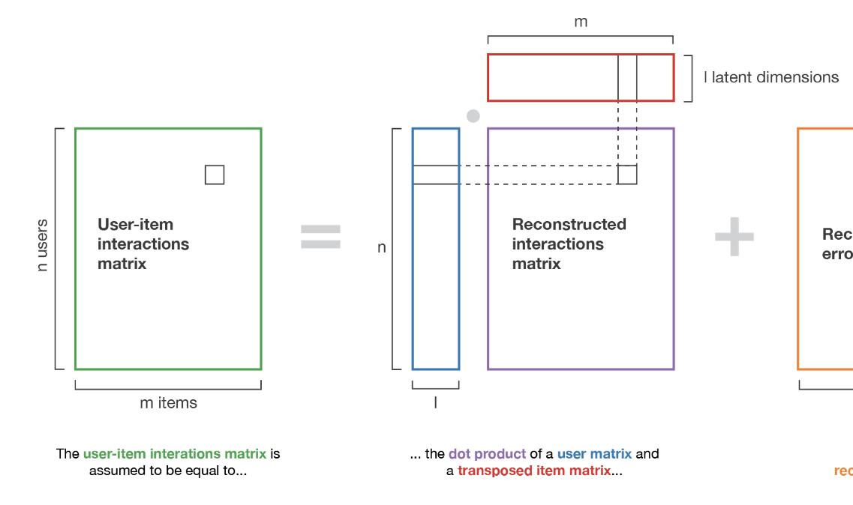
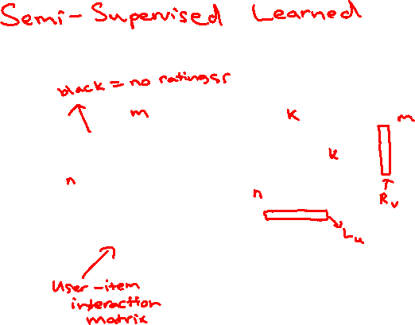
Why Is It Called Matrix Factorization?
Also called Matrix Completion, because this technique can be used to fill in missing values of a matrix
Notes:
WOS:
User-item interaction matrix
N users
M movies
Nm entries
nk+mk entries

Slide 22
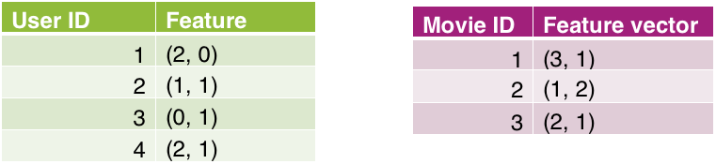
1 min
Suppose we have learned the following user and movie features using 2 features
What is the predicted rating user 1 will have of movie 2?
What is the highest predicted rating from this matrix factorization model? Which user made the prediction, for which movie?
Notes:
Write “L is 4x2” under green and “R is 3x2” under magenta
Write $u_{1},u_{2},…u_{m}$ next to users and $v_{1}, v_{2}, …, v_{n}$ next to users
Big idea: Given matrix with some values, learn L and R so predictions are close

Slide 23
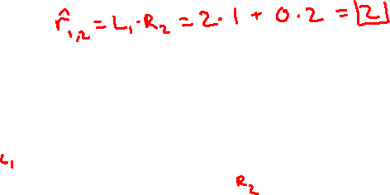
2 min
Suppose we have learned the following user and movie features using 2 features
What is the predicted rating user 1 will have of movie 2?
What is the highest predicted rating from this matrix factorization model? Which user made the prediction, for which movie?
Notes:
Write “L is 4x2” under green and “R is 3x2” under magenta
Write $u_{1},u_{2},…u_{m}$ next to users and $v_{1}, v_{2}, …, v_{n}$ next to users
Big idea: Given matrix with some values, learn L and R so predictions are close

Slide 24
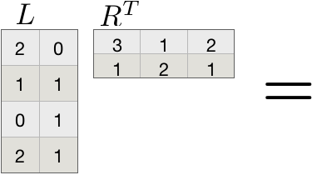
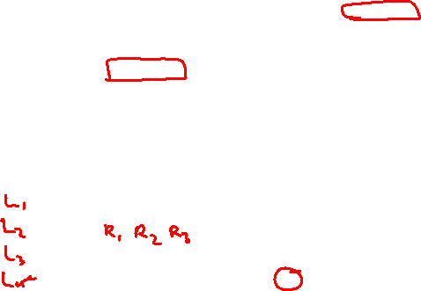
Example
Suppose we have learned the following user and movie features using 2 features
Then we can predict what each user would rate each movie
Notes:
Write “L is 4x2” under green and “R is 3x2” under magenta
Write $u_{1},u_{2},…u_{m}$ next to users and $v_{1}, v_{2}, …, v_{n}$ next to users
Big idea: Given matrix with some values, learn L and R so predictions are close

Slide 25
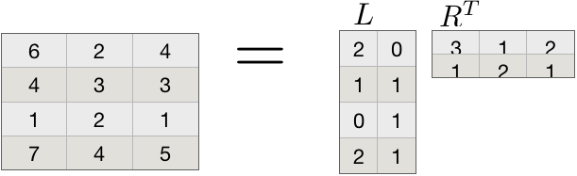
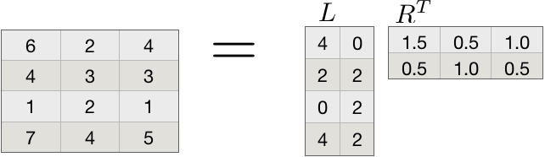

Unique Solution?
Is this problem well posed? Unfortunately, there is not a unique solution ☹
For example, assume we had a solution
Then doubling everything in $L$ and halving everything in $R$ is also a valid solution. The same is true for all constant multiples.
Notes:
This means we should not really interpret the individual values!

Slide 26


Slide 27
Coordinate Descent

Slide 28
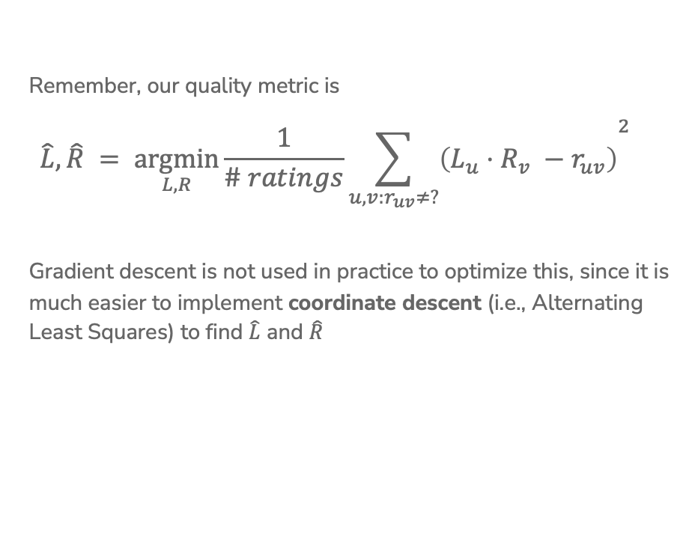

Find $\hat{L}$ & $\hat{R}$
Remember, our quality metric is
$${\hat{L}, \hat{R} = \underset{L, R}{argmin}{\frac{1}{\# ratings}\sum_{u, v:r_{uv}≠?}{\left(L_{u}⋅R_{v} −r_{uv}\right)}}}^{2}$$
Gradient descent is not used in practice to optimize this, since it is much easier to implement coordinate descent (i.e., Alternating Least Squares) to find $\hat{L}$ and $\hat{R}$

Slide 29
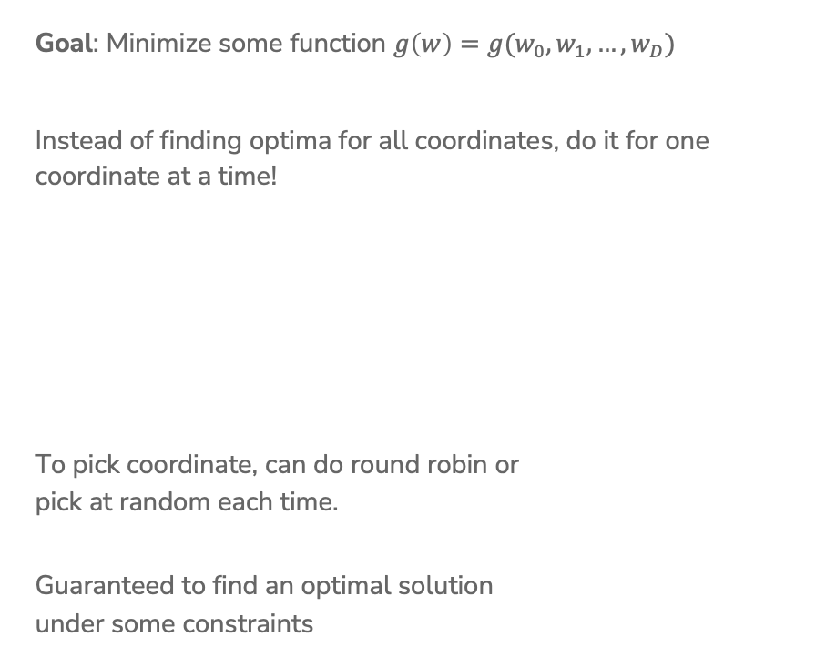
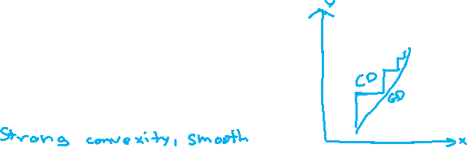
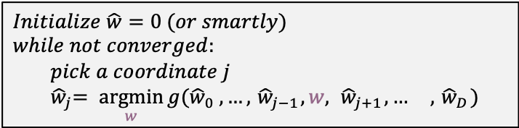
Coordinate Descent
Goal: Minimize some function $g\left(w\right)=g(w_{0},w_{1},…, w_{D})$
Instead of finding optima for all coordinates, do it for one coordinate at a time!
To pick coordinate, can do round robin or
pick at random each time.
Guaranteed to find an optimal solution
under some constraints
$Initialize \hat{w}=0 (or smartly)$
$while not converged:$
$pick a coordinate j$
$${ \hat{w}}_{j}= \underset{w}{argmin}{g({\hat{w}}_{0} , …, { \hat{w}}_{j−1}, w, { \hat{w}}_{j+1}, … , { \hat{w}}_{D}) }$$
Notes:
Write $\min_{w}{g(w)}$ at top
Draw GD vs. CD
It can be tricky to find minimum of all coordinates at once (need gradient descent), but in some cases it’s also possible to just find the minimum for each coordinate at a time
Constraints: Strong convex, smooth

Slide 30
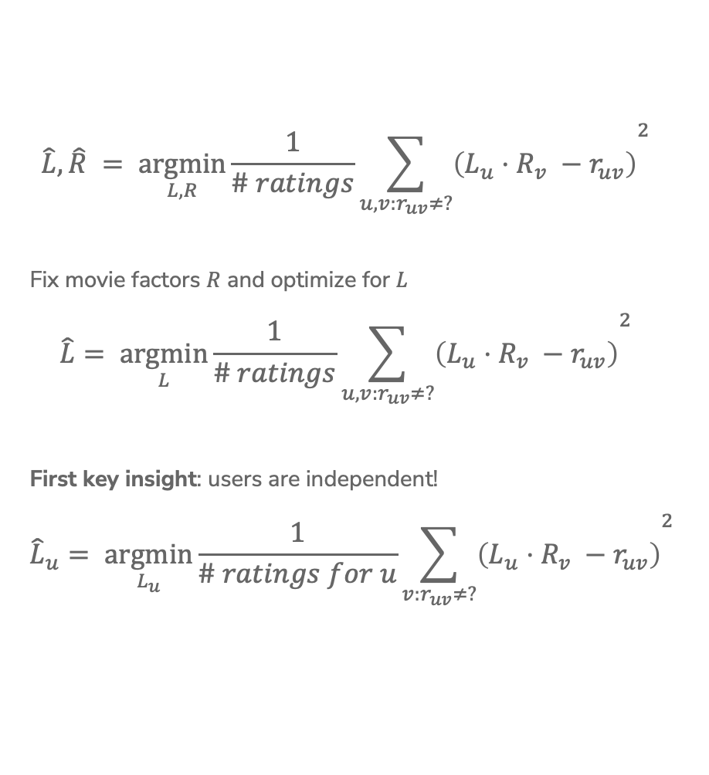
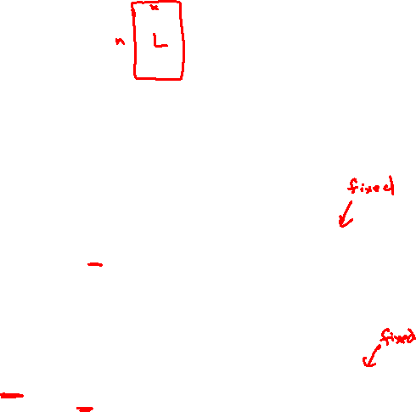
Coordinate Descent for Matrix Factorization
$${\hat{L}, \hat{R} = \underset{L, R}{argmin}{\frac{1}{\# ratings}\sum_{u, v:r_{uv}≠?}{\left(L_{u}⋅R_{v} −r_{uv}\right)}}}^{2}$$
Fix movie factors $R$ and optimize for $L_{}$
$${\hat{L}= \underset{L}{argmin}{\frac{1}{\# ratings}\sum_{u, v:r_{uv}≠?}{\left(L_{u}⋅R_{v} −r_{uv}\right)}}}^{2}$$
First key insight: users are independent!
$${{\hat{L}}_{u}= \underset{L_{u}}{argmin}{\frac{1}{\# ratings for u}\sum_{v:r_{uv}≠?}{\left(L_{u}⋅R_{v} −r_{uv}\right)}}}^{2}$$

Slide 31
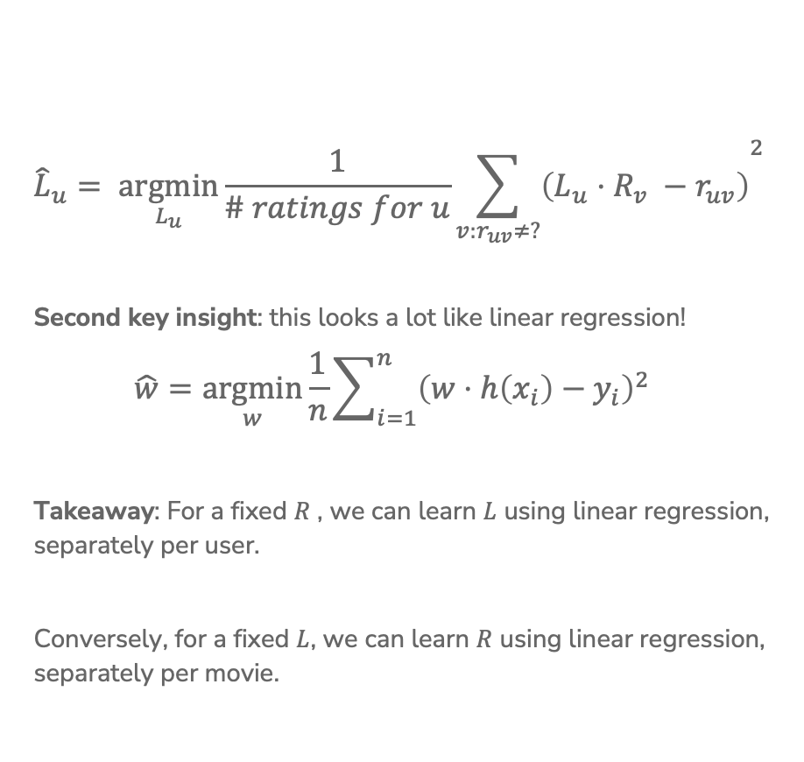
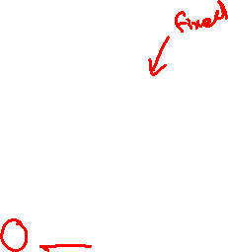
Coordinate Descent for Matrix Factorization
$${{\hat{L}}_{u}= \underset{L_{u}}{argmin}{\frac{1}{\# ratings for u}\sum_{v:r_{uv}≠?}{\left(L_{u}⋅R_{v} −r_{uv}\right)}}}^{2}$$
Second key insight: this looks a lot like linear regression!
$$\hat{w}=\underset{w}{argmin}{\frac{1}{n}\sum_{i=1}^{n}{{\left(w⋅h\left(x_{i}\right)−y_{i}\right)}^{2}}}$$
Takeaway: For a fixed $R$ , we can learn $L$ using linear regression, separately per user.
Conversely, for a fixed $L$, we can learn $R$ using linear regression, separately per movie.
Notes:
WOS:
Looks like $\underset{w}{argmin}\frac{1}{n}{\sum_{i=1}^{n}{{\left(w⋅h\left(x_{i}\right)−y_{i}\right)}^{2}}}$
L_u is parameters, R_v is features, r_{u.v} is labels.

Slide 32
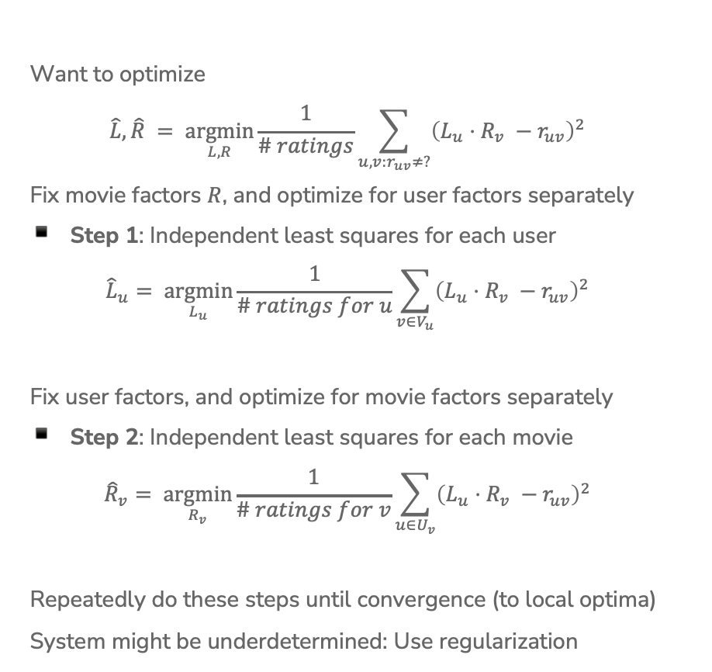
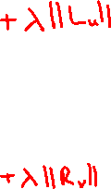
Overall Algorithm
Want to optimize
$$\hat{L}, \hat{R} = \underset{L, R}{argmin}{\frac{1}{\# ratings}\sum_{u, v:r_{uv}≠?}{{\left(L_{u}⋅R_{v} −r_{uv}\right)}^{2}}}$$
Fix movie factors $R$, and optimize for user factors separately
Step 1: Independent least squares for each user
$${\hat{L}}_{u}= \underset{L_{u}}{argmin}{\frac{1}{\# ratings for u}\sum_{v∈V_{u}}{{\left(L_{u}⋅R_{v} −r_{uv}\right)}^{2}}}$$
Fix user factors, and optimize for movie factors separately
Step 2: Independent least squares for each movie
$${\hat{R}}_{v}= \underset{R_{v}}{argmin}{\frac{1}{\# ratings for v}\sum_{u∈U_{v}}{{\left(L_{u}⋅R_{v} −r_{uv}\right)}^{2}}}$$
Repeatedly do these steps until convergence (to local optima)
System might be underdetermined: Use regularization
Notes:
Write + \lambda ||L||
Write you can use L1 norm or L2 norm (similar to ridge/LASSO)

Slide 33
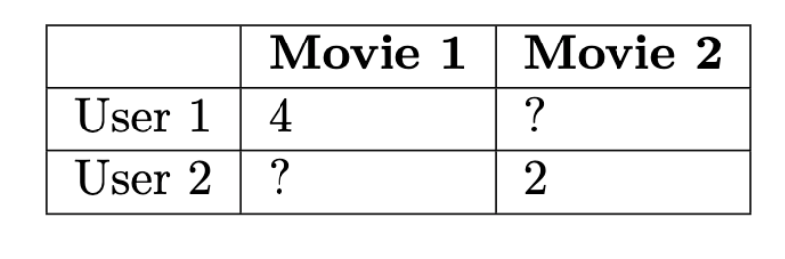
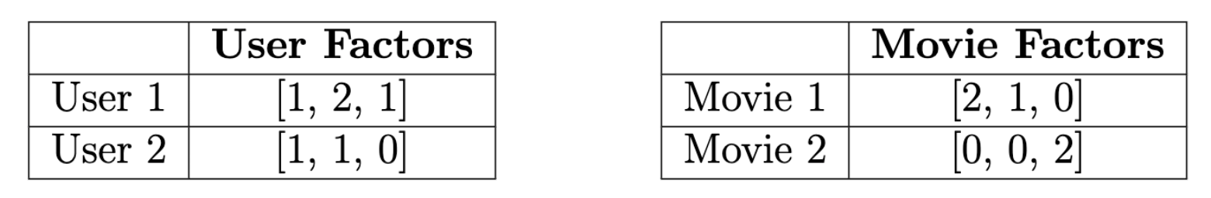
1.5 minutes
Consider we had the ratings matrix
During one step of optimization, user and movie factors are
Two questions:
What is the current MSE loss? (number)
Assume the next step of coordinate descent updates the user factors. Which factors would change?
User 1
User 2
User 1 and 2
None

Slide 34



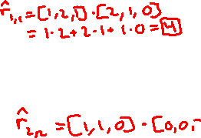





3 minutes
Consider we had the ratings matrix
During one step of optimization, user and movie factors are
Two questions:
What is the current MSE loss? (number)
Assume the next step of coordinate descent updates the user factors. Which factors would change?
User 1
User 2
User 1 and 2
None

Slide 35
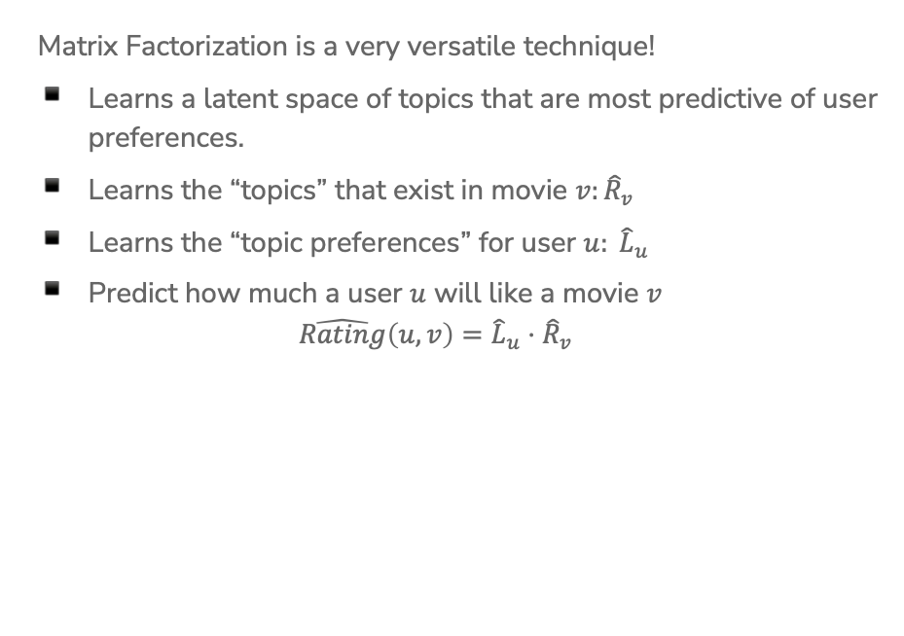
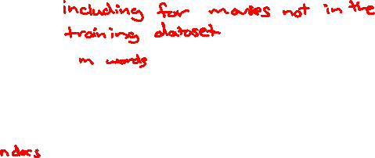
What Has Matrix Factorization Learnt?
Matrix Factorization is a very versatile technique!
Learns a latent space of topics that are most predictive of user preferences.
Learns the “topics” that exist in movie $v:{\hat{R}}_{v}$
Learns the “topic preferences” for user $u: {\hat{L}}_{u}$
Predict how much a user $u$ will like a movie $v$
$$\hat{Rating}\left(u, v\right)={\hat{L}}_{u}⋅{\hat{R}}_{v}$$

Slide 36
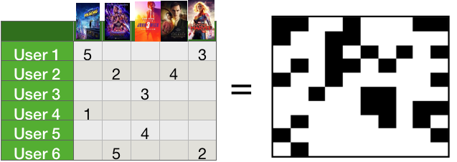
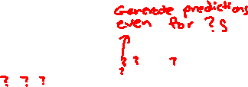
Applications: Recommender Systems
Recommendations: (Semi-Supervised)
Use matrix factorization to predict user ratings on movies the user hasn’t watched
Recommend movies with highest predicted rating

Slide 37

Applications: Topic Modeling
Topic Modeling: (Unsupervised)
Treat the TF-IDF matrix as the user-item matrix
  Documents are ”users”
  Words are “items”
$L$ tells us which topics are present in each document
$R$ tells us what words each topic is composed of
Oftentimes, the topics are interpretable!
HW7 Programming: Tweet Topic Modeling

Slide 38
Solution 4 (Matrix Factorization) Pros / Cons
Pros:
Personalizes to item and user!
Learns latent features that are most predictive of user ratings.
Cons:
Cold-Start Problem
  What do you do about new users or items, with no data?

Slide 39
Common Issues with Recommender Systems
(and some solutions)

Slide 40
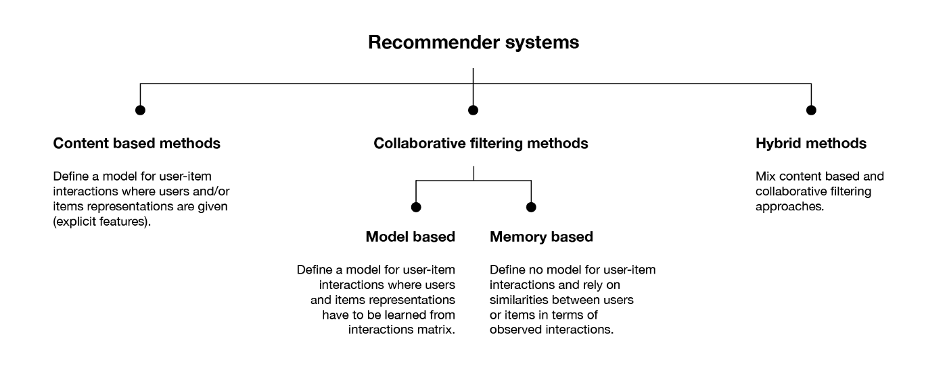
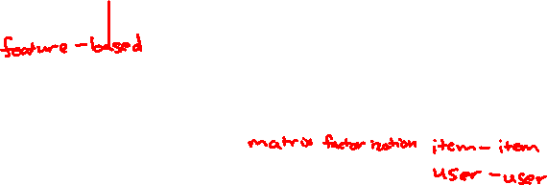
Notes:
WOS:
Taxonomy
Feature-Based
Matrix Factorization
User-user, user-item
https://towardsdatascience.com/introduction-to-recommender-systems-6c66cf15ada

Slide 41
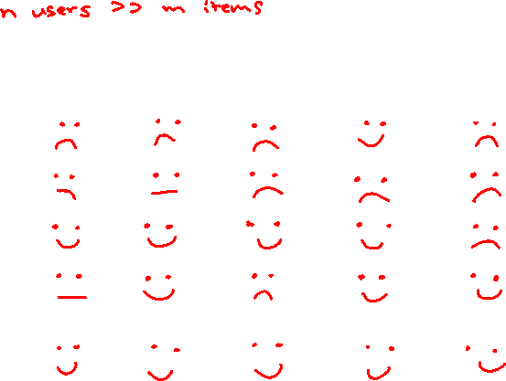
Comparing Recommender Systems
 | Efficiency (Space, Deploy) | Efficiency (Time, Deploy) | Addresses Cold-Start? | Personalizes to User? | Discovers Latent Features?
User-User
Item-Item
Feature-Based
Matrix Factorization
Hybrid (Feature-Based + Matrix Factorization)

Slide 42
Comparing Recommender Systems
 | Efficiency (Space, Deploy) | Efficiency (Time, Deploy) | Addresses Cold-Start? | Personalizes to User? | Discovers Latent Features?
User-User | 😟 | 😟 | 😟 | 😀 | 😟
Item-Item | 😟 | 😀 | 😟 | 😟 | 😟
Feature-Based | 😀 | 😀 | 😀 | 😀 | 😟
Matrix Factorization | 😐 | 😀 | 😟 | 😀 | 😀
Hybrid (Feature-Based + Matrix Factorization) | 😐 | 😀 | 😀 | 😀 | 😀

Slide 43
1 min
You are a software engineer at Spotify and have developed a matrix-factorization based recommendation system. The system works very well on existing users and songs, but does not work on new users or new songs.
How can you augment, extend, and/or modify your recommender system to handle new songs/users?

Slide 44
2 min
You are a software engineer at Spotify and have developed a matrix-factorization based recommendation system. The system works very well on existing users and songs, but does not work on new users or new songs.
How can you augment, extend, and/or modify your recommender system to handle new songs/users?

Slide 45
Cold-Start Problem
When a new user comes in, we don’t know what items they like! When a new item comes into our system, we don’t know who likes it! This is called the cold start problem.
Addressing the cold-start problem (for new users):
Give random predictions to a new user.
Give the globally popular recommendations to a new user.
Require users to rate items before using the service.
Use a feature-based model (or a hybrid between feature-based and matrix factorization) for new users.

Slide 46

Top-K versus Diverse Recommend-ations
Top-k recommendations might be very redundant
Someone who likes Rocky I also will likely enjoy Rocky II, Rocky III, Rocky IV, Rocky V
Diverse Recommendations
Users are multi-faceted & we want to hedge our bets
Maybe recommend: Rocky II, Always Sunny in Philadelphia, Robin Hood
Solution: Maximal Marginal Relevance
Pick recommendations one-at-a-time.
Select the item that the user is most likely to like and that is most dissimilar from existing recommendations.
  Hyperparameter $λ$ to trade-off between those objectives.

Slide 47
Feedback Loops / Echo Chambers
content users watch
influences
influences
their recommendations
Users always get recommended similar content and are unable to discover new content they might like.
Exploration-Exploitation Dilemma
  Common problem in “online learning” settings
Pure Exploration: show users random content
  Users can discover new interests, but will likely be unsatisfied
Pure Exploitation: show users content they’re likely to like
  Users can’t discover new interests.
Solution: Multi-Armed Bandit Algorithms (beyond the scope of 416)

Slide 48
Radicalization Pathways
In the real-world, recommender systems guide us along a path through the content in a service.
If watch video 1, recommend video 2
If watch video 2, recommend video 3
A 2019 study found that YouTube’s algorithms lead users to more and more radical content.
“Intellectual Dark Web” ➔ Alt-Lite ➔ Alt-Right
See more: iSchool 2021 Spring Lecture on Algorithmic Bias & Governance
Youtube’s response has been whack-a-mole. (Remove the content, manually tweak the recommendations for that topic)
A sustainable solution to this must incorporate both human values and technical innovation!
Notes:
Applies to other misinformation as well: flat earth, vaccine misinformation, etc.

Slide 49
Evaluating Recommender Systems

Slide 50

MSE / Accuracy?
It is possible to evaluate recommender systems using existing metrics we have learnt:
  MSE (if predicting ratings)
  Accuracy (if predicting like/dislike, or click/ignore)
However, we don’t really care about accurately predicting what a user won’t like.
Rather, we care about finding the few items they will like.
Instead, we focus on the following metrics:
How many of our recommendations did the user like?
How many of the items that the user liked did we recommend?
Sound familiar?
Notes:
WOS: Precision, Recall

Slide 51

Precision - Recall
Precision and recall for recommender systems
$$precision= \frac{\# liked \& shown}{\# shown}$$
$$recall= \frac{\#liked \& shown}{\#liked }$$
What happens as we vary the number of recommendations we make?
Best Recommender System:
Top-1: high precision, low recall
Top-k (large k): high precision, high recall
Average Recommender System:
Top-1: average precision, low recall
Top-k (large k): low precision, high recall
Notes:
In general, as we increase the number of recommendations, the precision goes down but the recall goes up. This is a general trend, it could vary locally.

Slide 52



Precision - Recall Curves
Notes:
WOS:
Optimal curve
Some other curve

Slide 53
Comparing Recommender Systems
In general, it depends
What is true always is that for a given precision, we want recall to be as large as possible (and vice versa)
What target precision/recall depends on your application
One metric: area under the curve (AUC)
Another metric: Set desired recall and maximize precision (precision at k)

Slide 54
Recap
Now you know how to:
Describe the input (observations, number of “topics”) and output (“topic” vectors, predicted values) of a matrix factorization model
Implement a coordinate descent algorithm for optimizing the matrix factorization objective presented
Compare different approaches to recommender systems
Describe the cold-start problem and ways to handle it (e.g., incorporating features)
Analyze performance of various recommender systems in terms of precision and recall
Use AUC or precision-at-k to select amongst candidate algorithms

