Slide 1
CSE/STAT 416 Dimensionality Reduction & Recommender Systems Intro Amal Nanavati University of Washington Aug 8, 2022 Adapted from Hunter Schafer’s slides

Slide 2
Administrivia
This Week: Dimensionality Reduction, Recommender Systems
Next Week: Course Wrap-Up & Guest Panel
Deadlines:
HW6 due TOMORROW, Tues 8/9 11:59PM
Submit Concept on Gradescope
Submit Programming on EdSTEM
HW7 (final HW) released Wed 8/10
Due Tues 8/16 11:59PM, NO LATE DAYS
LR 8 due Fri 8/12 11:59PM
Extra Credit Guest Panel Mon 8/15 during lecture.
Take-Home Final Exam: Wed 8/17 – Thurs 8/18

Slide 3
Addressing LR Questions

Slide 4
Fairness Definitions
“Fairness through Unawareness”
To avoid unfair decisions, prevent the model from every looking at protected attribute (e.g., race, gender).
Doesn’t work in practice
Statistical Parity
Idea: Equal performance across groups.
$$\operatorname{Pr}\left(\hat{Y}= +| A=\text{∎}\right)=\operatorname{Pr}\left(\hat{Y}= +| A=\text{◯}\right)$$
Also phrased as matching demographic statistics (e.g., if 33% of population are Circles, 33% of those admitted should be Circles).
Equal Opportunity
Idea: True positive rate should be equal across groups
$$\operatorname{Pr}\left(\hat{Y}= +| A=∎, Y=+\right)=Pr\left(\hat{Y}= +| A=\text{◯}, Y=+\right)$$
Notes:
Another approach is to change the model training procedure to itself be more fair. However, in order to do that we need some mathematical definition of fairness.
Definition 1: Shape Blind:
This does not prevent historical or measurement bias. Protected attributes can be unintentionally inferred from other, related attributes (e.g., in some cities, zip code can be deeply correlated with race).
Definition 2: Statistical Parity:
Pros:
Aligns with certain legal definitions of equity.
Cons:
A rather weak in fairness requirements. Allows for strategies that might not be desirable (e.g., random selection, self-fulfilling prophecy)
Definition 3: Equal Opportunity:
Pros:
Better controls for true outcome
Cons:
More complex to explain to non-experts
Only protects for the positive outcome
Note: Equality of true positives is the same as equality of false negatives

Slide 5
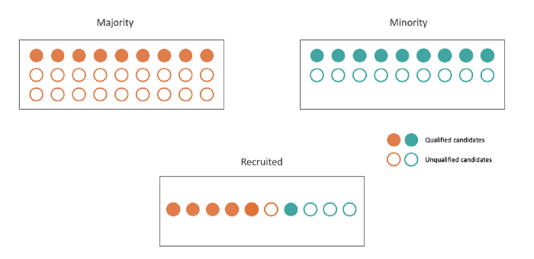
Statistical Parity Example
Notes:
https://medium.com/data-from-the-trenches/measuring-fairness-in-machine-learning-models-2be070fab712

Slide 6
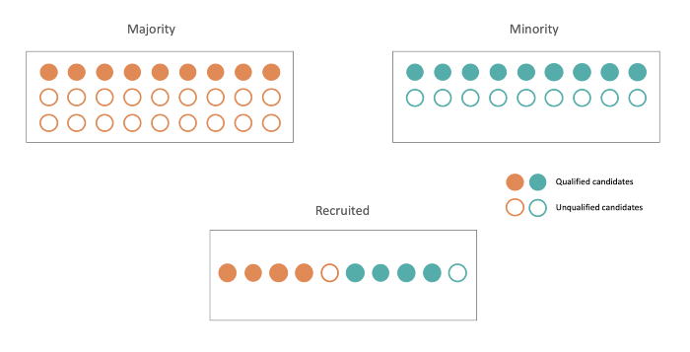
Equality of Opportunity Example
Notes:
https://medium.com/data-from-the-trenches/measuring-fairness-in-machine-learning-models-2be070fab712

Slide 7
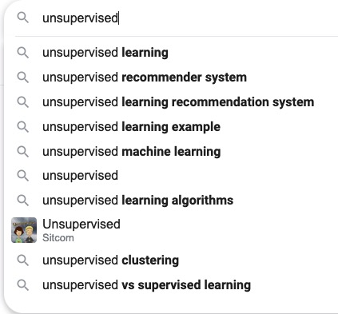
Unsupervised Learning
A type of machine learning that detects underlying patterns in unlabeled data.
Examples of unsupervised learning tasks:
Cluster similar articles together.
Cluster gene sequences.
Recommend items, searches, movies, etc.
Notes:
There are several other examples of unsupervised learning: outlier detection, topic modeling, social network clustering, etc.

Slide 8
Unlabeled Data
In many real world contexts, there aren’t clearly defined labels so we won’t be able to do classification
We will need to come up with methods that uncover structure from the (unlabeled) input data $X$.
Clustering is an automatic process of trying to find related groups within the given dataset.
$$Input:x_{1}, x_{2},…,x_{n}$$
$$Output:z_{1}, z_{2},…,z_{n}$$
Notes:
Write ”unsupervised learning”
Draw circles around clusters
Write z_i \in [1, …, k]
Show some examples

Slide 9
2 min
Which word(s) have the largest IDF? Which word(s) have the smallest IDF?
Review
“Sushi was great, the food was awesome, but the service was terrible”
“Terrible food; the sushi was rancid.”
Note that if we divide the Bag of Words embedding by the num words in the document, we get the TF!
Sushi | was | great | the | food | awesome | but | service | terrible | rancid
1 | 3 | 1 | 2 | 1 | 1 | 1 | 1 | 1 | 0
1 | 1 | 0 | 1 | 1 | 0 | 0 | 0 | 1 | 1

Slide 10
Coordinate Descent
k-means is trying to minimize the heterogeneity objective
$$\underset{z, μ}{argmin}\sum_{j=1}^{k}{\sum_{i=1}^{n}{{1\left\{z_{i}=j\right\}\left|\left|μ_{j}−x_{i}\right|\right|}_{2}^{2}}}$$
Step 0: Initialize cluster centers
Repeat until convergence:
Step 1: Assign each example to its closest cluster centroid
Step 2: Update the centroids to be the mean of all the points assigned to that cluster
Coordinate Descent alternates how it updates parameters to find minima. On each of iteration of Step 1 and Step 2, heterogeneity decreases or stays the same.
=> Will converge in finite time

Slide 11
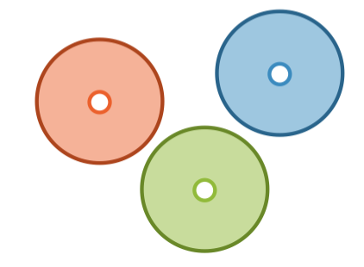
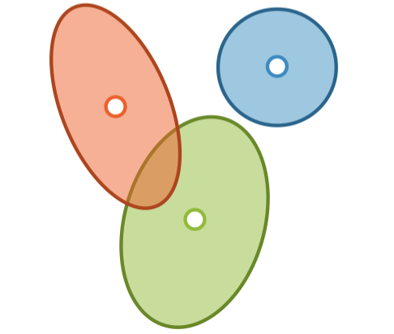
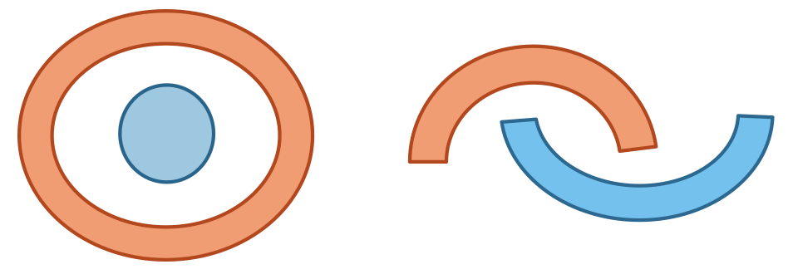
Finding Shapes
k-means
Mixture Models
Hierarchical Clustering
Notes:
Mutually exclusive spherical clusters can be found by both mixture models and hierarchical clustering.

Slide 12
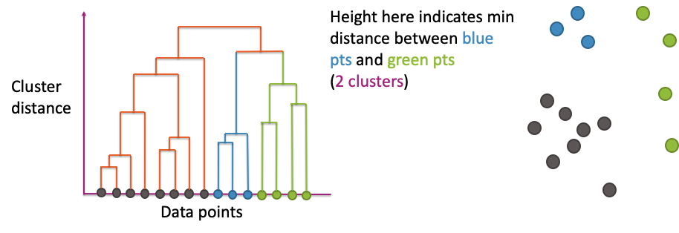
Dendrogram
x-axis shows the datapoints (arranged in a very particular order)
y-axis shows distance between pairs of clusters
Notes:
WOS:
Show alpha (merging 2 blues), b (merging next blue), and d (merging pairs of green)

Slide 13
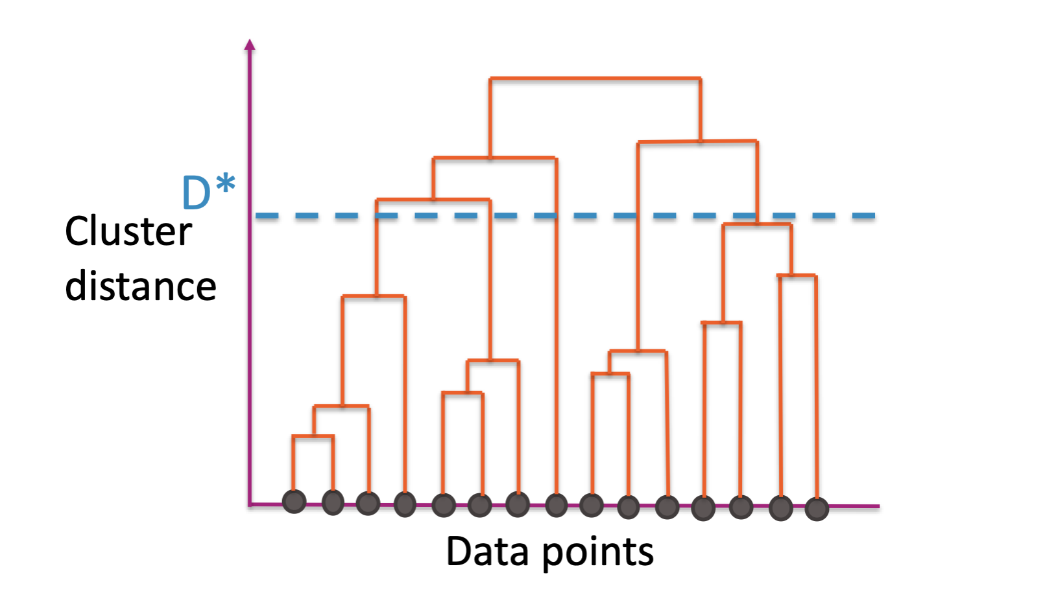
Cut Dendrogram
Choose a distance $D^{∗}$ to “cut” the dendrogram
Use the largest clusters with distance < $D^{∗}$
Usually ignore the idea of the nested clusters after cutting

Slide 14
Dimensionality Reduction

Slide 15
Large Dimensionality
Input data might have thousands or millions of dimensions!
Images: 200x200 image is 120,000 features!
Text: # features = # n-grams 😮
Course Success: dozen(s) of features
User Ratings: 100s of ratings (one per rate-able item)
Notes:
WOS: # instances, # dimensions

Slide 16
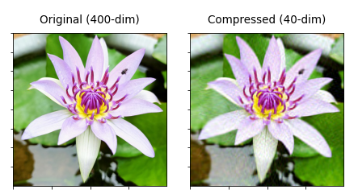
Issues with Too Many Dimensions
Visualization: Hard to visualize more than 3D.
Overfitting: Greater risk of overfitting with more features/dimensions
Scalability: some ML approaches (e.g., k-nn, k-means) perform poorly in high-dimensional spaces (curse of dimensionality)
Redundancy: high-dimensional data often occupies a lower-dimensional subspace.
Most pixels in MNIST (digit recognition) are white – are they necessary?
Image Compression
Notes:
The most important information for predictions using MNIST is captured in 5 dimensions!
Image Source: https://towardsdatascience.com/11-different-uses-of-dimensionality-reduction-4325d62b4fa6

Slide 17
Dimensionality Reduction is the the task of representing the data with a fewer number of dimensions, while keeping meaningful relations between data

Slide 18
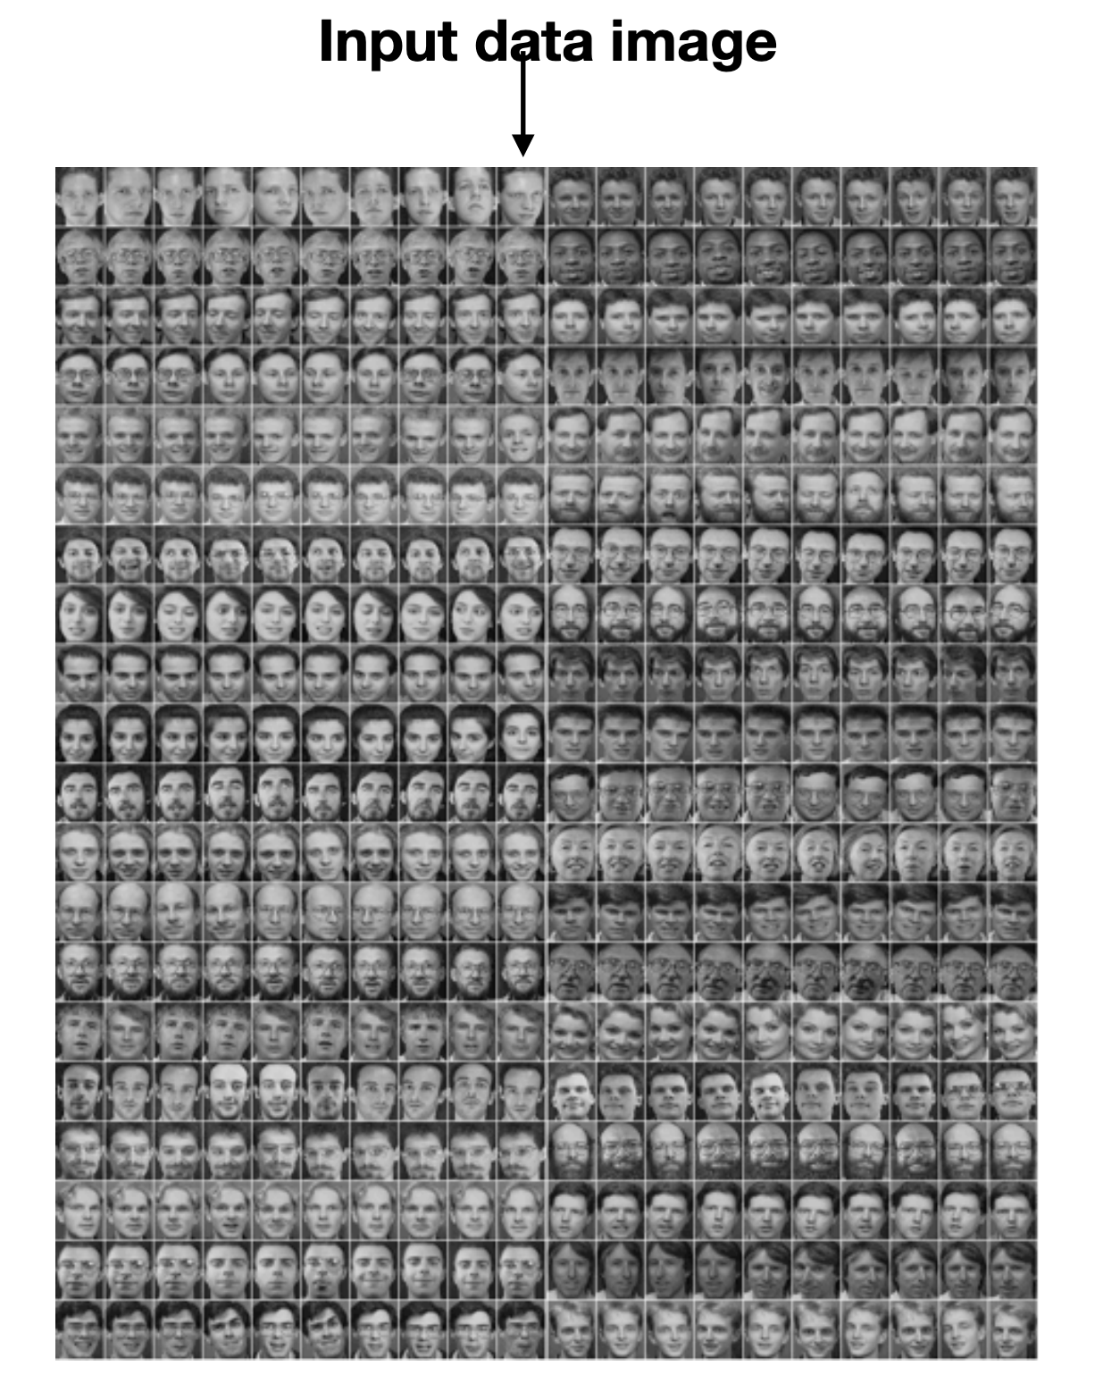
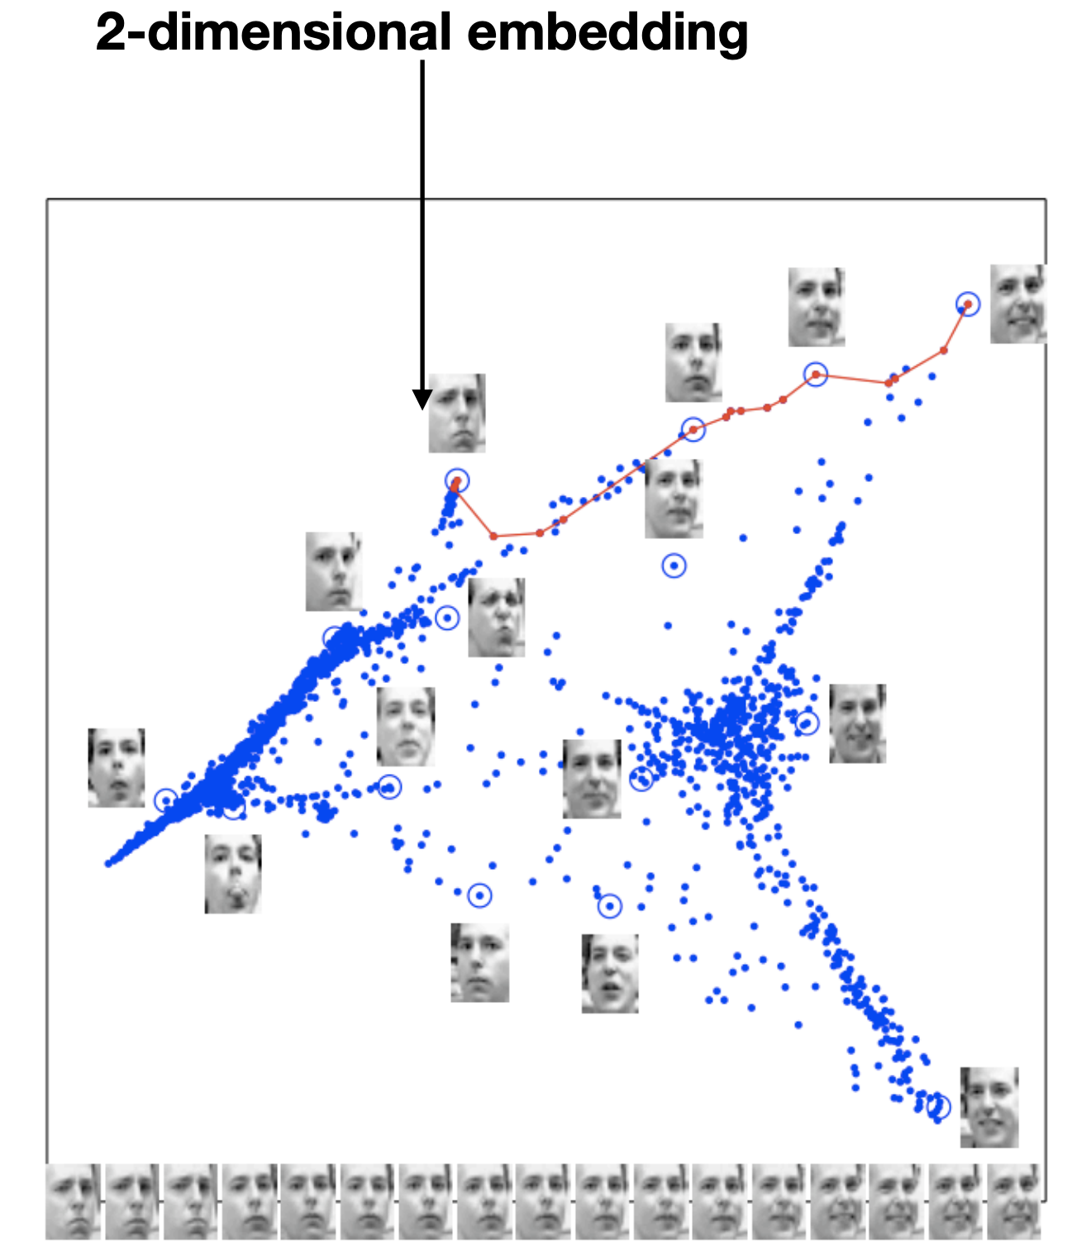
Example: Embedding Pictures
Example: Embed high dimensional data in low dimensions to visualize the data
Goal: Similar images should be near each other.
Notes:
Draw a 16x16 image, and expand it out into a 256D vector
Write: Image -> (x, y)
Similar images are close together
Horizontal corresponds to smiling or not, vertical is about face rotation
We want to learn properties like this automatically from the data itself!

Slide 19
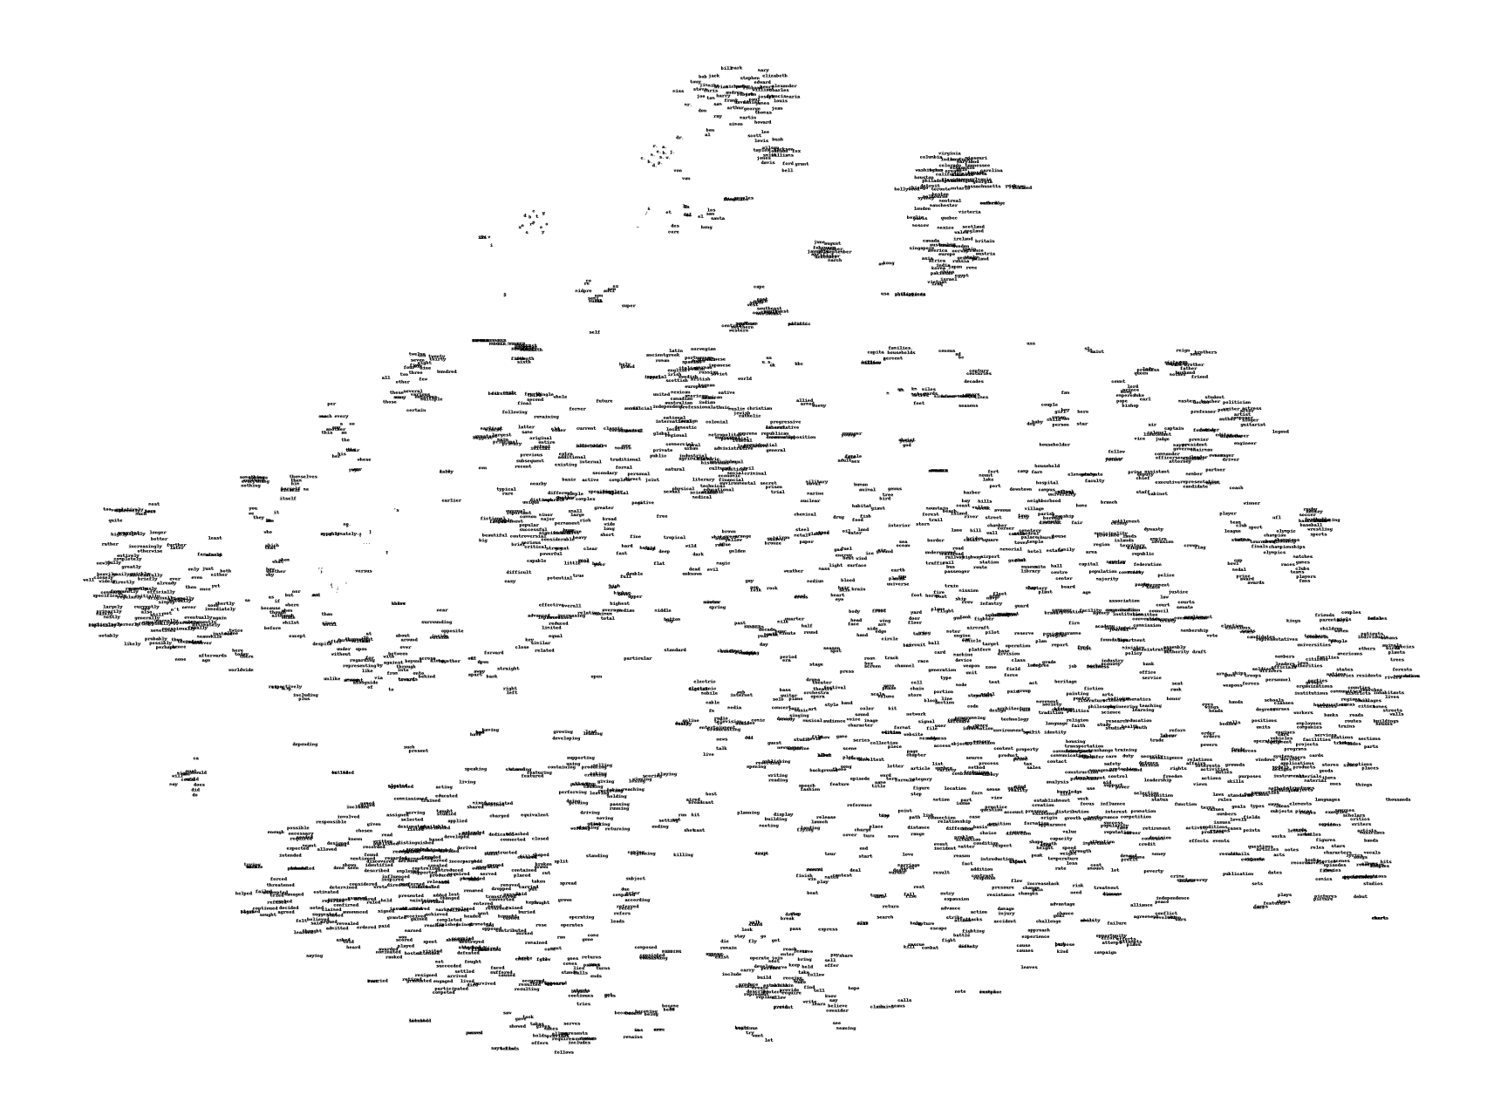
Example: Embedding Words

Slide 20
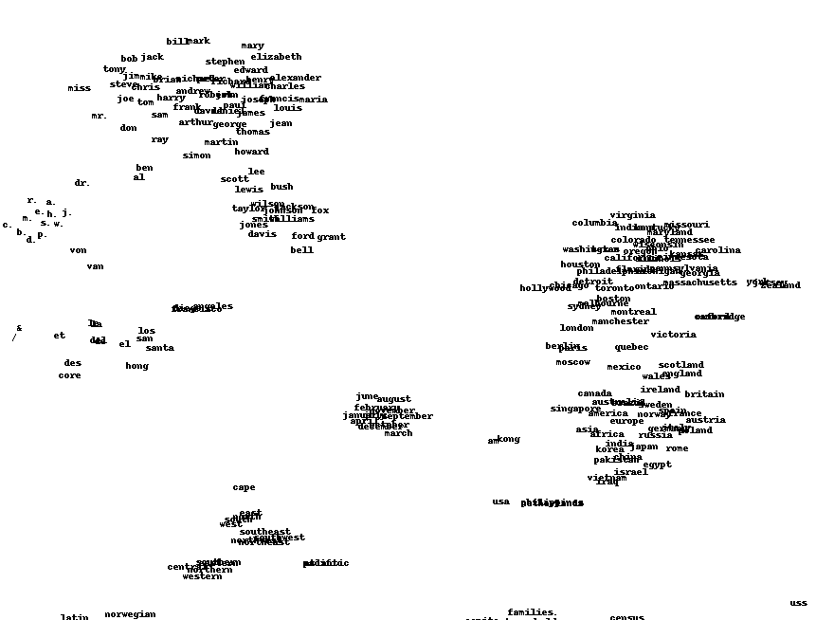
Example: Embedding Words
Notes:
Circle ”Names”, “Months”, “Places”
Not the same as clustering necessarily, clustering is given an embedding find the groups within it.
Now we are given a bunch of raw data, and want to come up with a good embedding (maybe even an embedding that makes clustering work well!)
These embeddings can be good to reduce the dimensionality of the data (“write dim reduction”) which can make data processing easier and/or help with visualizing data!

Slide 21
Principal Component Analysis (PCA)
One very popular dimensionality reduction algorithm is called Principal Component Analysis (PCA).
Idea: Use a linear projection from $d$-dimensional data to $k$-dimensional data
E.g. 1000 dimension word vectors to 3 dimensions
Choose the projection that minimizes reconstruction error
Idea: The information lost if you were to ”undo” the projection
Notes:
WOS: k << d

Slide 22
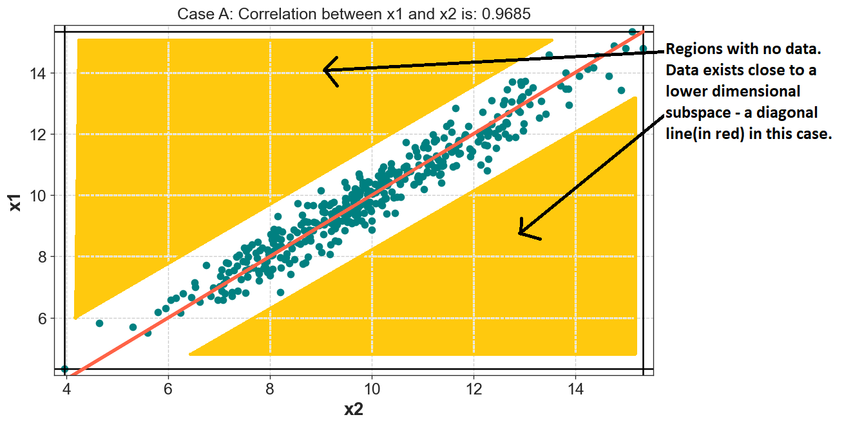
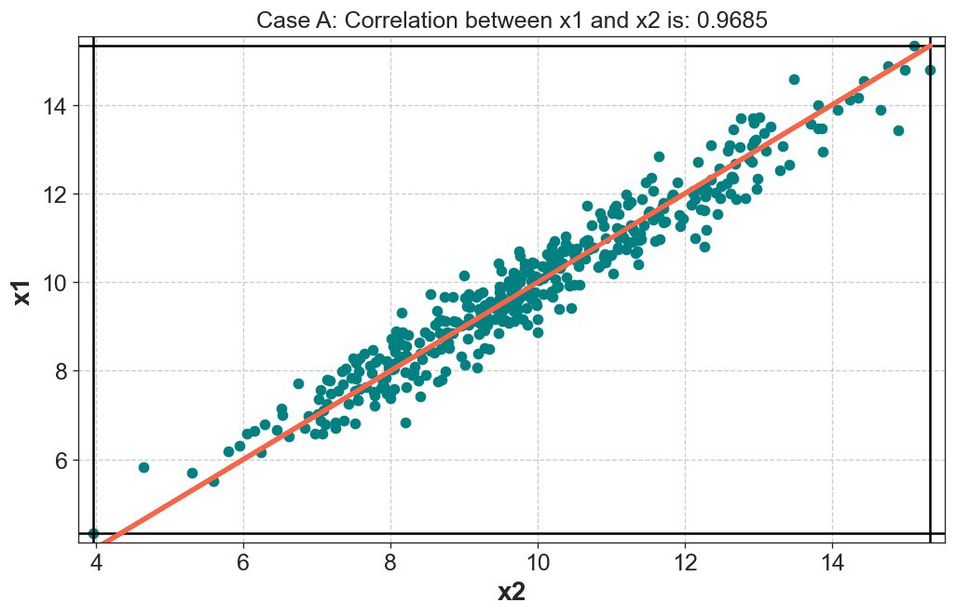
Principal Component Analysis (PCA)
Regions with no data. Data exists close to a lower-dimensional subspace.
Notes:
Image sources:
https://kindsonthegenius.com/blog/what-is-principal-component-analysis-pca-a-simple-tutorial/

Slide 23
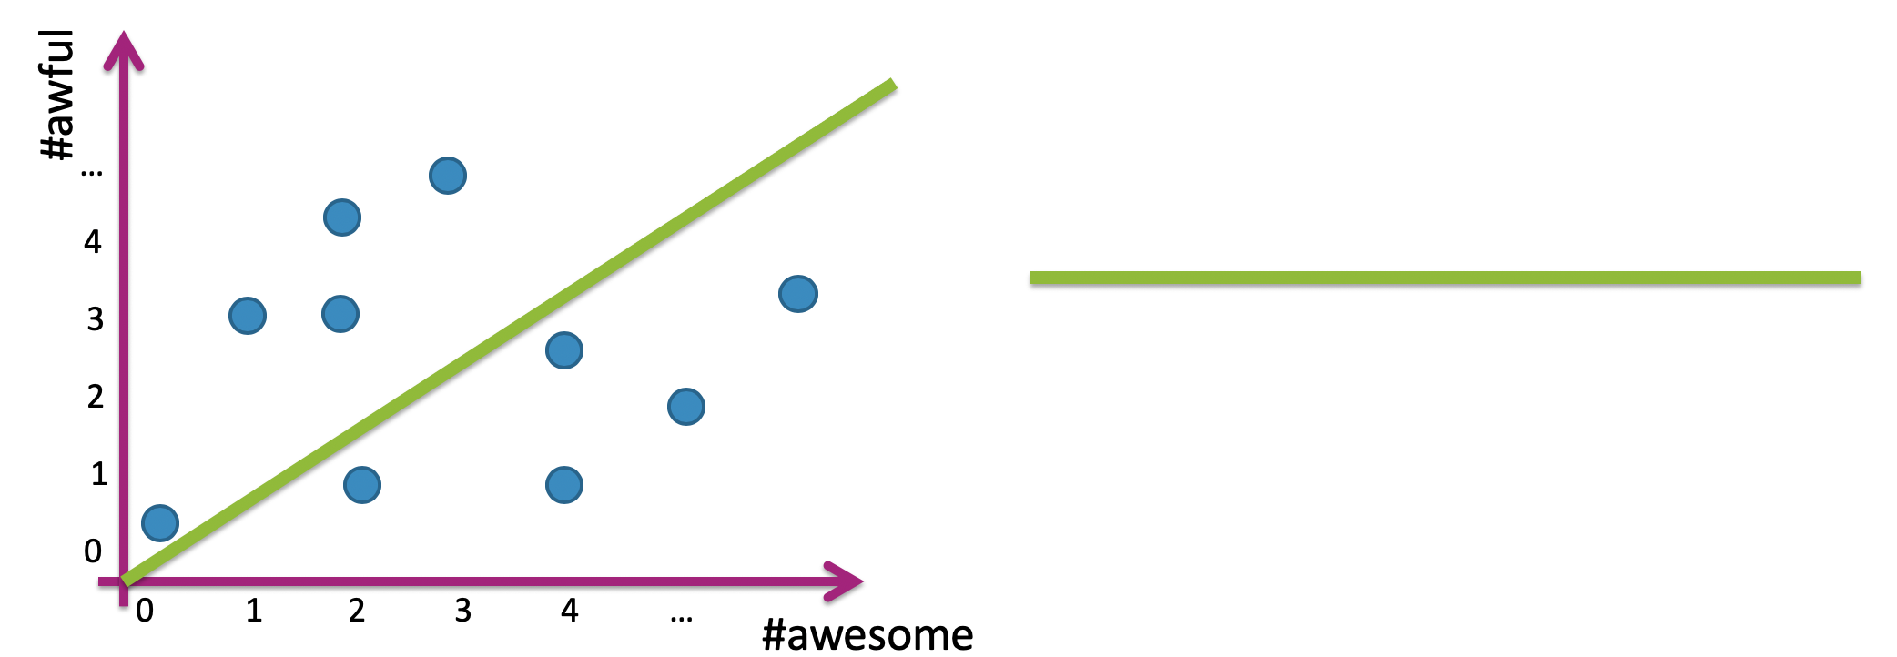
Linear Projection
Project data into 1 dimension along a line
Notes:
Draw $u_{i}$ on green line
Label a couple points, Draw lines going down to green line from points, draw points on green line
$z_{i}=u_{1}^{T}x_{i}$
Draw reminder of how this inner product works

Slide 24
Reconstruction
Reconstruct original data only knowing the projection
Notes:
Quickly draw points from last example on $u_{1}$, label $z_{i}$
Switch colors to purple, draw reconstructed points on line ${\hat{x}}_{i}$
Equation: ${\hat{x}}_{i}=z_{i}u_{1}$
Notice that there is reconstruction error! ${\hat{x}}_{1}≠x_{1}$

Slide 25
1 min
Compute the 2D coordinates of the following point. Then compute its reconstruction error.
$x_{i}=\left[0, −7, 3, 2, 5\right]$
$u_{1}=[−0.5, 0, 0.5, −0.5, 0.5]$
$u_{2}=[0.5, 0, 0.5, −0.5,−0.5]$
$z_{i}=$ ??
${\hat{x}}_{i}=$ ??
${\left\|{\hat{x}}_{i}−x_{i}\right\|}_{2}^{2}$ = ??

Slide 26
2 min
Compute the 2D coordinates of the following point. Then compute its reconstruction error.
$x_{i}=\left[0, −7, 3, 2, 5\right]$
$u_{1}=[−0.5, 0, 0.5, −0.5, 0.5]$
$u_{2}=[0.5, 0, 0.5, −0.5,−0.5]$
$z_{i}=$ ??
${\hat{x}}_{i}=$ ??
${\left\|{\hat{x}}_{i}−x_{i}\right\|}_{2}^{2}$ = ??
Notes:
WOS: dot product of principal components is 0!

Slide 27
Linear Projection in Higher Dimensions
Think of PCA as giving each datapoint a new ”address.”
Earlier, you could find the datapoint by going to the location (x, y, z).
Now, if you are just moving in the projection plane, you can (approximately) find the datapoint by going to the location ($u_{1}$, $u_{2}$)
Notes:
WOS: Show the projection of a point.
Image sources:
https://kindsonthegenius.com/blog/what-is-principal-component-analysis-pca-a-simple-tutorial/

Slide 28
How do we find the best projection vector(s)?
Pick the vector(s) along which the datapoints have the most variation!
Notes:
Image source: https://sophiesu.net/9-sagemaker-principal-component-analysis-pca-aws-certified-machine-learning-specialty/

Slide 29
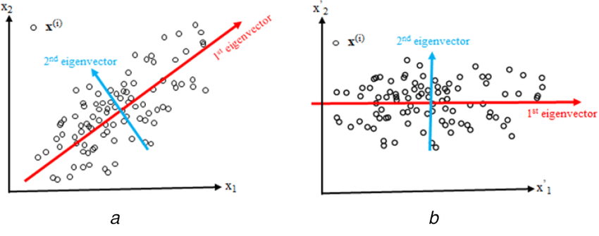
Eigenvectors
There is a quantity in linear algebra that does exactly that!
The eigenvectors of a d-dimensional dataset* are a collection of d perpendicular vectors that point in the directions of greatest variation amongst the points in the dataset.
Eigenvectors rotate the axes of the d dimensional space.
* (caveat) the eigenvectors are actually associated with the covariance matrix of the dataset
Notes:
Image source: https://www.researchgate.net/figure/Illustration-of-2D-data-projection-onto-principal-components-a-Sample-data-with-main_fig4_338765601

Slide 30
Eigenvalues
Each eigenvector has a corresponding eigenvalue, indicating how much the dataset varies in that direction.
Greater eigenvalue ➔ greater variance.
PCA: Take the $k$ eigenvectors with greatest eigenvalues.
Notes:
WOS: larger eigenvalue, smaller eigenvalue
Image source: https://www.researchgate.net/figure/Illustration-of-2D-data-projection-onto-principal-components-a-Sample-data-with-main_fig4_338765601

Slide 31
PCA Algorithm
Input Data: An $n×d$ data matrix $X$
Each row is an example
Center Data: Subtract mean from each row $X_{c}←X −\overline{X}[1:d]$
Compute spread/orientation: Compute covariance matrix $Σ$ $Σ\left[t, s\right]= \frac{1}{n}\sum_{i=1}^{n}{x_{c, i}\left[t\right]x_{c,i}[s]}$
Find basis for orientation: Compute eigenvectors of $Σ$
Select $k$ eigenvectors $u_{1}, …, u_{k}$ with largest eigenvalues
Project Data: Project data onto principal components $z_{i}\left[1\right]=u_{1}^{T}x_{c,i }=u_{1}\left[1\right]x_{c,i}\left[1\right]+…+u_{1}\left[d\right]x_{c,i}\left[d\right]$ $…$ $z_{i}\left[k\right]=u_{k}^{T}x_{c,i }=u_{k}\left[1\right]x_{c,i}\left[1\right]+…+u_{k}\left[d\right]x_{c,i}\left[d\right]$
Notes:
Draw data matrix up above
Draw dataset below
Show covariance matrix to side
Draw eigenvectors below
Show newly projected data

Slide 32
Reconstructing Data
Using principal components and the projected data, you can reconstruct the data in the original domain.
$${\hat{x}}_{i}\left[1:d\right]=\overline{X}\left[1:d\right]+ \sum_{j=1 }^{k}{z_{i}\left[j\right]{ u}_{j}}$$
Notes:
Draw picture of de-centering
Write “mean”
Write “tries to minimize |\hat{x}_i – x_i |^2_2”

Slide 33
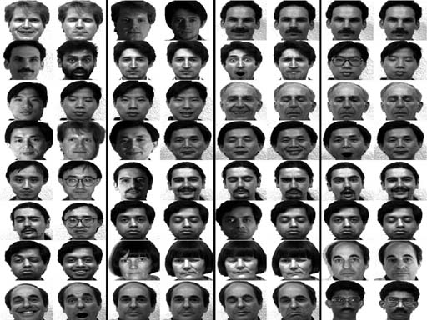
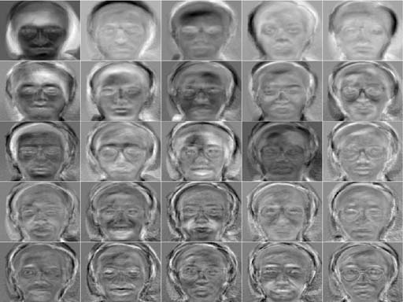
Example: Eigenfaces
Apply PCA to face data
Input Data
Principal Components
Notes:
Write how input image are high dim
Top 25 eigenvectors

Slide 34
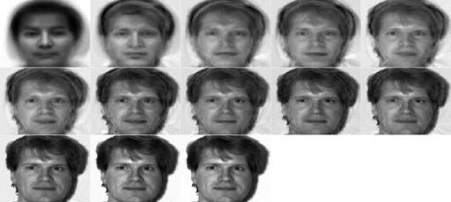
Reconstructing Faces
Depending on context, it may make sense to look at either original data or projected data.
In this case, let’s see how the original data looks after using more and more principal components for reconstruction.
Each image shows additional 8 principal components
Notes:
Write 8, 16, 24…
Write ${\hat{x}}_{i}=\overline{X}\left[1:d\right]+∑z_{j}u_{j}$

Slide 35
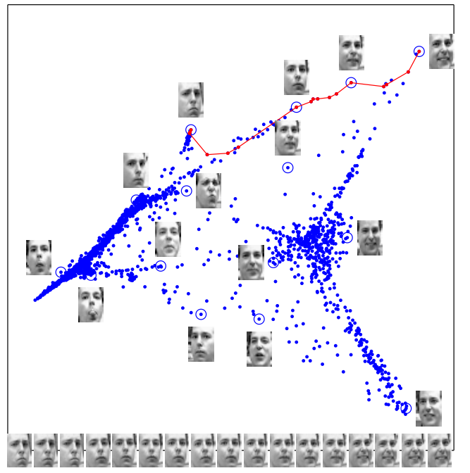
Embedding Images
Other times, it does make sense to look at the data in the projected space! (Usually if $k≤3$)
Notes:
Horizontal axis is facial expression, vertical axis is horizontal tilt of the face

Slide 36
Example: Genes
Dataset of genes of Europeans (3192 people; 500,568 loci) and their country of origin, ran PCA on the data and plotted 2 principal components.

Slide 38
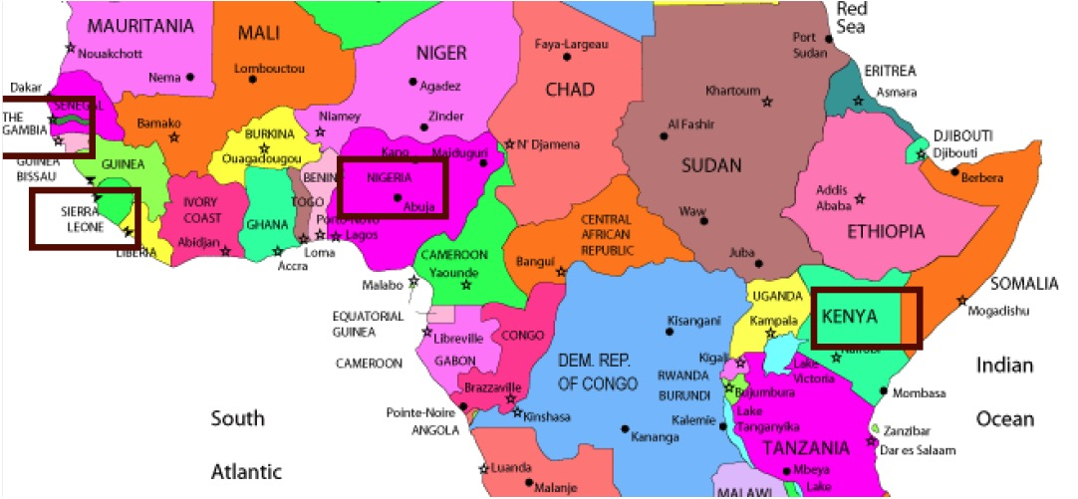
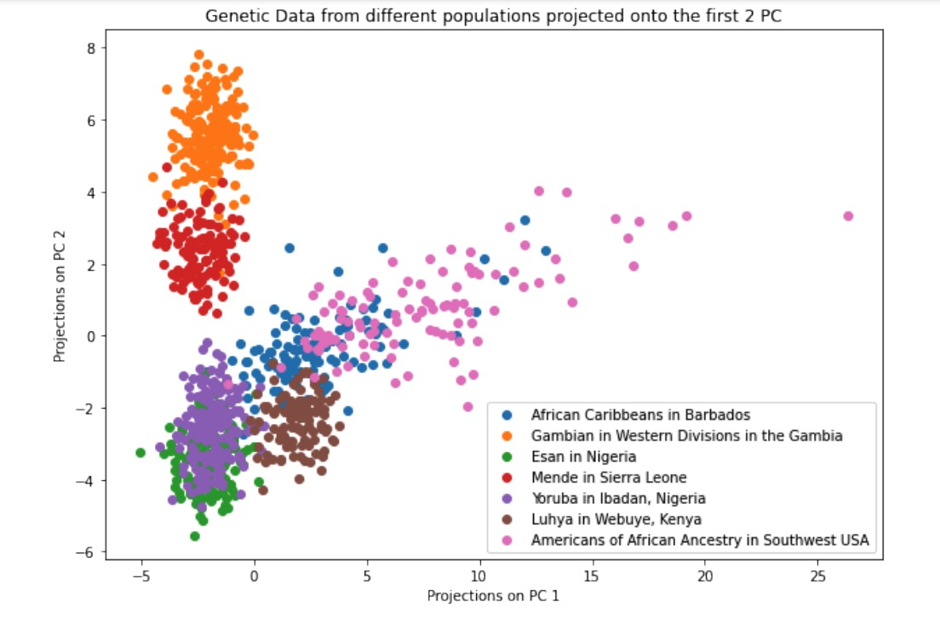
1 min
Consider the genetic data projected onto its top two PCs. How would you interpret PC1 and PC2?

Slide 39
1 min
Consider the genetic data projected onto its top two PCs. How would you interpret PC1 and PC2?

Slide 40
General Steps to Take as an ML Practitioner
Given a new dataset:
Split into train and test sets.
Understand the dataset:
Understand the feature/label types and values
Visualize the data: scatterplot, boxplot, PCA, clustering
Use that intuition to decide:
What features to use, and what transformations to apply to them (pre-processing).
What model(s) to train.
Train the models, evaluate them using a validation set or cross-validation.
Deploy the best model.

Slide 41
Intro to Recommender Systems

Slide 42
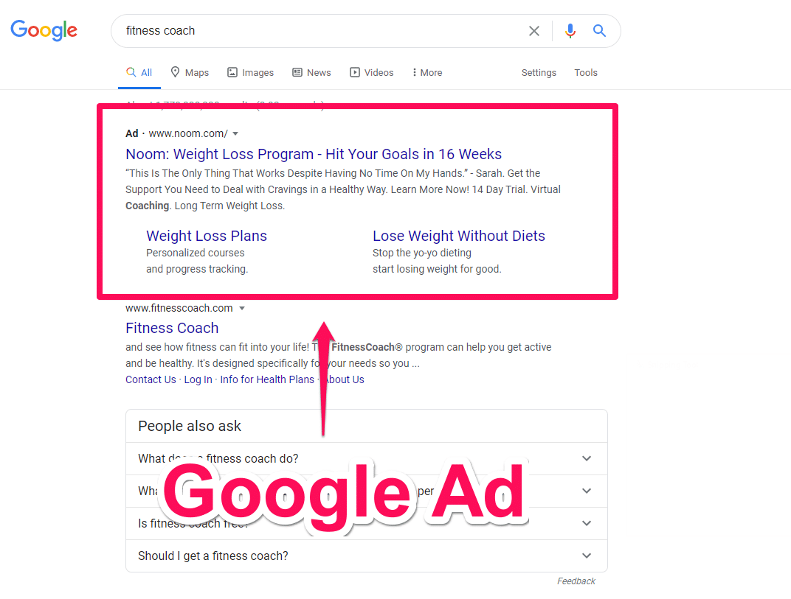
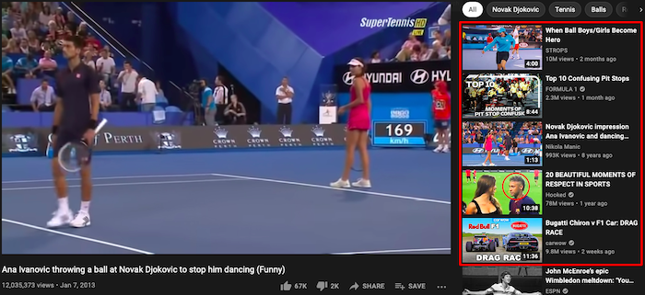
Recommender Systems are Everywhere
Notes:
Image sources:
https://mobilesyrup.com/2018/04/17/heres-how-to-make-netflixs-recommendation-algorithm-not-suck/
https://www.mageplaza.com/blog/product-recomendation-how-amazon-succeeds-with-it.html
https://www.theverge.com/2018/1/26/16937088/facebook-news-feed-explainability-ai
https://blog.hootsuite.com/google-ads/
https://medium.com/s/story/spotifys-discover-weekly-how-machine-learning-finds-your-new-music-19a41ab76efe
https://neilpatel.com/blog/youtube-recommendation/

Slide 43
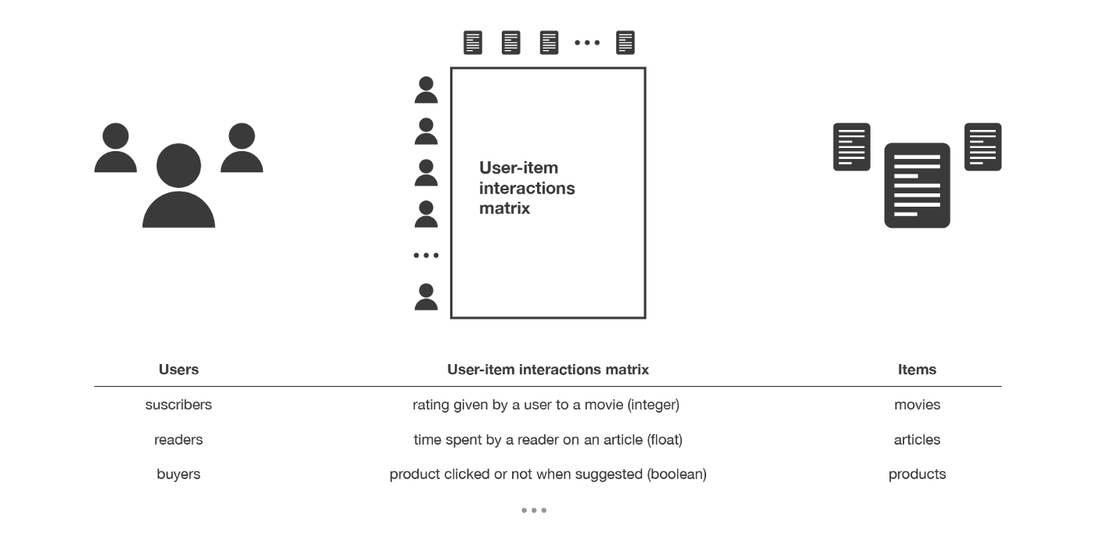
Recommender Systems Setup
You have $n$ users and $m$ items in your system
Typically, $n≫m$. E.g., Youtube: 2.6B users, 800M videos
Based on the content, we have a way of measuring user preference.
This data is put together into a user-item interaction matrix.
Task: Given a user $u_{i}$ or item $v_{j}$, predict one or more items to recommend.
Notes:
WOS: n, m near rows/columns
Say: Note that sometimes the feedback is explicit, other times its implicit
Sources:
https://www.globalmediainsight.com/blog/youtube-users-statistics/#:~:text=YouTube%20has%20more%20than%202.6,population%20use%20YouTube%20every%20month.
https://earthweb.com/how-many-videos-are-on-youtube/#:~:text=There%20are%20800%20million%20videos,are%20on%20YouTube%20in%202022%3F
https://towardsdatascience.com/introduction-to-recommender-systems-6c66cf15ada

Slide 44
Solution 0: Popularity

Slide 45
Solution 0: Popularity
Simplest Approach: Recommend whatever is popular
Rank by global popularity (i.e., Squid Game)
Sum Across Users
Recommend Top-K

Slide 46
Solution 0 (Popularity) Pros / Cons
Pros:
Easy to implement
Cons:
No Personalization
Feedback Loops
Top-K recommendations might be redundant
e.g., when a new Harry Potter movie is released, the others may also jump into top-k popularity.

Slide 47
Solution 1: Nearest User
User-User

Slide 48
Solution 1: Nearest User (User-User)
User-User Recommendation:
Given a user $u_{i}$, compute their $k$ nearest neighbors.
Recommend the items that are most popular amongst the nearest neighbors.

Slide 49
1 min
What do you see as pros / cons of the nearest user approach to recommendations?

Slide 50
2 min
What do you see as pros / cons of the nearest user approach to recommendations?

Slide 51
Solution 1 (User-User) Pros / Cons
Pros:
Personalized to the user.
Cons:
Nearest Neighbors might be too similar
This approach only works if the nearest neighbors have interacted with items that the user hasn’t.
Feedback Loop (Echo Chambers)
Scalability
Must store and search through entire user-item matrix
Cold-Start Problem
What do you do about new users, with no data?
Notes:
WOS: Ask them to rate items?

Slide 52
Solution 2: “People Who Bought This Also Bought…”
Item-Item

Slide 53
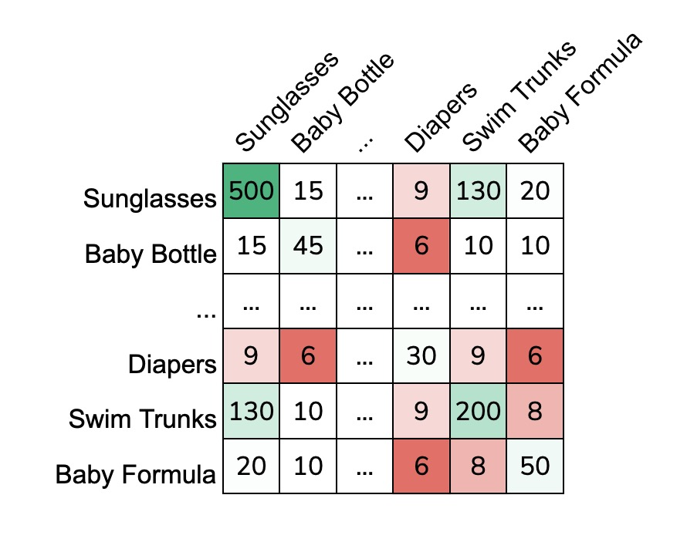
Solution 2: “People Who Bought This Also Bought…” (Item-Item)
Item-Item Recommendation:
Create a co-occurrence matrix $C∈ℝ^{m×m}$ ($m$ is the number of items). $C_{ij}$ = # of users who bought both item $i$and $j$.
For item $i$, predict the top-k items that are bought together.
Notes:
WOS:
Symmetric matrix
Select a cell, write what it means
Select diaper, show that the most similar are sunglasses and swim trunks
Anything wrong with this?

Slide 54
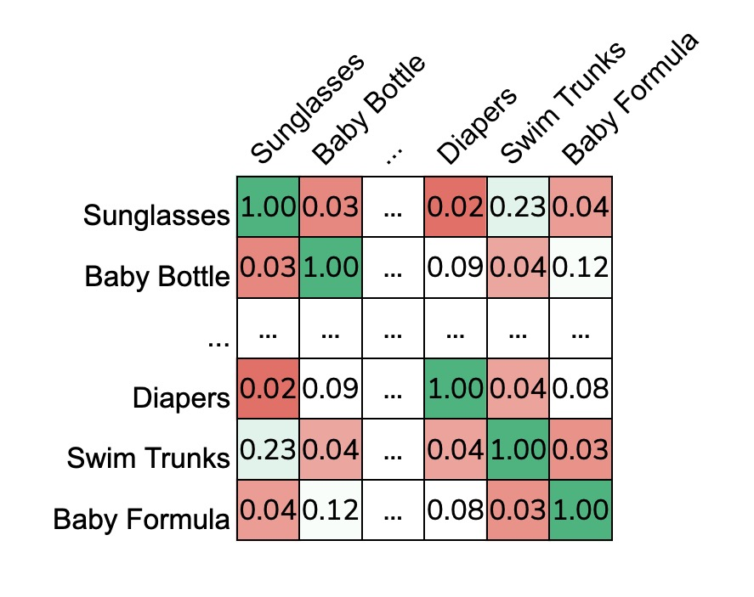
Normalizing Co-Occurence Matrices
Problem: popular items drown out the rest!
Solution: Normalizing using Jaccard Similarity.
$$S_{ij}= \frac{\# \text{purchased} i \text{and} j}{\# \text{purchased} i \text{or} j}= \frac{C_{ij}}{C_{ii}+C_{jj}−C_{ij}}$$
Notes:
WOS:
Select diaper, show that the most similar are baby bottle and baby formula
Anything wrong with this?

Slide 55
Incorporating Purchase History
What if I know the user $u$ has bought a baby bottle and formula?
Idea: Take the average similarity between items they have bought
$$Score\left(u, diapers\right)= \frac{S_{diapers,baby bottle}+S_{diapers, baby formula}}{2}$$
Could also weight them differently based on recency of purchase!
Then all we need to do is find the item with the highest average score!

Slide 56
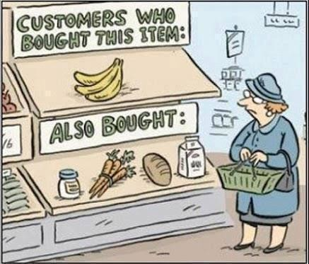
1 min
What do you see as pros / cons of the item-item approach to recommendations?
Notes:
Image Source: https://www.linkedin.com/pulse/content-based-recommender-engine-under-hood-venkat-raman

Slide 57
2 min
What do you see as pros / cons of the item-item approach to recommendations?
Notes:
Image Source: https://www.linkedin.com/pulse/content-based-recommender-engine-under-hood-venkat-raman

Slide 58
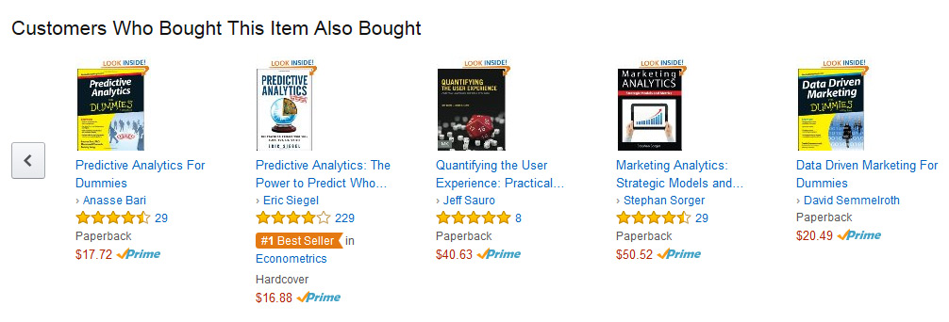
Solution 2 (Item-Item) Pros / Cons
Pros:
Personalizes to item (incorporating purchase history also personalizes to the user)
Cons:
Can still suffer from feedback loops
(As can all recommender systems – but in some cases it’s worse than others)
Scalability (must store entire item-item matrix)
Cold-Start Problem
What do you do about new items, with no data?
Notes:
Image source:
https://measuringu.com/affinity-analysis/

Slide 59
Solution 3: Feature-Based

Slide 60
Solution 3: Feature-Based
What if we know what factors lead users to like an item?
Idea: Create a feature vector for each item. Learn a regression model!
Define weights on these features for all users (global)
$$w_{G}∈ℝ^{d}$$
Fit linear model
Genre | Year | Director | …
Action | 1994 | Quentin Tarantino | …
Sci-Fi | 1977 | George Lucas | …
Notes:
Write h(v) = (genre: ‘action’, year: 1994, director: Tarantino, …) with dimensions
For all users, r_uv \approx w\cdot h(v)
Write OLS over movie ratings, with regularization

Slide 61
Solution 3: Feature-Based
What if we know what factors lead users to like an item?
Idea: Create a feature vector for each item. Learn a regression model!
Define weights on these features for all users (global)
$$w_{G}∈ℝ^{d}$$
Fit linear model
$${\hat{r}}_{uv}=w_{G}^{T}h\left(v\right)=\sum_{i}{w_{G,i} h_{i}(v)}$$
$${\hat{w}}_{G}=argmin_{w}\frac{1}{\# ratings}\sum_{u,v:r_{uv}≠?}{{\left(w_{G}^{T}h\left(v\right)−r_{uv}\right)}^{2}+λ\left\|w_{G}\right\|}$$
Genre | Year | Director | …
Action | 1994 | Quentin Tarantino | …
Sci-Fi | 1977 | George Lucas | …
Notes:
Write h(v) = (genre: ‘action’, year: 1994, director: Tarantino, …) with dimensions
For all users, r_uv \approx w\cdot h(v)
Write OLS over movie ratings, with regularization

Slide 62
Personalization: Option A
Add user-specific features to the feature vector!
Genre | Year | Director | … | Gender | Age | …
Action | 1994 | Quentin Tarantino | … | F | 25 | …
Sci-Fi | 1977 | George Lucas | … | M | 42 | …
Notes:
h(u) = (gender: F, age: 25, education: MSc, …)
h(u,v) = (…, h(v), …, …, h(u),…append features)

Slide 63
Personalization: Option B
Include a user-specified deviation from the global model.
$${\hat{r}}_{uv}={\left({\hat{w}}_{G}+{\hat{w}}_{u}\right)}^{T}h\left(v\right)$$
Start a new user at ${\hat{w}}_{u}=0$, update over time.
OLS on the residuals of the global model
Bayesian Update (start with a probability distribution over user-specific deviations, update as you get more data)
Notes:
r_uv = (w_g + w_u )h(v)
Start w_u = 0, As we gain more information about user w_u becomes more information
WOS: Linear Mixed Models

Slide 64
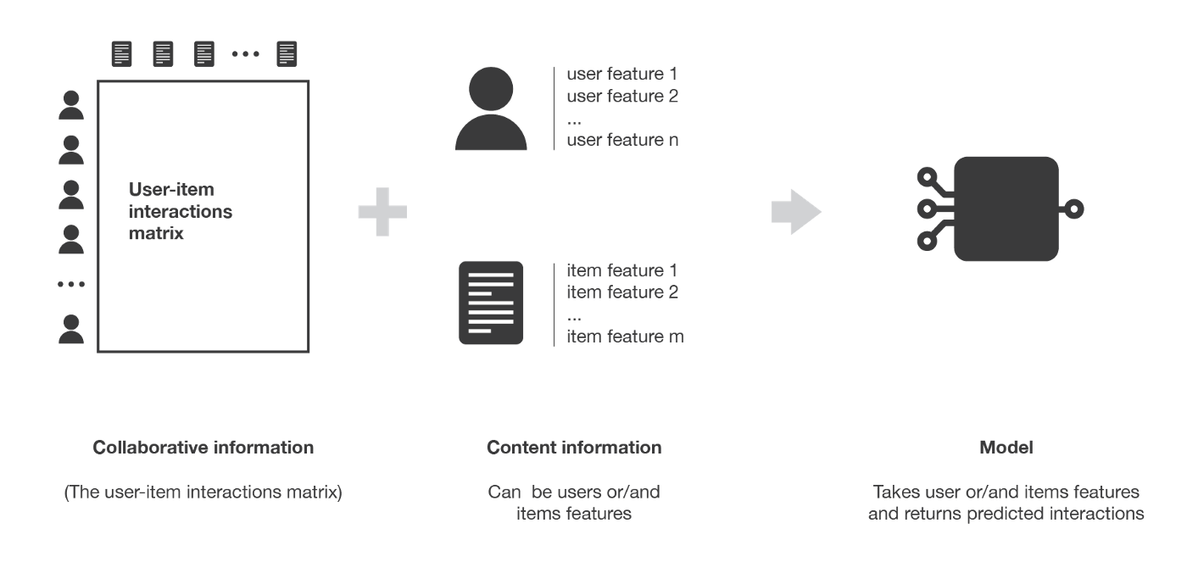
1 min
Will feature-based recommender systems suffer from the cold start problem? Why or why not?
What about other pros/cons of feature-based?

Slide 65
2 min
Will feature-based recommender systems suffer from the cold start problem? Why or why not?
What about other pros/cons of feature-based?

Slide 66
Solution 3 (Feature-Based) Pros / Cons
Pros:
No cold-start issue!
Even if a new user/item has no purchase history, you know features about them.
Personalizes to the user and item.
Scalable (only need to store weights per feature)
Can add arbitrary features (e.g., time of day)
Cons:
Hand-crafting features is very tedious and unscalable ☹

Slide 67
Recap
Dimensionality Reduction & PCA:
Why and when it’s important
High level intuition for PCA
Linear Projections & Reconstruction
Eigenvectors / Eigenvalues
Recommender Systems:
Sol 0: Popularity
Sol 1: Nearest User (User-User)
Sol 2: “People who bought this also bought” (item-item)
Sol 3: Feature-Base
Next Time (Rec System Continued):
Sol 4: Matrix Factorization
Sol 5: Hybrid Model
Addressing common issues with Recommender Systems
Evaluating Recommender Systems

