Slide 1
CSE/STAT 416
Other Clustering Methods
Amal Nanavati
University of Washington
Aug 3, 2022
Adapted from Hunter Schafer’s slides

Slide 2
Administrivia
Last lecture on clustering!
Next Week: Dimensionality Reduction, Recommender Systems
Next-Next Week: Course Wrap-Up & Final
Deadlines:
  HW5 late deadline TOMORROW, Thurs 8/4 11:59PM
    Uses two late days
    Submit Concept & Programming on Gradescope
  HW6 Released TODAY, due Tues 8/9 11:59PM
  LR 7 due Fri 8/5 11:59PM
Notes on the end of the quarter
  HW7 due Tues 8/16, NO LATE DAYS
  Take-Home Final Exam: Wed 8/17 9AM – Thurs 8/18 11:59PM

Slide 3
HW6 Walkthrough

Slide 4
Recap
K-Means Clustering

Slide 5
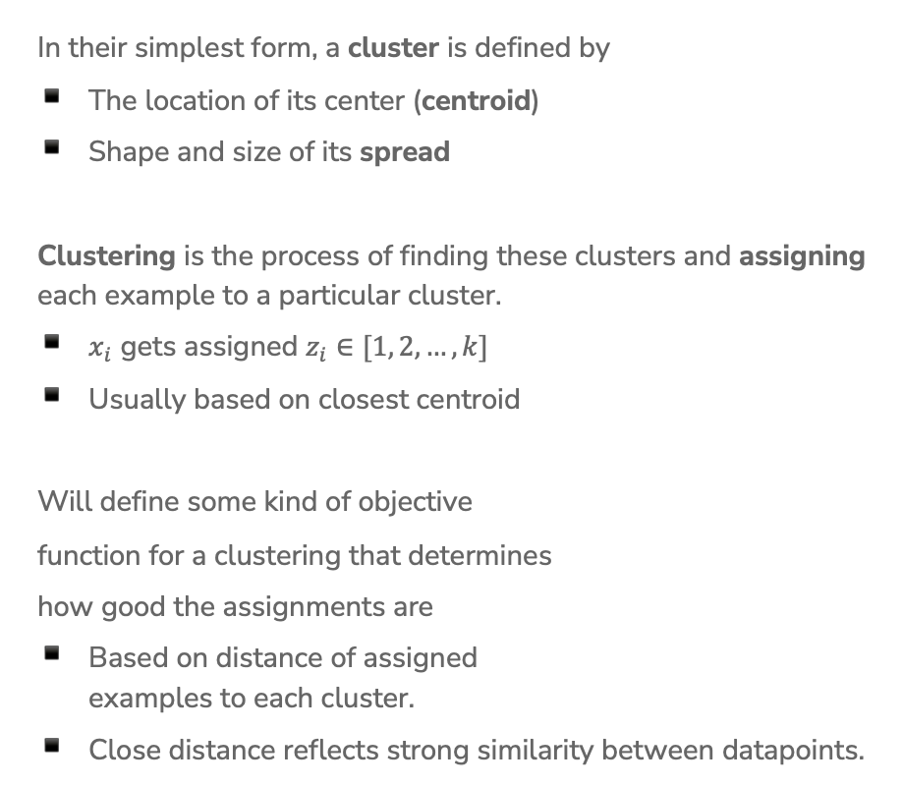
Define Clusters
In their simplest form, a cluster is defined by
The location of its center (centroid)
Shape and size of its spread
Clustering is the process of finding these clusters and assigning each example to a particular cluster.
$x_{i}$ gets assigned $z_{i}∈[1, 2, …,k]$
Usually based on closest centroid
Will define some kind of objective
function for a clustering that determines
how good the assignments are
Based on distance of assigned
examples to each cluster.
Close distance reflects strong similarity between datapoints.

Slide 6
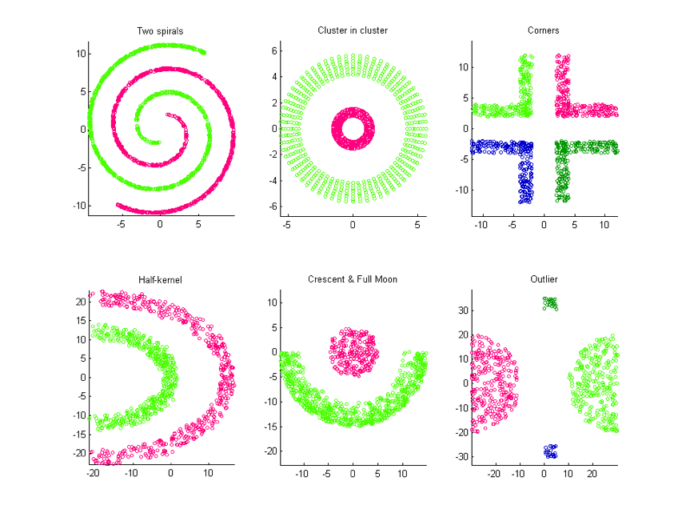
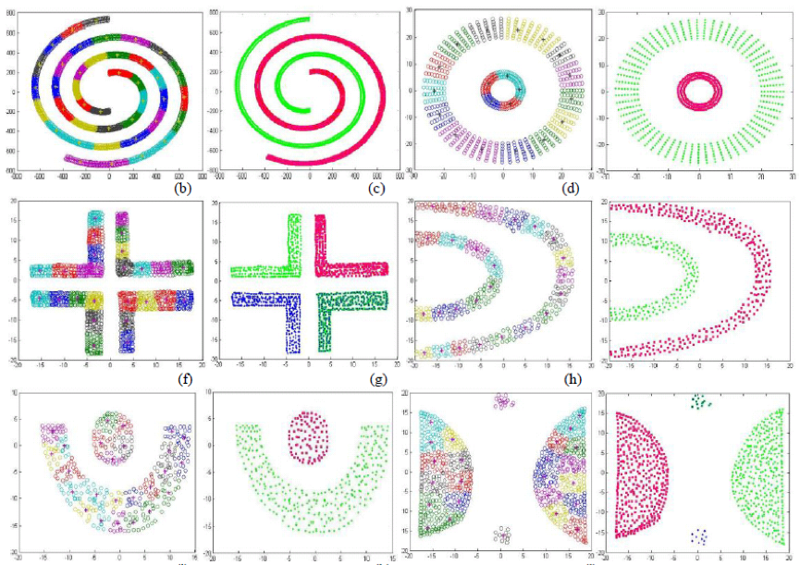
Not Always Easy
There are many clusters that are harder to learn with this setup
Distance does not determine clusters

Slide 7
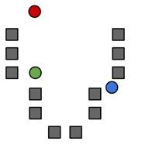




Step 0
Start by choosing the initial cluster centroids
A common default choice is to choose centroids $μ_{1},…,μ_{k}$ randomly
Will see later that there are smarter ways of initializing
$$μ_{2}$$
$$μ_{1}$$
$$μ_{3}$$

Slide 8
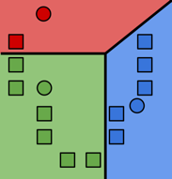

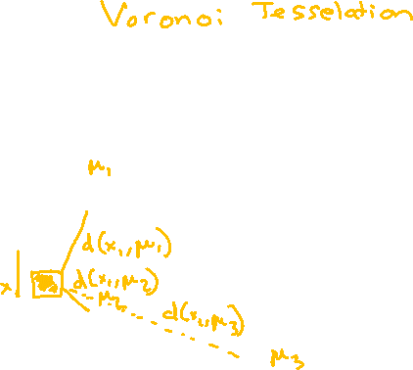

Step 1
Assign each example to its closest cluster centroid
For $i$= 1 to n
$$z_{i}←\underset{j∈[k]}{argmin}{{\left|\left|μ_{j}−x_{i}\right|\right|}_{2}^{2}}$$
Notes:
Draw the distance between green point and all centroids
Looks like a decision boundary, but is inferred without labels!
Write “Voronoi tessellation”

Slide 9
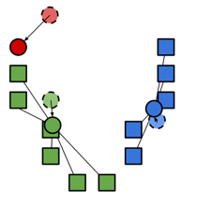
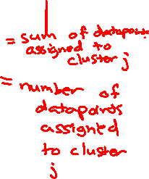

Step 2
Update the centroids to be the mean of points assigned to that cluster.
$$μ_{j}=\frac{\sum_{i=1}^{n}{1}\left\{z_{i}=j\right\}x_{i}}{\sum_{i=1}^{n}{1}\left\{z_{i}=j\right\}}$$
Computes center of mass for cluster!

Slide 10
Visualizing k-means
https://www.naftaliharris.com/blog/visualizing-k-means-clustering/

Slide 11
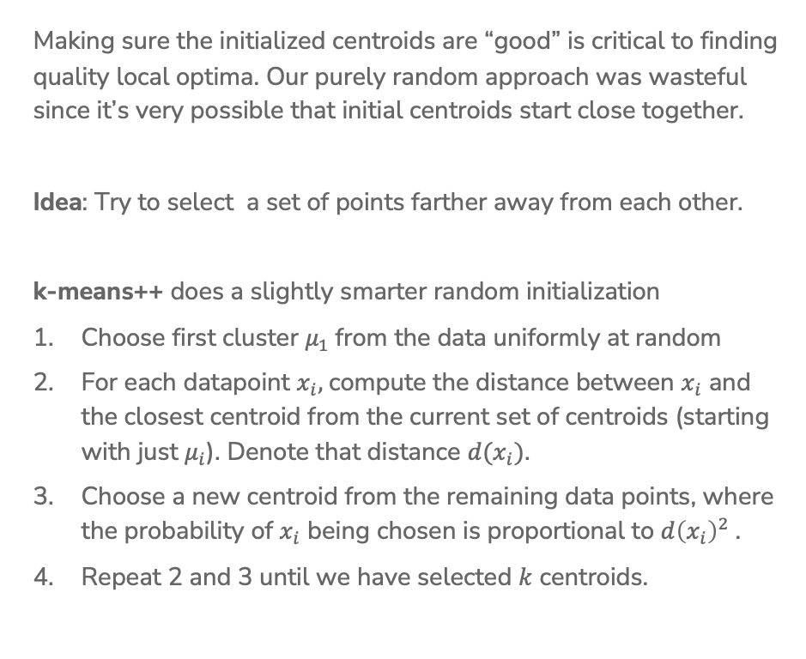
Smart Initializing w/ k-means++
Making sure the initialized centroids are “good” is critical to finding quality local optima. Our purely random approach was wasteful since it’s very possible that initial centroids start close together.
Idea: Try to select a set of points farther away from each other.
k-means++ does a slightly smarter random initialization
Choose first cluster $μ_{1}$from the data uniformly at random
For each datapoint $x_{i},$compute the distance between $x_{i}$ and the closest centroid from the current set of centroids (starting with just $μ_{i}$). Denote that distance $d(x_{i})$.
Choose a new centroid from the remaining data points, where the probability of $x_{i}$ being chosen is proportional to $d{\left(x_{i}\right)}^{2}$.
Repeat 2 and 3 until we have selected $k$ centroids.

Slide 12
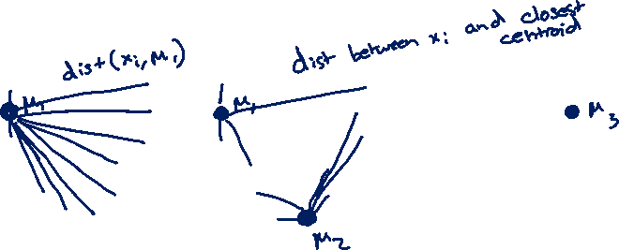
k-means++ Example
Start by picking a point at random
Then pick points proportional to their distances to their centroids
This tries to maximize the spread of the centroids!
Notes:
Pick Left Top middle
Pick bottom right
Pick top right

Slide 13
Clustering vs
Classification
Clustering looks like we assigned labels (by coloring or numbering different groups) but we didn’t use any labeled data.
In clustering, the “labels” don’t have meaning. To give meaning to the labels, human inputs is required
Classification learns from minimizing the error between a prediction and an actual label.
Clustering learns by minimizing the distance between points in a cluster.
Classification quality metrics (accuracy / loss) do not apply to clustering (since there is no label).
You can’t use validation set / cross-validation to choose the best choice of k for clustering.

Slide 14
Problems with k-means & Mixture Models

Slide 15
Problems with k-means
In real life, cluster assignments are not always clear cut
E.g. The moon landing: Science? World News? Conspiracy?
Because we minimize Euclidean distance, k-means assumes all the clusters are spherical
We can change this with weighted Euclidean distance
Still assumes every cluster is the same shape/orientation

Slide 16
Failure Modes of k-means
If we don’t meet the assumption of spherical clusters, we will get unexpected results
Notes:
WOS:
Soft clustering: allow overlap
Hard clustering: no overlap

Slide 17
Mixture Models
A much more flexible approach is clustering with a mixture model
Model each cluster as a different probability distribution and learn their parameters
One example is Gaussian Mixture Models
Allows for different cluster shapes and sizes
Typically learned using Expectation Maximization (EM) algorithm
Allows soft assignments to clusters
Example: A news article: 54% chance is about world news, 45% science, 1% conspiracy theory, 0% other

Slide 18
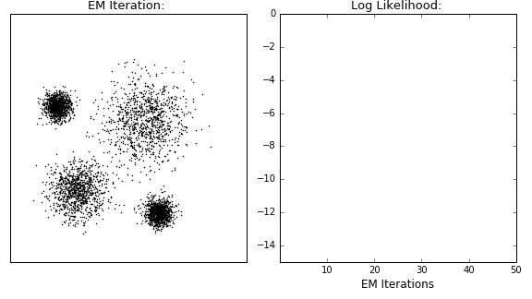
Visualizing Gaussian Mixture Models
Notes:
WOS: MLE

Slide 19
Hierarchical Clustering

Slide 20
Nouns
Lots of data is hierarchical by nature
https://www.techleer.com/articles/478-insight-into-hierarchical-representations-through-poincare-embedding/

Slide 21
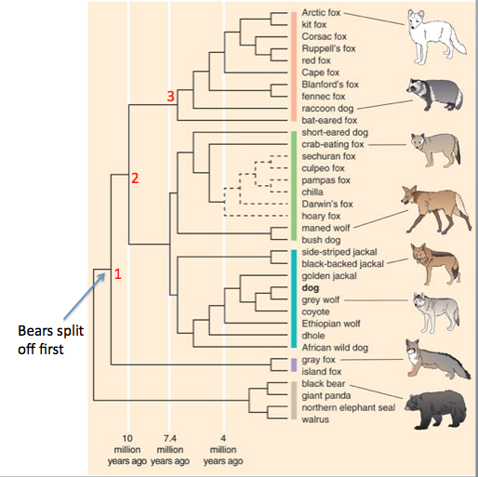
Species
https://www.instituteofcaninebiology.org/how-to-read-a-dendrogram.html

Slide 22
Motivation
If we try to learn clusters in hierarchies, we can
Avoid choosing the # of clusters beforehand
Use dendrograms to help visualize different granularities of clusters
Allow us to use any distance metric
  K-means requires Euclidean distance
Can often find more complex shapes than k-means
Notes:
It turns out that with some other distance functions, k-means may not converge. This reliance on Euclidean distance is also tied up with the heterogeneity bjective, which measures the within-cluster variance. https://stats.stackexchange.com/a/81496

Slide 23
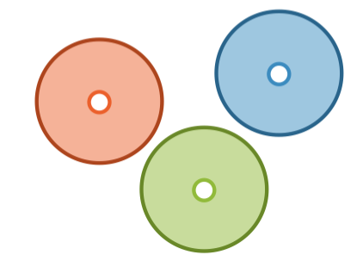
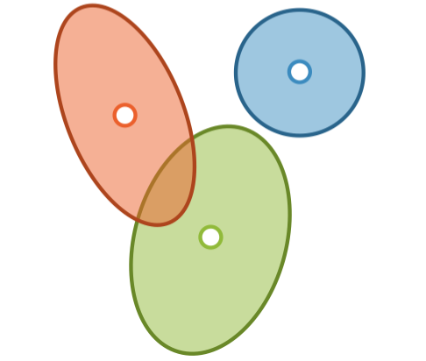
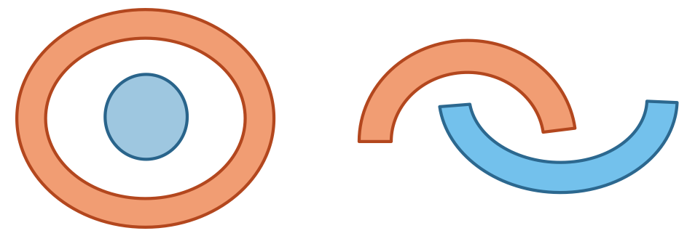
Finding Shapes
k-means
Mixture Models
Hierarchical Clustering
Notes:
Mutually exclusive spherical clusters can be found by both mixture models and hierarchical clustering.

Slide 24
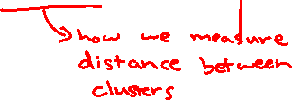
Types of Algorithms
Divisive, a.k.a. top-down
Start with all the data in one big cluster and then recursively split the data into smaller clusters
  Example: recursive k-means
Agglomerative, a.k.a. bottom-up:
Start with each data point in its own cluster. Merge clusters until all points are in one big cluster.
  Example: single linkage clustering

Slide 25
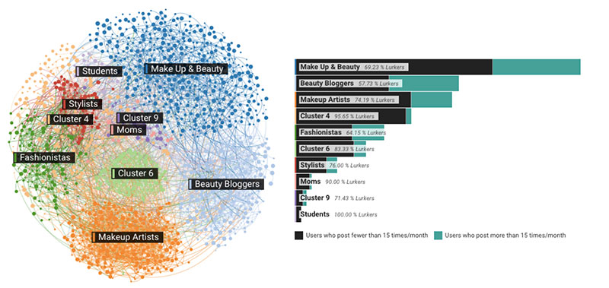
1 min
Think of a clustering problem, ideally one we have not discussed in class. For that clustering problem, think:
  Would you use hard clustering or soft clustering?
  Which clustering algorithm might you use, and why?
  What clusters do you think might arise?
Notes:
Image source: https://www.metamaven.com/14-ways-machine-learning-can-boost-marketing/loreal_cluster_800px_web/

Slide 26
2 mins
Think of a clustering problem ideally one we have not discussed in class. For that clustering problem, think:
  Would you use hard clustering or soft clustering?
  Which clustering algorithm might you use, and why?
  What clusters do you think might arise?
Notes:
Image source: https://www.metamaven.com/14-ways-machine-learning-can-boost-marketing/loreal_cluster_800px_web/

Slide 27
Divisive Clustering

Slide 28
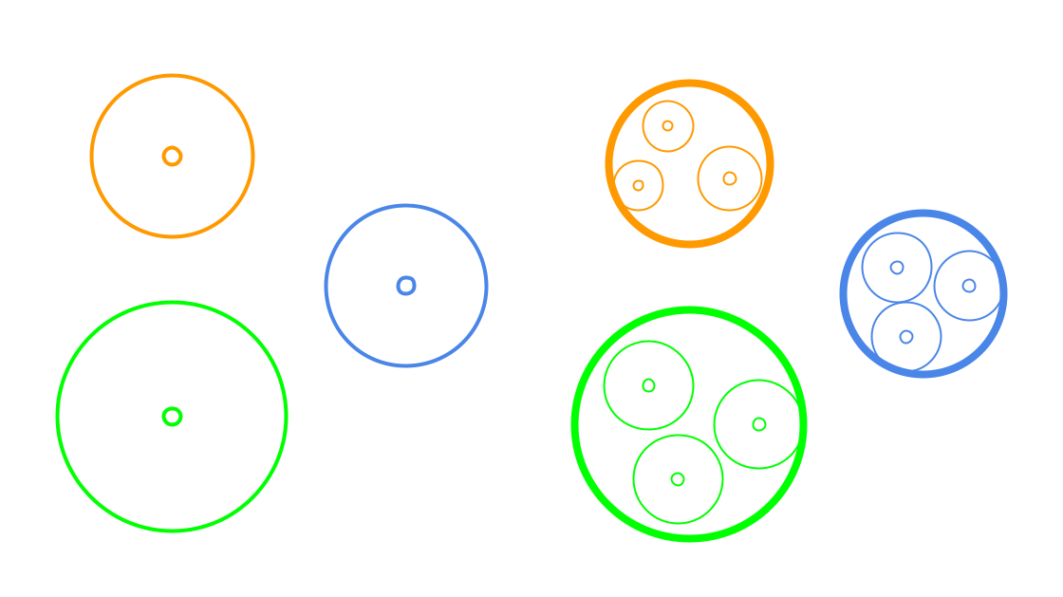
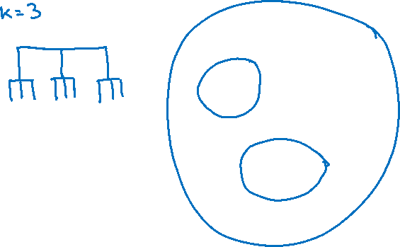
Divisive Clustering
Start with all the data in one cluster, and then repeatedly run k-means to divide the data into smaller clusters. Repeatedly run k-means on each cluster to make sub-clusters.

Slide 29

Example
Using Wikipedia

Slide 30
Choices to Make
For divisive clustering, you need to make the following choices:
Which algorithm to use (e.g., k-means)
How many clusters per split
When to split vs when to stop
  Max cluster size
  Number of points in cluster falls below threshold
  Max cluster radius
  distance to furthest point falls below threshold
  Specified # of clusters
  split until pre-specified # of clusters is reached

Slide 31
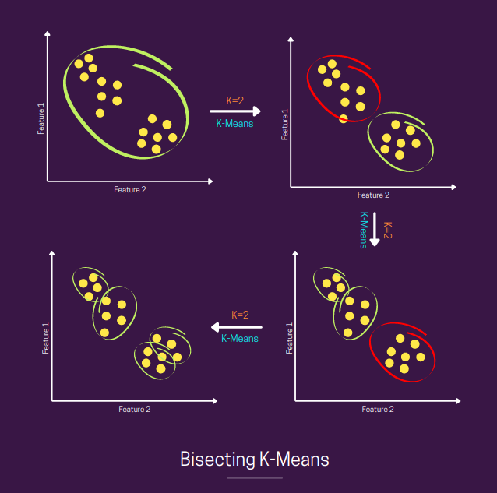
Bisecting K-Means
Notes:
Source: https://towardsdatascience.com/bisecting-k-means-algorithm-clustering-in-machine-learning-1bd32be71c1c

Slide 32
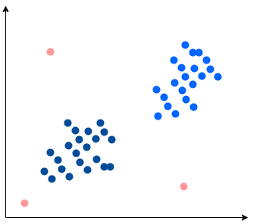
1 min
You want to detect outliers in a dataset (shown below).
  How would you use k-means clustering to detect outliers?
  How would you use divisive clustering to detect outliers?
Notes:
Picture Source: https://www.baeldung.com/cs/ml-outlier-detection-handling

Slide 33
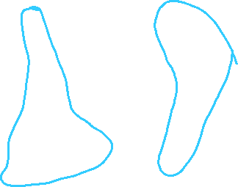

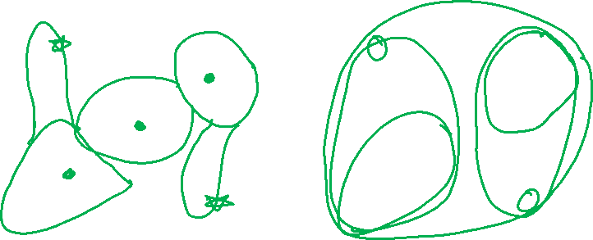
2 min
You want to detect outliers in a dataset (shown below).
  How would you use k-means clustering to detect outliers?
  How would you use divisive clustering to detect outliers?
Notes:
K-means:
For each cluster, find the points that are the farthest away from the centroids. Call them outliers.
Divisive:
Find the points that split off of a big cluster early on, call them outliers.

Slide 34
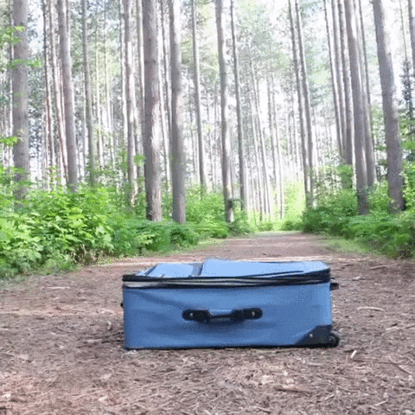

Slide 35
Agglomerative Clustering

Slide 36
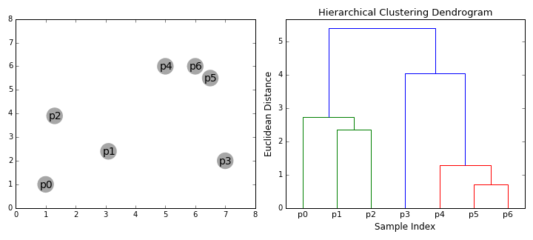
Agglomerative Clustering

Slide 37

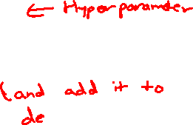
Agglomerative Clustering
Algorithm at a glance
Initialize each point in its own cluster
Define a distance metric between clusters
While there is more than one cluster
  Merge the two closest clusters
Notes:
WOS:
N points => n clusters

Slide 38

Step 1

Slide 39
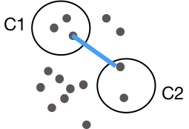


Step 2
2. Define a distance metric between clusters
This formula means we are defining the distance between two clusters as the smallest distance between any pair of points between the clusters.
Single Linkage
$$distance\left(C^{(1)},C^{(2)}\right)=\min_{x^{(i)}∈C^{(1)},x^{(j)}∈C^{(2)}}{d\left(x^{(i)},x^{(j)}\right)}$$
Notes:
Write box around min stuff to label “linkage criterion”
Draw arrow to d to point out “specified distance function”

Slide 40

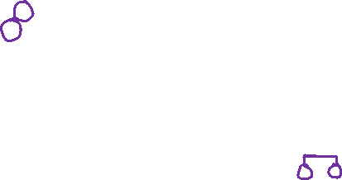
Step 3
Merge closest pair of clusters
Notes:
WOS:
Try all pairs of clusters
Evaluate cluster distance
Min_{x_i\in c_1, x_j\in d_2} dist(x_i, x_j)
Merge closest clusters

Slide 41
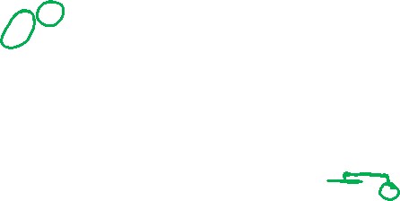
Repeat

Slide 42

Repeat
Notice that the height of the dendrogram is growing as we group points farther from each other

Slide 43
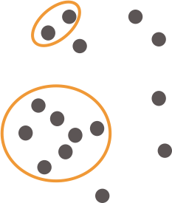

Repeat

Slide 44
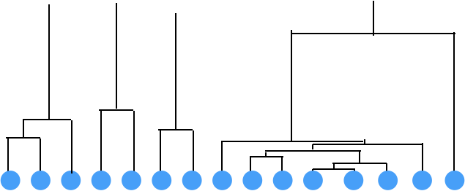
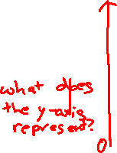
Repeat
Looking at the dendrogram, we can see there is a bit of an outlier!
Can tell by seeing a point join a
cluster with a really large distance.
Notes:
WOS:
Distance between merged clusters

Slide 45
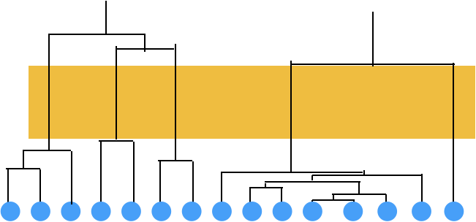
Repeat
The tall links in the dendrogram show us we are merging clusters that are far away from each other

Slide 46
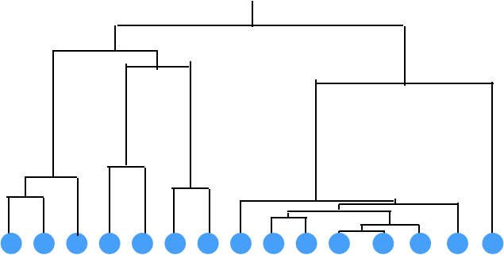

Repeat
Final result after merging all clusters

Slide 47
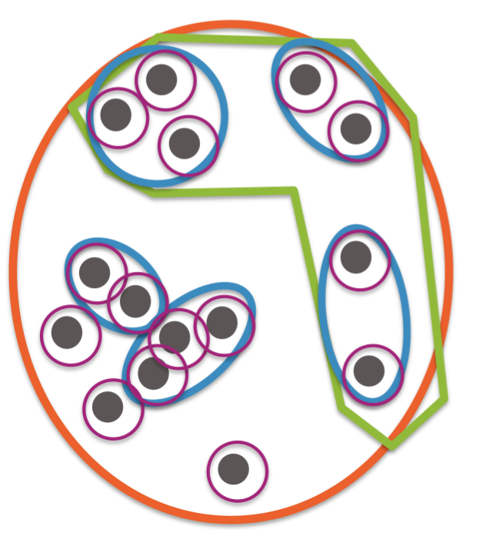
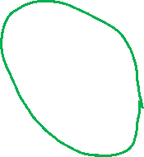
Final Result

Slide 48
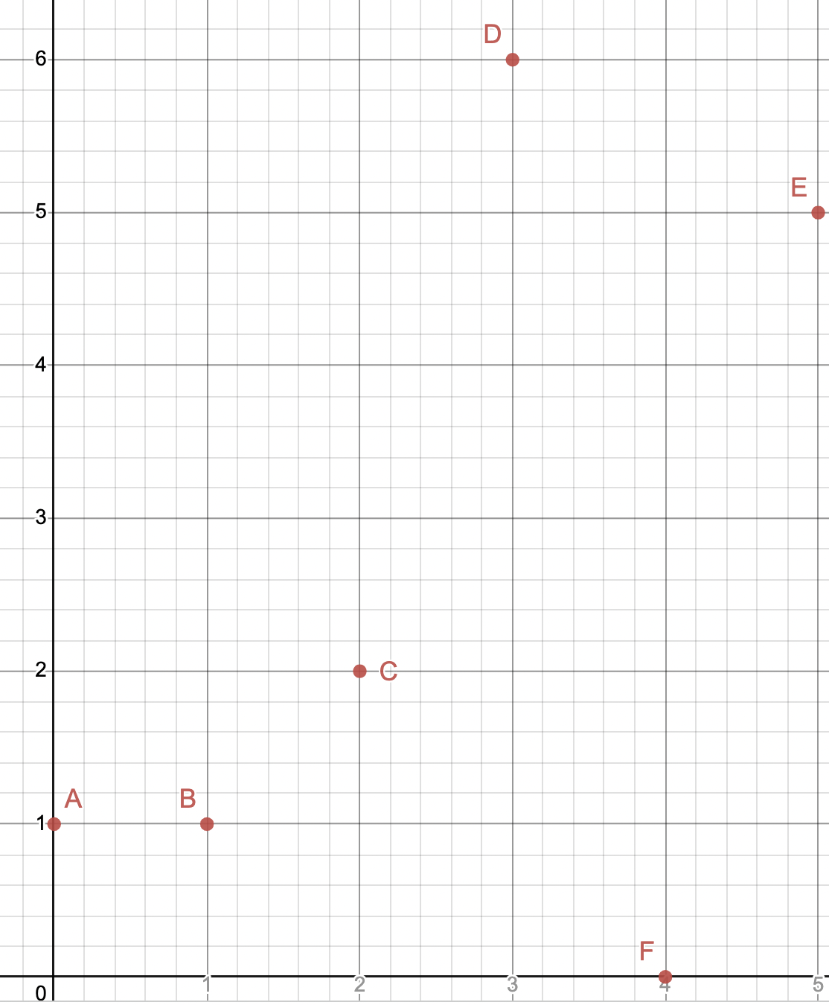
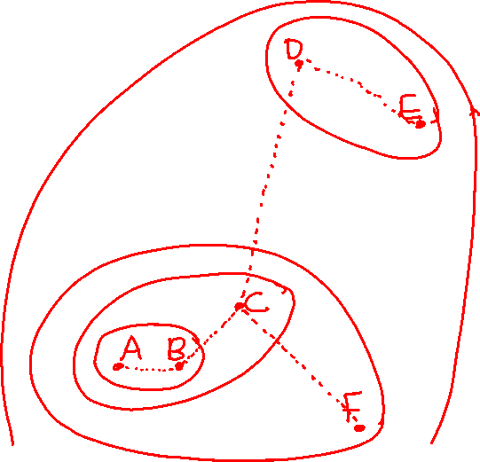
1 min
In what order will the following points get merged into clusters? Use L2 (Euclidean) distance, and the single linkage function.

Slide 49
2 min
In what order will the following points get merged into clusters? Use L2 (Euclidean) distance, and the single linkage function.

Slide 50
Dendrograms

Slide 51
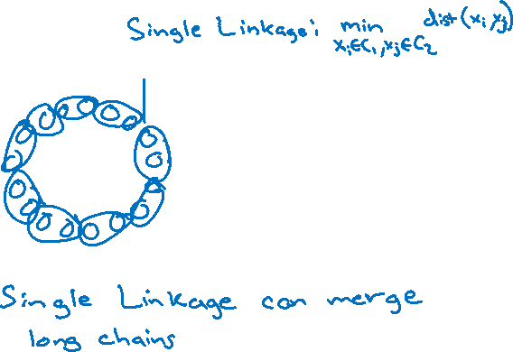
Agglomerative Clustering
With agglomerative clustering, we are now very able to learn weirder clusterings like
Notes:
Draw small clusters that single linkeabe would merge

Slide 52
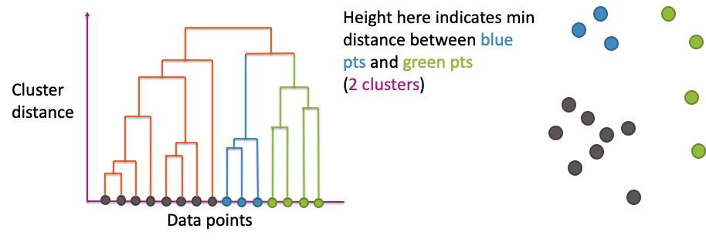
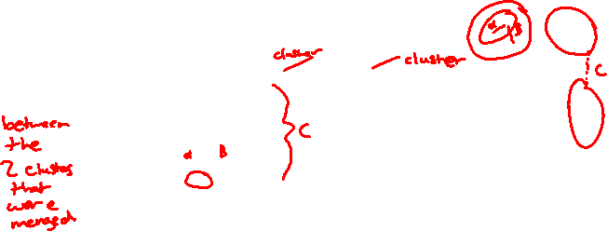
Dendrogram
x-axis shows the datapoints (arranged in a very particular order)
y-axis shows distance between pairs of clusters
Notes:
WOS:
Show alpha (merging 2 blues), b (merging next blue), and d (merging pairs of green)

Slide 53
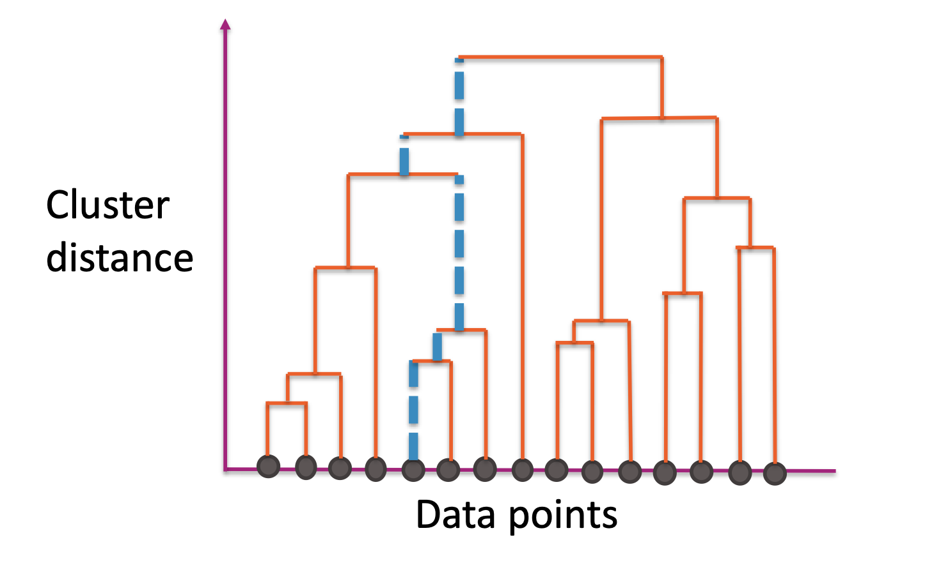
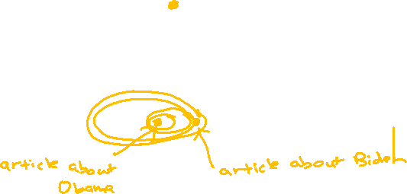
Dendrogram
The path shows you all clusters that a single point belongs and the order in which its clusters merged
Notes:
WOS: Draw the clusters that these points belong to
Given two points, you can find where in the dendogram they merged together

Slide 54
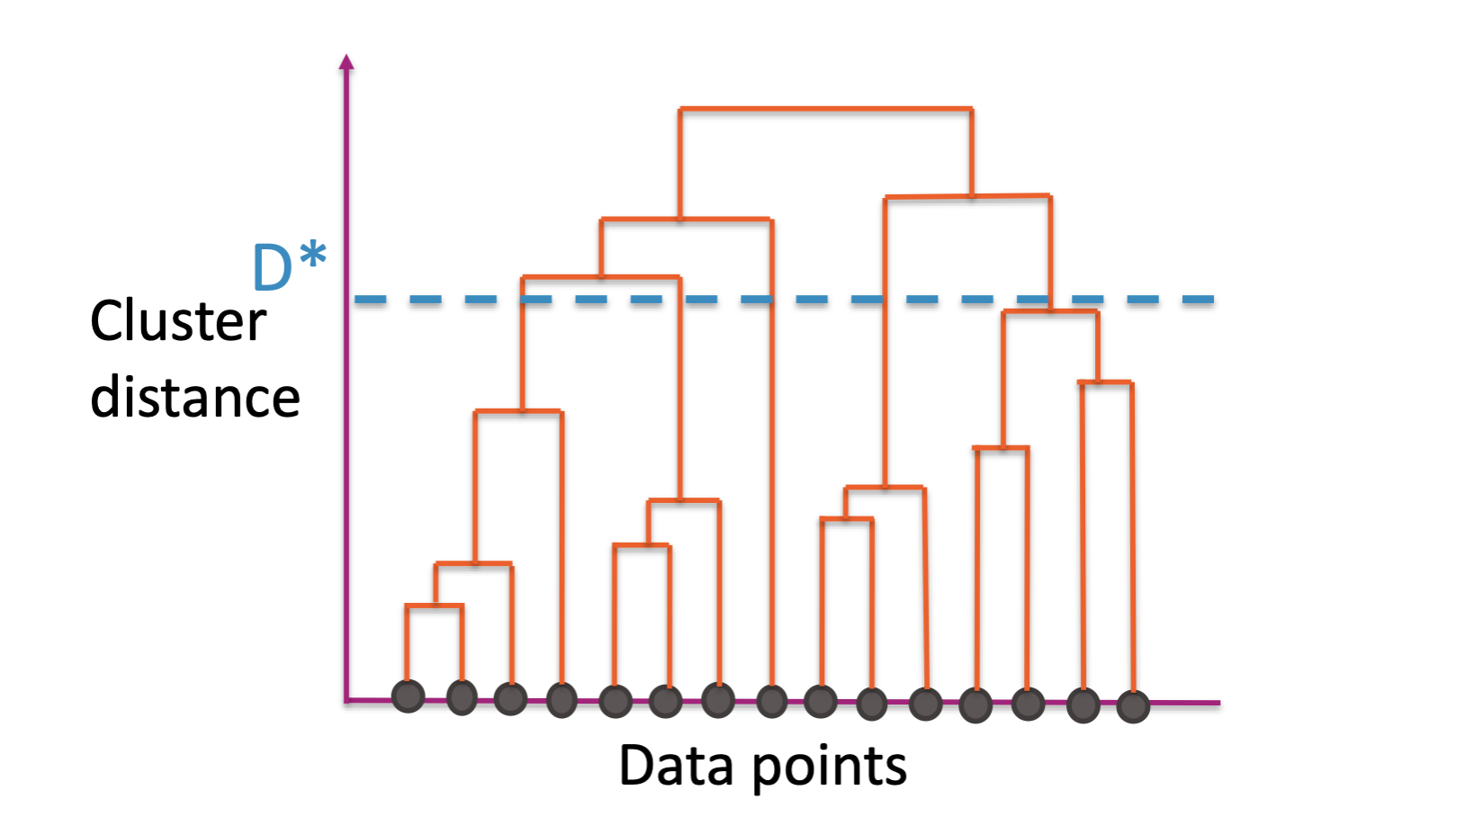

Cut Dendrogram
Choose a distance $D^{∗}$ to “cut” the dendrogram
Use the largest clusters with distance < $D^{∗}$
Usually ignore the idea of the nested clusters after cutting

Slide 55

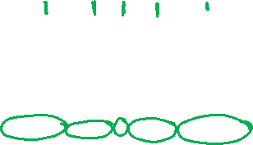
1 min
How many clusters would we have if we use this threshold?

Slide 56

2 min
How many clusters would we have if we use this threshold?

Slide 57



Cut Dendrogram
Every branch that crosses $D^{∗}$ becomes its own cluster
Notes:
Hide this slide when printing

Slide 58

Choices to Make
For agglomerative clustering, you need to make the following choices:
Distance metric $d\left(x_{i}, x_{j}\right)$
Linkage function
  Single Linkage:
  $\min_{x_{i}∈C_{1},x_{j}∈C_{2}}{d\left(x_{i}, x_{j}\right)}$
  Complete Linkage:
  $\max_{x_{i}∈C_{1},x_{j}∈C_{2}}{d\left(x_{i}, x_{j}\right)}$
  Centroid Linkage
  $d(μ_{1},μ_{2})$
  Others
Where and how to cut dendrogram

Slide 59

Linkage Functions

Slide 60
Practical Notes
For visualization, generally a smaller # of clusters is better
For tasks like outlier detection, cut based on:
Distance threshold
Or some other metric that tries to measure how big the distance increased after a merge
No matter what metric or what threshold you use, no method is “incorrect”. Some are just more useful than others.

Slide 61


Computational Cost of Agglomerative
Clustering
Computing all pairs of distances is pretty expensive!
A simple implementation takes $𝒪(n^{2}\log\left(n\right))$
Can be much implemented more cleverly by taking advantage of the triangle inequality
“Any side of a triangle must be less than the sum of its sides”
Best known algorithm is $𝒪\left(n^{2}\right)$
Notes:
WOS:
N points => n(n-1)/2 ~ n^2 pairs of points
Draw triangle, C < A+B

Slide 62
k-means vs. Agglomerative
Clustering
K-means is more efficient on big data than hierarchical clustering.
Initialization changes results in k-means, not in agglomerative clustering has reproducible results.
K-means works well only for hyper-spherical clusters, agglomerative clustering can handle more complex cluster shapes.
K-means requires selecting a number of clusters beforehand. In agglomerative clustering, you can decide on the number of clusters afterwards using the dendrogram.
Notes:
K-means is O(nkI), heirarchiccal is O(n^2)

Slide 63


Curse of Dimensionality

Slide 64


High Dimensions
Methods like k-NN and k-means that rely on computing distances start to struggle in high dimensions.
As the number of dimensions grow, the data gets sparser!
Need more data to make sure you cover all the space in high dim.
Notes:
To cover 20% of the range, need 20% of the complete population
If we add another feature but still want to cover 20% of the possible space, would need 45% coverage for each feature! (0.45^2 = 0.2)
In 3 dimensions, would need coverage over 58% of each feature
Write down that n approx. O(2^d)

Slide 65




Data Moves Farther Apart in Higher Dimensions
It’s believable with more dimensions the data becomes more sparse, but what’s even weirder is the sparsity is not uniform!
As $D$ increases, the “mass” of the space goes towards the corners.
Most of the points aren’t in the center.
The distance between points gets really high!
Notes:
For an 8-dimensional hypercube, about 98% of the data is concentrated in its 256 corners.

Slide 66



Practicalities
Have to pay attention to the number of dimensions with distance-based methods (k-means clustering, also k nearest neighbors).
Very tricky if $n<D$
Can run into some strange results if $D$ is very large
Later, we will talk about ways of trying to do dimensionality reduction in order to reduce the number of dimensions here.

Slide 67
Concept Inventory
This week we want to practice recalling vocabulary. Spend 10 minutes trying to write down all the terms for concepts we have learned in this class and try to bucket them into the following categories.
Regression
Classification
Document Retrieval
Misc – For things that fit in multiple places or none of the above
You don’t need to define/explain the terms for this exercise, but you should know what they are!
Try to do this for at least 5 minutes from recall before looking at your notes!

Slide 68
Recap
Problems with k-means
Mixture Models
Hierarchical clustering
Divisive Clustering
Agglomerative Clustering
Dendrograms

Slide 69
Activity: Promoting Fairness in Machine Learning Models

Slide 70
Ways to Promote Ethical Machine Learning
Notes:
In our last activity, we got a deep understanding of the biases that can come into every step of the ML pipeline, and many of you were left with the question of what we can do about this. In this activity, we'll come up with some ideas for solutions.

Slide 71
IBM abandons facial recognition
In the aftermath of killing of George Floyd, IBM decided to abandon its facial recognition for surveillance and profiling
IBM recognized that its software is biased and hence a hindrance in fight against racism.
We might not have technological solutions – sometimes, not creating a technology is the best route.
https://www.bbc.com/news/technology-52978191
Notes:
"One approach is just not developing the technology at all."

Slide 72

Education
Many top tech companies have made guidelines for Responsible AI practices.
These are prescribed to the AI teams and their engineers
These practices are (hopefully) utilized when developing their current and future products.
Notes:
Another approach is to educate your software developers.

Slide 73


Inclusive Datasets
In 2018, Google organized the inclusive dataset competition.
They released a 500K image dataset that had datapoints across the world.
Notes:
Another approach is diversifying the datasets you're using to train the ML models

Slide 74

Fairness Definitions
“Fairness through Unawareness”
  To avoid unfair decisions, prevent the model from every looking at protected attribute (e.g., race, gender).
  Doesn’t work in practice
Statistical Parity
  Idea: Equal performance across groups.
    $$\operatorname{Pr}\left(\hat{Y}= +| A=\text{∎}\right)=\operatorname{Pr}\left(\hat{Y}= +| A=\text{◯}\right)$$
  Also phrased as matching demographic statistics (e.g., if 33% of population are Circles, 33% of those admitted should be Circles).
Equal Opportunity
  Idea: True positive rate should be equal across groups
    $$\operatorname{Pr}\left(\hat{Y}= +| A=∎, Y=+\right)=Pr\left(\hat{Y}= +| A=\text{◯}, Y=+\right)$$
Notes:
Another approach is to change the model training procedure to itself be more fair. However, in order to do that we need some mathematical definition of fairness.
Definition 1: Shape Blind:
This does not prevent historical or measurement bias. Protected attributes can be unintentionally inferred from other, related attributes (e.g., in some cities, zip code can be deeply correlated with race).
Definition 2: Statistical Parity:
Pros:
Aligns with certain legal definitions of equity.
Cons:
A rather weak in fairness requirements. Allows for strategies that might not be desirable (e.g., random selection, self-fulfilling prophecy)
Definition 3: Equal Opportunity:
Pros:
Better controls for true outcome
Cons:
More complex to explain to non-experts
Only protects for the positive outcome
Note: Equality of true positives is the same as equality of false negatives

Slide 75


Facebook Ads
Facebook gave in to the allegations and agreed to take steps:
  Advertisers cannot target ads based on users’ age, gender, race, or zip code, and other membership categories.
    ^^ Fairness through Unawareness
  Require all advertisers to certify compliance with anti-discrimination laws.
  Meet with ACLU members every 6 months for 3 years to enable them to monitor the reforms Facebook is undertaking.
https://www.technologyreview.com/2019/03/20/1225/facebook-is-going-to-stop-letting-advertisers-target-by-race-gender-or-age/
Notes:
Facebook has begun using the fairness through unawareness approach to preventing discrimination through ads

Slide 76


Linkedin Ranking
Linkedin used fairness constraints (equal opportunity and statistical parity) to rank candidates.
Online A/B testing resulted in three-fold increase in fairness metrics while not affecting the business metrics.
Notes:
Linkedin incorporated fairness metrics -- both equal opportunity and statistical parity -- in their ranking algorithm

Slide 77

Regulations
EU has been championing the law landscape of AI regulation
GDPR enacted in 2018 requires companies to ask consent for use of personal data and several other regulations.
US has regulations on equal credit, housing, and job opportunities. But has lot of loopholes. It’s catching up!
Notes:
Yet another way to promote ethical ML is government regulations.

Slide 78

Brainstorming Ways to Address Bias:
Case Studies
Notes:
Now, we will think about what solutions we'd want to apply in 3 different case studies

Slide 79
Task
In groups of 2-3, do the following for each case study (Suggested time: 5 minutes per):
Read through the goal, data, analysis, action, and constraints.
Note what biases that might come up in the scenario.
Propose solutions that would solve or mitigate the biases.

Slide 80
Case Study 1: Student Support Programs
Goal: Improve graduation rates for students
Data: Student records from different school districts and states, National Student Clearinghouse data (which gives us information about college outcomes)
Analysis: Predict risk of not graduating on time
Actions: Assign after-school programs to most at-risk students
Constraints: Resources are available to target additional tutoring to 10% of students

Slide 81
Case Study 2: Loans
Goal: Provide loans while balancing repayment rates for bank loans
Data: Historical loans and payments, credit reporting data, background checks
Analysis: Build model to predict risk of not repaying on time
Actions: Deny loan or increase interest rate/penalties

Slide 82
Case Study 3: Disaster Relief
Goal: Accurately assess damage and send appropriate relief resources
Data: Twitter posts, Facebook posts geocoded with lat-long within disaster area and keywords/hashtags related to the storm
Analysis: Intensity and type of damage by neighborhood
Actions: Assessment and allocate relief effort (type and amount)
Constraints: Limited resources for relief efforts

Slide 83
Recap
Theme: Thinking about solutions for bias and how to encourage ethical machine learning
Approaches towards mitigating bias:
Not developing the technology
Educate software engineers
Using inclusive datasets
Applying fairness definitions
  Fairness through Unawareness
  Statistical Parity
  Equal Opportunity

