Slide 1
CSE/STAT 416 Bias and Fairness in ML Pemi Nguyen Paul G. Allen School of Computer Science & Engineering University of Washington Slides by Hunter Schafer Images were from MIT course 6.S191: AI Bias and Fairness lecture (2021) April 25, 2022

Slide 2
Class Logistics

Slide 3
Class logistics
Information regarding week 5 and week 6 logistics has been posted on Ed. Please make sure you check it out

Slide 4
ML and Society

Slide 5
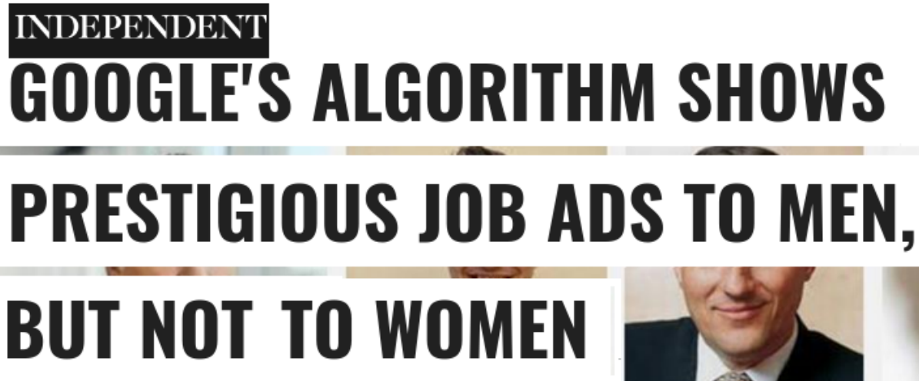
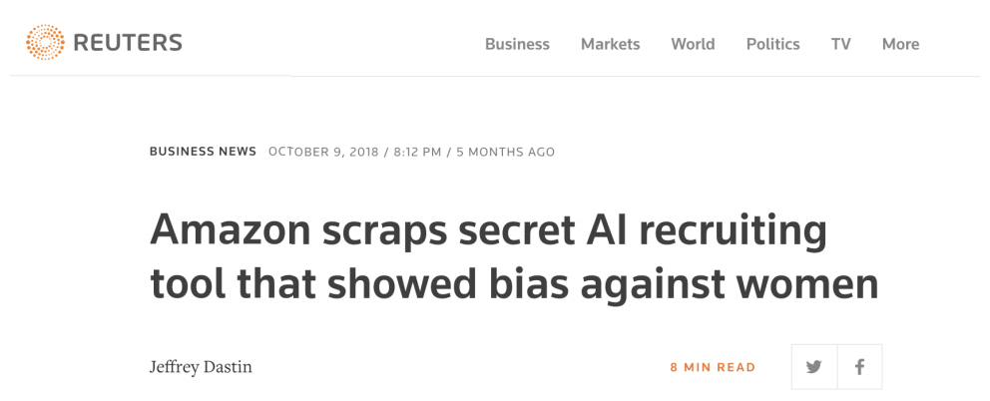
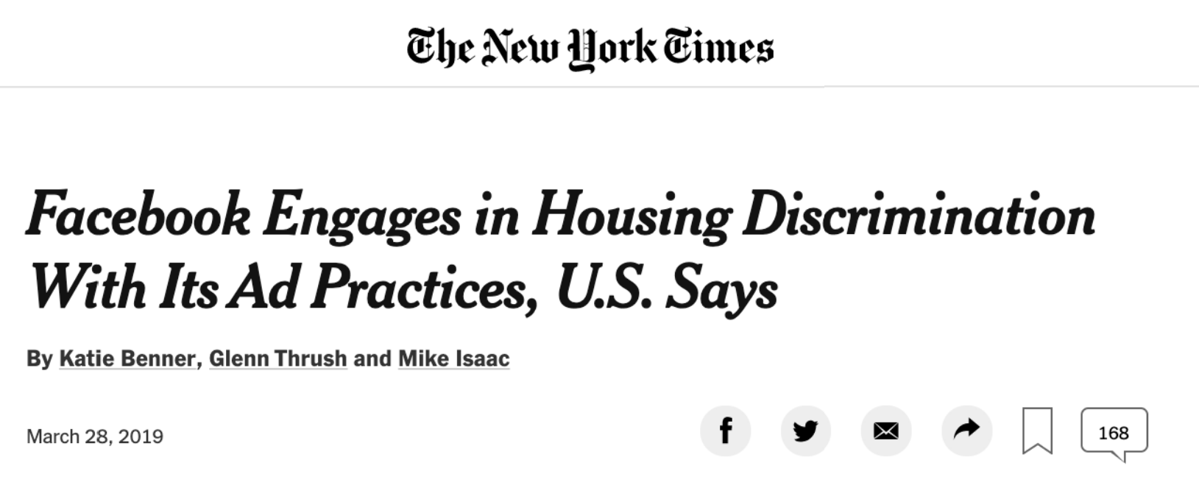
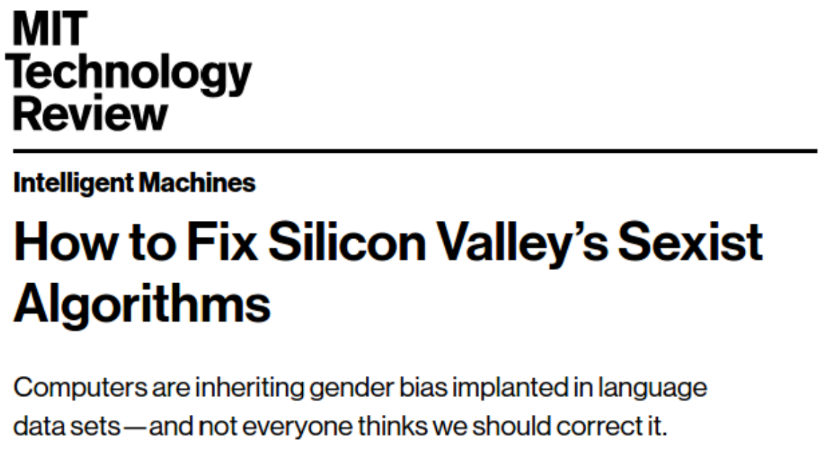
ML Systems Gone Wrong

Slide 6
Examples of Biases

Slide 7
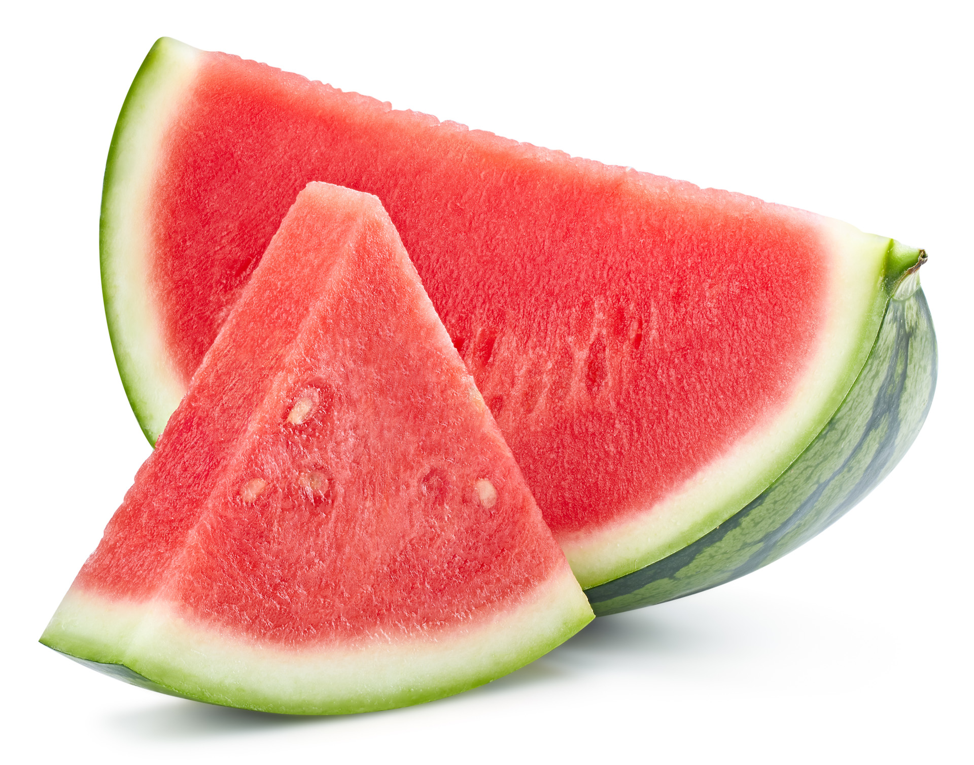
What is in this image?

Slide 8
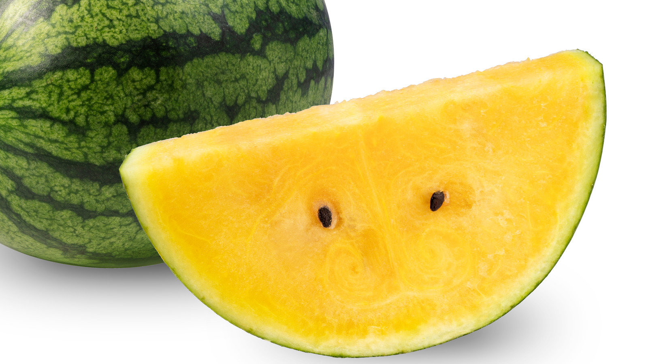
What about this one?

Slide 9
Humans have biases
We don’t call a red watermelon “red watermelon”, because we’re exposed to it frequently, and it’s a typical representation ingrained in our mind. However, ”yellow watermelon” is not as common.
Humans have the tendency to label and categorize complex sensory inputs into simplified groups, and pay attention to atypical things. Biases and stereotypes arise when we are confronted by confounding choices.

Slide 10
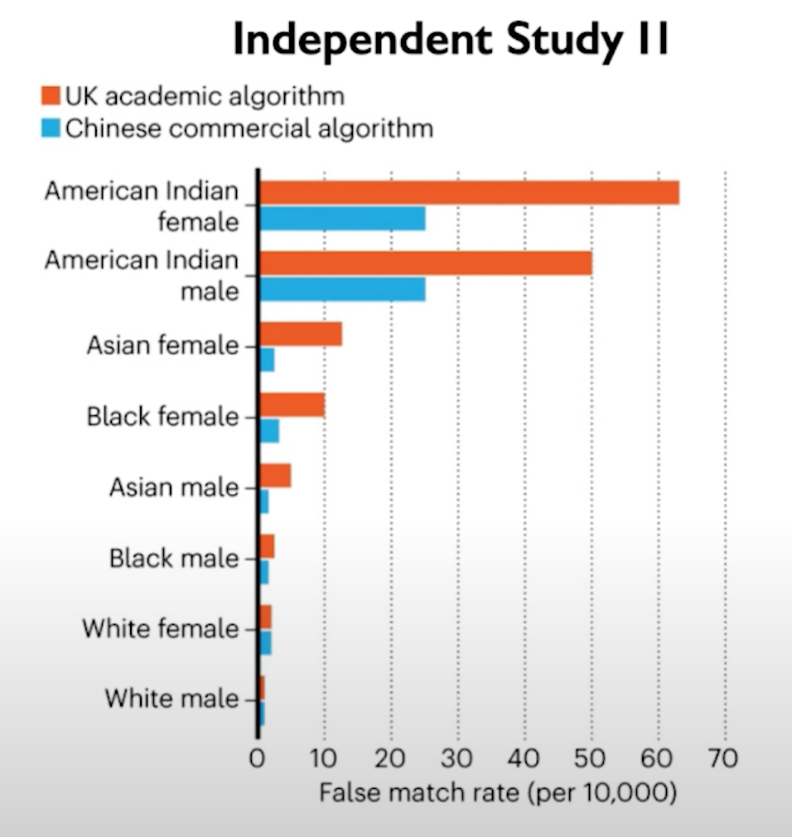
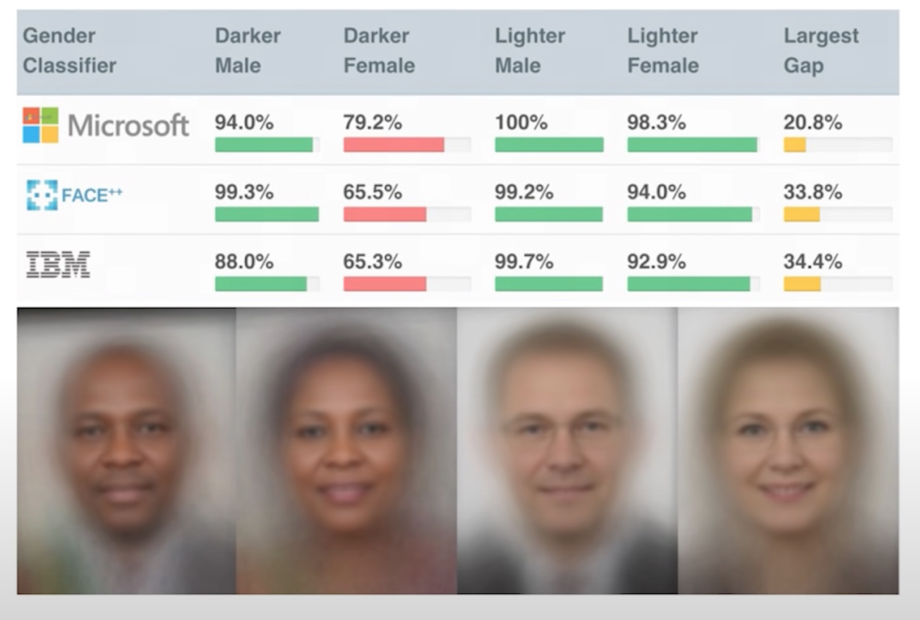
Example: Bias in Facial detection

Slide 11
Example: Bias in Image Classification
Pictures of a bride from a state-of-the-art image classifier
Predicted classes: Brides, dress, ceremony
Predicted classes: Clothing, event, costume

Slide 12
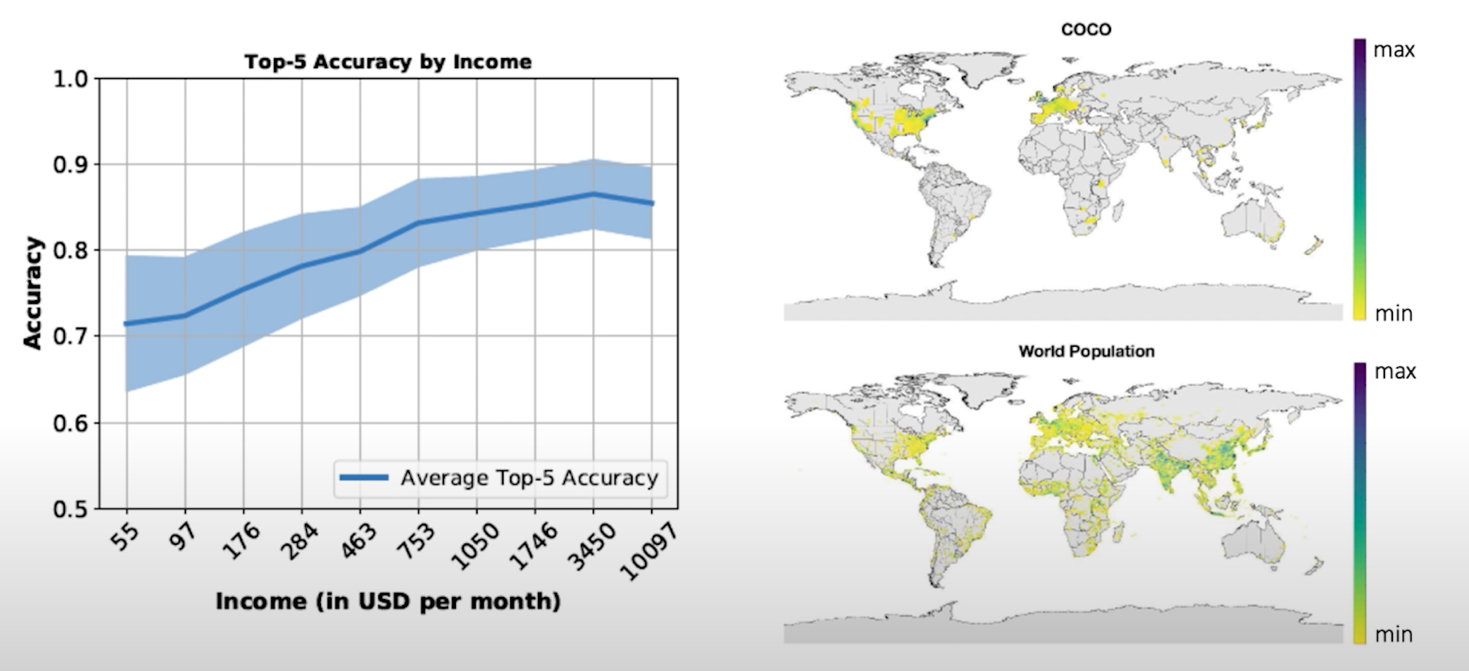
Bias correlation with income and geography

Slide 13
Bias from historical data
The world we lived in is one that contains biases for/against certain demographics. Even ‘accurate’ data could still be harmful.
Historical bias exists even with perfect sampling or feature measurement (other sources of bias are possible)!
Examples:
In 2018, 5% of Fortune 500 CEOs were women. Should search results for “CEO” match this statistic? Could reflecting the world (even if accurately) perpetuate more harm?

Slide 14
Bias in all stages in the ML pipeline
Data: Class imbalance from training datasets, data doesn’t reflect true distribution
Model: Biased, unclear quality metrics, lack of interpretability
Training and deployment: Feedback loops that further perpetuate biases
Evaluation: Lack of careful analysis of the subgroups
Interpretation: Human errors and biased perspectives that can affect results

Slide 15
Common Biases
Data-driven biases
Selection Bias: Data doesn’t reflection randomization
Sampling Bias: Examples of certain features are sampled more than others
Interpretation-driven biases
Correlation Fallacy (Correlation != Causation)
Evaluation bias (Data in the real world is much different from limited training data)
Measurement bias

Slide 16
Correlation Fallacy

Slide 17
Evaluation bias

Slide 18
Evaluation Bias
If the evaluation dataset or benchmark doesn’t represent the world well, we have evaluation bias.
Benchmarks are common datasets used to evaluate models from different researchers.
Examples:
If it is common to report accuracy on a benchmark, this might hide disparate performance on subgroups.
Drastically worse performance for facial recognition software when used on faces of darker-skinned females. Common evaluation datasets for facial recognition only had 5-7% had faces of darker-skinned women.

Slide 19
Evaluation Bias

Slide 20
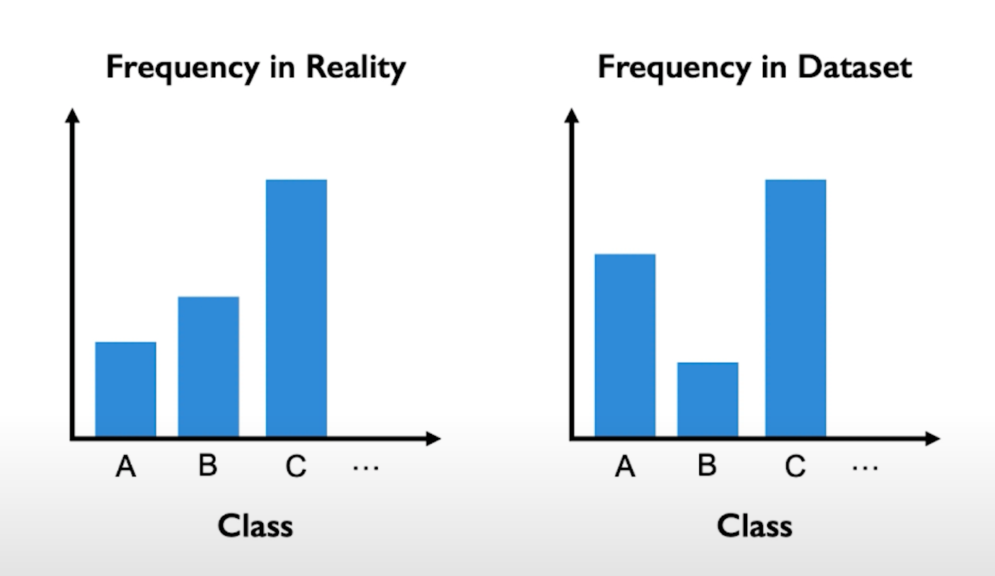
Bias due to class imbalance
Class imbalance will lead proportions of test accuracies in each class in the test set close to these of train accuracies
However, we want proportions of test accuracies in each class in the test set to be equal

Slide 21
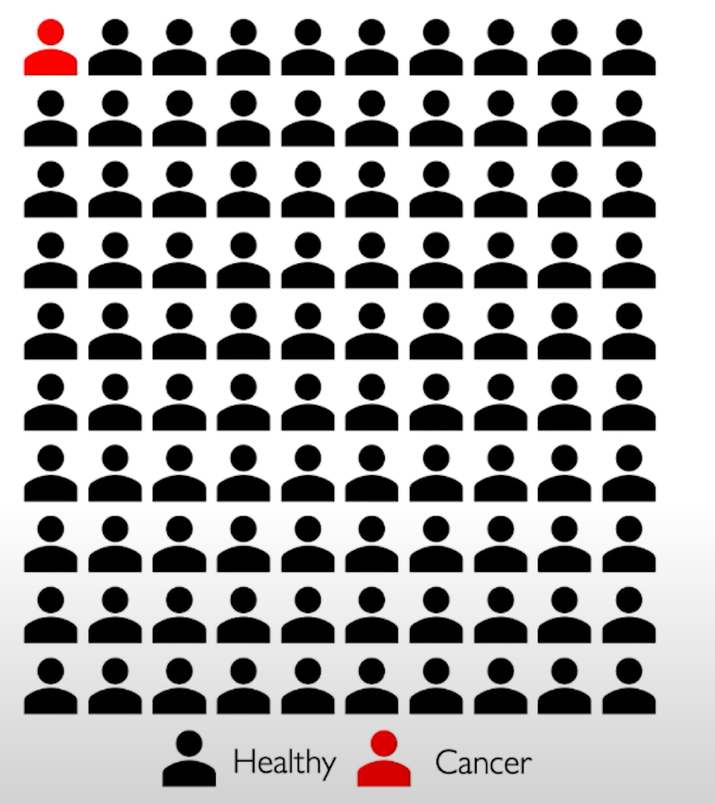
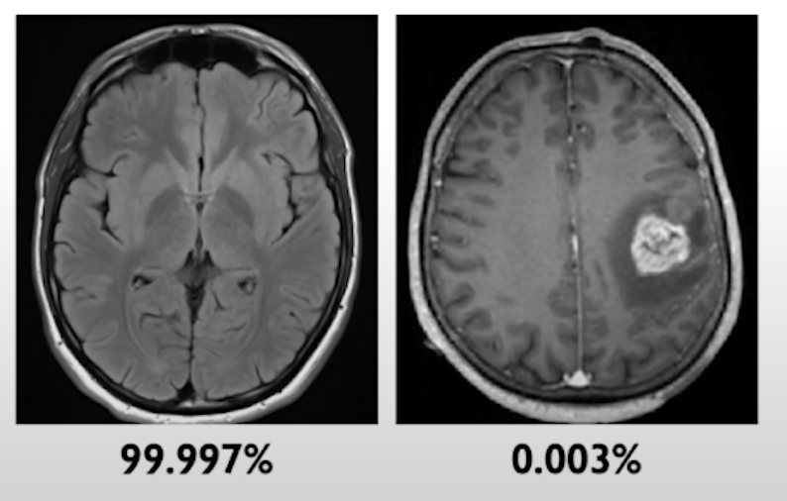
Danger of class imbalance in medical diagnosis
Class imbalance can affect medical diagnosis of diseases, even though the accuracy can be very very high.
Idea: Cancer is rare, but we might not want training dataset to be reflective of real-world distribution.
GBM is one of the most deadly brain tumor, which occurs to 3.19 per 100,000 people.

Slide 22
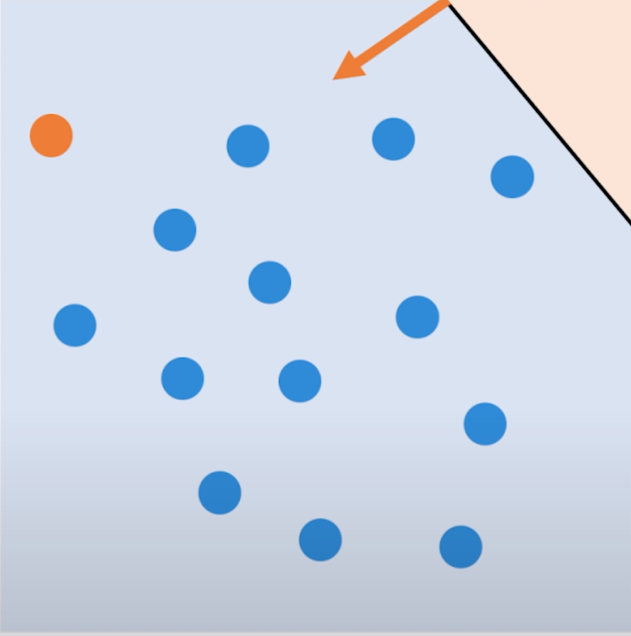
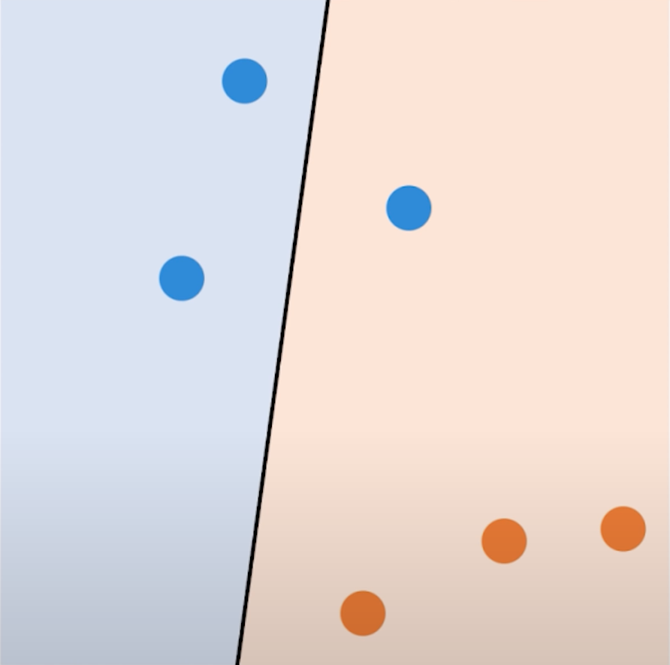
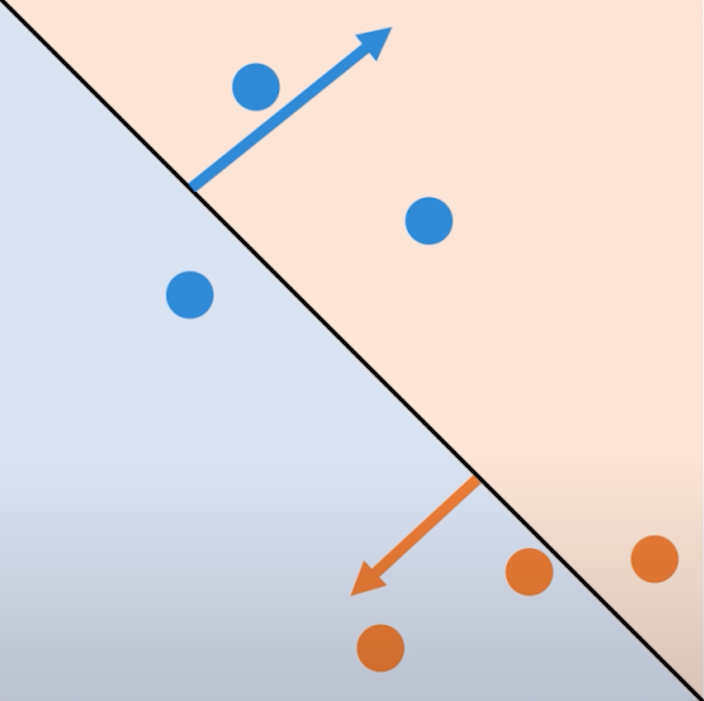
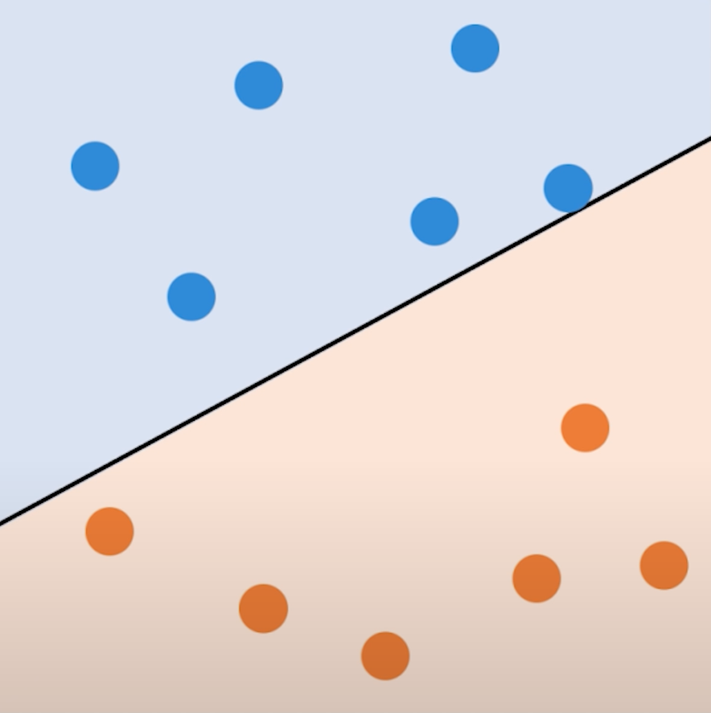
Learning in dataset with balanced classes

Slide 23
Sampling Bias
When the training data we collect does not contain representative samples of the true distribution.
Examples:
If we use data gathered from smart phones, we would likely be underestimating poorer and older populations.
ImageNet (a very popular image dataset) with 1.2 million images. About 45% of these images were taken in the US and the majority of the rest in North America and Western Europe. Only about 1% and 2.1% of the images come from China and India respectively.

Slide 24
Measurement Bias
Often we are gathering data that contains (noisy) proxies of characteristics of interest. Some examples:
Crime Rate → Arrest Rate
Intelligence → SAT Score
If these measurements are not measured equally across groups or places (or aren’t relevant to the task at hand), this can be another source of bias.

Slide 25
Measurement Bias (cont.)
Examples:
If factory workers are monitored more often, more errors are spotted. This can result in a feedback loop to encourage more monitoring in the future.
Same principles at play with predictive policing. Minoritized communities were more heavily policed in the past, which causes more instances of documented crime, which then leads to more policing in the future.
Women are more likely to be misdiagnosed (or not diagnosed) for conditions where self-reported pain is a symptom. In this case aspect of our data “diagnosed with X” is a biased proxy for “has condition X”.
The feature we measure is a poor representation of the quality of interest (e.g., SAT score doesn’t actually measure intelligence)

Slide 26
Mitigating bias
Remove problematic signals from datasets, add signals for desired features and re-weight signals
Constantly improve our bias evaluation metrics
Research methods to detect and mitigate biases during training

Slide 27
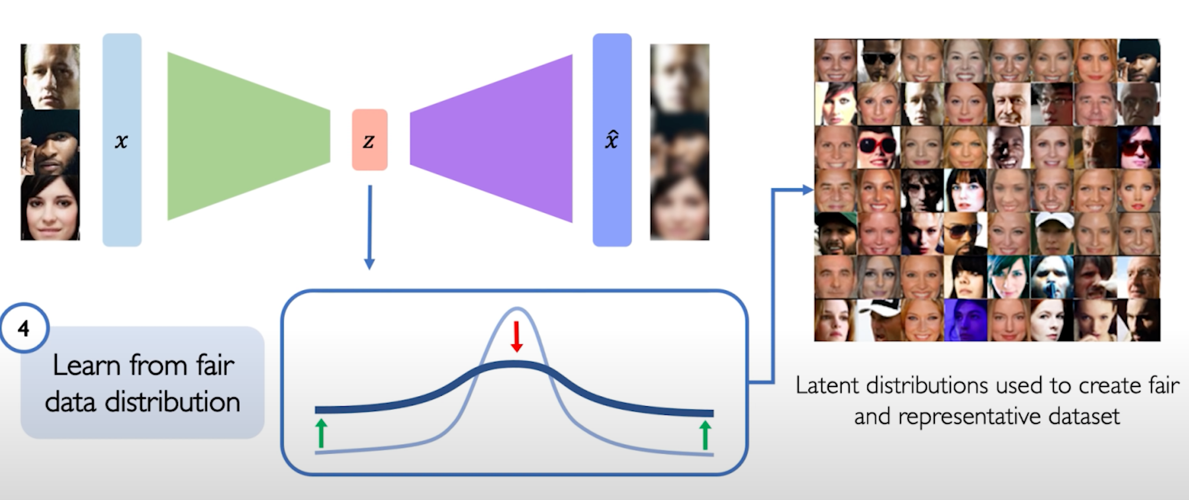
Learning latent distributions from generative models
Use generative models to learn latent distributions from datasets and readjust the sampling distributions
Latent distributions can be used to create more fair distributions in the datasets

Slide 28
Fairness in ML

Slide 29
Fairness
What does it mean for a model to be fair or unfair? Can we come up with a numeric way of measuring fairness?
Lots of work in the field of ML and fairness is looking into mathematical definitions of fairness to help us spot when something might be unfair.
There is not going to be one central definition of fairness, as each definition is a mathematical statement of which behaviors are/aren’t allowed.
Different definitions of fairness can be contradictory!
Today, we will focus on notions of group fairness in an attempt to prevent discriminatory outcomes.

Slide 30
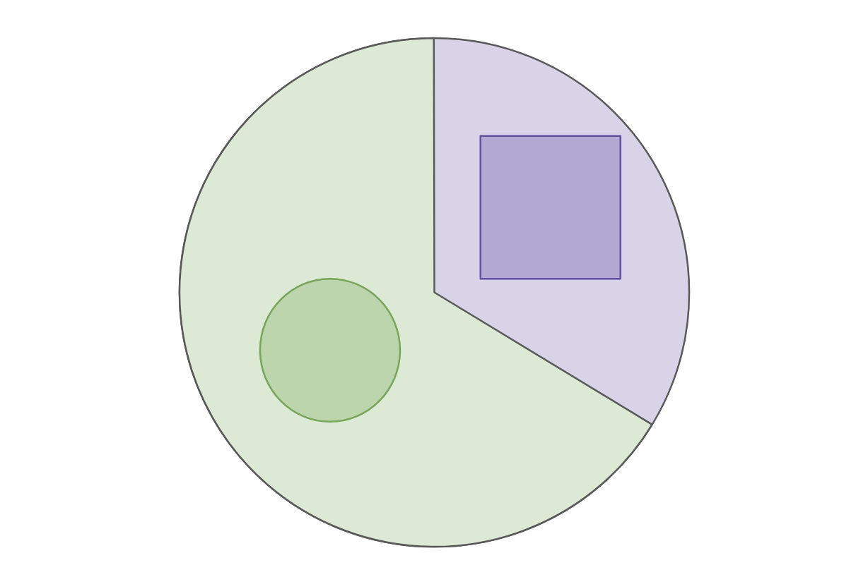
Example: College Admissions
Will use a very simplified example of college admissions. This is not an endorsement of such a system or a statement of how we think the world does/should work. Will make MANY simplifying assumptions (which are unrealistic).
There is a single definition of “success” for college applicants, and the goal of an admissions decision is to predict “success”
The only thing we will use as part of our decision is SAT Score
To talk about group fairness, will assume everyone belongs to exactly one of two races: Circles (66%) or Squares (33%).

Slide 31
Notation
Example: College admission only using SAT Score
$X$ input about a person for prediction
Example: $X$= SAT Score
$A$ variable indicating which group $X$ belongs in
Example: $A=\text{⬜}$or $A=\text{◯}$
$Y$ the “true label”
Example: $Y=+$ if truly successful in college, $Y=−$ if not
$\hat{Y}=\hat{f}(X)$ is our prediction for $Y$ using a learned model $\hat{f}$
Example: $\hat{Y}=+$ if predicted successful, $\hat{Y}=−$ otherwise

Slide 32
Fairness Definition 1: “Shape Blind”
To avoid unfair decisions, prevent the model from every looking at protected attribute (e.g., if the applicant is Circle/Square).
Often called “Fairness through unawareness”
Doesn’t work in practice. This does not prevent historical or measurement bias. Protected attributes can be unintentionally inferred from other, related attributes (e.g., in some cities, zip code can be deeply correlated with race).

Slide 33
Confusion Matrix
For binary classification, there are only two types of mistakes
$\hat{y}=+1, y=−1$
$\hat{y}=−1, y=+1$
Generally we make a confusion matrix to understand mistakes.
Predicted Label
 | True Positive (TP) | False Negative (FN)
 | False Positive (FP) | True Negative (TN)
True Label

Slide 34
Binary Classification Measures
Notation
$C_{TP}=\#TP, C_{FP}=\#FP, C_{TN}=\#TN, C_{FN}=\#FN$
$N=C_{TP}+C_{FP}+C_{TN}+C_{FN}$
$N_{P}=C_{TP}+C_{FN}, N_{N}=C_{FP}+C_{TN}$
Error Rate
$$\frac{C_{FP}+C_{FN}}{N}$$
Accuracy Rate
$$\frac{C_{TP}+C_{TN}}{N}$$
False Positive rate (FPR)
$$\frac{C_{FP}}{N_{N}}$$
False Negative Rate (FNR)
$$\frac{C_{FN}}{N_{P}}$$
True Positive Rate or Recall
$$\frac{C_{TP}}{N_{P}}$$
Precision
$$\frac{C_{TP}}{C_{TP}+C_{FP}}$$
F1-Score
$$2\frac{Precision⋅Recall}{Precison+Recall}$$
See more!

Slide 35
Fairness Definition 2: Statistical Parity
Idea: “Admit decisions are equivalent across groups”
$$\operatorname{Pr}\left(\hat{Y}= +| A=\text{⬜}\right)=\operatorname{Pr}\left(\hat{Y}= +| A=\text{◯}\right)$$
Also phrased as matching demographic statistics (e.g., if 33% of population are Squares, 33% of those admitted should be Square).
Pros:
Aligns with certain legal definitions of equity.
Cons:
A rather weak in fairness requirements. Allows for strategies that might not be desirable (e.g., random selection, self-fulfilling prophecy)

Slide 36
Fairness Definition 3: Equal Opportunity
Idea: True positive rate should be equivalent across groups
$$\operatorname{Pr}\left(\hat{Y}= +| A=\text{⬜}, Y=+\right)=Pr\left(\hat{Y}= +| A=\text{◯}, Y=+\right)$$
Pros:
Better controls for true outcome
Cons:
More complex to explain to non-experts
Only protects for the positive outcome
Note: Equality of true positives is the same as equality of false negatives

Slide 37
Fairness Definition 4: Predictive equality
Idea: True negative rate should be equivalent across groups
$$\operatorname{Pr}\left(\hat{Y}=−| A=\text{⬜}, Y=−\right)=Pr\left(\hat{Y}=−| A=\text{◯}, Y=−\right)$$
Same idea as equal opportunity, but controlling for different statistic. Might be favorable in situations you care more about false positives than a false negative.
Note: Equality of true negatives is the same as equality of false positives

Slide 38
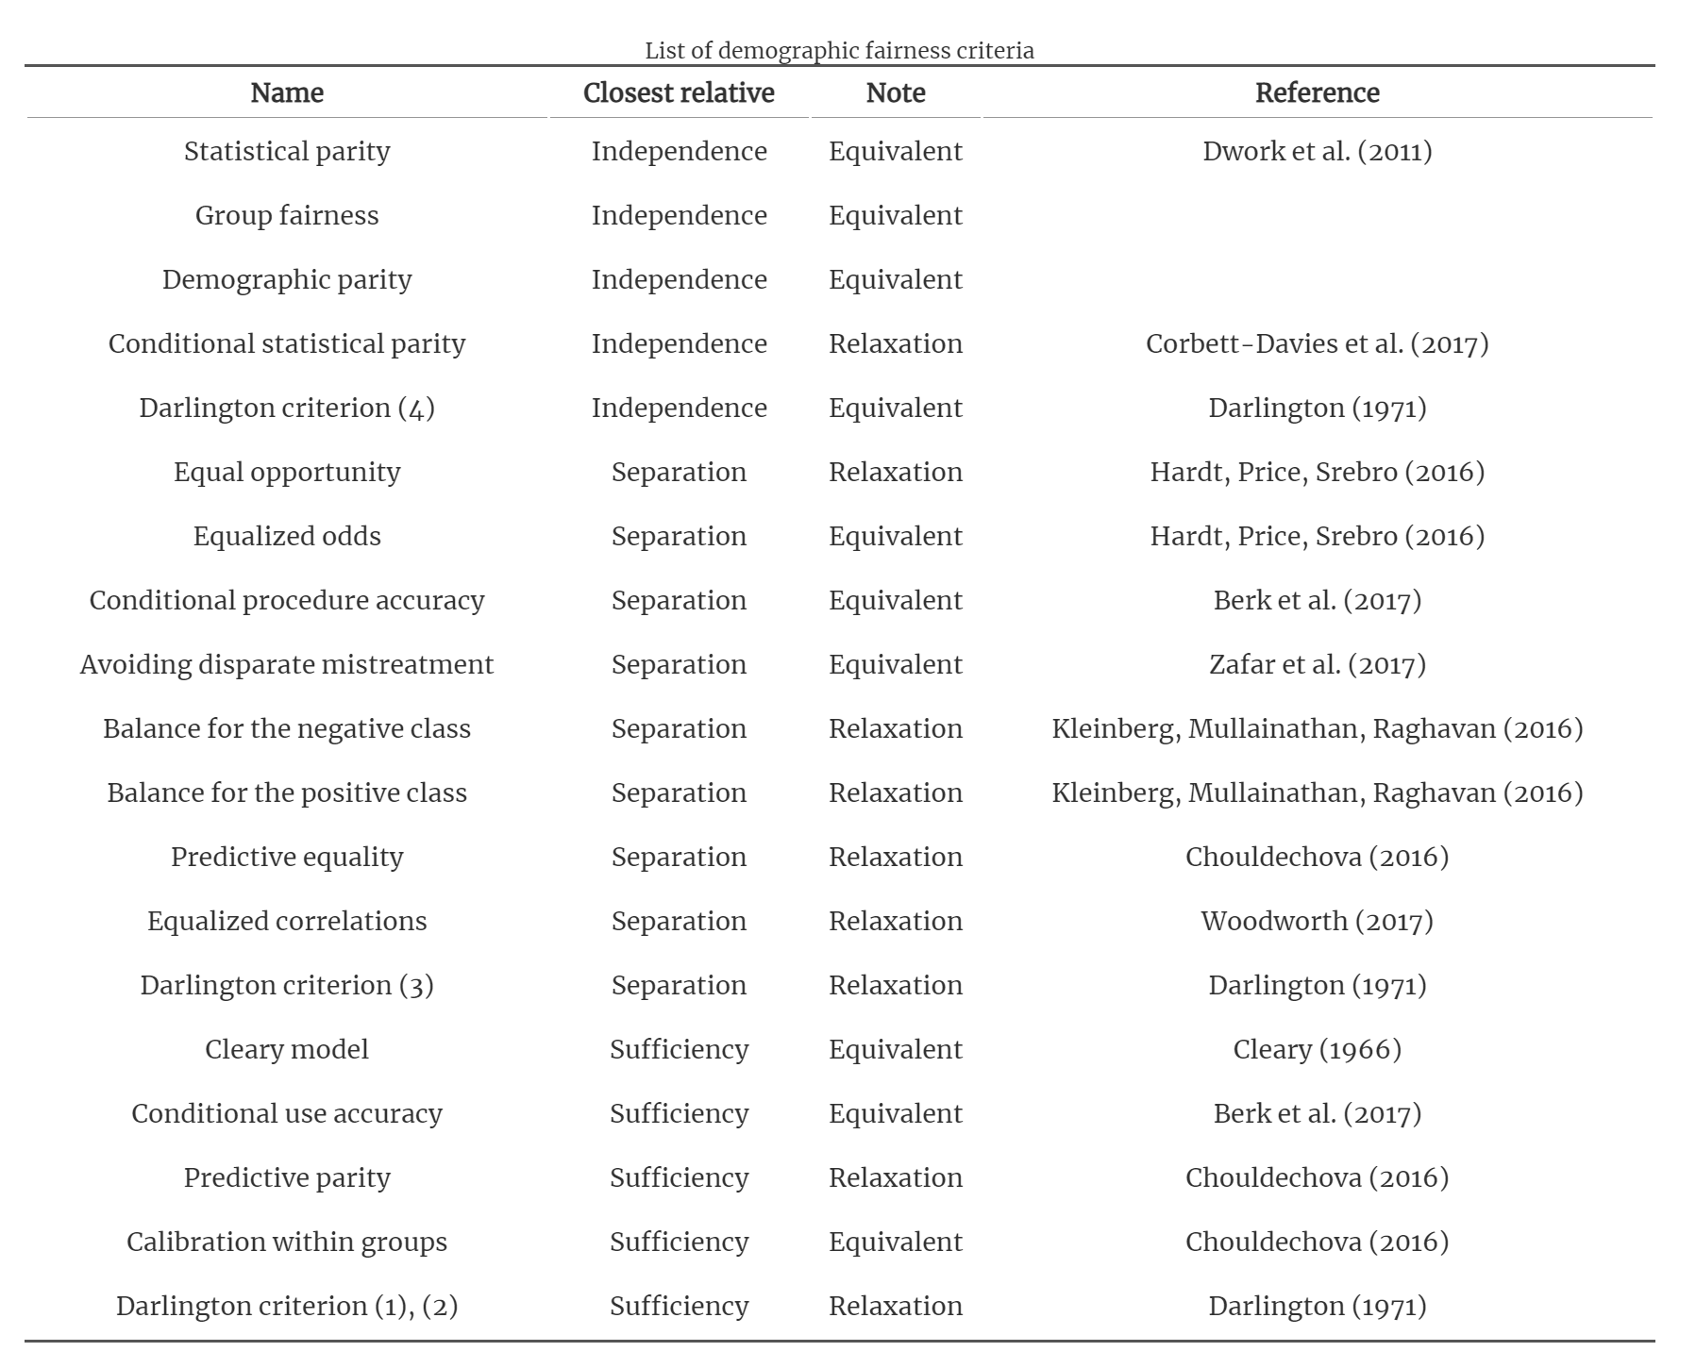
And many, many more
Table from Fairness and machine learning by Barocas, Hardt, Narayanan

Slide 39
Which one to use?
We can’t tell you! Each definition makes its own statement on what fairness means. Choosing a fairness measure is an explicit statement of what values we hold when thinking about fairness.
Takeaway: Discrimination in ML models is a crucial problem we need to work on. It’s not a problem that will only be solved algorithmically. We need people (e.g., policymakers, regulators, philosophers, developers) to be in the loop to determine the values we want to encode into our systems.

Slide 40
Next time
On Wednesday 5/27, we'll have a special lecture by my TA Sahil Verma, a PhD researcher in explainability and fairness in AI. Sahil will talk about the real world example of bias issues that were uncovered by different regulatory/advisory/journalistic bodies and some examples of how the bias has been effectively tackled.

Slide 41
Recap
Theme: It’s important to give terms to abstract notions like bias and fairness so we can have concrete things to look out for. There is not one right perspective though!
Ideas:
Calibration
Impacts of ML Systems on society
Bias
How to mitigate biases
Definitions of fairness

