Slide 1

CSE/STAT 416
Deep Learning
Hunter Schafer
University of Washington
May 24, 2021

Slide 2
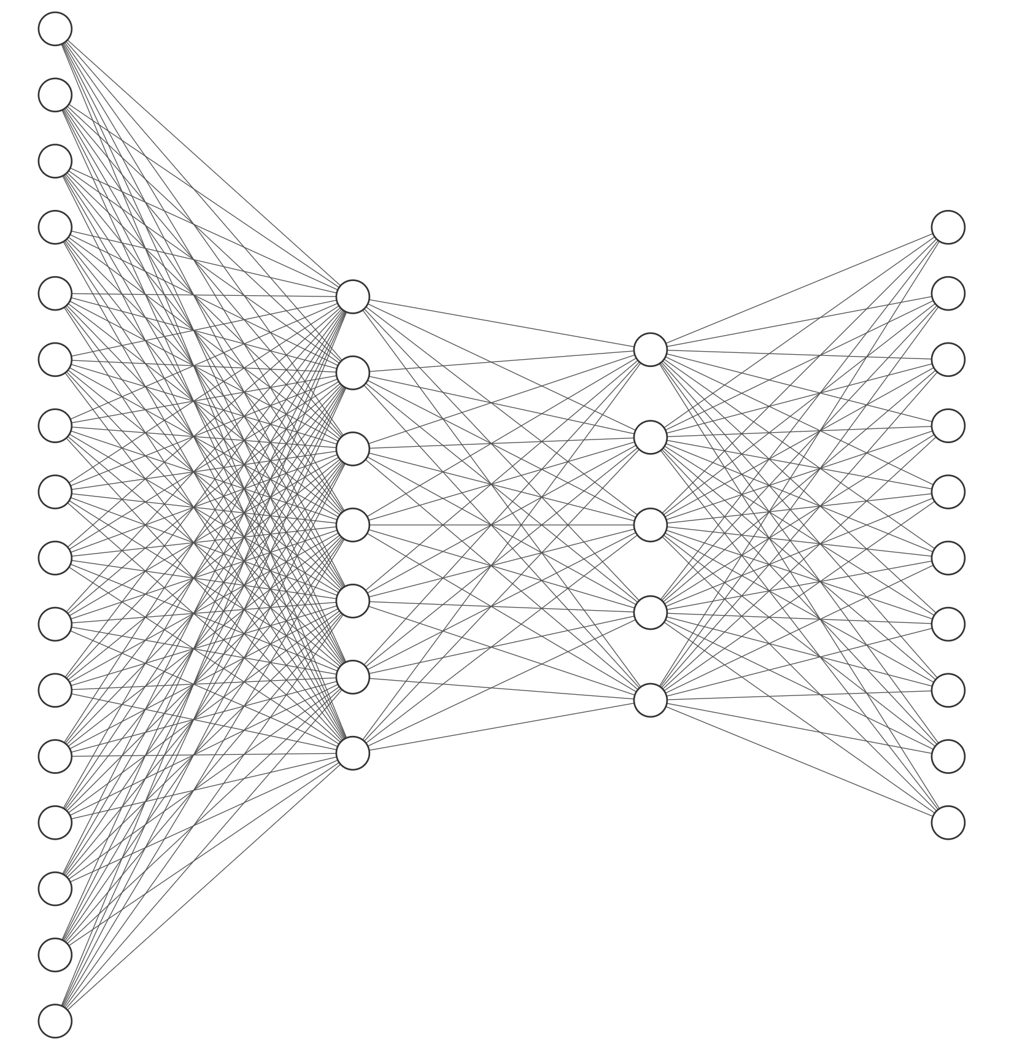
Deep Learning
A lot of the buzz about ML recently has come from recent advancements in deep learning.
When people talk about “deep learning” they are generally talking about a class of models called neural networks that are a loose approximation of how our brains work.

Slide 3
Recall:
Linear Classifier
Remember the linear classifier based on score

Slide 4
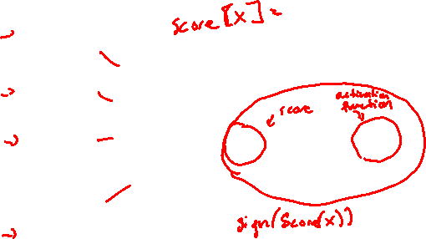
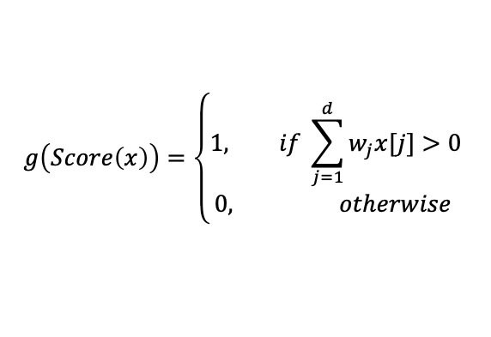
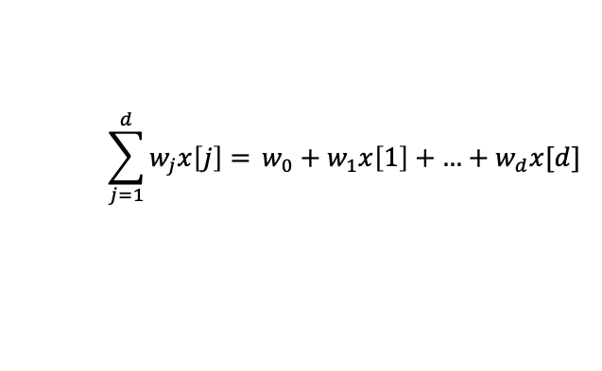
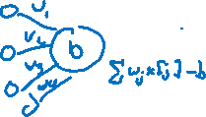
Perceptron
Graphical representation of this same classifier
This is called a perceptron
Input
Output
$$\sum_{j=1}^{d}{w_{j}x\left[j\right]= }w_{0}+w_{1}x\left[1\right]+\text{…}+w_{d}x[d]$$
$$g\left(Score\left(x\right)\right)=\left\{\begin{aligned}1, if \sum_{j=1}^{d}{w_{j}x[j]}>0 \\ 0, otherwise \end{aligned}\right.$$
Notes:
Write ”Score” next to sum
Write “Activation function” next to g
Circle last 3 bits

Slide 5
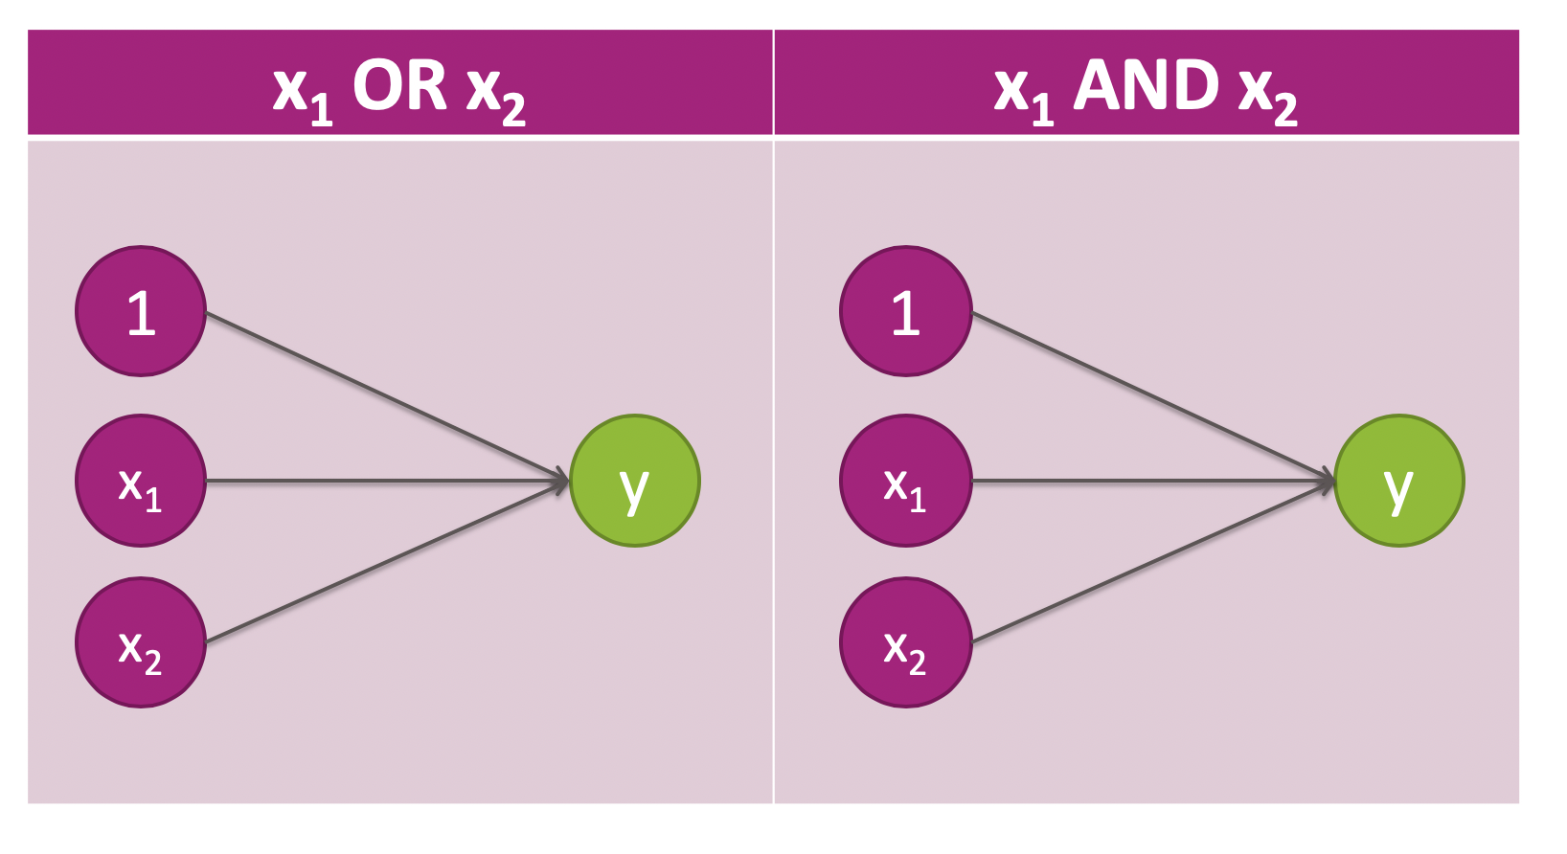
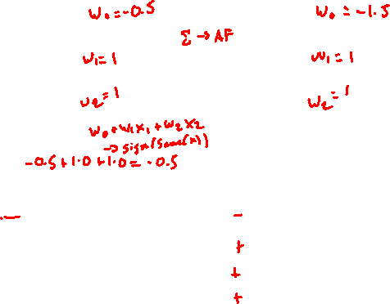
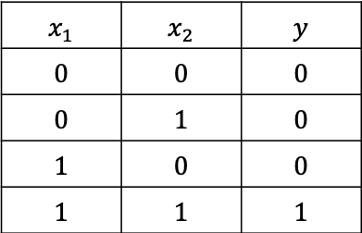
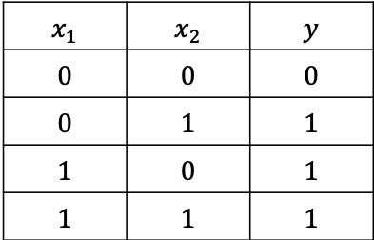
Learnable
What can a perceptrons represent?
$$x_{1}$$ | $$x_{2}$$ | $$y$$
$$0$$ | $$0$$ | $$0$$
$$0$$ | $$1$$ | $$1$$
$$1$$ | $$0$$ | $$1$$
$$1$$ | $$1$$ | $$1$$
$$x_{1}$$ | $$x_{2}$$ | $$y$$
$$0$$ | $$0$$ | $$0$$
$$0$$ | $$1$$ | $$0$$
$$1$$ | $$0$$ | $$0$$
$$1$$ | $$1$$ | $$1$$
Notes:
Note that the green node captures the steps of summing weighted inputs and activation function

Slide 6
XOR
The perceptron can learn most boolean functions, but XOR always has to ruin the fun.
This data is not linearly separable, therefore can’t be learned with the perceptron

Slide 7
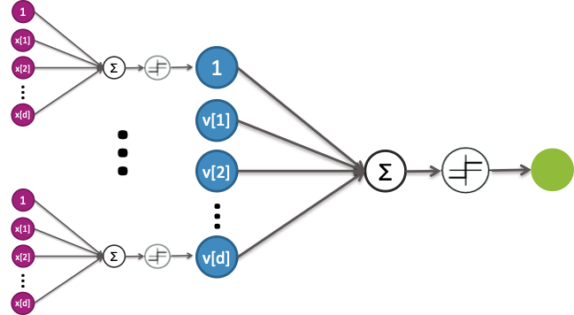
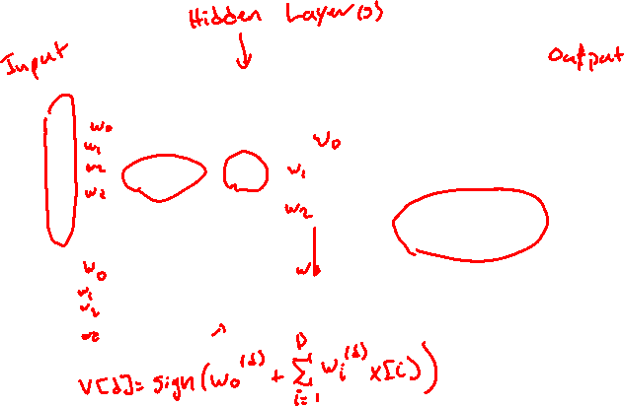
Neural Network
Idea: Combine these perceptrons in layers to learn more complex functions.
Notes:
The mechanics are the same as before, but we use the outputs of the blue layer as the input to the green layer
Write that some v[k] = sign(\sum_{j=1}^d w^(k)_jx[j])

Slide 8



XOR
Notice that we can represent
$$x\left[1\right] XOR x\left[2\right]=\left(x\left[1\right] AND !x[2]\right) OR (!x\left[1\right] AND x\left[2\right])$$
Notes:
Draw v[1] and v[2] under each clause
Walk through example of (1, 0)

Slide 9
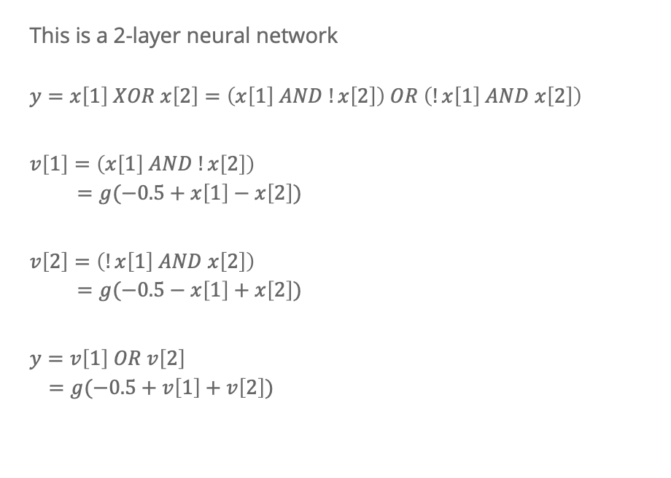
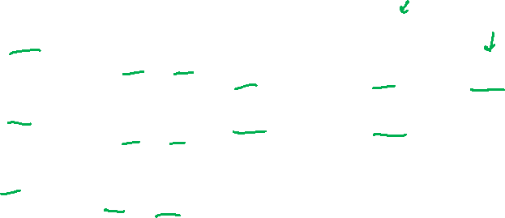
XOR
This is a 2-layer neural network
$$y=x\left[1\right] XOR x\left[2\right]=\left(x\left[1\right] AND !x\left[2\right]\right) OR \left(!x\left[1\right] AND x\left[2\right]\right)$$
$$v\left[1\right]=\left(x\left[1\right] AND !x\left[2\right]\right) \\ =g(−0.5+x\left[1\right]−x\left[2\right])$$
$$v\left[2\right]=\left(!x\left[1\right] AND x\left[2\right]\right) \\ =g(−0.5−x\left[1\right]+x\left[2\right])$$
$$y=v\left[1\right] OR v\left[2\right] \\ =g(−0.5+v\left[1\right]+v\left[2\right])$$

Slide 10
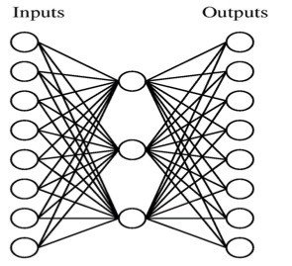
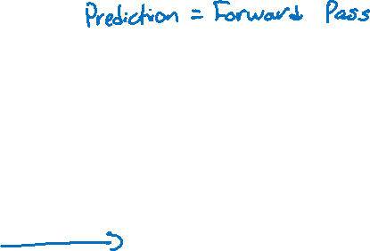
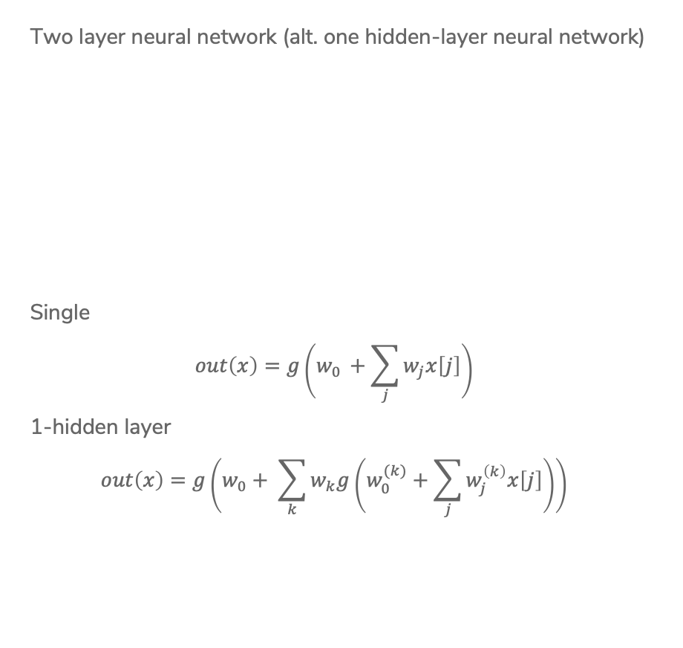
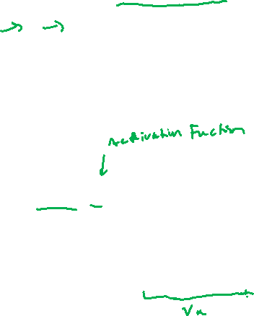
Neural Network
Two layer neural network (alt. one hidden-layer neural network)
Single
$$out\left(x\right)=g\left(w_{0 }+\sum_{j}{w_{j}x\left[j\right]}\right)$$
1-hidden layer
$$out\left(x\right)=g\left(w_{0}+ \sum_{k}{w_{k}g\left(w_{0 }^{(k)}+\sum_{j}{w_{j}^{\left(k\right)}x\left[j\right]}\right)}\right)$$
Notes:
Highlight inside is v[k]

Slide 11
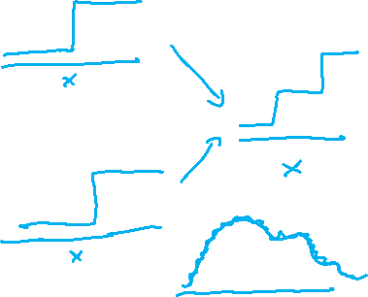
Power of 2-layer NN
A surprising fact is that a 2-layer network can represent any function, if we allow enough nodes in hidden layer.
For this example, consider regression function with one input.
See more here: http://neuralnetworksanddeeplearning.com/chap4.html
Notes:
Draw step function for each and how to combine them
Draw fancy function with step approximation

Slide 12
Class Session

Slide 13
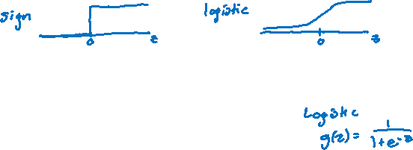
Activation Function
Before, we were using the sign activation function.
This is not generally used in practice.
  Not differentiable
  No notion of confidence
Generally, people use different sigmoid functions as activation functions. For example, the logistic function
Notes:
Draw picture

Slide 14
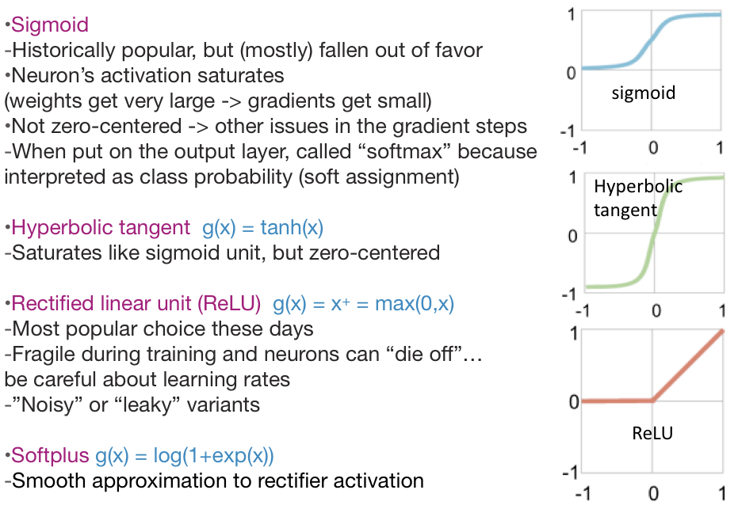

Sigmoid Functions
Notes:
Very important: These are considered hyperparameters to the model. Choosing which non-linearity you use affects your results! You sometimes have to try many to see which one works best

Slide 15
Neural Networks
Generally layers and layers of linear models and non-linearities (activation functions).
Have been around for about 50 years
Fell in “disfavor” in the 90s when simpler models were doing well
In the last few years, have had a huge resurgence
Impressive accuracy on several benchmark problems
Have risen in popularity due to huge datasets, GPUs, and improvements to

Slide 16
Overfitting NNs
Are NNs likely to overfit? YES.
Consequence of being able to fit any function!
How to avoid overfitting?
Get more training data
Few hidden nodes / better topology
  Rule of thumb: 3-layer NNs outperform 2-layer NNs, but going deeper only helps if you are very careful (different story next time with convolutional neural networks)
Regularization
  Dropout
Early stopping

Slide 17
Application to Computer Vision

Slide 18
Image Features
Features in computer vision are local detectors
Combine features to make prediction
In reality, these features are much more low level (e.g. Corner?)

Slide 19
The Past
A popular approach to computer vision was to make hand-crafted features for object detection
Relies on coming up with these features by hand (yuck!)

Slide 20
NN to the Rescue
Neural Networks implicitly find these low level features for us!
Each layer learns more and more complex features

Slide 21


Slide 22
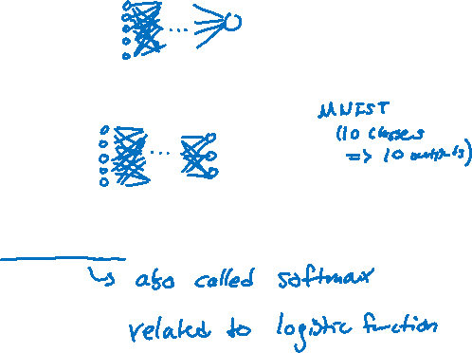
Classification or Regression
You can use neural networks for classification and regression!
Regression
The output layer will generally have one node that is the output (outputs a single number)
Classification
The output layer will have one node per class. Usually take the node with the highest score as the prediction for an example. Can also use the logistic function to turn scores into probabilities!

Slide 23
Learning Coefficients
So the idea of neural networks might make sense, but how do we actually go about learning the coefficients in the layers?
First we need to define a quality metric or cost function
For regression, generally use RSS or RMSE
For classification, generally use something call the Cross Entropy loss.
Can we use gradient descent here? Actually yes!
How do we take the derivative of a network?
Are there convergence guarantees?

Slide 24
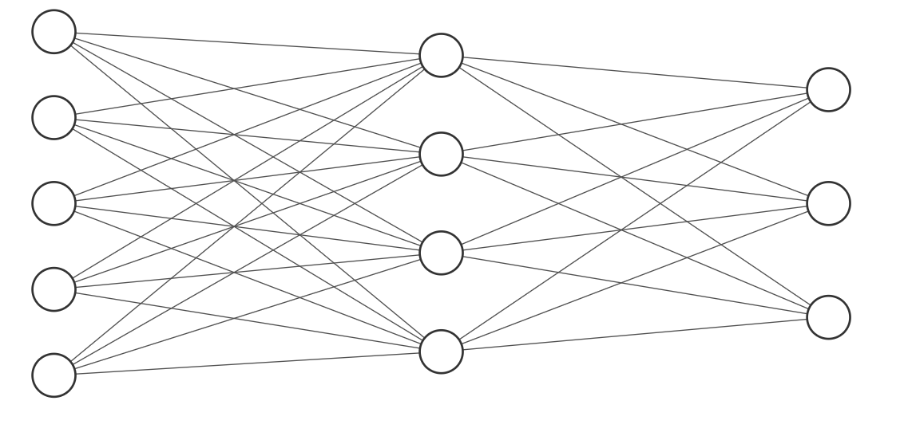
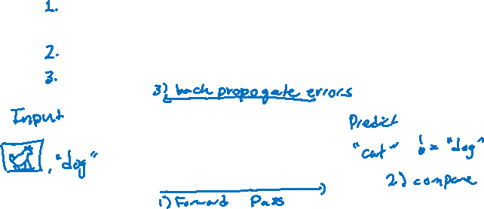
Backpropagation
What does gradient descent do in general? Have the model make predictions and update the model in a special way such that the new weights have lower error.
To do gradient descent with neural networks, we generally use the backpropagation algorithm.
Do a forward pass of the data through the network to get predictions
Compare predictions to true values
Backpropagate errors so the weights make better predictions

Slide 25
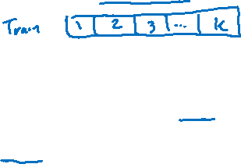
Training NN
It’s pretty expensive to do this update for the entire dataset at once, so it’s common to break it up into small batches to process individually.
However, processing each batch only once isn’t enough. You generally have to repeatedly update the model parameters. We call an iteration that goes over every batch once an epoch.
for i in range(num_epochs):
for batch in batches(training_data):
preds = model.predict(batch.data) # Forward pass
diffs = compare(preds, batch.labels) # Compare
model.backprop(diffs) # Backpropagation

Slide 26


Slide 27

Training NN
Neural Networks have MANY hyperparameters
How many hidden layers and hidden neurons?
What activation function?
What is the learning rate for gradient descent?
What is the batch size?
How many epochs to train?
And much much more!
How do you decide these values should be?
The most frustrating thing is that we don’t have a great grasp on how these things impact performance, so you generally have to try them all.
¯\_(ツ)_/¯

Slide 28
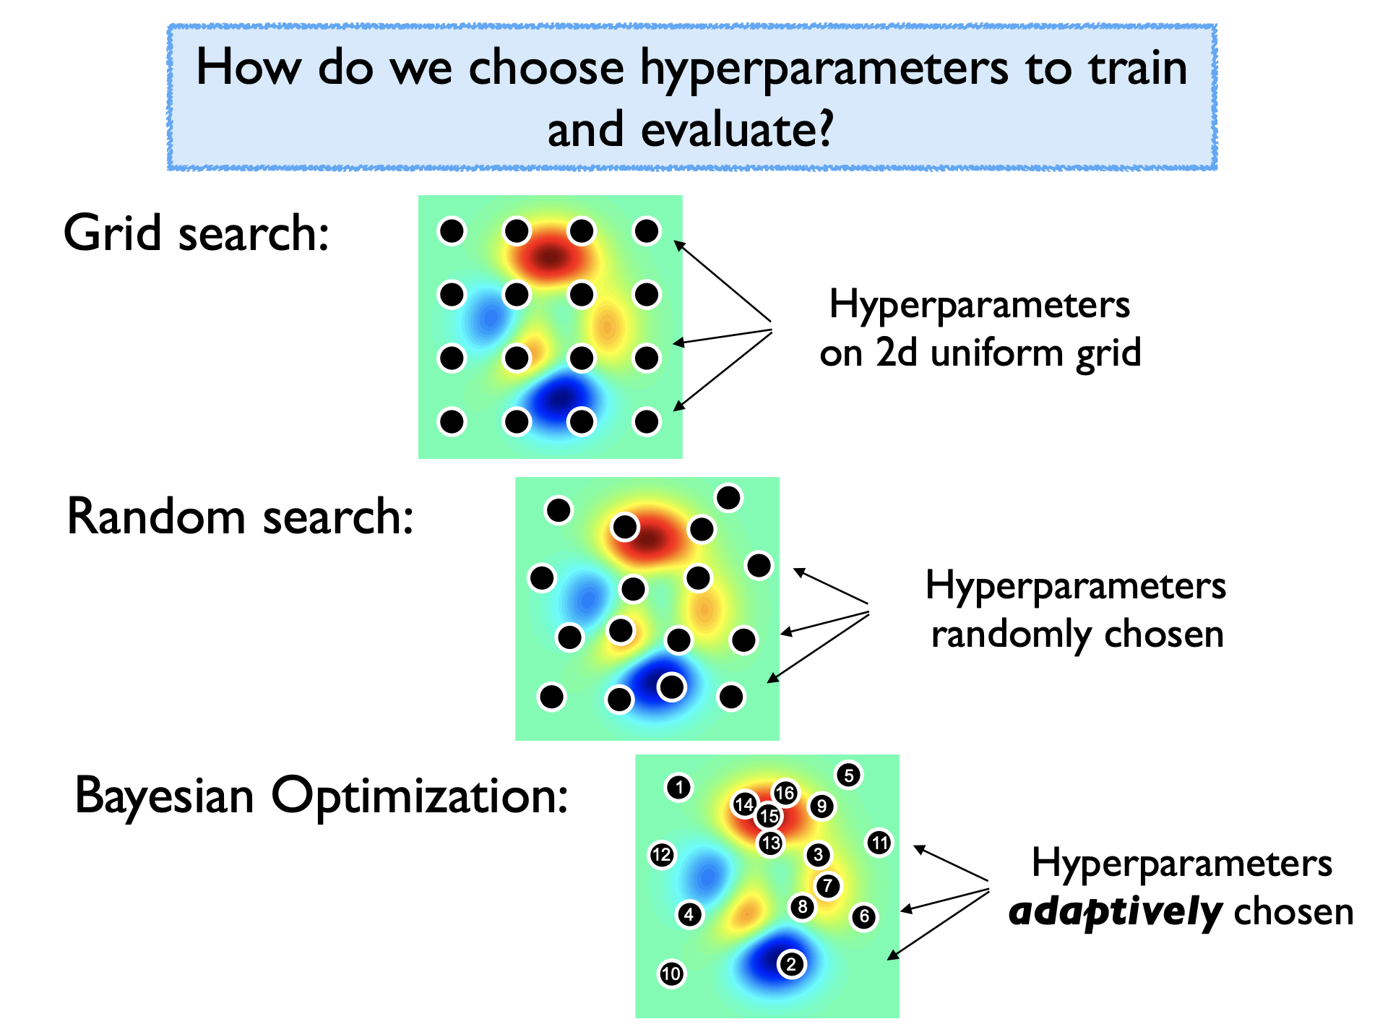
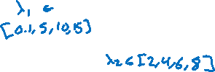
Hyperparameter Optimization

Slide 29
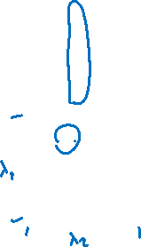
Hyperparameter Optimization

Slide 30
Hyperparameter Optimization

Slide 31
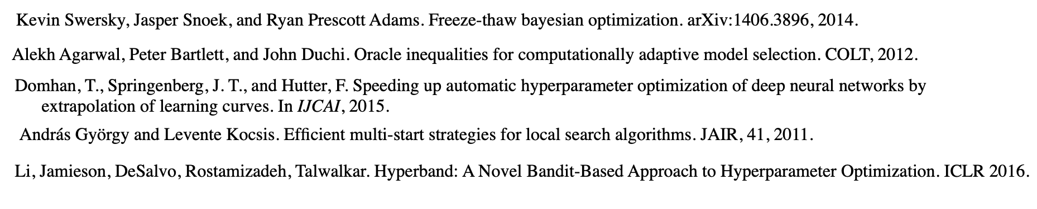
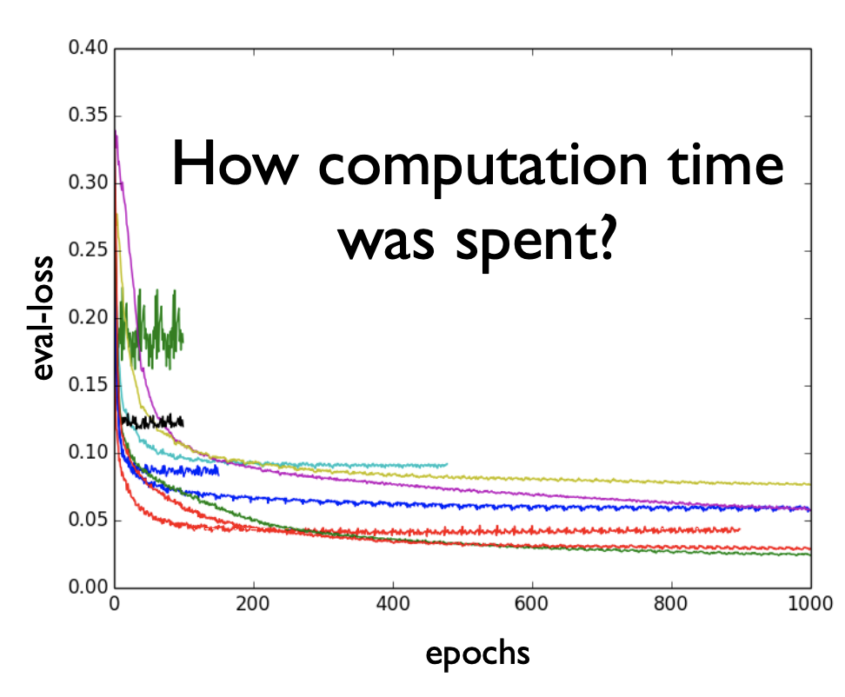
Hyperparameter Optimization
Recent work attempts to speed up hyperparameter evaluation by stopping poor performing settings before they are fully trained.

Slide 32
Hyperparameter Optimization
In general, hyperparameter optimization is a non-convex optimization problem where we know very little about how the function behaves.
Your time is valuable and compute time is cheap. Write your code to be modular so you can use compute time to try a range of values.
Tools for different purposes
Very few evaluations: use random search (and pray)
Few evaluations and long-run computations: See last slide
Moderate number of evaluations: Bayesian optimization
Many evaluations possible: Use random search. Why overthink it?

Slide 33

NN Convergence
In general, loss functions with neural networks are not convex.
This means the backprop algorithm for gradient descent will only converge to a local optima.
Like with k-means, this means that how you initialize the weights is really important and can impact the final result.
How should you initialize weights?
Usually people do random initialization
All the same rules apply from gradient descent with a learning rate, you might miss the mark of the local optima if the step size is too large.
¯\_(ツ)_/¯

