Slide 1

CSE/STAT 416
Local Methods
Locality Sensitive Hashing
Hunter Schafer
Paul G. Allen School of Computer Science & Engineering
University of Washington
May 5, 2021

Slide 2
Pre-Lecture Video

Slide 3
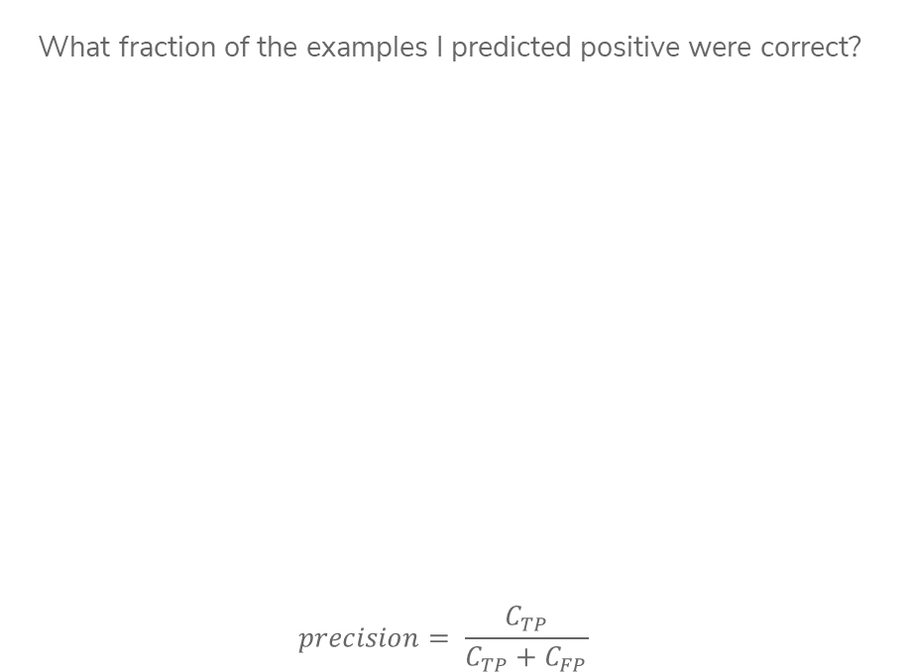
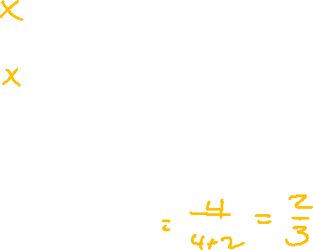

Precision
What fraction of the examples I predicted positive were correct?
$$precision= \frac{C_{TP}}{C_{TP}+C_{FP}}$$
Sentences predicted to be positive:
${\hat{y}}_{i}=+1$
Notes:
Calculate precision (4/ (2 + 4) = 2/3)
High precision means your positive predictions are trustworthy

Slide 4
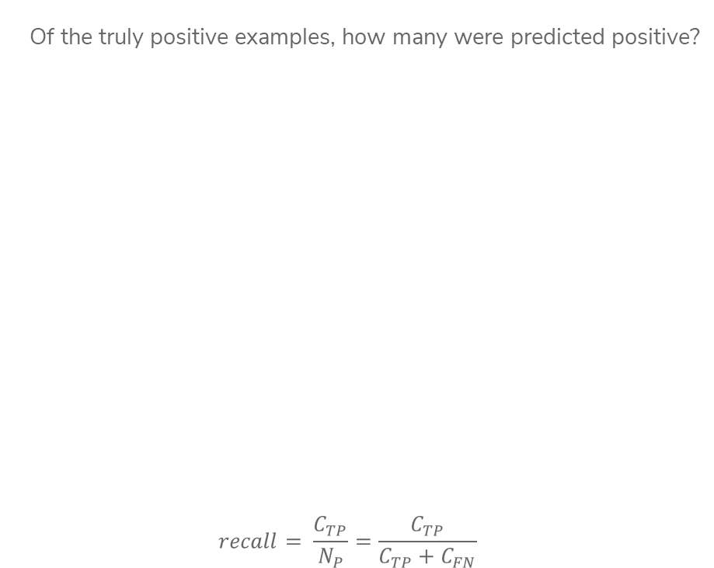
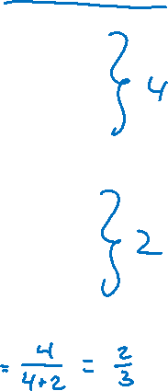
Recall
Of the truly positive examples, how many were predicted positive?
$$recall= \frac{C_{TP}}{N_{P}}=\frac{C_{TP}}{C_{TP}+C_{FN}}$$
Notes:
Calculate recall (4 / (4 + 2) = 2/3)
2 positive examples not shown
High recall means we are likely to “discover” all the positive examples

Slide 5

Document Retrieval
Consider you had some time to read a book and wanted to find other books similar to that one.
If we wanted to write an system to recommend books
  How do we measure similarity?
  How do we search over books?
  How do we measure accuracy?
Big Idea: Define an embedding and a similarity metric for the books, and find the “nearest neighbor” to some query book.
Notes:
Could also return set of nearest neighbors (draw circle)

Slide 6

Predicting House Prices
When we saw regression before, we assumed there was some linear/polynomial function that produced the data. All we had to do was choose the right polynomial degree.
Notes:
Draw curve vs 1-NN line

Slide 7

Predicting House Prices
What if instead, we didn’t try to find the global structure, but instead just tried to infer values using local information instead.
Big Idea: Use 1-nearest neighbor to predict the price of a house.
Not actually a crazy idea, something realtors do sometimes!
Notes:
Draw curve vs 1-NN line

Slide 8

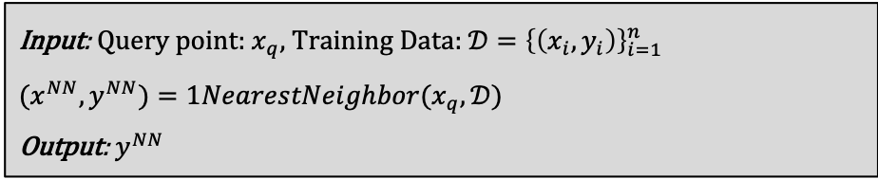
1-NN Regression
Where $1NearestNeighbor$ is the algorithm described yesterday to find the single nearest neighbor of a point.
Input: Query point: $x_{q}$, Training Data: ${𝒟=\left\{\left(x_{i},y_{i}\right)\right\}}_{i=1}^{n}$
${(x}^{NN}, y^{NN})=1NearestNeighbor(x_{q},𝒟)$
Output: $y^{NN}$
Notes:
Write O(n) above slide

Slide 9
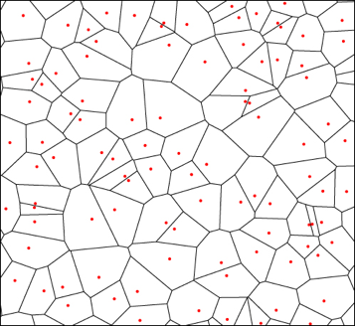
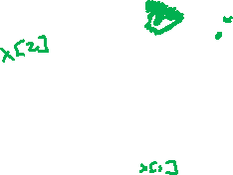
Visualizing 1-NN Regression
The function learned by 1-NN is “locally constant” in each region nearest to each training point.
Can visualize this with a Voronoi Tessellation
Shows all of the points that are “closest” to a particular training point
Not actually computed in practice, but helps understand

Slide 10
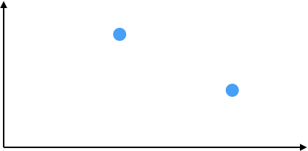


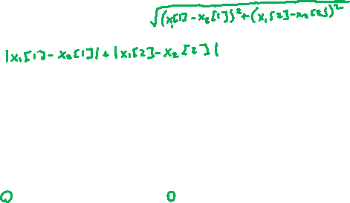
Visualizing 1-NN Regression
Like last time, how you define “closest” changes predictions

Slide 11

1-NN Regression
Weaknesses
Inaccurate if data is sparse
Can wildly overfit

Slide 12
1-NN Classification
Can we use the same algorithm for classification? Yes!
Predict the class of the nearest neighbor. Besides that, exactly the same as regression.

Slide 13
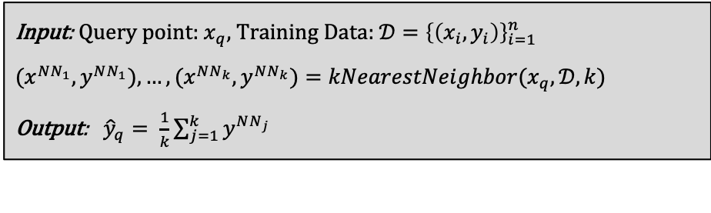
Prevent Overfitting
The downfalls of 1-NN come from it relies too much on a single data point (the nearest neighbor), which makes it susceptible to noise in the data.
More reliable estimate if you look at more than one house!
Input: Query point: $x_{q}$, Training Data: ${𝒟=\left\{\left(x_{i},y_{i}\right)\right\}}_{i=1}^{n}$
${(x}^{NN_{1}}, y^{NN_{1}}), …,(x^{NN_{k}}, y^{NN_{k}})=kNearestNeighbor(x_{q},𝒟, k)$
Output: ${\hat{y}}_{q}= \frac{1}{k}\sum_{j=1}^{k}{y^{NN_{j}}}$

Slide 14

k-NN Regression
By using a larger $k$, we make the function a bit less crazy
Still discontinuous though (neighbor is either in or out)
Boundaries are still sort of a problem

Slide 15
Issues with k-NN
While k-NN can solve some issues that 1-NN has, it brings some more to the table.
Have to choose right value of k.
  If k is too large, model is too simple
Discontinuities matter in many applications
  The error might be good, but would you believe a price jump for a 2640 sq.ft. house to a 2641 sq.ft. house?
Seems to do worse at the boundaries still

Slide 16
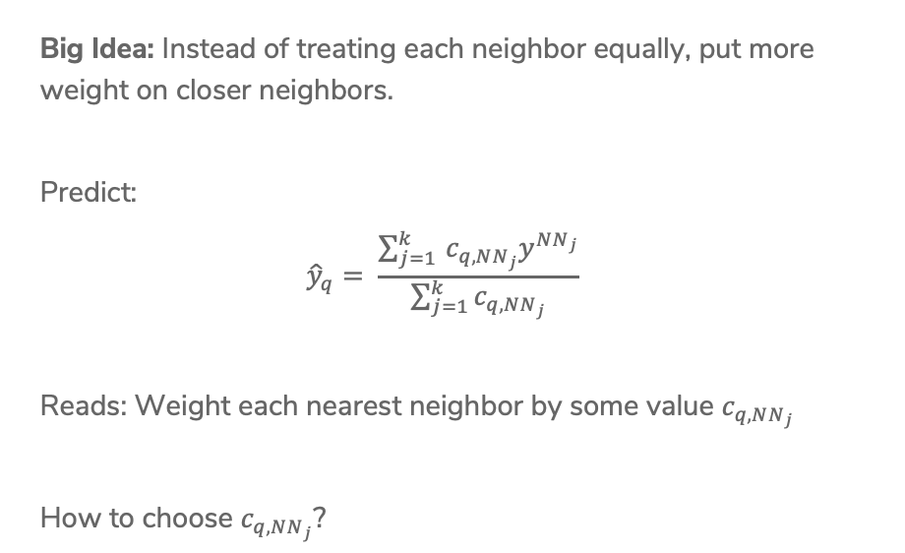
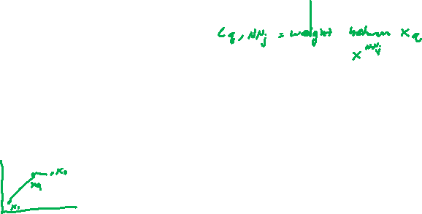
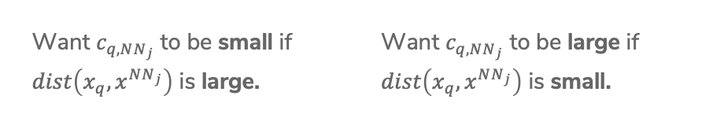
(Optional)
Weighted k-NN
Big Idea: Instead of treating each neighbor equally, put more weight on closer neighbors.
Predict:
$${\hat{y}}_{q}= \frac{\sum_{j=1 }^{k}{c_{q, NN_{j}}y^{NN_{j}}}}{\sum_{j=1}^{k}{c_{q,NN_{j}}}}$$
Reads: Weight each nearest neighbor by some value $c_{q,NN_{j}}$
How to choose $c_{q, NN_{j}}$?
Want $c_{q, NN_{j}}$ to be small if
$dist\left(x_{q}, x^{NN_{j}}\right)$ is large.
Want $c_{q, NN_{j}}$ to be large if
$dist\left(x_{q}, x^{NN_{j}}\right)$ is small.
Notes:
One idea is 1/dist

Slide 17
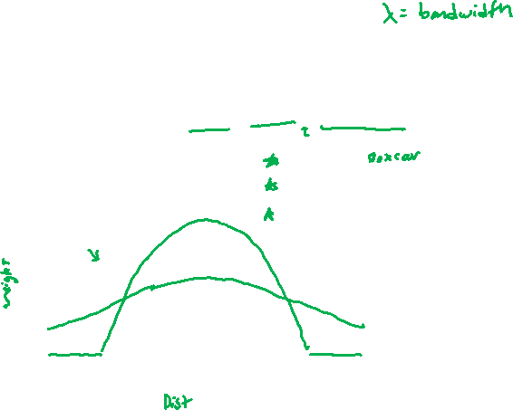

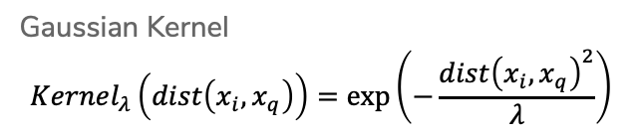

(Optional)
Kernels
Use a function called a kernel to turn distance into weight that satisfies the properties we listed before.
$$c_{q,NN_{j}}=Kernel_{λ}(dist\left(x_{q}, x^{NN_{j}}\right))$$
$−λ$ $0$ $λ$
Gaussian Kernel
$$Kernel_{λ}\left(dist\left(x_{i}, x_{q}\right)\right)=exp⁡\left(−\frac{dist{\left(x_{i}, x_{q}\right)}^{2}}{λ}\right)$$
Notes:
Write \lambda is “bandwidth” (controls “width” of kernel)
Point out Boxcar/triangle/gaussian

Slide 18

(Optional)
Kernel Regression
We can take this one step farther, instead of just using a kernel to weight the k nearest neighbors, can use the kernel to weight all training points! This is called kernel regression.
${\hat{y}}_{q}=\frac{\sum_{i=1}^{n}{c_{q,i}y_{i}}}{\sum_{i=1}^{n}{c_{q,i}}}=\frac{\sum_{i=1}^{n}{Kernel_{λ}\left(dist\left(x_{i}, x_{q}\right)\right)y_{i}}}{\sum_{i=1}^{n}{Kernel_{λ}\left(dist\left(x_{i}, x_{q}\right)\right)}}$

Slide 19

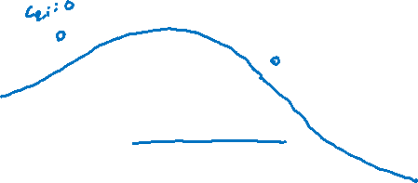
(Optional)
Visualizing Kernel Regression
This kernel has bounded support, only look at values $±λ$ away
Notes:
Write smooth!

Slide 20

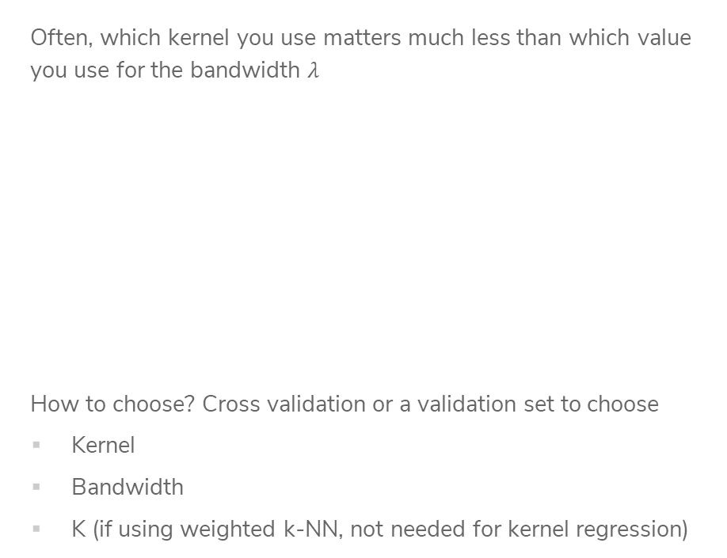
(Optional)
Choose Bandwidth $λ$
Often, which kernel you use matters much less than which value you use for the bandwidth $λ$
How to choose? Cross validation or a validation set to choose
Kernel
Bandwidth
K (if using weighted k-NN, not needed for kernel regression)
Notes:
Point out switch to boxcar in the middle, but fit looks like it’s in between the two

Slide 21

1.5 min
In a few sentences, compare and contrast the following ML models.
k-Nearest Neighbor Regression
Weighted k-Nearest Neighbor Regression
Kernel Regression

Slide 22

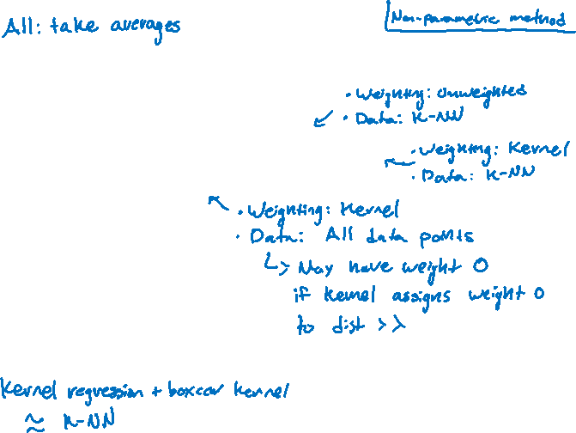
3 min
In a few sentences, compare and contrast the following ML models.
k-Nearest Neighbor Regression
Weighted k-Nearest Neighbor Regression
Kernel Regression

Slide 23
Efficient Nearest Neighbors

Slide 24
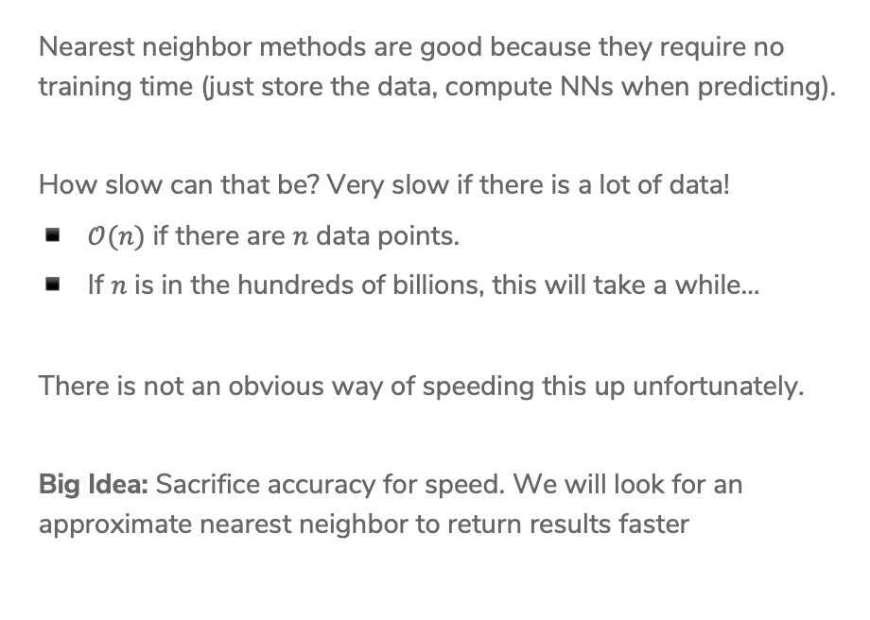
Nearest Neighbor Efficiency
Nearest neighbor methods are good because they require no training time (just store the data, compute NNs when predicting).
How slow can that be? Very slow if there is a lot of data!
$𝒪(n)$ if there are $n$ data points.
If $n$ is in the hundreds of billions, this will take a while…
There is not an obvious way of speeding this up unfortunately.
Big Idea: Sacrifice accuracy for speed. We will look for an approximate nearest neighbor to return results faster

Slide 25
Approximate Nearest Neighbor
Don’t find the exact NN, find one that is “close enough”.
Many applications are okay with approximate answers
The measure of similarity is not perfect
Clients probably can’t tell the difference between the most similar book and a book that’s pretty similar.
We will use locality sensitive hashing to answer this approximate nearest neighbor problem.
High level approach
Design an algorithm that yields a close neighbor with high probability
These algorithms usually come with a “guarantee” of what probability they will succeed, won’t discuss that in detail but is important when making a new approximation algorithm.

Slide 26
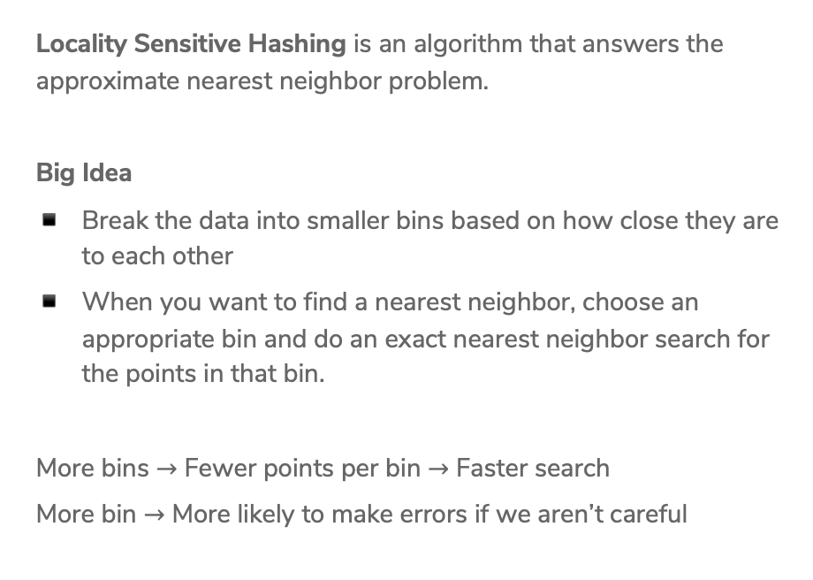
Locality Sensitive Hashing (LSH)
Locality Sensitive Hashing is an algorithm that answers the approximate nearest neighbor problem.
Big Idea
Break the data into smaller bins based on how close they are to each other
When you want to find a nearest neighbor, choose an appropriate bin and do an exact nearest neighbor search for the points in that bin.
More bins $→$ Fewer points per bin $→$ Faster search
More bin $→$ More likely to make errors if we aren’t careful

Slide 27
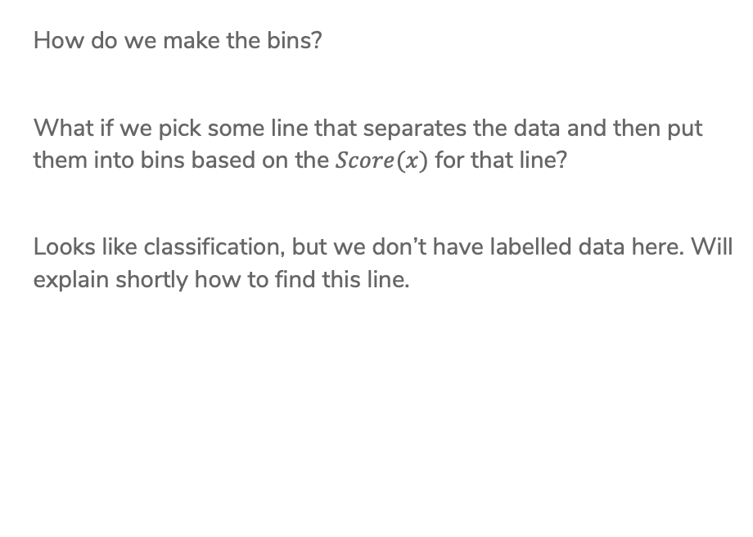
Binning
How do we make the bins?
What if we pick some line that separates the data and then put them into bins based on the $Score(x)$ for that line?
Looks like classification, but we don’t have labelled data here. Will explain shortly how to find this line.

Slide 28

Binning
Put the data in bins based on the sign of the score (2 bins total)
Call negative score points bin 0, and the other bin 1 (bin index)

Slide 29

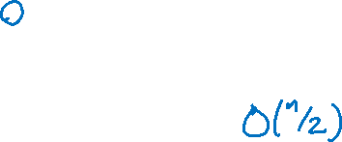
Binning
Put the data in bins based on the sign of the score (2 bins total)
Call negative score points bin 0, and the other bin 1 (bin index)
When asked to find neighbor for query point, only search through points in the same bin!
This reduces the search time to $\frac{n}{2}$ if we choose the line right.

Slide 30
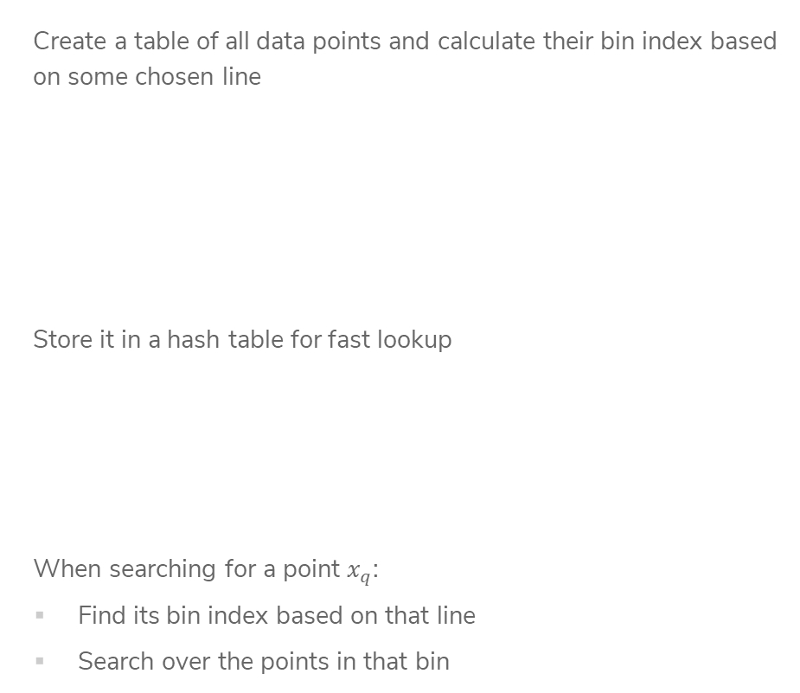
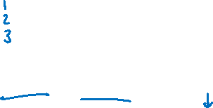
LSH with
2 bins
Create a table of all data points and calculate their bin index based on some chosen line
Store it in a hash table for fast lookup
When searching for a point $x_{q}$:
Find its bin index based on that line
Search over the points in that bin

Slide 31



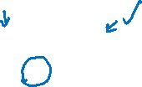








1 min
If we used LSH with this line, what would be the result returned for searching for the nearest neighbor of the green query point?
$$3$$
$$5$$
$$4$$
$$2$$
$$9$$
$1$0
$$1$$
$$6$$
$$8$$
$$7$$

Slide 32
Some Issues
How do we find a good line that divides the data in half?
Potential Errors: Points close together might be split up into separate bins
Large computation cost: Only dividing the points in half doesn’t speed things up that much…

Slide 33
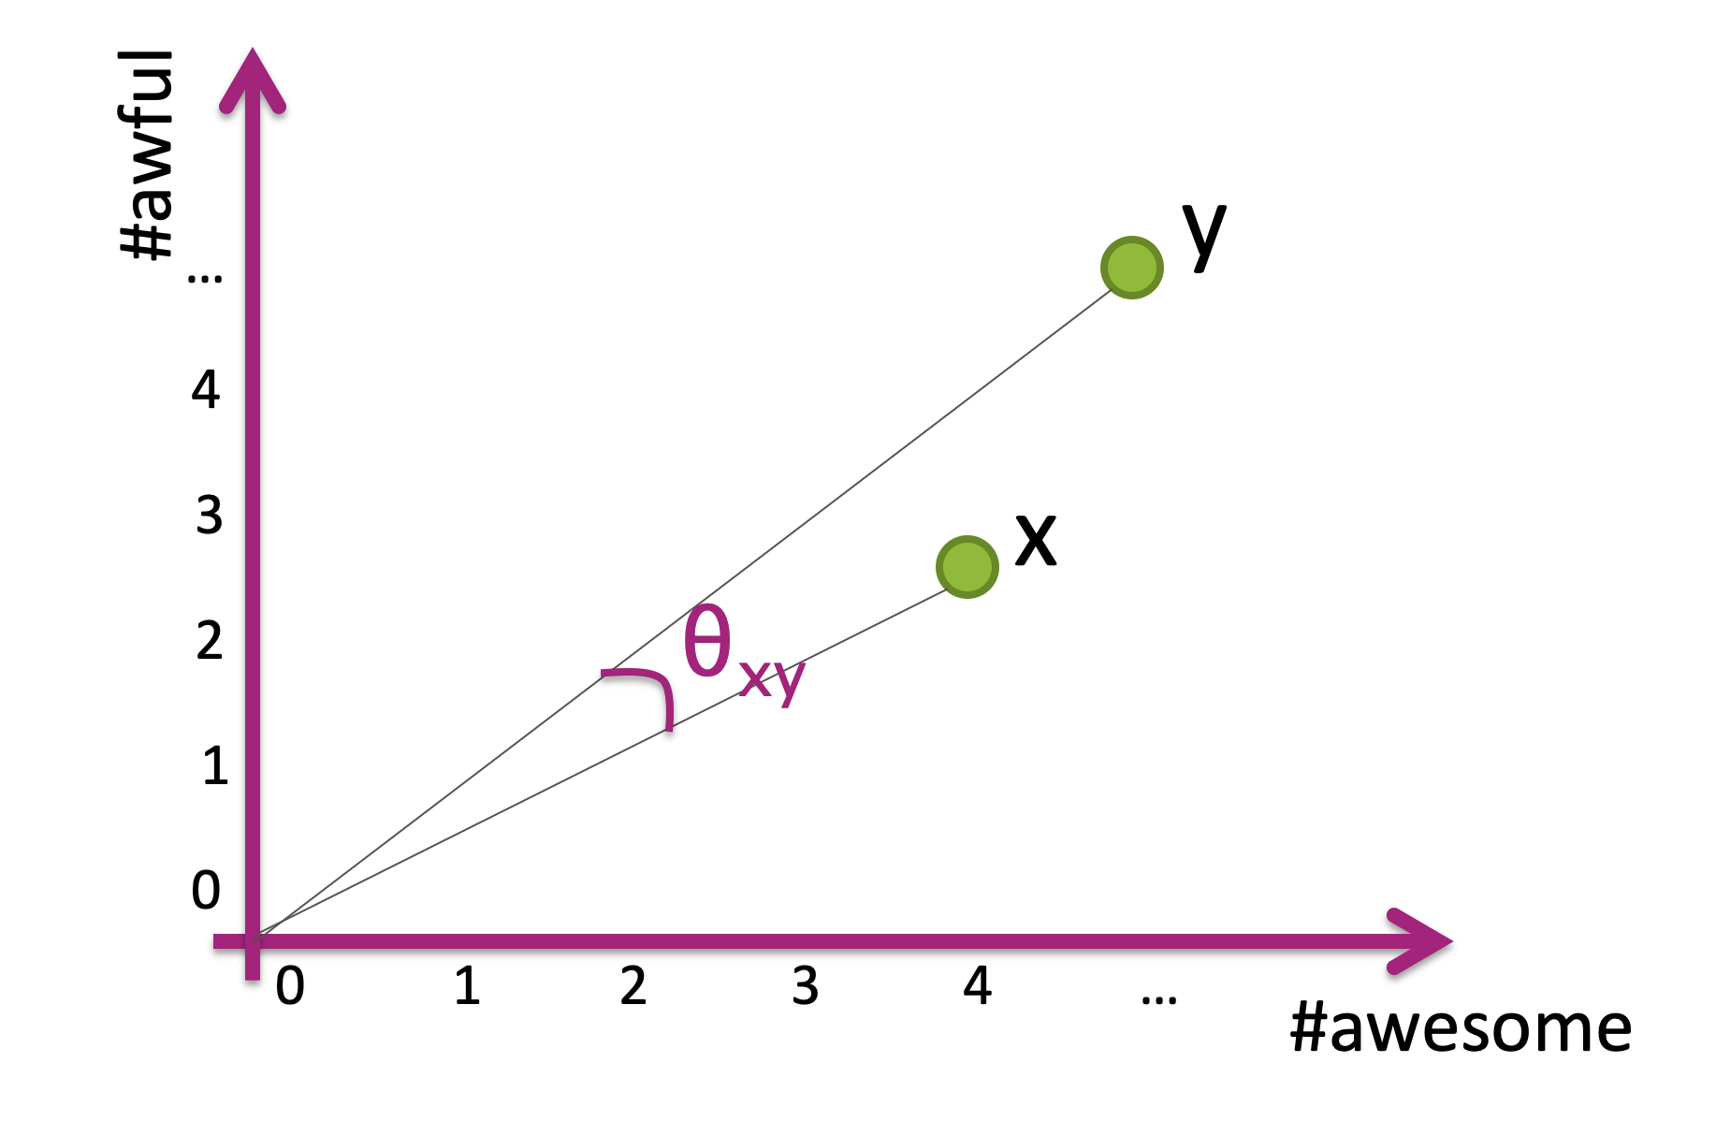

1. How to choose line?
Wild Idea: Choose the line randomly!
Choose a slope randomly between 0 and 90 degrees
How bad can randomly picking it be?
If two points have a small cosine distance, it is unlikely that we will split them into different bins!
Notes:
Draw random lines

Slide 34
Some Issues
How do we find a good line that divides the data in half?
Potential Errors: Points close together might be split up into separate bins
Large computation cost: Only dividing the points in half doesn’t speed things up that much…

Slide 35


Slide 36
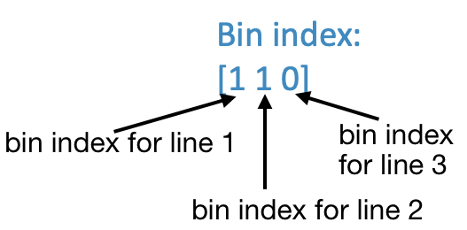

More Bins
Can reduce search cost by adding more lines, increasing the number of bins.
For example, if we use 3 lines, we can make more bins!

Slide 37
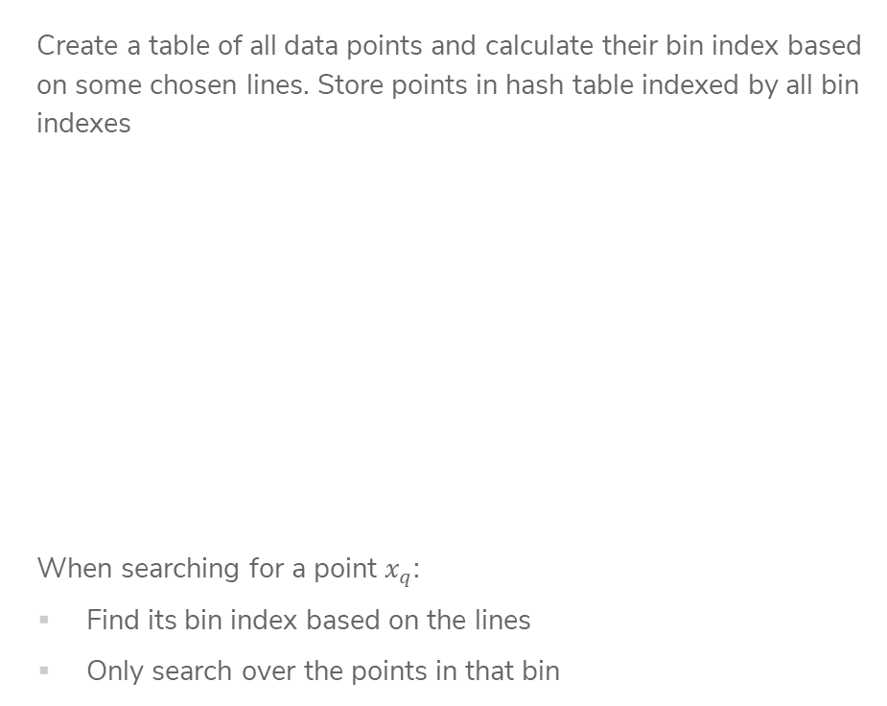
LSH with
Many Bins
Create a table of all data points and calculate their bin index based on some chosen lines. Store points in hash table indexed by all bin indexes
When searching for a point $x_{q}$:
Find its bin index based on the lines
Only search over the points in that bin
Notes:
Note about binary

Slide 38

LSH Example
Imagine my query point was (2, 2)
This has bin index [0 1 0]
By using multiple bins, we have reduced the search time!
However, it’s more likely that we separate points from their true nearest neighbors since we do more splits ☹
Often with approximate methods, there is a tradeoff between speed and accuracy.

Slide 39
Improve Quality
The nice thing about LSH is we can actually tune this tradeoff by looking at nearby bins. If we spend longer searching, we are likely to find a better answer.
What does ”nearby” mean for bins?
In practice, set some time “budget” and
keep searching nearby bins until budget
runs out
Notes:
Draw going out to 2 bits

Slide 40
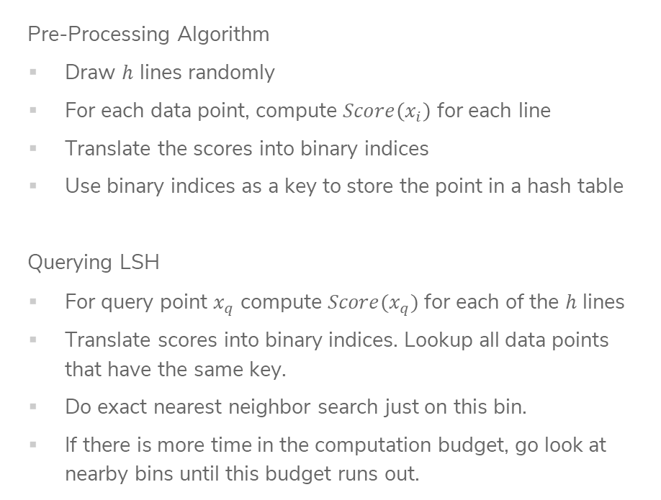
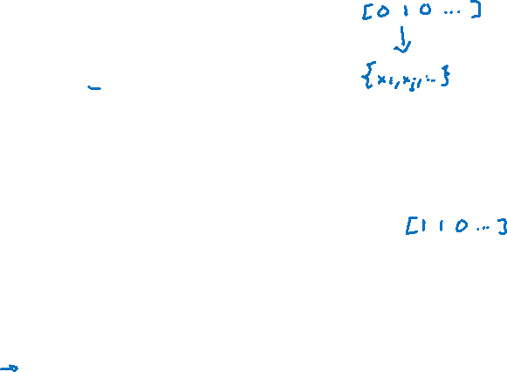
Locality Sensitive Hashing (LSH)
Pre-Processing Algorithm
Draw $h$ lines randomly
For each data point, compute $Score\left(x_{i}\right)$ for each line
Translate the scores into binary indices
Use binary indices as a key to store the point in a hash table
Querying LSH
For query point $x_{q}$ compute $Score(x_{q})$ for each of the $h$ lines
Translate scores into binary indices. Lookup all data points that have the same key.
Do exact nearest neighbor search just on this bin.
If there is more time in the computation budget, go look at nearby bins until this budget runs out.

Slide 41
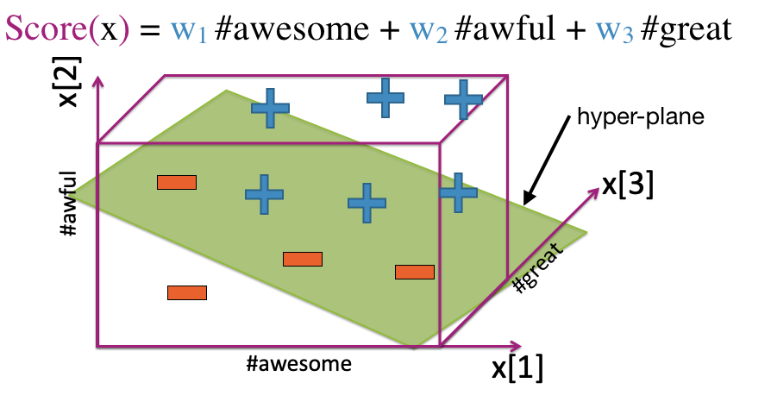

Higher Dimensions
Pick random hyper-plane to separate points for points in higher dimensions.
Unclear how to pick $h$ for LSH and you can’t do cross-validation here (why?)
Generally people use $h≈\log{(d)}$

Slide 42
Recap
Theme: Use local methods for classification and regression and speed up nearest neighbor search with approximation methods.
Ideas:
1-NN Regression and Classification
k-NN Regression and Classification
Locality Sensitive Hashing

