Slide 1
CSE/STAT 416 Recommender Systems Intro Dimensionality Reduction Hunter Schafer Paul G. Allen School of Computer Science & Engineering University of Washington May 17, 2021

Slide 2
Personalization
Personalization is transforming our experience of the world
Youtube
Netflix
Amazon
Spotify
Facebook
Many more…
Almost all have share a common trait where there are users that use the system and items that we want the user to look at.
A recommender system recommends items to a user based on what we think will be the most “useful” for the user.
Notes:
(100 hours uploaded a minute for youtube)
Before we talk about recommender system algorithms, we are going to talk about some challenges we face with recommender systems
Star next to netflix

Slide 3
Recommender System Challenges

Slide 4
Types of Feedback
Explicit - User tells us what she likes
Implicit – We try to infer what she likes from usage data
Notes:
Write “Clicked, time on site, …”

Slide 5
Top-k vs Diverse Outputs
Top-k recommendations might be very redundant
Someone who likes Rocky I also will likely enjoy Rocky II, Rocky III, Rocky IV, Rocky V
Diverse Recommendations
Users are multi-faceted & we want to hedge our bets
Maybe recommend: Rocky II, Always Sunny in Philadelphia, Robin Hood

Slide 6
Cold Start
When a new movie comes into our system, we don’t know who likes it! This is called the cold start problem.
Generally, to solve we will need “side information”
Genre, actors, if it’s a sequel
Could also try to test users to see if they like it to learn quickly

Slide 7
That’s So Last Year
Interests change over time
Is it 1967?
Or 1977?
Or 1998?
Or 2011?
Models need flexibility to adapt to users
Macro scale
Micro scale (fads)

Slide 8
Scalability
For $N$ users and $M$ movies, some approaches take $𝒪\left(N^{3}+M^{3}\right)$ time. This can be prohibitively slow for billions of users.
Big focus has been on:
Efficient implementations
Exact or faster approximate methods as needed

Slide 9
Popularity
Solution 0

Slide 10
Popularity
Simplest Approach: Recommend whatever is popular
Rank by global popularity (i.e. Avengers Endgame)
Limitations
No personalization
Feedback loops

Slide 11
Classification Model
Solution 1

Slide 12
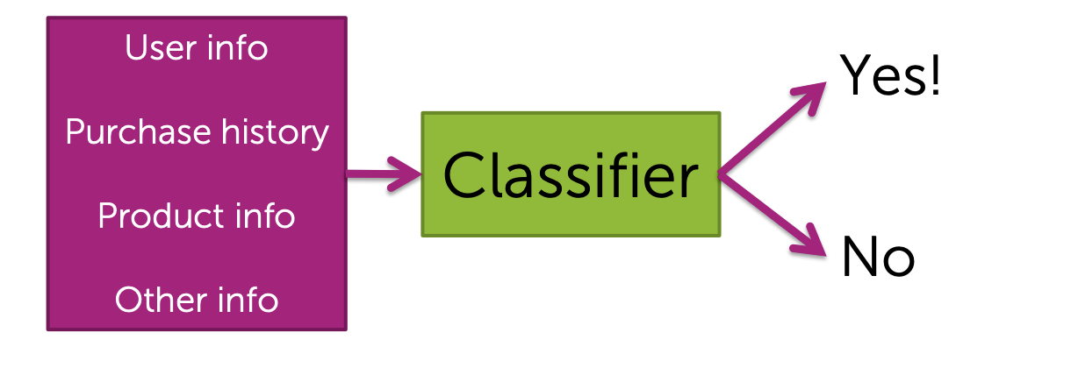
Learn a Classifier
Train a classifier to learn whether or not someone will like an item
Pros
Personalized
Features can capture context (time of day, recent history, …)
Can even handle limited user history (age of user, location, …)

Slide 13
Learn a Classifier
Train a classifier to learn whether or not someone will like an item
Cons
Features might not be available or hard to work with
Often doesn’t perform well in practice when compared to more advanced techniques like collaborative filtering
Can still lead to feedback loops.

Slide 14
Roadmap
We will learn more advanced ideas for recommendation. Before that, we want to explore a slightly unrelated idea of dimensionality reduction.
This will be useful in helping us think about some key ideas for what can make recommendation useful.
A very general/powerful tool useful in other ML applications.
Today:
Recommender System Intro
Dimensionality Reduction (PCA)
Wednesday
Matrix Factorization

Slide 15
Dimensionality Reduction

Slide 16
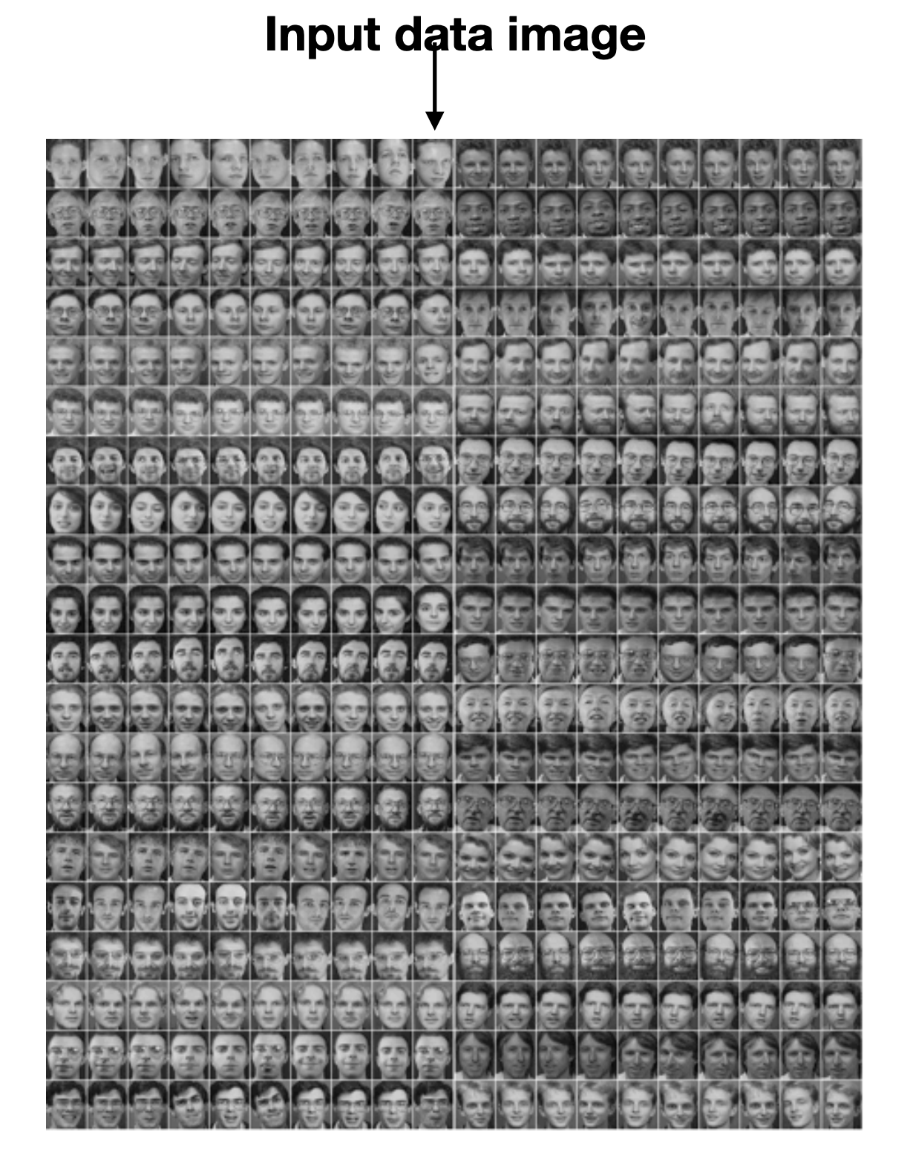
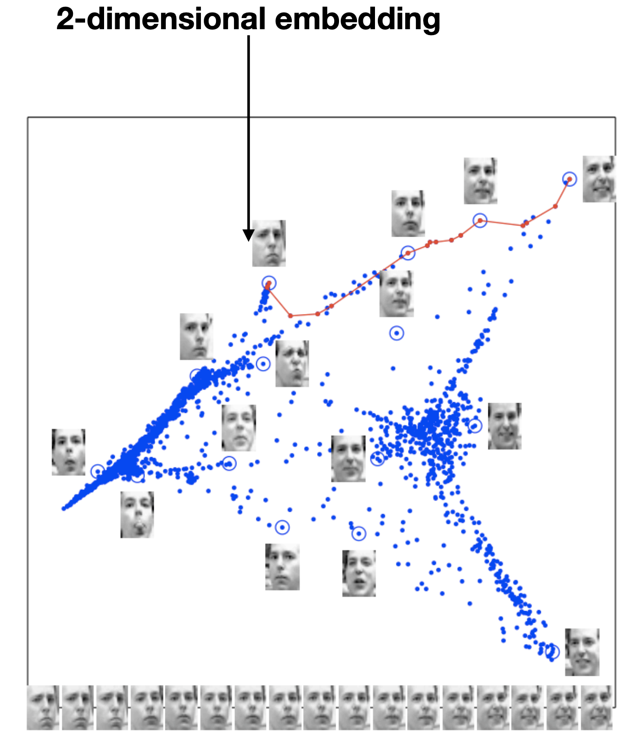
Embedding Pictures
Example: Embed high dimensional data in low dimensions to visualize the data
Goal: Similar images should be near each other.
Notes:
Write: Image -> (x, y)
Similar images are close together
Horizontal corresponds to smiling or not, vertical is about face rotation
We want to learn properties like this automatically from the data itself!

Slide 17
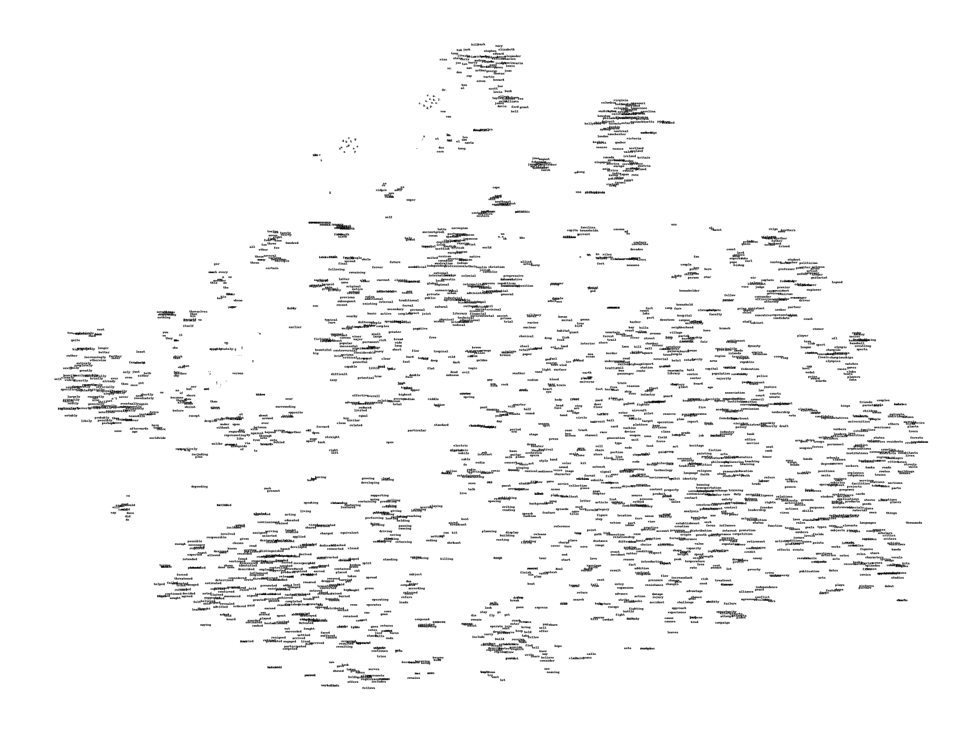
Embedding Words

Slide 18
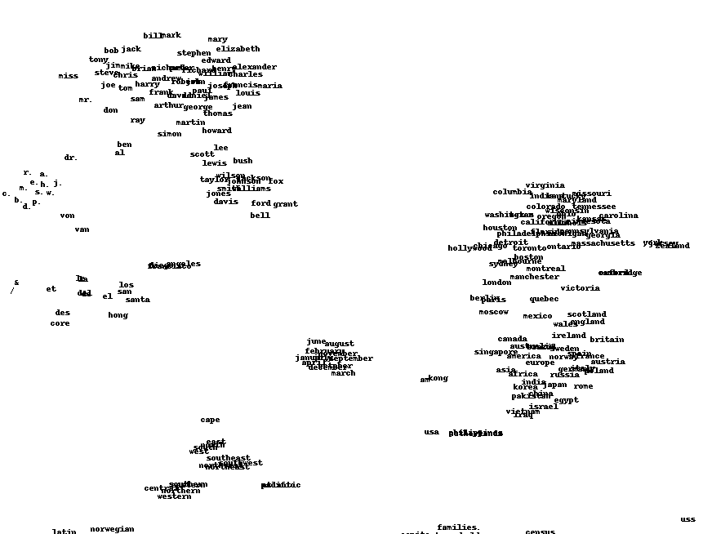
Embedding Words
Notes:
Circle ”Names”, “Months”, “Places”
Not the same as clustering necessarily, clustering is given an embedding find the groups within it.
Now we are given a bunch of raw data, and want to come up with a good embedding (maybe even an embedding that makes clustering work well!)
These embeddings can be good to reduce the dimensionality of the data (“write dim reduction”) which can make data processing easier and/or help with visualizing data!

Slide 19
Dimensionality Reduction
Input data might have thousands or millions of dimensions!
Dimensionality Reduction is the the task of representing the data with a fewer number of dimensions, while keeping meaningful relations between data
Easier Learning: fewer parameters, no curse of dimensionality
Visualization: Hard to visualize more than 3D
Discover “intrinsic dimensionality” of the data
High dimensional data is can sometimes be truly lower dimensional (i.e. redundant information)
Notes:
Example of low intrinsic dimensionality is MNIST, only need about 5 meaningful features to make good predictions!

Slide 20
PCA
One very popular dimensionality reduction algorithm is called Principal Component Analysis (PCA).
Idea: Use a linear projection from $d$-dimensional data to $k$-dimensional data
E.g. 1000 dimension word vectors to 3 dimensions
Choose the projection that minimizes reconstruction error
Idea: The information lost if you were to ”undo” the projection

Slide 21
Linear Projections
Could do something like feature importance and find the subset of features with most meaningful information.
A popular approach is to create new features that are combinations of existing features
Benefit: We can do this in the unsupervised setting when we only know x and not y!
Notes:
Write: z_i[1] = 2.5x_i[1] + 3x_i[2] -7 x_i[3] + …
Write: z_i[2] = ….
Came up with two features based on all the others.

Slide 22
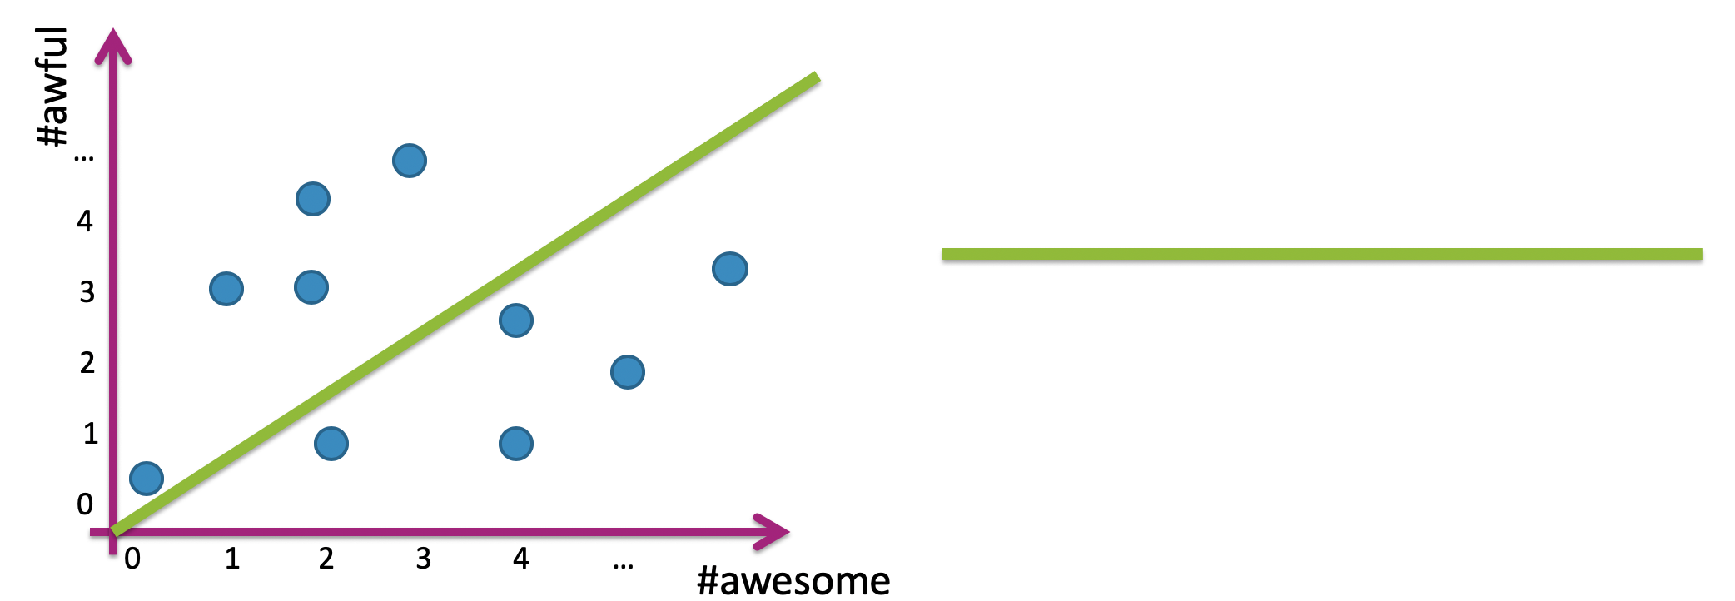
Linear Projection
Project data into 1 dimension along a li
Notes:
Draw $u_{i}$ on green line
Label a couple points, Draw lines going down to green line from points, draw points on green line
$z_{i}=u_{1}^{T}x_{i}$
Draw reminder of how this inner product works

Slide 23
Reconstruction
Reconstruct original data only knowing the projection
Notes:
Quickly draw points from last example on $u_{1}$, label $z_{i}$
Switch colors to purple, draw reconstructed points on line ${\hat{x}}_{i}$
Equation: ${\hat{x}}_{i}=z_{i}u_{1}$
Notice that there is reconstruction error! ${\hat{x}}_{1}≠x_{1}$

Slide 24
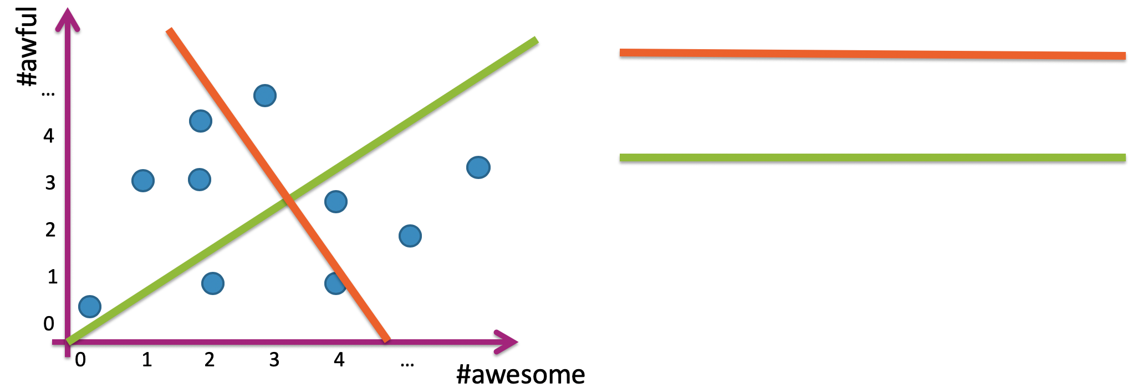
Projection w/ 2 Dimensions
What if projected onto $d$ orthogonal vectors?
Notes:
Label green as $u_{1}$ and orange as $u_{2}$
Show individual projects (different colors)
Write $z_{i}\left[1\right]=u_{1}^{T}x_{i}$ and $z_{i}\left[2\right]=u_{2}^{T}x_{i}$
If I only had to choose one line, which one would I choose?
Less reconstruction error with the line that is more spread

Slide 25
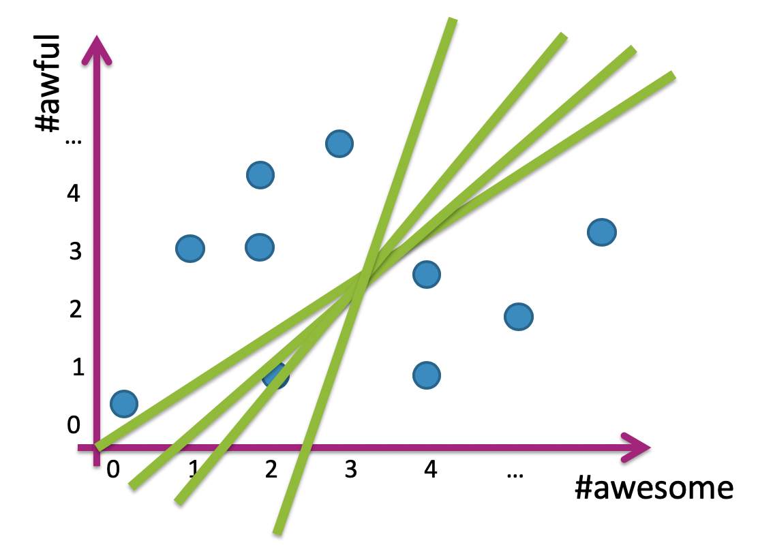
Which Line?
Given a dataset, how do we choose which line to project on?
Extreme Example
Notes:
Extreme examples of mostly 1-d data
Choose direction with greatest variation

Slide 26
PCA Visualized
This process can work with any dimension data (go from $d$ dimensions to $k$ dimensions).
PCA Explained Visually: http://setosa.io/ev/principal-component-analysis/

Slide 27
1 min
Assume we were trying to reduce the dimension of 3d data to 2d data, which of the following would be the result of PCA? Assume we are using the data from the visual demo and take pc1 and pc2 as the principal components.

Slide 28
2 min
Assume we were trying to reduce the dimension of 3d data to 2d data, which of the following would be the result of PCA? Assume we are using the data from the visual demo and take pc1 and pc2 as the principal components.

Slide 30
PCA Algorithm
Input Data: An $n×d$ data matrix $X$
Each row is an example
Recenter Data: Subtract mean from each row $X_{c}←X −\overline{X}[1:d]$
Compute spread/orientation: Compute covariance matrix $Σ$ $Σ\left[t, s\right]= \frac{1}{n}\sum_{i=1}^{n}{x_{c, i}\left[t\right]x_{c,i}[s]}$
Find basis for orientation: Compute eigenvectors of $Σ$
Select $k$ eigenvectors $u_{1}, …, u_{k}$ with largest eigenvalues
Project Data: Project data onto principal $z_{i}\left[1\right]=u_{1}^{T}x_{c,i }=u_{1}\left[1\right]x_{c,i}\left[1\right]+…+u_{1}\left[d\right]x_{c,i}\left[d\right]$ $…$ $z_{i}\left[k\right]=u_{k}^{T}x_{c,i }=u_{k}\left[1\right]x_{c,i}\left[1\right]+…+u_{k}\left[d\right]x_{c,i}\left[d\right]$
Notes:
Draw data matrix up above
Draw dataset below
Show covariance matrix to side
Draw eigenvectors below
Show newly projected data

Slide 31
Reconstructing Data
Using principal components and the projected data, you can reconstruct the data in the original domain.
$${\hat{x}}_{i}\left[1:d\right]=\overline{X}\left[1:d\right]+ \sum_{j=1 }^{k}{z_{i}\left[j\right]{ u}_{j}}$$
Notes:
Draw picture of reconstructed data

Slide 32
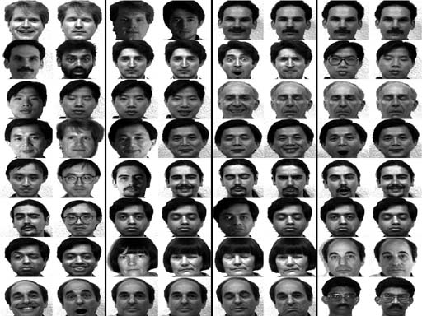
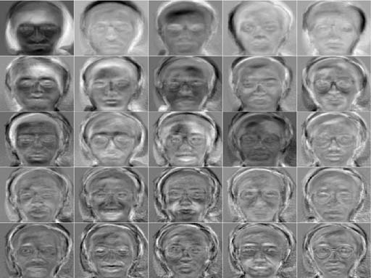
Example: Eigenfaces
Apply PCA to face data
Input Data
Principal Components
Notes:
Write how input image are high dim
Write how each PC is still high dim, but we can use them to transform the data to 25 dimensions

Slide 33
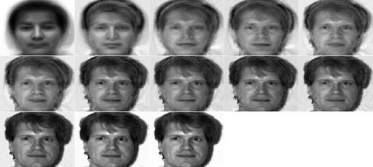
Reconstructing Faces
Depending on context, it may make sense to look at either original data or projected data.
In this case, let’s see how the original data looks after using more and more principal components for reconstruction.
Each image shows additional 8 principal components
Notes:
Write ${\hat{x}}_{i}=\overline{X}\left[1:d\right]+∑z_{j}u_{j}$

Slide 34
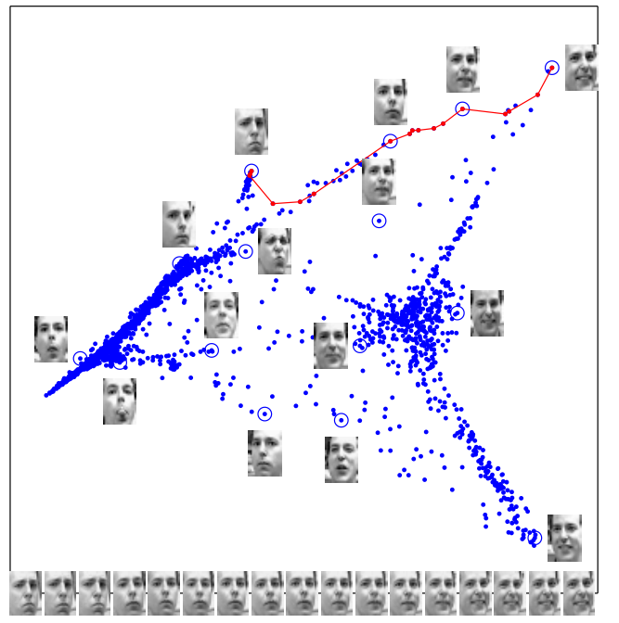
Embedding Images
Other times, it does make sense to look at the data in the projected space! (Usually if $k≤3$)

Slide 35
Example: Genes
Dataset of genes of Europeans (3192 people; 500,568 loci) and their country of origin, ran PCA on the data and plotted 2 principal components.

Slide 36
1 min
Using the PCA algorithm described in class on this gene data is an example of a:
Supervised Learning Problem
Unsupervised Learning Problem
Neither
I’m not sure

Slide 37
Scaling Up
Covariance matrix $Σ$ can be very large with high-dimensional data
$Σ∈ℝ^{d×d}$ which can be quite large for 10,000 features
This means finding the principal components will be slow
In practice, you can use the Singular Value Decomposition (SVD)
Can be used to find the $k$ eigenvectors with largest eigenvalue
Very fast implementations available
Don’t care if you know what SVD is, but you will likely use it in practice if you are doing anything with PCA.

Slide 38
PCA Failure Modes
PCA assumes there is a lower dimensional linear subspace that represents the data well. Works some times, but can fail in practice.
May want to look into non-linear dimensionality reduction
Manifold learning
Popular: SDD Maps, Isomap, LLE, t-SNE

Slide 39
PCA Recap
Dimensionality Reduction
Why and when it’s important
Principal Component Analysis (PCA)
High level intuition for what the algorithm is doing
Goal: Minimizing reconstruction error

