Slide 1
CSE/STAT 416
K-Means Clustering
Pemi Nguyen
University of Washington
May 2, 2022
Slides by Hunter Schafer

Slide 2
Recap
For the past 5 weeks, we have covered different supervised learning algorithms
Now, we’re going to explore unsupervised learning methods where don’t have labels / outputs in your datasets anymore

Slide 3
Clustering

Slide 4
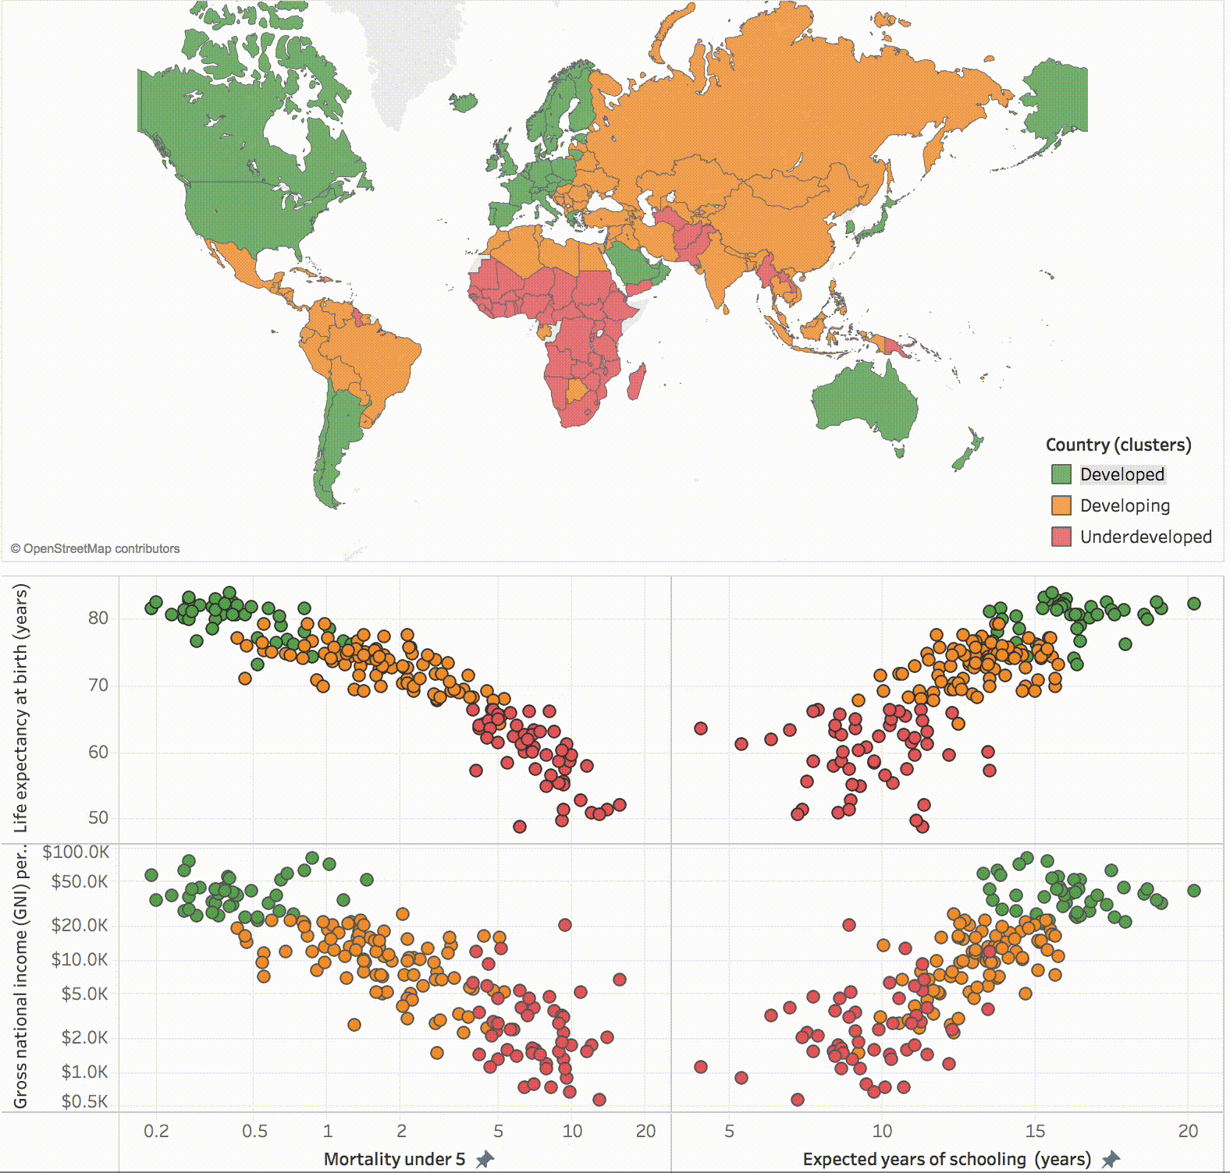
Clustering

Slide 5
Recommending News
User preferences are important to learn, but can be challenging to do in practice.
People have complicated preferences
Topics aren’t always clearly defined

Slide 6
Labeled Data
What if the labels are known? Given labeled training data
Can do multi-class classification methods to predict label

Slide 7
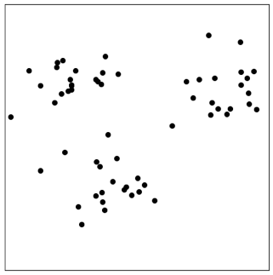



Unsupervised Learning
In many real world contexts, there aren’t clearly defined labels so we won’t be able to do classification
We will need to come up with methods that uncover structure from the (unlabeled) input data $X$.
Clustering is an automatic process of trying to find related groups within the given dataset.
$$Input:x^{(1)},x^{(2)},…,x^{(n)}$$
$$Output:y^{(1)},y^{(2)},…,y^{(n)}$$
Notes:
Write ”unsupervised learning”
Draw circles around clusters
Write z_i \in [1, …, k]
Show some examples

Slide 8
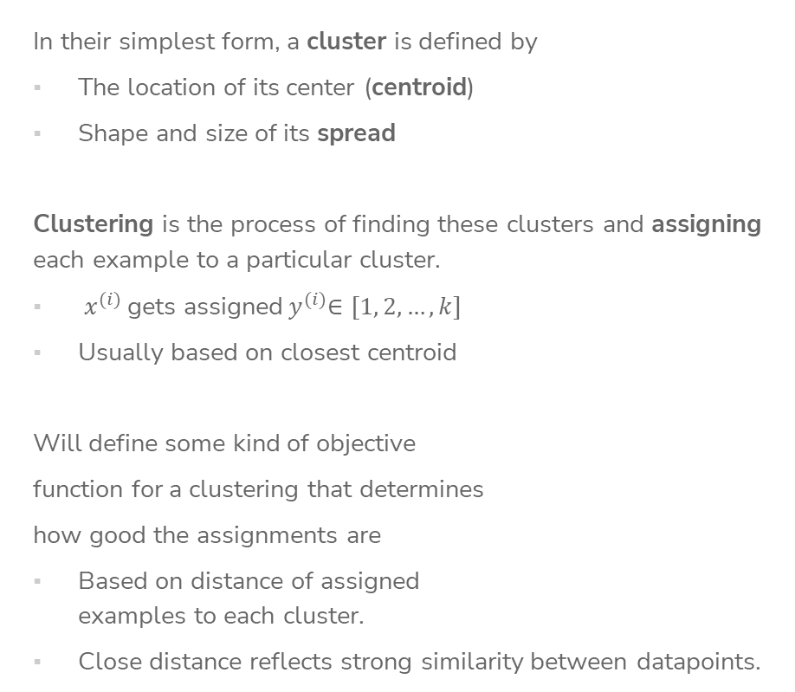
Define Clusters
In their simplest form, a cluster is defined by
The location of its center (centroid)
Shape and size of its spread
Clustering is the process of finding these clusters and assigning each example to a particular cluster.
${ x}^{(i)}$gets assigned${ y}^{(i)}∈[1, 2, …,k]$
Usually based on closest centroid
Will define some kind of objective
function for a clustering that determines
how good the assignments are
Based on distance of assigned
examples to each cluster.
Close distance reflects strong similarity between datapoints.

Slide 9
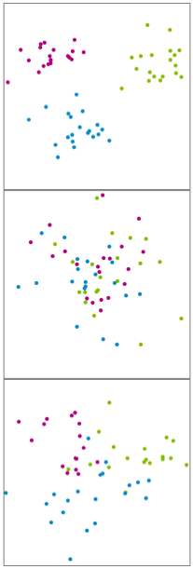
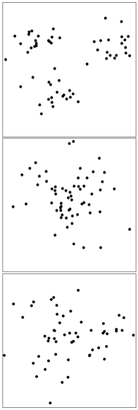
When does this works for k means?
Clustering is easy when distance captures the clusters.
Ground Truth (not visible) Given Data
Doable
Not possible
Not possible
Notes:
Try top draw clustesr
Easy
Impossible
Maybe?

Slide 10
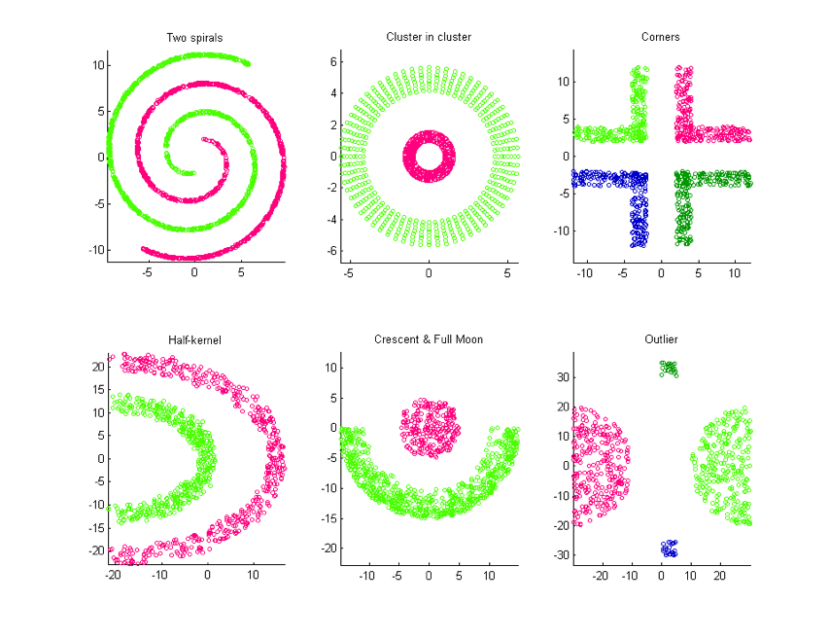
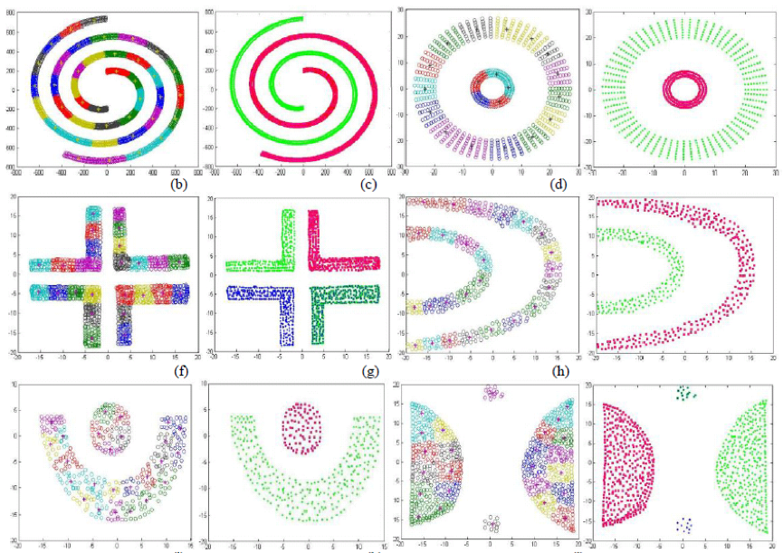
Clustering is not always straight- forward
There are many clusters that are harder to learn with this setup
Distance does not determine clusters

Slide 11
K-Means Clustering

Slide 12
K-Means
Clustering
Algorithm
We define the criterion of assigning point to a cluster based on its distance.
Shorter distance => Better Clustering
Algorithm
Given a dataset of n datapoints and a particular choice of k
Step 0: Initialize cluster centroids randomly
Repeat until convergence:
Step 1: Assign each example to its closest cluster centroid
Step 2: Update the centroids to be the average of all the points
assigned to that cluster

Slide 13
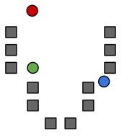




Step 0
Start by choosing the initial cluster centroids
A common default choice is to choose centroids $μ^{\left(1\right)},…,μ^{\left(k\right)}$randomly
Will see later that there are smarter ways of initializing
$$μ^{\left(1\right)}$$
$$μ^{\left(2\right)}$$
$$μ^{\left(3\right)}$$

Slide 14
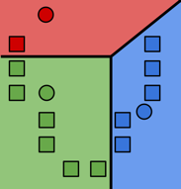

Step 1
Assign each example to its closest cluster centroid
For $i$= 1 to n
$$y^{(i)}←\underset{j}{argmin}{{\left|\left|μ^{\left(j\right)} −x^{\left(i\right)}\right|\right|}_{2}^{2}}$$
Notes:
Draw the distance between green point and all centroids
Looks like a decision boundary, but is inferred without labels!

Slide 15
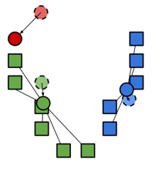

Step 2
Update the centroids to be the mean of all the points assigned to that cluster.
For $j$ = 1 to k
$$μ^{(j)}=\frac{\sum_{i=1}^{n}{1}\left\{y^{(i)}=j\right\}{ x}^{(i)}}{\sum_{i=1}^{n}{1}\left\{y^{(i)}=j\right\}}$$
Computes center of mass for cluster!

Slide 16
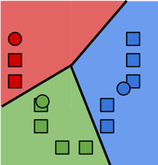
Repeat until convergence
Repeat Steps 1 and 2 until convergence
Stopping conditions
Cluster assignments haven’t changed
Centroids haven’t changed
Some number of max iterations
have been passed
What will it converge to?
Local Optima
Global optima
Neither
Notes:
Cross out global / neither
Draw squiggle curve

Slide 17
Visualization

Slide 18
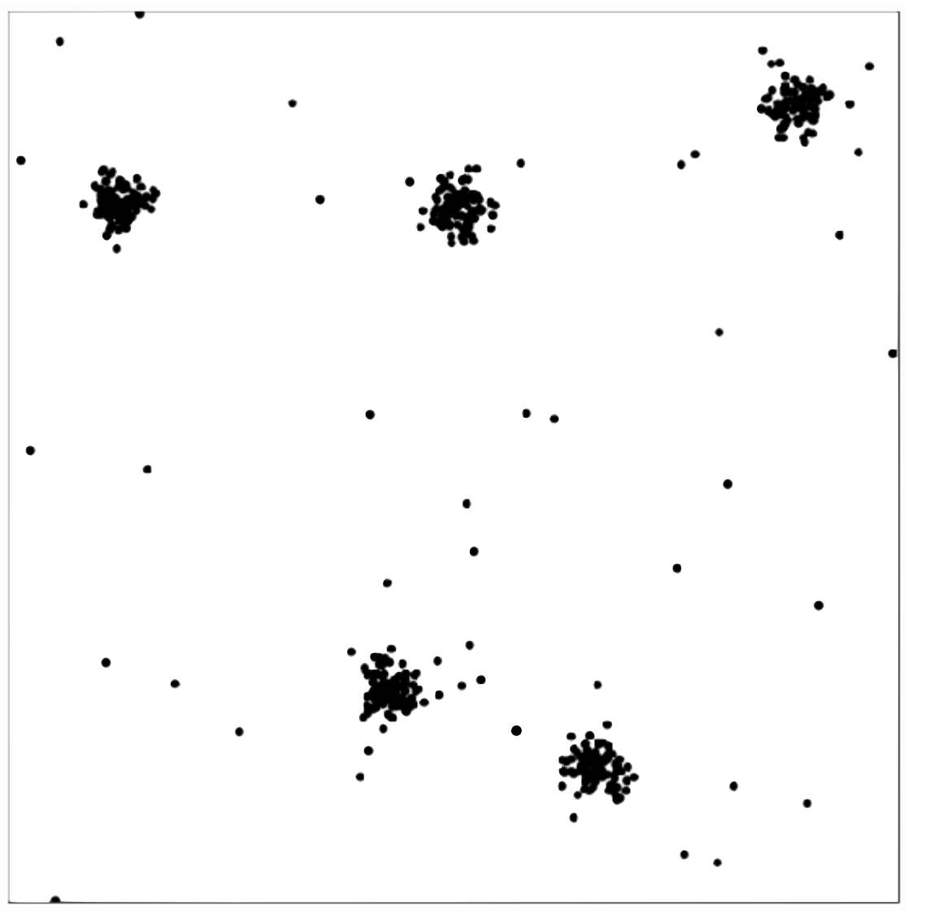

Slide 19
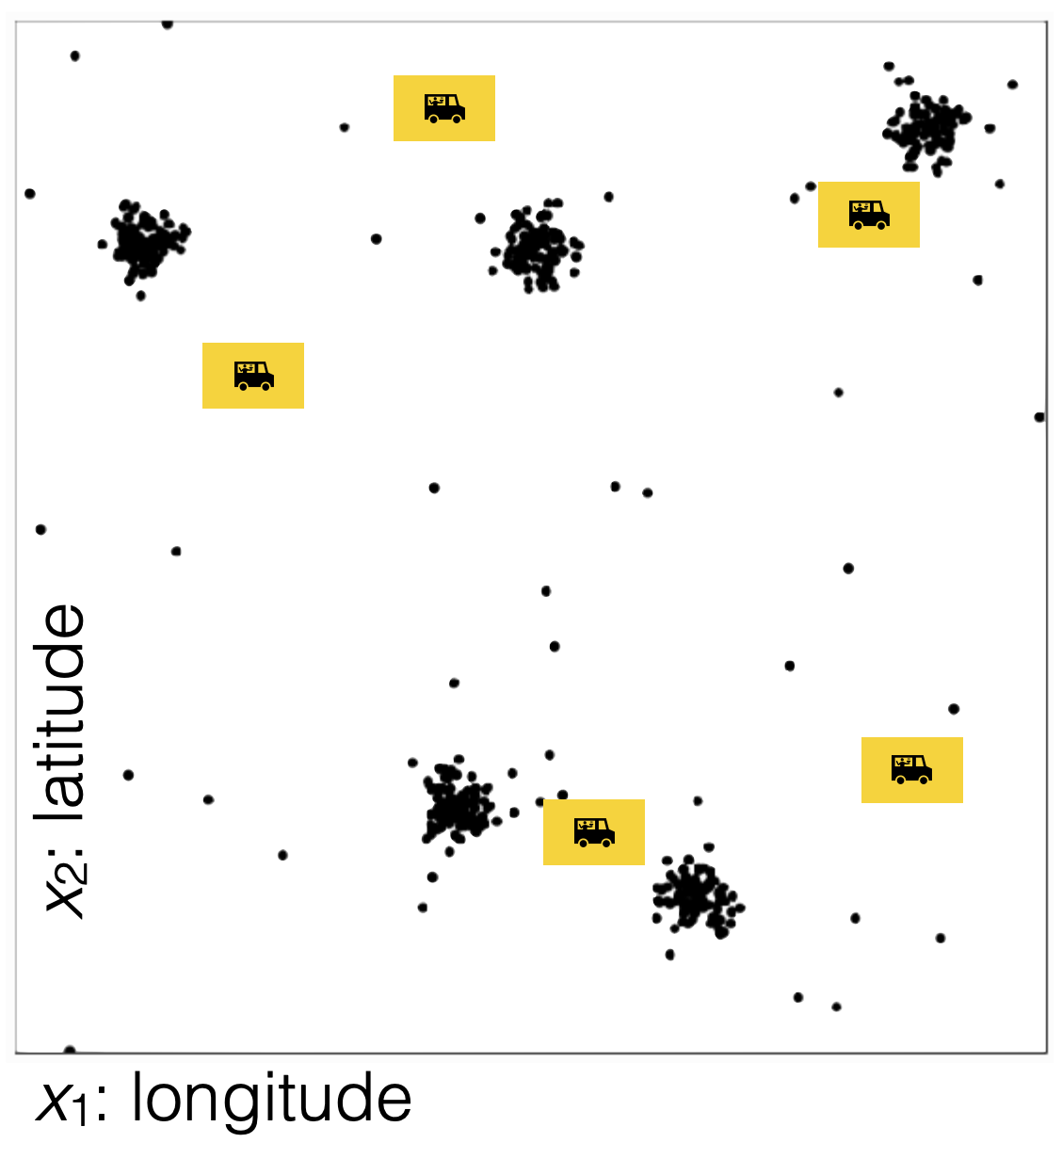

Slide 20
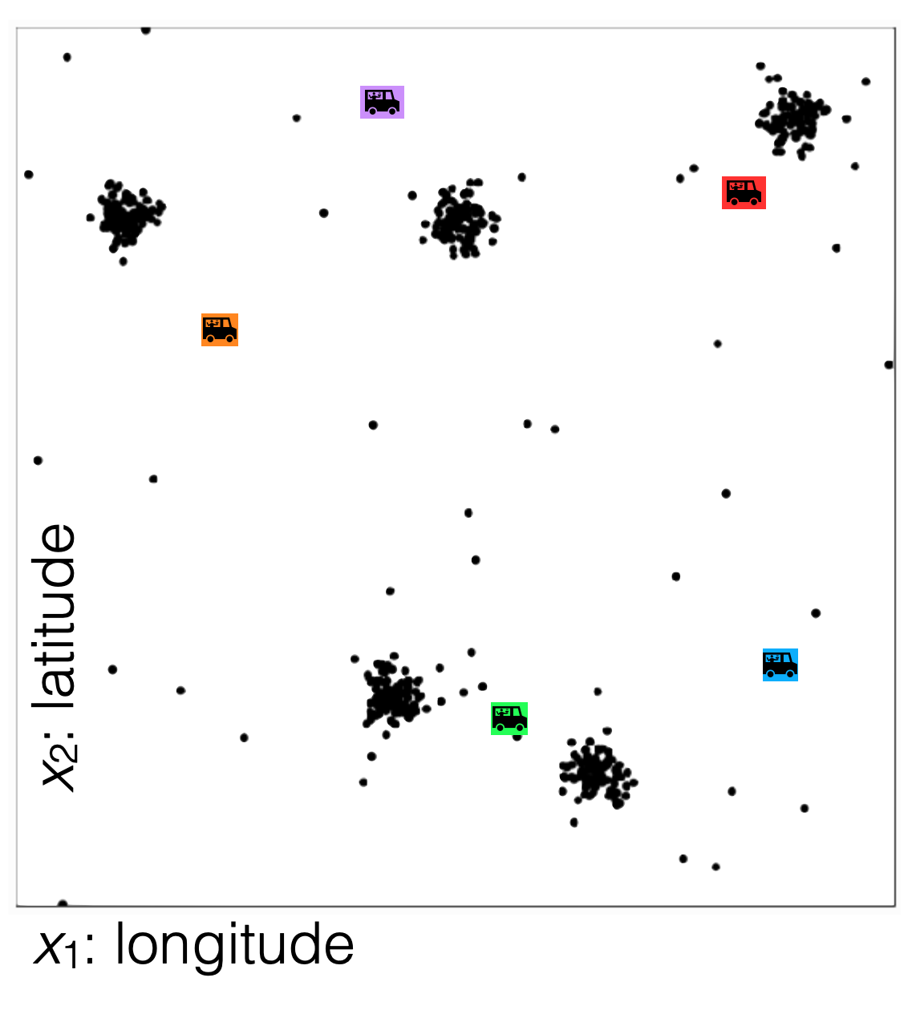

Slide 21
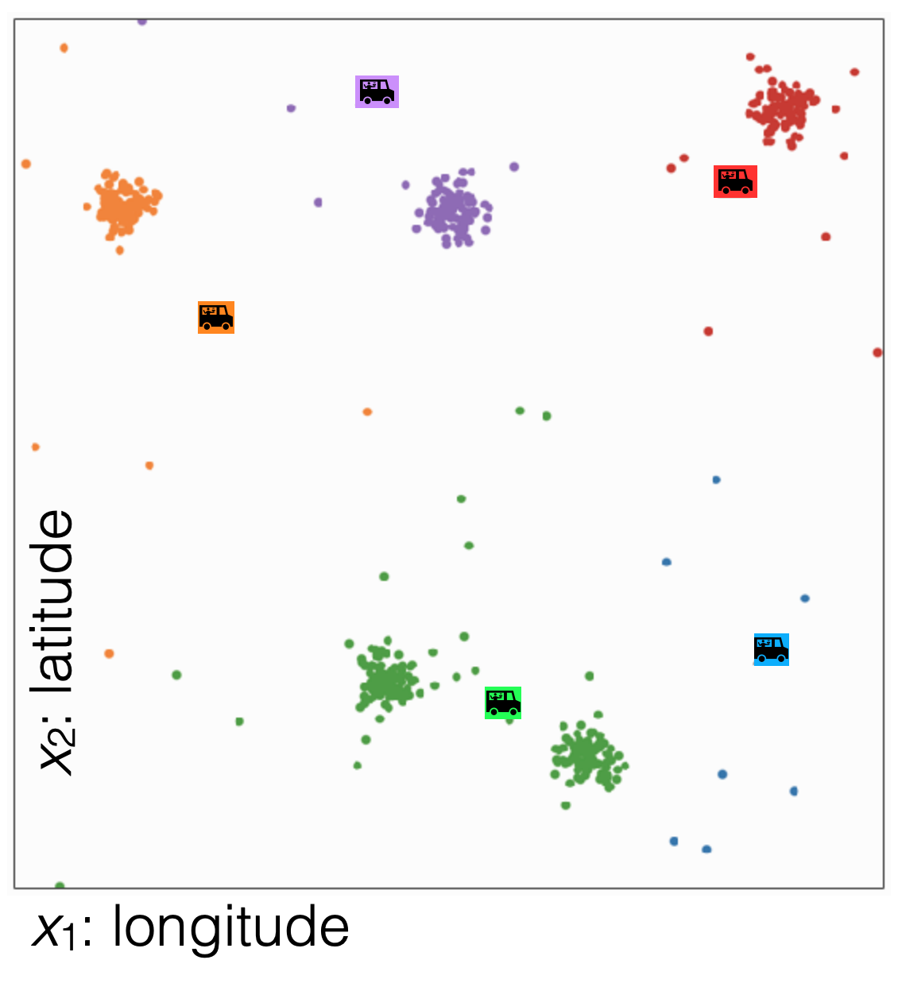

Slide 22
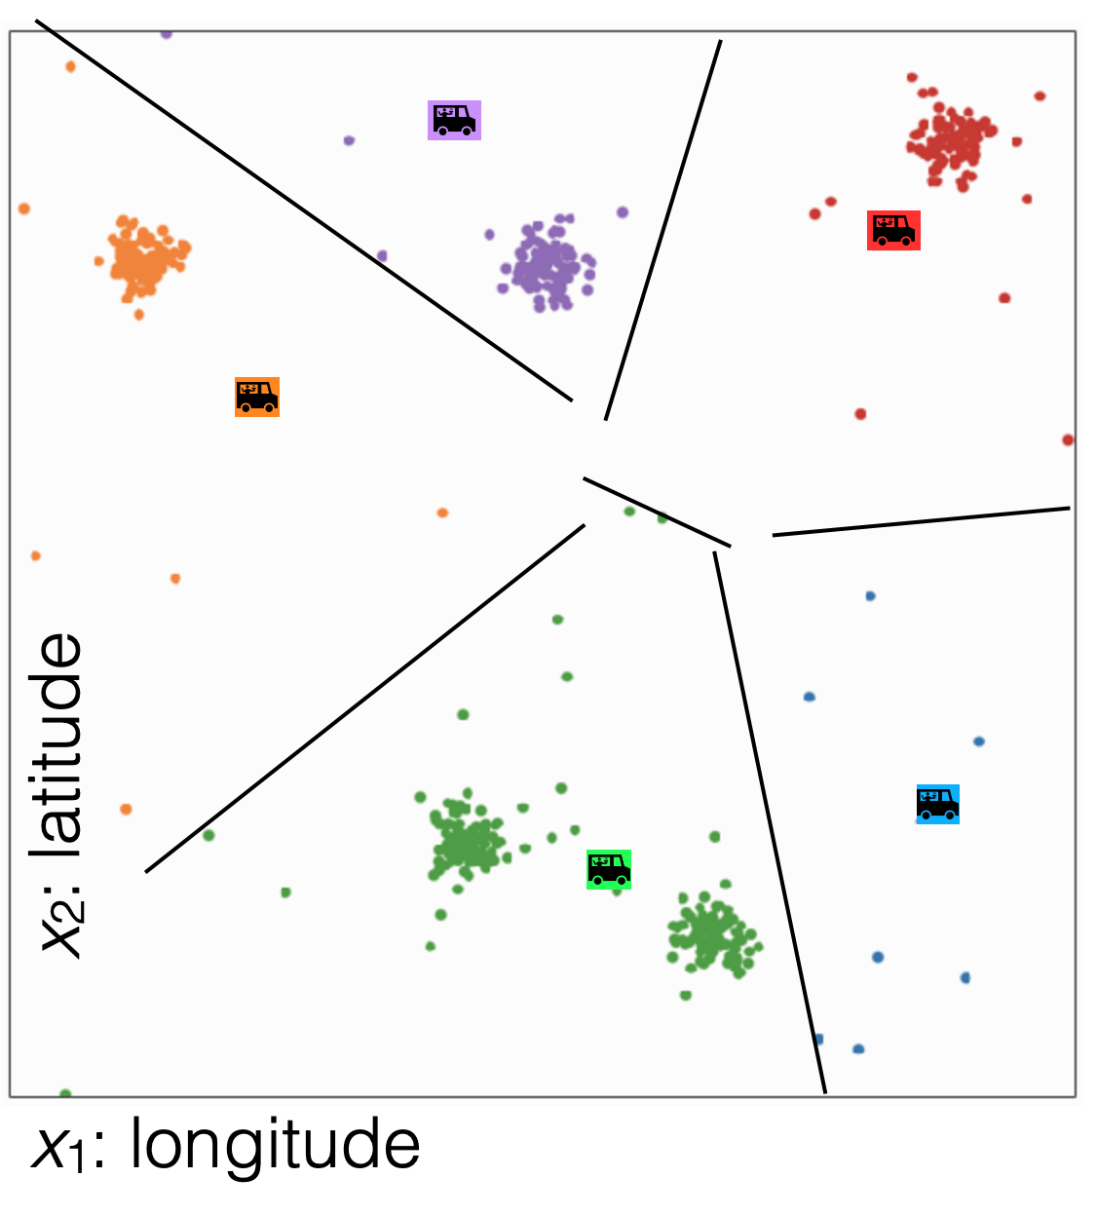

Slide 23
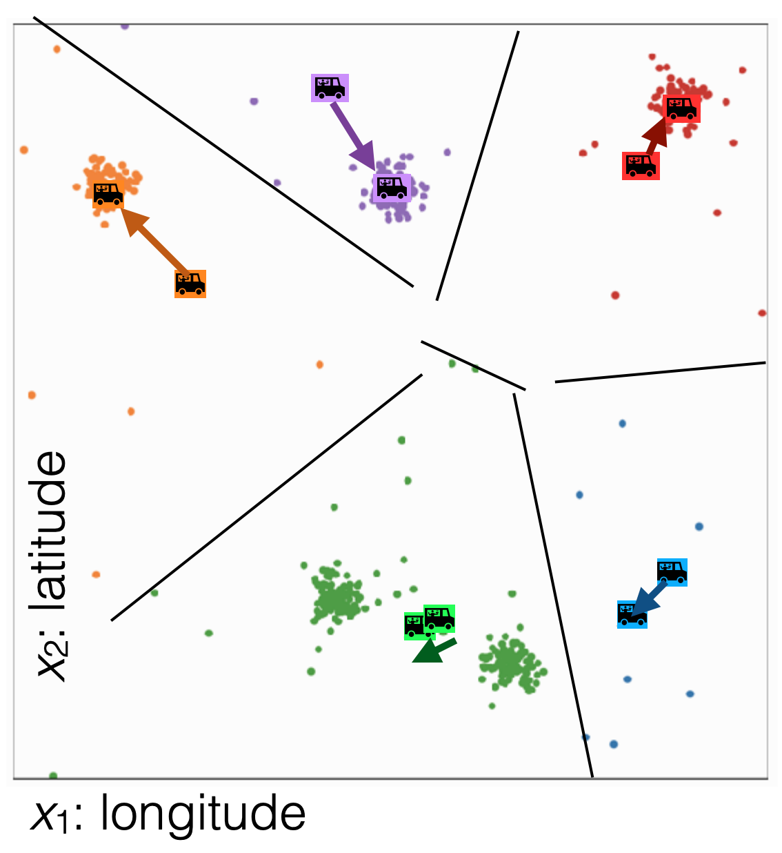

Slide 24
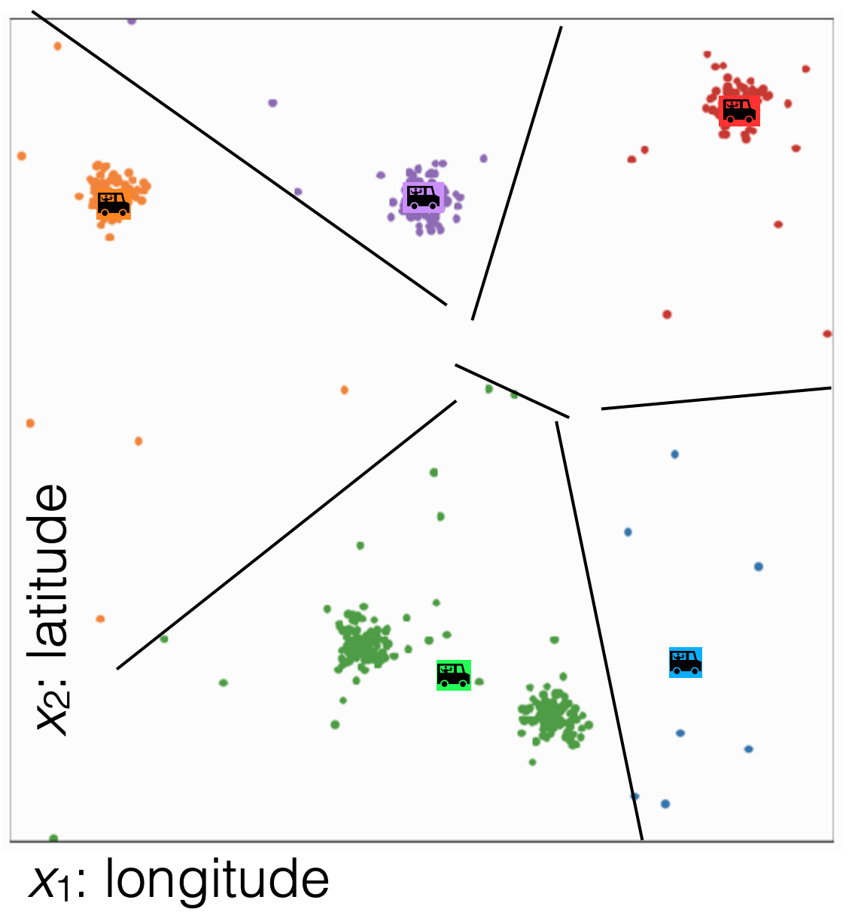

Slide 25
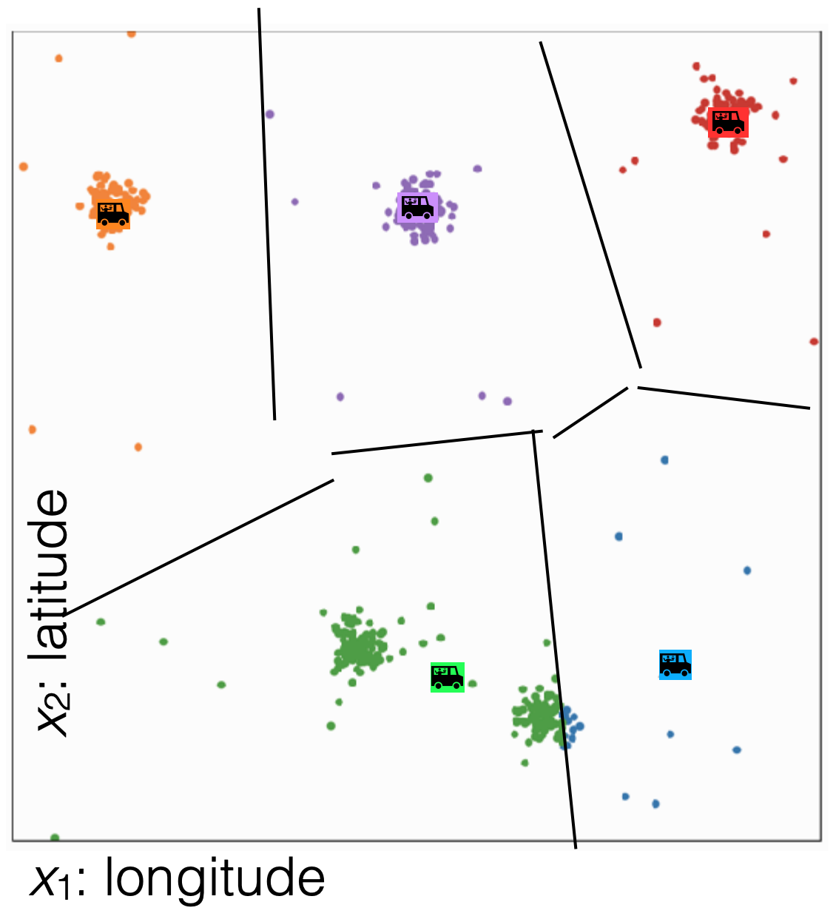

Slide 26
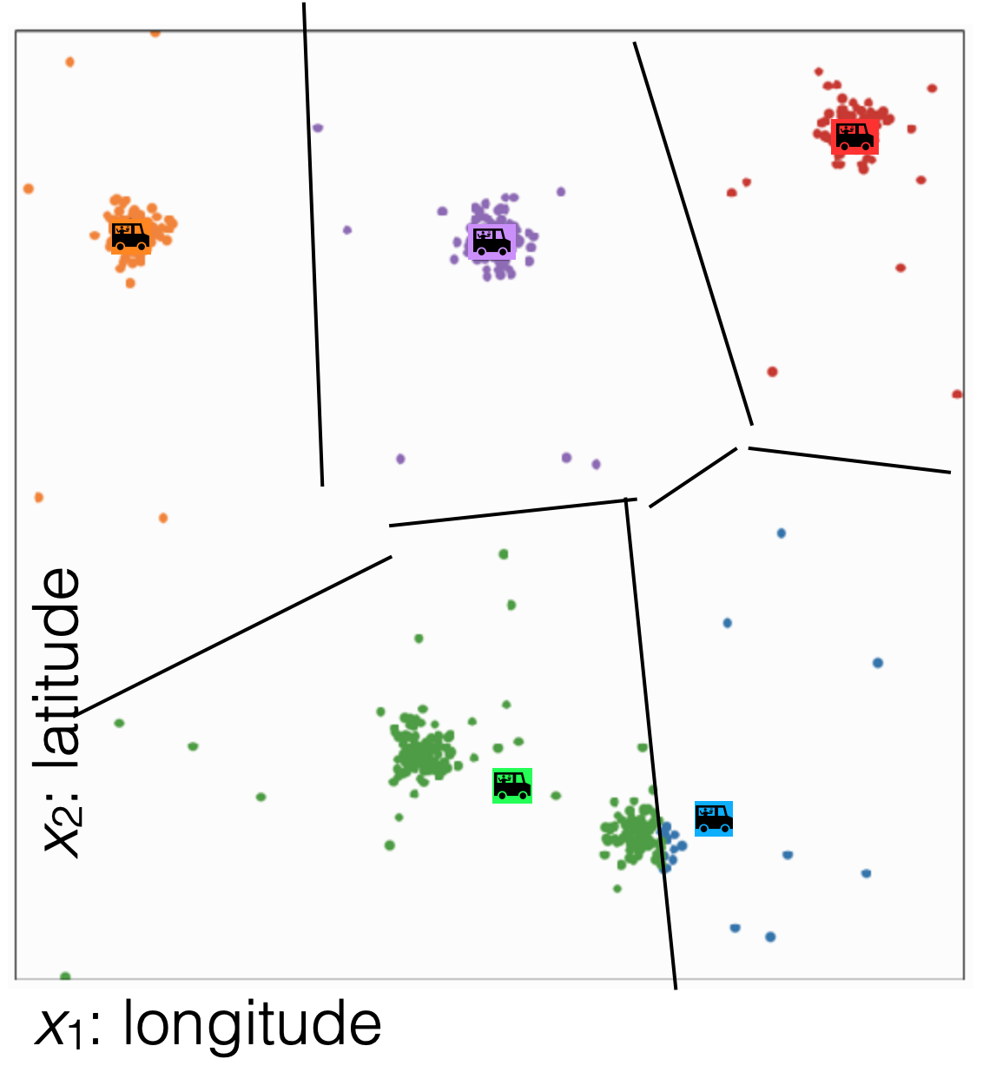

Slide 27
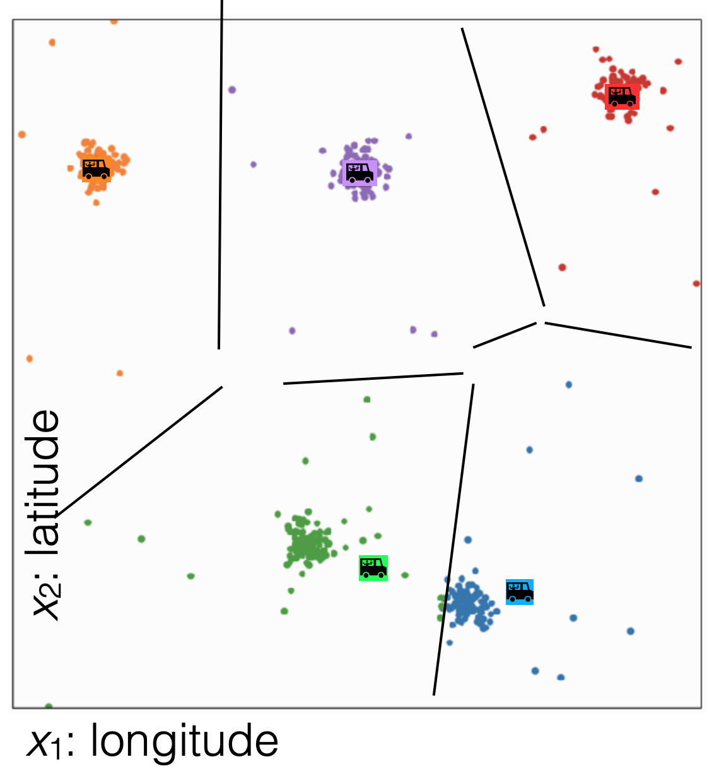

Slide 28
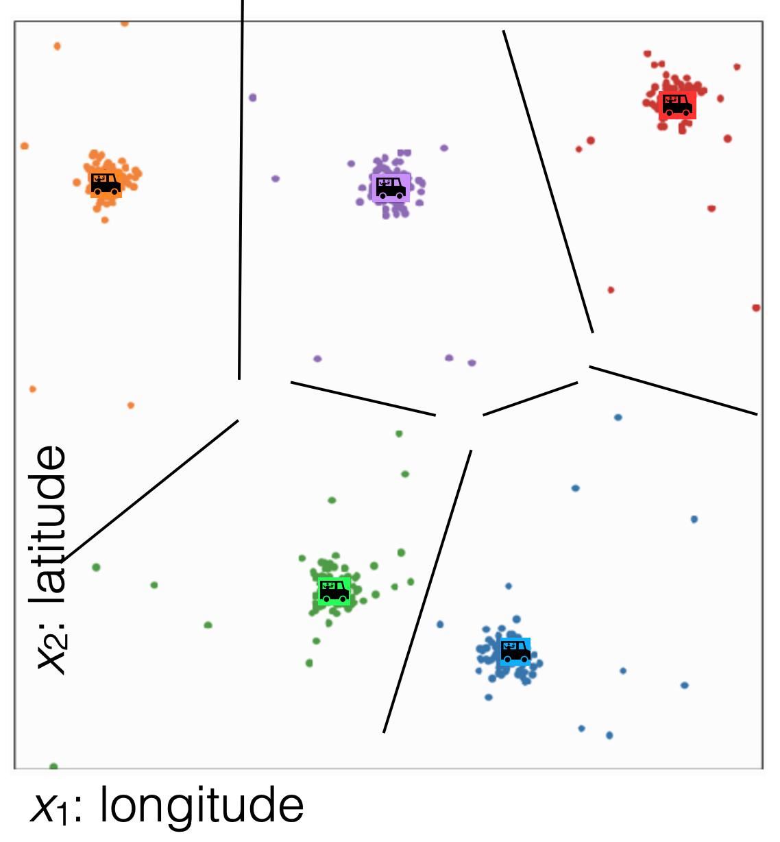

Slide 29
No more changes

Slide 30
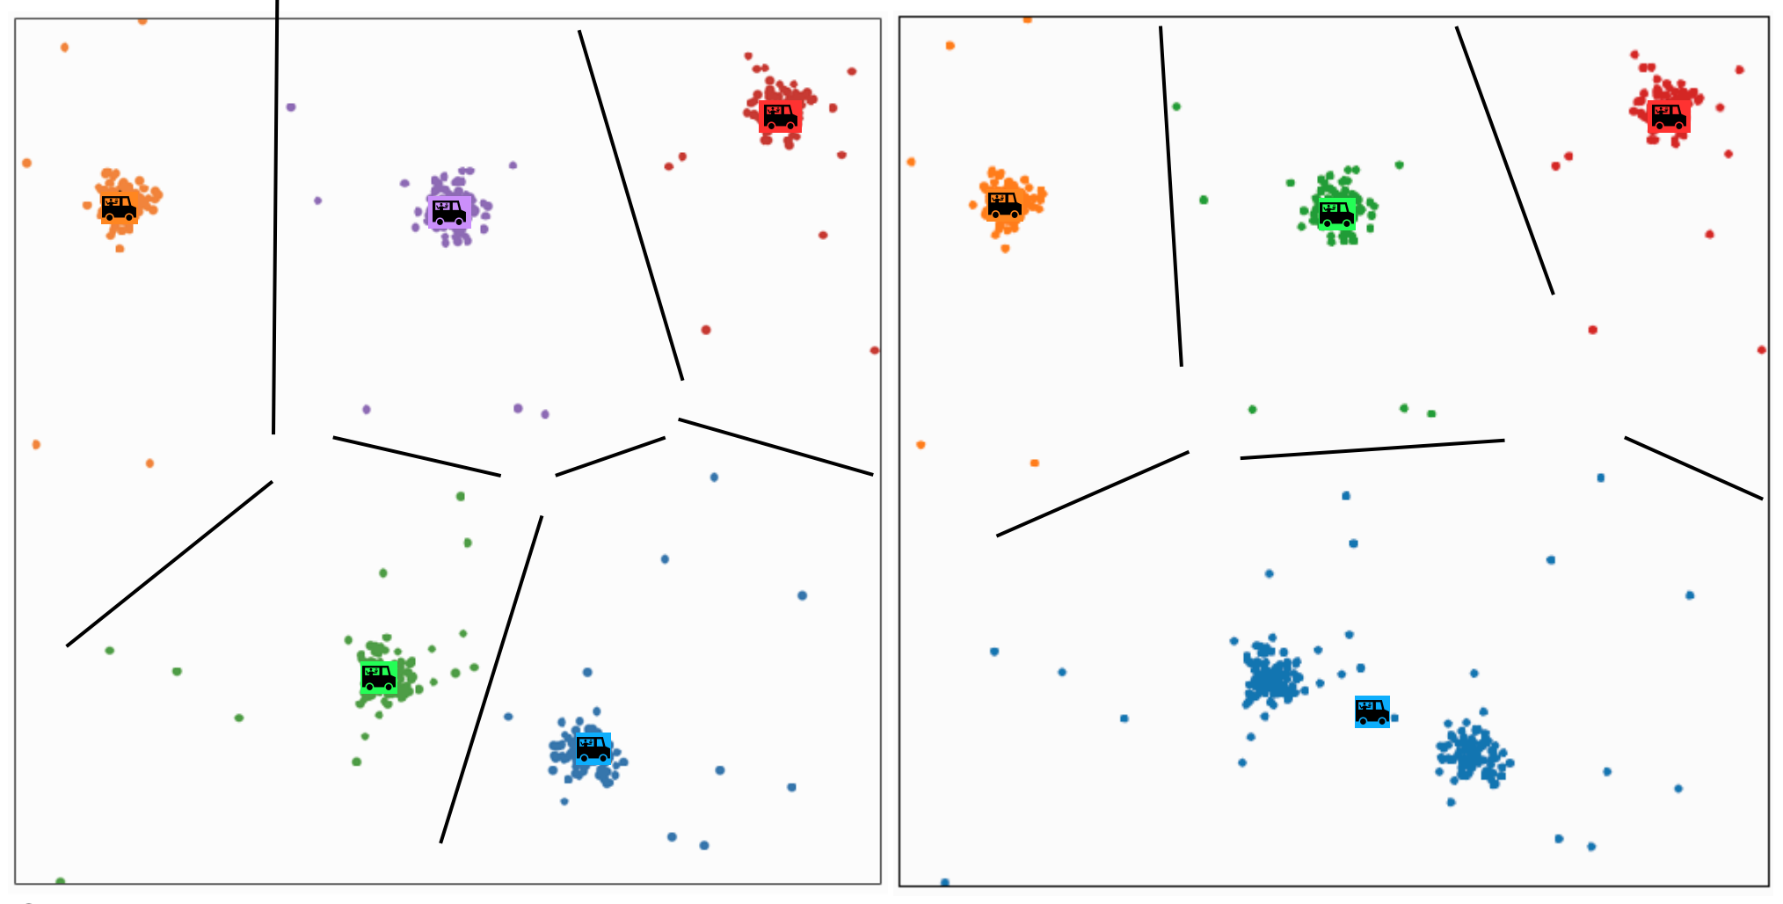
Different k gives different results

Slide 31
Clustering vs
Classification
Clustering looks like we assigned labels (by coloring or numbering different groups) but we didn’t use any labeled data.
In clustering, the “labels” here don’t have meaning. Permutating them gives the same result in k-means. To give meaning to the labels, human inputs are required
Classification learns from minimizing the error between a prediction and an actual label.
Clustering doesn’t derive learning from labelled data.
Classification quality metrics (accuracy / loss) do not apply to clustering.
You may not be able to use validation set / k-fold to choose the best choice of k for clustering.
Notes:
Notice there is no right answer since there are no labels! There is no true “green cluster”
Mention how we need to run this multiple times

Slide 32
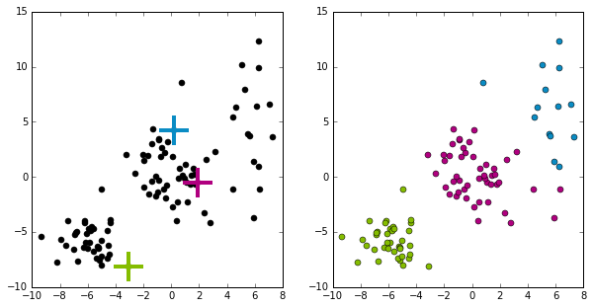
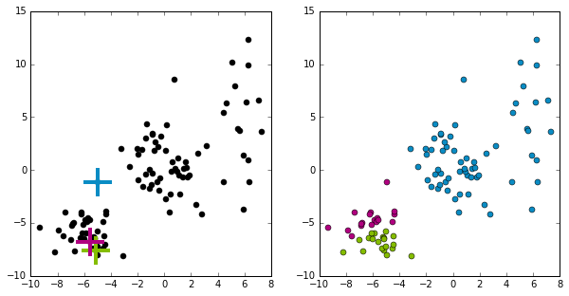
Effect of initialization
What does it mean for something to converge to a local optima?
Some initialization can be bad and affect the quality of clustering
Initialization will greatly impact results!
Notes:
Notice there is no right answer since there are no labels! There is no true “green cluster”
Mention how we need to run this multiple times

Slide 33
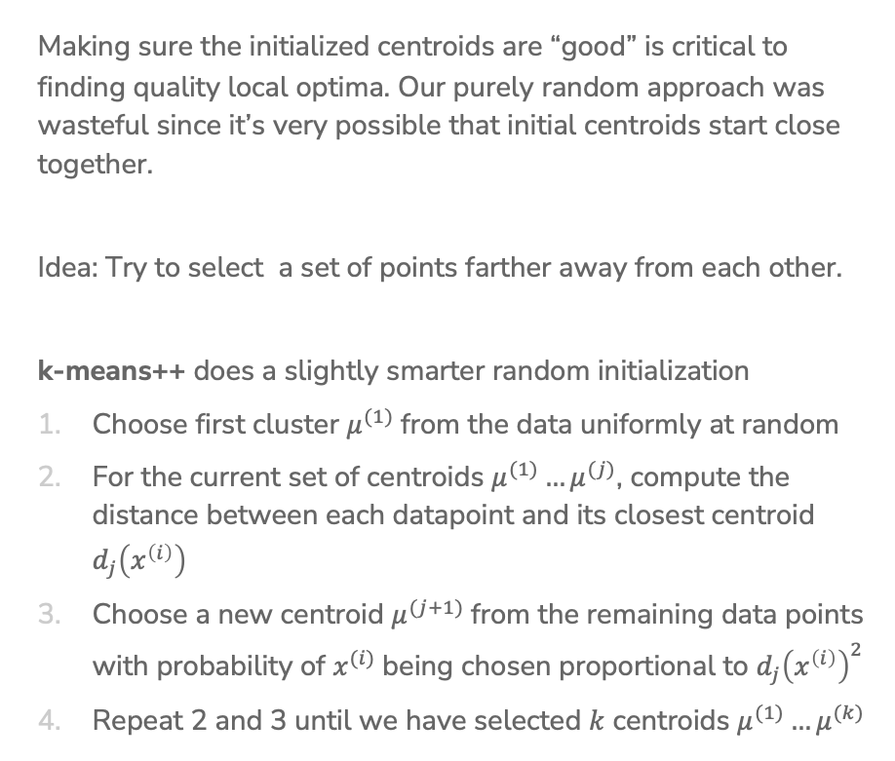
Smart Initializing w/ k-means++
Making sure the initialized centroids are “good” is critical to finding quality local optima. Our purely random approach was wasteful since it’s very possible that initial centroids start close together.
Idea: Try to select a set of points farther away from each other.
k-means++ does a slightly smarter random initialization
Choose first cluster $μ^{(1)}$from the data uniformly at random
For the current set of centroids $μ^{(1)}…μ^{(j)}$, compute the distance between each datapoint and its closest centroid $d_{j}\left(x^{\left(i\right)}\right)$
Choose a new centroid $μ^{(j+1)}$from the remaining data points with probability of $x^{(i)}$being chosen proportional to $d_{j}{\left(x^{\left(i\right)}\right)}^{2}$
Repeat 2 and 3 until we have selected $k$ centroids $μ^{(1)}…μ^{(k)}$

Slide 34
k-means++ Example
Start by picking a point at random
Then pick points proportional to their distances to their centroids
This tries to maximize the spread of the centroids!
Notes:
Pick Left Top middle
Pick bottom right
Pick top right

Slide 35
k-means++
Pros / Cons
Pros
Improves quality of local minima
Faster convergence to local minima
Cons
Computationally more expensive at beginning when compared to simple random initialization

Slide 36
Assessing Performance

Slide 37
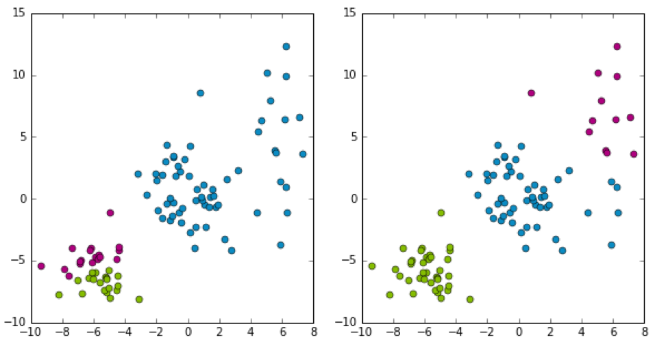
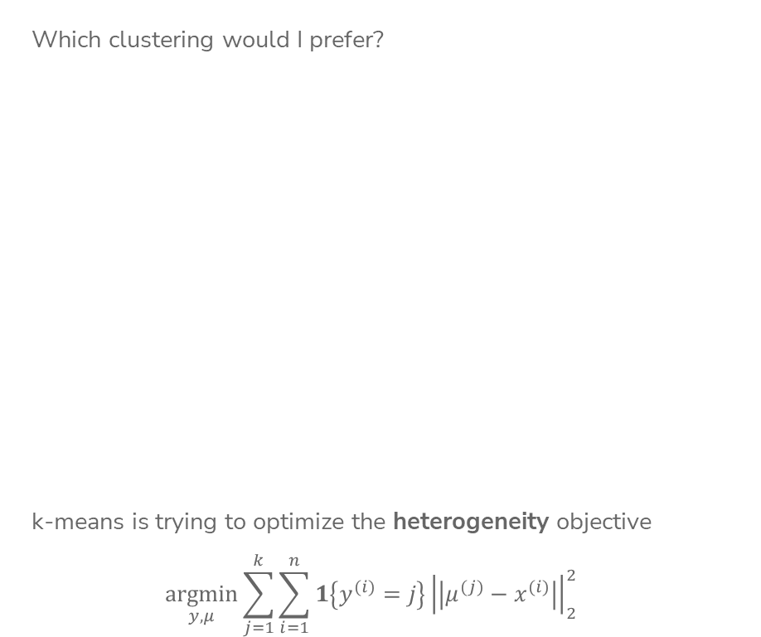
Which Cluster?
Which clustering would I prefer?
k-means is trying to optimize the heterogeneity objective
$$\underset{y,μ}{argmin}\sum_{j=1}^{k}{\sum_{i=1}^{n}{{1\left\{y^{(i)}=j\right\}\left|\left|μ^{(j)}−x^{(i)}\right|\right|}_{2}^{2}}}$$
Notes:
Write lower is better

Slide 38
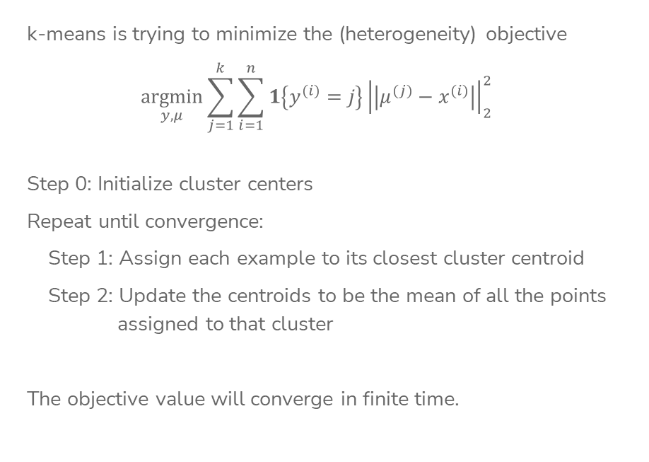
Objective function for k-means clustering
k-means is trying to minimize the (heterogeneity) objective
$$\underset{y,μ}{argmin}\sum_{j=1}^{k}{\sum_{i=1}^{n}{{1\left\{y^{(i)}=j\right\}\left|\left|μ^{(j)}−x^{(i)}\right|\right|}_{2}^{2}}}$$
Step 0: Initialize cluster centers
Repeat until convergence:
Step 1: Assign each example to its closest cluster centroid
Step 2: Update the centroids to be the mean of all the points
assigned to that cluster
The objective value will converge in finite time.

Slide 39
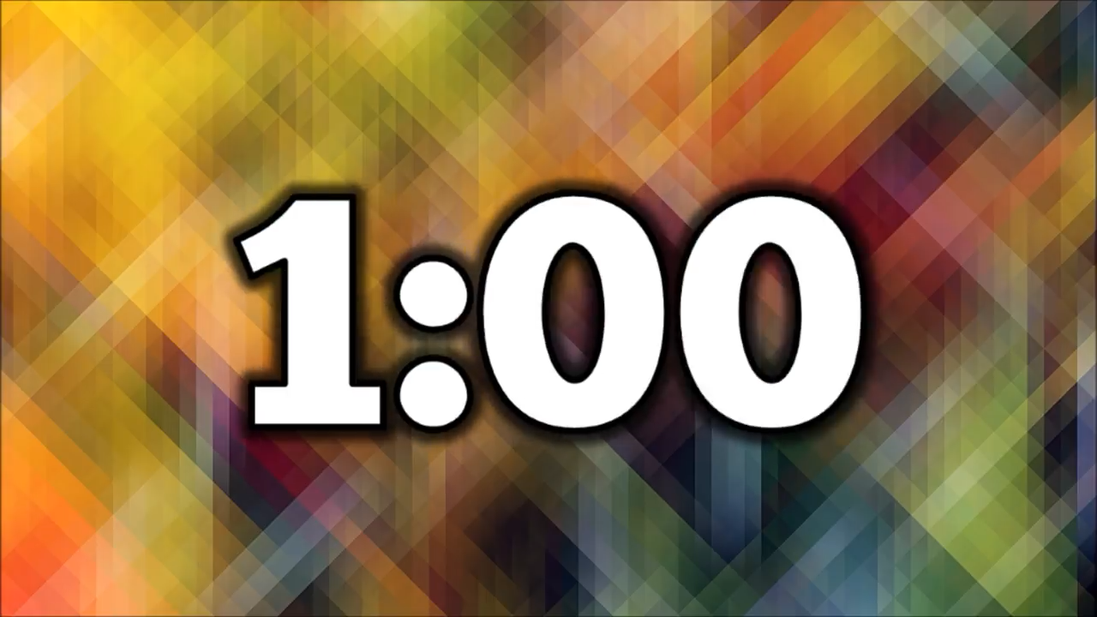
1 min
Consider trying k-means with different values of k. Which of the following graphs shows how the globally optimal heterogeneity changes for each value of k?
Lowest objective value
Lowest objective value
Lowest objective value
Lowest objective value

Slide 40
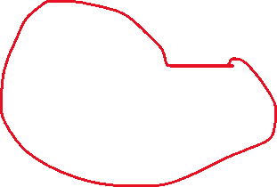
Discuss in groups for 2 mins
Consider trying k-means with different values of k. Which of the following graphs shows how the globally optimal heterogeneity changes for each value of k?
Lowest objective value
Lowest objective value
Lowest objective value
Lowest objective value

Slide 41
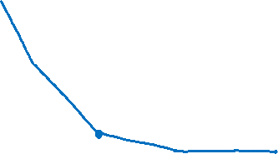
How to Choose k?
No right answer!
Human input is important. For example, if you cluster a lot of movies, you can pre-define the number of categories.
Practically, can choose k based on specific applications, such as based on cost-benefit tradeoff. The larger k is, the more costly it is.
In general, look for the “elbow” in the graph
Other methods: BIC (Bayesian Information Criterion), Silhouette, etc.
Note: You will usually have to run k-means multiple times for each k
Lowest objective value
Notes:
Draw in curve
Write: ”In extreme when k=N, heterogeneity will be 0”
Point out elbow

Slide 42
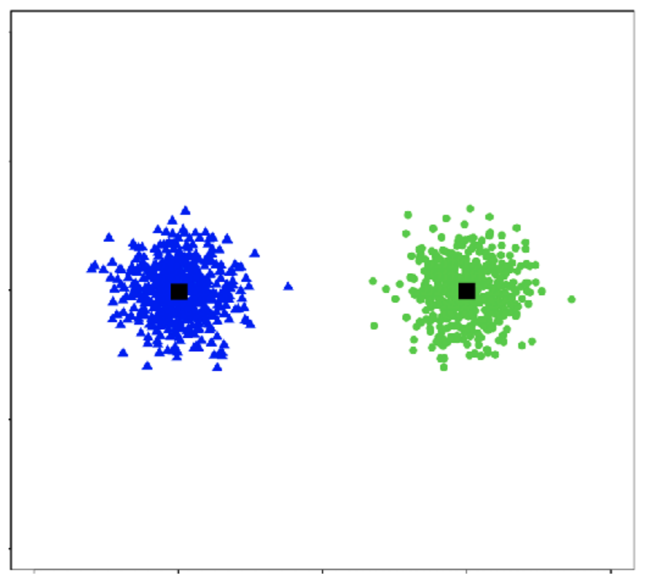
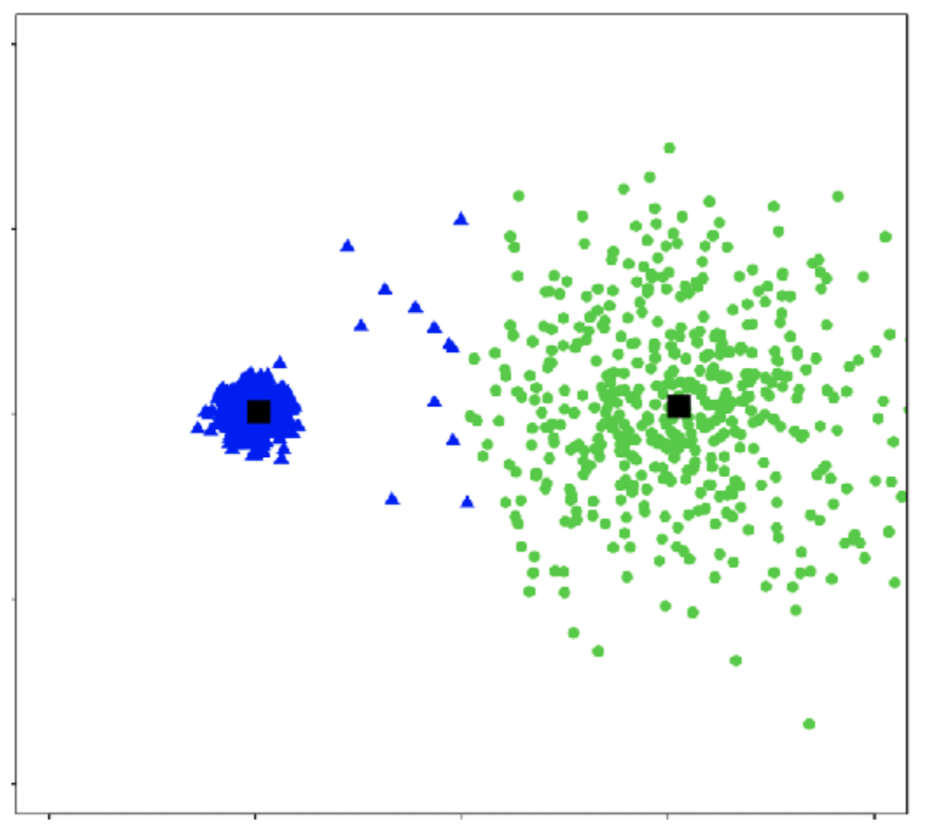
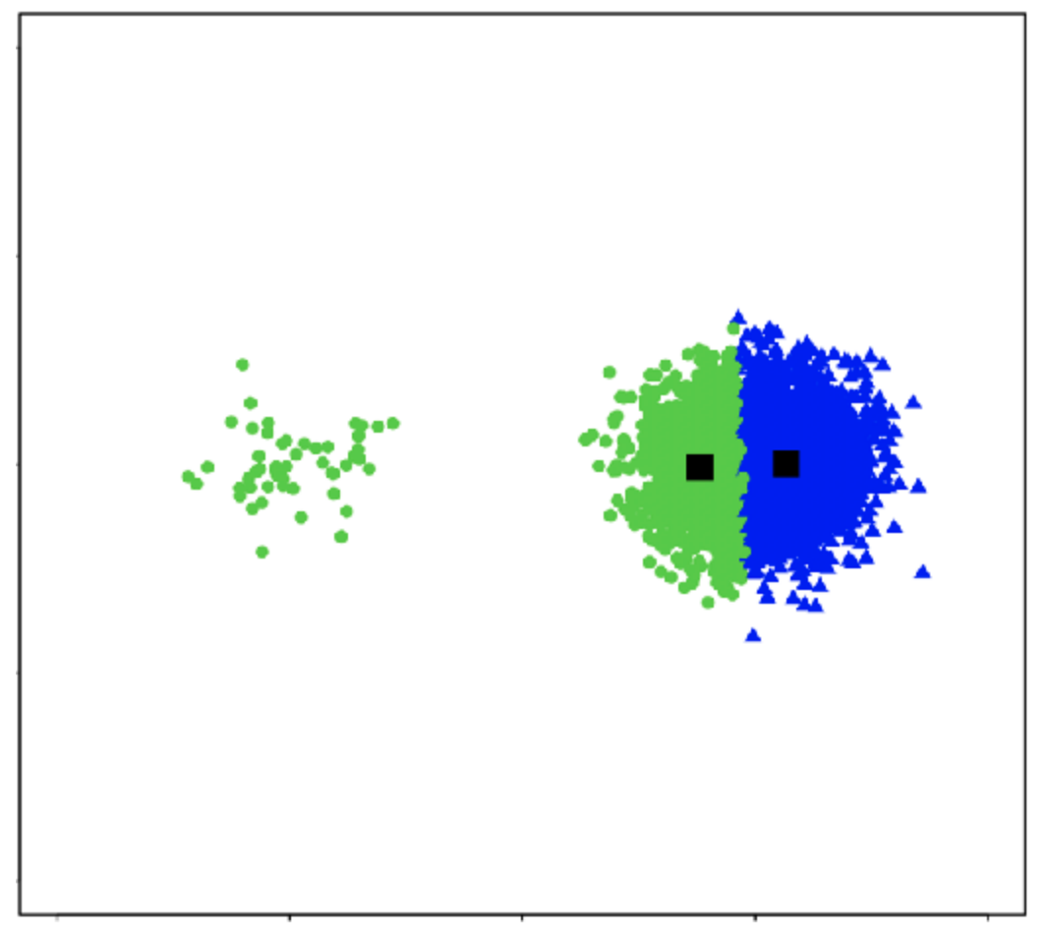
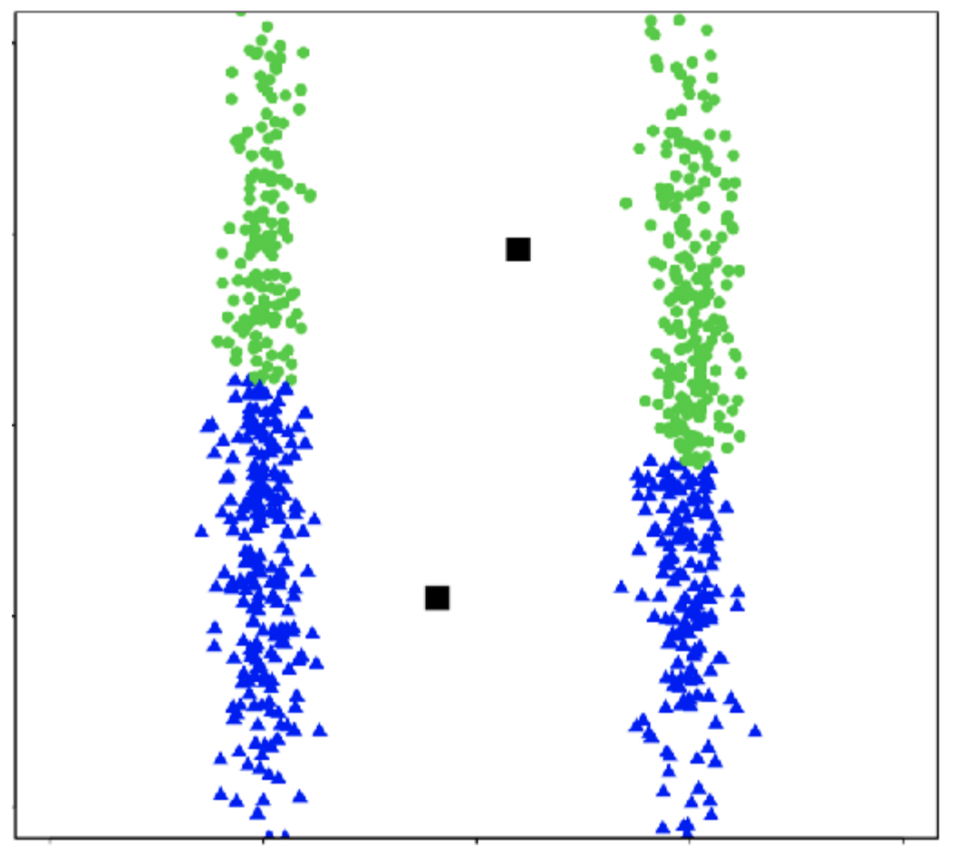
Cluster shape
k-means works well for well-separated hyper-spherical clusters of the same size

Slide 43
Note about clustering
As we embark in the unsupervised learning task, a lot of previous concepts we have learned so far about model performance might not necessarily apply.
  Usually, we don’t split train / test set for clustering problems, because there are no labels to measure how good a set of clusters are.
  Similarly, definitions like bias, variance, complexity bias-variance tradeoff might not work for unsupervised learning problems.
  The heterogeneity objective in clustering doesn’t have the same meaning as training error in supervised learning tasks. There is no definition of accuracy for clustering either.

Slide 44
Recap
Differences between classification and clustering
What types of clusters can be formed by k-means
K-means algorithm
Convergence of k-means
How to choose k
Better initialization using k-means++

