Slide 1
CSE/STAT 416
Assessing Performance
Hunter Schafer
University of Washington
March 31, 2021

Slide 2
Logistics
Check EdStem for any announcements or clarifications on assignments
Jupyter Notebooks on EdStem.
Section tomorrow will give you practice writing some of the code for HW1
Learning Reflection spec and HW1 released
  Remember there is a HW0 that introduces tools for the course that you should complete, but it’s not worth points or anything.

Slide 3
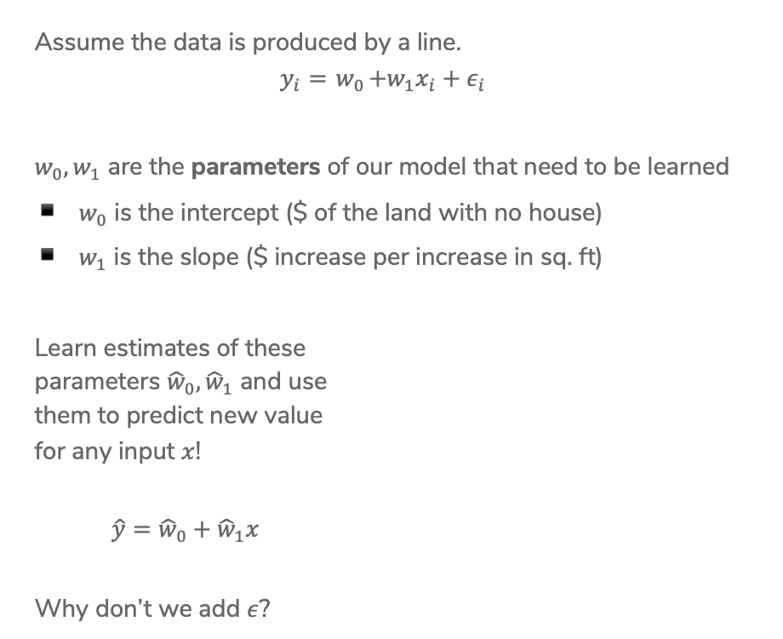
Linear Regression Model
Assume the data is produced by a line.
$$y_{i}={ w}_{0}+w_{1}x_{i}+ε_{i}$$
$w_{0}, w_{1}$ are the parameters of our model that need to be learned
$w_{0}$ is the intercept ($ of the land with no house)
$w_{1}$ is the slope ($ increase per increase in sq. ft)
Learn estimates of these
parameters ${\hat{w}}_{0}, {\hat{w}}_{1}$ and use
them to predict new value
for any input $x$!
$\hat{y}={\hat{w}}_{0}+{\hat{w}}_{1}x$
Why don’t we add $ε$?
Notes:
Talk about what happens if w_1 is 0

Slide 4
ML Pipeline
Training
Data
Feature
extraction
x
ML
model
ŷ
⌃
y
f
ML algorithm
Quality
metric
Notes:
Write these on the slide
Training data: Raw data about houses
Feature extraction: Extract / transform/ compute relevant features
X: SQ. FT
Y: Actual house prices
Quality Metric: Errors in predicted values
ML Algorithm: Estimate function from data to be best “quality”
\hat{Y}: predicted sales

Slide 5
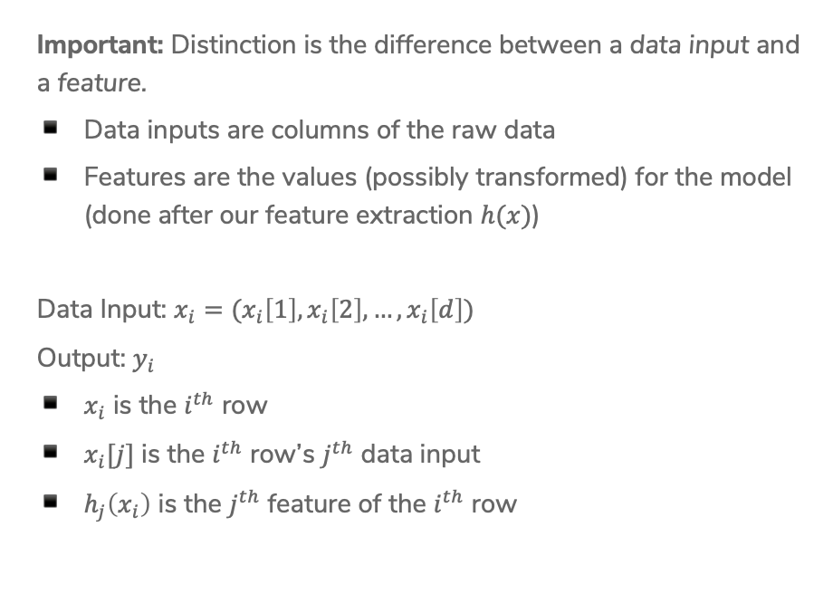
Notation
Important: Distinction is the difference between a data input and a feature.
Data inputs are columns of the raw data
Features are the values (possibly transformed) for the model (done after our feature extraction $h(x)$)
Data Input: $x_{i}=(x_{i}\left[1\right], x_{i}\left[2\right], …, x_{i}\left[d\right])$
Output: $y_{i}$
$x_{i}$ is the $i^{th}$ row
$x_{i}[j]$ is the $i^{th}$ row’s $j^{th}$ data input
$h_{j}\left(x_{i}\right)$ is the $j^{th}$ feature of the $i^{th}$ row

Slide 6
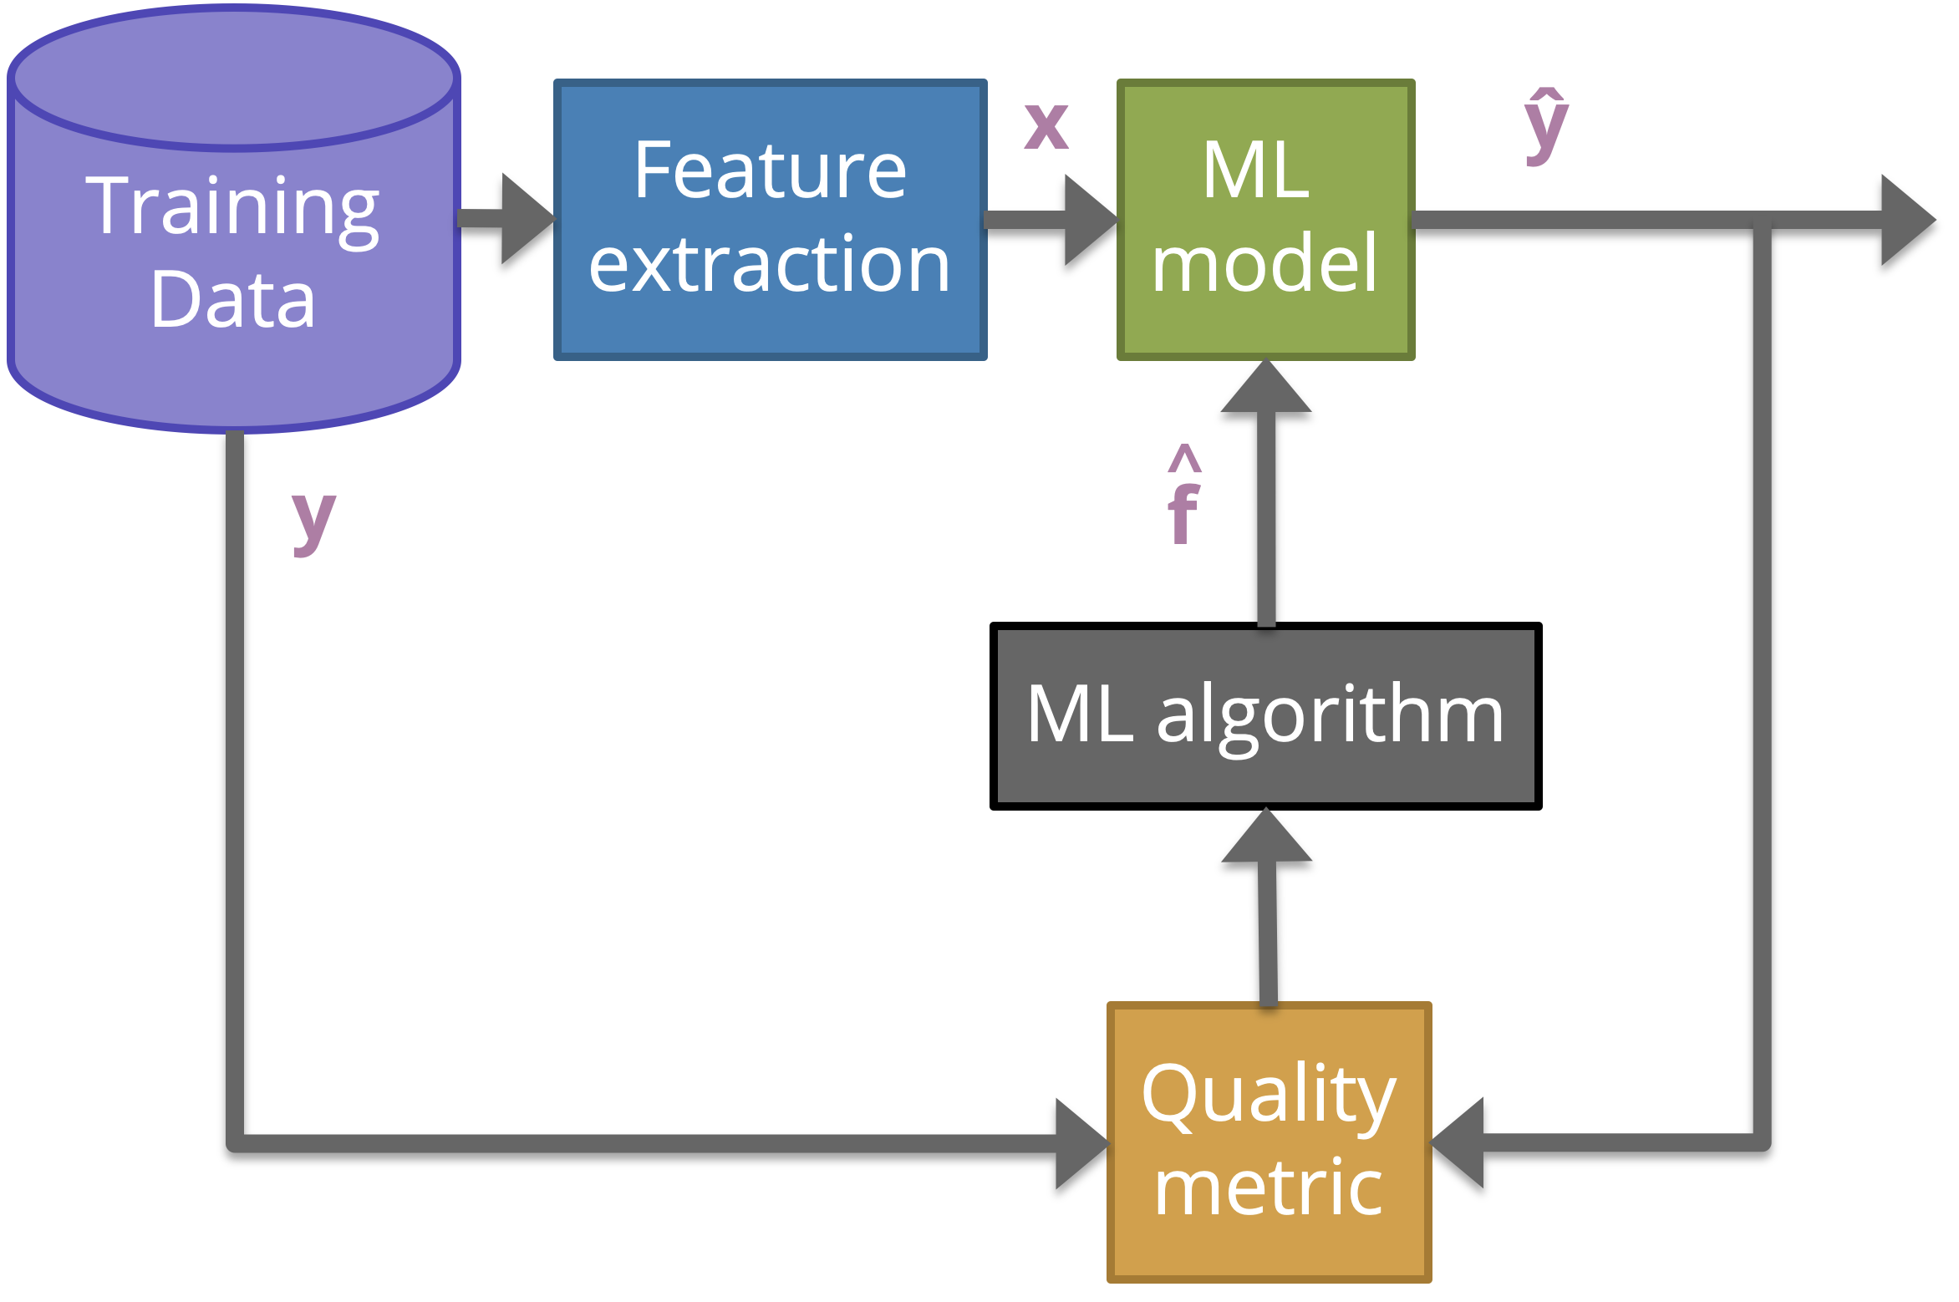

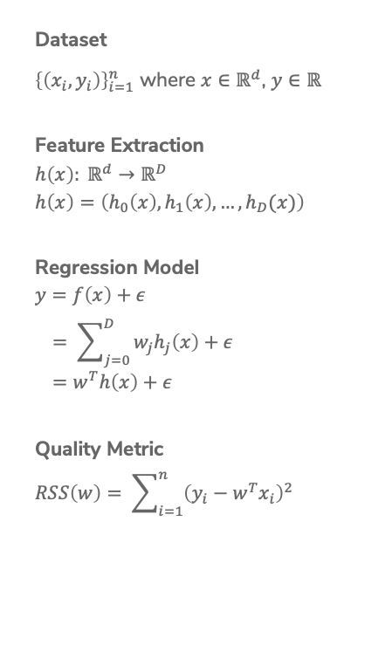
Linear Regression Recap
Dataset
${\left\{\left(x_{i}, y_{i}\right)\right\}}_{i=1}^{n}$ where $x∈ℝ^{d}$, $y∈ℝ$
Feature Extraction
$$h\left(x\right): ℝ^{d}→ℝ^{D}$$
$$h\left(x\right)=\left(h_{0}\left(x\right), h_{1}\left(x\right), …, h_{D}(x)\right)$$
Regression Model
$$y=f\left(x\right)+ε \\ = \sum_{j=0}^{D}{w_{j}h_{j}\left(x\right)+ε} \\ =w^{T}h\left(x\right)+ε$$
Quality Metric
$$RSS\left(w\right)= \sum_{i=1}^{n}{{\left(y_{i}−w^{T}x_{i}\right)}^{2}}$$
Predictor
$$\hat{w}= \min_{w}{RSS(w)}$$
ML Algorithm
Optimized using Gradient Descent
Prediction
$$\hat{y}={\hat{w}}^{T}h(x)$$

Slide 7
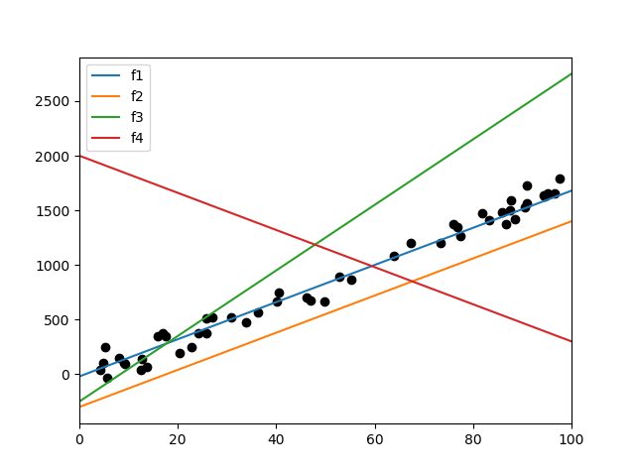
1 min
Sort the following lines by their RSS on the data, from smallest to largest. (estimate, don’t actually compute)

Slide 8
Pre-Lecture Video 1
Feature Extraction

Slide 9
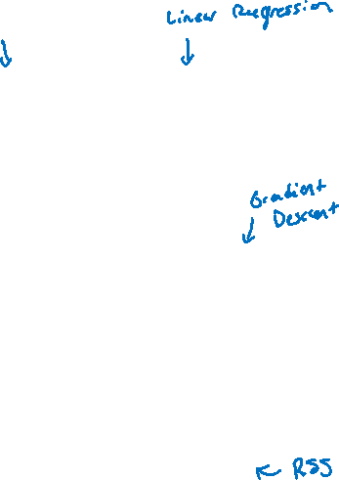
Training
Data
Feature
extraction
x
ML
model
ŷ
⌃
y
f
ML algorithm
Quality
metric

Slide 10

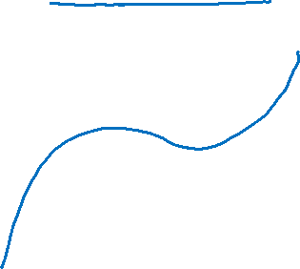
Higher Order Features
This data doesn’t look exactly linear, why are we fitting a line instead of some higher-degree polynomial?
We can! We just have to use a slightly different model!
$$y_{i}=w_{0}+w_{1}x_{i}+w_{2}x_{i}^{2}+w_{3}x_{i}^{3}+ε_{i}$$

Slide 11
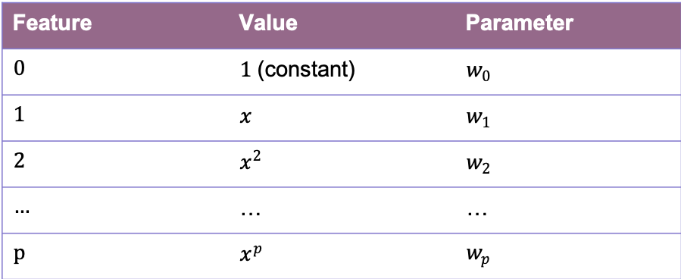
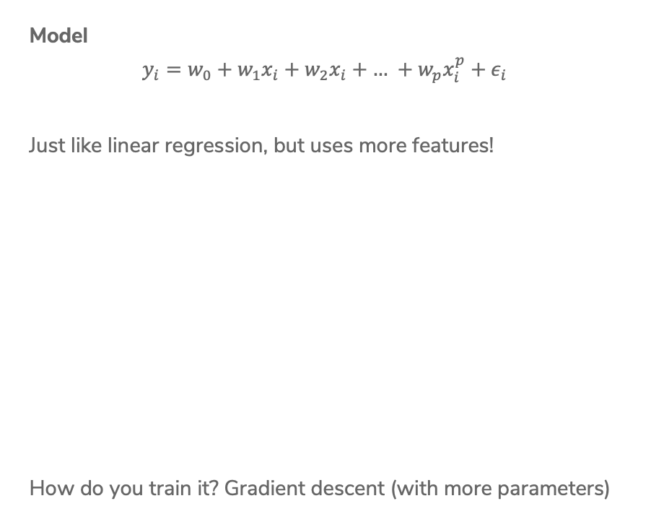
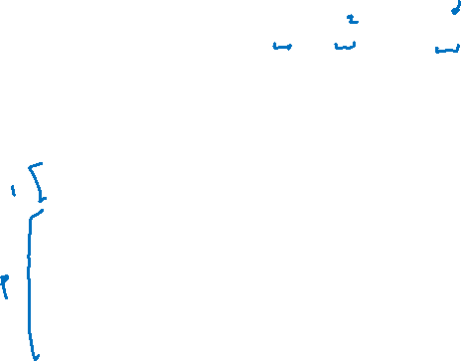
Polynomial Regression
Model
$$y_{i}=w_{0}+w_{1}x_{i}+w_{2}x_{i}+\text{…} +w_{p}x_{i}^{p}+ε_{i}$$
Just like linear regression, but uses more features!
How do you train it? Gradient descent (with more parameters)
Feature | Value | Parameter
0 | $1$ (constant) | $w_{0}$
1 | $x$ | $w_{1}$
2 | $x^{2}$ | $w_{2}$
… | … | …
p | $x^{p}$ | $w_{p}$

Slide 12
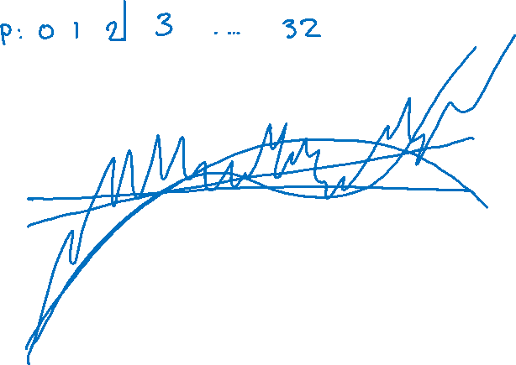
Polynomial Regression
How to decide what the right degree? Come back Wednesday!
Notes:
Draw different values of p in different colors
Max p = 32

Slide 13
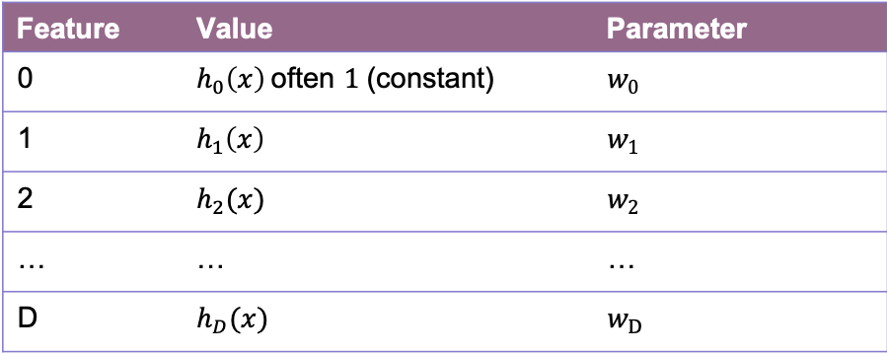

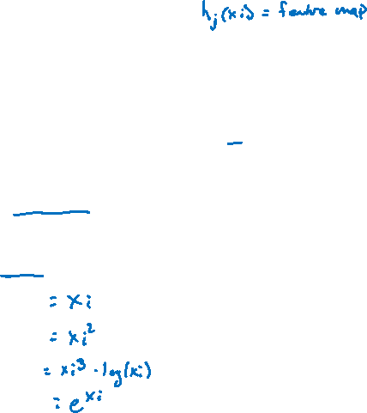
Features
Features are the values we select or compute from the data inputs to put into our model. Feature extraction is the process of turning the data into features.
Model
$$y_{i}=w_{0}h_{0}\left(x_{i}\right)+w_{1}h_{1}\left(x_{i}\right)+\text{…}+w_{D}h_{D}\left(x_{i}\right)+ε_{i} \\ = \sum_{j=0}^{D}{w_{j}h_{j}\left(x_{i}\right)+ε_{i}}$$
Feature | Value | Parameter
0 | $h_{0}\left(x\right)$often $1$ (constant) | $w_{0}$
1 | $h_{1}\left(x\right)$ | $w_{1}$
2 | $h_{2}(x)$ | $w_{2}$
… | … | …
D | $h_{D}(x)$ | $w_{D}$

Slide 14
Adding Other Inputs
Generally we are given a data table of values we might look at that include more than one value per house.
Each row is a single house.
Each column (except Value) is a data input.
sq. ft. | # bathrooms | owner’s age | … | value
1400 | 3 | 47 | … | 70,800
700 | 3 | 19 | … | 65,000
… | … | … | … | …
1250 | 2 | 36 | … | 100,000

Slide 15
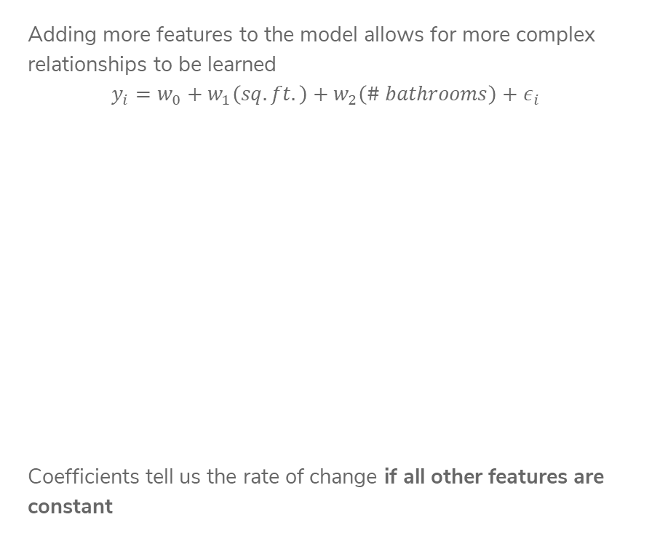
More Inputs - Visually
Adding more features to the model allows for more complex relationships to be learned
$$y_{i}=w_{0}+w_{1}\left(sq. ft.\right)+w_{2}\left(\# bathrooms\right)+ε_{i}$$
Coefficients tell us the rate of change if all other features are constant

Slide 16
Notation
Important: Distinction is the difference between a data input and a feature.
Data inputs are columns of the raw data
Features are the values (possibly transformed) for the model (done after our feature extraction $h(x)$)
Data Input: $x_{i}=(x_{i}\left[1\right], x_{i}\left[2\right], …, x_{i}\left[d\right])$
Output: $y_{i}$
$x_{i}$ is the $i^{th}$ row
$x_{i}[j]$ is the $i^{th}$ row’s $j^{th}$ data input
$h_{j}\left(x_{i}\right)$ is the $j^{th}$ feature of the $i^{th}$ row

Slide 17
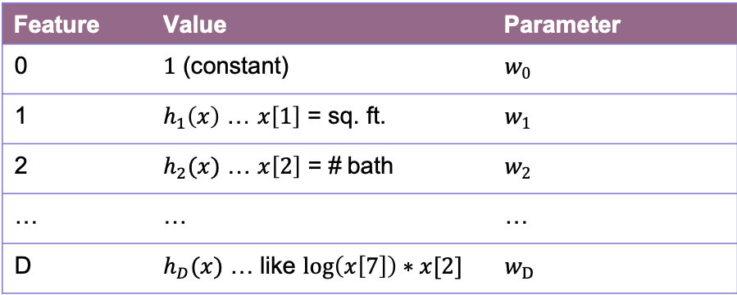
Features
You can use anything you want as features and include as many of them as you want!
Generally, more features means a more complex model. This might not always be a good thing!
Choosing good features is a bit of an art.
Feature | Value | Parameter
0 | $1$ (constant) | $w_{0}$
1 | $h_{1}\left(x\right)$ … $x\left[1\right]$ = sq. ft. | $w_{1}$
2 | $h_{2}(x)$ … $x\left[2\right]$ = # bath | $w_{2}$
… | … | …
D | $h_{D}(x)$ … like $\log\left(x\left[7\right]\right)∗x[2]$ | $w_{D}$

Slide 18
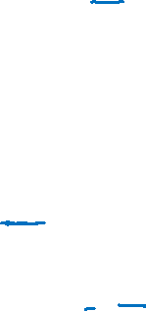
Linear Regression Recap
Dataset
${\left\{\left(x_{i}, y_{i}\right)\right\}}_{i=1}^{n}$ where $x∈ℝ^{d}$, $y∈ℝ$
Feature Extraction
$$h\left(x\right): ℝ^{d}→ℝ^{D}$$
$$h\left(x\right)=\left(h_{0}\left(x\right), h_{1}\left(x\right), …, h_{D}(x)\right)$$
Regression Model
$$y=f\left(x\right)+ε \\ = \sum_{j=0}^{D}{w_{j}h_{j}\left(x\right)+ε} \\ =w^{T}h\left(x\right)+ε$$
Quality Metric
$$RSS\left(w\right)= \sum_{i=1}^{n}{{\left(y_{i}−w^{T}x_{i}\right)}^{2}}$$
Predictor
$$\hat{w}= \min_{w}{RSS(w)}$$
ML Algorithm
Optimized using Gradient Descent
Prediction
$$\hat{y}={\hat{w}}^{T}h(x)$$

Slide 19
Pre-Lecture Video 2
Assessing Performance

Slide 20
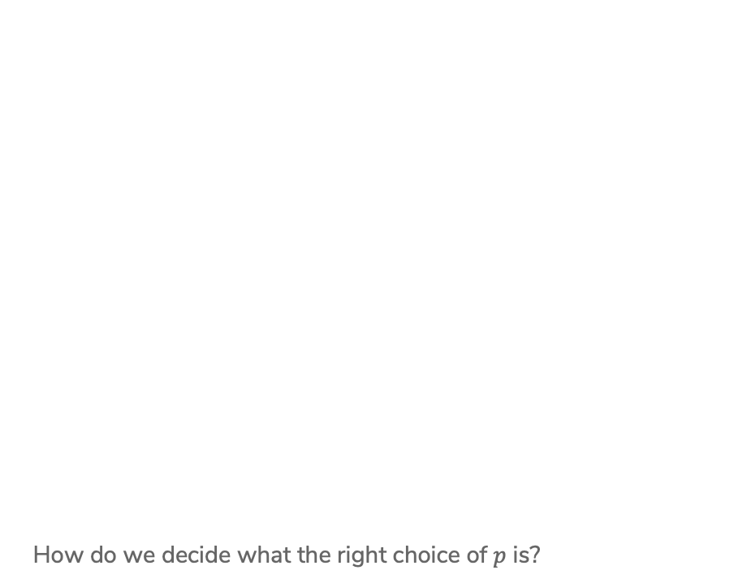
Polynomial Regression
How do we decide what the right choice of $p$ is?
Notes:
Draw different values of p in different colors
Max p = 32

Slide 21
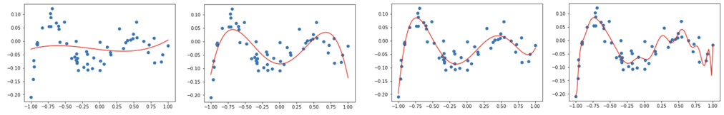
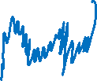




Polynomial Regression
Consider using different degree polynomials on the same dataset
Which one has a lower RSS on this dataset?
It seems like minimizing the RSS is not the whole story here…
$$p=3$$
$$p=4$$
$$p=5$$
$$p=20$$

Slide 22
Performance
Why do we train ML models?
We generally want them to do well on future data
If we choose the model that minimizes RSS on the data it learned from, we are just choosing the model that can memorize, not the one that generalizes well.
Just because you can get 100% on a practice exam you’ve studied for hours, it doesn’t mean you will also get 100% on the real test that you haven’t seen before.
Key Idea: Assessing yourself based on something you learned from generally overestimates how well you will do in the future!

Slide 23
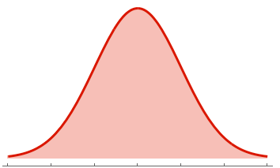
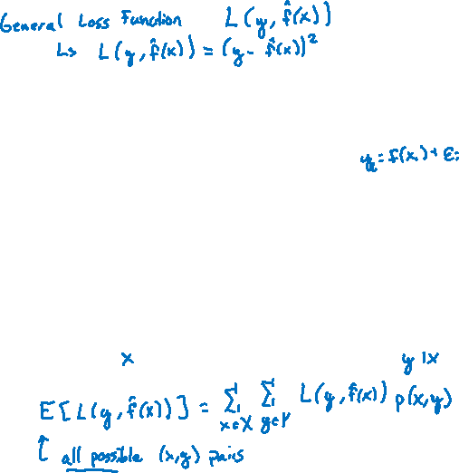
Future Performance
What we care about is how well the model will do in the future.
How do we measure this? True error
To do this, we need to understand uncertainty in the world
True Error
Sq. Ft.
Price | Sq. Ft.
Notes:
$$E_{xy}[L(y, f_w(x))]$$
Show that this is just the weight average over all pairs of x,y

Slide 24
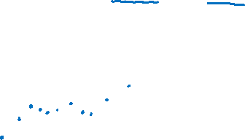
Model Assessment
How can we figure out how well a model will do on future data if we don’t have any future data?
Estimate it! We can hide data from the model to test it later as an estimate how it will do on future data
We will randomly split our dataset into a train set and a test set
The train set is to train the model
The test set is to estimate the performance in the future

Slide 25
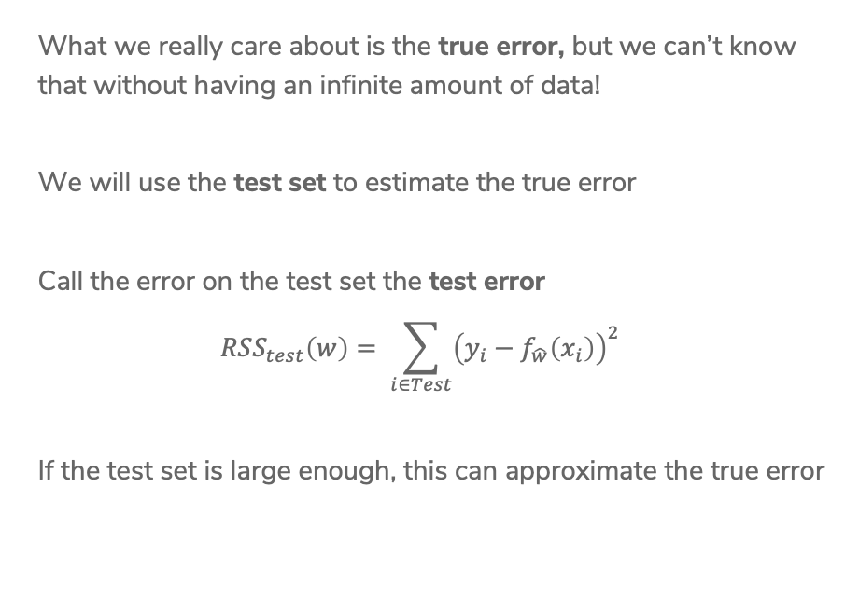
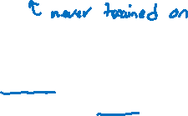
Test Error
What we really care about is the true error, but we can’t know that without having an infinite amount of data!
We will use the test set to estimate the true error
Call the error on the test set the test error
$$RSS_{test}\left(w\right)= \sum_{i∈Test}{{\left(y_{i}−f_{\hat{w}}\left(x_{i}\right)\right)}^{2}}$$
If the test set is large enough, this can approximate the true error

Slide 26
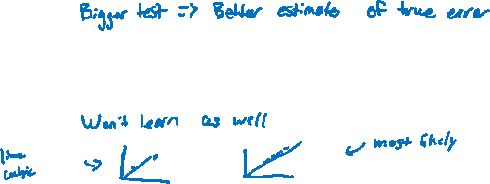
Train/Test Split
If we use the test set to estimate future, how big should it be?
This comes at a cost of reducing the size of the training set though (in the absence of being able to just get more data)
In practice people generally do train:test as either
80:20
90:10
Important: Never train your model on data in the test set!
Notes:
WOS “More test data => better estimate of true error”
WOS “What happens if training set is too small? Extreme example of two points”

Slide 27
Model Complexity

Slide 28
Train Error
What happens to training error as we increase model complexity?
Start with the simplest model (a constant function)
End with a very high degree polynomial

Slide 29
True Error
What happens to true error as we increase model complexity?
Start with the simplest model (a constant function)
End with a very high degree polynomial

Slide 30
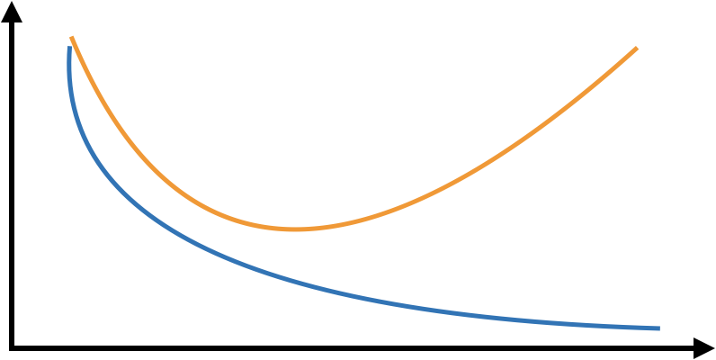
Train/True Error
Compare what happens to train and true error as a function of model complexity
Error
Low Model Complexity
High Model Complexity
Notes:
Draw a squiggly line for test error
Draw the just right zone
Draw the overfitting zone
Draw the underfitting zone

Slide 31
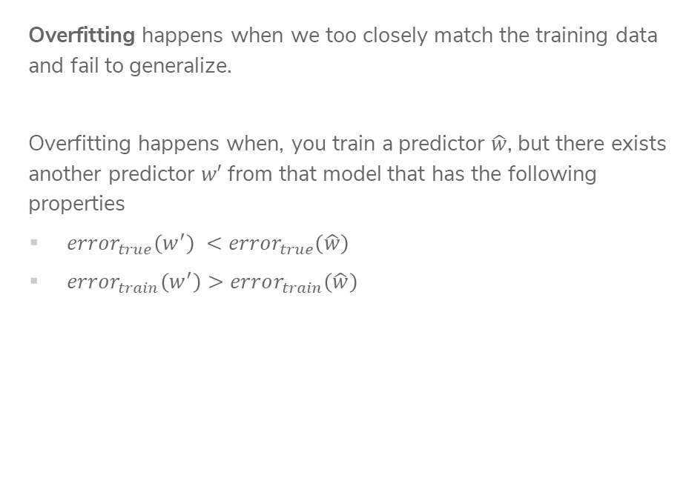
Overfitting
Overfitting happens when we too closely match the training data and fail to generalize.
Overfitting happens when, you train a predictor $\hat{w}$, but there exists another predictor $w′$ from that model that has the following properties
$error_{true}\left(w^{′}\right) <error_{true}\left(\hat{w}\right)$
$error_{train}\left(w^{′}\right)>error_{train}\left(\hat{w}\right)$
Error
Low Model Complexity
High Model Complexity

Slide 32
Bias-Variance Tradeoff

Slide 33
Underfitting / Overfitting
The ability to overfit/underfit is a knob we can turn based on the model complexity.
More complex => easier to overfit
Less complex => easier to underfit
In a bit, we will talk about how to chose the “just right”, but now we want to look at this phenomena of overfitting/underfitting from another perspective.
Underfitting / Overfitting are a result of certain types of errors

Slide 34
Signal vs.
Noise
Learning from data relies on balancing two aspects of our data
Signal
Noise
Complex models make it easier to fit too closely to the noise
Simple models have trouble picking up the signal

Slide 35
Bias
A model that is too simple fails to fit the signal. In some sense, this signifies a fundamental limitation of the model we are using to fail to fit the signal. We call this type of error bias.
Low complexity (simple) models tend to have high bias.*

Slide 36
Variance
A model that is too complicated for the task overly fits to the noise. The flexibility of the complicated model makes it capable of memorizing answers rather than learning general patterns. This contributes to the error as variance.
High complexity models tend to have high variance.*

Slide 37
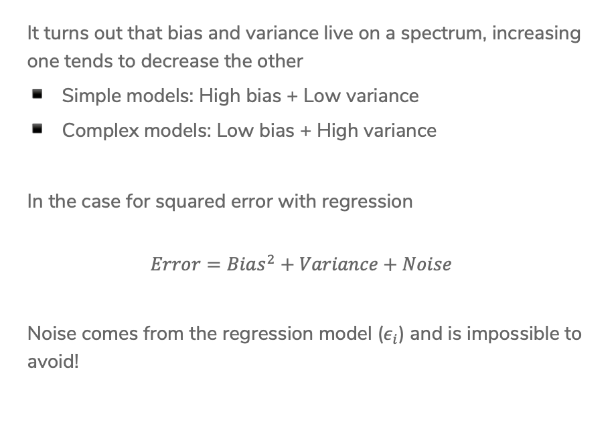
Bias-Variance Tradeoff
It turns out that bias and variance live on a spectrum, increasing one tends to decrease the other
Simple models: High bias + Low variance
Complex models: Low bias + High variance
In the case for squared error with regression
$$Error=Bias^{2}+Variance+Noise$$
Noise comes from the regression model ($ε_{i}$) and is impossible to avoid!

Slide 38


Slide 39

Bias-Variance Tradeoff
Visually, this looks like the following!
$$Error=Bias^{2}+Variance+Noise$$
Error
Low Model Complexity
High Model Complexity

Slide 40
Dataset Size
So far our entire discussion of error assumes a fixed amount of data. What happens to our error as we get more data?
Error
Small Train Set
Large Train Set

Slide 41
Choosing Complexity

Slide 42
Choosing Complexity
So far we have talked about the affect of using different complexities on our error. Now, how do we choose the right one?

Slide 43
1 min
Goal: Get you actively participating in your learning
Typical Activity
  Question is posed
  Think (1 min): Think about the question on your own
  Pair (2 min): Talk with your neighbor to discuss question
    If you arrive at different conclusions, discuss your logic and figure out why you differ!
    If you arrived at the same conclusion, discuss why the other answers might be wrong!
  Share (1 min): We discuss the conclusions as a class
During each of the Think and Pair stages, you will respond to the question via a Poll Everywhere poll
  The poll will only be open for the last 15 seconds of each of the stage
  Not worth any points, just here to help you learn!

Slide 44
1 min
Suppose I wanted to figure out the right degree polynomial for my dataset (we’ll try p from 1 to 20). What procedure should I use to do this? Pick the best option
For each possible degree polynomial p:
Train a model with degree p on the training set, pick p that has the lowest test error
Train a model with degree p on the training set, pick p that has the highest test error
Train a model with degree p on the test set, pick p that has the lowest test error
Train a model with degree p on the test set, pick p that has the highest test error
None of the above

Slide 45
2 min
Suppose I wanted to figure out the right degree polynomial for my dataset (we’ll try p from 1 to 20). What procedure should I use to do this? Pick the best option
For each possible degree polynomial p:
Train a model with degree p on the training set, pick p that has the lowest test error
Train a model with degree p on the training set, pick p that has the highest test error
Train a model with degree p on the test set, pick p that has the lowest test error
Train a model with degree p on the test set, pick p that has the highest test error
None of the above

Slide 46
Choosing Complexity
We can’t just choose the model that has the lowest train error because that will favor models that overfit!
It then seems like our only other choice is to choose the model that has the lowest test error (since that is our approximation of the true error)
This is almost right, but now we don’t have a good estimate of the true error anymore.
We didn’t technically train the model on the test set (that’s good), but we chose which model to use based on the performance of the test set.
  It’s no longer a stand in for “the unknown” since we probed it many times to figure out which model would be best.

Slide 47
Choosing Complexity
We will talk about two ways to pick the model complexity without ruining our test set.
Using a validation set
Doing cross validation

Slide 48
Validation Set
So far we have divided our dataset into train and test
We can’t use Test to choose our model complexity, so instead, break up Train into ANOTHER dataset
Train | Test
Train | Validation | Test

Slide 49
Validation Set
The process generally goes
train, validation, test = split_data(dataset)
for each model complexity p:
model = train_model(model_p, train)
val_err = error(model, validation)
keep track of p with smallest val_err
return best p + error(model, test)

Slide 50
Validation Set
Pros
Easy to describe and implement
Pretty fast
Only requires training a model and predicting on the validation set for each complexity of interest
Cons
Have to sacrifice even more training data! ☹

Slide 51
Cross Validation
In the pre-lecture videos for next week, we will introduce another way to perform validation called cross-validation.
We leave the slides here for reference, but we will cover this in Monday’s class.

Slide 52
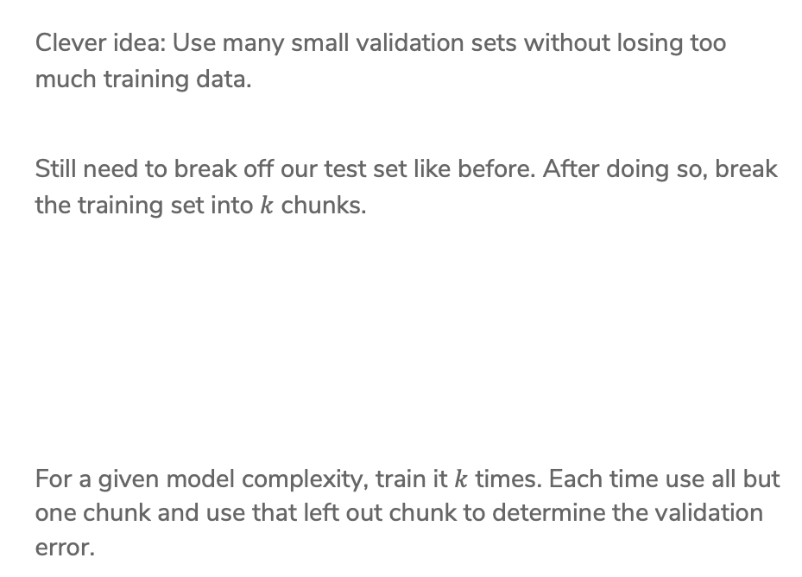
Cross-Validation
Clever idea: Use many small validation sets without losing too much training data.
Still need to break off our test set like before. After doing so, break the training set into $k$ chunks.
For a given model complexity, train it $k$ times. Each time use all but one chunk and use that left out chunk to determine the validation error.
Train | Test
Chunk1 | Chunk2 | Chunk3 | Chunk4 | Test

Slide 53
Cross-Validation
The process generally goes
chunk_1, …, chunk_k, test = split_data(dataset)
for each model complexity p:
for i in [1, k]:
model = train_model(model_p, chunks - i)
val_err = error(model, chunk_i)
avg_val_err = average val_err over chunks
keep track of p with smallest avg_val_err
return model trained on train with best p + error(model, test)

Slide 54
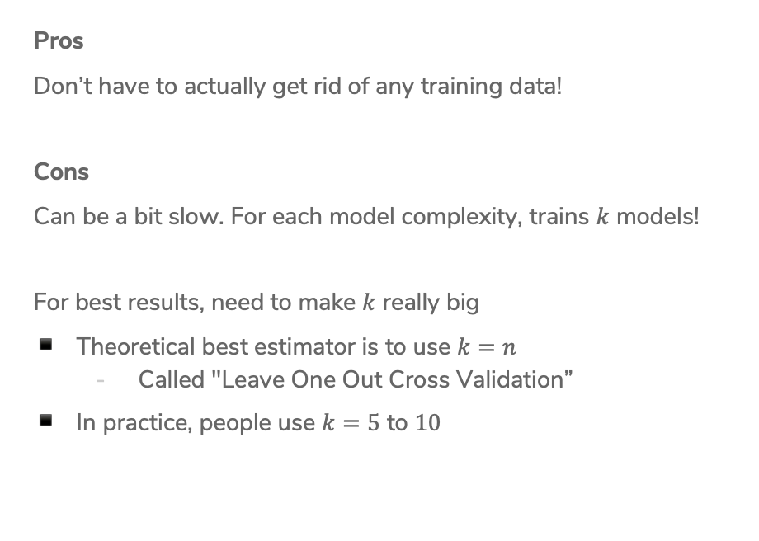
Cross-Validation
Pros
Don’t have to actually get rid of any training data!
Cons
Can be a bit slow. For each model complexity, trains $k$ models!
For best results, need to make $k$ really big
Theoretical best estimator is to use $k=n$
  Called "Leave One Out Cross Validation”
In practice, people use $k=5$ to $10$

Slide 55
Recap
Theme: Assess the performance of our models
Ideas:
Model complexity
Train vs. Test vs. True error
Overfitting and Underfitting
Bias-Variance Tradeoff
Error as a function of train set size
Choosing best model complexity
  Validation set
  Cross Validation

