Slide 1

CSE/STAT 416
Recommender Systems
Hunter Schafer
Paul G. Allen School of Computer Science & Engineering
University of Washington
May 17, 2021

Slide 2
Last Time…

Slide 3
Personalization
Personalization is transforming our experience of the world
  Youtube
  Netflix
  Amazon
  Spotify
  Facebook
  Many more…
Almost all have share a common trait where there are users that use the system and items that we want the user to look at.
A recommender system recommends items to a user based on what we think will be the most “useful” for the user.
Notes:
(100 hours uploaded a minute for youtube)
Before we talk about recommender system algorithms, we are going to talk about some challenges we face with recommender systems
Star next to netflix

Slide 4
Challenges
Types of Feedback (Explicit vs Implicit)
Diverse Outputs
Cold Start
Context (i.e. time)
Scalability

Slide 5
Solution 0 : Popularity
Simplest Approach: Recommend whatever is popular
Rank by global popularity (i.e. Avengers Endgame)
Limitations
No personalization
Feedback loop

Slide 6
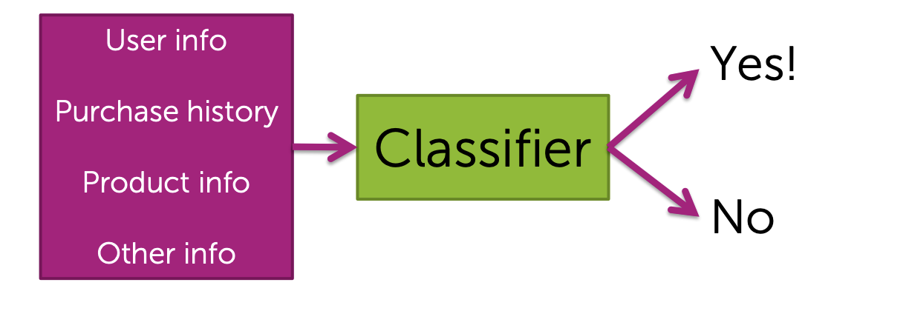
Solution 1:
Classification Model
Train a classifier to learn whether or not someone will like an item
Pros
Personalized
Features can capture context (time of day, recent history, …)
Can even handle limited user history (age of user, location, …)
Cons
Features might not be available or hard to work with
Often doesn’t perform well in practice when compared to more advanced techniques like collaborative filtering

Slide 7
Co-occurrence Matrix
Solution 2

Slide 8
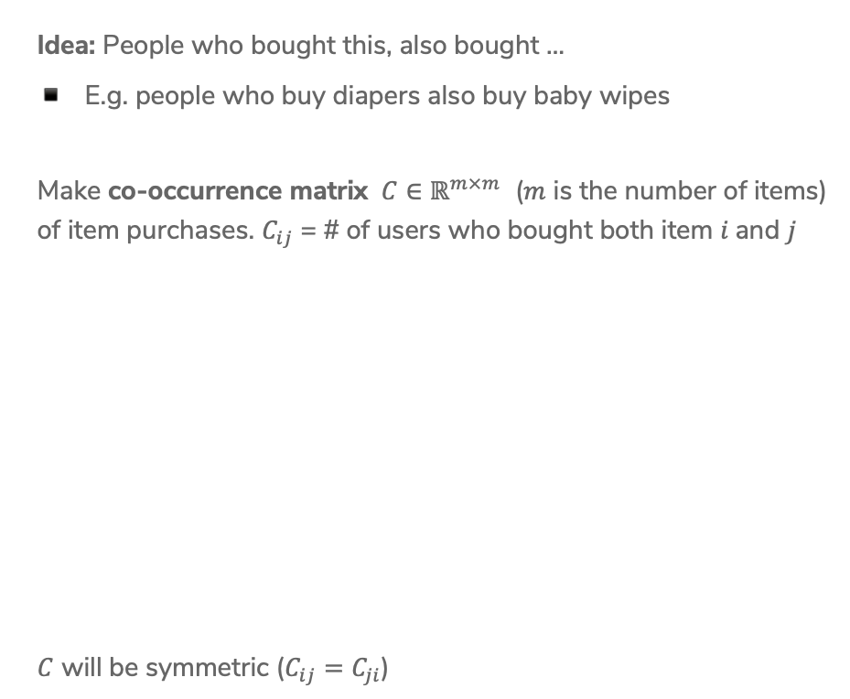

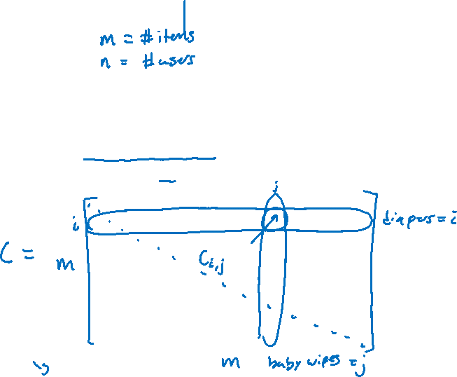
Co-occurrence Matrix
Idea: People who bought this, also bought …
E.g. people who buy diapers also buy baby wipes
Make co-occurrence matrix $C∈ℝ^{m×m}$ ($m$ is the number of items) of item purchases. $C_{ij}$ = # of users who bought both item $i$and $j$
$C$ will be symmetric ($C_{ij}=C_{ji}$)
Notes:
Draw C = matrix
Highlight diapers row and baby wipes column
Indicate intersection is # of times people bought both
Draw dash line for symmetric

Slide 9
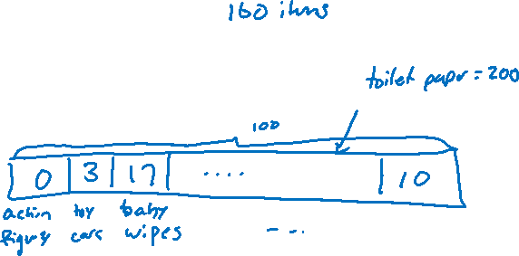
Recommending
Assume a user has purchased diapers.
Look at diapers row (or column)
Recommend items with largest counts
Baby wipes, milk, baby food, …

Slide 10
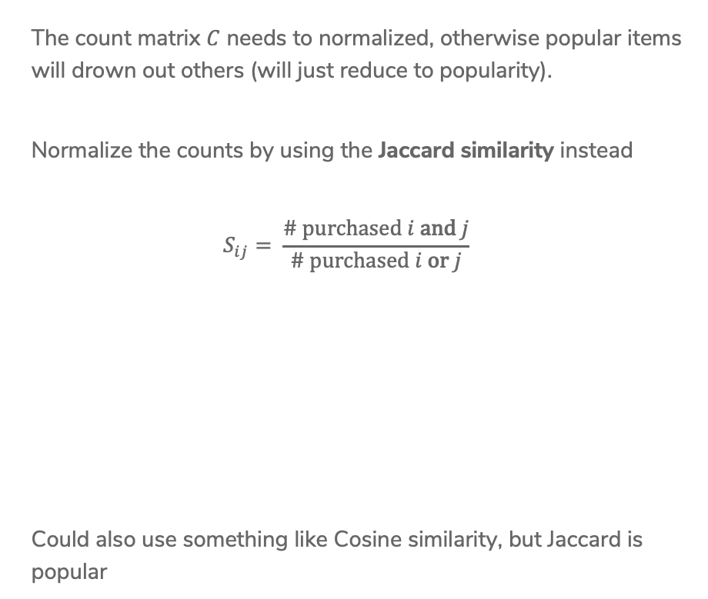
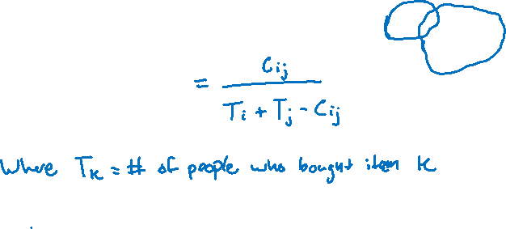
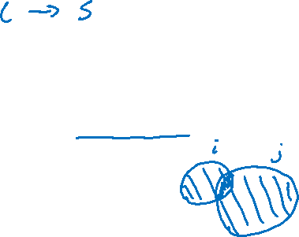
Normalization
The count matrix $C$ needs to normalized, otherwise popular items will drown out others (will just reduce to popularity).
Normalize the counts by using the Jaccard similarity instead
$$S_{ij}= \frac{\# \text{purchased} i \text{and} j}{\# \text{purchased} i \text{or} j}$$
Could also use something like Cosine similarity, but Jaccard is popular
Notes:
Call this matrix S
Draw ven-diagram
Show “or” is same as +

Slide 11
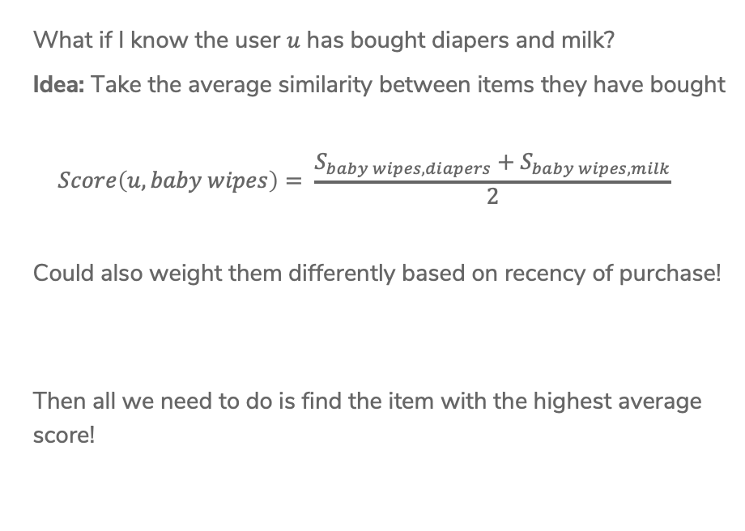

Purchase History
What if I know the user $u$ has bought diapers and milk?
Idea: Take the average similarity between items they have bought
$$Score\left(u, baby wipes\right)= \frac{S_{baby wipes, diapers}+S_{baby wipes, milk}}{2}$$
Could also weight them differently based on recency of purchase!
Then all we need to do is find the item with the highest average score!

Slide 12
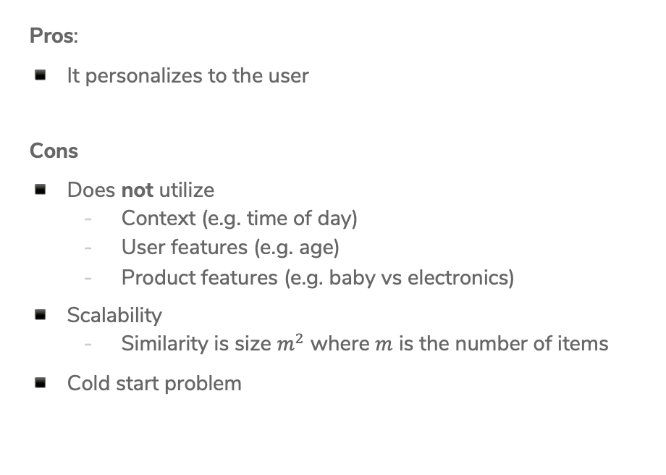

Analysis
Pros:
It personalizes to the user
Cons
Does not utilize
  Context (e.g. time of day)
  User features (e.g. age)
  Product features (e.g. baby vs electronics)
Scalability
  Similarity is size $m^{2}$ where $m$ is the number of items
Cold start problem

Slide 13
Matrix Factorization
Solution 4

Slide 14
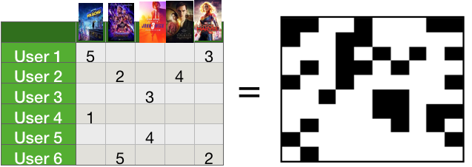
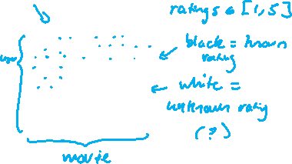
Matrix Completion
Input Data
Want to recommend movies based
on user ratings for movies.
Challenge: Users have rated relatively
few of the entire catalog
Can think of this as a matrix of
users and ratings with missing data!
Notes:
Write users on left, movies on bottom
Write black is known number ({1,2,3,4,5})
Write white is unknown (want to predict)

Slide 15
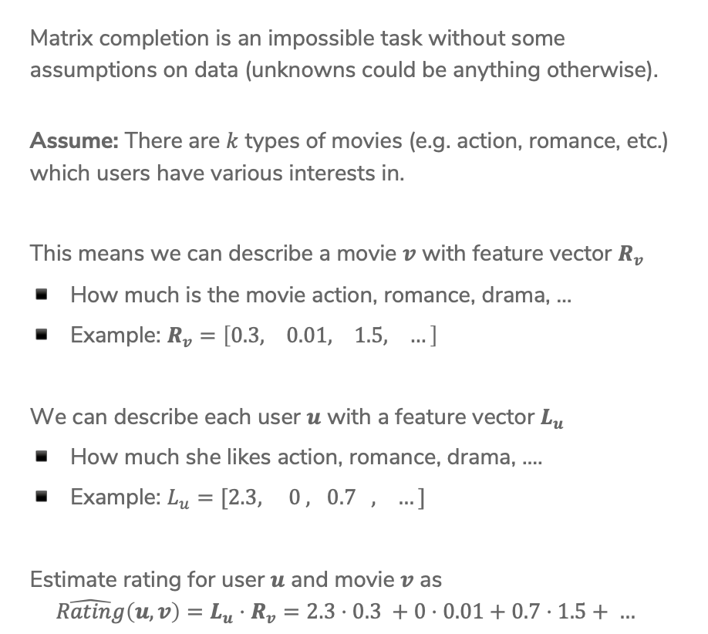
Assumption
Matrix completion is an impossible task without some assumptions on data (unknowns could be anything otherwise).
Assume: There are $k$ types of movies (e.g. action, romance, etc.) which users have various interests in.
This means we can describe a movie $v$ with feature vector $R_{v}$
How much is the movie action, romance, drama, …
Example: $R_{v}=\left[0.3, 0.01, 1.5, …\right]$
We can describe each user $u$ with a feature vector $L_{u}$
How much she likes action, romance, drama, ….
Example: $L_{u}=[2.3, 0 , 0.7 , …]$
Estimate rating for user $u$ and movie $v$ as
$$\hat{Rating}\left(u,v\right)=L_{u}⋅R_{v}=2.3⋅0.3 +0⋅0.01+0.7⋅1.5+ …$$
Notes:
Write: Works if she hasn’t seen movie v yet!

Slide 16
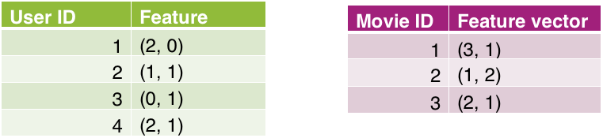
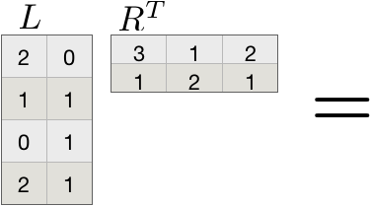
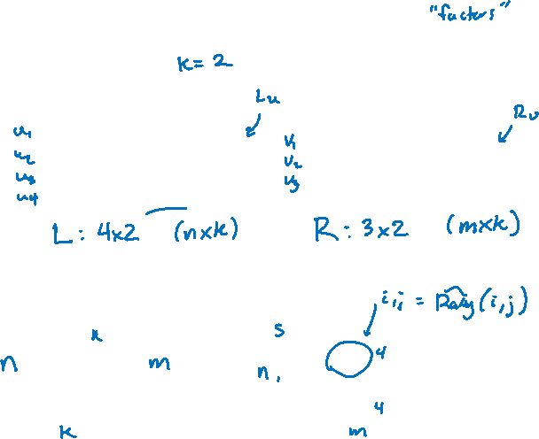

Example
Suppose we have learned the following user and movie features using 2 features
Then we can predict what each user would rate each movie
Notes:
Write “L is 4x2” under green and “R is 3x2” under magenta
Write $u_{1},u_{2},…u_{m}$ next to users and $v_{1}, v_{2}, …, v_{n}$ next to users
Big idea: Given matrix with some values, learn L and R so predictions are close

Slide 17

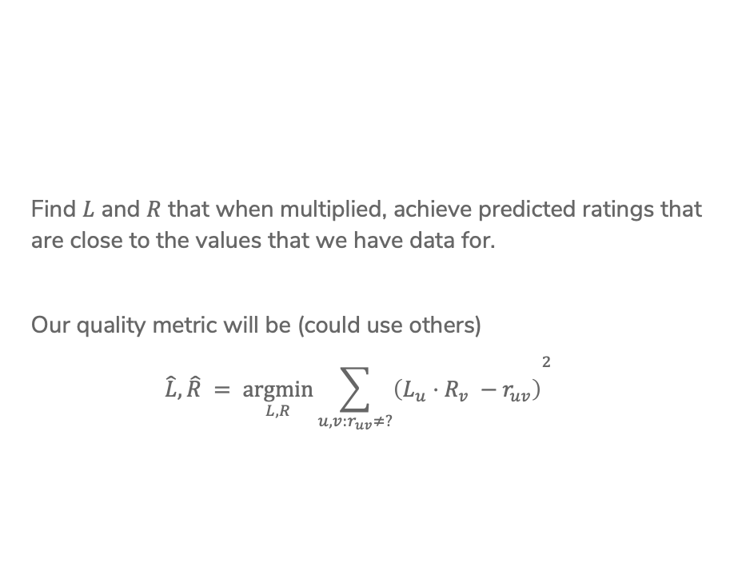
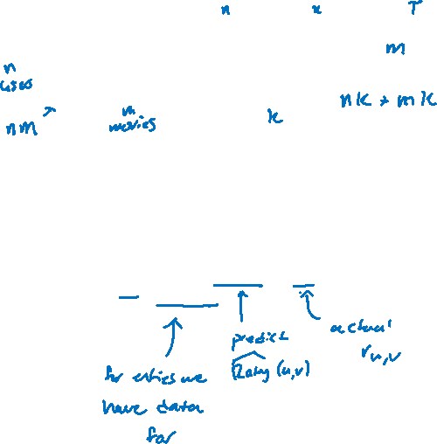



Matrix Factorization
Find $L$ and $R$ that when multiplied, achieve predicted ratings that are close to the values that we have data for.
Our quality metric will be (could use others)
$${\hat{L}, \hat{R} = \underset{L, R}{argmin}{\sum_{u, v:r_{uv}≠?}{\left(L_{u}⋅R_{v} −r_{uv}\right)}}}^{2}$$
Notes:
Highlight “only over data we have ratings for”, “predicted rating” and “Actual rating”
This helps because we reduce the number of parameters needed to be learned
Highlight number of users = n and number of movies = m
In this case, we only need to learn nk + mk parameters which can be much smaller than mn (full matrix)
Need about k(n + m) examples to make sure the problem is better defined

Slide 18
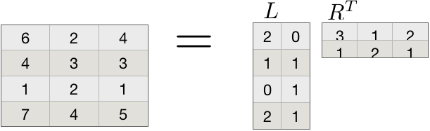
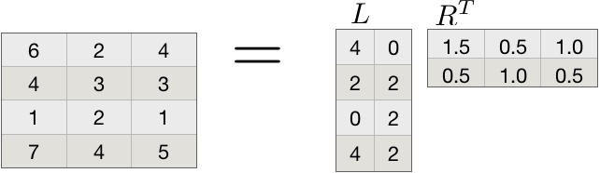

Unique Solution?
Is this problem well posed? Unfortunately, there is not a unique solution ☹
For example, assume we had a solution
Then doubling everything in $L$ and halving everything in $R$ is also a valid solution. The same is true for all constant multiples.
Notes:
This means we should not really interpret the individual values!

Slide 19
Coordinate Descent

Slide 20
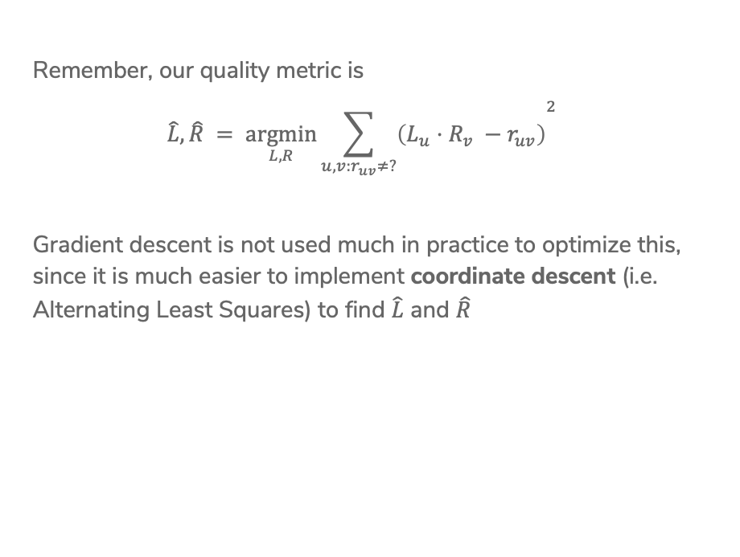

Find $\hat{L}$ & $\hat{R}$
Remember, our quality metric is
$${\hat{L}, \hat{R} = \underset{L, R}{argmin}{\sum_{u, v:r_{uv}≠?}{\left(L_{u}⋅R_{v} −r_{uv}\right)}}}^{2}$$
Gradient descent is not used much in practice to optimize this, since it is much easier to implement coordinate descent (i.e. Alternating Least Squares) to find $\hat{L}$ and $\hat{R}$

Slide 21
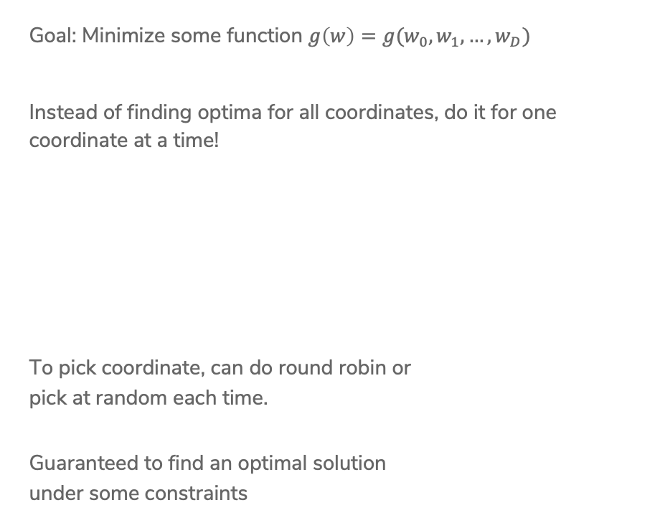
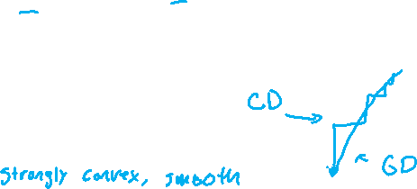
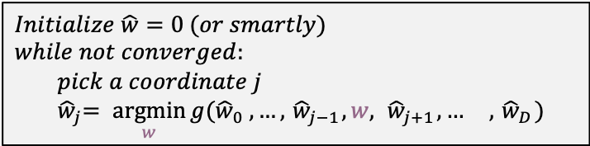
Coordinate Descent
Goal: Minimize some function $g\left(w\right)=g(w_{0},w_{1},…, w_{D})$
Instead of finding optima for all coordinates, do it for one coordinate at a time!
To pick coordinate, can do round robin or
pick at random each time.
Guaranteed to find an optimal solution
under some constraints
$Initialize \hat{w}=0 (or smartly)$
$while not converged:$
$pick a coordinate j$
$${ \hat{w}}_{j}= \underset{w}{argmin}{g({\hat{w}}_{0} , …, { \hat{w}}_{j−1}, w, { \hat{w}}_{j+1}, … , { \hat{w}}_{D}) }$$
Notes:
Write $\min_{w}{g(w)}$ at top
It can be tricky to find minimum of all coordinates at once (need gradient descent), but in some cases it’s also possible to just find the minimum for each coordinate at a time
Constraints: Strong convex, smooth

Slide 22







Coordinate Descent for Matrix Factorization
$${\hat{L}, \hat{R} = \underset{L, R}{argmin}{\sum_{u, v:r_{uv}≠?}{\left(L_{u}⋅R_{v} −r_{uv}\right)}}}^{2}$$
Fix movie factors $R$ and optimize for $L_{u}$
First key insight:
Notes:
$\min_{L_{1},…L_{n}}{\sum_{u,v :r_{uv}≠?}{{\left(L_{u}⋅R_{v}−r_{uv}\right)}^{2}}}$
$\min_{L_{1},…,L_{n}}{\sum_{u}{\sum_{v∈V_{u}}{{\left(L_{u}⋅R_{v}−r_{uv}\right)}^{2}}}}$ where $V_{u}$ is the set of movies user $u$has rated
Independent optimization for each user!
For each $u$, find $\min_{L_{u}}{…}$

Slide 23




Coordinate Descent for Matrix Factorization
Holding movies fixed, we can solve for each user separately!
For each user $u$
$${\hat{L}}_{u}= \underset{L_{u}}{argmin}{\sum_{v∈V_{u}}{{\left(L_{u}⋅R_{v} −r_{uv}\right)}^{2}}}$$
Second key insight:
Looks like linear regression!
Notes:
L_u is param vector
R_v is fixed
R_uv are observations
Looks like $\min_{w}{\sum_{i=1}^{n}{{\left(w⋅h\left(x_{i}\right)−y_{i}\right)}^{2}}}$
Can optimize with simple gradient descent (but simpler since just one vector)

Slide 24

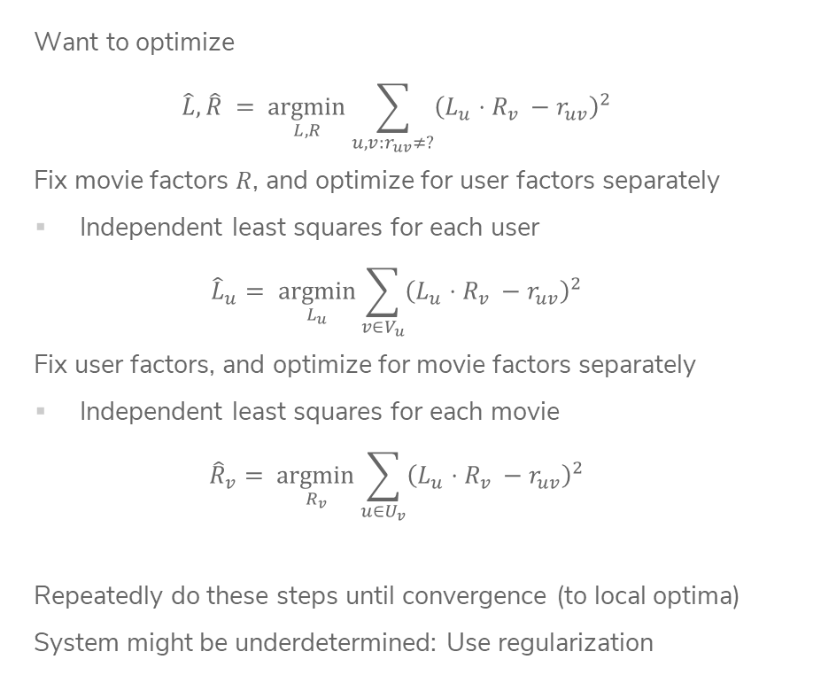
Overall Algorithm
Want to optimize
$$\hat{L}, \hat{R} = \underset{L, R}{argmin}{\sum_{u, v:r_{uv}≠?}{{\left(L_{u}⋅R_{v} −r_{uv}\right)}^{2}}}$$
Fix movie factors $R$, and optimize for user factors separately
Independent least squares for each user
$${\hat{L}}_{u}= \underset{L_{u}}{argmin}{\sum_{v∈V_{u}}{{\left(L_{u}⋅R_{v} −r_{uv}\right)}^{2}}}$$
Fix user factors, and optimize for movie factors separately
Independent least squares for each movie
$${\hat{R}}_{v}= \underset{R_{v}}{argmin}{\sum_{u∈U_{v}}{{\left(L_{u}⋅R_{v} −r_{uv}\right)}^{2}}}$$
Repeatedly do these steps until convergence (to local optima)
System might be underdetermined: Use regularization
Notes:
Write + \lambda ||L||
Write you can use L1 norm or L2 norm (similar to ridge/LASSO)

Slide 25
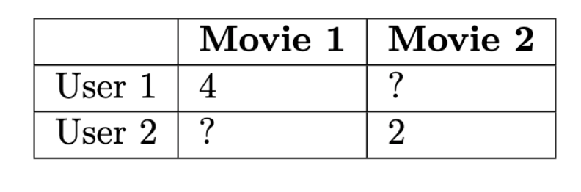
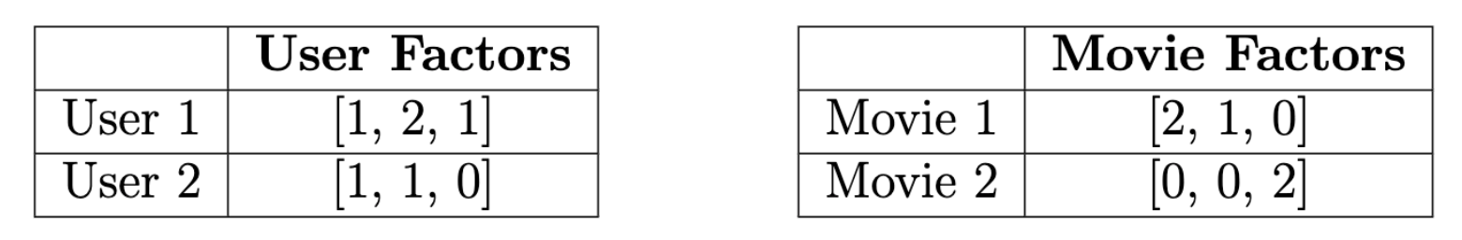

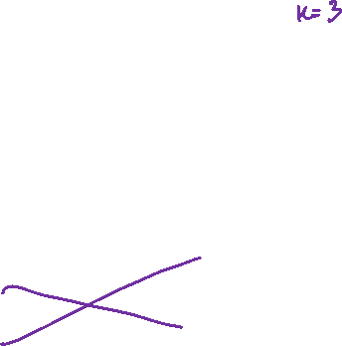
1.5 minutes
Consider we had the ratings matrix
During one step of optimization, user and movie factors are
Two questions:
What is the current residual sum of squares loss? (number)
If the next step of coordinate descent updates the user factors, which factors would change?
User 1
User 2
User 1 and 2
None

Slide 26

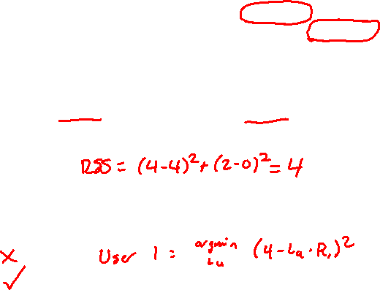

3 minutes
Consider we had the ratings matrix
During one step of optimization, user and movie factors are
Two questions:
What is the current residual sum of squares loss? (number)
If the next step of coordinate descent updates the user factors, which factors would change?
User 1
User 2
User 1 and 2
None

Slide 27
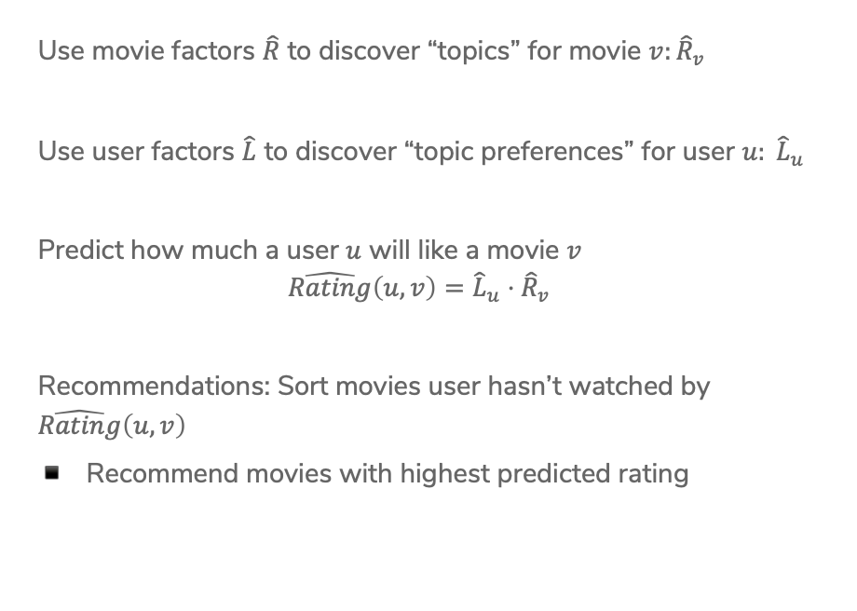
Using Results
Use movie factors $\hat{R}$ to discover “topics” for movie $v:{\hat{R}}_{v}$
Use user factors $\hat{L}$ to discover “topic preferences” for user $u: {\hat{L}}_{u}$
Predict how much a user $u$ will like a movie $v$
$$\hat{Rating}\left(u, v\right)={\hat{L}}_{u}⋅{\hat{R}}_{v}$$
Recommendations: Sort movies user hasn’t watched by $\hat{Rating}\left(u,v\right)$
Recommend movies with highest predicted rating

Slide 28


Slide 29
Topics
The “features” found by matrix factorization don’t always correspond to something meaningful (like film genre), but sometimes they do!
Remember, the exact values are meaningless since we can scale them an infinite number of ways, but directions might mean something

Slide 30

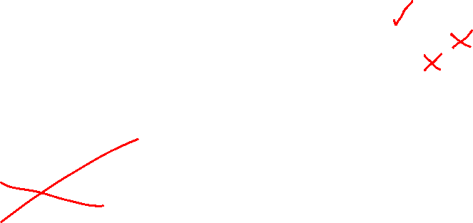
1 min
Which of the following are true about matrix factorization for recommendation systems?
Provides personalization
Captures context (e.g. time of day)
Solves the cold start problem

Slide 31
Blending Models:
Featurized Matrix Factorization
Final Solution

Slide 32
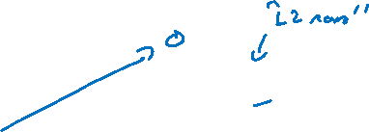
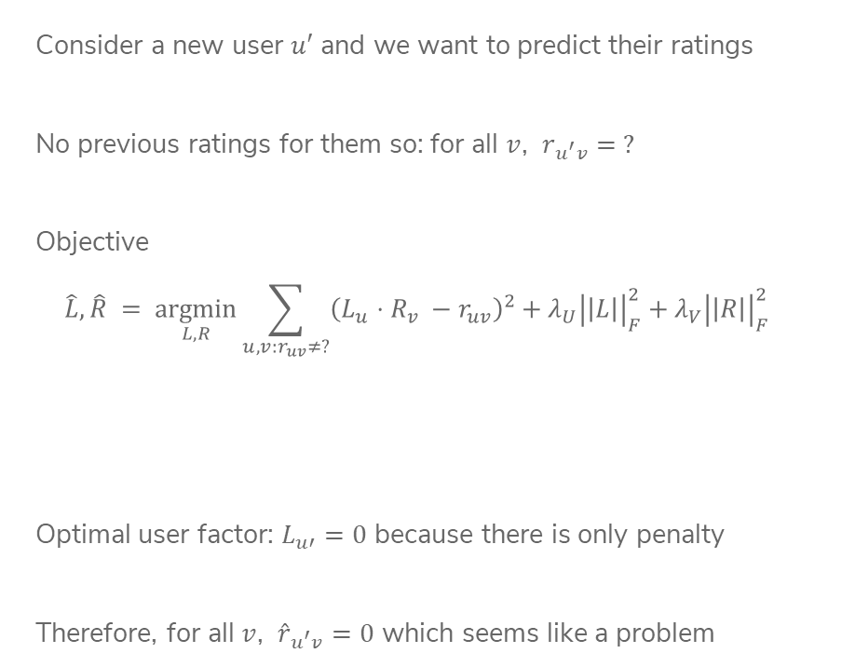
Cold Start Again
Consider a new user $u′$ and we want to predict their ratings
No previous ratings for them so: for all $v$, $r_{u^{′}v}= ?$
Objective
$$\hat{L}, \hat{R} = \underset{L, R}{argmin}{\sum_{u, v:r_{uv}≠?}{{\left(L_{u}⋅R_{v} −r_{uv}\right)}^{2}}}+λ_{U}{\left|\left|L\right|\right|}_{F}^{2}+λ_{V}{\left|\left|R\right|\right|}_{F}^{2}$$
Optimal user factor: $L_{u′}=0$ because there is only penalty
Therefore, for all $v$, ${\hat{r}}_{u^{′}v}=0$ which seems like a problem
Notes:
Write L_u’ next to top
Adding regularization, not important but wanted to be correct where you can’t talk about L2 norm of matrix (it’s called the Frobenius norm)
Cross out summation, circle L penalty
Theref

Slide 33




Blend Models
Idea: Learn a model to supplement the matrix factorization model!
Create a feature vector for each movie
Define weights on these features for all users (global)
$$w_{G}∈ℝ^{d}$$
Fit linear model
Notes:
Write h(v) = (genre: ‘action’, year: 1994, director: Tarantino, …) with dimensions
For all users, r_uv \approx w\cdot h(v)
Write OLS over rated movies with regularization

Slide 34




Add Personalization
Of course, not all users have same preferences.
Include a user-specific deviation from global model
Can also add user specific features to model
Notes:
r_uv = (w + w_u )h(v)
Start w_u = 0, As we gain more information about user w_u becomes more information
h(u) = (gender: F, age: 25, education: MSc, …)
h(u,v) = (…, h(u), …, …, h(v), … cross features)

Slide 35


Featurized Matrix Factorization
Feature-based approach
Feature representation of user and movie fixed
Can address cold start problem
Matrix factorization approach
Suffers from cold start problem
User & Movie features are learned from data
A unified model
Notes:
$r_{uv}={\hat{L}}_{u}⋅{\hat{R}}_{v}+\left(w+w_{u}\right)⋅h(u,v)$
Optimize using gradient descent, coordinate descent, etc.

Slide 36
Evaluating Recommendations

Slide 37
Accuracy?
Could we use classification accuracy to identify which recommender system is performing best?
We don’t really care to predict what a person does not like
Instead, we want to find the relatively few items from the catalog that they will like
Similar to a class imbalance
Instead, we want to look at our set of recommendations and ask:
How many of our recommendations did the user like?
How many of the items that the user liked did we recommend?
Sound familiar?

Slide 38
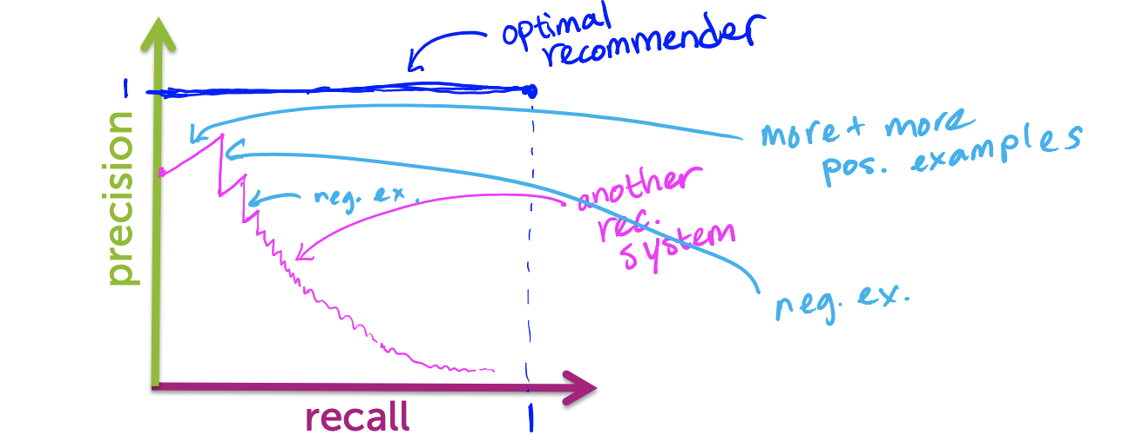

Precision - Recall
Precision and recall for recommender systems
$$precision= \frac{\# liked \& shown}{\# shown}$$
$$recall= \frac{\#liked \& shown}{\#liked }$$
For a given recommender system, plot precision and recall for different number of recommended items

Slide 39
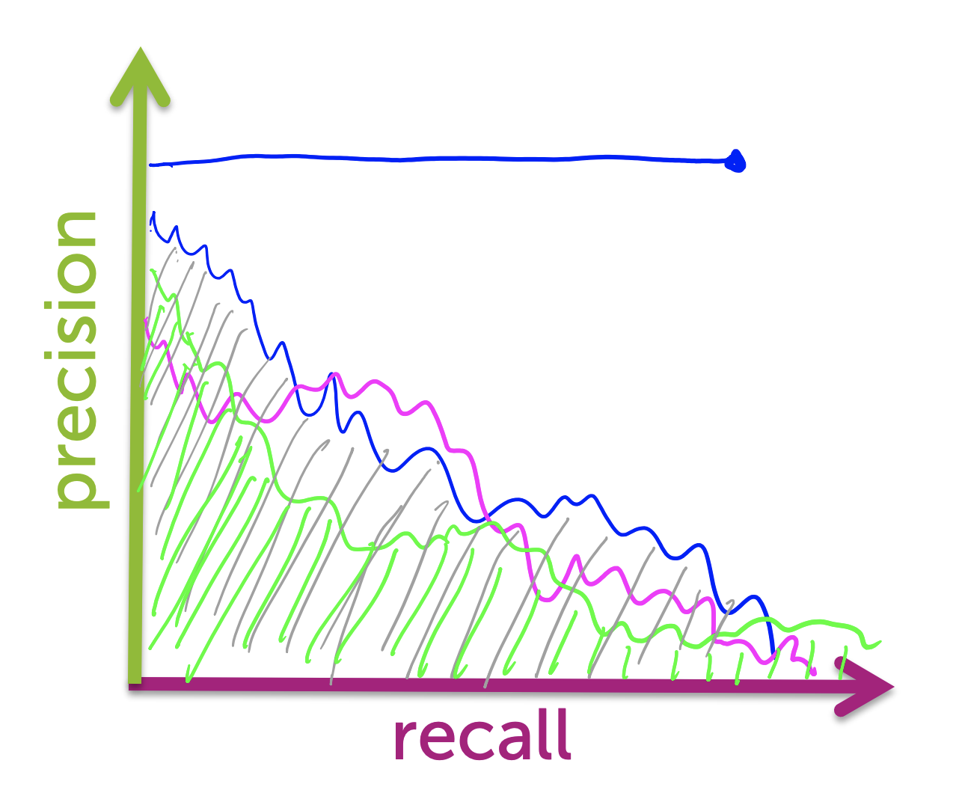
Comparing Algorithms
In general, it depends
What is true always is that for a given precision, we want recall to be as large as possible (and vice versa)
What target precision/recall depends on your application
One metric: area under the curve (AUC)
Another metric: Set desired recall and maximize precision (precision at k)

Slide 40



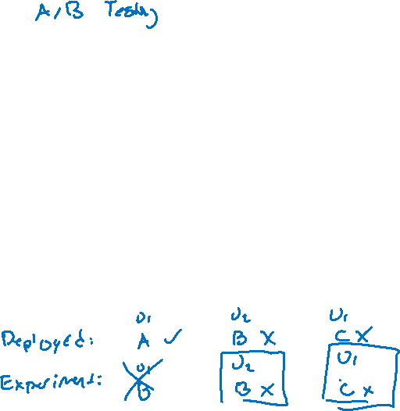

Optional: Offline Replay
Challenge: Deploying a new recommender system in-the-wild can be scary! Might not have confidence in how it will do.
One clever idea: use a simple model to start and record it’s predictions and if the user interacted with the content (e.g., watched movie). Use this data of the model in deployment to test new models without needing to deploy them!
Test your new model on this logged data, if your model makes the same prediction as the simple model did originally, use that as a test example!
Notes:
Note, other approach is commonly A/B testing

Slide 41
Recap
Now you can:
Describe the goal of a recommender system
Provide examples of applications where recommender systems are useful
Implement a co-occurrence based recommender system
Describe the input (observations, number of “topics”) and output (“topic” vectors, predicted values) of a matrix factorization model
Implement a coordinate descent algorithm for optimizing the matrix factorization objective presented
Exploit estimated “topic” vectors to make recommendations
Describe the cold-start problem and ways to handle it (e.g., incorporating features)
Analyze performance of various recommender systems in terms of precision and recall
Use AUC or precision-at-k to select amongst candidate algorithms
Notes:
Logistics
Course evals
Section tomorrow (think of review questions)
Section handouts
Exam materials and topics
Gradescope

