Slide 1

CSE/STAT 416
Ensemble Methods
Hunter Schafer
University of Washington
April 28, 2021

Slide 2
Roadmap
So Far
Housing Prices - Regression
  Regression Model
  Assessing Performance
  Ridge Regression
  LASSO
Sentiment Analysis – Classification
  Classification Overview
  Logistic Regression
  Bias / Fairness
  Naïve Bayes
  Decision Trees
  Ensemble Methods

Slide 3





Training
Data
$$x$$
Feature
extraction
$$h(x)$$
ML
model
$$\hat{y}$$
$$y$$
$$\hat{f}$$
ML algorithm
Quality
metric

Slide 4
Decision Trees

Slide 5
Decision Tree
Root
6 3
Branch/Internal node: splits into possible values of a feature
Leaf node: final decision (the class value)
credit?
excellent
2 0
fair
3 1
poor
1 2
Safe
Safe
Risky

Slide 6
Best threshold?
Infinite possible values of t
Income = t*
Income < t*
Income >= t*
Safe
Risky
Income
$10K
$120K

Slide 7
Predicting probabilities
Root
18 12
Loan status:
Safe Risky
Credit?
excellent
9 2
fair
6 9
poor
3 1
Safe
Risky
Safe
P(y = Safe | x)
= 3 = 0.75
3 + 1

Slide 8
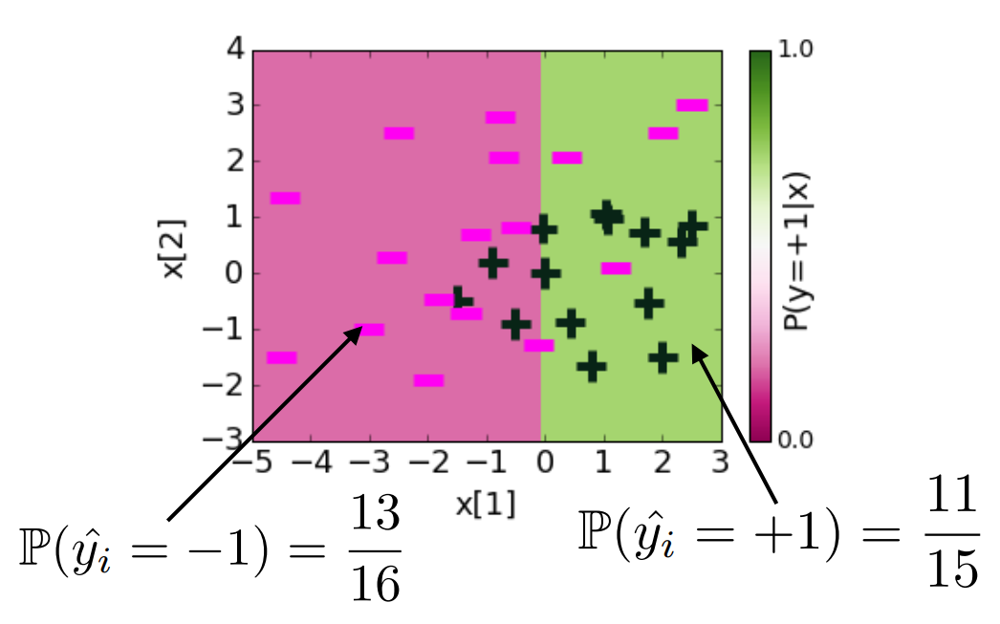
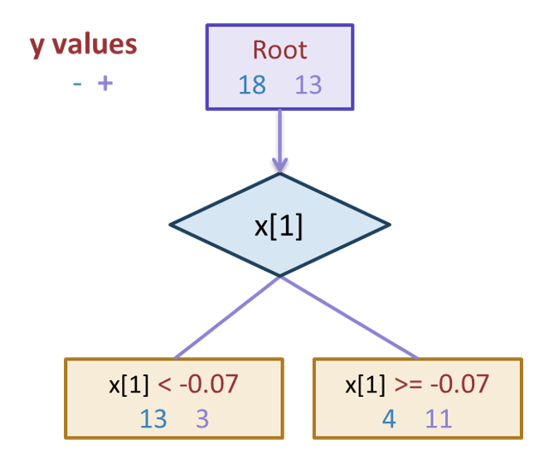
Probabilities (Depth 1)
Notes:
0.22542207904 + 1.12 x[1] -1.07 x[2]

Slide 9
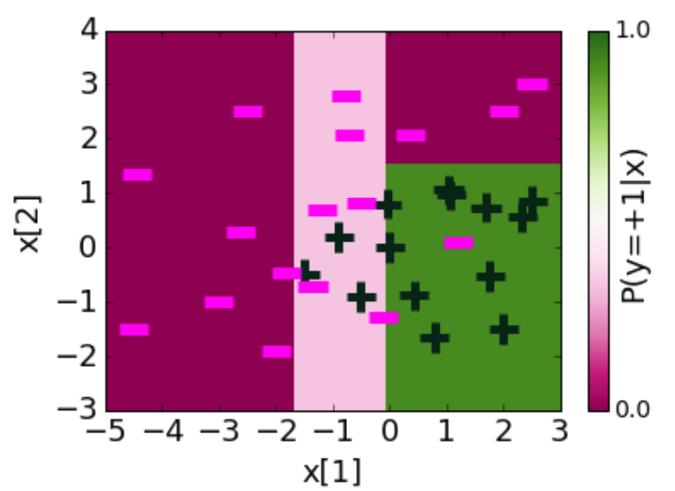
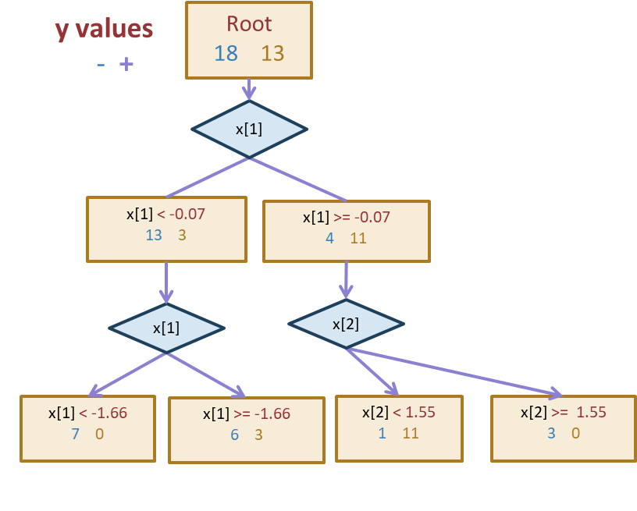
Depth 2
Notes:
0.22542207904 + 1.12 x[1] -1.07 x[2]

Slide 10
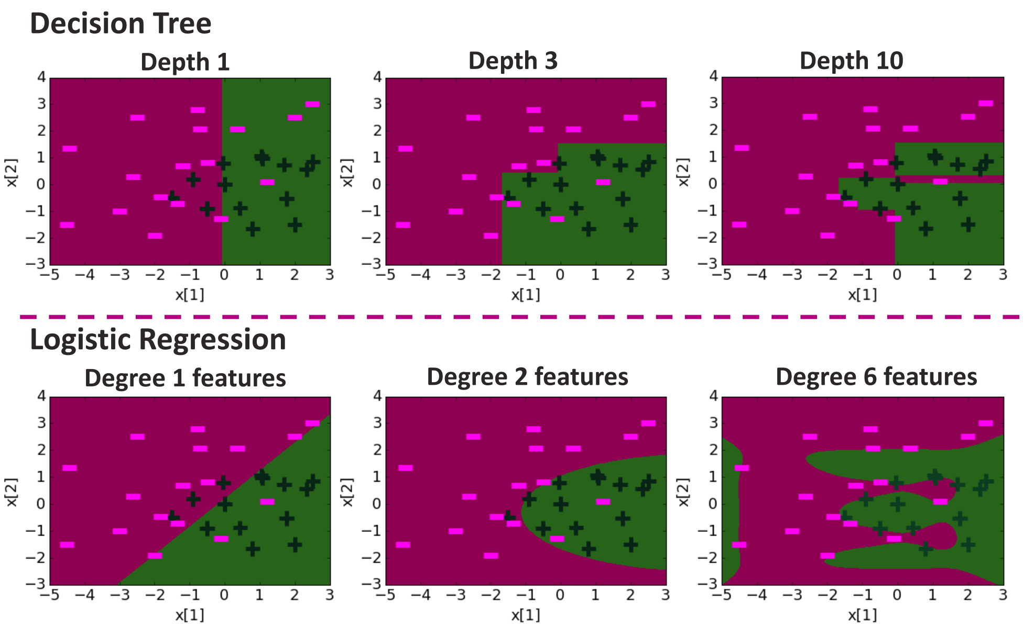
Compare Decision Boundaries

Slide 11
Overfitting
Deep decision trees are prone to overfitting
  Decision boundaries are interpretable but not stable
  Small change in the dataset leads to big difference in the outcome
Overcoming Overfitting:
  Early stopping
    Fixed length depth
    Stop if error does not considerably decrease
  Pruning
    Grow full length trees
    Prune nodes to balance a complexity penalty
Notes:
0.22542207904 + 1.12 x[1] -1.07 x[2]

Slide 12
Early Stopping
Stopping Rules:
  1) All data in the subset have the same label
  2) No more features left to split
Early Stopping Rule
  Only grow up to a max depth hyperparameter (choose via validation)
  Don’t split if there is not a sufficient decrease in error
  Require a minimum number of examples in a leaf node
    Will use this on HW

Slide 13
Decision Tree Overview
Super Simple: Interpretable model that is understandable by people without too much ML experience.
Very Efficient: It actually isn’t too hard to train a tree
Depth Matters
  Too small, it is too weak to learn the function (high bias)
  Too tall, it is likely to overfit to the data (high variance)
  Even by choosing depth appropriately, trees tend to not be the best performing models

Slide 14
Ensemble Methods
Bagging –
Random Forest

Slide 15
Training
Data
$$x$$
Feature
extraction
$$h(x)$$
ML
model
$$\hat{y}$$
$$y$$
$$\hat{f}$$
ML algorithm
Quality
metric

Slide 16
Ensemble Method
Instead of switching to a brand new type of model that is more powerful than trees, what if we instead tried to make the tree into a more powerful model.
What if we could combine many weaker models in such a way to make a more powerful model?
A model ensemble is a collection of (generally weak) models that are combined in such a way to create a more powerful model.
There are two common ways this is done with trees
Random Forest (Bagging)
AdaBoost (Boosting)

Slide 17

Overview
A Random Forest is a collection of $T$ Decision Trees. Each decision tree casts a “vote” for a prediction and the ensemble predicts the majority vote of all of its trees.
Notes:
Will first explain how we learn each tree, and then I’ll try to explain why this works!

Slide 18
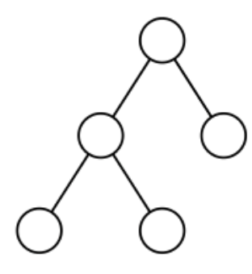

Training Trees
If I just have one dataset, how could I learn more than one tree?
Solve this with bootstrapping! Can create many similar datasets by randomly sampling with replacement.
Technically, you also randomly select features too!

Slide 19
Details
The Random Forest model is a specific type of ensemble model that uses bagging (bootstrapped aggregation).
When training the trees on the bootstrapped samples, we actually want to use very deep trees that overfit!
That sounds bad at first, but we are trying to take advantage of what it means to have a high variance model (low bias).
Remember that high variance models have low bias because if you “average out” over all the models you could learn, they will not have bias.
That is exactly what we are doing here! If we average over a bunch of high variance (overfit) models, to get an ensemble that has low bias and lower variance (if we add more trees)!

Slide 20
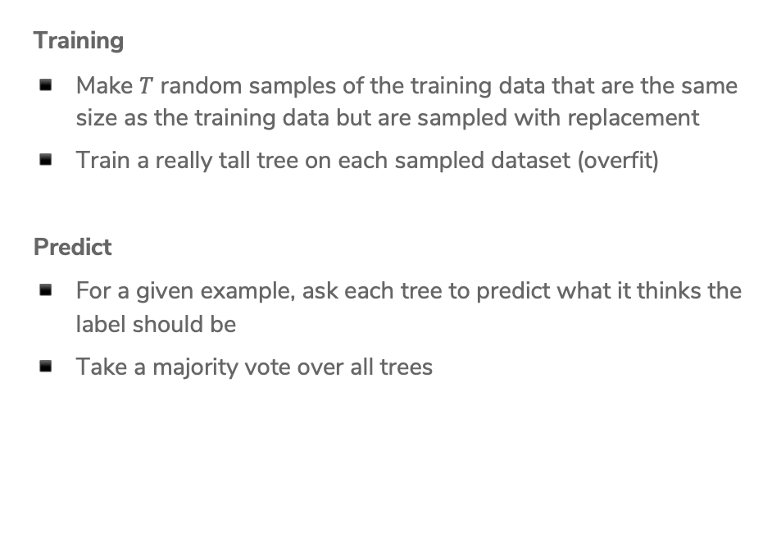
Random Forest Algorithm
Training
Make $T$ random samples of the training data that are the same size as the training data but are sampled with replacement
Train a really tall tree on each sampled dataset (overfit)
Predict
For a given example, ask each tree to predict what it thinks the label should be
Take a majority vote over all trees

Slide 21
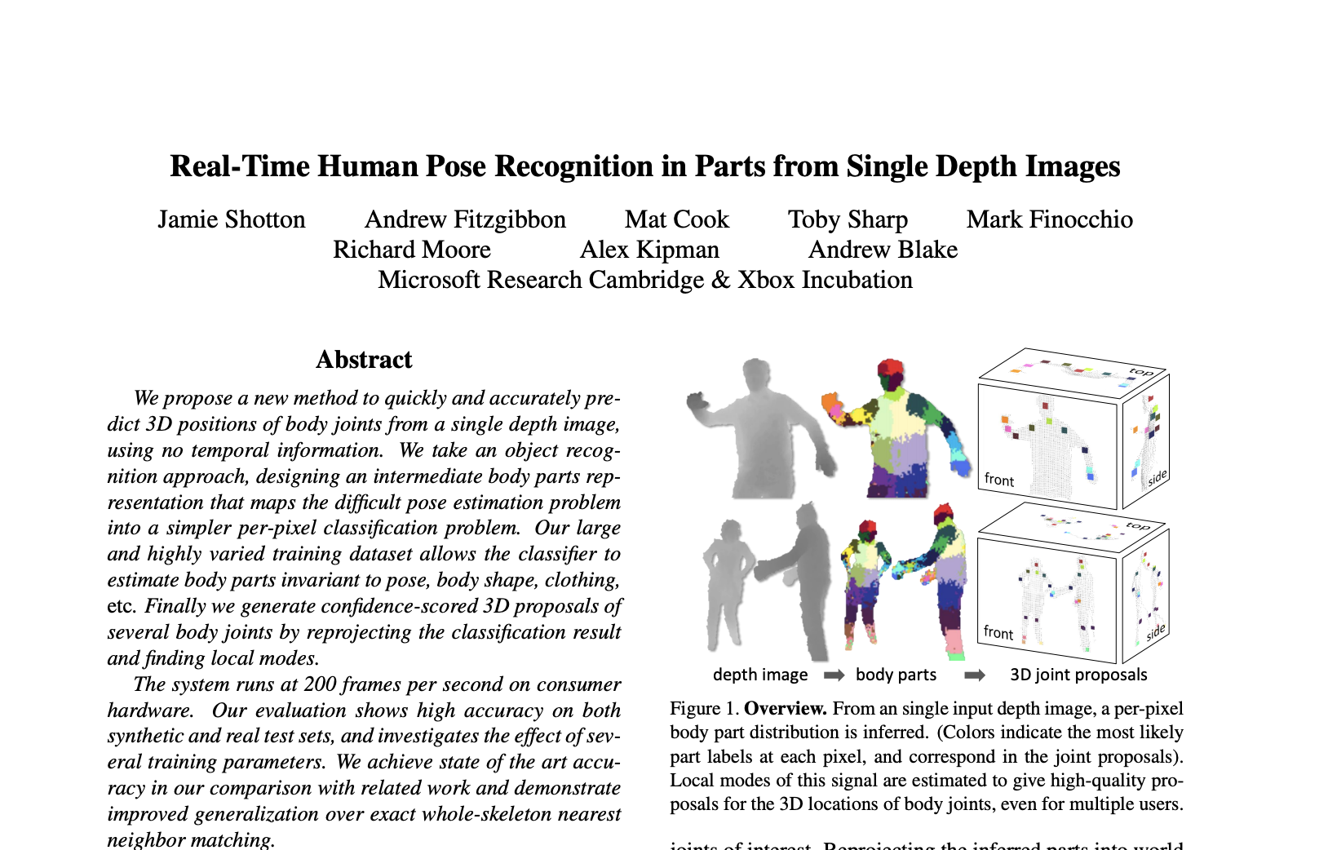
Application
Microsoft used Random Forests in their Kinect system to identify the “pose” of a person from the depth camera.

Slide 22
Random Forest Overview
Use overfitting to our advantage! Averaging overfit models can help make a strong model.
Versatile: Works pretty well in a lot of cases and can serve many different purposes.
  Classification, regression, clustering, feature importance
Low Maintenance: Tends to require less hyper-parameter tuning. Good “out of the box” model.
  More trees is always better here (but takes longer).
  Some other hyperparameters, but they tend to have a small affect on performance.
Efficient: Trees can be learned in parallel!

Slide 23
AdaBoost
Boosting
Notes:
We are going to talk about another ensemble model (a model that combines many weaker models), but that does it in a completely different way

Slide 24
Background
A weak learner is a model that only does slightly better than random guessing.
Kearns and Valiant (1988, 1989):
“Can a set of weak learners create a single strong learner?”
Schapire (1990)
“Yes!”

Slide 25
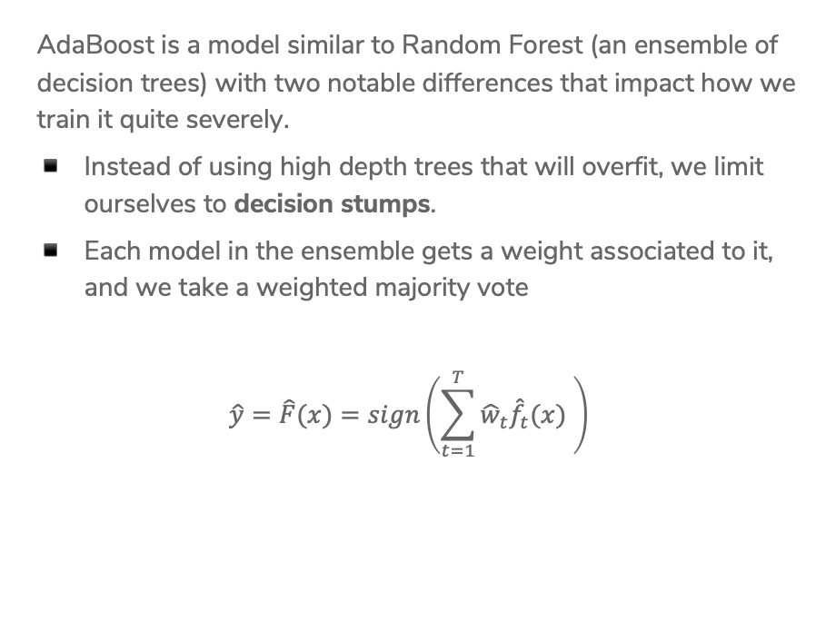

Overview
AdaBoost is a model similar to Random Forest (an ensemble of decision trees) with two notable differences that impact how we train it quite severely.
Instead of using high depth trees that will overfit, we limit ourselves to decision stumps.
Each model in the ensemble gets a weight associated to it, and we take a weighted majority vote
$$\hat{y}=\hat{F}(x)=sign\left(\sum_{t=1}^{T}{{\hat{w}}_{t}{\hat{f}}_{t}(x) }\right)$$
Notes:
Write where hat{f_t} is the t^th tree trained and it predicts +1 or -1 and hat{w} is some weight for that model’s predictions (also learned)

Slide 26

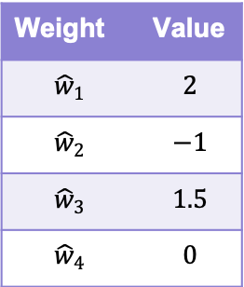



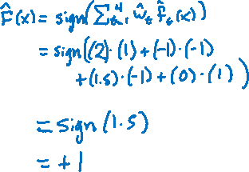
Example
Yes
Income >= 1000
No
$${\hat{f}}_{1}\left(x\right)= +1$$
Weight | Value
$${\hat{w}}_{1}$$ | $$2$$
$${\hat{w}}_{2}$$ | $$−1$$
$${\hat{w}}_{3}$$ | $$1.5$$
$${\hat{w}}_{4}$$ | $$0$$
SAFE
RISKY
Bad
Credit History?
Good
$${\hat{f}}_{2}\left(x\right)=−1$$
RISKY
SAFE
3 Years
5 Years
$${\hat{f}}_{3}\left(x\right)=−1$$
Savings >= 100k
SAFE
RISKY
Bad
Market Cond.
Good
$${\hat{f}}_{4}\left(x\right)= +1$$
RISKY
SAFE
Notes:
Write out hat{F}(x)

Slide 27
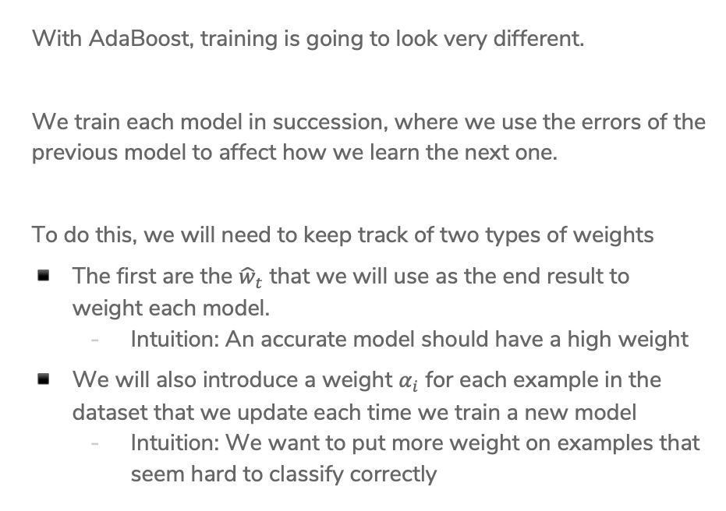
Training AdaBoost
With AdaBoost, training is going to look very different.
We train each model in succession, where we use the errors of the previous model to affect how we learn the next one.
To do this, we will need to keep track of two types of weights
The first are the ${\hat{w}}_{t}$ that we will use as the end result to weight each model.
  Intuition: An accurate model should have a high weight
We will also introduce a weight $α_{i}$ for each example in the dataset that we update each time we train a new model
  Intuition: We want to put more weight on examples that seem hard to classify correctly

Slide 28
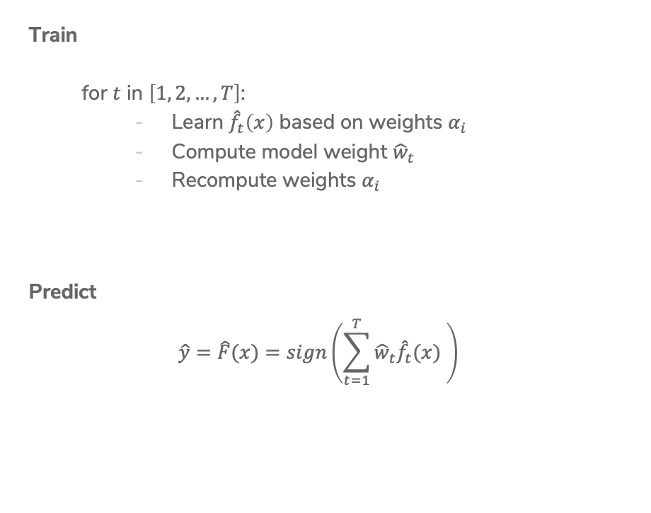

AdaBoost
Ada Glance
Train
  for $t$ in $\left[1, 2, …, T\right]$:
    Learn ${\hat{f}}_{t}\left(x\right)$ based on weights $α_{i}$
    Compute model weight ${\hat{w}}_{t}$
    Recompute weights $α_{i}$
Predict
$$\hat{y}=\hat{F}(x)=sign\left(\sum_{t=1}^{T}{{\hat{w}}_{t}{\hat{f}}_{t}(x) }\right)$$
Notes:
Write “How much we trust hat{f}_t next to compute hat{w}_t
Write “Pay more attention to examples we got wrong” next to recompute alpha_i

Slide 29
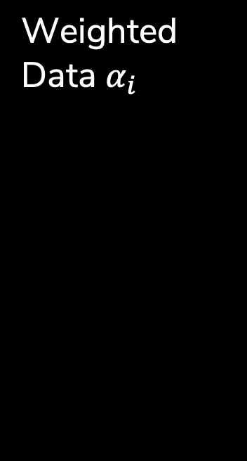
Weighted Data $α_{i}$
Start with a dataset and train our first model (a decision stump)
For all the things it gets wrong, increase the weight of that example. For each one that’s right, decrease its weight.

Slide 30
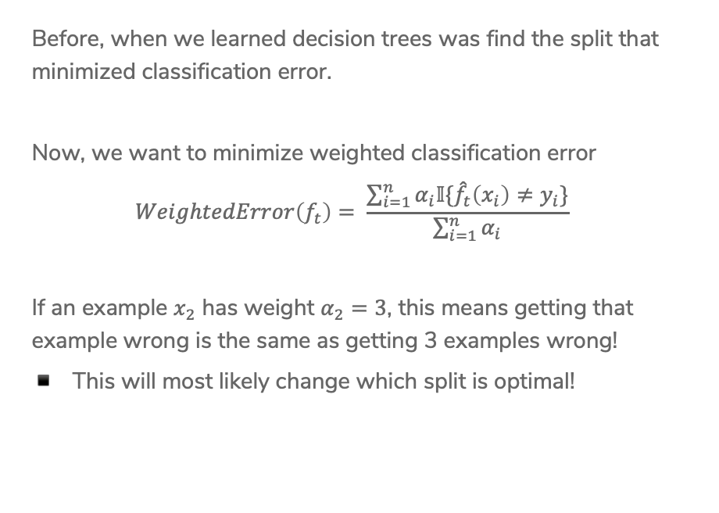
Learning w/ Weighted Data
Before, when we learned decision trees was find the split that minimized classification error.
Now, we want to minimize weighted classification error
$$WeightedError\left(f_{t}\right)= \frac{\sum_{i=1}^{n}{α_{i}𝕀\{{\hat{f}}_{t}\left(x_{i}\right)≠y_{i}\}}}{\sum_{i=1}^{n}{α_{i}}}$$
If an example $x_{2}$ has weight $α_{2}=3$, this means getting that example wrong is the same as getting 3 examples wrong!
This will most likely change which split is optimal!

Slide 31

2 min
Consider the following weighted dataset, what is the weighted classification error of the optimal decision stump (just one split)?
We want to use the TumorSize and IsSmoker to predict if a patient’s tumor is malignant.
TumorSize | IsSmoker | Malignant | Weight
Small | No | No | 0.5
Small | Yes | Yes | 1.2
Large | No | No | 0.3
Large | Yes | Yes | 0.5
Small | Yes | No | 3.3
Notes:
Options
IsSmoker, 3.3
IsSmoker, 1.7
IsSmoker, 2 (just count)
TumorSize, 1.2 + .3 = 1.5
TumorSize, 1+1 (just count)

Slide 32
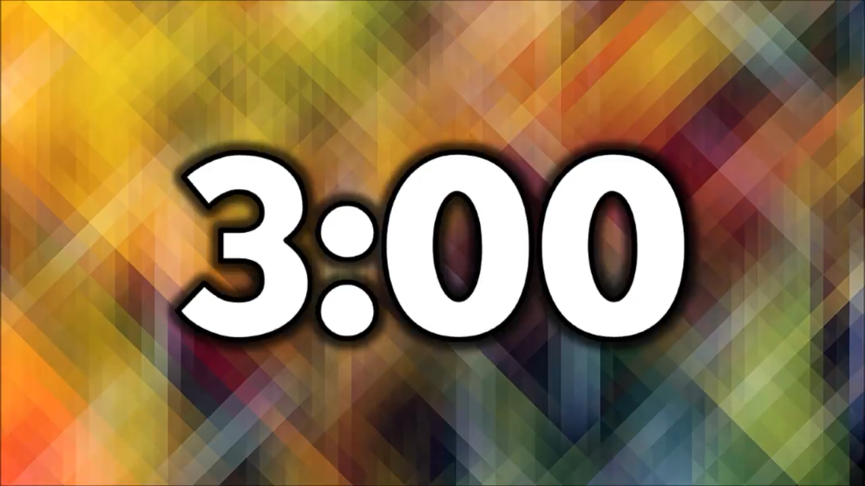
3 min
Consider the following weighted dataset, what is the weighted classification error of the optimal decision stump (just one split)?
We want to use the TumorSize and IsSmoker to predict if a patient’s tumor is malignant.
TumorSize | IsSmoker | Malignant | Weight
Small | No | No | 0.5
Small | Yes | Yes | 1.2
Large | No | No | 0.3
Large | Yes | Yes | 0.5
Small | Yes | No | 3.3
Notes:
Options
IsSmoker, 3.3
IsSmoker, 1.7
IsSmoker, 2 (just count)
TumorSize, 1.2 + .3 = 1.5
TumorSize, 1+1 (just count)

Slide 33
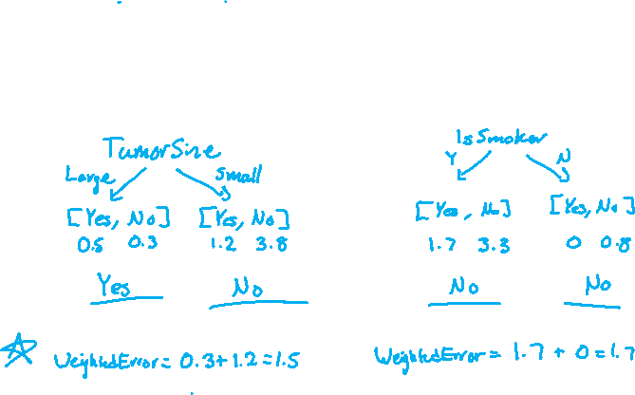
3 min
TumorSize | IsSmoker | Malignant | Weight
Small | No | No | 0.5
Small | Yes | Yes | 1.2
Large | No | No | 0.3
Large | Yes | Yes | 0.5
Small | Yes | No | 3.3
Notes:
Options
IsSmoker, 3.3
IsSmoker, 1.7
IsSmoker, 2 (just count)
TumorSize, 1.2 + .3 = 1.5
TumorSize, 1+1 (just count)

Slide 34
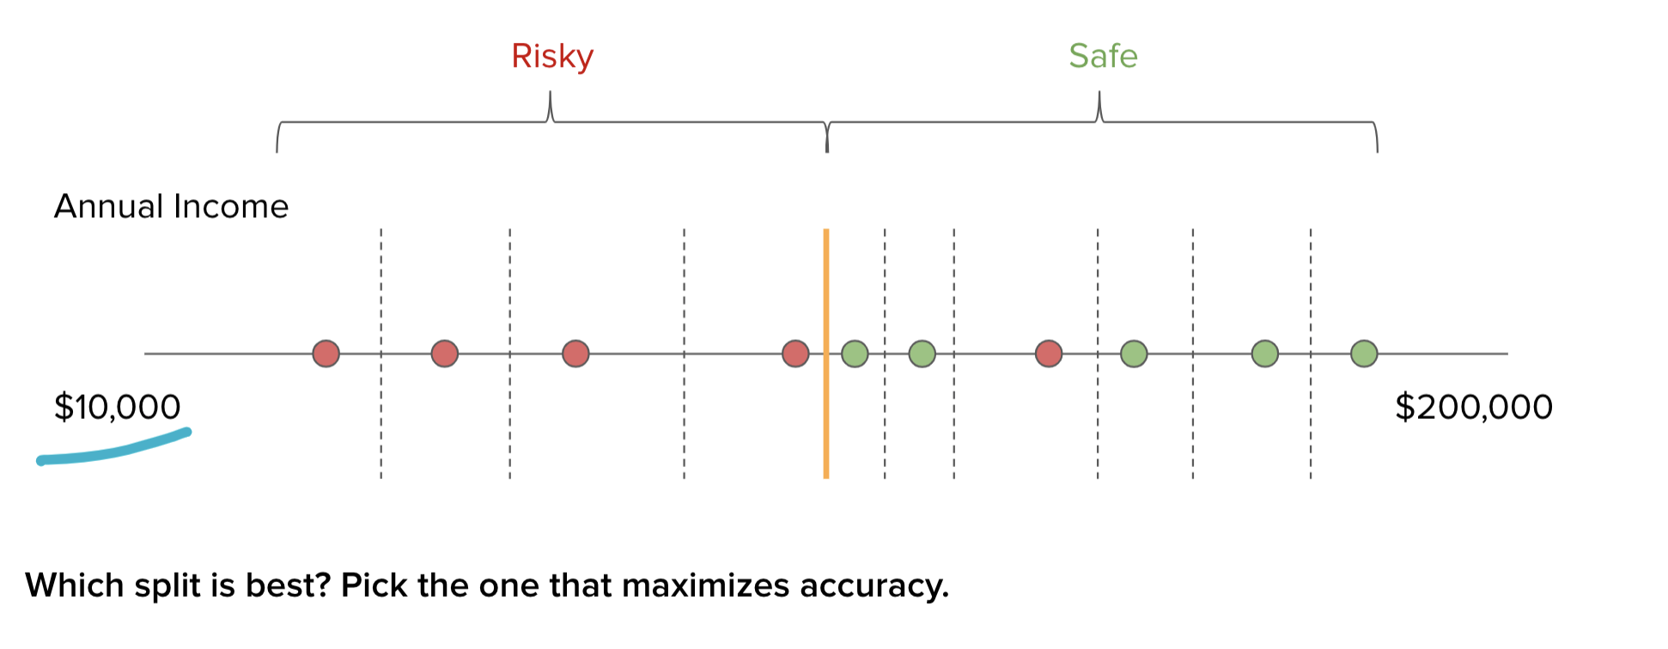
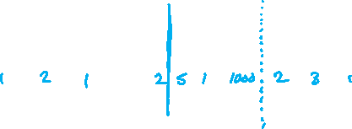
Real Valued Features
The algorithm is more or less the same, but now we need to account for weights

Slide 35


Slide 36

AdaBoost
Ada Glance
Train
  for $t$ in $\left[1, 2, …, T\right]$:
    Learn ${\hat{f}}_{t}\left(x\right)$ based on weights $α_{i}$
    Compute model weight ${\hat{w}}_{t}$
    Recompute weights $α_{i}$
Predict
$$\hat{y}=\hat{F}(x)=sign\left(\sum_{t=1}^{T}{{\hat{w}}_{t}{\hat{f}}_{t}(x) }\right)$$
Notes:
Circle what we just did
Going to do each of the next two steps

Slide 37
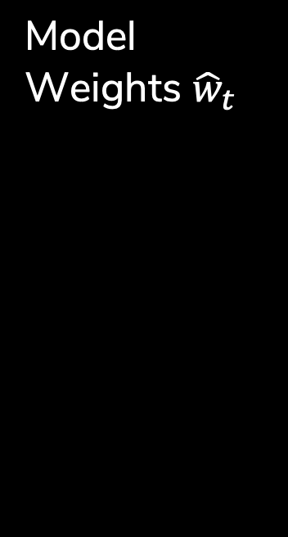
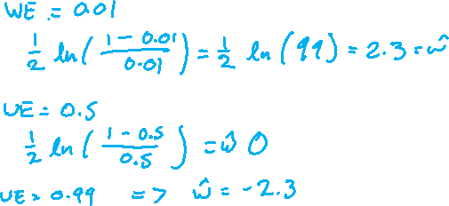

Model Weights ${\hat{w}}_{t}$
Goal: Want to have high weight for models that are very accurate, and low weight for models that are not.
The specific formula used for AdaBoost
$${\hat{w}}_{t}=\frac{1}{2}\ln\left(\frac{1−WeightedError\left({\hat{f}}_{t}\right)}{WeightedError({\hat{f}}_{t})}\right)$$
Notes:
If WeightedError(f_t) = 0.01 => 1-0.01 / 0.01 = 99 => \hat{w}_t = 2.3
If WeightedError(f_t) = 0.5 => 0.5/0.5 = 1 => \hat{w}_t = 0
If WeightedError(f_t) = 0.99 => 1-0.99 / 0.99 = 0.01 => \hat{w}_t = -2.3
Terrible classifier, but 1-f_t is good :)

Slide 38

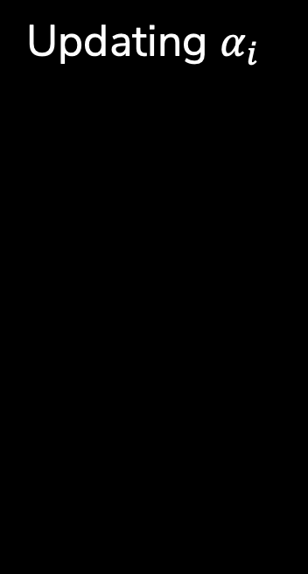

Updating $α_{i}$
Goal: Increase the weights of data examples that were hard to classify. If we got it wrong, increase the weight, otherwise decrease it.
$$α_{i}←\left\{\begin{aligned}α_{i}e^{−{\hat{w}}_{t}}, if {\hat{f}}_{t}\left(x_{i}\right)=y_{i} \\ α_{i}e^{{\hat{w}}_{t}}, if {\hat{f}}_{t}\left(x_{i}\right)≠y_{i} \end{aligned}\right.$$

Slide 39
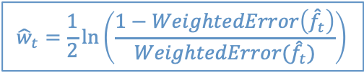
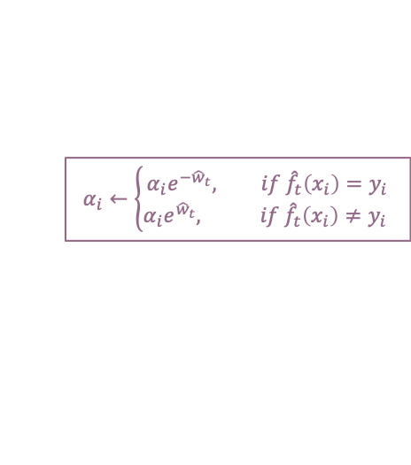
AdaBoost
Ada Glance
$${\hat{w}}_{t}=\frac{1}{2}\ln\left(\frac{1−WeightedError\left({\hat{f}}_{t}\right)}{WeightedError({\hat{f}}_{t})}\right)$$
Train
  for $t$ in $\left[1, 2, …, T\right]$:
    Learn ${\hat{f}}_{t}\left(x\right)$ based on weights $α_{i}$
    Compute model weight ${\hat{w}}_{t}$
    Recompute weights $α_{i}$
Predict
$$\hat{y}=\hat{F}(x)=sign\left(\sum_{t=1}^{T}{{\hat{w}}_{t}{\hat{f}}_{t}(x) }\right)$$
$$α_{i}←\left\{\begin{aligned}α_{i}e^{−{\hat{w}}_{t}}, if {\hat{f}}_{t}\left(x_{i}\right)=y_{i} \\ α_{i}e^{{\hat{w}}_{t}}, if {\hat{f}}_{t}\left(x_{i}\right)≠y_{i} \end{aligned}\right.$$
Notes:
Write “How much we trust hat{f}_t next to compute hat{w}_t
Write “Pay more attention to examples we got wrong” next to recompute alpha_i

Slide 40
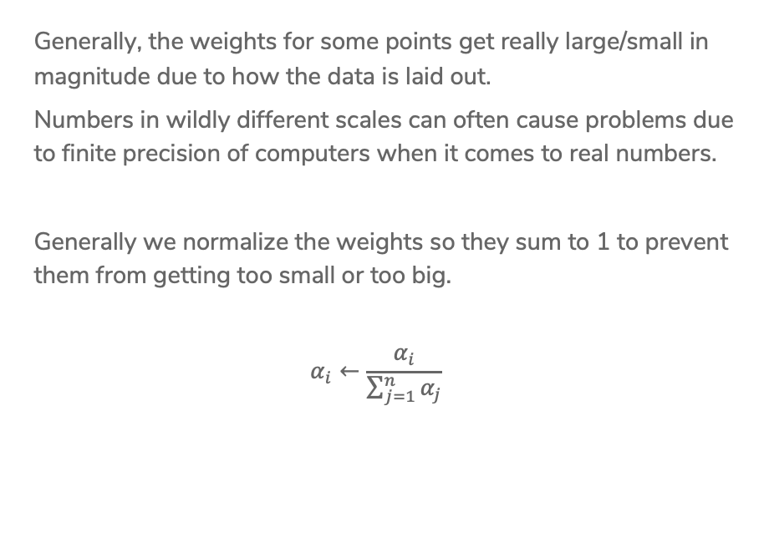
Normalizing Weights
Generally, the weights for some points get really large/small in magnitude due to how the data is laid out.
Numbers in wildly different scales can often cause problems due to finite precision of computers when it comes to real numbers.
Generally we normalize the weights so they sum to 1 to prevent them from getting too small or too big.
$$α_{i}←\frac{α_{i}}{\sum_{j=1}^{n}{α_{j}}}$$

Slide 41

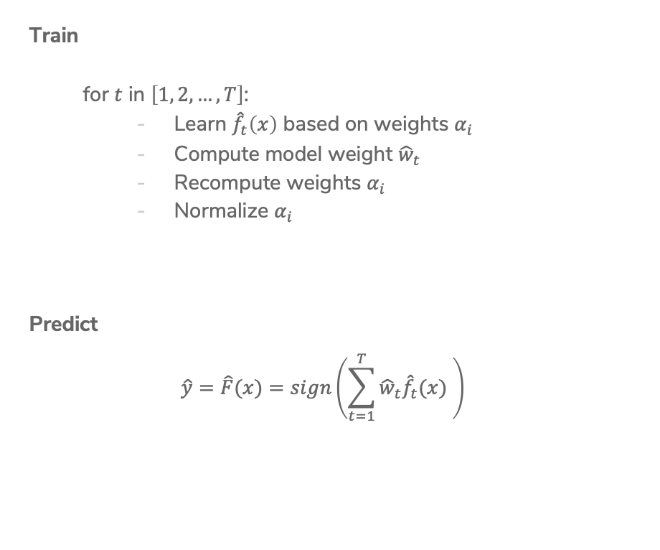
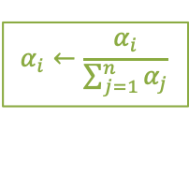
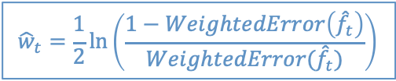

AdaBoost
Ada Glance
$${\hat{w}}_{t}=\frac{1}{2}\ln\left(\frac{1−WeightedError\left({\hat{f}}_{t}\right)}{WeightedError({\hat{f}}_{t})}\right)$$
Train
  for $t$ in $\left[1, 2, …, T\right]$:
    Learn ${\hat{f}}_{t}\left(x\right)$ based on weights $α_{i}$
    Compute model weight ${\hat{w}}_{t}$
    Recompute weights $α_{i}$
    Normalize $α_{i}$
Predict
$$\hat{y}=\hat{F}(x)=sign\left(\sum_{t=1}^{T}{{\hat{w}}_{t}{\hat{f}}_{t}(x) }\right)$$
$$α_{i}←\left\{\begin{aligned}α_{i}e^{−{\hat{w}}_{t}}, if {\hat{f}}_{t}\left(x_{i}\right)=y_{i} \\ α_{i}e^{{\hat{w}}_{t}}, if {\hat{f}}_{t}\left(x_{i}\right)≠y_{i} \end{aligned}\right.$$
$$α_{i}←\frac{α_{i}}{\sum_{j=1}^{n}{α_{j}}}$$
Notes:
Write “How much we trust hat{f}_t next to compute hat{w}_t
Write “Pay more attention to examples we got wrong” next to recompute alpha_i

Slide 42


Slide 43
Visualizing AdaBoost

Slide 44
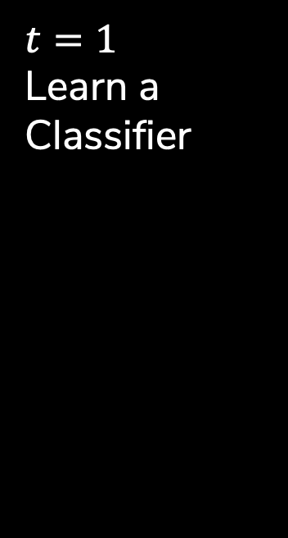

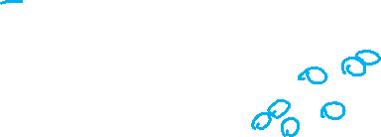
$t=1$
Learn a Classifier
Start with all data having same weight
Learn a decision stump that minimizes weighted error
With all the same weights, this is the same as before!
${\hat{f}}_{ 1}\left(x\right)=…$
Calculate ${\hat{w}}_{1}≈0.61$

Slide 45
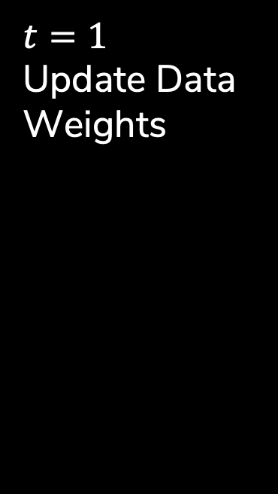

$t=1$
Update Data Weights
Compute new weights $α_{i}$ based on the errors of ${\hat{f}}_{1}$
The points with more weight are drawn larger
Notes:
Circle ones that are incorrect

Slide 46



$t=2$
Learn a Classifier
Now use new weights to learn best stump that minimizes weighted classification error.
${\hat{f}}_{ 2}\left(x\right)=…$
Calculate ${\hat{w}}_{2}≈0.53$
Then update weights based on errors.

Slide 47

AdaBoost Ensemble
If we plot what the predictions would be for each point, we get something that looks like this:
Notes:
Write out \hat{y}_i = sign(\hat{w}_1\hat{f}_1(x) +\hat{w}_1\hat{f}_1(x) )
Where the thing inside the sign is Score(x)
Graph is showing the score/confidence
Right now the first classifier outweighs the second one, but with more you get a much more interesting picture

Slide 48
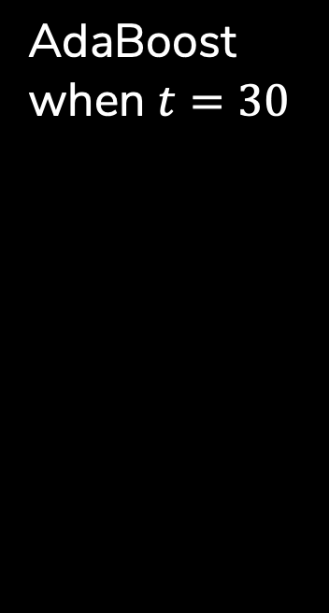
AdaBoost when $t=30$
Can eventually get 0 training error with a set of weak learners!
This is most likely overfit

Slide 49
AdaBoost
Ada Glance
$${\hat{w}}_{t}=\frac{1}{2}\ln\left(\frac{1−WeightedError\left({\hat{f}}_{t}\right)}{WeightedError({\hat{f}}_{t})}\right)$$
Train
  for $t$ in $\left[1, 2, …, T\right]$:
    Learn ${\hat{f}}_{t}\left(x\right)$ based on weights $α_{i}$
    Compute model weight ${\hat{w}}_{t}$
    Recompute weights $α_{i}$
    Normalize $α_{i}$
Predict
$$\hat{y}=\hat{F}(x)=sign\left(\sum_{t=1}^{T}{{\hat{w}}_{t}{\hat{f}}_{t}(x) }\right)$$
$$α_{i}←\left\{\begin{aligned}α_{i}e^{−{\hat{w}}_{t}}, if {\hat{f}}_{t}\left(x_{i}\right)=y_{i} \\ α_{i}e^{{\hat{w}}_{t}}, if {\hat{f}}_{t}\left(x_{i}\right)≠y_{i} \end{aligned}\right.$$
$$α_{i}←\frac{α_{i}}{\sum_{j=1}^{n}{α_{j}}}$$

Slide 50
AdaBoost Theorem
Technical condition: The weak learner can do at least slightly better than complete random guessing

Slide 51
Compare
Decision Tree
AdaBoost
Notes:
Best test error is around 34% which is worse than the best test error for boosting

Slide 52
Overfitting?
Boosting tends to be robust to overfitting
But will eventually overfit
Notes:
Choose with cross validation

Slide 53
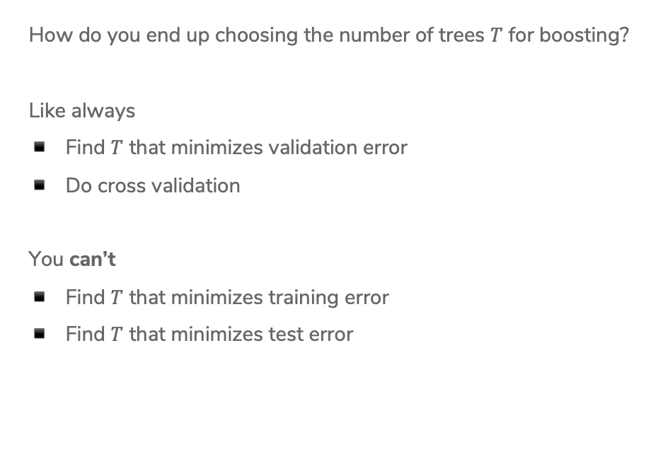
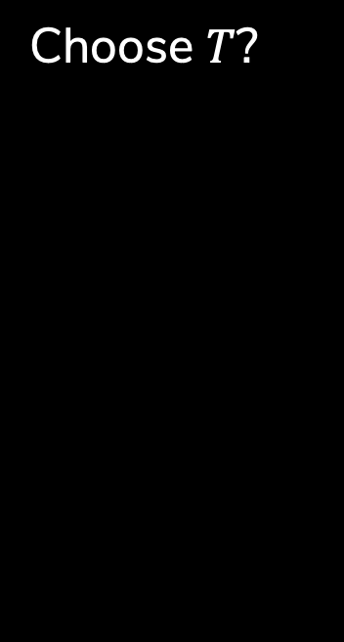
Choose $T$?
How do you end up choosing the number of trees $T$ for boosting?
Like always
Find $T$ that minimizes validation error
Do cross validation
You can’t
Find $T$ that minimizes training error
Find $T$ that minimizes test error

Slide 54
Application
Boosting, AdaBoost and other variants like gradient boosting, are some of the most successful models to date.
They are extremely useful in computer vision
  The standard for face detection
Used by most winners of ML competitions (Kaggle, KDD Cup, …)
Most industry ML systems use a use model ensembles
  Some with boosting, some with bagging
  Many times just use 6 different types of models and hand specify their weights.

Slide 55
AdaBoost Overview
Powerful! One of the most powerful set of models for many real world datasets.
  Typically does better than random forest with the same number of trees.
Higher Maintenance: You do have to tune parameters
  AdaBoost: Number of trees is technically important, but the model tends to be robust to overfitting in practice.
  Gradient Boosting: MANY parameters (all important)
Expensive: Boosting is inherently sequential which means its slow to learn ensembles with many trees.
  Can be made faster with optimized software like XGBoost (UW)

Slide 56
Recap
Theme: Compare two different ways of making ensembles
Ideas:
Describe what an ensemble model is
Explain what a random forest is and why adding trees improves accuracy.
Formalize how AdaBoost combines weighted votes from simple classifiers and how those classifiers are learned.
Compare/contrast bagging and boosting.
Describe the steps of the AdaBoost algorithm.

