Slide 1
CSE/STAT 416
Introduction + Regression
Hunter Schafer
University of Washington
March 29, 2021

Slide 2
Machine Learning is changing the world.

Slide 3
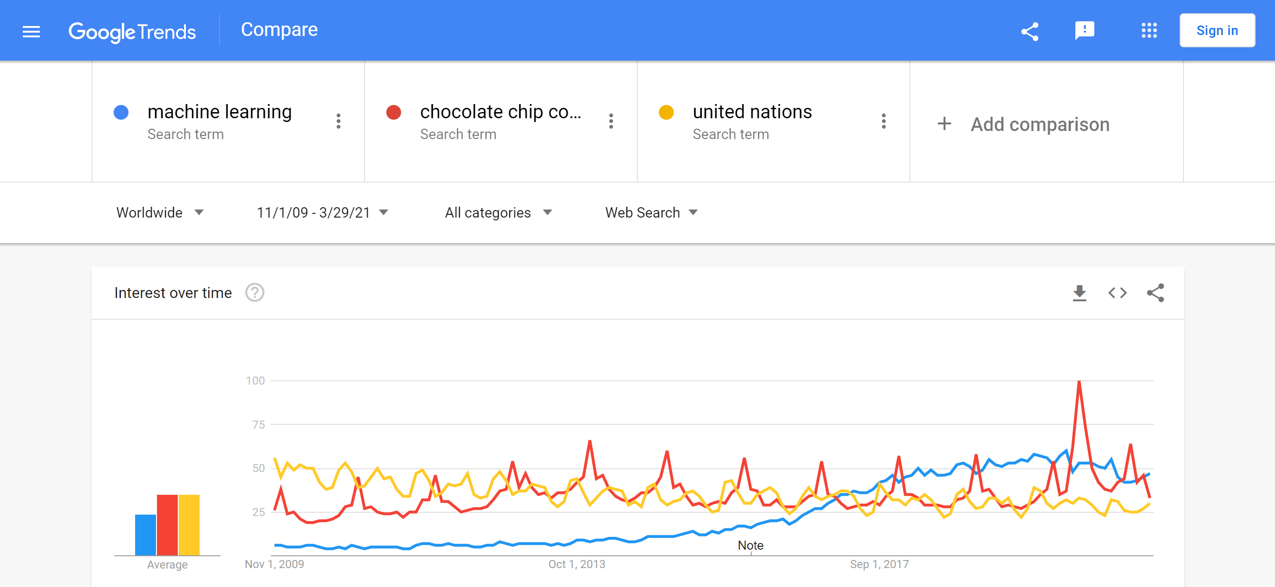

Slide 4














It’s Everywhere!
Retail
Coupons
Search
Movie Distribution
Campaigning
Real Estate
Legal Advice
Advertising
Human Resources
Dating
Networking
Disruptive companies
differentiated by
INTELLIGENT
APPLICATIONS
using
Machine Learning
CRM
Music
Wearables

Slide 5
It’s Everywhere…

Slide 6
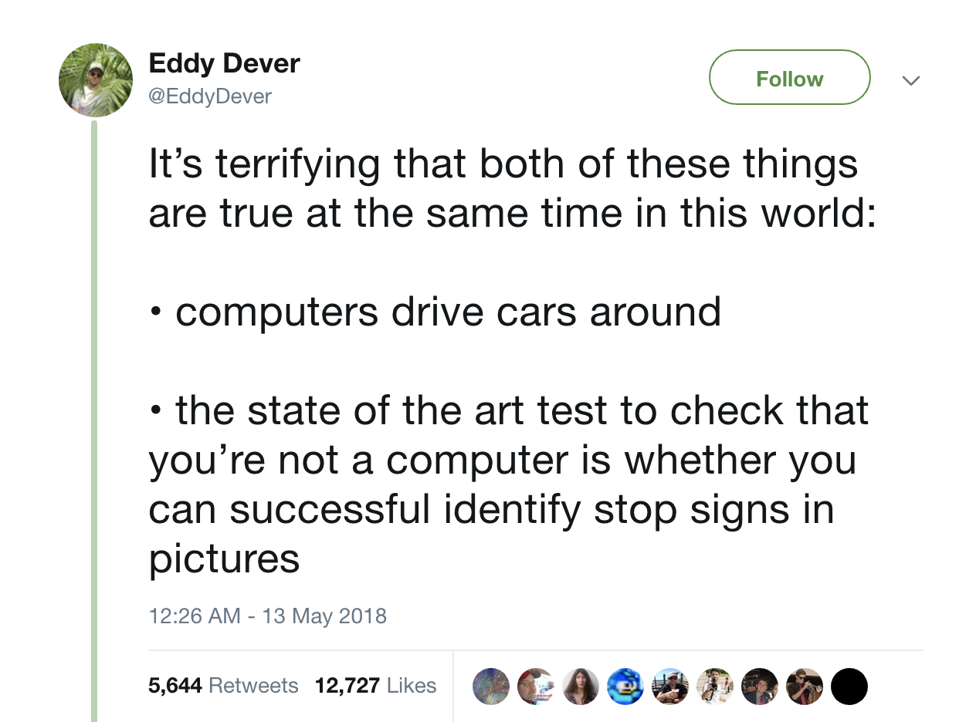
It’s Everywhere…

Slide 7
What is Machine Learning?
Generically (and vaguely)
Machine Learning is the study of algorithms that
improve their performance at some task with experience
Data
ML
Method
Intelligence

Slide 8
Course Overview
This course is broken up into 5 main case studies to explore ML in various contexts/applications.
Regression
  Predicting housing prices
Classification
  Positive/Negative reviews (Sentiment analysis)
Document Retrieval + Clustering
  Find similar news articles
Recommender Systems
  Given past purchases, what do we recommend to you?
Deep Learning
  Recognizing objects in images

Slide 9
Course Topics
Models
Linear regression, regularized approaches (ridge, LASSO)
Algorithms
Gradient descent
Concepts
Loss functions, bias-variance tradeoff, cross-validation
Linear classifiers: logistic regression
Nearest neighbors, clustering
Boosting
K-means
Deep learning
Sparsity, overfitting, model selection
Decision boundaries
Point estimation, MLE
Non-linear models: decision trees
Recommender systems

Slide 10
ML Course Landscape
CSE 446
CSE majors
Very technical course
STAT 435
STAT majors
Very technical course
CSE/STAT 416
Everyone else!
  This is a super broad audience!
Give everyone a strong foundational understanding of ML
  More breadth than other courses, a little less depth
CSE
446
STAT
435
CSE/STAT
416

Slide 11
Level of Course
Our Motto
Everyone should be able to learn machine learning, so our job is to make tough concepts intuitive and applicable.
This means…
Minimize pre-requisite knowledge
Focus on important ideas, avoid getting bogged down by math
Maximize ability to develop and deploy
Use pre-written libraries to do many tasks
Learn concepts in case studies
Does not mean course isn’t fast paced! There are a lot of concepts to cover!

Slide 12
Course Logistics

Slide 13

Who am I?
Hunter Schafer
  Assistant Teaching Professor
  Paul G. Allen School for Computer Science & Engineering (CSE)
Office Hours
  Time: 10:00 am - 12:00 pm, Tuesdays
  Location: Zoom/Discord
Contact
  Course Content + Logistics: EdStem
  Personal Matters: hschafer@cs.washington.edu

Slide 14






Who are the TAs?
Andrey Risukhin
he/him
risuka@uw
Gang Cheng
he/him
gang@uw
Leona Kazi
she/her
lkazi@uw
Rahul Biswas
he/him
rbiswas1@uw
Santino Iannone
he/him
iannos@uw
Svet Kolev
swetko@uw

Slide 15
Learning Reflections
Recap broader context of the past week.
Homework
With the scaffolding from 1 and 2, you are probably now capable to tackle the homework. These will be complex and challenging, but you’ll continue to learn by doing.
3
Sections
Practice material covered in 1 in a
context where a TA can help you.
The emphasis is still on you learning by doing.
2
Lectures
Introduced to material for the first time.
Mixed with activities and demos to give you a chance to learn by doing.
No where near mastery yet!
Concept Checks
Test your understanding of the last concept
1

Slide 16

Mon
Tue
Wed
Thur
Fri
Lecture
Nothing
Lecture
Section
Nothing
Previous CP Due
Previous HW Due
Previous CP Due
Next HW Released
Learning Refl. Due
We happen to not record attendance in lectures and section, but attending these sessions is expected
Panopto for Lecture (on Canvas)

Slide 17
Assessment
Weekly Homework Assignments
  Weight: 65%
  Number: Approximately 9
  Each Assignment has two parts that contribute to your grade separately:
    Programming (50%)
    Conceptual (15%)
Checkpoints
  Weight: 10%
  Number: Approximately 20 (each lecture, drop 3)
Learning Reflections
  Weight: 10%
  Number: Approximately 10 (each week, drop 1)
Final Exam
  Weight: 15%
  Date: Monday 6/8 – Wednesday 6/9

Slide 18
Homework Logistics
Late Days
  6 Free Late Days for the whole quarter.
  Can use up to 2 Late Days on any assignment.
  Each Late Day used after the 6 Free Late Days results in a -10% on that assignment
  Learning reflections and checkpoints can be turned in up to a week later for 50% credit.
Collaboration
  You are encouraged to discuss assignments and concepts at a high level
    If you are reading off parts of your solution, it’s likely not high level
    Discuss process, not answers!
  All code and answers submitted must be your own
Turn In
  Concept portions and Learning reflections are turned in on Gradescope
  Everything else (Programming portion and checkpoints) are turned in on EdStem

Slide 19
Getting Help
The best place to get asynchronous help is EdStem. You can post questions (publicly or privately) to get help from peers or members of the course staff.
  You’re encouraged to respond with your ideas to other posts!
The best place to get synchronous help is office hours or to form a study group.
  Office hours will be run on Discord! See course website for more info.
  Will try to help you meet peers this quarter to form study groups. More on this next time!

Slide 20

1 minute
On your phone / laptop
If you could only have one pet, would you rather have a dog or cat?

Slide 21
Case Study 1
Regression:
Housing Prices

Slide 22
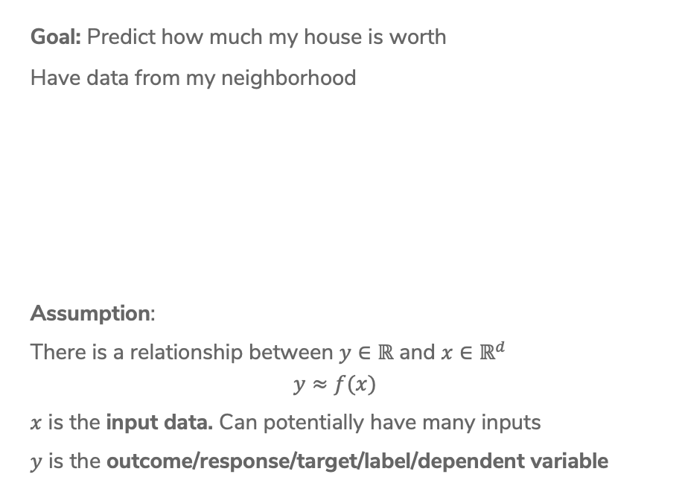
Fitting Data
Goal: Predict how much my house is worth
Have data from my neighborhood
Assumption:
There is a relationship between $y∈ℝ$ and $x∈ℝ^{d}$
$$y≈f(x)$$
$x$ is the input data. Can potentially have many inputs
$y$ is the outcome/response/target/label/dependent variable

Slide 23
Model
A model is how we assume the world works
Regression model:
“Essentially, all models are wrong, but some are useful.”
- George Box, 1987
Notes:
Write the model $y_i = f(x_i) + \eps_i$ and $E[\eps_i] = 0$

Slide 24
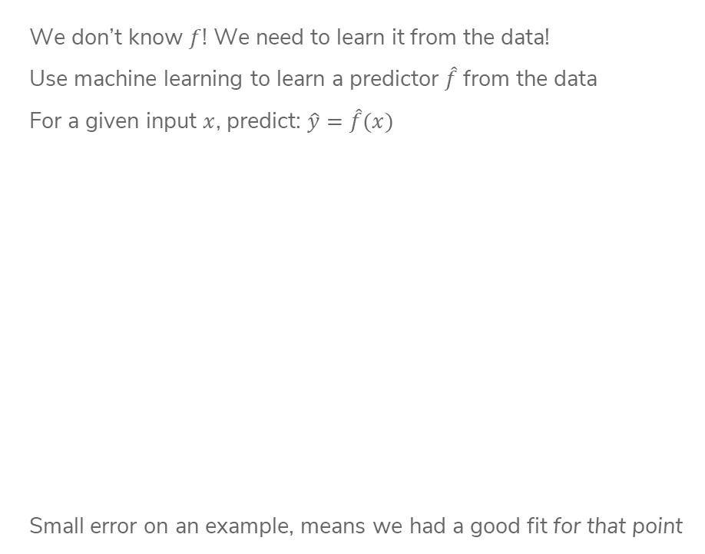
Predictor
We don’t know $f$! We need to learn it from the data!
Use machine learning to learn a predictor $\hat{f}$from the data
For a given input $x$, predict: $\hat{y}=\hat{f}(x)$
Small error on an example, means we had a good fit for that point
Notes:
Draw line and visually draw error

Slide 25
ML Pipeline
Training
Data
Feature
extraction
x
ML
model
ŷ
⌃
y
f
ML algorithm
Quality
metric
Notes:
Write these on the slide
Training data: Raw data about houses
Feature extraction: Extract / transform/ compute relevant features
X: SQ. FT
Y: Actual house prices
Quality Metric: Errors in predicted values
ML Algorithm: Estimate function from data to be best “quality”
\hat{Y}: predicted sales

Slide 26
Linear Regression

Slide 27
Training
Data
Feature
extraction
x
ML
model
ŷ
⌃
y
f
ML algorithm
Quality
metric

Slide 28
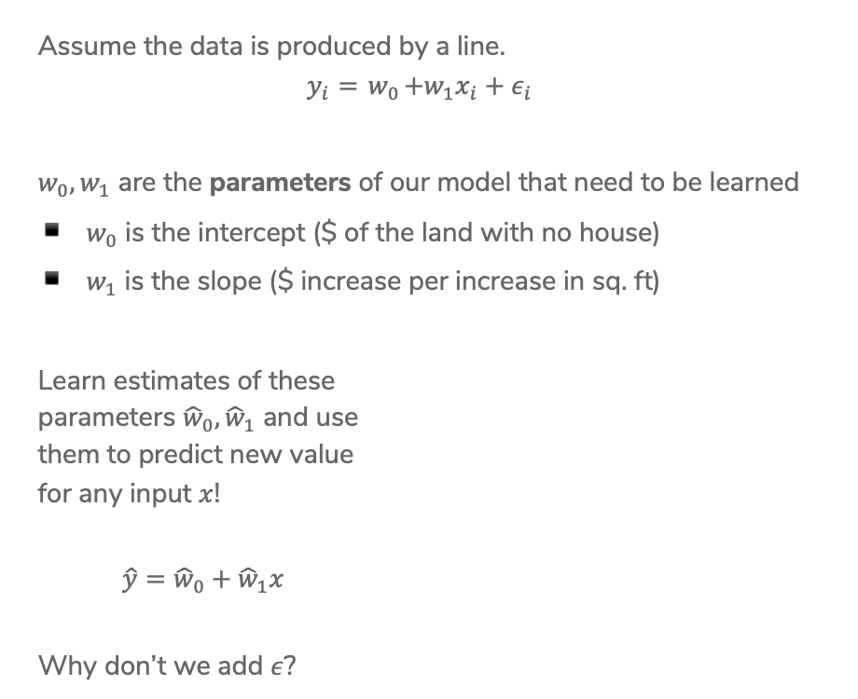
Linear Regression Model
Assume the data is produced by a line.
$$y_{i}={ w}_{0}+w_{1}x_{i}+ε_{i}$$
$w_{0}, w_{1}$ are the parameters of our model that need to be learned
$w_{0}$ is the intercept ($ of the land with no house)
$w_{1}$ is the slope ($ increase per increase in sq. ft)
Learn estimates of these
parameters ${\hat{w}}_{0}, {\hat{w}}_{1}$ and use
them to predict new value
for any input $x$!
$\hat{y}={\hat{w}}_{0}+{\hat{w}}_{1}x$
Why don’t we add $ε$?
Notes:
Talk about what happens if w_1 is 0

Slide 29
Basic Idea
Try a bunch of different lines and see which one is best!
What does best even mean here?

Slide 30
Training
Data
Feature
extraction
x
ML
model
ŷ
⌃
y
f
ML algorithm
Quality
metric

Slide 31
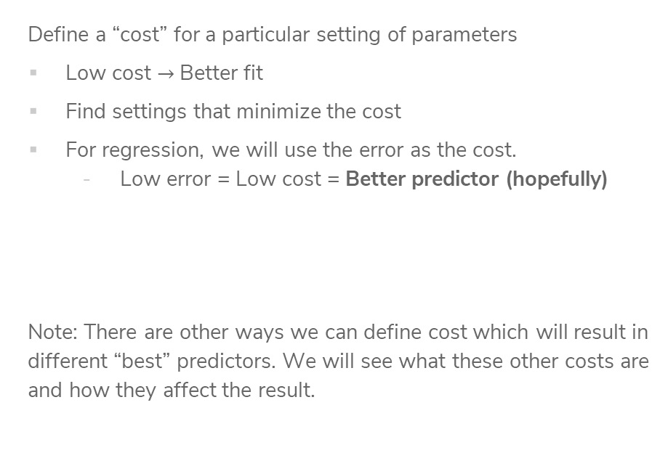
“Cost” of predictor
Define a “cost” for a particular setting of parameters
Low cost $→$ Better fit
Find settings that minimize the cost
For regression, we will use the error as the cost.
  Low error = Low cost = Better predictor (hopefully)
Note: There are other ways we can define cost which will result in different “best” predictors. We will see what these other costs are and how they affect the result.
Notes:
Write out definition of RSS(w_0, w_1)

Slide 32
Residual Sum of Squares (RSS)
How to define error? Residual sum of squares (RSS)
Notes:
Write definition of RSS out, first as individual sum and then sigma notation

Slide 33
1 min
Goal: Get you actively participating in your learning
Typical Activity
  Question is posed
  Think (1 min): Think about the question on your own
  Pair (2 min): Talk with your neighbor to discuss question
    If you arrive at different conclusions, discuss your logic and figure out why you differ!
    If you arrived at the same conclusion, discuss why the other answers might be wrong!
  Share (1 min): We discuss the conclusions as a class
During each of the Think and Pair stages, you will respond to the question via a Poll Everywhere poll
  Not worth any points, just here to help you learn!

Slide 34
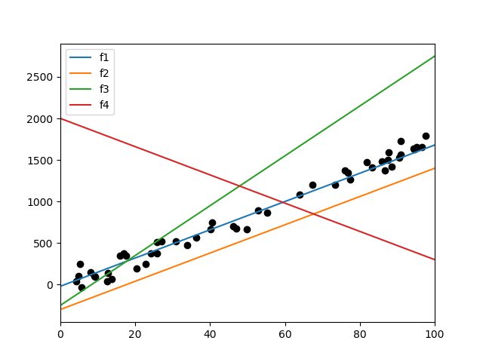
1 min
Sort the following lines by their RSS on the data, from smallest to largest. (estimate, don’t actually compute)

Slide 35
2 min
Sort the following lines by their RSS on the data, from smallest to largest. (estimate, don’t actually compute)

Slide 36
Training
Data
Feature
extraction
x
ML
model
ŷ
⌃
y
f
ML algorithm
Quality
metric

Slide 37
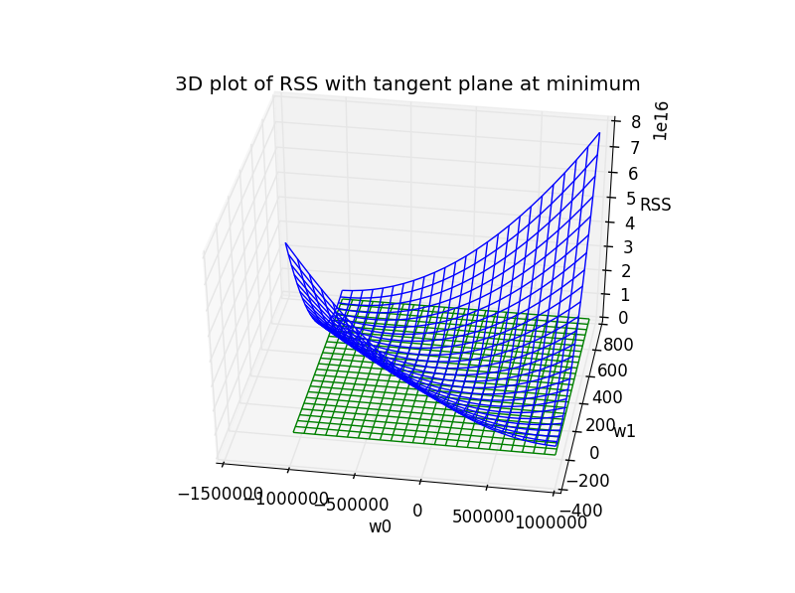

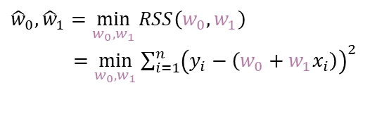
Minimizing Cost
RSS is a function with inputs $w_{0}, w_{1}$, different settings have different RSS for a dataset
$${\hat{w}}_{0}, {\hat{w}}_{1}=\min_{w_{0}, w_{1}}{RSS\left(w_{0}, w_{1}\right)}$$
$=\min_{w_{0}, w_{1}}{\sum_{i=1}^{n}{{\left(y_{i}−\left(w_{0}+w_{1}x_{i}\right)\right)}^{2}}}$
Unfortunately, we can’t try it out on all possible settings ☹

Slide 38
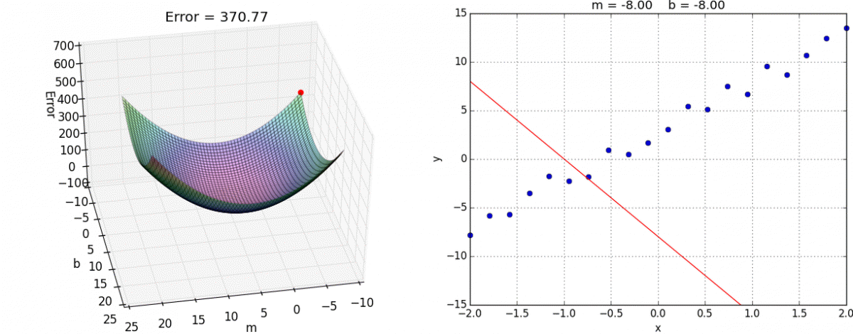

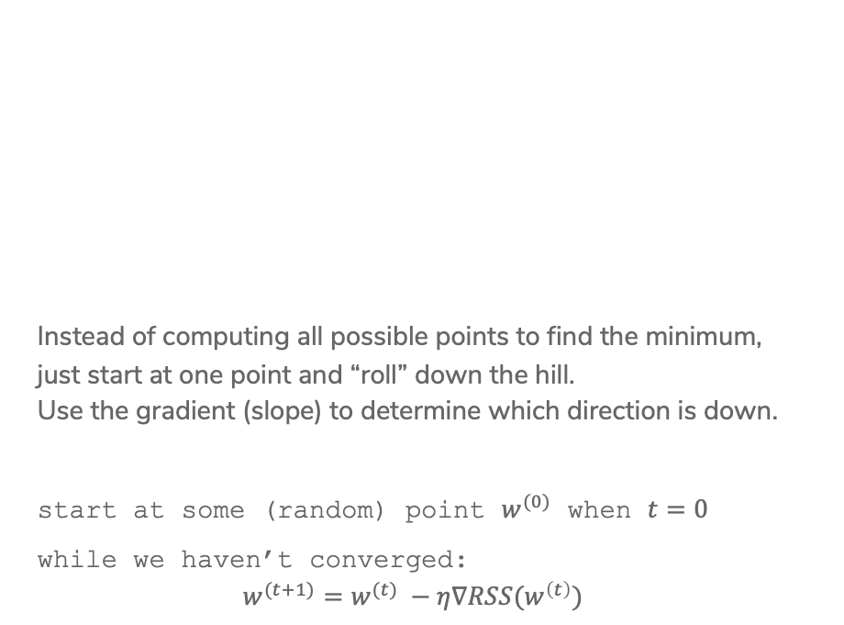
Gradient Descent
Instead of computing all possible points to find the minimum,
just start at one point and “roll” down the hill.
Use the gradient (slope) to determine which direction is down.
start at some (random) point $w^{(0)}$ when $t=0$
while we haven’t converged:
$$w^{(t+1)}=w^{(t)} −η∇RSS(w^{\left(t\right)})$$

Slide 39


Slide 40
Training
Data
Feature
extraction
x
ML
model
ŷ
⌃
y
f
ML algorithm
Quality
metric

Slide 41

Higher Order Features
This data doesn’t look exactly linear, why are we fitting a line instead of some higher-degree polynomial?
We can! We just have to use a slightly different model!
$$y_{i}=w_{0}+w_{1}x_{i}+w_{2}x_{i}^{2}+w_{3}x_{i}^{3}+ε_{i}$$

Slide 42
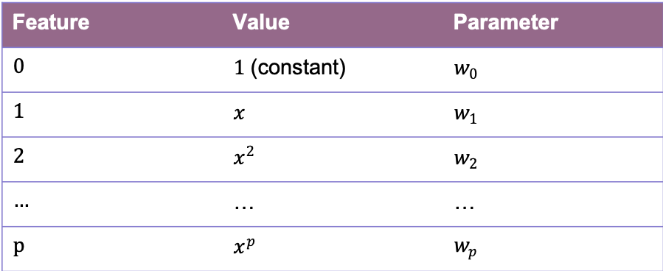
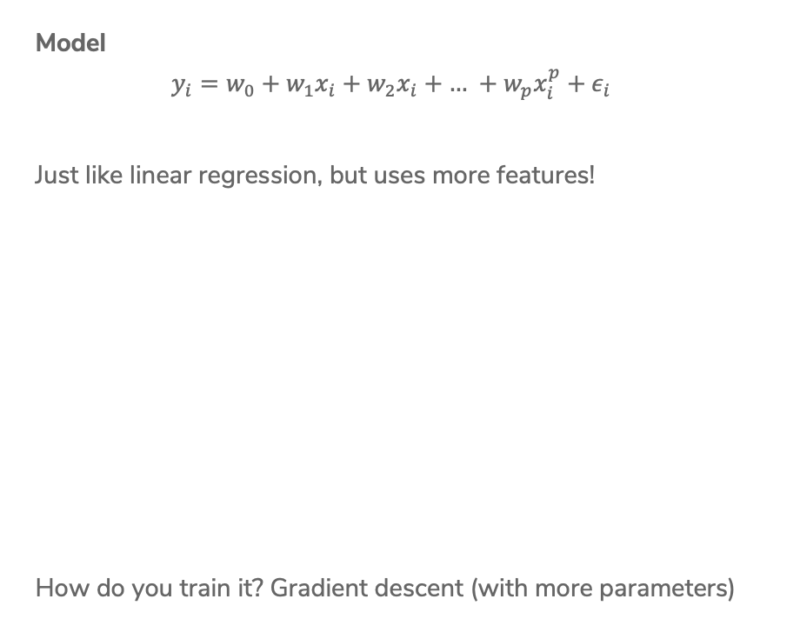
Polynomial Regression
Model
$$y_{i}=w_{0}+w_{1}x_{i}+w_{2}x_{i}+\text{…} +w_{p}x_{i}^{p}+ε_{i}$$
Just like linear regression, but uses more features!
How do you train it? Gradient descent (with more parameters)
Feature | Value | Parameter
0 | $1$ (constant) | $w_{0}$
1 | $x$ | $w_{1}$
2 | $x^{2}$ | $w_{2}$
… | … | …
p | $x^{p}$ | $w_{p}$

Slide 43
Polynomial Regression
How to decide what the right degree? Come back Wednesday!
Notes:
Draw different values of p in different colors
Max p = 32

Slide 44
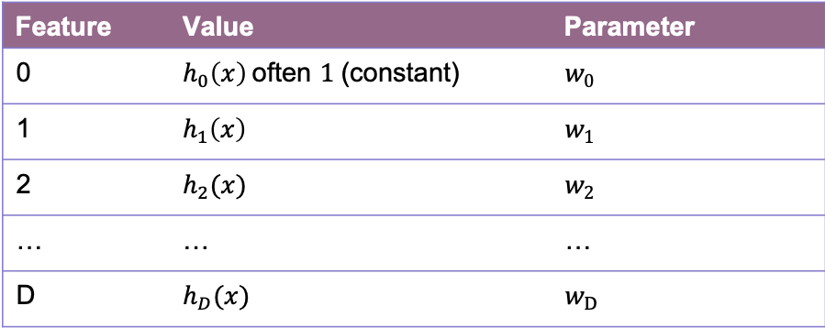

Features
Features are the values we select or compute from the data inputs to put into our model. Feature extraction is the process of turning the data into features.
Model
$$y_{i}=w_{0}h_{0}\left(x_{i}\right)+w_{1}h_{1}\left(x_{i}\right)+\text{…}+w_{D}h_{D}\left(x_{i}\right)+ε_{i} \\ = \sum_{j=0}^{D}{w_{j}h_{j}\left(x_{i}\right)+ε_{i}}$$
Feature | Value | Parameter
0 | $h_{0}\left(x\right)$often $1$ (constant) | $w_{0}$
1 | $h_{1}\left(x\right)$ | $w_{1}$
2 | $h_{2}(x)$ | $w_{2}$
… | … | …
D | $h_{D}(x)$ | $w_{D}$

Slide 45
Adding Other Inputs
Generally we are given a data table of values we might look at that include more than one value per house.
Each row is a single house.
Each column (except Value) is a data input.
sq. ft. | # bathrooms | owner’s age | … | value
1400 | 3 | 47 | … | 70,800
700 | 3 | 19 | … | 65,000
… | … | … | … | …
1250 | 2 | 36 | … | 100,000

Slide 46
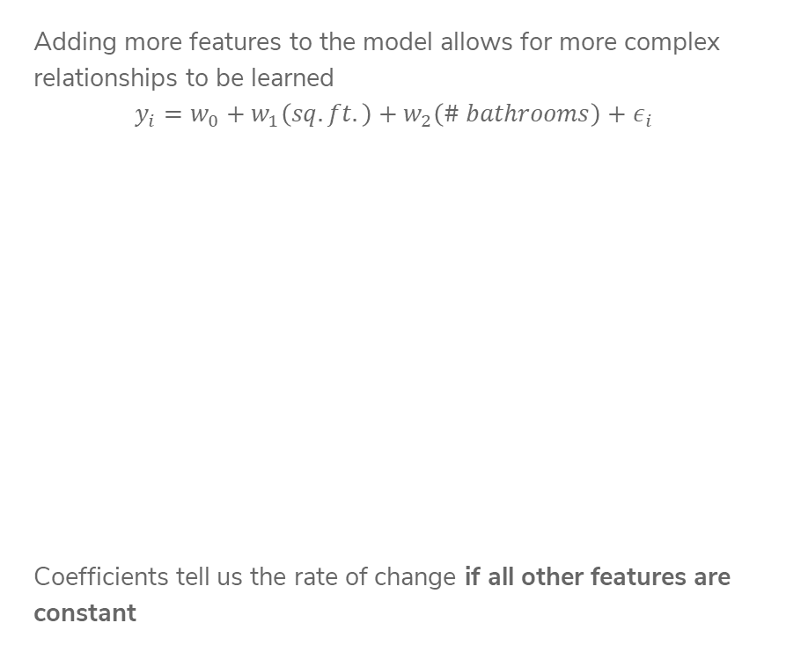
More Inputs - Visually
Adding more features to the model allows for more complex relationships to be learned
$$y_{i}=w_{0}+w_{1}\left(sq. ft.\right)+w_{2}\left(\# bathrooms\right)+ε_{i}$$
Coefficients tell us the rate of change if all other features are constant

Slide 47
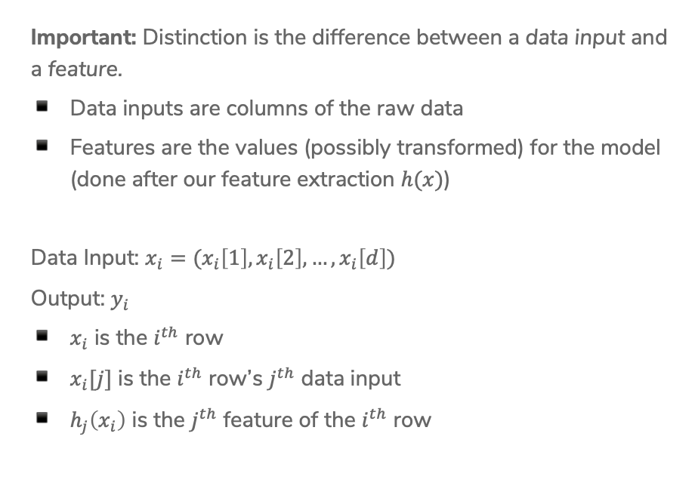
Notation
Important: Distinction is the difference between a data input and a feature.
Data inputs are columns of the raw data
Features are the values (possibly transformed) for the model (done after our feature extraction $h(x)$)
Data Input: $x_{i}=(x_{i}\left[1\right], x_{i}\left[2\right], …, x_{i}\left[d\right])$
Output: $y_{i}$
$x_{i}$ is the $i^{th}$ row
$x_{i}[j]$ is the $i^{th}$ row’s $j^{th}$ data input
$h_{j}\left(x_{i}\right)$ is the $j^{th}$ feature of the $i^{th}$ row

Slide 48
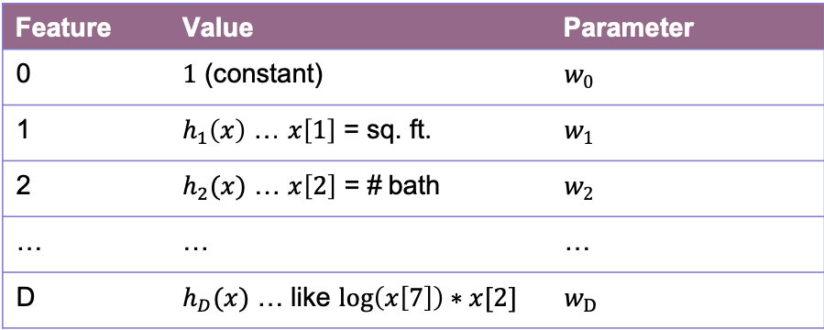
Features
You can use anything you want as features and include as many of them as you want!
Generally, more features means a more complex model. This might not always be a good thing!
Choosing good features is a bit of an art.
Feature | Value | Parameter
0 | $1$ (constant) | $w_{0}$
1 | $h_{1}\left(x\right)$ … $x\left[1\right]$ = sq. ft. | $w_{1}$
2 | $h_{2}(x)$ … $x\left[2\right]$ = # bath | $w_{2}$
… | … | …
D | $h_{D}(x)$ … like $\log\left(x\left[7\right]\right)∗x[2]$ | $w_{D}$

Slide 49
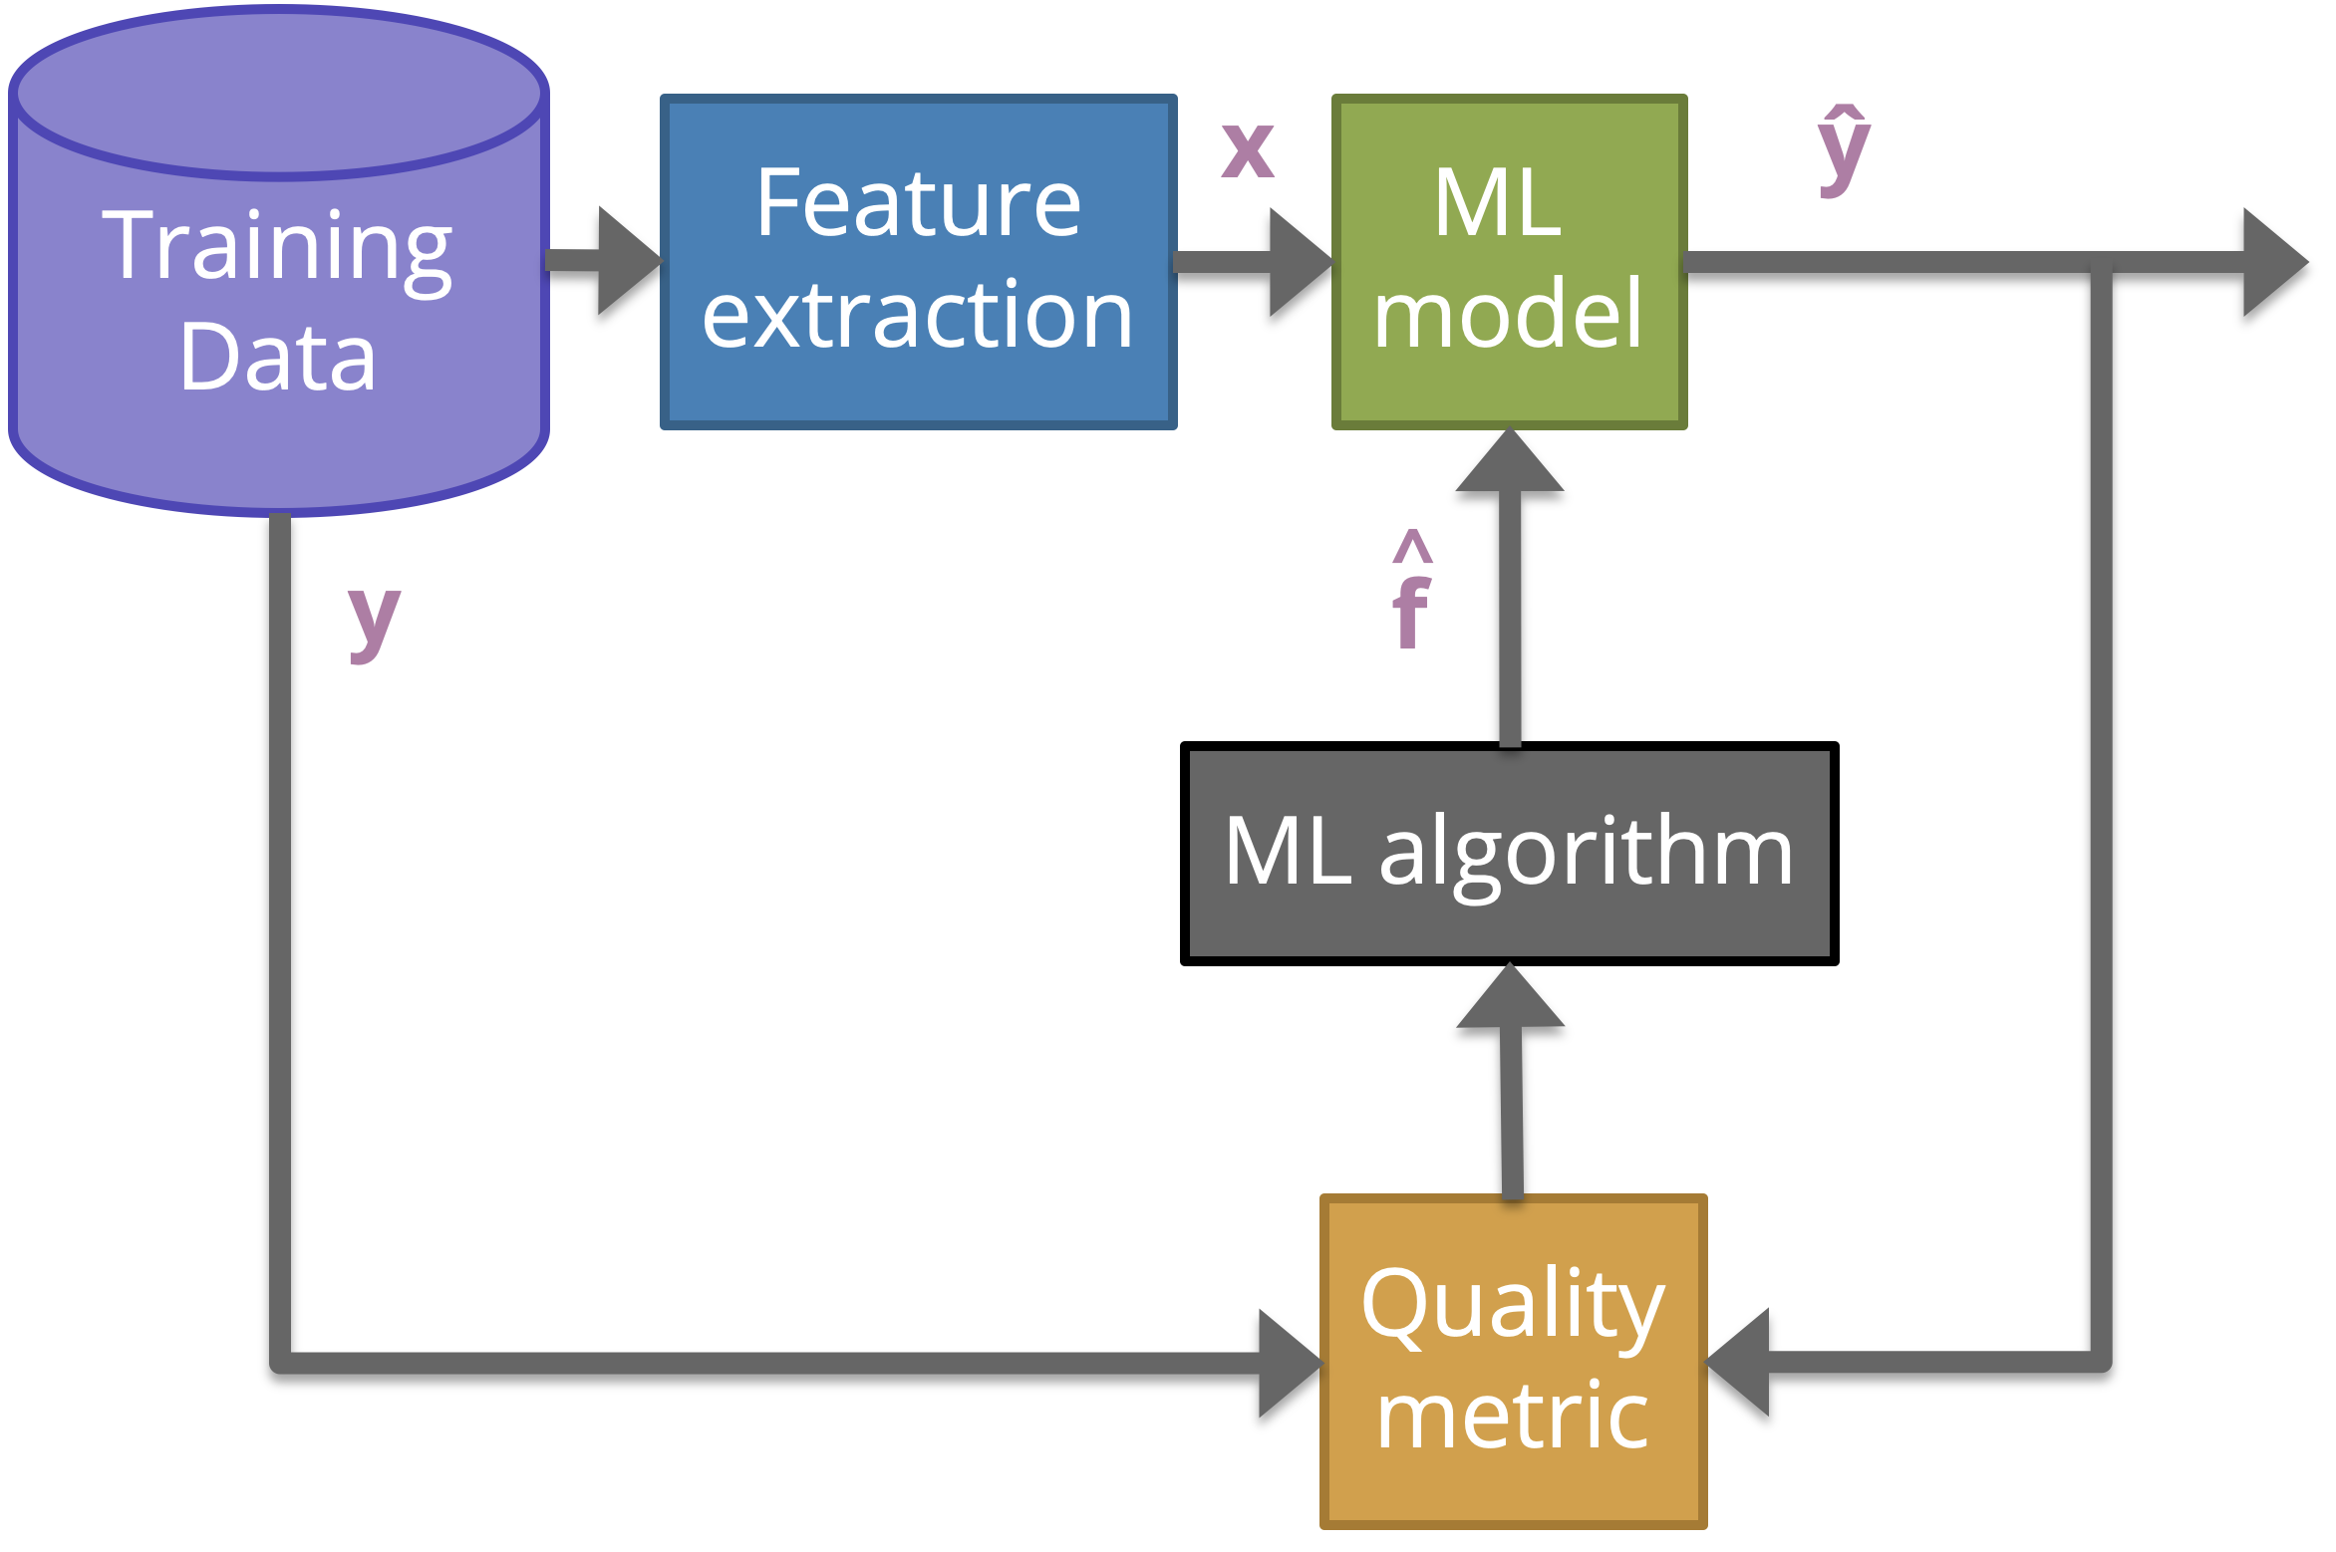

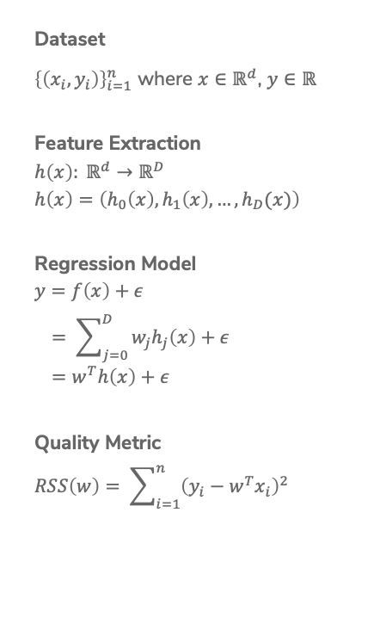
Linear Regression Recap
Dataset
${\left\{\left(x_{i}, y_{i}\right)\right\}}_{i=1}^{n}$ where $x∈ℝ^{d}$, $y∈ℝ$
Feature Extraction
$$h\left(x\right): ℝ^{d}→ℝ^{D}$$
$$h\left(x\right)=\left(h_{0}\left(x\right), h_{1}\left(x\right), …, h_{D}(x)\right)$$
Regression Model
$$y=f\left(x\right)+ε \\ = \sum_{j=0}^{D}{w_{j}h_{j}\left(x\right)+ε} \\ =w^{T}h\left(x\right)+ε$$
Quality Metric
$$RSS\left(w\right)= \sum_{i=1}^{n}{{\left(y_{i}−w^{T}x_{i}\right)}^{2}}$$
Predictor
$$\hat{w}= \min_{w}{RSS(w)}$$
ML Algorithm
Optimized using Gradient Descent
Prediction
$$\hat{y}={\hat{w}}^{T}h(x)$$

