Slide 1
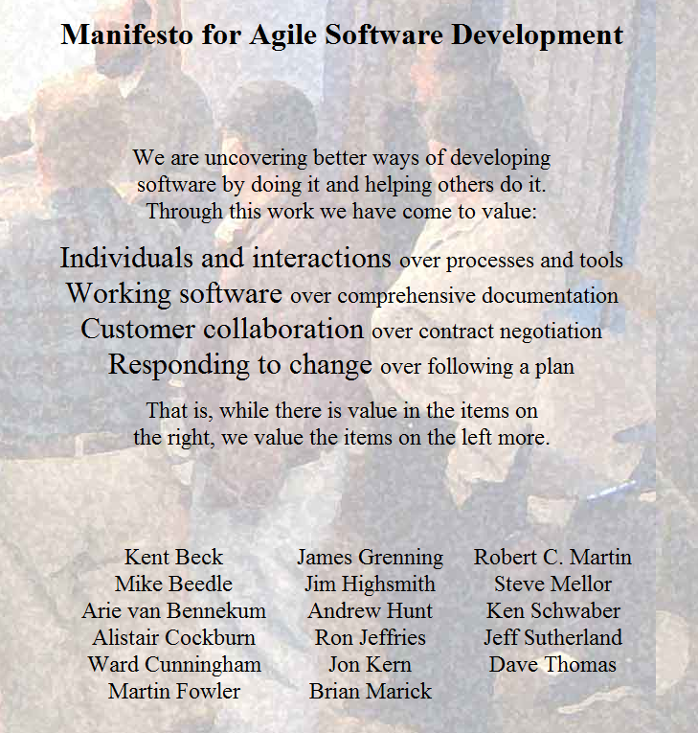
CSE403 ● Software engineering ● sp12

Slide 2
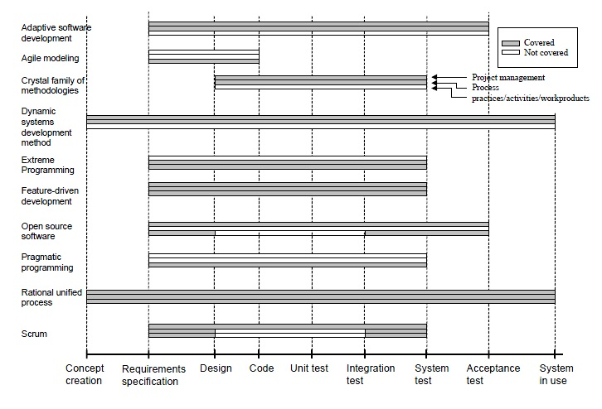
Genuine differences among agile approaches in scope and in content – but the commonalities are more important for now

Slide 3
A core issue – rarely explicit
Developers write programs – static descriptions
Customers care about the behavior of those static descriptions
This is a huge gap, especially when we modify a program with the objective of achieving a new behavior
  Might change the program to fix bugs
  Might change the program to meet new or better understood customer needs
Software is discrete – a small change in the program can cause a disproportional change in the behavior

Slide 4
Feedback loops in agile
Customer-team
Team-team
Frequently interactions and iterations between the customer and the team decrease the potential for big jumps in expected behavior
Such jumps in behavior would, of course, often demand big changes in the program
Ensuring that changes to a program do what is intended is hard
A tighter loop between the changes to the program and the changes to behavior decreases the potential for them to become significantly out of whack

Slide 5
Bounding divergence
In other words, a lot of agile – and indeed a lot of software engineering techniques, methods, tools, and approaches in general – try to bound divergence
  The divergence between the behaviors provided by the software and the behaviors desired by the customers [building the right system]
  The divergence between the behaviors provided by the software and the behaviors the development team thinks (wants) the program will provide [building the system right]
Another example from around the mid-1990’s was Microsoft’s nightly builds (or sync-and-stabilize) – at the very least, don’t get too far from an executable program!

Slide 6
Concrete example of the “past”
DOD-STD-2167A, MILITARY STANDARD: DEFENSE SYSTEM SOFTWARE DEVELOPMENT (29 FEB 1988) [S/S BY MIL-STD-498]., This standard establishes uniform requirements for software development that are applicable throughout the system life cycle. The requirements of this standard provide the basis for Government insight into a contractor's software development, testing, and evaluation efforts.
  This was the basis for all US government procurement of software
  Thousands of pages of specifications, documentation, diagrams, etc. – valuable in some cases, but not in all

Slide 7
http://www.agile-process.org/
“We realize the way a team works together is far more important than any process. While a new process can easily improve team productivity by a fraction, enabling your team to work effectively as a cohesive unit can improve productivity by several times. …
“The most brilliant programmers alive working competitively in an ego-rich environment can’t get as much done as ordinary programmers working cooperatively as a self disciplined and self-organizing team. You need a process where team empowerment and collaboration thrive to reach your full potential.”
Note: agile and flexible does not equate to code-and-fix

Slide 8
Extreme Programming (XP)
Kent Beck, mid-1990’s
Focuses on the customer, the development team, and the need for change
A set of short development cycles instead of a long one
Changes are desirable and unavoidable, so plan around that notion rather than pretending to define a stable set of requirements a priori
Four activities: coding, testing, listening, and designing

Slide 9
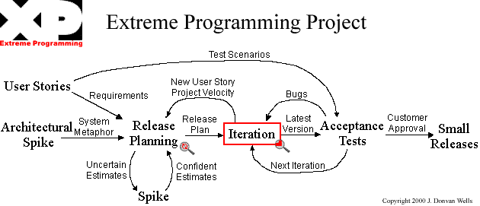
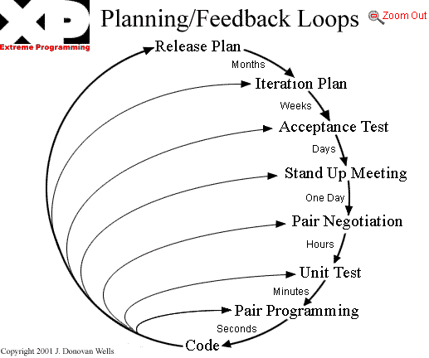

Slide 10
XP: Coding
“It’s the source, Luke!”
It’s a way to communicate both with the computer and also with other developers in a more precise way

Slide 11
XP: Testing
If a little testing is good, a lot of testing is better
Unit tests essentially represent the specification of a feature works
When all the tests pass, the coding is complete
All code is tested as it is developed

Slide 12
XP: Listening
The developers have to listen, carefully, to the customers
Not only to figure out what to build, but also to provide clear information about the technical aspects and costs of how the problem might be solved (or not)
User stories (roughly, use cases) are a key vehicle for this
The Planning Game – meeting once/iteration (often weekly) with both release planning – customers and developers determine what features should go in upcoming releases – and iteration planning – developers defines the tasks and activities to achieve the releases
  Intent of planning is to steer the project in the right direction

Slide 13
XP: Designing
“Good design will avoid lots of dependencies within a system; this means that changing one part of the system will not affect other parts of the system.”
In XP, this goes with the notion of simplicity – don’t anticipate change but when you see an actual need for abstraction, do it
We’ll look next week, and in Reading III, at the more common notion of information hiding and anticipating change

Slide 14
XP Values
Simplicity: “We will do what is needed and asked for, but no more. … We will take small simple steps to our goal and mitigate failures as they happen. We will create something we are proud of and maintain it long term for reasonable costs.”
Communication: …
Feedback: “We will take every iteration commitment seriously by delivering working software.”
Respect: “Everyone gives and feels the respect they deserve as a valued team member. Everyone contributes value even if it's simply enthusiasm. Developers respect the expertise of the customers and vice versa. Management respects our right to accept responsibility and receive authority over our own work.”
Courage: “We will tell the truth about progress and estimates. …”

Slide 15
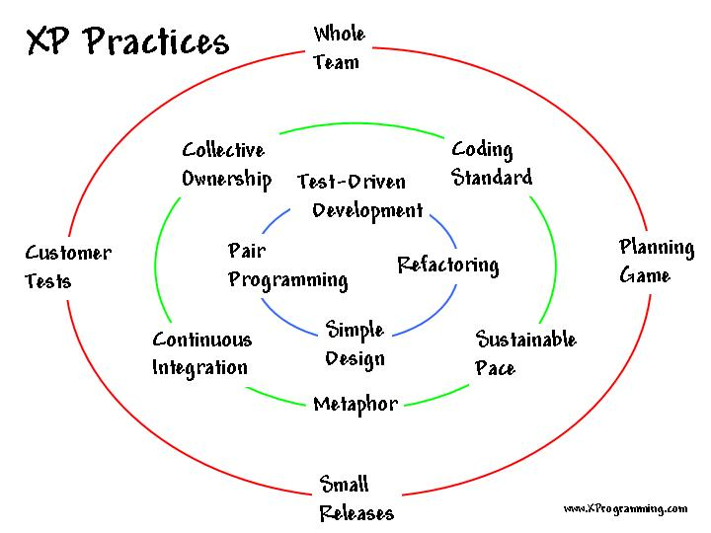

Slide 16
12 in four categories
[Previous slide has 13, including refactoring]
Fine scale feedback
  Pair programming
  Planning game
  Test driven development
  Whole team
Continuous process
  Continuous integration
  Design improvement
  Small releases
Shared understanding
  Coding standard
  Collective code ownership
  Simple design
  System metaphor
Programmer welfare
  Sustainable pace
Is it XP unless it follows all practices?

Slide 17
Comparison to SCRUM?
Extra credit

Slide 18
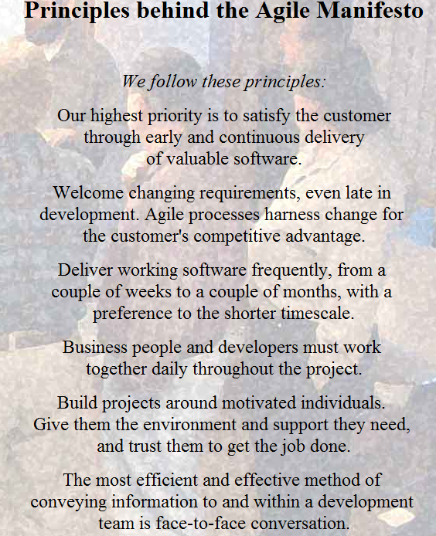

Slide 19
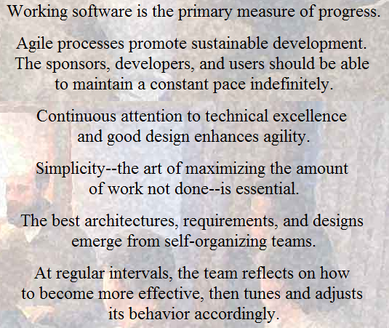

Slide 20
WebQ feedback: easy comments
I think it's too early to really tell.
meeting with TA, teaming up with people
The website is pretty poorly formatted-- that's probably the most/only annoying thing so far.
It is okay.
Fun times with a big project

Slide 21
WebQ feedback: other comments
--
--Fun times with a big project :D
I have a way to manage project *code*, but I'd like an easy way to keep track of tasks for members in my group. I'd like to be able to assign tasks to members, track due dates, keep a work log history, etc. And it should have a sexy UI. And it should be free and come with lots of awesome. Thanks.
I am a little bit confused so far about what the exams will be like. Is it going to be about the readings? Is it going to be about the topics discussed in lecture? Is it going to be multiple choice?
I don't have a rough idea about what I am gonna learn throughout this course.
The readings are way too long and thorough, and because of that it is less useful. A more concise article would be more useful, as one would be reading only the important points, which would be easier to understand, as we read exactly what is important.

Slide 22
WebQ feedback: other comments
So far the class seems to be going fairly well. The lectures are moving a little slowly though. Other than that, I have no complaints or suggestions.
I am a little bit confused so far about what the exams will be like. Is it going to be about the readings? Is it going to be about the topics discussed in lecture? Is it going to be multiple choice?
I am concern about the midterms and how we will be tested.

Slide 23
Week 2 -3
Monday | Tuesday | Wednesday | Thursday | Friday
Requirements … | Group meetings | Team work and structure | SRS information | Agile
Design | Group meetings | Design | Section | Design
Weekly team summary: due Friday @ 11PM on DropBox by each PM SRS: due Tuesday April 10 @ 11PM on DropBox by each PM
Any questions?

