Slide 1
Overview
What: An Android app that Integrates a clipboard manager and a notepad.
How: It uploads all copied text to the cloud, and provides fast pasting, modification, and searching of these notes on the mobile device and the web UI. The chosen notes will be on the clipboard for pasting, or if they contain certain meaningful text such as URL, phone numbers, or names in the user’s contacts, the app can invoke special actions based on user decision.
Why: Many mobile device users face great inconveniences when trying to read an email, SMS, blog post, or document while jotting down multiple notes or keywords at the same time. This app enables these users to simply copy all the notes they want, and manage them later—not only to paste somewhere else, but also to call the number, look up an address, or open an URL.

Slide 2
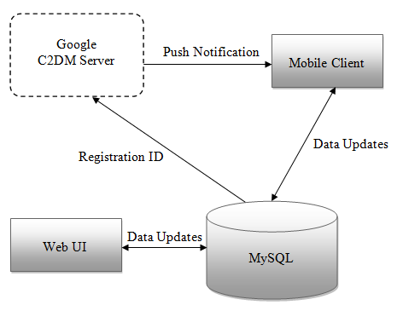
Software Architecture

Slide 3
Challenges and Risks
Android API Limitation: It might decrease functionality and/or user experience.
Failing the Goal: The goal is to improve experiences on common tasks. If the final performance is not up to snuff, then the project fails.
Learning new platform: If learning to code for a different platform takes too much time, it might not be able to meet the first prototype deadline.

