Slide 1
REAL-LIFE ACHIEVEMENTS
Pania Thong
Venkat Rao
Jon McCord

Slide 2
Vision
Have you ever achieved something that you wanted to share with the world. Maybe you….
Went skydiving for the first time
Got to meet a famous celebrity
Attended a great concert
Real-Life Achievements allows users to post these feats for all their friends to see!
Who is it for?
Anyone who is proud of an achievement
Why is it interesting?
Friends can view each other’s achievement and compete!
You can see who else around the world has accomplished the same achievement

Slide 3
Implementation
How will it be implemented (one of 3 options or a combination)
Web App
Facebook App
Mobile App
Each achievement will get a “rank” based on the number of people that rate it highly. Users would also receive virtual “badges” for their accomplishments
In order to ensure that users are truthful about their achievements, they must also post a related picture for credibility

Slide 4
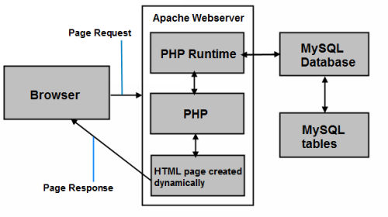
Software Architecture
PHP Framework
MySQL
Apache
Ajax
Facebook API

Slide 5
Challenges and Risks
Cheating
Can post fake achievements
Minimize risks:
Take a picture
Set your location with you mobile phone
Have friends approved your achievement
Learning new programming languages, frameworks and tools
Working in a large team
Thoroughly testing code

