Slide 1
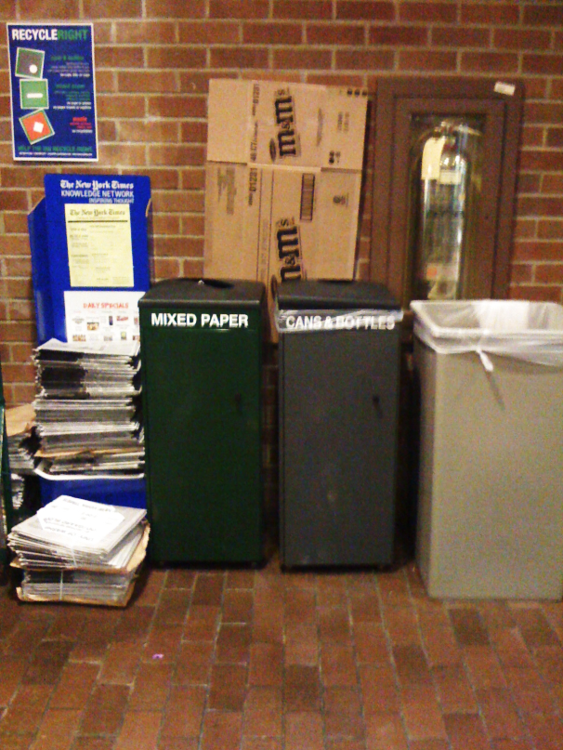
Recycle Locator
Chanel Huang, Eric Hare, Mai Dang

Slide 2
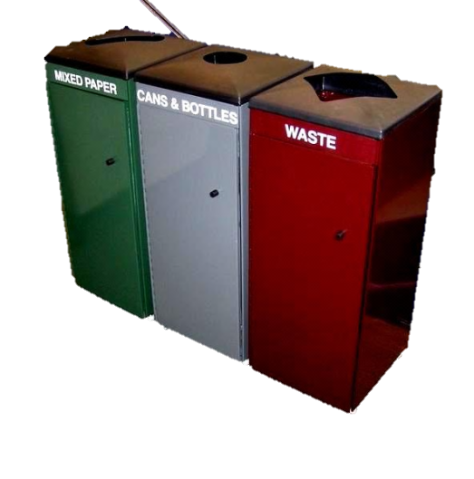
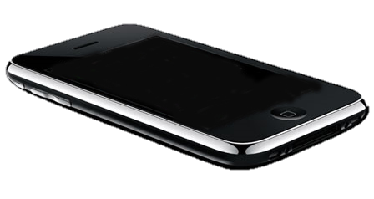
Vision
iPhone app that shows the recycle/ compost/waste bins near you.
Allows users to add the locations of the bins and correct any existing ones.
For those who are environmentally- conscious, or those who usually wouldn’t be bothered to find the correct recycle bins.
App would cover the grounds of UW Seattle campus.
Useful tool for UW students!

Slide 3
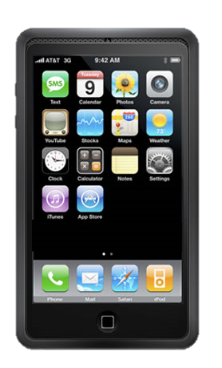
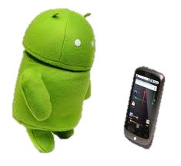
Software Architecture
Initially targeting iOS (iPhone, iPod Touch, potentially iPad) – Objective C
  Location services provided
  Target audience more likely to have smartphone on hand, than laptop or desktop
Client/Server design by nature
  MySQL database backend
Future possibilities
  Android, Web Interface

Slide 4
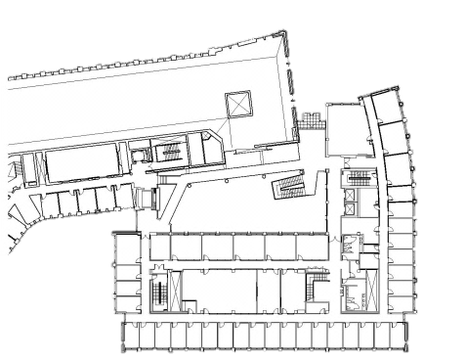

Challenges and Risks
Single main challenge: obtaining electronic layouts/blueprints of each building’s floors.
Useful on what size scale? How much area is reasonable for the app to cover?
Whose responsibility is it to build up the blueprint database?
Fair/poor quality of GPS tracking of a location within a building.

