Slide 1
Twitter Statistics
CSE 403 Product Pitch
Mitchell Hashimoto and Steven Pell

Slide 2
Vision
What: Tool to view detailed statistics of a user’s activity on Twitter using graphical representations
Tweets per day
Average length of tweets over time
Followers over time
Etc.
Audience: Curious users and businesses to analyze other users.
Interesting because Twitter is the “heartbeat” of the internet

Slide 3
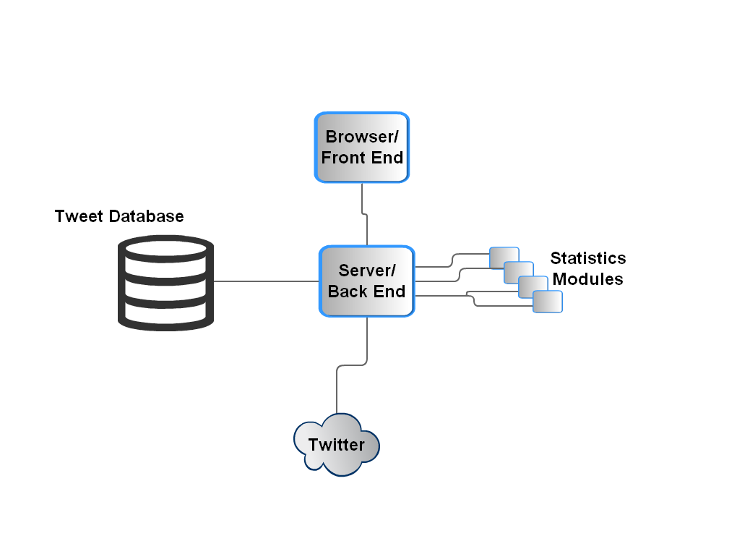
Software Architecture

Slide 4
Challenges and Risks
Integrating with the Twitter API
Integrating the various statistics modules into a single UI
Getting all the tweets for a user in a background process so it doesn’t hang the user’s browser.
Risks are mitigated/minimized because these are well documented problems.

