Slide 1
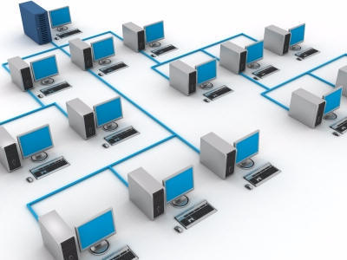
Sharezilla
Robert Chu & Liem Dinh
WHAT?
Similar to Windows File Sharing with worldwide access.
Capable of maintaining structure with a filetree
WHY?
Sharing multiples files in a large group is a hassle.
Collaborators can access your files from anywhere with internet access

Slide 2
Server
Authenticates clients when connecting
Provides a tree of collaborating clients
Stores a cache of the filenames and basic info
Manages permissions for specific users
Client
Provides actual files.
During file access, clients talk to each other without server.
User GUI to access and manage files

