Slide 1
Gantter
A simple solution for software collaboration & sharing
By Gary Lengkong and Kevin Widjaja

Slide 2
Problem & Solution
Problem:
The project manager need to keep track of everyone’s progress in a gantt chart
No way to accurately guess a team member’s progress on a task
Someone possibly is stuck or slacking off
Team members are isolated.
Solution:
Keeps track of members progress by checking repository log
Moving the responsibility in updating the gantt chart from project manager to the team member
Provide newsfeed service to share status, questions & answers, and everybody “follows” other team members

Slide 3
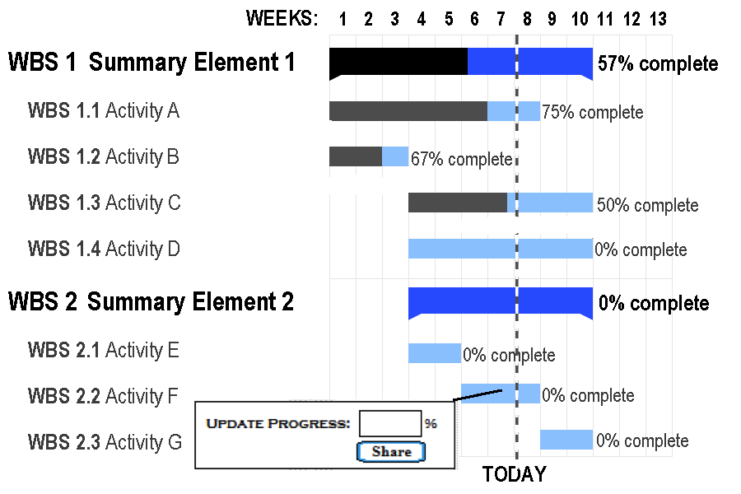
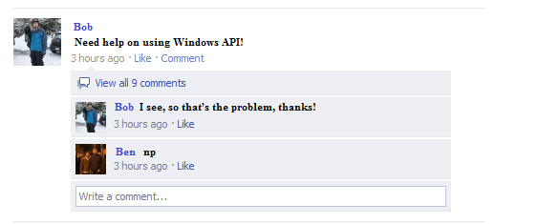
Illustrations & Implementation
The server frequently polls the repository, looking for any changes
When a change is detected, the server notifies the client app owned by the team member who committed the change
The client app then forces the team member to update his/her progress in the gantt chart
If no change is detected for a long period of time, change the team member’s status to “stuck”
Newsfeed is similar to facebook’s newsfeed

Slide 4
Pros & Cons
Pros:
Makes a project manager’s life easier
Everybody gets notified when a team member is stuck on a problem
Makes sure you commit changes frequently
The project manager can immediately assign someone to help others or give him/her new tasks when he/she has finished his/her task
Less meetings and more sense of “owning” the project (because everybody knows the overall project’s status if they check the gantt chart and newsfeed frequently)
Cons:
Team member can just fake his/her commit to hide that they are stuck/slacking off
Newsfeed can be a place for off-topic conversations, or trolling

