Slide 1
CouponStash
Brittany Shieh, Chonghua Dong, Marvin Cheng

Slide 2
Vision
With the rise of daily deal websites such as Groupon, LivingSocial, and Restaurant.com, it’s becoming more difficult to manage all the coupons accumulated from many different sources.
CouponStash is a mobile application that:
Integrates all of your coupon sources into one organized interface for easy management.
Caches your coupons onto your device for offline access
Allows for quick and easy on-the-go use of coupons without the hassle of printing!
Different from other coupon sites: management phone app for all of your coupons
Aimed toward consumers who like to use coupons for everyday purchases
Notes:
Hassle to memorize many different login names and passwords for different coupon sites
CouponStash requires only one login experience
Mark coupons as used, Import coupons from Photo Library
Every time CouponStash is accessed, if web connectivity is available, the accumulated coupons from all added coupon websites will be refreshed.
Without the web, you can still access your coupons from the last time you had internet connection when you accessed CouponStash.
This way, you can use your coupons on-the-go! Just show the coupon from your phone to the cashier.

Slide 3
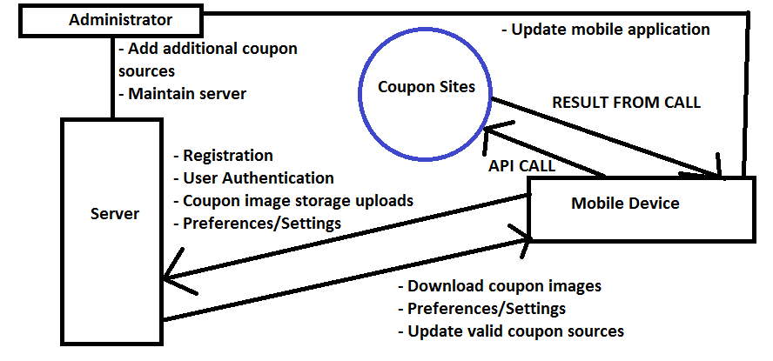
Software Architecture
CouponStash will require one login per user. The user can add on different coupon site accounts to their CouponStash account. Account information is stored server-side and registration can be done on a mobile device or web browser.
Will access the coupon website’s API to load coupons the user has purchased, and can be organized according to user preference.
Ability to cache coupon images and delete expired coupons.
Ability to access Photo Library of mobile device for manual importing and upload to server
Server: Linux-based, manage user accounts via database, store user submitted images in filesystem
Languages/Toolkits: Java (Android), Objective-C/Cocoa (iPhone), C#/Silverlight (WP7), MySQL
Notes:
There will only be one login required by the user

Slide 4
Challenges and risks
Single main challenge in developing product on schedule?
Accessibility of popular Coupon Websites APIs
If API not accessible, is there a way to obtain data from coupon websites?
How will we minimize the risk?
Recognize when there is no API provided from popular sites, and turn to alternatives like letting the user manually import coupons onto the app
Notes:
(third bullet: For example, marked as used on app won’t mark it as used on website).

