Slide 1
Your kitchen manager
Web service for families to efficiently manage their recipes, meal planning, inventory, and grocery shopping
Scope: Just sophisticated enough to be “useful” (without requiring too much effort to use)
Differentiator: Integrates 4 tasks into one convenient interface
Kitchen
Manager
Meal
Planning
Shopping + Coupons
Inventory
Recipes

Slide 2
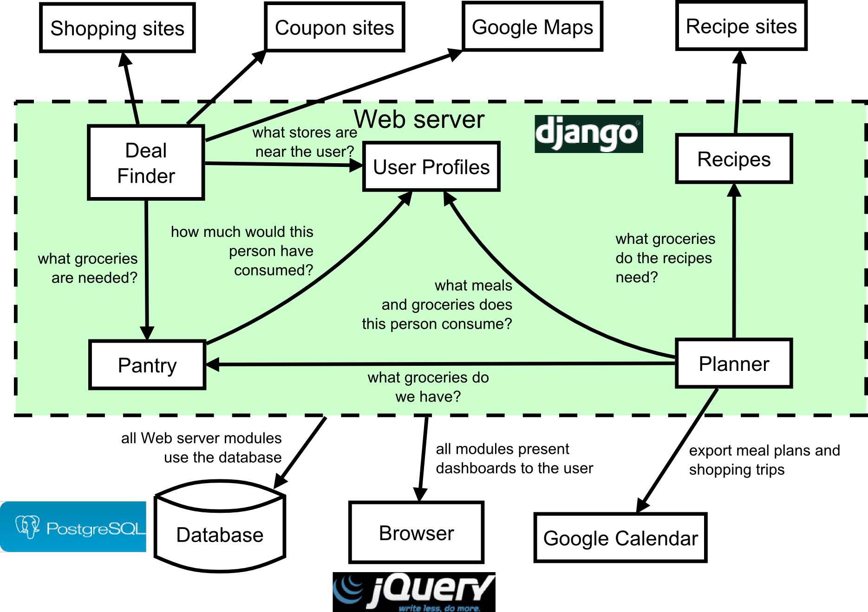
Software Architecture

Slide 3
Challenges and Risks
Biggest implementation challenge: interfacing with external sites
Many different formats
Optimize to work with 1-2 sites in each category (shopping, coupons, recipes)

