Slide 1
TuneBook
Nathan Armstrong
Corneliu Suciu
Purpose: Share music library information
How it works: Download client, upload song information, and show off to friends
Supports:
Gathering and editing of MP3 file metadata to place in the library
Allows searching and sorting by artist, album & title
Can show song ratings and library statistics

Slide 2
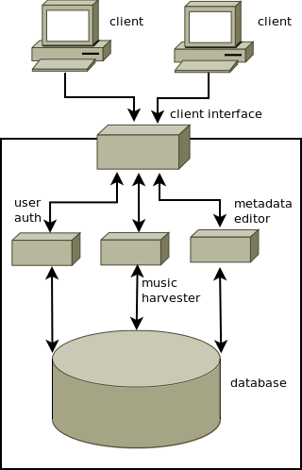
Software Architecture
Client:
Software Client:
Java Application
Alternate Web-based interface for browsing
Server: MySQL
Useful 3rd party tools:
Java ID3 tag library

