Slide 1
Massive Mosaic
Combining Photos with Friends
Jeremy Lenz
Austin Nakamura
Michael Rush

Slide 2
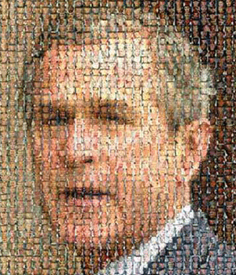
Product Overview
Product Features
Allows multiple users to create a giant mosaic by uploading their photos
Add variety by including stock images of a specified subject from the internet
Final mosaic can be manipulated by user
Intended Audience
Helps add flavor to social events
Brings friends memories together
Why this Product?
Increases variety while saving time

Slide 3
Software Architecture
Server
Client
GUI: OpenGL, Flash
Web Service
Ruby on Rails, AJAX
Server
Image Processing: C++
Database & DBMS: MySQL
Stock Photos: Flickr API
Flickr
MySQL
C++
DB
RoR, AJAX
GUI
Client

Slide 4
Challenges & Risks
Challenges
Supporting multiple image formats
Stock image locator
Image comparison algorithm
Risks
Possibility of feature creep

