Slide 1
Scheduler
CSE 403 Project SDS Presentation

Slide 2
What is our project?
We are building a web application to manage user’s time online
User comes to our webpage. Logs in; inputs various tasks, necessary information associated with each task and we provide them with a schedule
The key features include:
User will be able to create an account
Scheduler allows user to enter fixed and flexible tasks
User can prioritize tasks
We provide various calendar view options
We allow integration with google apps

Slide 3
The design
Here is the class diagram
We are dividing our project into following components
Server side development
Client side development
Features and UI designing
Integration and Testing
We have assigned leads for each component. Who will explain developments on their side in the following slides.

Slide 4
Server side development
Work on class diagrams, sequence diagrams
Set up and implement database to store user’s credentials and task information
Login, Sign up, Add task, Edit task etc.
Write an algorithm that takes input and produces the schedule
Integrate client, database and the algorithm
Testing
So far we have finished working on the class diagrams and sequence diagrams. Currently we are working on setting up the database with minimum functionality of login and sign up.

Slide 5
Class diagram
Notes:
Since the diagram is pretty hard to see I am also attaching the image of the diagram along with the .violet file.

Slide 6
Client side development
Design the features and functionality of the web pages
Implement web pages – content and style
Home page
Forgot password page
Password reset page
Scheduler page
Privacy, FAQ, About us
Implement client-server interaction
Testing pages
So far we have designed and implemented home page, forgot password page and password reset page. Next we will be working on the scheduler page.

Slide 7
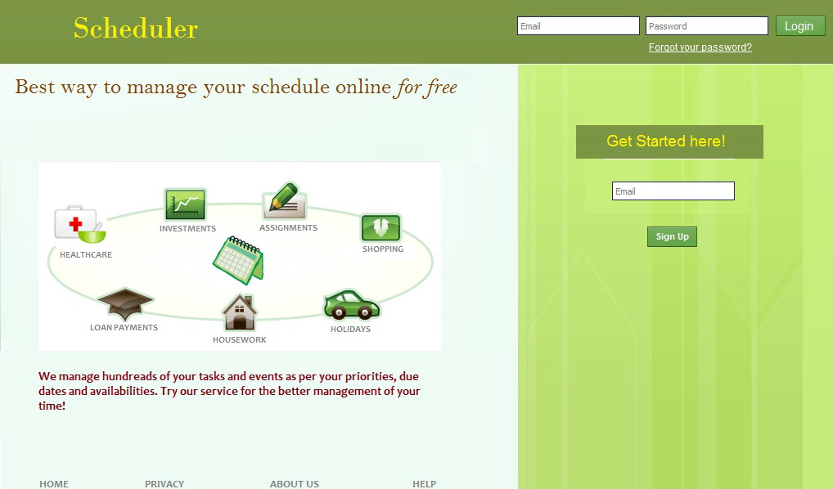
Home page

