Slide 1
Live Lecture “Improving our nation’s education, one Stepp at a time.”
CSE 403 Winter 2008
Design Team: Patrick Tsao, Elliott Miller, Jordan Ludke
Dev. Team: Kyung Park, Michael Wetzel, Brandon Barton

Slide 2
Project Premise/Applications
Brings classroom to YOU
Up-close and personal view
Reduce commute time to ZERO
…and for those who are lazy
Target Market:
Businesses – training and remote education
Schools – offer online courses

Slide 3
Features
Major
Live video stream
Whiteboard capability
Q&A Message communication
Enrollment, authentication, admin control
Minor
Save lectures for future
Add codes

Slide 4
Languages/Tools
Development:
Google Web Toolkit
Java
Flash Actionscript
Backend/Adminstrative
MySQL
SVN
Trac
CheckStyle

Slide 5
Team Roles
Team Members | Major Role | Minor Roles
Patrick Tsao | Project Manager | Design
Elliott Miller | Technical Lead/Design | Development
Jordan Ludke | Design | More Design
Kyung Park | Development (Back end) | QA
Michael Wetzel | Development (UI) | QA
Brandon Barton | QA | Development

Slide 6
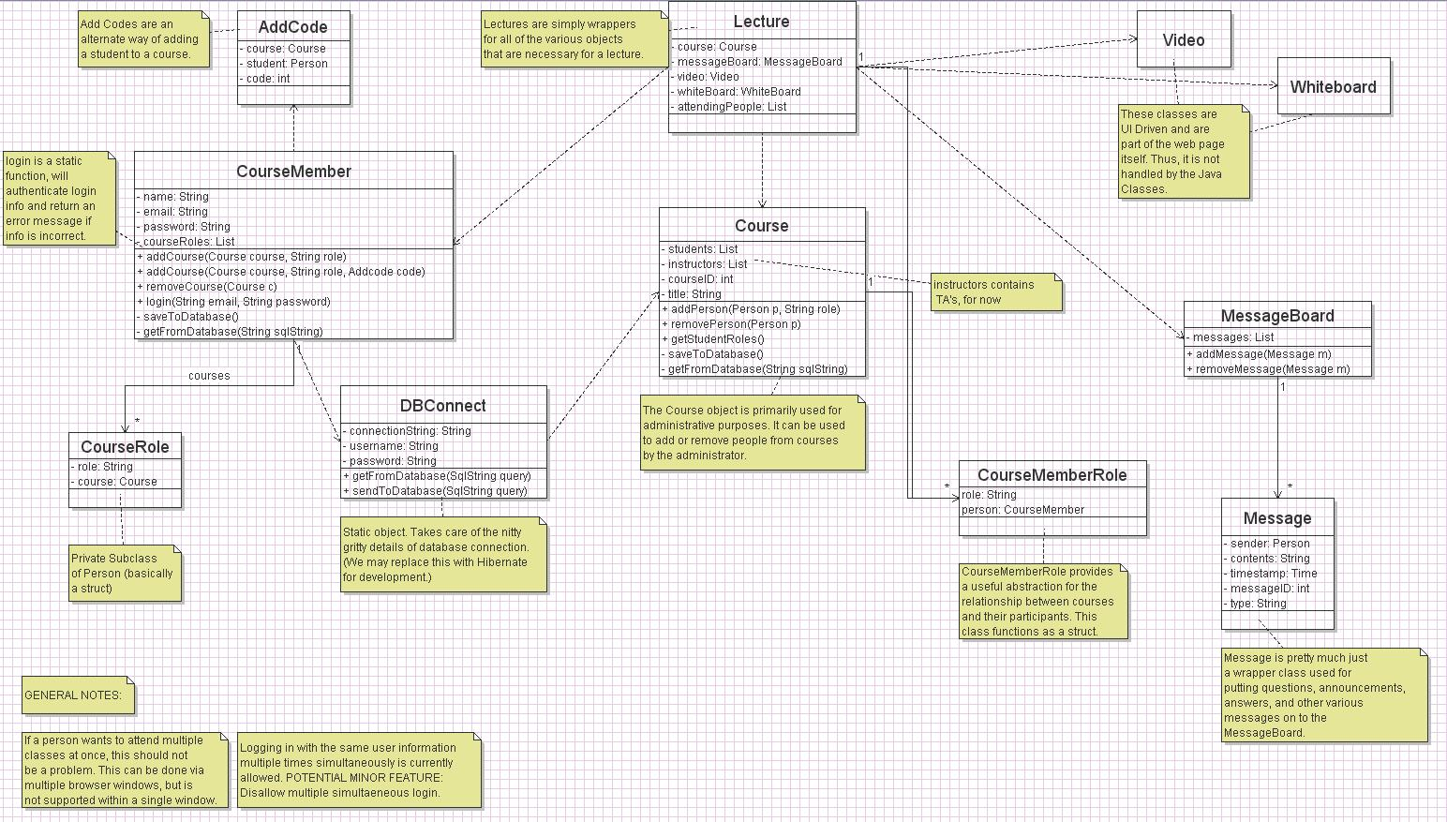
Model

Slide 7
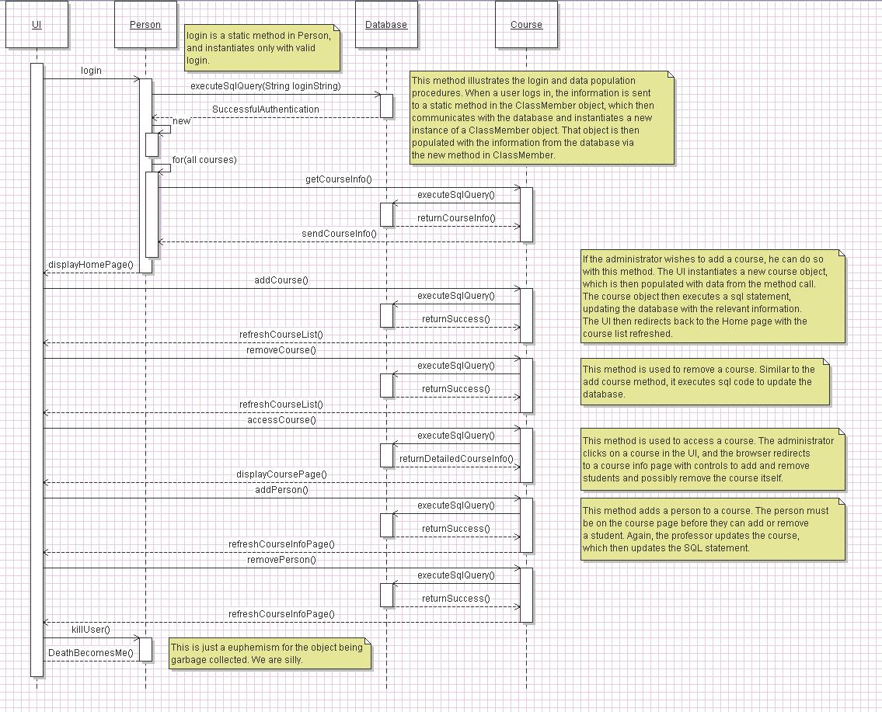
Sequence

Slide 8
User Interface

Slide 9
Questions?

