Slide 1
Week 8
CSE 390Z
February 21, 2022
Notes:
Pass out syllabi

Slide 2
Welcome in!
Grab your nametag and the workshop problems from the front
Notes:
Pass out workshop problems

Slide 3
Announcements
Quick Check 8 due Monday, February 27th @ 11:59PM
*** Imposter Syndrome Reflection due Monday, February 27th @ 11:59PM ***
Next Workshop (Week 9) will feature an Impostor Syndrome panel with the Tas in addition to standard workshop problems
Start thinking of questions to ask or topics of discussion ☺
Notes:
Also mention OH, Quick Check email resubs

Slide 4
Conceptual Review
Notes:
Pass out workshop problems

Slide 5
Structural Induction
A lot of students are confused by Structural Induction when they first see it, but it is the same in principle as Weak/Strong Induction.
We prove that a statement is true about a set by assuming that it holds for an arbitrary member of the set and then showing that it must also hold for the next element in the set.
However, in Structural Induction, we are working with Recursively Defined sets!
Structural Induction problems have many interesting variations often involving things like Binary Trees, Strings, CFGs (foreshadowing…)

Slide 6
Refresher: Recursively Defined Sets
A recursively defined set has three components:
Basis Step – Essentially the base case for the set, often this will be 0 for a set of integers, the empty string for a set of strings, a root node for a binary tree, etc.
Recursive Step – The rules by which we go from step K to step K+1. Note that there can be more than one!
Exclusion Rule – This rule states that every element of the set is generated either by the basis step alone or the basis step and some combination of applications of the recursive step
Typically, we don’t explicitly state the exclusion rule.
These recursively defined sets are also the basis for RegEx and CFGs!

Slide 7
Example: Spring 22 Lecture 19

Slide 8
Back to Structural Induction
As we said, Structural Induction is very similar to Weak and Strong Induction conceptually but there are a few key things to keep in mind:
Your Base Case is going to correspond with the Basis Step of the recursive set definition. We have to prove the predicate holds at the lowest level and build our argument up!
It is possible that our recursive set will have more than one Recursive Step/Rule, if that’s the case then we will need to have more than one Inductive Step in our proof. **You must have one inductive step for each recursive step/rule.**
So how does Structural Induction even work???
Think of each element of the set S as being generated by some K applications of the recursive rule. If we assume the predicate is true for some arbitrary element of the set and then show that the predicate still holds after every possible recursive rule application, we have proven the predicate for all members of the set.
This is analogous to showing P(K) implies P(K+1)

Slide 9
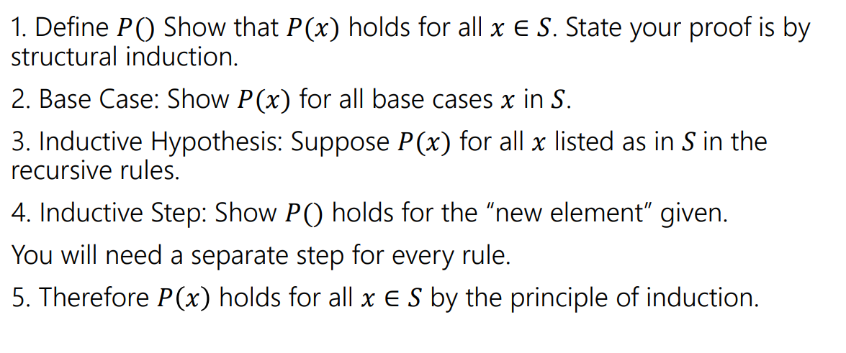
Here’s a template! Thanks again, Spring 22!

Slide 10
Regular Expressions (RegEx)
Reminder: A set of strings is called a language.
What Regular Expressions do is define a language for us, namely, the set of all strings matching some particular pattern.
Regular Expressions are recursively defined, meaning they have a basis rule, a recursive rule, and obey the exclusion rule.
Basis: empty string, no string, and a single character.
The recursive rule is where the magic happens! There are three recursive rules for RegEx:

Slide 11
RegEx Recursive Rules (Operations)
Union: If A and B are regular expressions then (A U B) is a regular expression that matches either A or B or both.
Concatenation: If A and B are regular expressions then AB is a regular expression that matches the contents of A + the contents of B
Wildcard (*): If A is a regular expression, A* is a regular expression which matches any string which can be subdivided into 0 (remember this) or more strings that match A
Examples:
(a U bc)
0(0 U 1)1
0*
Notes:
{a, bc}, {001, 011}, {empty, 0, 00, 000, 0000, …}

Slide 12
Notes about RegEx
While RegEx is powerful, they can’t define every possible language. For example, the set of all palindromes can’t be defined by regular expressions.
The CSE311, simple machine version of Regular Expressions are not interchangeable with the regular expressions some of you may be familiar with in programming languages such as Java. These programming languages extend our definition of regular expressions with features that make these regular expressions more powerful.
As a result, our definition of RegEx may have some limitations that don’t exist in other versions of RegEx, just FYI!

Slide 13
Example Problem
Notes:
Take attendance

Slide 14
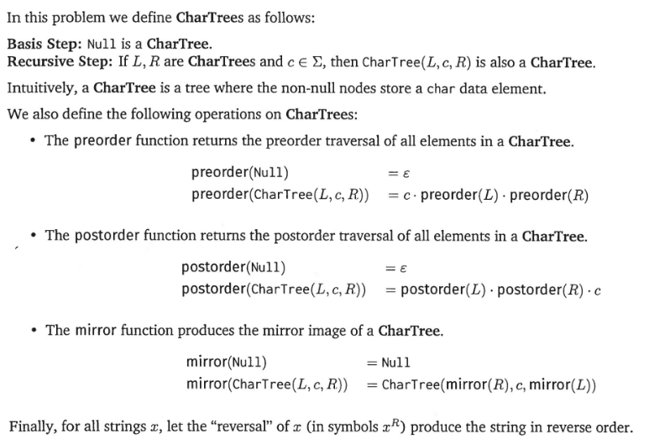
Structural Induction on Complex Objects

Slide 15
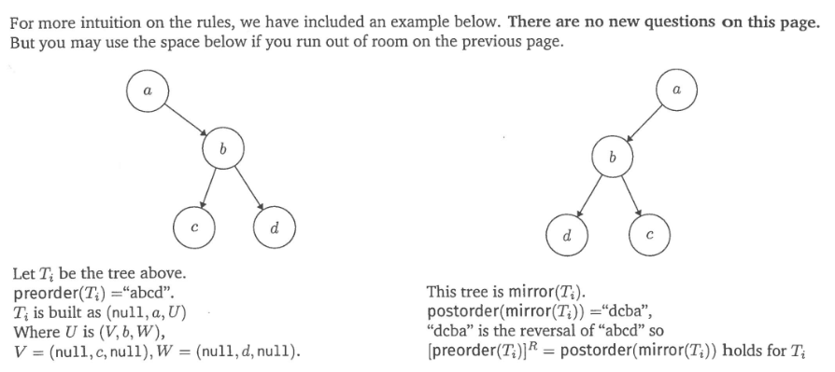
Examples of Char Trees

Slide 16
The Problem

Slide 17
Here’s a template! Thanks again, Spring 22!

Slide 18
Workshop Problems
Notes:
Take attendance

