Slide 1
Thank You CSE 333 Course Staff!
These slides were modified from a CSE 333 lecture with the permission of the instructor.

Slide 2
C++ Smart Pointers
CSE 333 Winter 2023
Instructor: Justin Hsia
Teaching Assistants:
Adina Tung Danny Agustinus Edward Zhang
James Froelich Lahari Nidadavolu Mitchell Levy
Noa Ferman Patrick Ho Paul Han
Saket Gollapudi Sara Deutscher Tim Mandzyuk
Timmy Yang Wei Wu Yiqing Wang
Zhuochun Liu

Slide 3
Lecture Outline
Introducing STL Smart Pointers
  std::shared_ptr
  std::unique_ptr
Smart Pointer Limitations
  std::weak_ptr

Slide 4
Why Smart Pointers?
C++ programming is hard for many reasons, especially its memory management component which does not exist in languages like Java or Python
According to Microsoft, Smart Pointers are “to help ensure that programs are free of memory and resource leaks and are exception-safe”
  “Exception safety” means the code works properly when exceptions are thrown

Slide 5
Goals for Smart Pointers
Should automatically handle dynamically-allocated memory to decrease programming overhead of managing memory
  Don’t have to explicitly call delete or delete[]
  Memory will deallocate when no longer in use – ties the lifetime of the data to the smart pointer object
Should work similarly to using a normal/“raw” pointer
  Expected/usual behavior using ->, *, and [] operators
  Only declaration/construction should be different

Slide 6
A Naïve Example: ToyPtr
ToyPtr.h
#ifndef TOYPTR_H_
#define TOYPTR_H_
template <typename T>
class ToyPtr {
public:
ToyPtr(T* ptr) : ptr_(ptr) { } // constructor
~ToyPtr() { delete ptr_; } // destructor
T& operator*() { return *ptr_; } // * operator
T* operator->() { return ptr_; } // -> operator
private:
T* ptr_; // the pointer itself
};
#endif // TOYPTR_H_
Notes:
T: Responsible for cleaning up the “dumb/raw” ptr it manages, but this is a toy since it is missing a lot of the functionality needed (arrays for example)
Ties lifetime of heap data to an object

Slide 7
ToyPtr Class Issue
toyuse.cc
#include "ToyPtr.h"
// We want two pointers!
int main(int argc, char** argv) {
ToyPtr<int> x(new int(5));
ToyPtr<int> y(x);
return EXIT_SUCCESS;
}
x
ptr_
5
⚠️ double delete ⚠️
y
ptr_
Brainstorm ways to design around this. 🤔💭
Notes:
T: What Happens when we copy construct this pointer?

Slide 8
Smart Pointers Solutions
Option 1: Reference Counting
  shared_ptr (and weak_ptr)
  Track the number of references to an “owned” piece of data and only deallocate when no smart pointers are managing that data
Option 2: Unique Ownership of Memory
  unique_ptr
  Disable copying (cctor, op=) to prevent sharing

Slide 9
Option 1: Reference Counting
shared_ptr implements reference counting
  https://cplusplus.com/reference/memory/shared_ptr/
  Counts the number of references to a piece of heap-allocated data and only deallocates it when the reference count reaches 0
    This means that it is no longer being used and its lifetime has come to an end
  Managed abstractly through sharing a resource counter:
    Constructors will create the counter
    Copy constructor and operator= will increment the counter
    Destructor will decrement the counter

Slide 10
Now using shared_ptr
shareduse.cc
#include <memory> // for std::shared_ptr
#include <cstdlib> // for EXIT_SUCCESS
// We want two pointers!
int main(int argc, char** argv) {
std::shared_ptr<int> x(new int(5));
*x += 3;
std::shared_ptr<int> y(x);
return EXIT_SUCCESS;
}
std::shared_ptr<int> x(new int(5)); // creates ref count
*x += 3; // usage is the same
std::shared_ptr<int> y(x); // increments ref count
x
🎉 No error &
no leak! 🎉
5
8
y
ref count: 1
2
1
0
Notes:
T: Now what happens when we copy construct this pointer?

Slide 11
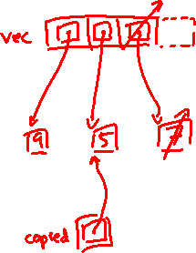
shared_ptrs and STL Containers
Use shared_ptrs inside STL Containers
  Avoid extra object copies
  Safe to do, since copy/assign maintain a shared reference count
    Copying increments ref count, then original is destructed
sharedvec.cc
vector<std::shared_ptr<int> > vec;
vec.push_back(std::shared_ptr<int>(new int(9)));
vec.push_back(std::shared_ptr<int>(new int(5)));
vec.push_back(std::shared_ptr<int>(new int(7)));
int& z = *vec[1];
std::cout << "z is: " << z << std::endl;
std::shared_ptr<int> copied(vec[1]); // works!
std::cout << "*copied: " << *copied << std::endl;
vec.pop_back(); // removes smart ptr & deallocates 7!
Notes:
int& z reference doesn’t contribute to reference count.
Worth stepping through gdb for this file + valgrind results.

Slide 12

Option 2: Unique Ownership
A unique_ptr is the sole owner of a pointer to memory
  https://cplusplus.com/reference/memory/unique_ptr/
  Enforces uniqueness by disabling copy and assignment
  (compiler error if these methods are used)
    Will therefore always call delete on the managed pointer when destructed
  As the sole owner, a unique_ptr can choose to transfer or release ownership of a pointer

Slide 13
unique_ptrs Cannot Be Copied
std::unique_ptr has disabled its copy constructor and assignment operator
  You cannot copy a unique_ptr, helping maintain “uniqueness” or “ownership”
uniquefail.cc
#include <memory> // for std::unique_ptr
#include <cstdlib> // for EXIT_SUCCESS
int main(int argc, char** argv) {
std::unique_ptr<int> x(new int(5)); //
std::unique_ptr<int> y(x); //
std::unique_ptr<int> z; //
z = x; //
return EXIT_SUCCESS;
}
1-arg ctor (pointer) ✓
cctor disabled; compiler error ✗
default ctor, holds nullptr ✓
op= disabled; compiler error ✗
Notes:
Succeed – constructor that takes a pointer
Fail – no copy constructor
Succeed – default constructor starts with NULL pointer
Fail – no assignment operator

Slide 14
unique_ptrs and STL
unique_ptrs can also be stored in STL containers!
  Contradiction? STL containers make copies of stored objects and unique_ptrs cannot be copied…
Recall: why do container operations/methods create extra copies?
  Generally to move things around in memory/the data structure
  The end result is still one copy of each element – this doesn’t break the sole ownership notion!

Slide 15
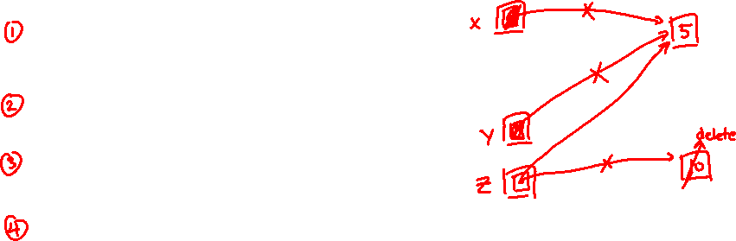
Passing Ownership
As the “owner” of a pointer, unique_ptrs should be able to remove or transfer its ownership
  release() and reset() free ownership
uniquepass.cc
int main(int argc, char** argv) {
unique_ptr<int> x(new int(5));
cout << "x: " << *x << endl;
return EXIT_SUCCESS;
}
// Releases ownership and returns a raw pointer
unique_ptr<int> y(x.release()); // x gives ownership to y
cout << ”y: " << *y << endl;
unique_ptr<int> z(new int(10));
// y gives ownership to z
// z’s reset() deallocates "10" and stores y’s pointer
z.reset(y.release());
Notes:
TODO: Drawing

Slide 16

unique_ptr and STL Example
STL supports transfer ownership of unique_ptrs using move semantics
uniquevec.cc
int main(int argc, char** argv) {
std::vector<std::unique_ptr<int> > vec;
vec.push_back(std::unique_ptr<int>(new int(9)));
vec.push_back(std::unique_ptr<int>(new int(5)));
vec.push_back(std::unique_ptr<int>(new int(7)));
//
int z = *vec[1];
std::cout << "z is: " << z << std::endl;
//
std::unique_ptr<int> copied(vec[1]);
return EXIT_SUCCESS;
}
z holds 5
vec
compiler error!
9
5
7
Notes:
z gets copy of the int pointed to by the unique_ptr in vec[1]
compiler error, since unique_ptrs can’t be copied
works, but now vec[1] has a null pointer
TODO: drswing

Slide 17
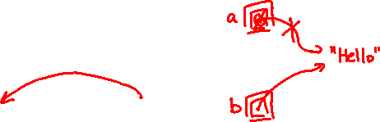
unique_ptr and Move Semantics
“Move semantics” (as compared to “Copy semantics”) move values from one object to another without copying
  https://cplusplus.com/doc/tutorial/classes2/#move
  Useful for optimizing away temporary copies
  STL’s use move semantics to transfer ownership of unique_ptrs instead of copying
uniquemove.cc
... (includes and other examples)
int main(int argc, char** argv) {
std::unique_ptr<string> a(new string("Hello"));
// moves a to b
std::unique_ptr<string> b = std::move(a);
// a is now nullptr (default ctor of unique_ptr)
std::cout << "b: " << *b << std::endl; // "Hello"
return EXIT_SUCCESS;
}

Slide 18
Aside: Smart Pointers and Arrays
Smart pointers can store arrays as well and will call delete[] on destruction
uniquearray.cc
#include <memory> // for std::unique_ptr
#include <cstdlib> // for EXIT_SUCCESS
using std::unique_ptr;
int main(int argc, char **argv) {
unique_ptr<int[]> x(new int[5]);
x[0] = 1;
x[2] = 2;
return EXIT_SUCCESS;
}
Notes:
35:28-40:40

Slide 19
Choosing Between Smart Pointers
unique_ptrs make ownership very clear
  Generally the default choice due to reduced complexity – the owner is responsible for cleaning up the resource
    Example: would make sense in HW1 & HW2, where we specifically documented who takes ownership of a resource
  Less overhead: small and efficient
shared_ptrs allow for multiple simultaneous owners
  Reference counting allows for “smarter” deallocation but consumes more space and logic and is trickier to get right
  Common when using more “well-connected” data structure
    Can you think of an example?
Notes:
Use by a lot of companies!!!!!!!

Slide 20
Lecture Outline
Introducing STL Smart Pointers
  std::shared_ptr
  std::unique_ptr
Smart Pointer Limitations
  std::weak_ptr

Slide 21
Limitations with Smart Pointers
Smart pointers are only as “smart” as the behaviors that have been built into their class methods and non-member functions!
Limitations we will look at now:
  Can’t tell if pointer is to the heap or not
  Circumventing ownership rules
  Still possible to leak memory!
  Sorting smart pointers [Bonus slides]

Slide 22
Using a Non-Heap Pointer
Smart pointers will still call delete when destructed
#include <cstdlib>
#include <memory>
using std::shared_ptr;
int main(int argc, char** argv) {
int x = 333;
shared_ptr<int> p1(&x);
return EXIT_SUCCESS;
}

Slide 23
Re-using a Raw Pointer (unique_ptr)
Smart pointers can’t tell if you are re-using a raw pointer
#include <cstdlib>
#include <memory>
using std::unique_ptr;
int main(int argc, char** argv) {
int* x = new int(333);
unique_ptr<int> p1(x);
unique_ptr<int> p2(x);
return EXIT_SUCCESS;
}
x
p1
333
p2
⚠️ double delete ⚠️

Slide 24
Re-using a Raw Pointer (shared_ptr)
Smart pointers can’t tell if you are re-using a raw pointer
#include <cstdlib>
#include <memory>
using std::shared_ptr;
int main(int argc, char** argv) {
int* x = new int(333);
shared_ptr<int> p1(x);
shared_ptr<int> p2(x);
return EXIT_SUCCESS;
}
x
p1
ref count = 1
333
p2
ref count = 1
⚠️ double delete ⚠️

Slide 25
Solution: Don’t Use Raw Pointer Variables
Smart pointers replace your raw pointers; passing new and then using the copy constructor is safer:
#include <cstdlib>
#include <memory>
using std::shared_ptr;
int main(int argc, char** argv) {
int* x = new int(333);
shared_ptr<int> p1(new int(333));
shared_ptr<int> p2(p1);
return EXIT_SUCCESS;
}

Slide 26
Caution Using get()
Smart pointers still have functions to return the raw pointer without losing its ownership
  get() can circumvent ownership rules!
#include <cstdlib>
#include <memory>
// Same as re-using a raw pointer
int main(int argc, char** argv) {
unique_ptr<int> p1(new int(5));
unique_ptr<int> p2(p1.get());
return EXIT_SUCCESS;
}
Notes:
T: What Happens when we copy construct this pointer?
TODO: Add animation that explains the double delete error

Slide 27

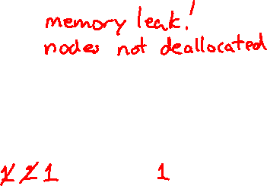
Cycle of shared_ptrs
What happens when main returns?
#include <cstdlib>
#include <memory>
using std::shared_ptr;
struct A {
shared_ptr<A> next;
shared_ptr<A> prev;
};
int main(int argc, char** argv) {
shared_ptr<A> head(new A());
head->next = shared_ptr<A>(new A());
head->next->prev = head;
return EXIT_SUCCESS;
}
head
next
$$∅$$
next
$$∅$$
prev
$$∅$$
prev
$$∅$$
sharedcycle.cc
Notes:
Both head and the 2nd node prev have access to shared reference count information for 1st node.
Run in gdb to see shared/weak count

Slide 28
Solution: weak_ptrs
weak_ptr is similar to a shared_ptr but doesn’t affect the reference count
  https://cplusplus.com/reference/memory/weak_ptr/
  Not really a pointer as it cannot be dereferenced (!) – would break our notion of shared ownership
    To deference, you first use the lock method to get an associated shared_ptr

Slide 29

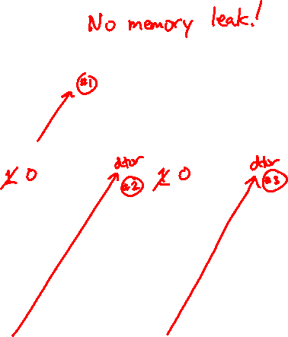
Breaking the Cycle with weak_ptr
Now what happens when main returns?
#include <cstdlib>
#include <memory>
using std::shared_ptr;
using std::weak_ptr;
struct A {
shared_ptr<A> next;
weak_ptr<A> prev;
};
int main(int argc, char** argv) {
shared_ptr<A> head(new A());
head->next = shared_ptr<A>(new A());
head->next->prev = head;
return EXIT_SUCCESS;
}
head
next
$$∅$$
next
$$∅$$
prev
$$∅$$
prev
weakcycle.cc

Slide 30
Dangling weak_ptrs
weak_ptrs don’t change reference count and can become “dangling”
  Data referenced may have been delete’d
weakrefcount.cc
... (includes and other examples)
int main(int argc, char** argv) {
std::weak_ptr<int> w;
{ // temporary inner scope
std::shared_ptr<int> y(new int(10));
w = y; // assignment operator of weak_ptr takes a shared_ptr
std::shared_ptr<int> x = w.lock(); // "promoted" shared_ptr
std::cout << *x << " " << w.expired() << std::endl;
}
std::cout << w.expired() << std::endl;
w.lock(); // returns a nullptr
return EXIT_SUCCESS;
}
Notes:
w.use_count() – get reference count
w.expired() – returns (w.use_count() == 0)
TODO: add ref count

Slide 31
Summary of Smart Pointers
A shared_ptr utilizes reference counting for multiple owners of an object in memory
  deletes an object once its reference count reaches zero
A weak_ptr works with a shared object but doesn’t affect the reference count
  Can’t actually be dereferenced, but can check if the object still exists and can get a shared_ptr from the weak_ptr if it does
A unique_ptr takes ownership of a pointer
  Cannot be copied, but can be moved

Slide 32
Some Important Smart Pointer Methods
Visit http://www.cplusplus.com/ for more information on these!
std::unique_ptr<T> U;
  U.get()
  U.release()
  U.reset(q)
std::shared_ptr<T> S;
  S.get()
  S.use_count()
  S.unique()
std::weak_ptr<T> W;
  W.lock()
  W.use_count()
  W.expired()
Returns the raw pointer U is managing
U stops managing its raw pointer and returns the raw pointer
U cleans up its raw pointer and takes ownership of q
Returns the raw pointer S is managing
Returns the reference count
Returns true iff S.use_count() == 1
Constructs a shared pointer based off of W and returns it
Returns the reference count
Returns true iff W is expired (W.use_count() == 0)
Notes:
unique_ptr
get: return the stored pointer
release: release stored pointers, replace with NULL (nice parent)
reset: delete pointer, replace with q (mean parent)
shared_ptr
get: return the stored pointer
use_count: get ref count
unique: use_count() == 1
weak_ptr
lock: “promote” to shared_ptr
use_count: return ref count of SHARED PTRs
expired: check if use_count == 0
http://www.cplusplus.com/reference/memory/unique_ptr/
http://www.cplusplus.com/reference/memory/shared_ptr/
http://www.cplusplus.com/reference/memory/weak_ptr/

Slide 33
BONUS SLIDES

Slide 34
Smart Pointers and “<”
Smart pointers implement some comparison operators, including operator<
  However, it doesn’t invoke operator< on the pointed-to objects; instead, it just promises a stable, strict ordering (probably based on the pointer address, not the pointed-to-value)
To use the sort() algorithm on a container like vector, you need to provide a comparison function
To use a smart pointer in a sorted container like map,
you need to provide a comparison function when you declare the container

Slide 35
unique_ptr and STL Sorting
uniquevecsort.cc
using namespace std;
bool sortfunction(const unique_ptr<int> &x,
const unique_ptr<int> &y) { return *x < *y; }
void printfunction(unique_ptr<int> &x) { cout << *x << endl; }
int main(int argc, char **argv) {
vector<unique_ptr<int> > vec;
vec.push_back(unique_ptr<int>(new int(9)));
vec.push_back(unique_ptr<int>(new int(5)));
vec.push_back(unique_ptr<int>(new int(7)));
// buggy: sorts based on the values of the ptrs
sort(vec.begin(), vec.end());
cout << "Sorted:" << endl;
for_each(vec.begin(), vec.end(), &printfunction);
// better: sorts based on the pointed-to values
sort(vec.begin(), vec.end(), &sortfunction);
cout << "Sorted:" << endl;
for_each(vec.begin(), vec.end(), &printfunction);
return EXIT_SUCCESS;
}

Slide 36
unique_ptr, “<”, and maps
Similarly, you can use unique_ptrs as keys in a map
  Reminder: a map internally stores keys in sorted order
    Iterating through the map iterates through the keys in order
  By default, “<” is used to enforce ordering
    You must specify a comparator when constructing the map to get a meaningful sorted order using “<” of unique_ptrs
Compare (the 3rd template) parameter:
  “A binary predicate that takes two element keys as arguments and returns a bool. This can be a function pointer or a function object.”
    bool fptr(T1& lhs, T1& rhs); OR member function
    bool operator() (const T1& lhs, const T1& rhs);

