Slide 1
C++ Casting
CSE 390C

Slide 2
C-Style Casting
Simple syntax that we’ve seen in Java and C
Converts primitive data types to another (ex. double to int)
Can also be used to convert between pointers of different types
The data being pointed to will just be interpreted differently
Still valid in C++, but bad style…

Slide 3
C++ Casting
Four different types of casts:
static_cast<type>(expression)
dynamic_cast<type>(expression)
const_cast<type>(expression)
reinterpret_cast<type>(expression)
Makes your intent clearer for readers of your code!

Slide 4
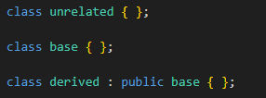
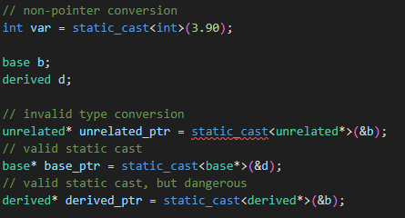
static_cast
Used to:
Convert class pointers to a related type (within the same class hierarchy)
Be careful casting down a class hierarchy
Convert between different primitive types
static_casts are checked at compile time

Slide 5
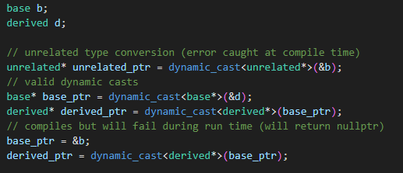
dynamic_cast
Used to:
Convert pointers/references of related types (within the same class hierarchy)
At compile time, verify that the pointers have related types
At run time, if casting from base class to derived class, verify that object is actually an instance of the derived class.
Used mainly for handling polymorphism/inheritance

Slide 6
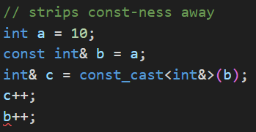
const_cast
Used to add or strip “const-ness” of a pointer or reference.
Often, regarded as bad style (and even dangerous), since violates the intent and const-ness of the variable
Striping const-ness:
If variable being pointed to was defined as const, this behavior is undefined!
Otherwise, can modify underlying data through this pointer/reference

Slide 7
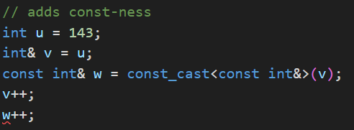
const_cast cont.
Adding const-ness:
Only gives this pointer/reference const-ness, but others can still modify the data this points to/references

Slide 8
reinterpret_cast
Used to convert between incompatible types
Ex. int to a pointer or vice-versa
Also, can convert between incompatible pointer types
Low-level bit pattern is kept the same, just interpreted differently
Dangerous!!!

Slide 9
Implicit Conversion
When a variable is used in the context of a different type (without an explicit cast)
The compiler will then attempt to infer the correct conversion
The compiler can also take advantage of single parameter class constructors
ex. (const char*) -> string

