Slide 1
Procrastination, Networking, & Managing stress Part II
Finals Week Prep, Connecting our Computer to the Internet
Significant material adapted from www.nand2tetris.org. © Noam Nisan and Shimon Schocken.

Slide 2
Agenda
Procrastination (our fav)
Intro to Networking
  Connecting our Computer to the Internet
Stress Response Cycle Discussion

Slide 3
Let’s Talk Procrastination

Slide 4
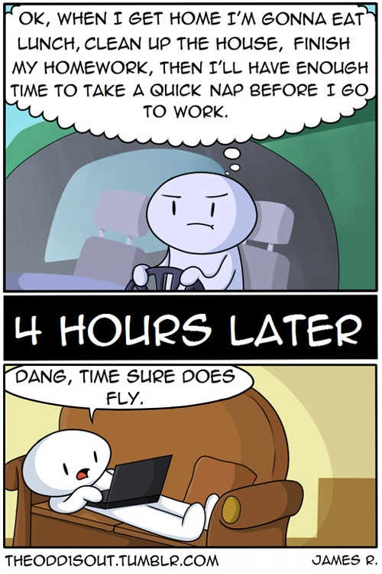
Let’s Talk Procrastination
What is procrastination?
  Procrastination is the act of putting things off or choosing to do something you prefer to do (or might even need to do) instead of the actual project or chore or work you need to be doing now.
  Common challenge for college students, with about 80-95% of students reporting that they procrastinate (Steel, 2003)

Slide 5

How do we combat procrastination?
Identifying why we procrastinate and the internal dialogue we have with ourselves
Creating a proactive strategy to course-correct when you notice you're putting off what needs to be done

Slide 6
Grab a piece of paper!

Slide 7
Grab a piece of paper!

Slide 8
Grab a piece of paper!
AVOIDANCE AREAS
When you procrastinate, what do you avoid doing?
Identify 3 -5 areas

Slide 9
Where does procrastination impact you most?
PERSONAL
Eating well
Exercising / Wellness activities
Getting enough sleep
Bathing & hygiene
Health care (i.e. doctor’s visit)
Balancing bank account
Relaxation & hobbies
SCHOOL/COLLEGE
Going to class
Doing class readings
Studying for tests/exams
Doing homework/ assignments
Writing papers
Starting long-term projects
Finding a study group
Talking to an instructor or TA
Making an advising appointment
SHOPPING/HOME/
MAINTENANCE
Paying bills
Getting financial aid taken care of (i.e. FAFSA, forms, etc)
Doing laundry
Cleaning
Grocery shopping
Doing dishes
SOCIAL/RELATIONSHIPS
Talking with friends
Writing email responses
Socializing
Calling relatives
WORK/CAREER
Going to work
Applying to internships/jobs
Preparing a resume
Studying for interviews
Notes:
When you procrastinate, what do you avoid doing?

Slide 10
Grab a piece of paper!
AVOIDANCE AREAS
PROCRASTINATION BEHAVIORS
When you procrastinate, what do you avoid doing?
How do you procrastinate?
In other words, what do you do instead of the work that needs to be done?
Identify 3 -5 areas
Identify 3 -5 behaviors

Slide 11
Grab a piece of paper!
AVOIDANCE AREAS
PROCRASTINATION BEHAVIORS
PLANNING FOR SUCCESS
When you procrastinate, what do you avoid doing?
How do you procrastinate?
In other words, what do you do instead of the work that needs to be done?
What can you do to avoid procrastination?
What action can you take to refocus yourself on the task you need to complete?
Identify 3 -5 areas
Identify 3 -5 behaviors
Identify 3 -5 actions

Slide 12
Tips for surviving dead week...
Revisit and reassess your goals each day
  Break-up into different levels - minimal, solid, reach
Have an accountability buddy
  Study groups, working sessions, zoom meet-ups..
  whatever you want to call it, having someone who can help you stay motivated, accountable, and avoid procrastination
Remember bloom’s taxonomy!!
  How is your preparation involving higher level thinking skills?
Try and stick to a routine
  Provides normalcy and structure for maintaining sleep and wellness

Slide 13
Agenda
Procrastination
Intro to Networking
  Connecting our Computer to the Internet
Stress Response Cycle Discussion
Notes:
Brief overview of topic
Mysterious thing, black box
Goal by end of lecture: not so magical anymore
Become interested in this topic

Slide 14
Intro to Networking
We won’t go very deep on this topic
  Take CSE 333 (Systems Programming), CSE 461 (Computer Networks), and CSE 452 (Distributed Systems) to learn more!
Our focus:
Brief intro to what connecting to the internet looks like under the hood
What that connection might look like implemented in our computer!
Notes:
Interesting? Take these courses!
333 - writing programs that interact with network, browser → network
461 - create a network, organize a network, scale, error detection
452 - coordinate individual computers
Focus: peel that layer back! connection to components we’ve learned before

Slide 15








Really, Really Long Wires
At a fundamental level, there’s nothing magic about the Internet -- it’s the same concepts we used to build our CPU, just with longer wires.
  Still 1s and 0s, still just combinational + sequential logic!
≈
Computer.hdl
Combinational & Sequential Logic
Combinational & Sequential Logic
Computer.hdl
Notes:
Networks are just computers connected by really long wires
Could be connected to wifi though!
Computers around house, the city, even the bottom of the ocean floor
Crazy tech—but just wires lol.
At the fundamental level, still 1s and 0s across this wire.

Slide 16

Thinking about the Network: Layers
To manage the complexity, we think about the network in layers
It’s all 1’s and 0’s, but each layer is a different way of “framing” or thinking about those 1’s and 0’s
  Each layer zooms out a little more
Application Layer
webpage (.html)
meme (.png)
*
Data Link Layer
dest address
source address
data
Physical Layer
1
0
1
0
0
0
1
0
1
1
0
0
*Others exist between here; out of 390B scope
Notes:
Complicated applications!! Like Chrome, Zoom, Slack
For one app to take 1s and 0s to convert directly into your applications?
Don’t want every app to need to reimplement that
So, we have layers
Physical
Data Link
Application Layer → here’s the data, image or webpage
Each is a complex part, each layer can handle on part of the problem!
Same layers we have in a computer program!
CPU executes binary
Binary comes from assembler assembling assembly
Assembly coming from the compiler compiling a high level language like Java
Each layer zooms out a little more
Actually more layers!
The internet processes a lot of data and sends it to a lot of different places
Analogy: moving into CSE 2

Slide 17


Application Layer
Conceptually the “top” layer: looking at internet traffic as direct communication between applications
Common use: HTTP (HyperText Transfer Protocol)
  Your browser sends an HTTP request to a server
  The server sends back an HTTP response with data attached
I would like to load: http://instagram.com/dog/latest_story.png
I found it:
Browser
Server
Notes:
Top layer, app layer is communication between different applications
Give URL, browser sends out. Translated by lower layers
Browser POV, think of the application, lower layers can do translation
Toss around huge words like “webpage”, “PDF”, “instagram story”

Slide 18
Application Layer
Conceptually the “top” layer: looking at internet traffic as direct communication between applications
Common use: HTTP (HyperText Transfer Protocol)
  Your browser sends an HTTP request to a server
  The server sends back an HTTP response with data attached
I would like to load: http://instagram.com/dog/latest_story.png
Data Link Layer
dest address
source address
data
dest address
source address
data
Browser
Server
dest address
source address
data
dest address
source address
data
Notes:
Data Link Layer
Questions?
I have a question!!! Why smaller messages?
Toss around huge words like “webpage”, “PDF”, “instagram story”

Slide 19
Data Link Layer
A computer network is simply multiple computers connected by a single wire
Gets data from Internet (beyond scope of 390B)
computer
00:1d:4f:47
computer
4c:44:1e:8f
computer
de:ad:be:ef
router
(also a computer)
24:48:96:12
dest address
4c:44:1e:8f
source address
24:48:96:12
data
Notes:
Data Link Layer
Small messages. 1) less frequent errors, 2) sharing is caring
Less likely for corruption, more space for other computers to send messages
Click.

Slide 20
Data Link Layer
But every computer will “hear” the message. How do the others know to ignore it?
Gets data from Internet (beyond scope of 390B)
computer
00:1d:4f:47
computer
4c:44:1e:8f
computer
de:ad:be:ef
router
(also a computer)
24:48:96:12
dest address
4c:44:1e:8f
source address
24:48:96:12
data
Notes:
Issue: all connected to one wire. How do we know to make the puppy photo to just go to you and not everyone else?
Kind of like wifi
Routing involved- 1) job is to filter traffic. knows which direction to send it. talk to server at UW, there should be short path for packet travel. 2) incoming packet, only filter information for your computer specifically. Where should packets go? it’s like a GPS.

Slide 21

NIC (Network Interface Card)
We don’t want the CPU to waste time always listening to the network wire, especially when it’s not even the destination computer
Solution: the NIC -- a new piece of the computer dedicated to dealing with the network wire
  Listens to the network wire until it hears a dest address, checks if it matches this computer, and only sends to CPU if so
computer
00:1d:4f:47
NIC
dest address
4c:44:1e:8f
source address
24:48:96:12
data
Notes:
CPU does a lot of work. Performs operation, quick math, executing instructions, don’t want to take CPU’s time!
Hardware in computer, called the NIC, job is to pick up info from these wires and place it in memory.
Computer will take information from the NIC when it has time

Slide 22
NIC Implementation in Your Computer
Before, would have to accept NIC as “magic”
Now, can imagine exactly how to build this chip -- and for a simple implementation, turns out it’s pretty easy!
(controls whether to pass on to CPU)
AND
0
=
1
=
1
=
1
=
0
=
1
=
0
=
0
=
0
1
1
Next Index:
3
1
0
1
0
Notes:
We’ve talked about many of the concepts that we can use to build a fundamental NIC!
Do some of these components look familiar?

Slide 23
NIC Implementation in Your Computer
Before, would have to accept NIC as “magic”
Now, can imagine exactly how to build this chip -- and for a simple implementation, turns out it’s pretty easy!
(controls whether to pass on to CPU)
Bitwise/multi-bit operations? Sounds like And16.hdl
AND
Selectable read/write? Sounds like RAM.hdl
0
=
1
=
1
=
1
=
0
=
1
=
0
=
0
=
0
1
1
Constantly incrementing an address? Sounds like PC.hdl
Making a choice? Our good friend Mux.hdl!
Next Index:
3
1
0
1
0
Notes:
Gee, we’ve worked with all of these components before!!!
Lesson: what you’re learning in this course isn’t just used to build Nand2Tetris. It can be applied to so many other software and hardware disciplines. And as you’re taking more CSE courses, you’ll find that a lot of the concepts you learn build on these core concepts we’ve touched on in this class. At the fundamental level, they’re all bits and gates and chips that you slowly build up into more meaningful information. So don’t let those upper-division courses scare you—you are more than qualified to take them with the knowledge that you have now!
And this isn’t just in 390B :)

Slide 24
Connecting NIC to Memory
The keyboard and screen communicated with the CPU via memory maps -- agreed-upon regions of RAM that can be read/written by the hardware of the devices themselves
NIC could be no different!
  Every time the right address is detected, copy the following data into part of RAM where the CPU can retrieve it once it gets a chance
NIC
CPU
Screen
Keyboard
Notes:
Screen and keyboard devices talk to screen/keyboard devices and store them in the memory region. CPU logic for fetching that information for memory. Whenever the CPU has the opportunity to get that information.
Memory mapping—allocating certain areas of memory for certain devices. CPU can communicate to that device
It turns out we can do the exact same thing with NIC.

Slide 25
Takeaways: Networking
The network is fundamentally the same hardware we’ve been looking at
Its incredible power comes from scale: how much data and how many computers it connects
  To manage this complexity, we think of it in layers
Interfacing with the network can be done with specialized hardware
  This frees the CPU from monitoring constantly; can access data only when needed
Notes:
You all have the tools to learn about networks! It just has a specific application to what we’ve been learning so far in this course
How do networks even work?
It’s really from scale, becomes complicated
Use layers to manage these complexity, give each layer its own task. Easier to implement
Interface w/ hardware done using specialized hardware, the NIC, so that the CPU can focus on what it does best and delegate work to other pieces of hardware
Definitely take 461 again!
Take it even if you’re remotely interested!
If not, it’s probably because I’m not delivering it in an interesting way, not an accurate representation of how interesting you may find networks lol
Hopefully networks feel less like magic now, that you’re more interested in networks, and you feel more confident peeling behind layers of some other very magical concepts in CS! At the very core, they all rely on the same hardware. Although, I still think it’s incredible that computers even work in the first place.

Slide 26
Agenda
Procrastination
Intro to Networking
  Connecting our Computer to the Internet
Stress Response Cycle Discussion

Slide 27
Episode II: Complete the Stress Response Cycle
In episode 2, the Nagoski sisters talk about 12 evidence-based strategies to deal with the stress itself (vs. the stressors) that could help you complete the stress response cycle and return to a state of safety inside your body.
  Of the 12 strategies discussed in the podcast episode, which one resonated most with you and why?
A big part of finding activities that complete your stress response cycle is being able to judge if an activity caused a release feeling for you.
  Can you think of any moments in the past where this release occurred? Can you think of any moments where you were trying to relieve your stress but you didn't feel that release?
How can we build these practices into our daily routine without thinking about them as a “chore” we have to do?

Slide 28
Wrapping Up
What’s in store for Week 10(!!)?
Final Project Check-in
Final Social Computing Reflection discussion
Final week of lectures
Reminders
Professor Meeting Report due 11:59PM Tonight!
Project 7 due Tuesday!
TAs will be talking to you about your final 1:1 session
Let’s finish strong!!

Slide 29
Preparing for Finals Week
Identifying what is being expected of you for your finals
  Revisiting course syllabi
  Reviewing finals instructions or specs
Make a plan
  What does preparing for each of your classes look like?
  What materials, tools, resources are needed?
Make a schedule
  How does what you need to do fit into your schedule?

Slide 30
Preparing for Finals Week - CSE 390B!
Identifying what is being expected of you for your finals
  Revisiting course syllabi
  Reviewing finals instructions or specs
Make a plan
  What does preparing for each of your classes look like?
  What materials, tools, resources are needed?
Make a schedule
  How does what you need to do fit into your schedule?

Slide 31

Preparing for Finals Week - CSE 390B!
Identifying what is being expected of you for your finals
  Revisiting course syllabi
  Reviewing finals instructions or specs
Make a plan
  What does preparing for each of your classes look like?
  What materials, tools, resources are needed?
Make a schedule
  How does what you need to do fit into your schedule?

Slide 32
Preparing for Finals Week - CSE 390B!
Identifying what is being expected of you for your finals
  Revisiting course syllabi
  Reviewing finals instructions or specs
Make a plan
  What does preparing for each of your classes look like?
  What materials, tools, resources are needed?
Make a schedule
  How does what you need to do fit into your schedule?

Slide 33
CSE 390B Final Project Plan
What could preparing for your CSE 390B final project look like?

Slide 34
CSE 390B Final Project Plan
What could preparing for your CSE 390B final project look like?
Review previous projects and reflections as inspiration

Slide 35

CSE 390B Final Project Plan
What could preparing for your CSE 390B final project look like?
Review previous projects and reflections as inspiration
Create an outline of your project that addresses the required elements
(conveniently we have built this in as part of your final project )

Slide 36
CSE 390B Final Project Plan
What could preparing for your CSE 390B final project look like?
Review previous projects and reflections as inspiration
Create an outline of your project that addresses the required elements
(conveniently we have built this in as part of your final project )
Meet with an instructor or TA for guidance/support
(conveniently we have built in one opportunity for you to do this next week )

Slide 37
CSE 390B Final Project Plan
What could preparing for your CSE 390B final project look like?
Review previous projects and reflections as inspiration
Create an outline of your project that addresses the required elements
(conveniently we have built this in as part of your final project )
Meet with an instructor or TA for guidance/support
(conveniently we have built in one opportunity for you to do this next week )
What else?

Slide 38
Preparing for Finals Week - CSE 390B!
Identifying what is being expected of you for your finals
  Revisiting course syllabi
  Reviewing finals instructions or specs
Make a plan
  What does preparing for each of your classes look like?
  What materials, tools, resources are needed?
Make a schedule
  How does what you need to do fit into your schedule?

Slide 39
Preparing for Finals Week - CSE 390B!
Identifying what is being expected of you for your finals
  Revisiting course syllabi
  Reviewing finals instructions or specs
Make a plan
  What does preparing for each of your classes look like?
  What materials, tools, resources are needed?
Make a schedule
  How does what you need to do fit into your schedule?

Slide 40
Preparing for Finals Week - CSE 390B!
Identifying what is being expected of you for your finals
  Revisiting course syllabi
  Reviewing finals instructions or specs
Make a plan
  What does preparing for each of your classes look like?
  What materials, tools, resources are needed?
Make a schedule
  How does what you need to do fit into your schedule?

Slide 41
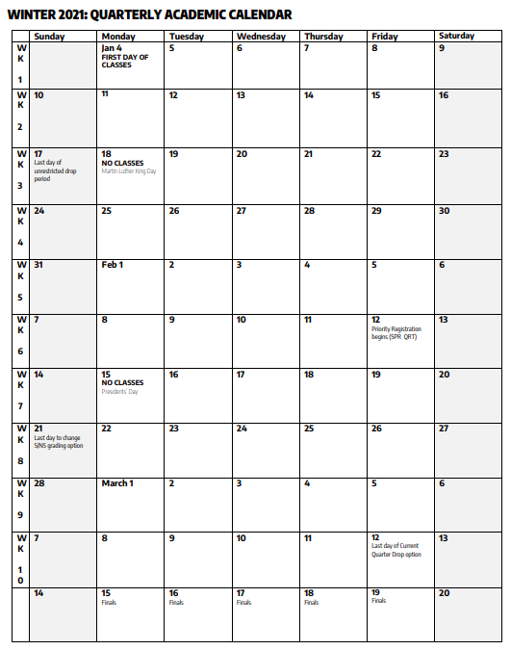
Quarterly Calendar

Slide 42
Quarterly Calendar

Slide 43
Quarterly Calendar
CSE 390B
Final Project!

Slide 44
Quarterly Calendar
CSE 390B
Final Project!

