Slide 1
Mid-Quarter Retrospective & Reflection
CSE 390B Midterm Debrief, Time Management Check-in, Nand2Tetris Reflection/Look Ahead
Significant material adapted from www.nand2tetris.org. © Noam Nisan and Shimon Schocken.

Slide 2
Agenda
Midterm Recap
Revisiting Time Management
Where we’ve been, where we’re at, & where we’re going
Nand2Tetris Reflection/Look Ahead

Slide 3
Midterm Overview

Slide 4
A Few Midterm Notes
Overall awesome work!
For almost all questions everyone seemed to understand the general idea/start in the right direction
Figuring out the details was where most of the mistakes were made
Likely this is a product of the time pressure?

Slide 5
A Few More Midterm Notes
If you think a problem was graded unfairly or wrong, submit a regrade request in Gradescope!
Don’t be too scared to do so; this is a great learning opportunity both for you and me!
If you are unhappy with your score, you will have a chance to get points back w/midterm corrections as part of project 6

Slide 6
Agenda
Midterm Recap
Revisiting Time Management
Where we’ve been, where we’re at, & where we’re going
Nand2Tetris Reflection/Look Ahead

Slide 7

Time Management Revisited
Identify which time management interval (quarter, week, day, length of project) you feel you’ve improved your time management skills in the most and why? Which area(s) do you still want to improve in? Try to be as specific as possible.
What are specific time management strategies that you think would be helpful but have yet to regularly practice? What are some ways for you to shift from thinking/knowing a practice could be helpful to actually implementing that practice?
Quarterly Calendar
Weekly Time Commitments schedule
24-Hour Time Audit
Project planning document

Slide 8
Time Management Revisited
Identify which time management interval (quarter, week, day, length of project) you feel you’ve improved your time management skills in the most and why? Which area(s) do you still want to improve in? Try to be as specific as possible.
What are specific time management strategies that you think would be helpful but have yet to regularly practice? What are some ways for you to shift from thinking/knowing a practice could be helpful to actually implementing that practice?
Quarterly Calendar
Weekly Time Commitments schedule
24-Hour Time Audit
Project planning document
Before leaving the breakout session, execute one of the practices you identified.

Slide 9
Agenda
Midterm Recap
Revisiting Time Management
Where we’ve been, where we’re at, & where we’re going
Nand2Tetris Reflection/Look Ahead

Slide 10
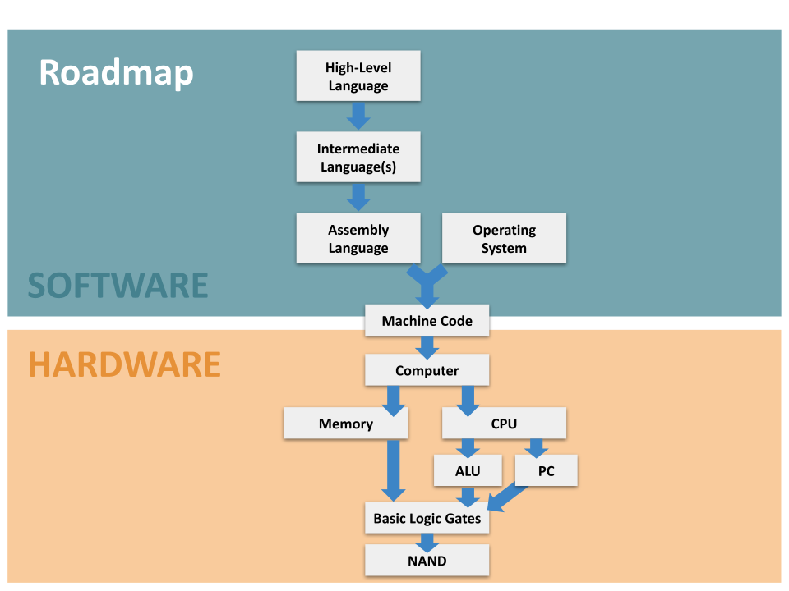

Slide 11
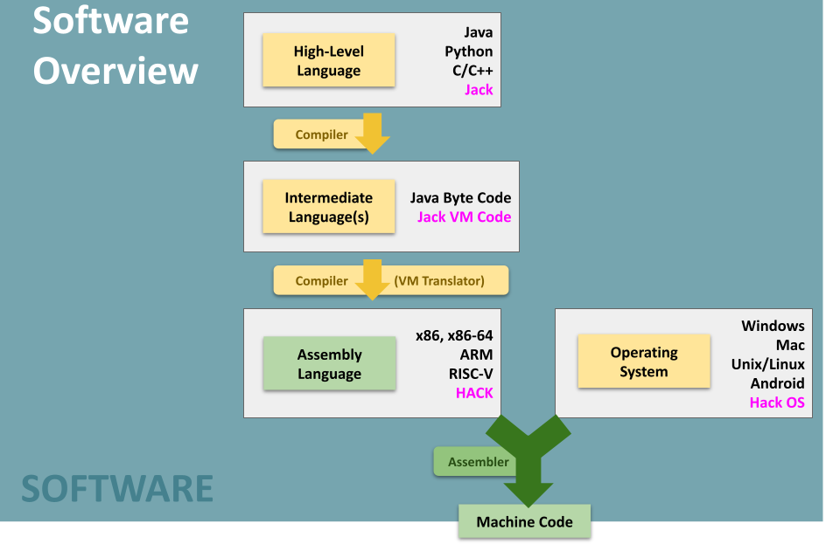

Slide 12
Agenda
Midterm Recap
Revisiting Time Management
Where we’ve been, where we’re at, & where we’re going
Nand2Tetris Reflection/Look Ahead

Slide 13
Bells and Whistles… Why Bother?
Tradeoff: Adding convenience for programmer makes it harder to build programming languages
E.g. Removing symbols from Hack assembly would make Assembler much simpler, still possible to write all the same programs!
But language would be far more annoying to use

Slide 14
Bells and Whistles… Why Bother?
Tradeoff: Adding convenience for programmer makes it harder to build programming languages
E.g. Removing symbols from Hack assembly would make Assembler much simpler, still possible to write all the same programs!
But language would be far more annoying to use
Don’t underestimate the importance of convenience!
Put another way: adding these extra features makes programmers more productive
Language design can also reduce the number of bugs, some of which can have serious real-world consequences

Slide 15
Bells and Whistles… Why Bother?
Tradeoff: Adding convenience for programmer makes it harder to build programming languages
E.g. Removing symbols from Hack assembly would make Assembler much simpler, still possible to write all the same programs!
But language would be far more annoying to use
Don’t underestimate the importance of convenience!
Put another way: adding these extra features makes programmers more productive
Language design can also reduce the number of bugs, some of which can have serious consequences
This is a general theme of programming language design!

Slide 16

Bells and Whistles… Why Bother?
Example: HTTP (HyperText Transfer Protocol)
Loading a website: (1) Browser sends HTTP request to Server, (2) Server sends HTTP response back with website data
GET /midterm.pdf HTTP/1.1 Host: cs.washington.edu:80
Connection: close

Slide 17
Bells and Whistles… Why Bother?
Example: HTTP (HyperText Transfer Protocol)
Loading a website: (1) Browser sends HTTP request to Server, (2) Server sends HTTP response back with website data
Until 2015, every request was plain text!
Request MUST have hostname… but MUST precede with “Host:”
Connection can be “close” or “keep-alive”. Why not 0 or 1?
GET /midterm.pdf HTTP/1.1 Host: cs.washington.edu:80
Connection: close

Slide 18
Bells and Whistles… Why Bother?
Example: HTTP (HyperText Transfer Protocol)
Loading a website: (1) Browser sends HTTP request to Server, (2) Server sends HTTP response back with website data
Until 2015, every request was plain text!
Request MUST have hostname… but MUST precede with “Host:”
Connection can be “close” or “keep-alive”. Why not 0 or 1?
Inefficient, but easy for programmers to develop with/debug → widespread adoption!
GET /midterm.pdf HTTP/1.1 Host: cs.washington.edu:80
Connection: close

Slide 19
Where We’ve Been: Hardware
The physical devices that execute instructions
Made up of a combination of both combinational logic and sequential logic
Takes our theoretical code and actually performs computations to make it “real”
Uses instructions that are part of an instruction set to determine what computations it should perform

Slide 20
Where We’ve Been: Machine Code
Binary instructions that tell the hardware what to execute
Hardware interprets the binary to know what the instruction means
Example: Our Hack instructions have 3 bits detailing where to store the result of a computation
Really annoying to program in… hard to remember binary encoding, easy to introduce bugs, hard to find them, etc.

Slide 21
Where We’ve Been: Assembly
Human readable format of machine code
Each assembly instruction corresponds to exactly one binary instruction
Adds some human-friendly features such as symbols and labels
These aren’t represented explicitly in the machine code
The assembler translates the human-readable assembly to binary machine code

Slide 22
Where We Are Going: Compiler
Assembly is better to program in than machine code, but not as nice as a high level language like Java
If statements and for loops are much nicer than jumps...
In order to program in a high level language like Java, need a tool to convert to assembly/machine code
A compiler translates from one programming language to another (e.g. from Java to assembly code)
Our next big topic - we will build part of one in Project 7!

Slide 23
Reminders!
Eric & Margot’s Office Hours are happening right after class!
Project 5 due this Thursday 11:59PM PDT
Timed Mock Exam
Build a Computer!
Social Computing Reflection II
Autumn 2021 registration has started
“Caring for myself is not self-indulgence, it is self-preservation…” - Audre Lorde
https://www.washington.edu/counseling/resources/

