Slide 1
Mock Exam, Test-Taking Strategies
Mini mock exam, intro to test-taking strategies, & exam design 101
Significant material adapted from www.nand2tetris.org. © Noam Nisan and Shimon Schocken.

Slide 2
Agenda
Mock Exam
Debrief & Test-Taking strategies
Self-Grading Your Mock Exam
Designing Exams 101

Slide 3
Mock Exam
This exam is closed-note, closed-book
  You may only use the midterm reference sheet available under the “Resources” page on our course website
Have your zoom video on and mics muted during the exam
Questions are not necessarily in order of difficulty
You have 25 minutes to complete the exam
  We will give you a 5 min warning
When you are finished, take a picture of your paper and upload it to Gradescope.
BREATHE.
Notes:
https://docs.google.com/document/d/1qhkIpTnH7EG-x1-_65XC2mgMtrOXD_wsALP8jK3GQTg/edit#heading=h.w3ivtdg2xd03 (20sp mock exam)

Slide 4
Agenda
Mock Exam
Debrief & Test-Taking strategies
Self-Grading Your Mock Exam
Designing Exams 101

Slide 5
Evaluating your test-taking practices...
Notes:
https://docs.google.com/document/d/1CqUNoOpyUPG9BUk_RsP_REJR9C_iz3zC5JGHLztGYEE/edit

Slide 6
Mock Exam Debrief & Reflection
What did you learn about yourself through this process? About your test-taking practices?
What are two test-taking strategies that you would like to engage with in your next exam? Why?
What is one thing that can help you relax and calm down before or during your exam?

Slide 7
Agenda
Mock Exam
Debrief & Test-Taking strategies
Self-Grading Your Mock Exam
Designing Exams 101

Slide 8
Question 1: Circuit Design
Part a: Truth Table
A_{t} | B_{t} | -> | A_{t+1} | B_{t+1}
1 | 1 |  | 1 | 0
1 | 0 |  | 0 | 1
0 | 1 |  | 0 | 0
0 | 0 |  | 1 | 1
11 -> 10 -> 01 -> 00 -> 11

Slide 9
Question 1: Circuit Design
Part a: Truth Table
A_{t} | B_{t} | -> | A_{t+1} | B_{t+1}
1 | 1 |  | 1 | 0
1 | 0 |  | 0 | 1
0 | 1 |  | 0 | 0
0 | 0 |  | 1 | 1
11 -> 10 -> 01 -> 00 -> 11

Slide 10
Question 1: Circuit Design
Part a: Truth Table
A_{t} | B_{t} | -> | A_{t+1} | B_{t+1}
1 | 1 |  | 1 | 0
1 | 0 |  | 0 | 1
0 | 1 |  | 0 | 0
0 | 0 |  | 1 | 1
A_{t+1} = (A_{t} & B_{t})
A_{t+1} = (~A_{t} & ~B_{t})
Part b: Boolean Expressions
A_{t+1} = (A_{t} & B_{t}) | (~A_{t} & ~B_{t})
B_{t+1} = (A_{t} & ~B_{t}) | (~A_{t} & ~B_{t})
= (A_{t} | ~ A_{t}) & ~B_{t}
= ~B_{t}

Slide 11
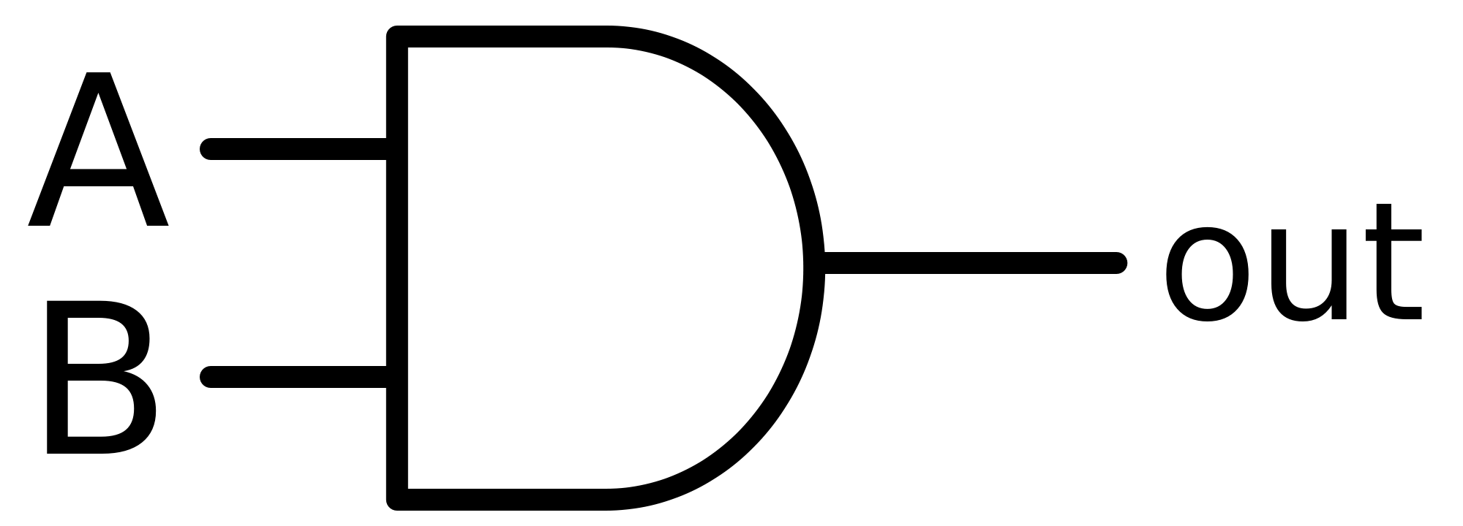
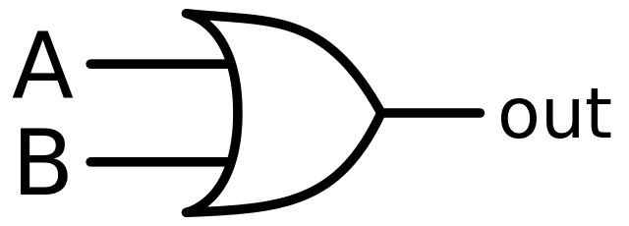
Question 1: Circuit Design
Part a: Truth Table
A_{t} | B_{t} | -> | A_{t+1} | B_{t+1}
1 | 1 |  | 1 | 0
1 | 0 |  | 0 | 1
0 | 1 |  | 0 | 0
0 | 0 |  | 1 | 1
Part b: Boolean Expressions
A_{t+1} = (A_{t} & B_{t}) | (~A_{t} & ~B_{t})
B_{t+1} = ~B_{t}

Slide 12
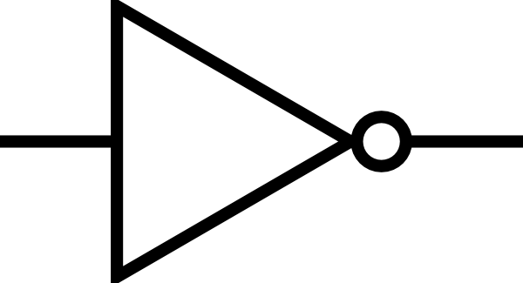
Question 1: Circuit Design
Part a: Truth Table
A_{t} | B_{t} | -> | A_{t+1} | B_{t+1}
1 | 1 |  | 1 | 0
1 | 0 |  | 0 | 1
0 | 1 |  | 0 | 0
0 | 0 |  | 1 | 1
Part b: Boolean Expressions
A_{t+1} = (A_{t} & B_{t}) | (~A_{t} & ~B_{t})
B_{t+1} = ~B_{t}

Slide 13
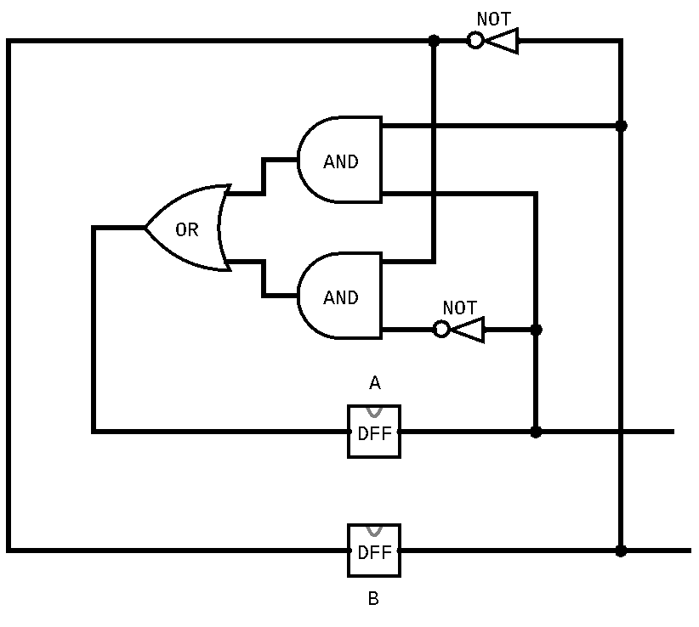
Question 1: Circuit Design
Part a: Truth Table
A_{t} | B_{t} | -> | A_{t+1} | B_{t+1}
1 | 1 |  | 1 | 0
1 | 0 |  | 0 | 1
0 | 1 |  | 0 | 0
0 | 0 |  | 1 | 1
Part b: Boolean Expressions
A_{t+1} = (A_{t} & B_{t}) | (~A_{t} & ~B_{t})
B_{t+1} = ~B_{t}

Slide 14
Question 1: Circuit Design Sample Rubric
Category | Points | Criteria
Truth Table | 4 points | 1 point for each row in the truth table that is correct
Boolean expressions | 6 points | 4 points for correct expression for A_{t+1} 2 points if truth table is wrong but expression matches truth table 2 points for correct expression for B_{t+1} 1 point if truth table is wrong but expression matches truth table
Circuit Diagram | 5 points | 3 points for having circuits that match the boolean expressions in part b 2 points for fully correct diagram
Total | 15 points

Slide 15
Question 2: Math Puzzle
Dana needs 300 pickets for her colorful picket fence. She wants equal amounts of each of her 4 selected colors. She already has 32 red, 26 green, 9 yellow, and no blue. If the pickets cost 25 cents and you get 20% off if you purchase 50 or more of the same color, and 30% off if you purchase 60 or more of one color, how much does Dana need to spend? List your answer to two decimal places. You may use a calculator application on your computer to solve this problem.

Slide 16
Question 2: Math Puzzle
Dana needs 300 pickets for her colorful picket fence. She wants equal amounts of each of her 4 selected colors. She already has 32 red, 26 green, 9 yellow, and no blue. If the pickets cost 25 cents and you get 20% off if you purchase 50 or more of the same color, and 30% off if you purchase 60 or more of one color, how much does Dana need to spend? List your answer to two decimal places. You may use a calculator application on your computer to solve this problem.
Solution
75 - 32 = 43 red
75 - 26 = 49 green
75 - 9 = 66 yellow
75 - 0 = 75 blue
43 * 0.25 + 49 * 0.25 + 0.7 * 66 * 0.25 + 0.7 * 75 * 0.25 = $47.675 = $47.68
(rounding down is fine too)

Slide 17
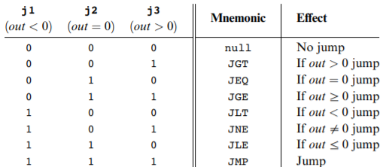
Question 3: Hack Assembly Programming
Our solution:
@R0
D = M
@NEGATIVE
D; JLT
@POSITIVE
D; JGT
// R0 == 0 case
@R1
M = 0
@END
0; JMP
(NEGATIVE)
// R0 < 0 case
@R1
M = -1
@END
0; JMP
(POSITIVE)
// R0 > 0 case
@R1
M = 1
(END)
@END
0; JMP
Write a Hack assembly program that stores -1, 0, or 1 in R1 based on the sign of R0. To be more specific, your program should store a -1 in R1 if R0 is negative, a 0 in R1 if R0 is 0, and a 1 in R1 if R0 is positive.
Equivalent pseudocode:
if(R0 < 0){
R1 = -1;
}elseif(R0 > 0){
R1 = 1;
}else{ //R0 == 0
R1 = 0;
}

Slide 18
Question 3: Hack Assembly Sample Rubric
Category | Points | Criteria
Has Infinite End Loop | 1 point | 1 Point if program has an Infinite End Loop
Conditional Checks | 4 points | 2 points for having at least two checks for cases. Almost all solutions will need a check for 2 of the three cases (negative, zero, positive). 2 points for correctly matching jump condition to cases (e.g. jump to negative case when negative, etc.)
Assigns Correct R1 Value | 3 points | One point for each case: negative: R1 = -1 zero: R1 = 0 positive: R = 1
Fully Correct Implementation | 2 points | Covers any little mistakes that may result in a not quite correct implementation (e.g. forgetting to jump to the end when a case is done).
Total | 10 points

Slide 19
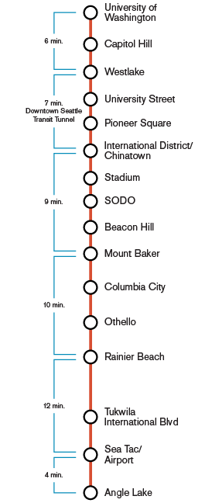
Question 4: Link Light Rail
Name two (2) stations that the Seattle Link Light Rail train stops at.

Slide 20
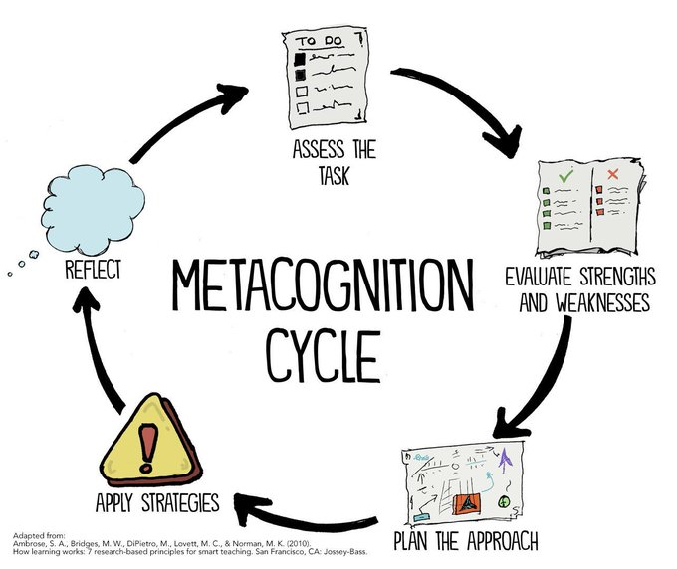
Why are we making you doing this...

Slide 21
Why are we making you doing this...
Self-assessing your current test-taking practices!

Slide 22
Why are we making you doing this...
Self-assessing your current test-taking practices!
What test-taking strategies are you engaging with? What aren’t you?

Slide 23
Why are we making you doing this...
Self-assessing your current test-taking practices!
What test-taking strategies are you engaging with? What aren’t you?
Creating a plan for strengthening your test-taking practices

Slide 24
Why are we making you doing this...
Self-assessing your current test-taking practices!
What test-taking strategies are you engaging with? What aren’t you?
We’ve conveniently done this before your midterm :)
Creating a plan for strengthening your test-taking practices

Slide 25
Why are we making you doing this...
Self-assessing your current test-taking practices!
Post-midterm debrief
What test-taking strategies are you engaging with? What aren’t you?
We’ve conveniently done this before your midterm :)
Creating a plan for strengthening your test-taking practices

Slide 26
Agenda
Mock Exam
Debrief & Test-Taking strategies
Self-Grading Your Mock Exam
Designing Exams 101

Slide 27
How (Some) Instructors Write Exams
And How Knowing This
Can Be Metacognitive Gold

Slide 28
Intended purpose of an exam
Goals:
Assess students’ mastery of the learning objectives
Have grades correlate with level of mastery
Practicalities:
Fit in available time
Reasonably easy to grade (e.g., answers pretty short!)
Complement vs. repeat homework coverage
Similarity or not compared to sample/old exams

Slide 29
Bloom’s Taxonomy (!)
If you study how to do some mechanical drill and the instructor tests the conceptual design, uh-oh!
And vice versa!
So this is tricky… we’re not going to tell you what’s on the exam.
And learning objectives aren’t always explicit.
Best to know the details and the big ideas.

Slide 30
Example: BST insertion
Insert 17 into this BST.
In 1-2 English sentences, what makes a binary tree a binary search tree.
Give all the BSTs that contain exactly the numbers 5, 7, 9, and 25.
Suppose in every node of a binary tree T, the left child is less than the parent and the right child is greater than the parent. Is T definitely a BST? If not, give a counterexample.
Write a Java method that takes a BST and returns the second smallest element. You can assume the input has at least two elements.

Slide 31
Some connection to a learning objective
A question is about some topic or topics in the course
First meta-answer as you take an exam: what topics is it testing?
  The “whole trick” to the question might be answering this, particularly for harder questions
  Or it may be obvious

Slide 32
Range of difficulty
Ideally each question would have the perfect range of natural partial credit available
In practice, often need some easier questions and some harder questions to correlate with mastery
  Don’t lose time on the wrong-difficulty questions
  But requires some guessing to know which is which

Slide 33
Exams are only one form of evaluation
Time-pressured exams are not an objective measure of your learning or your abilities in a subject
  They are one type of evaluation and favor certain learning styles/habits/mental organization
  They are a reflection of the priorities/style/mindset of your instructor and are only one view of the material
  If you don’t do well on an exam, it doesn’t mean you haven’t learned anything or are not as “smart” as your peers.
Unfortunately, many classes in our educational system make frequent use of high-stakes, time-pressured exams
  Our goal in this class is to help you improve your skills related to preparing, taking, and reflecting on these exams

Slide 34
Reminders
Midterm on Thursday
  Consider signing on a few minutes early to get settled
Project 5 due next Thursday (5/13)
  Timed Mock Exam
  Build a Computer!
  Social Computing Reflection II
Course registration is approaching…

