Slide 1
Building a Computer & Exam Preparation
Organization of a Computer, Fetch/Execute Cycle, Hack CPU Design, Exam prep fundamentals
Significant material adapted from www.nand2tetris.org. © Noam Nisan and Shimon Schocken.

Slide 2
Agenda
Cornell Note-Taking Debrief
Exam Preparation
Building a Computer Overview
Reading Review and Q&A
Hack CPU Logic

Slide 3
Project 3 Cornell Note-Taking Debrief
Take a look at your Cornell notes from CSE 390B and from another course that you practiced Cornell note-taking with.
What elements of the cornell note-taking method allowed you to better understand and work on Project 3?
  How are these elements similar/different when comparing this to your other course?
What were barriers that prevented you from fully engaging in the cornell note-taking method (either in this class or another class)?
  What are ways that can help address this?

Slide 4
Agenda
Cornell Note-Taking Debrief
Exam Preparation
Building a Computer Overview
Reading Review and Q&A
Hack CPU Logic

Slide 5

Gearing up for your exams...
Make a Study Plan
  What key topics/concepts with your exam cover?
  How might your study guides look different for specific classes?
  What resources, materials, or people might you need to engage with?
Create a Schedule
  DON’T CRAM
  Office hours, review sessions, study groups
  Reference your weekly time commitments & quarterly calendar
Test Yourself
  Utilize your cornell question notes
  Replicate exam-like environments
Notes:
https://www.when2meet.com/?9068938-jWAX1

Slide 6
Gearing up for your exams...
Make a Study Plan
  What key topics/concepts with your exam cover?
  How might your study guides look different for specific classes?
  What resources, materials, or people might you need to engage with?
Create a Schedule
  DON’T CRAM
  Office hours, review sessions, study groups
  Reference your weekly time commitments & quarterly calendar
Test Yourself
  Utilize your cornell question notes
  Replicate exam-like environments

Slide 7
Project 5: Timed Mock Exam Problem
Schedule a 30-minute session is based on your group members availability do one mock exam problem
Determine how you will get in touch with each other if needed
Determine who will be the zoom host for the session
Email cse390b-staff@cs.washington.edu with your group’s meeting day & time
Notes:
Study groups!
offers accountability
gaining a deeper understanding by articulating your understanding to your peers
able to hear another perspective

Slide 8
Agenda
Cornell Note-Taking Debrief
Exam Preparation
Building a Computer Overview
Reading Review and Q&A
Hack CPU Logic

Slide 9
Building a Computer
All your hardware efforts are about to pay off! In project 5, you will build Computer.hdl -- the final, top-level chip in this course
  For all intents and purposes, a real computer
  Simplified, but organization very similar to your laptop
Later projects we will start writing software to make it useful

Slide 10

Hack CPU
COMPUTER
ROM
(Instructions)
CPU
RAM
(Data)
instr
data out
0
1
2
010111001110
101100010101
111000101111
...
Instructions
0
1
2
100110010111
100011001111
000000000010
...
Data
REGISTERS
data in
addr of next instruction
CONTROL
INPUT
OUTPUT

Slide 11
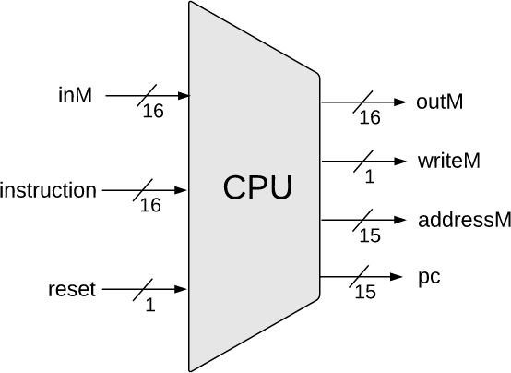
Hack CPU Interface Inputs
Inputs:
  inM: Value coming from memory
  instruction: 16-bit instruction
  reset: if 1, reset the program

Slide 12
Hack CPU Interface Outputs
Outputs:
  outM: value used to update memory if writeM is 1
  writeM: if 1, update value in memory at addressM with outM
  addressM: address to read from or write to in memory
  pc: address of next instruction to be fetched from memory

Slide 13
Basic CPU Loop
Repeat forever:
  Fetch an instruction from the program memory
  Execute that instruction

Slide 14
Fetching
Specify which instruction to read as the address input to our memory
Data output: actual bits of the instruction
MEMORY
Memory Output: Data
Instruction
D=A;JMP
0
1
2
0101110011100110
1011000101010100
1110001011111100
...
Instructions
n
n+1
n+2
1100101010010101
1100100101100111
0011001010101011
...
Data
Memory Input: Address
Instruction Address
PC
1

Slide 15
Executing
The instruction bits describe exactly “what to do”
  A-instruction or C-instruction? Which operation for the ALU? What memory address to read? To write? If / where to jump after this instruction?
Executing the instruction involves data of some kind.
  Accessing registers
and/or
  Accessing memory

Slide 16
Combining Fetch & Execute
MEMORY
Memory Output: Data
Instruction
D=A;JMP
0
1
2
0101110011100110
1011000101010100
1110001011111100
...
Instructions
Data
245
n
n+1
n+2
1100101010010101
1100100101100111
0011001010101011
...
Data
Memory Input: Address
Instruction Address
PC
1
Data Address (from instruction or register)

Slide 17
Combining Fetch & Execute
MEMORY
Memory Output: Data
Instruction
D=A;JMP
0
1
2
0101110011100110
1011000101010100
1110001011111100
...
Instructions
Data
245
n
n+1
n+2
1100101010010101
1100100101100111
0011001010101011
...
Data
Memory Input: Address
Instruction Address
PC
1
Data Address (from instruction or register)
Could we implement with RAM16K.hdl?
Notes:
Q: Could we implement with RAM16K.hdl?

Slide 18
Combining Fetch & Execute
MEMORY
Memory Output: Data
Instruction
D=A;JMP
0
1
2
0101110011100110
1011000101010100
1110001011111100
...
Instructions
Data
245
n
n+1
n+2
1100101010010101
1100100101100111
0011001010101011
...
Data
Memory Input: Address
Instruction Address
PC
1
Data Address (from instruction or register)
Could we implement with RAM16K.hdl?
  No! Our memory chips only have one input and one output!

Slide 19


Solution 1: Handling Single Input/Output
MEMORY
Instruction, when fetching
Memory Output: Data
0
1
2
0101110011100110
1011000101010100
1110001011111100
...
Instructions
Data, when executing
n
n+1
n+2
1100101010010101
1100100101100111
0011001010101011
...
Data
Memory Input: Address
Instruction Address
Data Address
Fetching vs. Executing
Can use multiplexing to share single input/output!
Notes:
Q: Is this all we need to enable two different phases? What happens to the instruction when we’re accessing data?

Slide 20

Solution 1: Fetching/Executing Separately
Fetching vs. Executing
MEMORY
Instruction, when fetching
Memory Output: Data
0
1
2
0101110011100110
1011000101010100
1110001011111100
...
Instructions
Data, when executing
n
n+1
n+2
1100101010010101
1100100101100111
0011001010101011
...
Data
Memory Input: Address
Instruction Address
Data Address
Fetching vs. Executing
Need to store fetched instruction so it’s available during execution phase.

Slide 21
Solution 2: Separate Memory Units
Separate instruction memory and data memory into two different chips
  Each can be independently addressed, read from, written to
This is what we will do in Project 5!
  See Chapter 5 for more detail on design
Pros:
  Simpler to implement
Cons:
  Fixed size of each partition, rather than flexible storage
  Two chips → redundant circuitry

Slide 22
Agenda
Cornell Note-Taking Debrief
Exam Preparation
Building a Computer Overview
Reading Review and Q&A
Hack CPU Logic

Slide 23
Hack CPU Implementation
Need to be able to provide the functionality our assembly language specifies
A-instructions
  Need to be able to load values into the A-Register
C-instructions
  Need to perform different computations w/varying inputs
  Need to be able to store the results in different destinations
Flow Control
  Need to keep track of our current instruction address and know what address to execute next

Slide 24
Hack CPU Implementation
Only 4 main components needed!
  ALU
  PC
  Registers (x2) for A and D
    For testing & debugging reasons, you’ll use built-in ARegister.hdl and DRegister.hdl instead.
Tricky Part: All the control logic
  We’ll recommend an overall flow of data
  Your task: to design and implement proper control logic

Slide 25
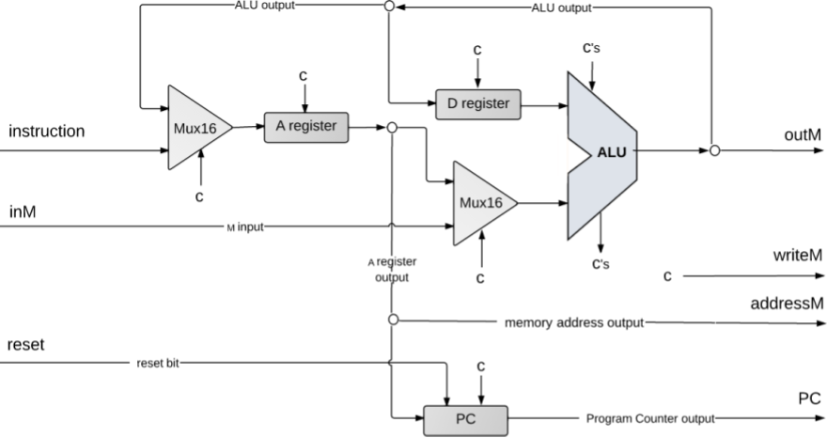
Hack CPU Design

Slide 26
A-Instruction Design
Need to load value of instruction into the A-register
  Corresponds to our @value syntax
Possible solution: setup A-register w/instruction as input
  Problem: sometimes need to store a computation result in the A-register (e.g. A = D + 1)
Solution: use a mux to choose either the instruction value or the previous ALU output as the A-register input
  Still need logic to determine if the A-regiseter should be loaded

Slide 27
Hack CPU Design: A-instructions

Slide 28
C-Instruction Design: Inputs
Need inputs from the A, D, and M registers
  Never need to use the A register and M register in a computation together!
One ALU input will always be the D register
The other will either be the A register or the M register
  inM is the input w/the M register value
  Can use a Mux to make this choice!
Remember constants are generated by the ALU internally

Slide 29
C-Instruction Design: Computations
ALU performs the computations
Now that we have our inputs, just need to specify the correct computation for the ALU to execute
You’ll note the computation bits in the instruction binary are very similar to the control inputs to the ALU

Slide 30
C-Instruction Design: Destinations
Can store computations in three destinations: the A, D, or M registers
  Loop ALU output back to the A and D registers
  outM, writeM, and addressM used to write to the M register
Even though our ALU output is connected to these locations, we don’t always want to update them
  Control logic will specify when we want to write to these locations

Slide 31
Hack CPU Design: C-instructions

Slide 32
Flow Control Design: Flow Control
Use the Program Counter chip to keep track of the current instruction address
Input will be from the A-register
  When we jump to an address in assembly, we jump to the address specified in the A-register
Load (jump) or increment determined by the output from our ALU
  More specifically can use the status flags to determine if the output is < 0, == 0, or > 0

Slide 33
Hack CPU Design: Flow Control

Slide 34
Agenda
Cornell Note-Taking Debrief
Exam Preparation
Building a Computer Overview
Reading Review and Q&A
Hack CPU Logic

Slide 35
Hack CPU Logic
How do we determine the unimplemented logic for the CPU (all of the c’s in the diagrams)?
Need to refer to the assembly specification!
Project 5 will require a good bit of consulting of Chapter 4 to figure out how to use the instruction bits to implement the control logic

Slide 36
Hack CPU Logic Workflow
Step 1: Figure out what to pay attention to
  Usually will be some combination of instruction bits and/or intermediate outputs
  These are the “inputs” to your sub-problem
Step 2: determine logic for the part you are working on
  Uses the “inputs” from step 1
  Usually requires reading a relevant section of the textbook/assembly specification

Slide 37
Instruction Bits: A-instruction
16 bits: 0 v v v v v v v v v v v v v v v
Most significant bit is a 0 (indicates an A-instruction)
Rest of the bits are the value to be loaded
  Since most significant bit is 0, entire A-instruction is also the value to be loaded

Slide 38
Instruction Bits: C-instruction
16 bits: 1 1 1 a c1 c2 c3 c4 c5 c6 d1 d2 d3 j1 j2 j3
Most significant bit is a 1 (indicates a C-instruction)
Next two most significant bits aren’t used (always 1)
a-bit and c-bits are related to computations
d-bits are related to destination locations
j-bits are related to jumping

Slide 39
Hack CPU Logic Example: writeM
Example: determining when writeM should be set to 1
Step 1: figure out what to pay attention to
  writeM is related to where we store the output, or what destination we use
  We need to look up the destination bits specification from Chapter 4!

Slide 40
Hack CPU Logic Example: writeM
Example: determining when writeM should be set to 1
Step 2: determine logic for specification
  Read the “Destination Specification” section of Chapter 4
  d3 determines if the output should be written to memory
  Which bit of our instruction is that???
  Instruction bits:
1 1 1 a c1 c2 c3 c4 c5 c6 d1 d2 d3 j1 j2 j3
  So writeM = instruction[3]?

Slide 41
Hack CPU Logic Example: writeM
Example: determining when writeM should be set to 1
Not so fast…
  What happens if it’s an A-instruction?
  We only write to destinations in the case of a C-instruction
  So writeM = C-instruction & instruction[3]
  Remember that certain actions only occur on certain instruction types, you may have to include a check for instruction type in your logic depending on the action!

Slide 42
Hack CPU Implementation: Logic sub-chips
We provide you with 3 sub-chips and tests that implement the control logic for the A Register, D Register, and PC
  LoadAReg contains logic for loading the A Register
  LoadDReg contains logic for loading the D Register
  JumpLogic contains logic for determining if the PC should load/jump or increment
Implement/test these first, then use them in your CPU implementation!
  Intended to help you narrow the scope of any bugs you may have

Slide 43
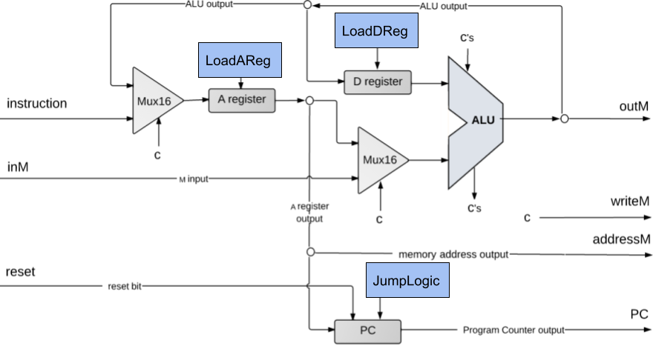
Hack CPU Implementation: Logic sub-chips

Slide 44
Hack CPU Implementation: Logic sub-chips
No in-class work today :(
Thursday we will give you time to implement at least one of the Logic sub-chips

Slide 45
Reminders
Office Hours
  Eric & Margot’s office hours happening right after class!
Project 4:
  Due Thursday 11:59PM PDT
CSE 390B Midterm
  Thursday May 6th

