Slide 1
Exam Problem Review & Project 5
Exam Review Session, Project 5 demo, CPU Logic
Significant material adapted from www.nand2tetris.org. © Noam Nisan and Shimon Schocken.

Slide 2
CSE 390B Midterm Brainstorm
Based on what we’ve covered thus far in class, what are topics, concepts, questions that you might expect to show-up on next week’s midterm?

Slide 3
Agenda
390B Exam Review Session
Project 5 Overview
CPU Logic Review and Practice

Slide 4
Agenda
390B Exam Review Session
Project 5 Overview
CPU Logic Review and Practice

Slide 5
CSE 390B Review Session

Slide 6
Review Session Activity
In breakouts work through three potential exam problems, spending ~12-15min per problem
Problem #1: Circuit Design
Problem #2: Writing Hack Assembly Programs
Problem #3: Tracing Hack Assembly Programs
For each problem:
You will spend 5 min working on the problem individually
You will then check in with each other and see if anyone has questions or is having difficulty getting started
You will spend 3-4 min more working on the problem, either together or individually
You will then create a list of strategies/tips for that problem type (edit the slide corresponding to the current question)

Slide 7
Problem #1: Circuit Design
Tips for working through these types of problems (how to approach them, things to remember, ways to get partial credit, etc.)

Slide 8
Problem #2: Writing Hack Assembly
Tips for working through these types of problems (how to approach them, things to remember, ways to get partial credit, etc.)

Slide 9
Problem #3: Tracing Hack Assembly
Tips for working through these types of problems (how to approach them, things to remember, ways to get partial credit, etc.)

Slide 10
What now?
Based on your experience with this exercise, how does it inform how you approach your studying?
Identify one exam problem type/concept that you want to prioritize in your studying
What resources can you utilize to help you deepen your understanding?

Slide 11
Previous CSE 390B Midterms
We have two old midterms from previous quarters
Spring 2020 is likely more difficult than the midterm this quarter
Winter 2021 is more similar to what this quarter’s midterm will look like
We recommend you use Spring 2020’s midterm to become familiar with problem types and gauge what you need to study and practice more
We recommend you use Winter 2021’s midterm as a chance to practice taking a timed exam
Set a timer for 50 min and fully take the exam
Will help you practice time management

Slide 12
Agenda
390B Exam Review Session
Project 5 Overview
CPU Logic Review and Practice

Slide 13
Project 5: Overview
Timed Mock Exam Problem
Build a Computer!
LoadAReg.hdl, LoadDReg.hdl -- Easier
JumpLogic.hdl -- Mediumish
CPU.hdl -- Quite Hard
Computer.hdl -- Easier
Social Computing Reflection II and Annotation
New prompts, plus using at least three annotation strategies while reading your article
Project 5 is due in two weeks. Don’t delay in getting started!
Note: Project 3 grades have been released. We encourage you all to review the feedback that was given

Slide 14
Project 5: Timed Mock Exam Problem
Your group will meet for a 30-min session to do one mock exam problem
Your group’s mock exam problem will be emailed right before your session
Your 30-min session will include:
Set-Up: 5 minutes
Mock Exam Problem: 10 minutes
Debrief & Reflection: 15 minutes
Complete and submit the reflection questions
Notes:
Study groups!
offers accountability
gaining a deeper understanding by articulating your understanding to your peers
able to hear another perspective

Slide 15
Project 5 Tips
CPU.hdl: we provide an overview diagram, but there are plenty of details to fill in (especially for control)!
Very interconnected → tough to split up
Instead, crucial to draw your own detailed diagram first!
Handling jumps will require a lot of logic; make sure to sketch out all possible cases
Chapter 4 and 5 are going to be extremely useful!!!
Multi-Bit Buses: we typically write MSB to the left and LSB to the right: 15 14 13 12 11 10 … 3 2 1 0
Important to keep in mind when taking apart the instruction!
Debugging: when something goes wrong, consult .out and .cmp files. Then, look at internal wires in simulator
See also the “Debugging tips” section of the spec

Slide 16
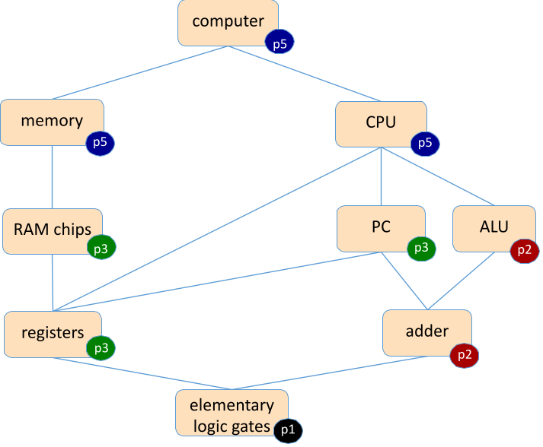
How Far You’ve Come!

Slide 17
Agenda
Approaching Exam Review Sessions
390B Exam Review Session
Project 5 Overview
CPU Logic Review and Practice

Slide 18
Hack CPU Logic
How do we determine the unimplemented logic for the CPU (all of the c’s in the diagrams)?
Need to refer to the assembly specification!
Project 5 will require a good bit of consulting of Chapter 4 to figure out how to use the instruction bits to implement the control logic

Slide 19
Hack CPU Logic Workflow
Step 1: Figure out what to pay attention to
Usually will be some combination of instruction bits and/or intermediate outputs
These are the “inputs” to your sub-problem
Step 2: determine logic for the part you are working on
Uses the “inputs” from step 1
Usually requires reading a relevant section of the textbook/assembly specification

Slide 20
Instruction Bits: A-instruction
16 bits: 0 v v v v v v v v v v v v v v v
Most significant bit is a 0 (indicates an A-instruction)
Rest of the bits are the value to be loaded
Since most significant bit is 0, entire A-instruction is also the value to be loaded

Slide 21
Instruction Bits: C-instruction
16 bits: 1 1 1 a c1 c2 c3 c4 c5 c6 d1 d2 d3 j1 j2 j3
Most significant bit is a 1 (indicates a C-instruction)
Next two most significant bits aren’t used (always 1)
a-bit and c-bits are related to computations
d-bits are related to destination locations
j-bits are related to jumping

Slide 22
Hack CPU Logic Example: writeM
Example: determining when writeM should be set to 1
Step 1: figure out what to pay attention to
writeM is related to where we store the output, or what destination we use
We need to look up the destination bits specification from Chapter 4!

Slide 23
Hack CPU Logic Example: writeM
Example: determining when writeM should be set to 1
Step 2: determine logic for specification
Read the “Destination Specification” section of Chapter 4
d3 determines if the output should be written to memory
Which bit of our instruction is that???
Instruction bits:
1 1 1 a c1 c2 c3 c4 c5 c6 d1 d2 d3 j1 j2 j3
So writeM = instruction[3]?

Slide 24
Hack CPU Logic Example: writeM
Example: determining when writeM should be set to 1
Not so fast…
What happens if it’s an A-instruction?
We only write to destinations in the case of a C-instruction
So writeM = C-instruction & instruction[3]
Remember that certain actions only occur on certain instruction types, you may have to include a check for instruction type in your logic depending on the action!

Slide 25
Hack CPU Implementation: Logic sub-chips
We provide you with 3 sub-chips and tests that implement the control logic for the A Register, D Register, and PC
LoadAReg contains logic for loading the A Register
LoadDReg contains logic for loading the D Register
JumpLogic contains logic for determining if the PC should load/jump or increment
Implement/test these first, then use them in your CPU implementation!
Intended to help you narrow the scope of any bugs you may have

Slide 26
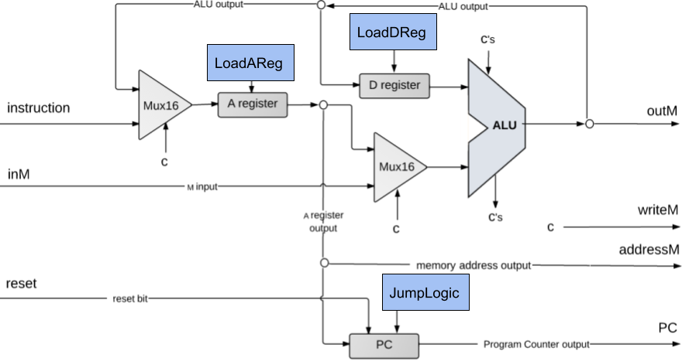
Hack CPU Implementation: Logic sub-chips

Slide 27
Hack CPU: LoadAReg and LoadDReg
Now we will give you some time to work on LoadDReg and LoadAReg in groups
Will require you to run “git pull” to retrieve the starter code
We recommend starting with LoadDReg
Use lecture examples and ask questions if you don’t know where to begin!
Working together might be nice because you can all share when you’ve potentially found relevant information

Slide 28
Wrapping Up
What’s in store for Week 6?
Test-Taking Strategies via a mock exam
Midterm on Thursday, May 6th
Reminders
Project 3 Grades Released on Gradescope
Project 4 Due Tonight 11:59PM PDT

Slide 29
Approaching Review Sessions
PREPARATION
Reviewing exam review guides / past exams
Reviewing lecture notes and past homework assignments
Doing sample exam questions
What remains unclear / confusing that your review session could help clarify?

Slide 30
Approaching Review Sessions
PREPARATION
Reviewing exam review guides / past exams
Reviewing lecture notes and past homework assignments
Doing sample exam questions
What remains unclear / confusing that your review session could help clarify?
GENERATING QUESTIONS
Asking questions that help you understand the significance of a particular topic/concept
Asking for examples that help you see a concept applied in a new way
Writing your questions down ahead of time or as you think of them can be helpful to reference during the review session

Slide 31
Approaching Review Sessions
PREPARATION
Reviewing exam review guides / past exams
Reviewing lecture notes and past homework assignments
Doing sample exam questions
What remains unclear / confusing that your review session could help clarify?
GENERATING QUESTIONS
Asking questions that help you understand the significance of a particular topic/concept
Asking for examples that help you see a concept applied in a new way
Writing your questions down ahead of time or as you think of them can be helpful to reference during the review session
ACTIVE PARTICIPATION
Going through the process of writing down notes, example questions and if given the space to solve, solve them!
Mark the questions that you were able to get answered within the review session. Identify what’s left
Bloom’s taxonomy! Active participation can engage the higher levels of learning.

