Slide 1
Machine Languages & Annotation
Annotation Strategies, Machine Language Considerations, Hack Assembly Language & Project 4 Tools Practice
Significant material adapted from www.nand2tetris.org. © Noam Nisan and Shimon Schocken.

Slide 2
Agenda
Check-In Survey
24-Hour Time Audit Debrief
Annotation Strategies
Reading Review and Q&A
Hack Assembly Language

Slide 3
Agenda
Check-In Survey
24-Hour Time Audit Debrief
Annotation Strategies
Reading Review and Q&A
Hack Assembly Language

Slide 4
Check-in survey related to how the lecture readings and time spent in lecture is going
Specifically for the technical portions of lecture
Completely anonymous!!!
It may ask you to log in but it won’t record your info
A few multiple choice questions and an open-feedback section at the end

Slide 5
Agenda
Check-In Survey
24-Hour Time Audit Debrief
Annotation Strategies
Reading Review and Q&A
Hack Assembly Language

Slide 6
24-Hour Time Audit Debrief
What was the most surprising to you about your day?
# of hours you spent sleeping…
# of hours you spend sitting…
What is one thing that you want to change in how you spend your time? How will you implement this change?

Slide 7
Agenda
Check-In Survey
24-Hour Time Audit Debrief
Annotation Strategies
Reading Review and Q&A
Hack Assembly Language

Slide 8

Annotating Your Texts
WHY DO WE CARE?!
WHAT Intentionality of interacting with a text to enhance the reader's understanding of, recall of, and reaction to the text

Slide 9
Annotating Your Texts
WHY DO WE CARE?!
WHAT Intentionality of interacting with a text to enhance the reader's understanding of, recall of, and reaction to the text
HOW
Highlighting, underlining or using [brackets] to note key points or ideas

Slide 10
Annotating Your Texts
WHY DO WE CARE?!
WHAT Intentionality of interacting with a text to enhance the reader's understanding of, recall of, and reaction to the text
HOW
Highlighting, underlining or using [brackets] to note key points or ideas
Circling unfamiliar words or confusing parts of the text

Slide 11
Annotating Your Texts
WHY DO WE CARE?!
WHAT Intentionality of interacting with a text to enhance the reader's understanding of, recall of, and reaction to the text
HOW
Highlighting, underlining or using [brackets] to note key points or ideas
Circling unfamiliar words or confusing parts of the text
Paraphrasing or summarizing passages/chapters/sections

Slide 12

Annotating Your Texts
WHY DO WE CARE?!
WHAT Intentionality of interacting with a text to enhance the reader's understanding of, recall of, and reaction to the text
HOW
Highlighting, underlining or using [brackets] to note key points or ideas
Circling unfamiliar words or confusing parts of the text
Paraphrasing or summarizing passages or chapters
Commenting or reacting to the text

Slide 13
Agenda
Check-In Survey
24-Hour Time Audit Debrief
Annotation Strategies
Reading Review and Q&A
Hack Assembly Language

Slide 14

Revisiting: The Von Neumann Architecture
COMPUTER
MEMORY
CPU
PROGRAM
INPUT
OUTPUT
DATA
REGISTERS
CONTROL
(This picture will get more detailed as we go!)

Slide 15
Machine Code
Instructions are stored in memory, so they have to be able to be encoded in binary
When we refer to machine code we typically are talking about this binary representation of code
Each instruction ends up being a sequence of 1s and 0s, our computer/hardware specification is what gives meaning to each part of this sequence
Is this an add or subtract instruction, what are the inputs, etc.
More on this later!

Slide 16
Storing the Program
COMPUTER
MEMORY
CPU
0
1
2
0101110011100110
1011000101010100
1110001011111100
...
Instructions
INPUT
OUTPUT
n
n+1
n+2
1100101010010101
1100100101100111
0011001010101011
...
Data
REGISTERS
CONTROL
(This picture will get more detailed as we go!)

Slide 17
Assembly Languages
Writing code as a bunch of 1s and 0s seems tedious and error prone right?
Assembly languages are a more human readable format of the binary instructions your CPU runs
Developed to help humans write programs!
Each human-readable assembly instruction has a corresponding binary machine code instruction
addq reg1, reg2 == 1011000101010100
Often assembly is used as an intermediary between a high level language (e.g. Java) and machine code

Slide 18
Producing Machine Code
while (i < 100) {
sum += arr[i];
i++;
}
Java
Compile
MEM
CPU
0101110011100110
1011000101010100
1110001011111100
...
Machine Code Instructions
PROGRAM
Compile
DATA
Load & Execute
REGISTERS
CONTROL
movq $5, %rdx
addq %rsx, %rdx
movq %rdx, %rax
ret
Assembly Language
Assemble

Slide 19
Machine Language
Specification of the Hardware/Software interface
What operations are supported?
What do they operate on?
How is the program controlled?
Usually in close correspondence with the hardware architecture
Different specification for different hardware platforms!
Cost/Performance Tradeoffs
Silicon area/complexity
Time to complete instruction
Power consumption

Slide 20
Machine Operations
Correspond to the operations supported by hardware:
Arithmetic (+, -)
Logical (And, Or)
Flow Control (“goto instruction n”, “if (condition) then goto instruction n”)
Differences between machine languages:
Instruction set richness (e.g. division? bulk copy?)
Data types (e.g. word size, floating point)

Slide 21
Registers
CPU
CPU typically has a small number of registers
Very efficient to access
Used for intermediate, short-term “scratch work”
Number and use of registers is a central part of any machine language
REGISTERS
rsp
0101110011100110
reg2
0101110011100110
D
0101110011100110
CONTROL

Slide 22
Addressing Modes
reg1, reg2 are the names of registers
Memory[N] means “access the giant array that is memory, at index N”
A fancy way of saying what locations can I specify in my assembly code?
Some useful options:
Register
add reg1, reg2
Direct Memory Access
add reg1, Memory[200]
Indirect Memory Access
add reg1, Memory[reg2]
Immediate
add 100, reg2

Slide 23
Flow Control
COMPUTER
Which instruction should execute next?
MEMORY
CPU
0
1..
2
0101110011100110
1011000101010100
1110001011111100
...
Instructions
INPUT
OUTPUT
n
n+1
n+2
1100101010010101
1100100101100111
0011001010101011
...
Data
REGISTERS
CONTROL
PC
1

Slide 24
Flow Control
Usually the CPU just executes machine instructions in a sequence
Typically moves to the instruction with the next highest address
Sometimes we want to “jump” to another location no matter what
E.g. at the end of an infinite loop!
High Level Code (similar to Java) | Assembly Code
while (true) { reg1++; <more loop body> } <code after loop> | TOP: add 1, reg1 <more loop body> jmp TOP <code after loop>

Slide 25
Flow Control
Usually the CPU just executes machine instructions in a sequence
Typically moves to the instruction with the next highest address
Sometimes we want to “jump” only if a condition is met
E.g. to implement an if statement!
We will focus more on this on Thursday!
High Level Code (similar to Java) | Assembly Code
if (reg1 < reg2) { reg1++; } reg2++; | cmp reg1, reg2 jge SKIP add 1, reg1 SKIP: add 1, reg2

Slide 26
Reading Q&A

Slide 27
Agenda
Check-In Survey
24-Hour Time Audit Debrief
Annotation Strategies
Reading Review and Q&A
Hack Assembly Language

Slide 28
The Hack Computer
The hardware you will build!
16-bit word size
ROM: sequence of instructions
ROM[0], ROM[1]...
RAM: sequence of data
RAM[0], RAM[1]...
COMPUTER
MEMORY
CPU
ROM
(16-bit Instructions, Read-Only)
1110001011111100
REGISTERS
RAM
(16-bit Data, Read/Write)
1100101010010101
A/M
D
SCREEN
CONTROL
KEYBOARD
PC

Slide 29
The Hack Machine Language
2 types of instructions (16-bit)
A-instructions load data
C-instructions do computations
Program: sequence of instructions
COMPUTER
MEMORY
CPU
ROM
(16-bit Instructions, Read-Only)
1110001011111100
REGISTERS
RAM
(16-bit Data, Read/Write)
1100101010010101
A/M
D
SCREEN
CONTROL
KEYBOARD
PC

Slide 30
Hack: Control Flow
Startup
Hack instructions loaded into ROM
Reset signal initializes computer state (instruction 0)
Execution
Usually, advance to next instruction each cycle
On jump instruction, write a different address into the PC
0
1
2
3
4
5
6
7
...
0101110011100110
1011000101010100
1110001011111100
0101110101101110
0001011000111010
0010111011011001
0110111110101001
0001110010110110
ROM (Instructions)

Slide 31
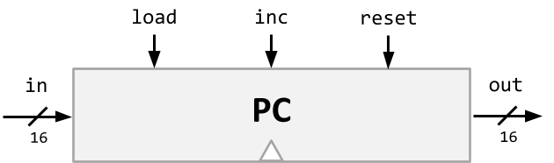
Program Counter
Keeps track of what instruction we’re executing
If it outputs 24, on the next clock cycle the computer runs the instruction at address 24 in the code segment
Program counter interface:
if (reset[t] == 1) out[t+1] = 0 // restart!
else if (load[t] == 1) out[t+1] = in[t] // jump!
else if (inc[t] == 1) out[t+1] = out[t] + 1 // next!
else out[t+1] = out[t]
Notes:
instruction and memory chips are separate (not on actual computer)
in: 16-bit address to load if load is selected
load: if 1, use in as the current address for the next cycle
inc: if 1, add 1 to the current address for the next cycle
reset: if 1, set the current address to 0 for the next cycle
out: address of instruction to execute next

Slide 32
Hack: Registers
D Register: For storing data
A Register: For storing data AND addressing memory
M “Register”: The 16-bit word of memory currently being
referenced by the address in A
RAM
1100101010010101
...
106
107
108
109
110
...
REGISTERS
M
A
108
D

Slide 33
Hack: A-Instructions
Syntax:
value can either be:
non-negative decimal constant
symbol referring to a constant
Semantics:
Stores value in the A register
@value

Slide 34
Hack: A-Instructions
Symbolic Syntax:
Binary Syntax:
@value
0000000000010101
Simply loads a value into the A register
Family:
A-Instruction
Value:
Binary encoding of 21
Example:
A Register
D Register
...
@21
...
0
0
A Register
D Register
21
0
Notes:
Family, value literally appears
Not important to know binary

Slide 35
Hack: Symbols
Symbols are simply an alias for some address
ONLY in the symbolic code -- don’t turn into a binary instruction
Instead, the Assembler converts any use of that symbol to its value
Example:
LOOP = 02
00
01
02
03
04
@3
D=0
(LOOP)
@21
D=1
@LOOP
...
00
01
02
03
04
0000000000000011
1110101010010000
0000000000010101
1110111111010000
0000000000000010
...
Assemble
Notes:
Exactly the same as writing @2, as far as binary code is concerned!

Slide 36
Hack: Built-In Symbols
Using ( ) defines a symbol in ROM/Instructions
Assembler knows a few built-in symbols in RAM/Data
R0, R1, ... R15: Correspond to addresses at the very beginning of RAM (0, 1, … 15)
“Virtual registers”, Useful to store variables
SCREEN, KBD: Base of I/O Memory Maps
Example:
A Register
D Register
...
@R3
...
0
0
A Register
D Register
3
0
Notes:
Also can create symbols in RAM (read book for more)

Slide 37
Hack: C-Instructions
Syntax: (dest or jump is optional)
dest is a combination of destination registers:
comp is a computation:
jump is an unconditional or conditional jump:
Semantics:
Computes value of comp
Stores results in dest (if specified)
If jump is specified and condition is true (by testing comp result), jump to instruction ROM[A]
dest = comp ; jump
M, D, MD, A, AM, AD, AMD
0, 1, -1, D, A, !D, !A, -D, -A, D+1, A+1, D-1, A-1, D+A, D-A, A-D, D&A, D|A M, !M, -M, M+1, M-1, D+M, D-M, M-D, D&M, D|M
JGT, JEQ, JGE, JLT, JNE, JLE, JMP

Slide 38
Hack: C-Instructions
Symbolic:
dest = comp ; jump
Binary:
1 1 1 a c1 c2 c3 c4 c5 c6 d1 d2 d3 j1 j2 j3
Family:
C-Instruction
unused
Comp:
ALU Operation (a bit chooses between A and M)
Dest:
Where to store result
Jump:
Condition for jumping

Slide 39
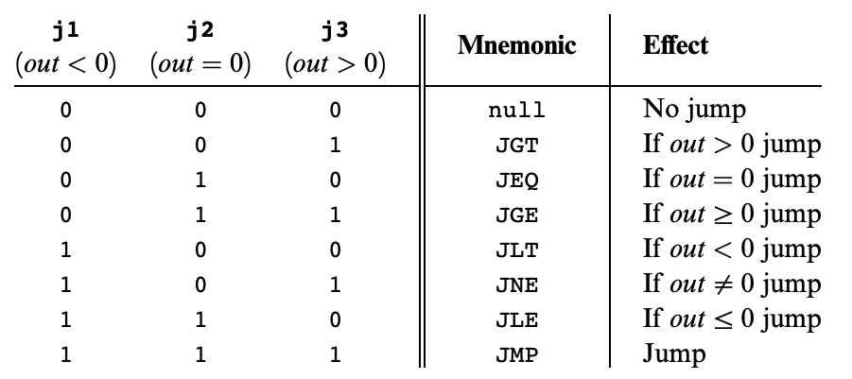
Hack: C-Instructions
Symbolic:
dest = comp ; jump
Binary:
1 1 1 a c1 c2 c3 c4 c5 c6 d1 d2 d3 j1 j2 j3
Jump:
Condition for jumping
Chapter 4

Slide 40
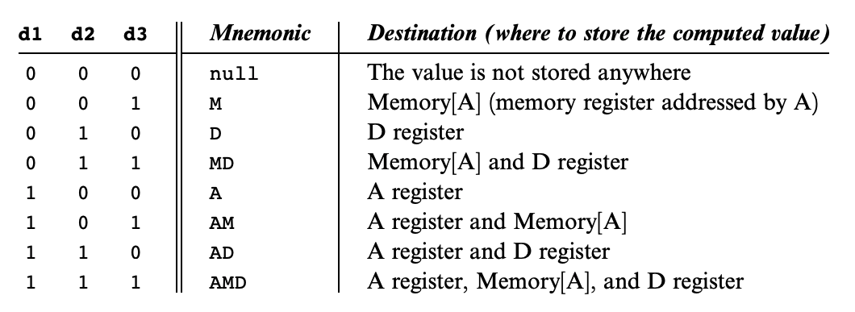
Hack: C-Instructions
Symbolic:
dest = comp ; jump
Binary:
1 1 1 a c1 c2 c3 c4 c5 c6 d1 d2 d3 j1 j2 j3
Dest:
Where to store result
Chapter 4

Slide 41
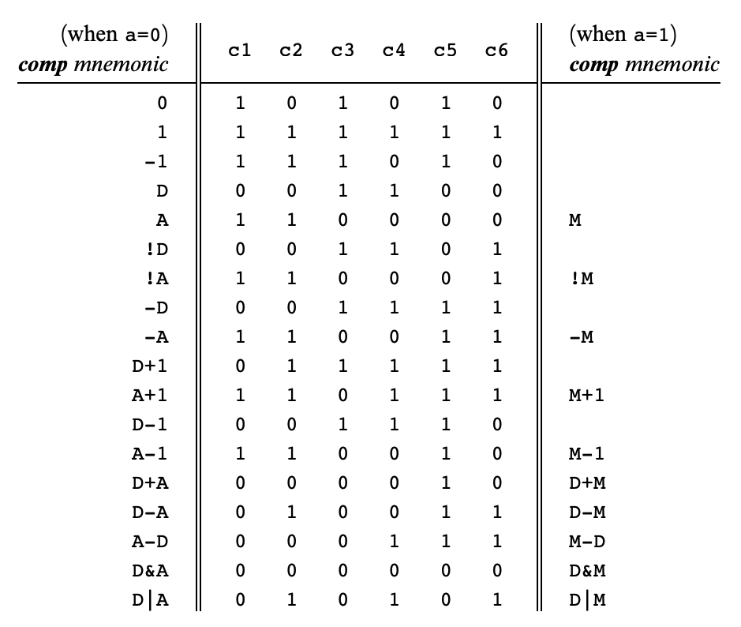
Hack: C-Instructions
Symbolic:
dest = comp ; jump
Binary:
1 1 1 a c1 c2 c3 c4 c5 c6 d1 d2 d3 j1 j2 j3
Comp:
ALU Operation (a bit chooses between A and M)
Chapter 4
Important: just pattern matching text!
Can’t do “1+M”

Slide 42
Hack: C-Instructions
Example:
A Register
D Register
55
56
00
01
(EXAMPLE)
@55
D=A+1
Notes:
do math, store result

Slide 43
Hack: C-Instructions
Example:
A Register
D Register
55
56
00
01
02
03
(EXAMPLE)
@55
D=A+1
@R2
M=D
RAM
0
?
A Register
D Register
1
?
2
56
2
56
...
Notes:
writing to memory at this address, affects RAM[2]

Slide 44
Hack: C-Instructions
Example:
A Register
D Register
55
56
00
01
02
03
04
05
(EXAMPLE)
@55
D=A+1
@R2
M=D
@EXAMPLE
D;JGT
RAM
0
?
A Register
D Register
1
?
2
56
2
56
...
A Register
D Register
0
56
(will jump to instruction 0, since D > 0)
Notes:
loads EXAMPLE (0) into A, JGT says jump if greater than

Slide 45
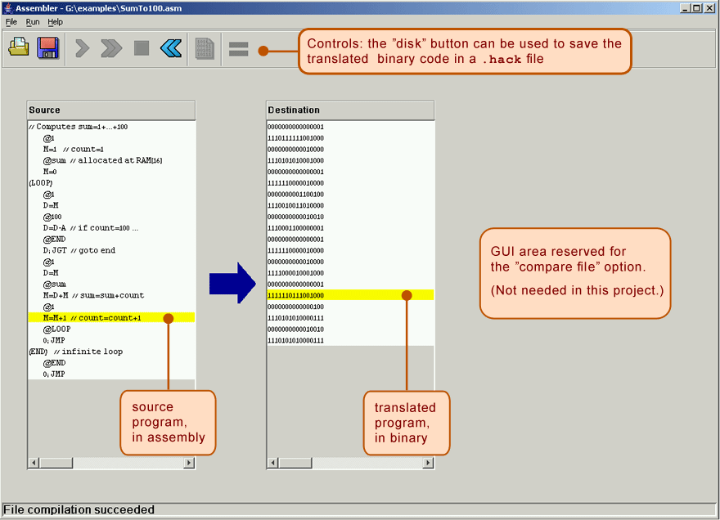
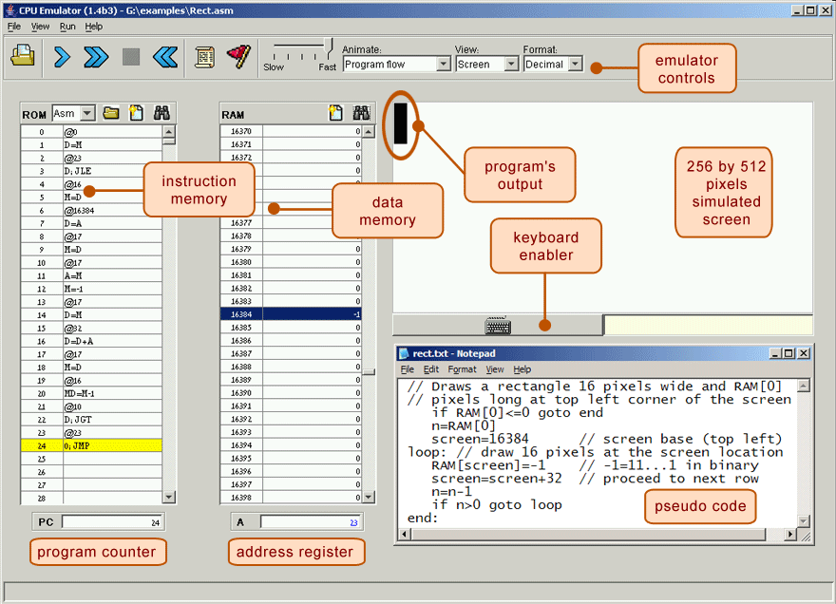
Project 4: Tools
Running a Test Script (recommended flow):
The test scripts use the .hack files directly! Don’t let your .asm and .hack get out of sync!
Max.asm
Max.hack
Assembler
CPUEmulator
Quickly Iterating or Experimenting:
Max.asm
CPUEmulator
Can still “run” the program, even without a script

Slide 46
Tools Exercise: Run SimpleAdd.tst
In gitlab, a projects/lecture/ folder was added with a SimpleAdd example
Open up the assembly file SimpleAdd.asm. What does this program do?
Assemble SimpleAdd.asm using the Assembler to produce SimpleAdd.hack
Run SimpleAdd.tst using the CPUEmulator and verify there are no errors

Slide 47
Reminders
Office Hours
Eric & Margot’s office hours happening right after class!
Project 3: Memory & Cornell Note-Taking
Due Thursday 11:59PM PDT
Reminder of Project 3 Resources..

Slide 48
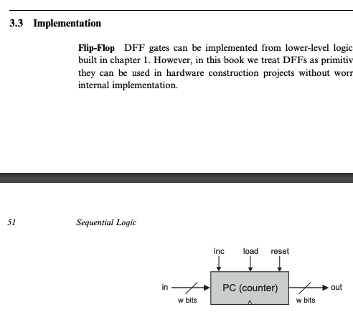
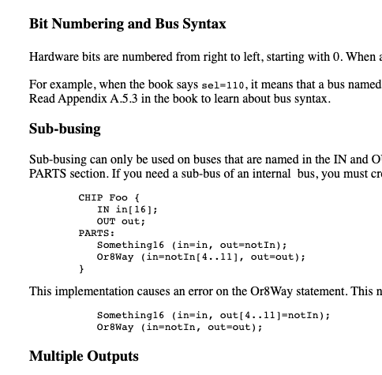
Reminder: Project 3 Resources
Take advantage of hints in project 3 readings
Chapter 3 HDL Survival Guide
Reach out to your classmates and course staff
Post on discussion board: https://us.edstem.org
Come to office hours!

