Slide 1
Cornell Notes Review & Memory
Building memory and revisiting cornell note-taking
Significant material adapted from www.nand2tetris.org. © Noam Nisan and Shimon Schocken.

Slide 2
Agenda
Cornell Note-Taking Review
Building a Bit
DFF Example Review
Building a bit exercise
Building Memory
Reading Review and Q&A
Building memory: Bit to RAM
Program Counter
Project 3 Overview

Slide 3
Agenda
Cornell Note-Taking Review
Building a Bit
DFF Example Review
Building a bit exercise
Building Memory
Reading Review and Q&A
Building memory: Bit to RAM
Program Counter
Project 3 Overview

Slide 4
Breakouts: Cornell Note-Taking Discussion
In your small groups, compare and contrast your Cornell Notes from Tuesday’s lecture.
What are some of the key points you wrote in your summary?
What were some of the questions you came up with?
What are you still left feeling confused/uncertain about after Tuesday’s lecture?

Slide 5
Agenda
Cornell Note-Taking Review
Building a Bit
DFF Example Review
Building a bit exercise
Building Memory
Reading Review and Q&A
Building memory: Bit to RAM
Program Counter
Project 3 Overview

Slide 6
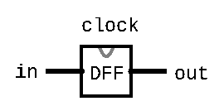
Review: Sequential Chips & DFF
Sequential Chips
A category of chips that utilize the clock signal, in addition to any combinational logic
Maintains state
Constructed from DFF and combinational logic
Data Flip Flop (DFF)
Foundational state-keeping component
1-bit input, 1-bit output
Wired to the clock signal
Always outputs its previous input: out(t) = in(t-1)

Slide 7
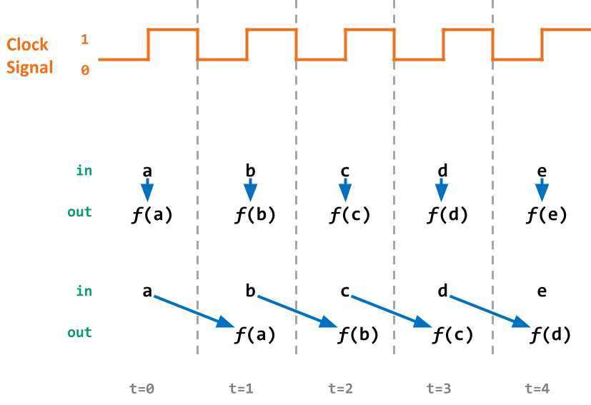
Combinational vs. Sequential Abstraction
Combinational: a function of the inputs from the current time cycle
Sequential: a function of inputs from the previous cycle (has “memory”)
Notes:
ANALOGY: Car manufacturing

Slide 8
DFF Example 2 Specification
Example specification:
out(t) = Xor(out(t-1), in(t-1))
Notice how the specification uses out(t-1) as an input for out(t)
Need some sort of circular wiring, separated by a DFF
Notes:
Sequential logic and DFF review
DFF - reusing output bc of state, gives the inputs time to “sync”, do anything, once it stablilizes then we can read the stable value

Slide 9
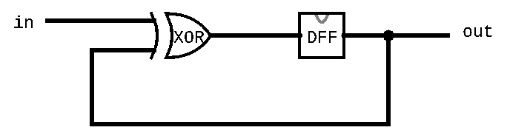
DFF Example 2 Circuit Diagram
Example specification:
out(t) = Xor(out(t-1), in(t-1))
Circuit diagram:

Slide 10
DFF Example 2 Time Series
pin | t=0 | t=1 | t=2 | t=3 | t=4 | t=5 | t=6 | ...
in | 0 | 0 | 1 | 1 | 1 | 0 | 0 | ...
out | 0 | 0 | 0 | 1 | 0 | 1 | 1 | ...
Example:
out(t=3) = Xor(in(t=2), out(t=2))

Slide 11
DFF Example 2 HDL Implementation
CHIP Example2 {
IN in;
OUT out;
PARTS:
Xor(a=in, b=prevout, out=xorout);
DFF(in=xorout, out=prevout, out=out);
}

Slide 12
Agenda
Cornell Note-Taking Review
Building a Bit
DFF Example Review
Building a bit exercise
Building Memory
Reading Review and Q&A
Building memory: Bit to RAM
Program Counter
Project 3 Overview

Slide 13
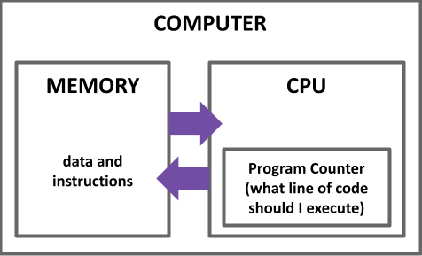
Computer Overview
CPU is the “brain” of our computer
Does necessary computations (add, subtract, multiply, etc.)
Memory is used to store/remember values for later use
Needs to be able to persist across multiple computations!
Need to be able to change the values when we want to
Notes:
sometimes write back to memory
CPU fetch data/code from memory, can write it back

Slide 14
Storing Data: Bit
In memory, we want data to stay the same until we tell it to change
Currently our DFFs always change based on the inputs!
Need a new circuit: Bit
If we tell it to change, updates its value
Otherwise maintains its previous value
Bit is the first chip you implement in project 3!

Slide 15
Storing Data: Bit
More formal specification of Bit:
// if (load(t-1)): out(t) = in(t-1)
// else: out(t) = out(t-1)
CHIP Bit {
IN in, load;
OUT out;
PARTS:
// TODO
}

Slide 16
Bit Time Series
if (load(t-1)): out(t) = in(t-1)
else: out(t) = out(t-1)
pin | t=0 | t=1 | t=2 | t=3 | t=4 | t=5 | t=6 | ...
in | 1 | 0 | 0 | 0 | 1 | 0 | 1 | ...
load | 1 | 0 | 0 | 1 | 1 | 1 | 0 | ...
out | 0 | 1 | 1 | 1 | 0 | 1 | 0 | ...
Example 1: load(t=0) == 1 so out(t=1) = in(t=0)
Example 2: load(t=2) == 0 so out(t=3) = out(t=2)

Slide 17
In order to implement Bit, what gates do you think we will need? (Select all that apply)
Bit Spec:
if (load(t-1)): out(t) = in(t-1)
else: out(t) = out(t-1)
Options:
Mux
Xor
And
DFF
Notes:
AARON

Slide 18
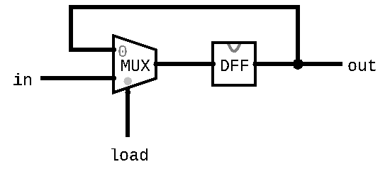
Implementing Bit Activity
Now you know what gates to use!
In groups, fill in the connections to the gates to create a circuit diagram of Bit
We encourage you to reference examples from the previous lecture!

Slide 19
Agenda
Cornell Note-Taking Review
Building a Bit
DFF Example Review
Building a bit exercise
Building Memory
Reading Review and Q&A
Building memory: Bit to RAM
Program Counter
Project 3 Overview

Slide 20
Reading Review: Memory Abstraction
Memory is just one big array!
Addresses are indices into different memory slots
The width of an address is fixed for the system
The Nand2Tetris project will use 16-bit addresses
Each slot in memory takes up a fixed width
Not the same as address width
The Nand2Tetris project uses 16-bit slots in memory
Notes:
each element of an array is a 16 bit register
computer is byte

Slide 21
Reading Review: Memory Abstraction
Can read and write to memory by specifying an address
More details next week!
Example: x = memory[01...00]
Reads the value in memory at address 01...00 and stores it in x
Example: memory[01...00] = 7
Writes the value 7 in the memory slot at address 01...00
Notes:
64 bit address for array (2^64)
16 bit for Nand2tetris

Slide 22
Agenda
Cornell Note-Taking Review
Building a Bit
DFF Example Review
Building a bit exercise
Building Memory
Reading Review and Q&A
Building memory: Bit to RAM
Program Counter
Project 3 Overview

Slide 23
Building Memory: Register
Bits can store a single value, 0 or 1, but in memory we need a way to store 16-bit values!
Register: Same idea as a Bit but for 16 of them!
Allows us to store and change 16-bit values
Groups together 16 individual bits that share a load signal
// if (load(t-1)): out(t) = in(t-1)
// else: out(t) = out(t-1)
CHIP Register {
IN in[16], load;
OUT out[16];
...
}
Notes:
key: share a load signal. not 16 bits duplicated, just one load, not 16 loads. Grouping element.

Slide 24
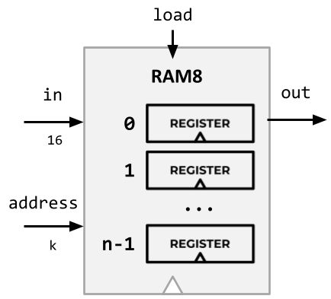
Building Memory: RAM8 From Registers
RAM interface:
address: address used to specify memory slot
in: 16-bit input used to update specified memory slot if load is 1
load: if 1, then in should be written to specified memory slot
out: 16-bit output from the slot specified by address
RAM8 can be built from 8 registers
address width is log₂(8) = 3 bits

Slide 25
Building Memory: RAM8 From Registers
Step 1: Route in to every register
But we don’t want every register to update!
Solution: choose which register to enable w/ load
Step 2: Choose which register to use for the output
These are choices we need to make in circuits: perfect tasks for Mux and Demux

Slide 26
Building Memory: The rest of RAM
After RAM8, can build larger RAM chips from a combination of smaller RAM chips
e.g. RAM64 can be built using eight RAM8 chips
Technique will be similar to RAM8 but will have to use different portions of the address
The blocks section of the reading will likely be helpful!
For example, can think of each RAM8 as a block of RAM64

Slide 27
Agenda
Cornell Note-Taking Review
Building a Bit
DFF Example Review
Building a bit exercise
Building Memory
Reading Review and Q&A
Building memory: Bit to RAM
Program Counter
Project 3 Overview

Slide 28
Program Counter
Memory is used to store data but it also stores code!
Instructions/operations are stored at different addresses in memory
Program Counter in the CPU keeps track of which address contains the instruction that should be executed next

Slide 29
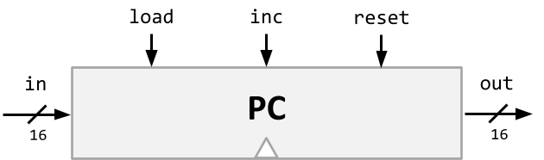
Program Counter
Keeps track of what instruction we’re executing
If it outputs 24, on the next clock cycle the computer runs the instruction at address 24 in the code segment
Program counter interface:
if (reset[t] == 1) out[t+1] = 0
else if (load[t] == 1) out[t+1] = in[t]
else if (inc[t] == 1) out[t+1] = out[t] + 1
else out[t+1] = out[t]
Notes:
instruction and memory chips are separate (not on actual computer)
in: 16-bit address to load if load is selected
load: if 1, use in as the current address for the next cycle
inc: if 1, add 1 to the current address for the next cycle
reset: if 1, set the current address to 0 for the next cycle
out: address of instruction to execute next

Slide 30
Agenda
Cornell Note-Taking Review
Building a Bit
DFF Example Review
Building a bit exercise
Building Memory
Reading Review and Q&A
Building memory: Bit to RAM
Program Counter
Project 3 Overview

Slide 31
Project 3 Overview
Cornell Note-Taking Method
Practice taking detailed notes in another class. Think critically about the technique.
Memory & Sequential Logic
Build our first sequential chips, from a 1-bit register to a 16K RAM module.
Program Counter
Build a counter that can keep track of where we are in a program, with support for several operations we’ll need later.
Note: folder split for performance reasons only!
Notes:
complicated logic

Slide 32
Wrapping Up
What’s in store for Week 4?
Assembly Languages
Annotation
Project 4 Released
Reminders
Project 1 Grades Released on Gradescope
Project 2 Due Tonight 4/15 11:59PM PDT

