Slide 1
Sequential Logic & Bloom’s Taxonomy
Project 1 Reflection, Introduction to Bloom’s Taxonomy, Cornell Note-Taking, Continuation of Circuit Design, & Physical Timekeeping
Significant material adapted from www.nand2tetris.org. © Noam Nisan and Shimon Schocken.

Slide 2
Agenda
Project 1 Reflection
Bloom’s Taxonomy
Cornell Note-Taking Method
Representing Time in Hardware
Sequential Logic

Slide 3
Project 1 Discussion
What was the most frustrating or difficult part of the Boolean Logic assignment?
What tools, questions, strategies did you utilize to persist through the assignment?
What discrepancy did you have been your estimated time to complete the assignment and your actual time? Why?

Slide 4
Agenda
Project 1 Reflection
Bloom’s Taxonomy
Cornell Note-Taking Method
Representing Time in Hardware
Sequential Logic

Slide 5
Bloom’s Taxonomy
Creating
Producing something new
Justifying your decisions or position
Evaluating
Drawing connections among ideas
Analyzing
Using information in a new (or similar) situation
Applying
Understanding
Explaining ideas or concepts
Remembering
Recalling facts and basic concepts
Notes:
Boom’s Taxonomy is a model coined by Benjamin Bloom that classifies different levels of cognition and learning
maps the way we learn and process

Slide 6
Bloom’s Taxonomy in Action
Creating
Creating your own Java objects in your CSE 143 assignments
Justifying why one would use a particular Java object (ArrayList)?
Evaluating
How do Java objects relate to other real-word tools?
Analyzing
Using Java objects defined in the standard class libraries
Applying
Understanding
Understanding the use Java objects
Remembering
Remembering what Java objects are
Notes:
Boom’s Taxonomy is a model coined by Benjamin Bloom that classifies different levels of cognition and learning
maps the way we learn and process
Introduce a practice that gets at some of the higher order thinking skills...

Slide 7
Agenda
Project 1 Reflection
Bloom’s Taxonomy
Cornell Note-Taking Method
Representing Time in Hardware
Sequential Logic

Slide 8
Cornell Note-Taking Method
Questions
Notes
Main Topic
Sub point
definition
example **
Object-Oriented Programming
Encapsulates the data and the operations for a given data type
Provides abstractions - you don’t need to know how a car is implemented in order to use it
Extensibility - easier to add new data types
Functional Programming
Extensibility - easier to add new operations
Compose a question that corresponds to the notes you took
In what ways is object-oriented programming more extensible than functional programming?
Summary
Object-oriented programming and functional programming are two types of programming paradigms…
Notes:
What kinds of note-taking applications / tools do you use to take notes?
1. Record: During the lecture, use the note-taking column to record the
lecture using telegraphic sentences.
2. Questions: As soon after class as possible, formulate questions based on
the notes in the right-hand column. Writing questions helps to clarify
meanings, reveal relationships, establish continuity, and strengthen
memory. Also, the writing of questions sets up a perfect stage for exam-studying
later.
3. Recite: Cover the note-taking column with a sheet of paper. Then, looking
at the questions or cue-words in the question and cue column only, say
aloud, in your own words, the answers to the questions, facts, or ideas
indicated by the cue-words.
4. Reflect: Reflect on the material by asking yourself questions, for example:
“What’s the significance of these facts? What principle are they based on?
How can I apply them? How do they fit in with what I already know?
What’s beyond them?
5. Review: Spend at least ten minutes every week reviewing all your previous
notes. If you do, you’ll retain a great deal for current use, as well as, for the
exam.

Slide 9
Cornell Note-Taking Method
Questions
Notes
Main Topic
Sub point
definition
example **
Object-Oriented Programming
Encapsulates the data and the operations for a given data type
Provides abstractions - you don’t need to know how a car is implemented in order to use it
Extensibility - easier to add new data types
Functional Programming
Extensibility - easier to add new operations
Compose a question that corresponds to the notes you took
In what ways is object-oriented programming more extensible than functional programming?
Summary
Object-oriented programming and functional programming are two types of programming paradigms…
Notes:
What kinds of note-taking applications / tools do you use to take notes?
1. Record: During the lecture, use the note-taking column to record the
lecture using telegraphic sentences.
2. Questions: As soon after class as possible, formulate questions based on
the notes in the right-hand column. Writing questions helps to clarify
meanings, reveal relationships, establish continuity, and strengthen
memory. Also, the writing of questions sets up a perfect stage for exam-studying
later.
3. Recite: Cover the note-taking column with a sheet of paper. Then, looking
at the questions or cue-words in the question and cue column only, say
aloud, in your own words, the answers to the questions, facts, or ideas
indicated by the cue-words.
4. Reflect: Reflect on the material by asking yourself questions, for example:
“What’s the significance of these facts? What principle are they based on?
How can I apply them? How do they fit in with what I already know?
What’s beyond them?
5. Review: Spend at least ten minutes every week reviewing all your previous
notes. If you do, you’ll retain a great deal for current use, as well as, for the
exam.

Slide 10
Applying the Cornell Note-Taking Method
You are going to try it… TODAY!
Thursday you will come & contrast cornell notes with your classmates
You are also going to try it with one of your other classes as part of Project 3 (more on Thursday)

Slide 11
Agenda
Project 1 Reflection
Bloom’s Taxonomy
Cornell Note-Taking Method
Representing Time in Hardware
Sequential Logic

Slide 12
Combinational Logic vs. Sequential Logic
So far, we ignored “time” in our circuits
Our chips use combinational logic
When given inputs, the chip computes its output “instantaneously”
The output is a pure function of the current inputs, no memory of previous events
Today, we’ll start exploring what happens when we consider time, ultimately building to sequential logic

Slide 13
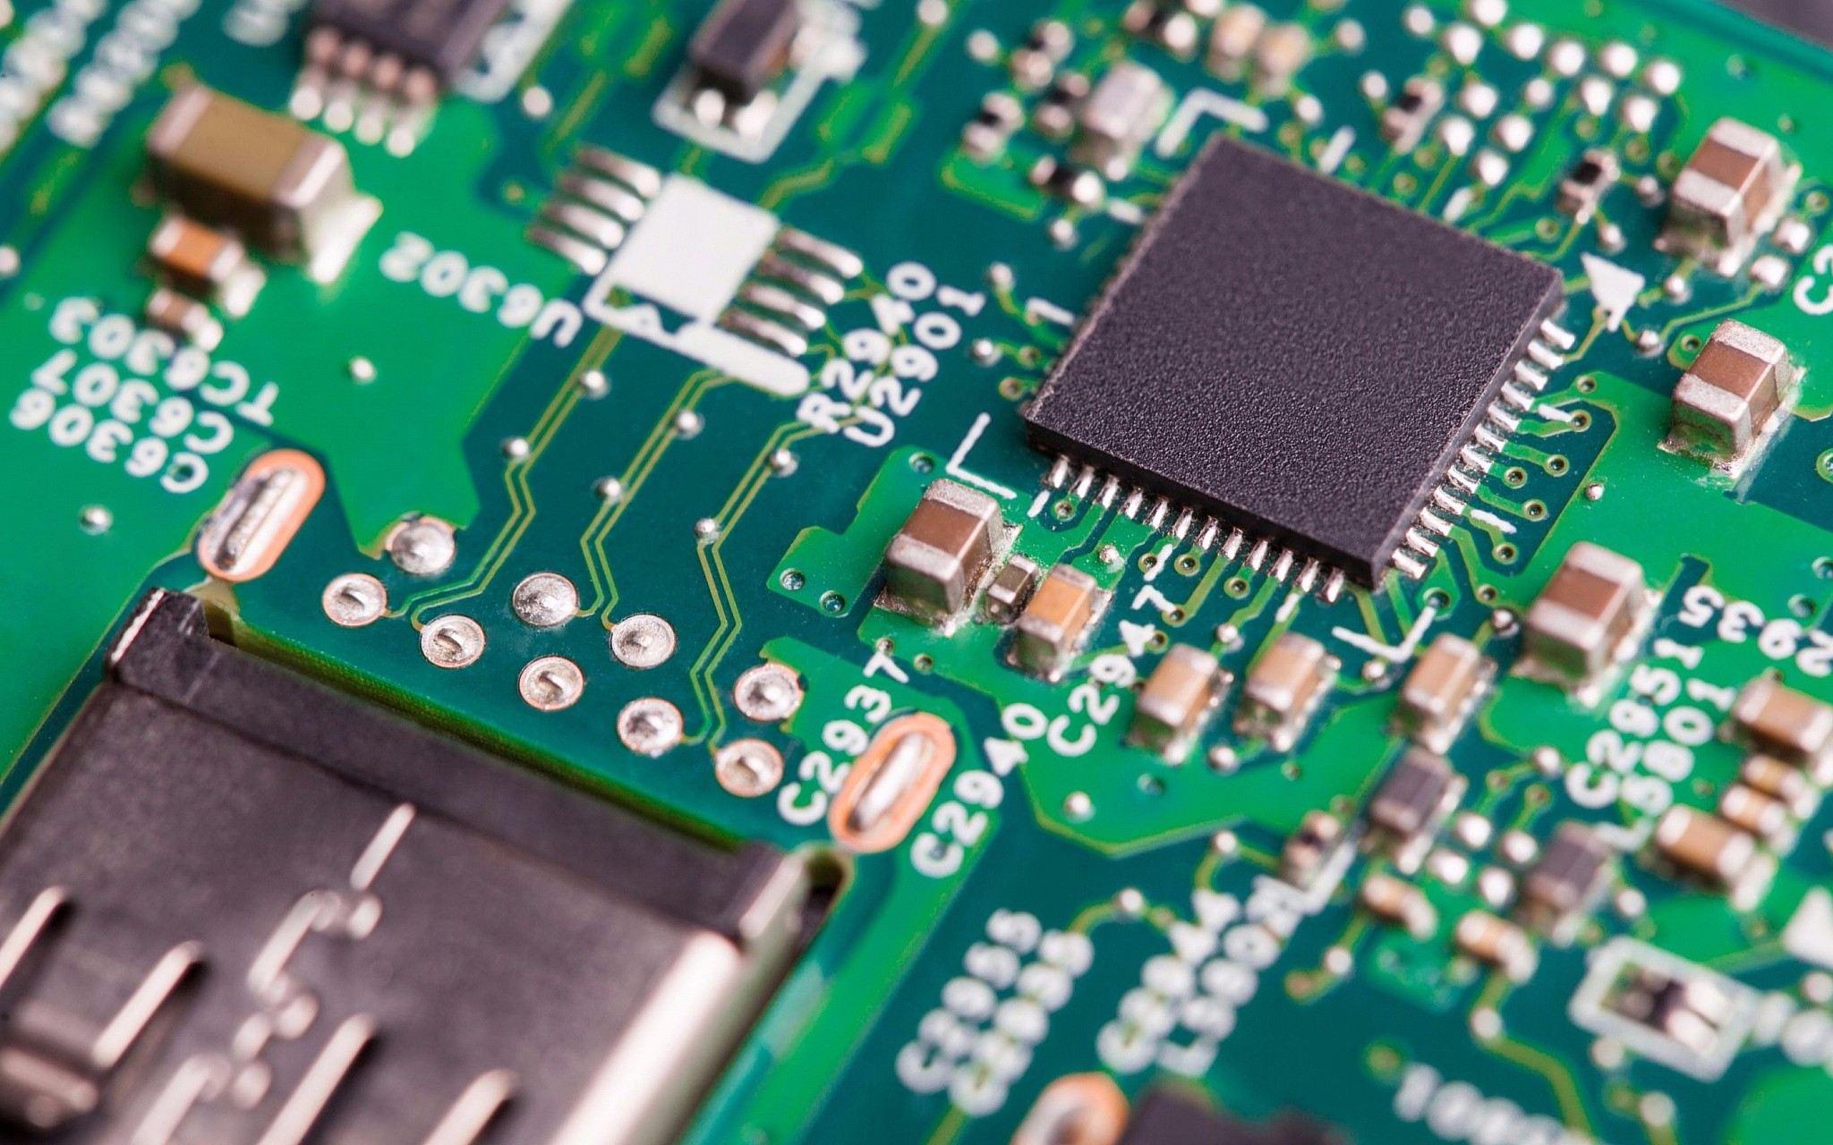
Why Consider Time Now?
Needed for Our Abstraction:
For memory, we need to talk about hardware maintaining state. To do so, we need a vocabulary to talk about time.
Needed for Implementation:
Physical implementations of chips cannot be instantaneous. We need to account for physical delays in signal propagation.

Slide 14
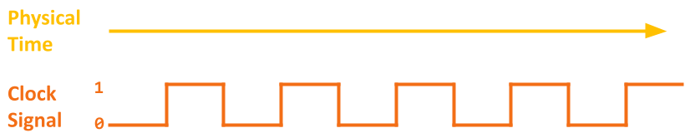
Physical Timekeeping
In hardware, keep track of time with an alternating signal
Creates idea of discrete time -- state changes only occur in discrete intervals, right when signal alternates

Slide 15
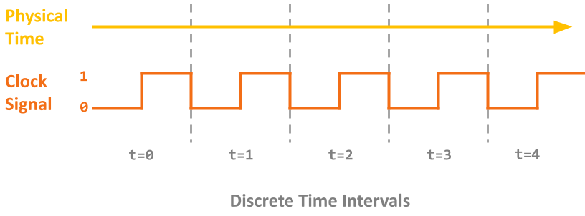
Physical Timekeeping
In hardware, keep track of time with an alternating signal
Creates idea of discrete time -- state changes only occur in discrete intervals, right when signal alternates

Slide 16
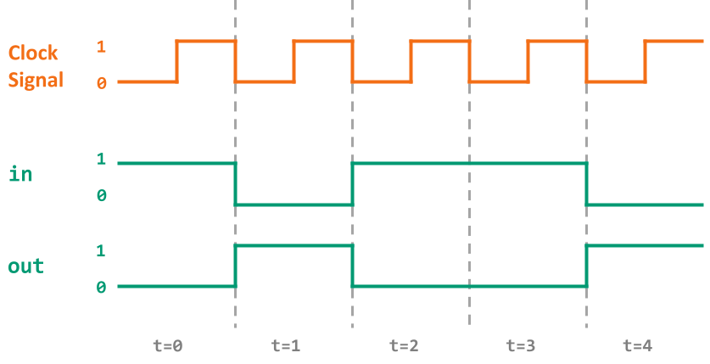
Adding a Clock: Ideal
We want this behavior from a simple, combinational Not gate:

Slide 17
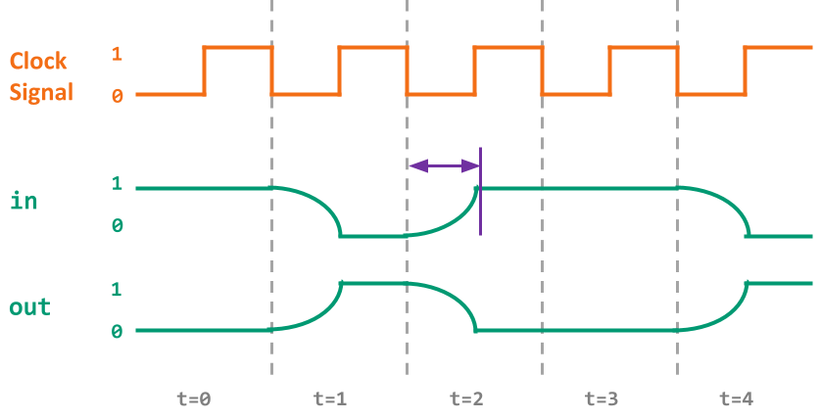
Adding a Clock: Reality
Combinational logic may be incorrect for a period immediately after inputs change
computation delays (logic gates) and propagation delays (wires)

Slide 18
Adding a Clock: Clock Cycles
Choose a clock cycle length slightly longer than the delays

Slide 19
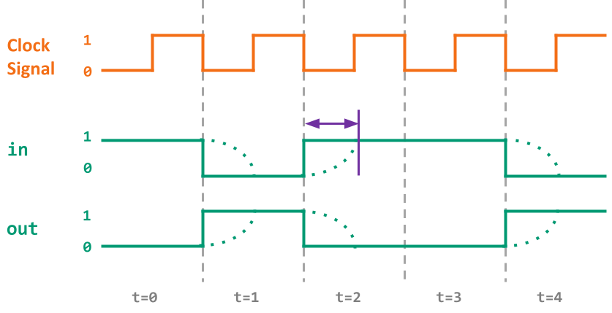
Adding a Clock: Abstraction
If we use a long enough clock cycle, we can pretend that combinational chips (like Not) work instantly

Slide 20
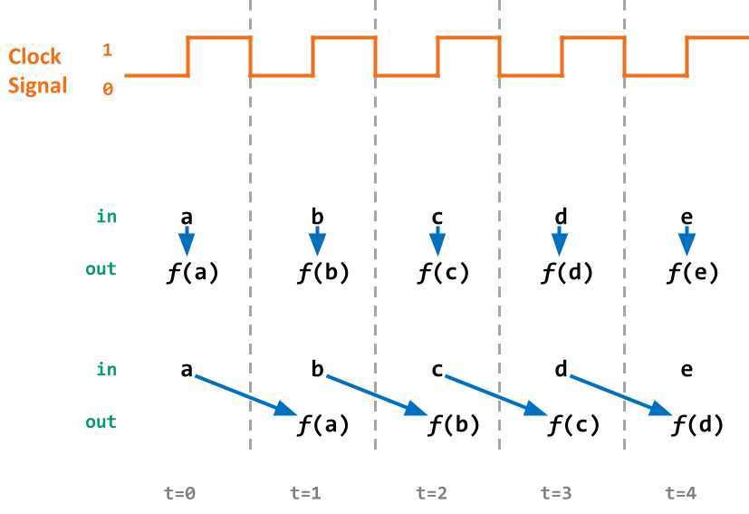
Combinational vs. Sequential Abstraction
Combinational: a function of the inputs from the current time cycle
Sequential: a function of inputs from the previous cycle (has “memory”)
Notes:
ANALOGY: Car manufacturing

Slide 21
Agenda
Project 1 Reflection
Bloom’s Taxonomy
Cornell Note-Taking Method
Representing Time in Hardware
Sequential Logic

Slide 22
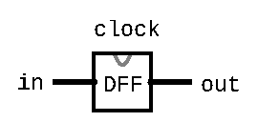
A New Primitive: Flip Flop
Simplest state-keeping component
1-bit input, 1-bit output
Wired to the clock signal
Always outputs its previous input: out(t) = in(t-1)
Implementation: a gate that can flip between two stable states (remembering 0 vs. remembering 1)
Gates with this behavior are “Data Flip Flops”

Slide 23
Flip-Flop Time Series
pin | t=0 | t=1 | t=2 | t=3 | t=4 | t=5 | t=6 | ...
in | 0 | 0 | 1 | 1 | 0 | 1 | 0 | ...
out | 0 | 0 | 0 | 1 | 1 | 0 | 1 | ...
Example:
out(t=3) = in(t=2)

Slide 24
Aside: Treating Flip-Flop as Primitive
Disclaimer: CAN be made from Nand gates exclusively!
BUT requires wiring them together in a “messy” loop that the hardware simulator can’t simulate and isn’t very educational
For simplicity, we’ll treat Flip-Flop as primitive in homeworks
Just like Nand, you can use the built-in implementation

Slide 25
Sequential Chips
A category of chips that utilize the clock signal, in addition to any combinational logic
Capable of:
Maintaining state
Optionally, acting on that state & current inputs
Can incorporate combinational logic as well!
Constructed from:
DFFs
Combinational logic (which is entirely constructed from Nand)

Slide 26
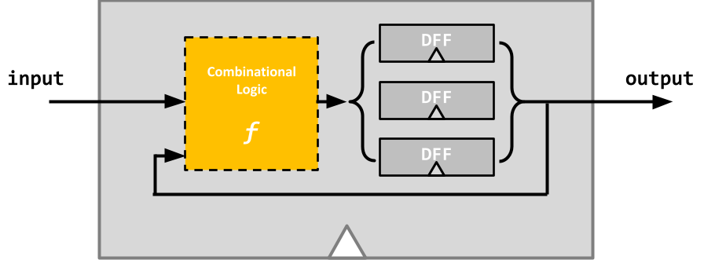
Sequential Chips
output(t) = f(state(t-1), input(t-1))

Slide 27
DFF Example 1 Specification
Example specification:
out(t) = Xor(a(t-1), b(t-1))
Takes two inputs, a and b, and outputs the Xor of them
Note that out at time t is determined by a and b at time t-1
We will need to use a DFF!

Slide 28
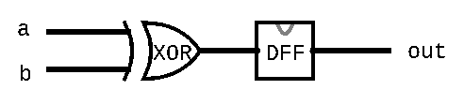
DFF Example 1 Circuit Diagram
Example specification:
out(t) = Xor(a(t-1), b(t-1))
Circuit diagram:

Slide 29
DFF Example 1 Time Series
pin | t=0 | t=1 | t=2 | t=3 | t=4 | t=5 | t=6 | ...
a | 0 | 0 | 1 | 1 | 1 | 0 | 0 | ...
b | 0 | 1 | 0 | 1 | 1 | 1 | 0 | ...
out | 0 | 0 | 1 | 1 | 0 | 0 | 1 | ...
Example:
out(t=3) = Xor(a(t=2), b(t=2))

Slide 30
DFF Example 1 HDL Implementation
CHIP Example1 {
IN a, b;
OUT out;
PARTS:
Xor(a=a, b=b, out=xorout);
DFF(in=xorout, out=out);
}

Slide 31
DFF Example 2 Specification
Example specification:
out(t) = Xor(out(t-1), in(t-1))
Notice how the specification uses out(t-1) as an input for out(t)
Need some sort of circular wiring, separated by a DFF

Slide 32
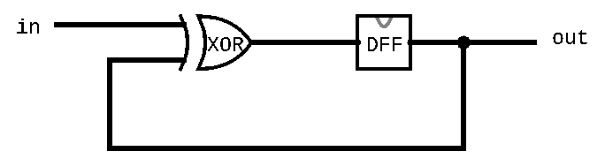
DFF Example 2 Circuit Diagram
Example specification:
out(t) = Xor(out(t-1), in(t-1))
Circuit diagram:

Slide 33
DFF Example 2 Time Series
pin | t=0 | t=1 | t=2 | t=3 | t=4 | t=5 | t=6 | ...
in | 0 | 0 | 1 | 1 | 1 | 0 | 0 | ...
out | 0 | 0 | 0 | 1 | 0 | 1 | 1 | ...
Example:
out(t=1) = Xor(in(t=0), out(t=0))

Slide 34
DFF Example 2 HDL Implementation
CHIP Example2 {
IN in;
OUT out;
PARTS:
Xor(a=in, b=prevout, out=xorout);
DFF(in=xorout, out=prevout, out=out);
}

Slide 35
DFF Example 3 Specification
Example specification:
out(t) = And(Not(out(t-1)), in(t-1))

Slide 36
DFF Example 3 Time Series
out(t) = And(Not(out(t-1)), in(t-1))
pin | t=0 | t=1 | t=2 | t=3 | t=4 | t=5 | t=6 | ...
in | 1 | 1 | 0 | 1 | 1 | 0 | 0 | ...
out | 0 | 1 | 0 | 0 | 1 | 0 | 0 | ...
Example:
out(t=1) = And(Not(out(t=0)), in(t=0))

Slide 37
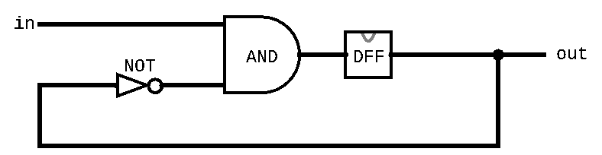
DFF Example 3 Circuit Diagram
Example specification:
out(t) = And(Not(out(t-1)), in(t-1))
Circuit diagram:

Slide 38
DFF Example 3 HDL Implementation
out(t) = And(Not(out(t-1)), in(t-1))
CHIP Example3 {
IN in;
OUT out;
PARTS:
Not(in=prevout, out=notprevout);
And(a=in, b=notprevout, out=andout);
DFF(in=andout, out=prevout, out=out);
}

Slide 39
Reminders
Project 2 is due Thursday 11:59PM PDT
Margot and Eric have office hours NOW(!) 2:00 - 3:00PM on Tuesdays!
Message board! Discord!

