Slide 1
Growth vs. Fixed Mindset & The ALU
Growth vs. Fixed Mindset, Goal-Setting and the ALU
Significant material adapted from www.nand2tetris.org. © Noam Nisan and Shimon Schocken.

Slide 2
Agenda
Growth vs. Fixed Mindset
Reading Review and Q&A
If/Else Logic In Hardware
Introduction to the Arithmetic Logic Unit (ALU)
Project 2 Overview

Slide 3
Agenda
Growth vs. Fixed Mindset
Reading Review and Q&A
If/Else Logic In Hardware
Introduction to the Arithmetic Logic Unit (ALU)
Project 2 Overview

Slide 4

Growth vs. Fixed Mindset
Notes:
Psychologist Carol Dweck coined this idea of Fixed vs. Growth mindset. She has done a ton research looking at the BELIEF that people have on their abilities and intelligence

Slide 5
Setting SMART Goals
S -- Be specific, simple and significant.
M -- Make sure your goals are measurable. How many times within a week, month, the quarter do you want to do x goal?
A -- Make sure your goals are achievable. Is your goal within your scope of control?
R -- Be realistic and reasonable.
T -- Be time-bound. When will you accomplish x goal?
Notes:
END BY 1:25PM

Slide 6
Breakout Rooms
SPRING QUARTER GOALS
SPHERE OF CONTROL
SMART GOAL FRAMEWORK
What are skills, practices or habits that are not strengths YET?
Getting a 4.0 in a course VS. Attending course office hours
S -- Specific
M -- Measurable
A -- Achievable.
R -- Realistic
T -- Timebound
Attending CSE 390B
office hours at least 5x this quarter (or once every other week)
Notes:
END BY 1:25PM

Slide 7
Agenda
Growth vs. Fixed Mindset
Reading Review and Q&A
If/Else Logic In Hardware
Introduction to the Arithmetic Logic Unit (ALU)
Project 2 Overview

Slide 8
Two’s Complement
Way of interpreting binary numbers to represent negative values
Give a negative weight to the most significant digit, then compute the value like normal
Example: 1101 in a 4-bit representation
-2^3 + 2^2 + 2^0 = -8 + 4 + 1 = -3
For a value x, -x = ~x + 1
Example: x = 4 = 0100
-x = ~x + 1 = ~0100 + 1 = 1011 + 1= 1100 = -8 + 4 = -4

Slide 9
Two’s Complement 4-bit Values
Binary | 2’s Complement Value
0000 | 0
0001 | 1
0010 | 2
0011 | 3
0100 | 4
0101 | 5
0110 | 6
0111 | 7
1000 | -8
1001 | -7
1010 | -6
1011 | -5
1100 | -4
1101 | -3
1110 | -2
1111 | -1

Slide 10
Two’s Complement Addition
Can use exactly the same addition process for both unsigned and signed (two’s complement) binary!
Hardware doesn’t need to know the sign of the values it is working on, just does the same calculation
Example: 1001 + 0010 = 1011
Unsigned interpretation: 9 + 2 = 11
Signed interpretation: -7 + 2 = -5
carry | 0 | 0 | 0
x | 1 | 0 | 0 | 1
y | 0 | 0 | 1 | 0
result | 1 | 0 | 1 | 1

Slide 11
Reading Q&A

Slide 12
Agenda
Growth vs. Fixed Mindset
Reading Review and Q&A
If/Else Logic In Hardware
Introduction to the Arithmetic Logic Unit (ALU)
Project 2 Overview

Slide 13
Making If/Else Decisions In Hardware
In programming languages like Java, we write if/else statements with the notion that only one of the branches will execute!
For example, in the following code we only expect to compute either add a & b or a | b, not both:
if (c == 0) {
out = a & b;
} else {
out = a | b;
}

Slide 14
Making If/Else Decisions In Hardware
In hardware, all of our circuits are executing at all times
Can’t “turn off” a circuit based on a condition
Instead of expecting only one circuit to execute, we write circuits for different cases and choose which output we want to use based on a condition
We can use Mux gates to choose which input!!!

Slide 15
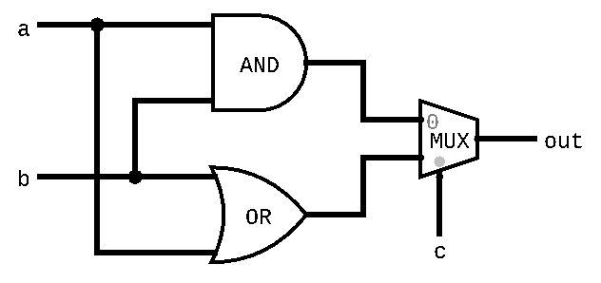
Example:
High level view of implementing the following code:
if (c == 0) {
out = a & b;
} else {
out = a | b;
}

Slide 16
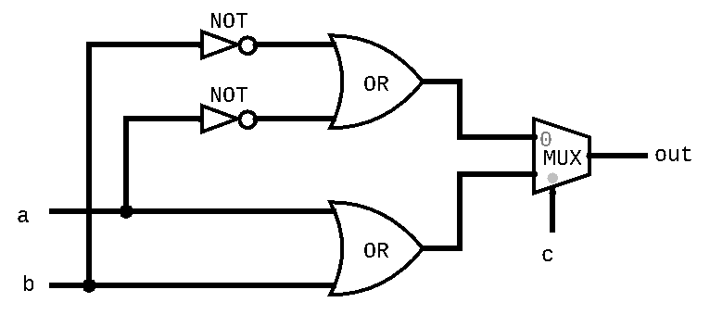
Practice problem 1
Implement the following pseudo-code in hardware:
if (c == 0) {
out = ~a | ~b;
} else {
out = a | b;
}

Slide 17
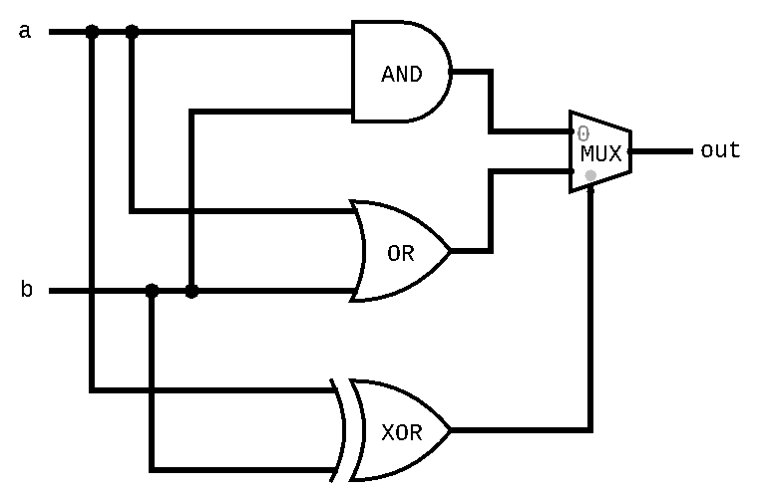
Practice problem 2
Implement the following pseudo-code in hardware:
if (a == b) {
out = a & b;
} else {
out = a | b;
}

Slide 18
Agenda
Growth vs. Fixed Mindset
Reading Review and Q&A
If/Else Logic In Hardware
Introduction to the Arithmetic Logic Unit (ALU)
Project 2 Overview

Slide 19
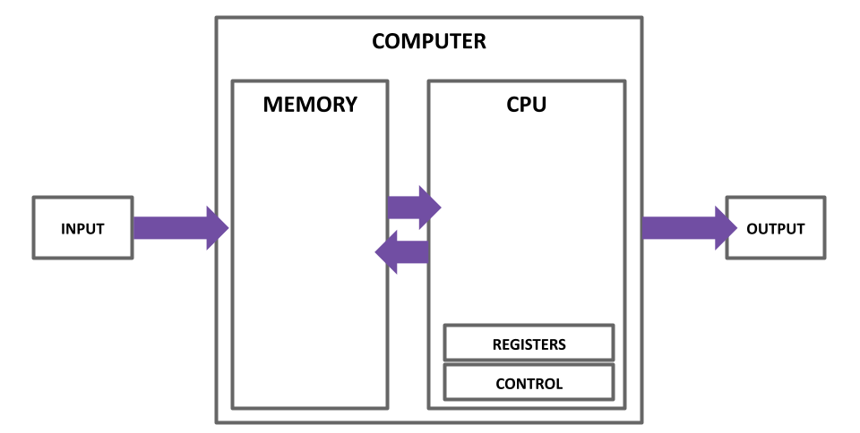
The Von Neumann Architecture
(This picture will get more detailed as we go!)

Slide 20
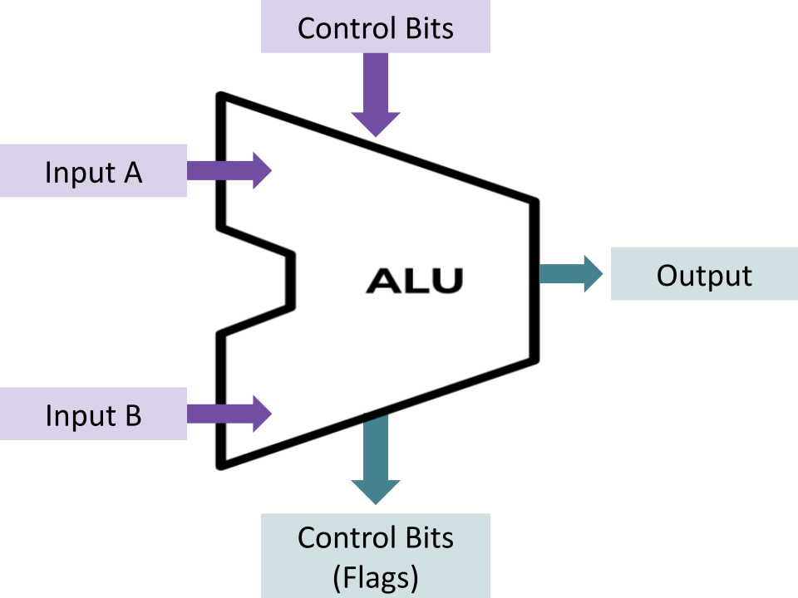
The Arithmetic Logic Unit
Computes a function on two inputs to produce output
Input Control Bits specify what should be computed
Supports some combo of logical (And, Or) and arithmetic (+, -)
Indicate properties of the result with Output Control Bits (commonly called Flags)

Slide 21
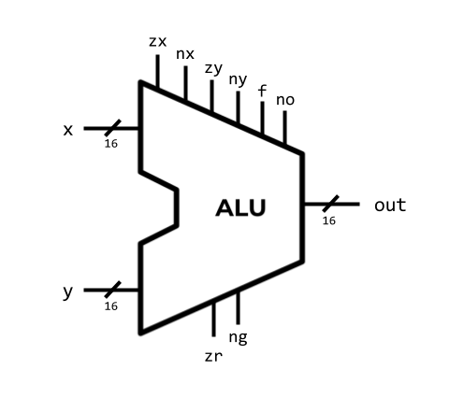
Our ALU Implementation
Inputs & Output
16-bit
Interpret as two’s complement
Input Control Bits
6 bits specify which function
18 functions to choose from
Output Control Bits (Flags)
2 bits describe properties of the output

Slide 22
ALU Functions: “Black Box” View
We support 18 different functions
3 that simply give constant values (ignoring operands)
10 that change a single operand, possibly with a constant
5 that combine both operands using some operation
zx | nx | zy | ny | f | no | out
1 | 0 | 1 | 0 | 1 | 0 | 0
1 | 1 | 1 | 1 | 1 | 1 | 1
1 | 1 | 1 | 0 | 1 | 0 | -1
0 | 0 | 1 | 1 | 0 | 0 | x
1 | 1 | 0 | 0 | 0 | 0 | y
0 | 0 | 1 | 1 | 0 | 1 | !x
1 | 1 | 0 | 0 | 0 | 1 | !y
0 | 0 | 1 | 1 | 1 | 1 | -x
1 | 1 | 0 | 0 | 1 | 1 | -y
0 | 1 | 1 | 1 | 1 | 1 | x+1
1 | 1 | 0 | 1 | 1 | 1 | y+1
0 | 0 | 1 | 1 | 1 | 0 | x-1
1 | 1 | 0 | 0 | 1 | 0 | y-1
0 | 0 | 0 | 0 | 1 | 0 | x+y
0 | 1 | 0 | 0 | 1 | 1 | x-y
0 | 0 | 0 | 1 | 1 | 1 | y-x
0 | 0 | 0 | 0 | 0 | 0 | x&y
0 | 1 | 0 | 1 | 0 | 1 | x|y
To select a function, set the control bits to the corresponding combination

Slide 23
ALU Functions: Implementer’s View
“18 functions” is really clever combination of 6 core operations
First, preprocess inputs
If zx is set, then zero out x
If nx is set, then negate x
If zy is set, then zero out y
If ny is set, then negate y
Next compute the operation
If f is set, compute x + y, else compute x & y
Finally postprocess the output
If no, negate the output
zx | nx | zy | ny | f | no | out
1 | 0 | 1 | 0 | 1 | 0 | 0
1 | 1 | 1 | 1 | 1 | 1 | 1
1 | 1 | 1 | 0 | 1 | 0 | -1
0 | 0 | 1 | 1 | 0 | 0 | x
1 | 1 | 0 | 0 | 0 | 0 | y
0 | 0 | 1 | 1 | 0 | 1 | !x
1 | 1 | 0 | 0 | 0 | 1 | !y
0 | 0 | 1 | 1 | 1 | 1 | -x
1 | 1 | 0 | 0 | 1 | 1 | -y
0 | 1 | 1 | 1 | 1 | 1 | x+1
1 | 1 | 0 | 1 | 1 | 1 | y+1
0 | 0 | 1 | 1 | 1 | 0 | x-1
1 | 1 | 0 | 0 | 1 | 0 | y-1
0 | 0 | 0 | 0 | 1 | 0 | x+y
0 | 1 | 0 | 0 | 1 | 1 | x-y
0 | 0 | 0 | 1 | 1 | 1 | y-x
0 | 0 | 0 | 0 | 0 | 0 | x&y
0 | 1 | 0 | 1 | 0 | 1 | x|y

Slide 24
ALU Functions: Implementer’s View
Example: Computing x-1
Given inputs x=0101 (5), y=0010 (2)
For x-1, zx=0, nx=0, zy=1, ny=1, f=1, no=0
zx=0 so don’t zero out x
nx=0 so don’t negate x
zy=1 so do zero out y
y becomes 0000
ny=1 so do negate y
y becomes 1111
f=1 so compute x + y
x hasn’t changed, but y has become 1111 (or -1!), so this is equivalent to x + (-1)
no=0 so don’t negate output
out = x + (-1) = 0101 + 1111 = 0100 (4)
zx | nx | zy | ny | f | no | out
0 | 0 | 1 | 1 | 1 | 0 | x-1

Slide 25
ALU Output Control Bits
zr is 1 if out == 0
ng is 1 if out < 0
We’ll use these in a later project
The basis of comparison! To evaluate if x == 4, compute x - 4 and check zr flag!
These are deceptively hard to implement. Don’t put them off too long!

Slide 26
Implementation Strategy
We suggest doing the ALU in three parts:
First deal with zeroing out/negating inputs (x and y) and negating the output
Ignore the f bit (only compute And) and ignore flag outputs
Test your implementation using ALU-nostat-noadd.tst
Next support both And and Add operations by incorporating f
Test your implementation using ALU-nostat.tst
Finally implement the logic for the status flags (zr and ng)
Test your full ALU using ALU.tst

Slide 27
Agenda
Growth vs. Fixed Mindset
Reading Review and Q&A
If/Else Logic In Hardware
Introduction to the Arithmetic Logic Unit (ALU)
Project 2 Overview

Slide 28
Project 2 Overview
Part I: 24-Hour Time Audit
Part II: Boolean Arithmetic
Goal: implement our ALU, which performs the core computations we need (+/&)
First implement HalfAdder, FullAdder, Add16
Then implement the ALU in the order suggested by the spec
Remember the textbook chapters can be helpful!!
Part III: Social Computer Reflection Prompt #1

Slide 29
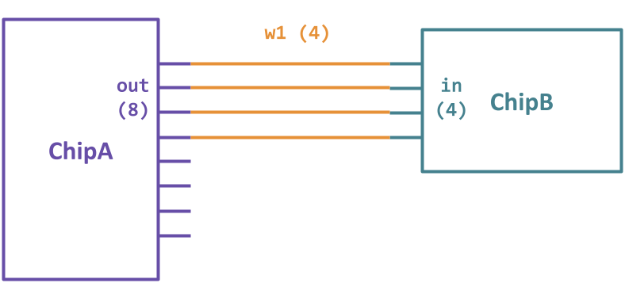
HDL Tips: Slicing
Sometimes want to connect only part of a multi-bit bus
HDL lets us with slicing notation
Example: Say ChipA has 8 output pins, and we want to connect the first 4 to ChipB’s 4 inputs:
ChipA(out[0..3]=w1);
ChipB(in=w1);
Note: Can ONLY slice chip connections, can’t slice internal wires (e.g. w1[0..3] not allowed!)
Need to use half an 8-bit wire? Instead, make two 4-bit wires and slice the output they’re connected to

Slide 30
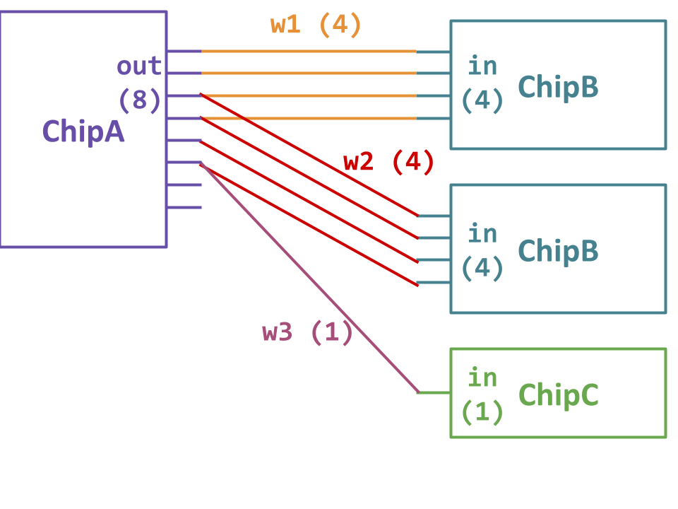
HDL Tips: Connections
Can connect a chip output multiple times, or not at all!
Hint: In Add16, do we need to use the last carry bit?
ChipA (
out[0..3]=w1,
out[2..5]=w2,
out[5]=w3
);
ChipB (in=w1);
ChipB (in=w2);
ChipC (in=w3);

Slide 31
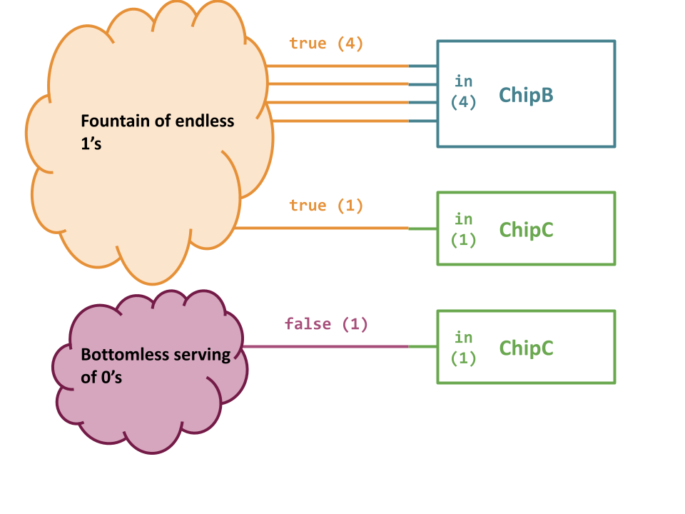
HDL Tips: Constants
The special buses true and false contain all 1s and all 0s, and can implicitly act as whatever width is needed
Example: Say ChipB has 4 inputs and ChipC has 1 input
ChipB(in=true); assigns all 4 inputs the value of 1 (true)
ChipC(in=true); assigns the one input the value of 1 (true)
ChipC(in=false); assigns the one input the value of 0 (false)

Slide 32
Wrapping Up
What’s in store for Week 3?
Sequential Logic & Building Memory
Note-Taking Practices
Project 3 Released
Reminders
Project 1 Due Tonight 4/8 11:59PM PDT
Join the discord channel

