Slide 1
Boolean Arithmetic & Time Management
Continuation of Circuit Design, Time Management, Project 2 Overview
Significant material adapted from www.nand2tetris.org. © Noam Nisan and Shimon Schocken.

Slide 2
Agenda
Connecting w/Other 390B Students
Introduction to Time Management
Reading Review and Q&A
Circuits For Adding Binary Numbers

Slide 3
Agenda
Connecting w/Other 390B Students
Introduction to Time Management
Reading Review and Q&A
Circuits For Adding Binary Numbers

Slide 4

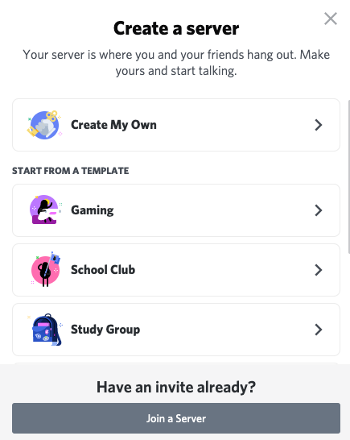

Connect w/Other 390B Students
Download Discord from https://discord.com/download
Log in or create an account
Click on icon in left-most column to create channel
Select “Create My Own”
Select “For me and my friends”
Give your server a name! (e.g., “CSE 390B”)
Use the sd button to invite peers!
Create some text and voice channels! Ideas:
Text: #projects, #questions, #chill, #off-topic
Voice: 🔊 Study Room, 🔊 Lounge
Feel free to connect via Slack, Messenger, etc. too!

Slide 5
Agenda
Connecting w/Other 390B Students
Introduction to Time Management
Reading Review and Q&A
Circuits For Adding Binary Numbers

Slide 6

Introduction to Time Management
One of your most precious resources is your time.
Notes:
[2 min] There will always be things that demand your time.
We are talking about this at the start of the quarter bc time management is often the backbone of understanding the landscape of what you have going on for the next 3 months.
I hear a lot of students say “I ran out of time”, I didn’t have enough time to spend on X because I had to work on Y. -- make no mistake, this will be an ONGOING skill that you will need to continue to assess, refine, and practice. But I want to introduce you to some exercises to help you address procrastination and mitigate the stress of not having enough time.
First we need to identify what ARE the things that fill up your time.

Slide 7
WHAT TYPICALLY FILLS UP YOUR TIME DURING THE QUARTER?
CLASS LECTURES & QUIZ SECTIONS
WORKING
STUDYING
FAMILY COMMITMENTS
OFFICE HOURS
EXTRACURRICULAR INVOLVEMENT
COMMUTING
HOME CHORES
FRIENDS/PARTNERS
ADMINISTRATIVE WORK
PHYSICAL /MENTAL ACTIVITIES
MORE!
Notes:
[5 min] Debunk this idea that online classes will mean you have a plethora of time.
You might gain more time in some areas (commuting for example) but you might lose time in other ways (admin work in getting ready in courses, needing social interaction so you’re video chatting with your friends and family a lot more)
I want us to spend some time quantifying these activities a bit more. [send Weekly Time Commitments file] https://drive.google.com/file/d/1g3bHgmPizu5n-ekW2S1vLmB_kh4DgfJP/view?usp=sharing

Slide 8
Weekly Time Commitments
Notes:
[10 min] https://drive.google.com/file/d/1g3bHgmPizu5n-ekW2S1vLmB_kh4DgfJP/view?usp=sharing
CLASS MEETING TIMES & QUIZ SECTIONS
Block out all the time in which you are meeting for your classes and their quiz sections
FAMILY / FRIENDS / COMMUNITY COMMITMENTS
Video chatting with your family or chosen family
Maybe part of your role is looking after your siblings if you’re at home
WHEN DO YOU EAT?
when do you typically eat breakfast, lunch, dinner?
Preparation for these meals?
PHYSICAL & MENTAL HEALTH ACTIVITIES?
Activities that you’re doing for your own mental health and well-being?
STUDYING
The expectation is that students are studying/doing 2 hours of for every 1 hours in class.
For example, this class meetings for 3 hours per week and therefore is a 3 credit course.
The expectation is that students are committing 6 hours per week on homework
A 15-credit load should end up taking about 45 hours of time per week (15 hours of class time plus 30 hours of homework).
WHAT ELSE?
working? walking your dog?
What it doesn’t reflect?
How are you accomplishing these activities each day? What daily action items/to-dos do you work to accomplish within the context of what you have going on each day (could look different depending on the day)
How do the time of these activities change depending on where you are at in the quarter?

Slide 9
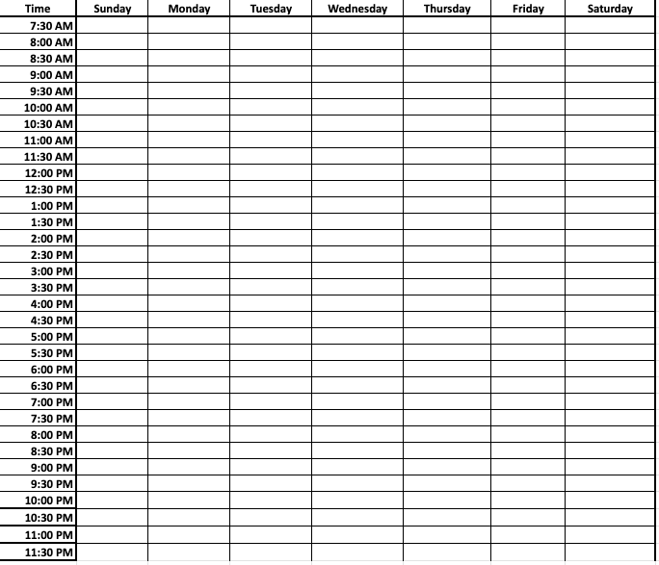
Weekly Time Commitments
Notes:
[10 min] https://drive.google.com/file/d/1g3bHgmPizu5n-ekW2S1vLmB_kh4DgfJP/view?usp=sharing
CLASS MEETING TIMES & QUIZ SECTIONS
Block out all the time in which you are meeting for your classes and their quiz sections
FAMILY / FRIENDS / COMMUNITY COMMITMENTS
Video chatting with your family or chosen family
Maybe part of your role is looking after your siblings if you’re at home
WHEN DO YOU EAT?
when do you typically eat breakfast, lunch, dinner?
Preparation for these meals?
PHYSICAL & MENTAL HEALTH ACTIVITIES?
Activities that you’re doing for your own mental health and well-being?
STUDYING
The expectation is that students are studying/doing 2 hours of for every 1 hours in class.
For example, this class meetings for 3 hours per week and therefore is a 3 credit course.
The expectation is that students are committing 6 hours per week on homework
A 15-credit load should end up taking about 45 hours of time per week (15 hours of class time plus 30 hours of homework).
WHAT ELSE?
working? walking your dog?
What it doesn’t reflect?
How are you accomplishing these activities each day? What daily action items/to-dos do you work to accomplish within the context of what you have going on each day (could look different depending on the day)
How do the time of these activities change depending on where you are at in the quarter?

Slide 10
Weekly Time Commitments
Class meeting times and quiz sections
Family, friends, community, extracurricular commitments
Meals!
Physical and Mental Activities
Studying for each of your classes
The # of credits for a course reflects the # of hours the class meets. In general, courses require 2 hours of homework for every 1 hour of class.
What else is not reflected given your specific situation?
Notes:
[10 min] https://drive.google.com/file/d/1g3bHgmPizu5n-ekW2S1vLmB_kh4DgfJP/view?usp=sharing
CLASS MEETING TIMES & QUIZ SECTIONS
Block out all the time in which you are meeting for your classes and their quiz sections
FAMILY / FRIENDS / COMMUNITY COMMITMENTS
Video chatting with your family or chosen family
Maybe part of your role is looking after your siblings if you’re at home
WHEN DO YOU EAT?
when do you typically eat breakfast, lunch, dinner?
Preparation for these meals?
PHYSICAL & MENTAL HEALTH ACTIVITIES?
Activities that you’re doing for your own mental health and well-being?
STUDYING
The expectation is that students are studying/doing 2 hours of for every 1 hours in class.
For example, this class meetings for 3 hours per week and therefore is a 3 credit course.
The expectation is that students are committing 6 hours per week on homework
A 15-credit load should end up taking about 45 hours of time per week (15 hours of class time plus 30 hours of homework).
WHAT ELSE?
working? walking your dog?
What it doesn’t reflect?
How are you accomplishing these activities each day? What daily action items/to-dos do you work to accomplish within the context of what you have going on each day (could look different depending on the day)
How do the time of these activities change depending on where you are at in the quarter?

Slide 11
Agenda
Connecting w/Other 390B Students
Introduction to Time Management
Reading Review and Q&A
Circuits For Adding Binary Numbers

Slide 12
What is Binary?
A base n number system is a system of number representation w/n symbols
We are super used to the decimal system, a base 10 number system, with the symbols 0, 1, 2, 3, 4, 5, 6, 7, 8, 9
Increase a number by moving to the next greatest symbol
Add another digit when we run out of symbols!
Binary is a base 2 number system
Only two symbols (0 and 1)
Example values: 1 is the same in decimal and binary, 3 in decimal is 11 in binary

Slide 13
Representing Numbers in Binary
Binary | Decimal
0 | 0
1 | 1
10 | 2
11 | 3
100 | 4
101 | 5
110 | 6
111 | 7
... | ...

Slide 14
Representing Numbers in Base 2
Binary numbers are identical, except “Base 2”
Describe a value by specifying multiples of powers of 2
For example, a breakdown of 1101 in binary (which is 13 in decimal)
Binary | Power of 2 | Decimal
1000 | (1 * 2³) | 8
100 | (1 * 2²) | 4
00 | (0 * 2¹) | 0
1 | (1 * 2⁰) | 1

Slide 15
Addition
How do we add two binary numbers?
As humans, could convert to decimal and then back
Example: 0101 + 0010 = ?
First convert 0101 to decimal (result is 5)
Next convert 0010 to decimal (result is 2)
Add the decimal numbers and convert back to binary. 2 + 5 = 7, 7 is 0111 in binary.
More useful: understand the rules of binary addition so we can teach them to a computer

Slide 16
Binary Addition
Exactly the same as decimal addition!
Right to left (least significant place to most significant place)
When a result is more than one digit, carry the “overflow”
carry | 1 | 1 | 1
x | 0 | 1 | 1 | 1
y | 0 | 1 | 0 | 1
result | 1 | 0 | 0 | 0

Slide 17
Overflow
What if there’s a carry bit in the last column?
We can’t represent it in our fixed-width numbers
We are going to “drop” or ignore the extra carry bit
carry | 1 | 1 | 1 | 0
x |  | 0 | 1 | 1 | 0
y |  | 1 | 0 | 1 | 0
result |  | 0 | 0 | 0 | 0

Slide 18
Reading Q&A

Slide 19
Assuming we are fixing the width of our numbers to be 4-bits, what is the result of adding 1011 and 0110 in binary?
Options:
1101
0001
10001
0111
Notes:
AARON

Slide 20
Agenda
Connecting w/Other 390B Students
Introduction to Time Management
Reading Review and Q&A
Circuits For Adding Binary Numbers

Slide 21
Roadmap: Boolean Arithmetic
Addition
Subtraction
Comparison (<, >, ==)
Multiplication
Division
Implement
Get it for free!
Get it for free!
Postpone to software
Postpone to software

Slide 22
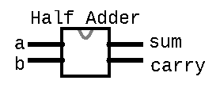
Half Adder
Circuit that is the logic for adding two bits together
Takes in two inputs
“a” - a bit from the first number being added
“b” - a corresponding bit from the second number being added
Produces two outputs
sum - the value to be put for this column in the result
carry - the value to be carried over to the next column
/**
* Computes the sum of
* 2 bits
*/
CHIP HalfAdder {
IN a, b;
OUT sum, carry;
PARTS:
// Put your code here:
}

Slide 23
Half Adder
Example: 0111 + 0101
For the first (least significant) column:
a = 1
b = 1
result = 0
carry = 1
carry | 1 | 1 | 1
x | 0 | 1 | 1 | 1
y | 0 | 1 | 0 | 1
result | 1 | 0 | 0 | 0

Slide 24
Half Adder Group Work
As a group, come up with the boolean expression that implements the half adder logic
First fill in the truth table on the next slide with the correct values for sum and carry-out based on the inputs
Develop a boolean expression for sum based on the truth table
Develop a boolean expression for carry based on the truth table
Present your solutions to the course staff (as though we were students learning about half adders)
One person give an overview of what the half adder does
One person detail how the expression for sum was determined
One person detail how the expression for carry was determined

Slide 25
Half Adder Group Work
a | b | sum | carry
0 | 0 | 0 | 0
0 | 1 | 1 | 0
1 | 0 | 1 | 0
1 | 1 | 0 | 1
Boolean expressions:
sum = a Xor b
carry = a And b

Slide 26
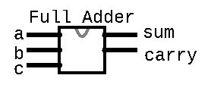
Full Adder
Circuit that is the logic for adding two bits and the carry from the previous column together
Takes in three inputs
“a” - a bit from the first number being added
“b” - a corresponding bit from the second number being added
“c” - the carry bit from the previous column
Produces two outputs
sum - the value to be put for this column in the result
carry - the value to be carried over to the next column
/**
* Computes the sum of
* 3 bits
*/
CHIP FullAdder {
IN a, b, c;
OUT sum, carry;
PARTS:
// Put your code here:
}

Slide 27
Full Adder
Example: 0111 + 0101
For the second (second least significant) column:
a = 1
b = 0
c = 1
result = 0
carry = 1
carry | 1 | 1 | 1
x | 0 | 1 | 1 | 1
y | 0 | 1 | 0 | 1
result | 1 | 0 | 0 | 0

Slide 28
Full Adder Truth Table
a | b | c | sum | carry
0 | 0 | 0 | 0 | 0
0 | 0 | 1 | 1 | 0
0 | 1 | 0 | 1 | 0
0 | 1 | 1 | 0 | 1
1 | 0 | 0 | 1 | 0
1 | 0 | 1 | 0 | 1
1 | 1 | 0 | 0 | 1
1 | 1 | 1 | 1 | 1

Slide 29
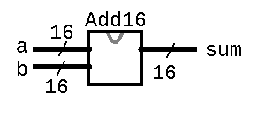
Multi-Bit Adder
Adds two 16-bit numbers
Connects the full adders for each column together (wires the out carry from one column to the in carry of the next)
/**
* Adds two 16-bit two’s complement
* values. Overflow is ignored.
*/ CHIP Add16 {
IN a[16], b[16];
OUT sum[16];
PARTS:
// Put your code here:
}

Slide 30
Reminders
1:1 TA-Student Meetings
First meeting is this week! 1-hour first time; 45-min going forward
Office Hours
Porter Wednesdays 4 - 5PM PDT
Leslie Tuesdays 4 - 4:30PM PDT
Eric & Margot Tuesdays 2 -3PM PDT
Project 1: Boolean Logic & Study Skills Inventory
Due Thursday 11:59PM PDT

