Slide 1
Final Class! :(
Social Computing Reflection, CSE 390B victory lap, TA-led activity
Significant material adapted from www.nand2tetris.org. © Noam Nisan and Shimon Schocken.

Slide 2
Agenda
Social Computing Discussion III
Victory Lap
End of Quarter Activity led by your lovely TAs
Reminders

Slide 3
Social Computing Reflection Discussion III
Share the article you found for your third social reflection!
Things to include:
Give a summary of the article
Share how it changed/influenced your thinking
Share your follow up questions
Feel free to have discussions beyond these bullet points too!

Slide 4
What can we do to change things as computer scientists?
We’ve spent some time exploring social issues in computing, and you may feel like you want to help change things about the current computing culture!
I know there are things I would definitely like to change
But it can be hard to feel like you have any power or control over what are very complex issues

Slide 5
Individualistic Ethics Can be Misleading
Often our society portrays solutions to systemic issues as a sum of a bunch of individual actions
While individual choices do add up, this view does not acknowledge the structural pressures placed on individuals that lead them to make certain choices
It also doesn’t account for the things that individuals don’t have control over (or very indirect control over)
Systemic problems need systemic solutions
Changing systems to incentivize better choices by individuals
Changing systems to prioritize better choices at all levels (not just the individual level)

Slide 6
Example: Carbon Emissions
Often our society portrays solutions to systemic issues as a sum of a bunch of individual actions
Carbon emissions are so bad because of all the individual choices we make to drive/fly/use lawn mowers/etc.
While individual choices do add up, this view does not acknowledge the structural pressures placed on individuals that lead them to make certain choices
You may have to drive to work because the only bus option requires 2 transfers and takes 2 hours
It also doesn’t account for the things that individuals don’t have control over (or very indirect control over)
You have little direct control over how energy companies generate their energy (aside from your power to vote)
Systemic problems need systemic solutions
Individual incentives: Providing more options for public transport/greener commutes
Better choices at all levels: taxing carbon emissions produced by organizations

Slide 7
Individualistic Ethics in Computing
Movements towards ethics/social issues/change in computing often emphasize individual responsibilities
In reality, there may be very few times where you will be programming and have a direct ethical question in front of you
These are often decided at other levels and then passed down as instructions for “what to do”
Obviously depends on where you are working, what you are working on, etc.
But there are still ways in which you can pressure the systems to change!

Slide 8
Lobbying Your Skills as a Computer Scientist
Y’all have amazing skills! You get to decide what you want to use them on
This might be the career choice you make
Whether you work at a company, nonprofit, university, etc.
What organizations you choose to work for
Example: Finding a company/nonprofit that works on an issue you think is meaningful
Example: Researching technologies aimed a social good (lots of labs at UW that aim to do this)
This might be choices you make within a role
Advocating for best practices on a project you are working on
Declining to work on a project because of concerns over the ethics of it
Example: pointing out harmful bias in the design of a product

Slide 9
Pressuring Systems to Change
You might run into a system (company, institution, committee, etc.) that you think is really difficult to change
I super relate to this feeling
The only way for that system to change is for there to be consistent pressure for it to do so
These systems want us to give up trying to change them!
One way to create pressure is to come together as a collective and advocate for your beliefs
There is strength in numbers!
A bunch of google employees recently created a union
Amazon workers have discussed unionizing

Slide 10

Agenda
Social Computing Discussion III
Victory Lap
End of Quarter Activity led by your lovely TAs
Reminders

Slide 11
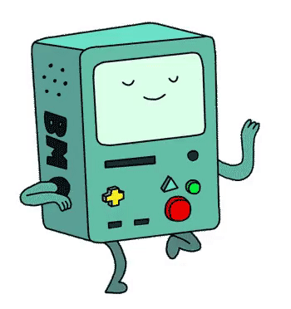
Nand2Tetris Projects
By building a computer, you’ve accomplished something that very few
CSE students have done!
Many software writers consider building the computer as Somebody Else’s Problem™
But so many technical skills and CSE courses tie in to this task
And even if you only write Java for the rest of time…
Understanding the “layer below” makes you a better engineer in the “layer above”!
Notes:
Take a min going through what you’ve done!

Slide 12
Roadmap
SOFTWARE
HARDWARE
High-Level Language
Intermediate Language(s)
Assembly Language
Operating System
Assembler
Machine Code
Computer
Memory
CPU
ALU
PC
Basic Logic Gates
NAND
Notes:
Let’s revisit

Slide 13
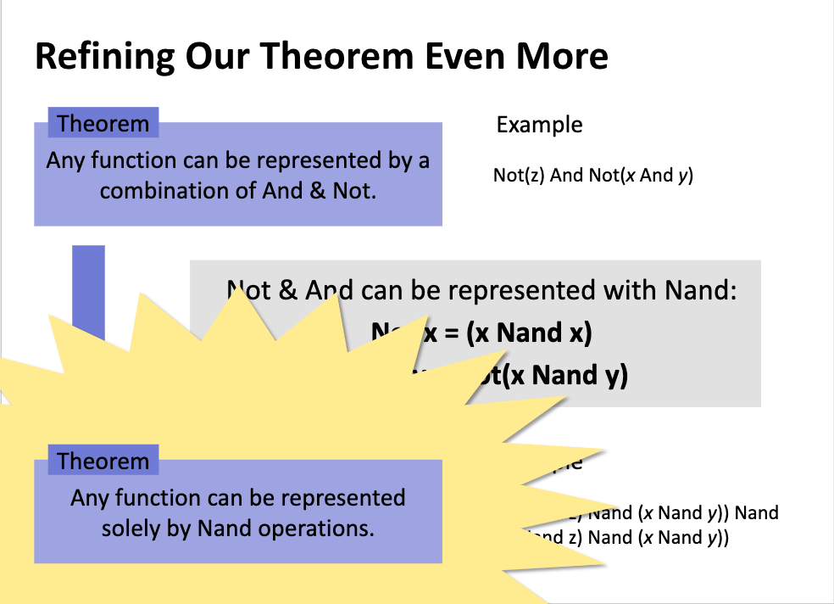
Boolean function synthesis
Practice with an unfamiliar, declarative style of programming
Project 1
Basic Logic Gates
NAND
Notes:
Any function -- that includes the “Computer”

Slide 14
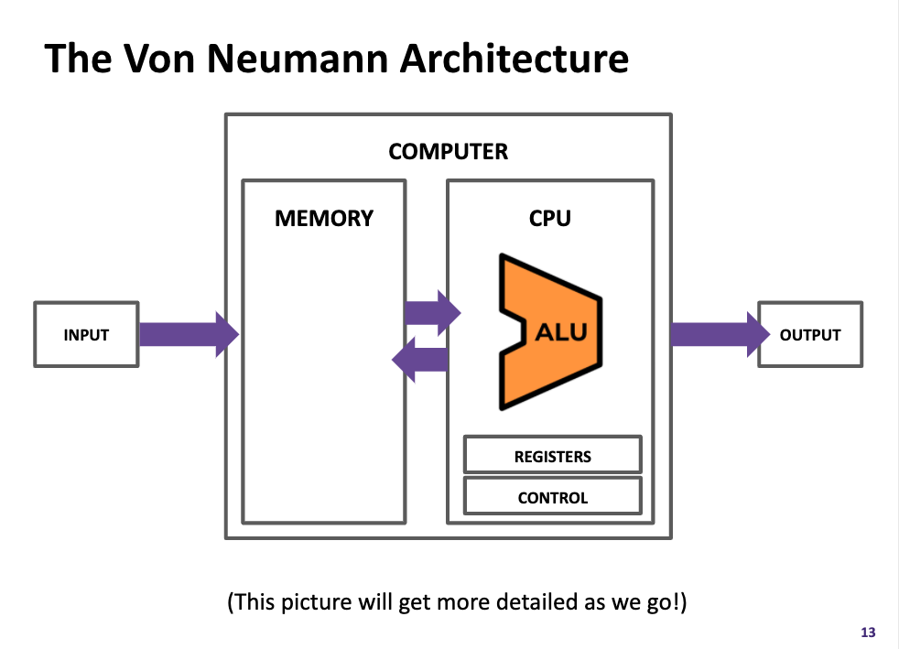
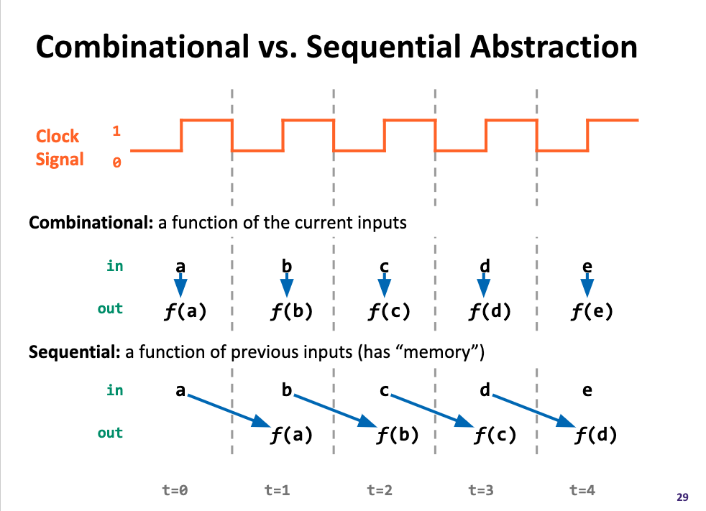
Project 3
Memory
Components found in “real-world” computers: ALU, PC, Memory...
Learning a mental model for sequential logic
Project 2
ALU
PC
Basic Logic Gates
NAND

Slide 15
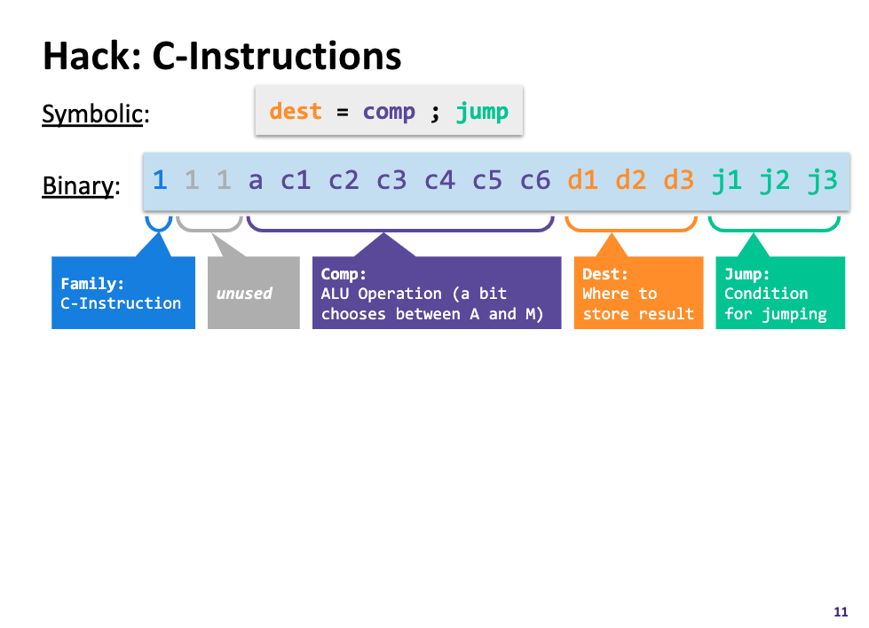
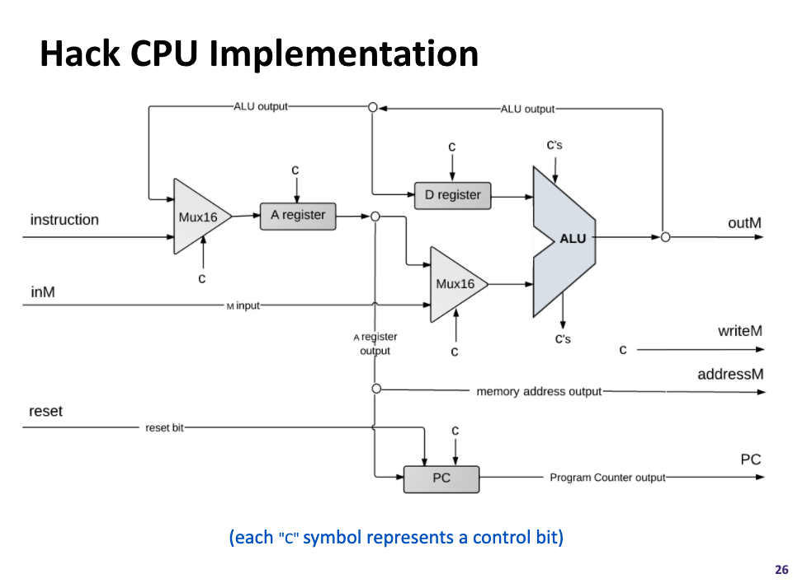
Project 4
Assembly Language
Assembler
Machine Code
Project 5
Computer
Memory
CPU
The connection between software and hardware through binary instructions
What has to happen in a clock cycle to process one instruction
ALU
PC
Basic Logic Gates
NAND

Slide 16
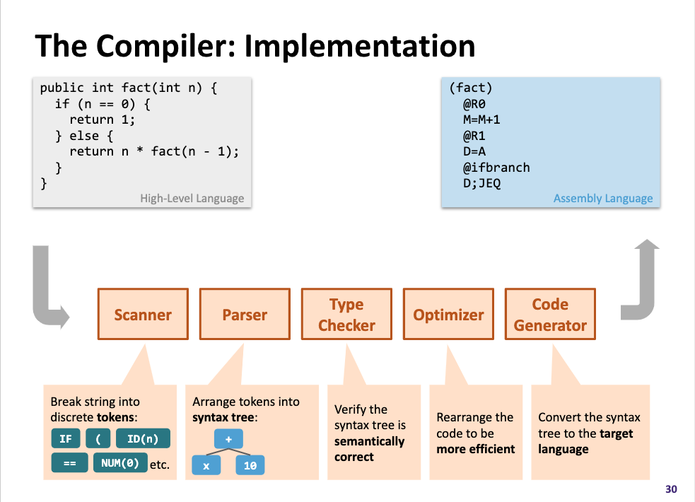
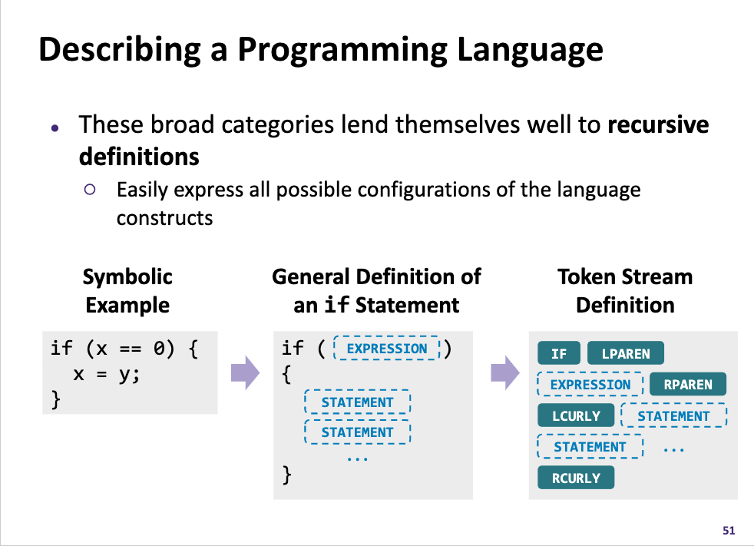
High-Level Language
Project 7
Intermediate Language(s)
Assembly Language
Operating System
Assembler
Machine Code
Computer
Memory
CPU
What actually happens when you click that green run button?
Programs can read in programs and then spit out equivalent programs
ALU
PC
Basic Logic Gates
NAND
Notes:
Getting at: what is a program?

Slide 17
Takeaways: Why Build a Computer?
Undeniably a significant engineering effort
You practiced so many skills and programmed with so many different languages, tools, & paradigms -- and you can do it again!
We hope this was demystifying experience
To see CSE not as isolated courses, but as a big inter-connected jigsaw puzzle.
And hopefully at least a little fun :)
CSE has something for everyone, and with any luck you found something exciting enough to pursue further.

Slide 18
SOFTWARE
HARDWARE
331: Software Design 332: Data Structures 421: Algorithms
446: ML … & many more
341: Programming Languages
High-Level Language
Intermediate Language(s)
401: Compilers
333: Systems Programming
Assembly Language
Operating System
451: Operating Systems
452: Distributed Systems
461: Networks
Assembler
351: HW/SW Interface
Machine Code
Computer
Memory
CPU
469: Computer Architecture
ALU
PC
311: Foundations I
Basic Logic Gates
369: Digital Design
NAND
371: Digital Circuits

Slide 19
Remember this?
The UW Student Experience
Math
Metacognitive
Skills
CSE
Nand2Tetris
Projects
Sociology
CSE 390B

Slide 20
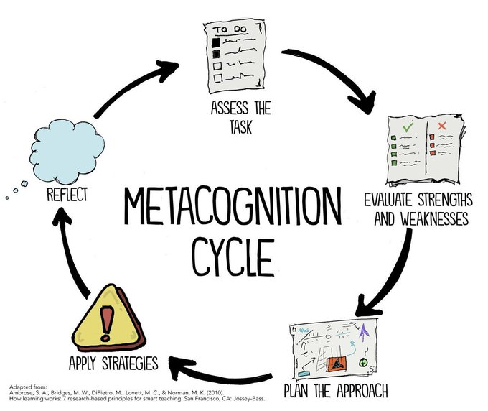
Metacognitive Skills Victory Lap!
Time Management
Note-Taking
Annotation
Exam Preparation
Test-Taking
Debugging
Working with Instructors & TAs
Design Decisions
Oral Communication
Notes:
Also acknowledging an extremely difficult quarter…
Your UW experience this quarter has included SO MANY HURDLES and CHALLENGES.
You have experienced (and still are experiencing) navigating a global pandemic and the impacts that COVID-19 has had on our world and daily lives. You have endured an entire quarter (and then some) of online learning - we all have a very special relationship with zoom..
And certainly given recent events, you are still processing so much that is happening in our community and across the world.

Slide 21


Slide 22
Agenda
Social Computing Discussion III
Victory Lap
End of Quarter Activity led by your lovely TAs
Reminders

Slide 23
Agenda
Social Computing Discussion III
Victory Lap
End of Quarter Activity led by your lovely TAs
Reminders

Slide 24
Reminders!
Office Hours ending this week
Happy to meet during finals week by appointment
Final Project Part I: Project Outline
Due TONIGHT 11:59PM PST
Final Project Part II: Mock Presentation
Due next Wed 6/9 11:59PM PST
Final Project Presentations Thursday June 10th @ 10:30AM PST
Course Evaluations
Please, please, pleaseeeeeee complete this!

Slide 25
Thanks for an incredible quarter!
Stay in touch :)
-- The CSE 390B Staff

