Slide 1
CSE 374: Programming Concepts and Tools
Spring 2026
Instructor: Megan Hazen

Slide 2
Today’s Goals
Subject Matter
Sed review
Version Control
gitlab
Your Goals
Find your gitlab account
Clone the CSE 374 repo
Start your own repo

Slide 3
Aside: GNU
Goal is to be completely free
  Mostly licensed under ‘GNU General Public License (GPL)’
Many software tools
Typically used with a linux kernel
Managed by the Free Software Foundation
https://www.gnu.org/home.en.html
GNU’s Not Unix
Notes:
Demo emacs -nw

Slide 4
Basic sed (more)
$sed [OPTIONS] [COMMAND] [FILE]
$input_stream | sed [COMMAND]
$sed -i 's/orig/replace/g’ FILE
FILE: An input file, could be more than one.
-i: an example of an OPTION (flag) – this replaces the original file with an edited one.
s/orig/replace/g: the command, enclosed in single quote to avoid globbing.
S indicates substitution, orig& replace are regex patterns, g indicates global.

Slide 5
Sed Commands
P : print this line (often used with ‘-n’ to suppress printing of non-marked lines)
d : delete this pattern space and continue
y : transliterate characters
a: append text
i : insert text
c : replace text
$ echo hello world | sed 'y/abcdefghij/0123456789/'
74llo worl3$
$ seq 3 | sed '2i hello'
1
hello
2
3
$ seq 10 | sed '2,9c hello'
1
hello
10

Slide 6
SED
Demo
wget https://courses.cs.washington.edu/courses/cse374/26sp/assignments/numberslist
Notes:
wc numberslist
4 grep '+\?1\?[- .]\?(\?[0-9]\{3\})\?[- .]\?[0-9]\{3\}[- .]\?[0-9]\{4\}' numberslist
5 grep -c '+\?1\?[- .]\?(\?[0-9]\{3\})\?[- .]\?[0-9]\{3\}[- .]\?[0-9]\{4\}' numberslist
6 sed 's/+\?1\?[- .]\?(\?[0-9]\{3\})\?[- .]\?[0-9]\{3\}[- .]\?[0-9]\{4\}/TEXT/g' numberslist
7 sed -n '/+\?1\?[- .]\?(\?[0-9]\{3\})\?[- .]\?[0-9]\{3\}[- .]\?[0-9]\{4\}/p' numberslist
8 sed -n '/+\?1\?[- .]\?(\?[0-9]\{3\})\?[- .]\?[0-9]\{3\}[- .]\?[0-9]\{4\}/!p' numberslist
9 sed -n '/+\?1\?[- .]\?(\?[0-9]\{3\})\?[- .]\?[0-9]\{3\}[- .]\?[0-9]\{4\}/p' numberslist > phonenumberlist
10 more phonenumberlist
11 wc phonenumberlist
12 sed -e 1d -e 5d numberslist
13 sed 's/+\?1\?[- .]\?(\?\([0-9]\{3\}\))\?[- .]\?\([0-9]\{3\}\)[- .]\?\([0-9]\{4\}\)/(\1) \23/g' phonenumberslist
14 sed 's/+\?1\?[- .]\?(\?\([0-9]\{3\}\))\?[- .]\?\([0-9]\{3\}\)[- .]\?\([0-9]\{4\}\)/(\1) \23/g' phonenumberlist
15 sed 's/+\?1\?[- .]\?(\?\([0-9]\{3\}\))\?[- .]\?\([0-9]\{3\}\)[- .]\?\([0-9]\{4\}\)/(\1) \2-\3/g' phonenumberlist
16 sed 's/\([A-Z]\)., *\([A-Z][a-z]*\) *\(.*$\)/\2 \1\ \3/g' phonenumberlist
17 more phonenumberlist
18 sed 's_+\?1\?[- .]\?(\?[0-9]\{3\})\?[- .]\?[0-9]\{3\}[- .]\?[0-9]\{4\}_TEXT_g' phonenumberlist
19 sed -n '4,$p' phonenumberlist

Slide 7
Sed additional thoughts
Sed encounters one line at a time
and does one pass of the input.
Delimiter ‘/’ can be changed to anything, like ‘_’ or ‘:’
  may help if COMMAND contains many ‘/’
Multi-line editing is possible, but painful, with sed (with ‘hold buffer’). Use another scripting program (like ‘awk’).
Branches are also possibly (‘b’ and ‘t’ commands)
Use backreferences (\1, \2 etc) to refer back to regex gathered with \( to \)

Slide 8
What about awk?
(or perl? Or ed? Or ruby?)
`awk` allows you to edit an input stream with more power than `sed`
All of these, though, are scripting languages with their own flavor and their own power. `sed` is one of the most basic.

Slide 9
What is version control?
Keeps track of files
Tracks changes to files
Manages sharing of files
Merges multiple and sometimes conflicting updates

Slide 10
Modern version control?
Keeps track of files
  Backs up to cloud
Tracks changes to files
  Keeps history and traces changes to user
Manages sharing of files
  Branching and Merging
  Rollback and recovery
  Collaboration and merge conflict resolution

Slide 11
Have you heard of this before?
Perforce
Apache SVN
Unity
Azure
Git
Mercurial

Slide 12
Why is version control?
Backups: Archive a project to keep a safe copy
Collaboration: Shared copy, manages concurrent and maybe conflicting changes
Version log: Keeps copies of previous versions and changes made
Note: This is not software only – version control can be used for all types of documents

Slide 13
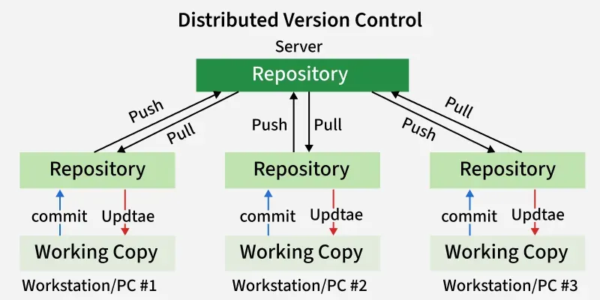
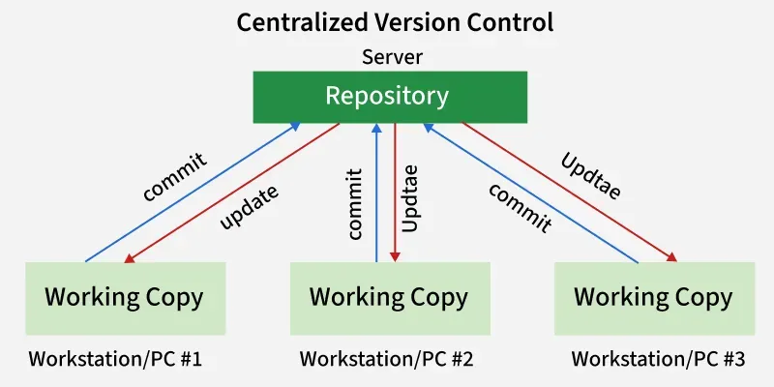
Models of version control
Local
Centralized (Subversion)
Distributed (git)
https://www.geeksforgeeks.org/git/version-control-systems/

Slide 14
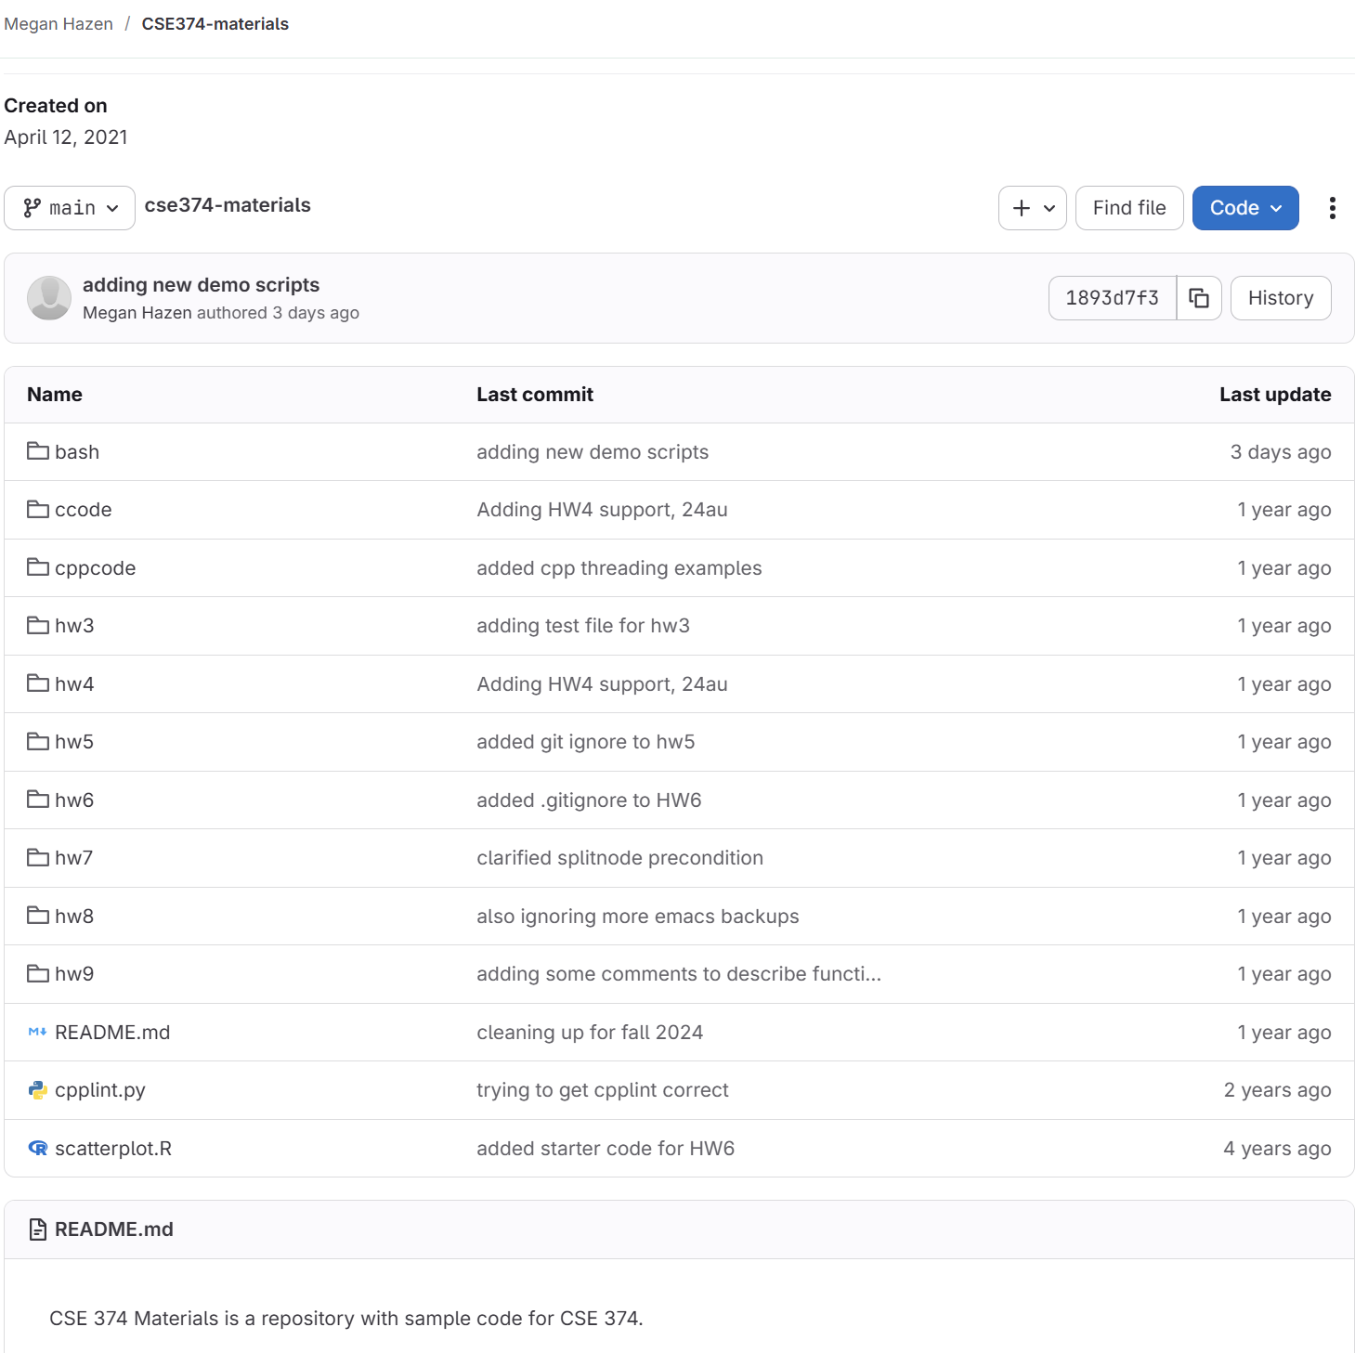
Repositories (repos)
A repository is a collection of all the files.
  Consider it a set of nested folders and files
  Or one branch of the file system tree
Also includes a history of changes

Slide 15
Repos store
Source code
Build files
Resources files (pictures, data files)
NOT derived files (object files, backups)

Slide 16

What is git?
Git is a free and open source distributed version control system
  We’ll use git on Calgary
  It is already installed.
Gitlab provides a cloud-based system that hosts gits repositories.
  Gitlab offers many features beyond basid git, including a web interface.
Github and Bitbucket are also services that host git repositories
Currently most popular version control software
Developed in 2005 to support Linux work
Both Linux and Git were designed by Linus Torvalds – open source development model

Slide 17
Using your repo
Gitlab server maintains central copy of each repo (the ‘origin’)
Users ‘clone’ (get a copy of) in their local account (on Calgary)
Users get changes from the origin using pull
Users put their local changes back into origin using push
Gitlab
User1
User2
User3

Slide 18
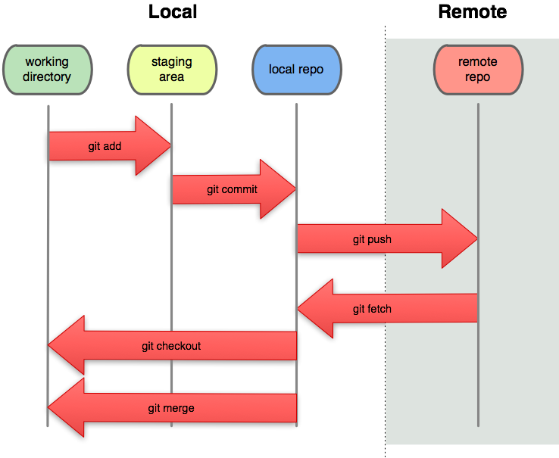
Using your local repo
On your local machine you can make changes to your local copy of the repo.
Adding, and committing, changes the status of your local repo.
In order to put those changes back on the cloud, to back up or share with others, you need to do git push.
Notes:
`git pull` does a `git fetch` and a `git merge` in one single command.

Slide 19
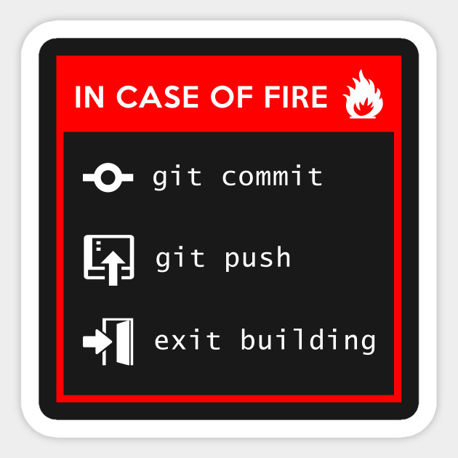
Cloud based back up
Re-access anywhere
Safe against local hardware damage
Can share with others

Slide 20
Git command
The git command lets you interact with git
In a folder that is a repo you can use this like any other shell command
[mh75@attu2 cse374-materials]$ ls -a
. bash cppcode .git hw4 hw6 hw8 README.md
.. ccode cpplint.py hw3 hw5 hw7 hw9 scatterplot.R
[mh75@attu2 cse374-materials]$ git status
On branch main
Your branch is ahead of 'origin/master' by 24 commits.
(use "git push" to publish your local commits)
nothing to commit, working tree clean
[mh75@attu2 cse374-materials]$ git pull
Already up to date.

Slide 21
Git commands
Command | Operation
git clone url [dir] | Copy a Git repository so you can add to it
git add file | Adds file contents to the staging area
git commit | Records a snapshot of the staging area
git status | View the status of your files in the working directory and staging area
git diff | Shows diff of what is staged and what is modified but unstaged
git help [command] | Get help info about a particular command
git pull | Fetch from a remote repo and try to merge into the current branch
git push | Upload your local commits to the remote repository/server

Slide 22
Creating a new repo
Three common scenarios (only do one of these):
To create a new local Git repo in your current directory: git init
  This will create a .git directory in your current directory.
  Then you can commit files in that directory into the repo.
To clone a remote repo to your current directory:
  git clone url [localDirectoryName]
  This will create the given local directory, containing a working copy of the files from the repo, and a .git directory.
Use the web interface, and then clone

Slide 23
Add and commit a file
$ git status
On branch main
Your branch is ahead of 'origin/master' by 24 commits.
(use "git push" to publish your local commits)
Changes not staged for commit:
(use "git add <file>..." to update what will be committed)
(use "git restore <file>..." to discard changes in working directory)
modified: README.md
no changes added to commit (use "git add" and/or "git commit -a")
$ git add README.md
$ git commit -m 'Updating README for new quarter'
[main 63996fc] Updating README for new quarter
1 file changed, 4 insertions(+), 2 deletions(-)
If you change a file, or create a new file, you:
git add filename
Takes a snapshot of the file and puts it in the staging area
To put the changes into the local repo you:
git commit –m “<message”

Slide 24
What is a commit?
commit 63996fcdae5603da03f47c5ee78cab11eb68f849 (HEAD -> main, origin/main)
Author: Megan Hazen <mh75@cs.washington.edu>
Date: Fri Apr 10 15:27:12 2026 -0700
Updating README for new quarter
commit 1893d7f3470099159b79ae05290f33ad109f1389
Author: Megan Hazen <mh75@cs.washington.edu>
Date: Mon Apr 6 14:47:11 2026 -0700
adding new demo scripts
One single set of changes to your local repository
Also records
  Name of author
  Date and time
  A commit message: a brief description of the change
Identified by an ID, or “SHA”

Slide 25
Commit messages
Commit messages are the way you remind yourself and tell others what you did
Commit messages should be descriptive
  E.g. "Added test for predicting null string"
  not "changed test"
Commit messages should be short/medium length
If you want to know exactly what code was changed, you can check the full changes.

Slide 26
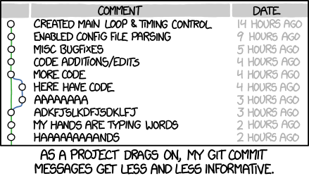
XKCD Commit messages

Slide 27
Know your history
git status
git status –s
  Lists files with changes
  Tell you un-pushed commits
git diff
git diff –cached
  Tells you what you changed
git log
  Tells you commit history
[mh75@attu2 cse374-materials]$ git status
On branch main
Your branch is ahead of 'origin/master' by 25 commits.
(use "git push" to publish your local commits)
Changes not staged for commit:
(use "git add <file>..." to update what will be committed)
(use "git restore <file>..." to discard changes in working directory)
modified: README.md
no changes added to commit (use "git add" and/or "git commit -a")
[mh75@attu2 cse374-materials]$ git status -s
M README.md

Slide 28
Moving or removing
Once files have been committed to gitlab repository:
  git mv files
  git rm files
git will make changes locally then update the remote GitLab repo when you push
Can be fixed if you use regular mv/rm commands, but its awkward
Notes:
Git reset –hard HEAD might work

Slide 29
Keep your local repo clean
Commit early and often
Don’t lose your work!
Clean up errors as you go
Don’t let them accumulate
Local repo doesn’t affect others
Can even commit incomplete work
(could always revert)

Slide 30
Collaboration!
Good practice – update with remote changes: git pull
  Also do this any time you want to merge changes pushed by your partner
Possibly fix any merge messages
Test, fix anything, git add / git commit
Push accumulated changes to server: git push
Use the central server repository to work with others (or back up your latest best copy!)

Slide 31
Combining Efforts: Ideal
Main
Alice
Bob
Alice
Main
Alice makes a commit and pushes
Bob pulls, makes a change, commits the change, and pushes
Alice pulls, makes a change, commits, and pushes
...etc.
Ideal

Slide 32
Combining Efforts: Reality
Main
Charlie
Charlie makes a change and creates commit C, but doesn't push
Diane also makes a change and commit D, and pushes
Charlie pulls from the remote repo
It's no longer a list! The history has diverged
Diane
Whose changes?

Slide 33
Combining Efforts: Merging
Main
Charlie
A merge commit has two ‘parents’
  Combines the changes in each
  Final main contains all of Diane’s changes and all of Charlie’s changes.
Diane
Main merged

Slide 34
Combining Efforts: Merge Conflict
Main
Charlie
A merge commit has two ‘parents’
  Sometimes you changed the same line
  There is a conflict
Edit the file to remove the conflict.
  Just edit the file removing notes and fixing the issue
  Recommit and push
  HEAD is local version
Diane
  <<<<<<< HEAD
  The code is gradescope autograder code. Example solutions may be found in submissions subfol
  ders or under homework folder.
  =======
  The folders primarily contain gradescope autograder code. Example solutions may be found in
  submissions subfolders or under homework folder.
  >>>>>>> e570402d9a0953cdc5e9469d6210ab1a76a239d1
Main merged

Slide 35
Branching
‘main’ refers to the main line, ground truth branch
‘HEAD’ refers to the branch you are working on in your local repo / the last commit you made
‘remote’ is the server where the repo is stored
Git supports branching, which allows you to split out lines of work.
Branches consist of one or more commits. A repo may have one or more branches.
  Create a branch to fix a bug git branch bugfix
  Create a different branch to make a new feature git branch feature
  Switch between branches git checkout bugfix
When you are done with the work of a branch, you can re-merge it into Main.
  Go back to main with git checkout main
  Merge in your bug fix with git merge bugfix

Slide 36
Fixing Mistakes
Can git checkout FILE to get the last committed version of the FILE.
Set local repository to the last commit (forget all changes that you've made), you can run git reset --hard HEAD
Here "HEAD" refers to the most recent commit in your local repository
Undo a commit using git revert
If the second-to-last commit was bad, you can undo it by saying
git revert HEAD~1
Commits aren't completely static and permanent. If you make a commit but then realize you forgot one little thing, you can "amend"/modify your previous commit
git commit --amend

Slide 37
.gitignore
Git may be used to store any types of files.
However… do not store files that are unnecessary.
Backup files (like *.swp vim files)
Files that can be recreated (such as .o files) should not be added.
System specific files
‘.gitignore’ lists files not to upload to HEAD.
# Ignore emacs backup files
*.~
# Ignore OS X finder info files
.DS_Store
# Ignore built object files
*.o

Slide 38
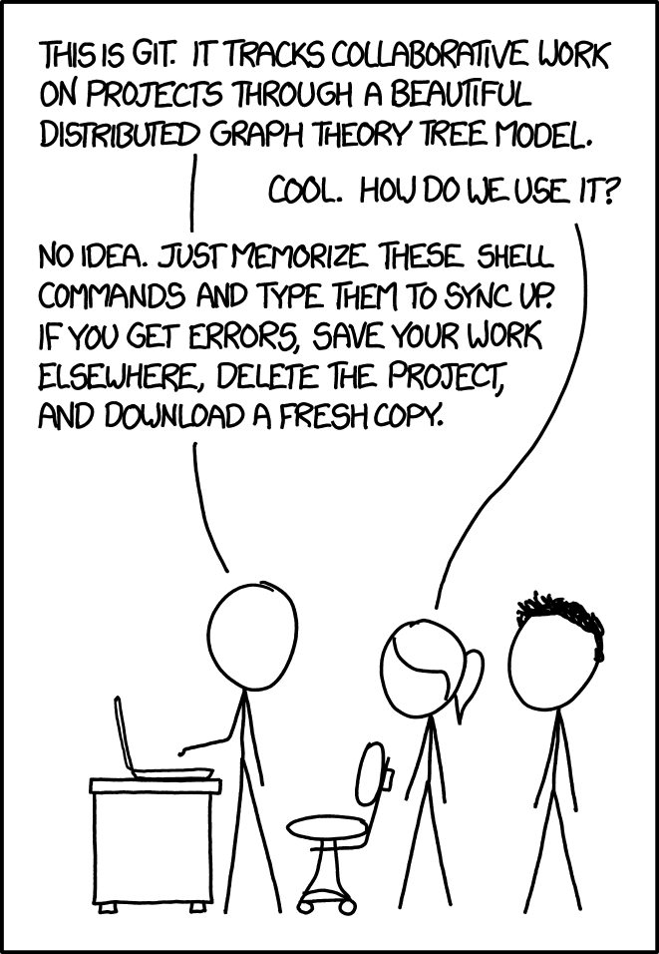
Fixing Git
You will inevitably run into frustrating situations with git
Even for experienced users, sometimes you may accidentally get your git repo into an undesirable situation
There is always a way to fix this, although it's not always obvious how
Online resources are helpful
  https://ohshitgit.com/

Slide 39
Week three!
Clone your repo
Push some changes

