Slide 1
CSE 374: Programming Concepts and Tools
Spring 2026 Instructor: Megan Hazen

Slide 2
Today’s Goals
Subject Matter
Regular Expressions
SED
Your Goals
HW2
Practice practice practice …

Slide 3
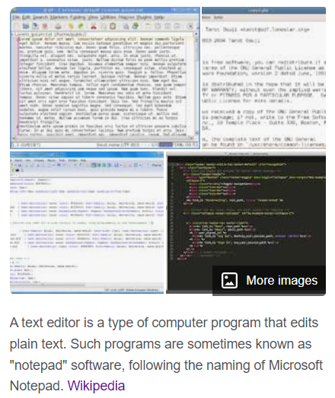
Aside: text editors
Vi (Vim)
Move around, mark edit using letter keys <hjkl>
Get to insert mode by typing ‘i’, ‘esc’ out
Get to menu by typing “:”
Save and quit “:wq”, no-save and quit: “:q!”
Vim is ‘improved’ vi - more powerful
Vimtutor at prompt
Emacs
Endlessly extendable; can use arrows to move
Menu commands use C (control) or M (meta/alt)
Quit: C-x C-c
Tutorial, C-h for help
Notes:
`grep` comes from g/re/p which is an ed command to print (p) things that match the regular expression (re) globally (g)

Slide 4
Emacs
1 ;; use spaces to indent
2 ;; Note - can be over-ridden for other modes
3 (setq-default indent-tabs-mode nil)
4
5 ;; change the default tab width to 2 spaces
6 ;; and then use that width.
7 (setq-default tab-width 2)
8 (setq indent-line-function 'insert-tab)
9
10 ;; always display line numbers
11 (global-display-line-numbers-mode 1)
12
13 ;; Don't use delete mode
14 (normal-erase-is-backspace-mode 0)
Try
M-x doctor
M-x snake
M-x morse-region

Slide 5
Grep matching
Looks at one line at a time to match a pattern
Default is to match .*p.*
(just means that anything can come before or after the string)
But you can anchor a pattern with ^ (beginning) and/or $ (end) or both.
[mh75@calgary scripts]$ ls -R ~ | grep demo
demoscript
shiftdemo
[mh75@calgary scripts]$ ls -R ~ | grep '^demo'
demoscript
[mh75@calgary scripts]$ ls -R ~ | grep 'demo$'
shiftdemo
[mh75@calgary scripts]$ ls -R ~ | grep '^demo$'
[mh75@calgary scripts]$

Slide 6
Regular Expressions
A set of rules for matching a pattern (P) to a string (S)
All strings are made of a combination of the null (empty) set, the empty string 𝜺, and a single character.
Regular expressions match a string if
P is a literal character (a, b, …) that matches the string S
P₁P₂ matches S if S = S₁S₂ such that P₁ matches S₁ and P₂ matches S₂
P₁|P₂ matches S if P₁ matches S OR P₂ matches S
P* matches S if there is an i such that P...P (i times) matches S. Includes i=0 which matches 𝜺.

Slide 7
Basic Regex
Characters: literal characters [a b 9] (S is an exact duplicate of P)
Anchors: sets the position in the line where P may be found (^ or $)
Modifiers: modify the range of text P may match (* or [set_of_chars])
Notes:
Details vary by implementation, but these basic rules apply.

Slide 8
Special characters in Regex
\ : escape following character
. : matches any single character at least once
p₁|p₂ : matches p₁ OR p₂
*: matches zero or more of the previous p
? : matches zero or one of the previous p (𝜺|p)
+: matches one or more of previous p (pp*)
() : group patterns for order of operations
{} : repeat n times
[] : contain literals to be matched (single or range)
^ : Anchors to beginning of line
$ : anchors to end of line
<> : word boundaries
Some of these characters are escaped, using \ Some are not
Which is which depends on implementation

Slide 9
Character Classes
. → any character
[a-z] → a, b, c, d … z
[A-Z] → A, B, C, D … Z
[0-9] → 0,1,2,3,4,5,6,7,8,9
abc → literally abc
c.t → cat, cut, cot
[Hh]ello! → Hello!, hello!
[BLERG] -> B, L, E, R or G
[0-5][5-9] → 15,16,17,18,19 25,26,27,28,29 35,36,37,38,39 45,46,47,48,49 55,56,57,58,59

Slide 10
Character Classes (more demo)
$ cat testfile
Megan teaches 374
kayak
rubber duck
$ grep '[u-z]' testfile
kayak
rubber duck
$ grep 'teaches' testfile
Megan teaches 374
$ grep [A-Z].*[0-9] testfile
Megan teaches 374
. → any character
[a-z] → a, b, c, d … z
[A-Z] → A, B, C, D … Z
[0-9] → 0,1,2,3,4,5,6,7,8,9
abc → literally abc

Slide 11
Invisible characters
$ cat testfile
Megan teaches 374
wow kayak rubber duck
rahrah yeah yeah wow wow
$ grep '^wow' testfile
wow kayak rubber duck
$ grep 'wow$' testfile
rahrah yeah yeah wow wow
$ grep -P '([a-z]*)\t\1' testfile
rahrah yeah yeah wow wow
$ grep '\([a-z]*\)[[:space:]]\1' testfile
Megan teaches 374
wow kayak rubber duck
rahrah yeah yeah wow wow
$ grep ‘[^0-9]’ testfile
Megan teaches 374
^ → start of a line
$ → end of a line
\t → a tab
\s or [[:space:]] → white space
[^abc] → NOT abc

Slide 12
Repetition
$ cat testfile
wf wof woof wooooof
$ grep 'w[o]*f' testfile
wf wof woof wooooof
$ grep 'w[o]\+f' testfile
wf wof woof wooooof
$ grep 'w[o]\?f' testfile
wf wof woof wooooof
$ grep 'w[o]\{2\}f' testfile
wf wof woof wooooof
$ grep 'woof\|wof' testfile
wf wof woof wooooof
* → zero or more
+ → one or more
? → zero or one
{n} → exactly n repetitions
A|b → A or b

Slide 13
Backreferences
Up to 9 times in a pattern, you can group with (p) and refer to the matched text later!
You can refer to the text (most recently) matched by the nth group with \n.
Simple example: double-words ^\([a-zA-Z]*\)\1$
\(p\)\{n\} will match the p n times. \{n,m\} matches at least n, but not more than m times.
You cannot do this with actual regular expressions; the program must keep the previous strings.
$ cat testfile
kayak rubber duck
$ grep '\([a-z]\)\([a-z]\).*\2\1' testfile
kayak rubber duck
$ cat testfile
wf wof woof wooof wooooof
$ grep 'w[o]\{2,4\}f' testfile
wf wof woof wooof wooooof

Slide 14
Demo
$ ls /usr/share/dict/words $ ln –s /usr/share/dict/words words $ wc words
wget https://courses.cs.washington.edu/courses/cse374/26sp/assignments/numberslist
Notes:
Grep ‘moon’ words | wc
Grep ‘^moon’ words | wc
Grep ‘moon&’ words | wc
Grep ‘^moon&’ words | wc
Grep ‘^[a-c]’ words | wc
Grep ‘^[^a-y]’ words | wc
grep '^\([A-Za-z]*\)\1$' words
grep '^\([A-Za-z]*\)\1\1$' words
grep '^\(.\)\(.\)\(.\)\3\2\1$' words

Slide 15
Gotchyas
Modern (i.e., gnu) versions of grep and egrep use the same regular expression engine for matching, but the input syntax is different for historical reasons
For instance, \{ for grep vs { for egrep – See grep manual sec. 3.6
Must quote patterns so the shell does not glob them – and use single quotes if they contain $ (why?)
Must escape special characters with \ if you need them literally: \. and . are very different
But inside [ ] many more characters are treated literally, needing less quoting (\ becomes a literal!)

Slide 16
Try this with Grep
Can you write a regular expression to identify every phone number?
\ : escape following character ‘.’ : matches any single character at least once p₁|p₂ : matches p₁ OR p₂ ‘*’ : matches zero or more of the previous p ‘?’ : matches zero or one of the previous p (𝜺|p) ‘+’ : matches one or more of previous p (pp*) () : group patterns for order of operations {} : repeat n times [] : contain literals to be matched (single or range) ^ : Anchors to beginning of line $ : anchors to end of line <> : word boundaries
D., Mark (206) 901-2345 E., Clarence +1-206-789-0123 E., Philip 1-206-890-1234 G., Timnit (206) 4569012 H., Grace +1 206.345.6789 H., Margaret (206)567-8901 J., Katherine 206 456 7890 L., Ada (206) 123-4567 L.,Jerry 2061235678 O., Ellen 206 2346789 T., Alan 206-234-5678 W., Jeannette 206 678.9012
(download ‘numberslist’ from website)
Notes:
grep '+\?1\?[- .]\?(\?[0-9]\{3\})\?[- .]\?[0-9]\{3\}[- .]\?[0-9]\{4\}' numberslist

Slide 17
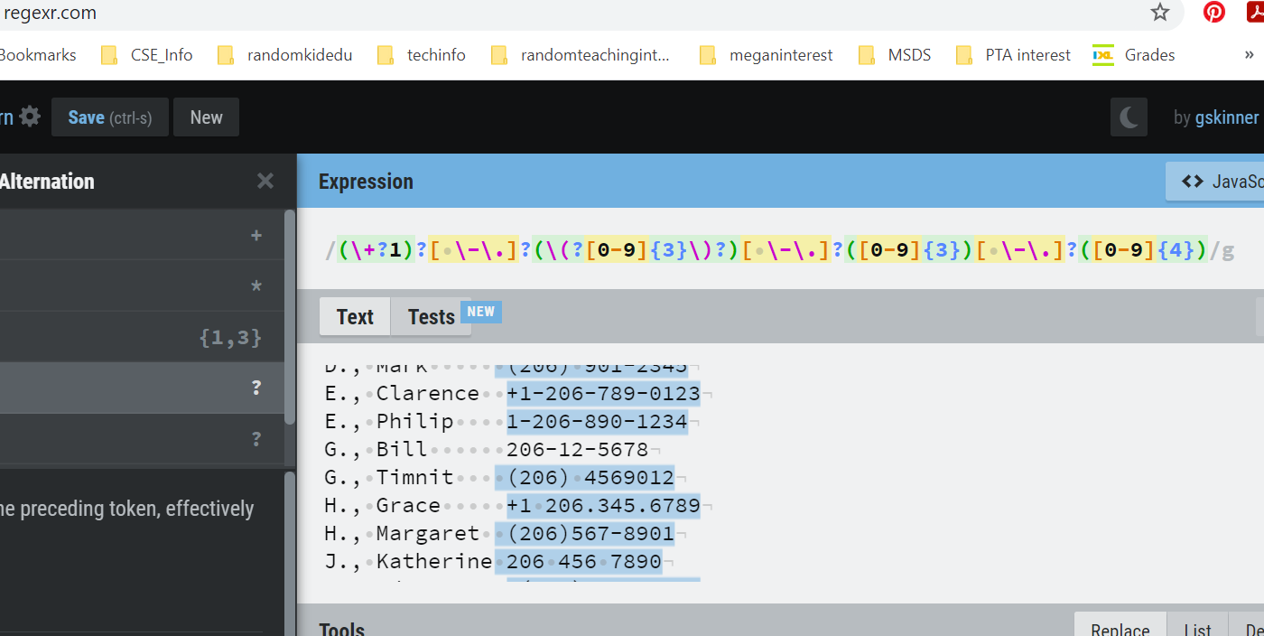
https://regexr.com/

Slide 18
SED
Stream editor: makes basic text transformations on an input stream
Use ‘sed command file[s]’
Changes line by line, one pass through
Run man sed now!

Slide 19
Basic sed
$sed [OPTIONS] [COMMAND] [FILE]
$input_stream | sed [COMMAND]
$sed -i 's/orig/replace/g’ FILE
Useful options:
-i : replace input file with edited version
-e : allows for multiple commands - applies each left to right (sed -e 's/a/A/' -e 's/b/B/' <old >new)
-f : reads command from a file
-n : suppresses output except when told otherwise
Omitting file applies [COMMAND] to stdin

Slide 20
Basic sed (more)
$sed [OPTIONS] [COMMAND] [FILE]
$input_stream | sed [COMMAND]
$sed -i 's/orig/replace/g’ FILE
FILE: An input file, could be more than one.
-i: an example of an OPTION (flag) – this replaces the original file with an edited one.
s/orig/replace/g: the command, enclosed in single quote to avoid globbing. S indicates substitution, orig& replace are regex patterns, g indicates global.

Slide 21
Sed cycle
Read one line from input stream (or file)
Put into pattern space without trailing \n
Execute command
Commands with addresses only executed with those addresses
Pattern space printed to output stream

Slide 22
Sed Addresses
Addresses apply sed only to specific lines. Address comes before command.
Number : only that line number
$: last line of input
First~step : every ‘step’ lines starting with ‘first’
/regexp/ : only lines matching the regular expression
l1,l2: range - between line that matches l1, and line that matches l2 (l1&l2 can be numbers or regex)

Slide 23
Sed Commands
P : print this line (often used with ‘-n’ to suppress printing of non-marked lines)
d : delete this pattern space and continue
y : transliterate characters
a: append text
i : insert text
c : replace text
$ echo hello world | sed 'y/abcdefghij/0123456789/'
74llo worl3$
$ seq 3 | sed '2i hello'
1
hello
2
3
$ seq 10 | sed '2,9c hello'
1
hello
10

Slide 24
SED Demo
wget https://courses.cs.washington.edu/courses/cse374/26sp/assignments/numberslist
Notes:
wc numberslist
4 grep '+\?1\?[- .]\?(\?[0-9]\{3\})\?[- .]\?[0-9]\{3\}[- .]\?[0-9]\{4\}' numberslist
5 grep -c '+\?1\?[- .]\?(\?[0-9]\{3\})\?[- .]\?[0-9]\{3\}[- .]\?[0-9]\{4\}' numberslist
6 sed 's/+\?1\?[- .]\?(\?[0-9]\{3\})\?[- .]\?[0-9]\{3\}[- .]\?[0-9]\{4\}/TEXT/g' numberslist
7 sed -n '/+\?1\?[- .]\?(\?[0-9]\{3\})\?[- .]\?[0-9]\{3\}[- .]\?[0-9]\{4\}/p' numberslist
8 sed -n '/+\?1\?[- .]\?(\?[0-9]\{3\})\?[- .]\?[0-9]\{3\}[- .]\?[0-9]\{4\}/!p' numberslist
9 sed -n '/+\?1\?[- .]\?(\?[0-9]\{3\})\?[- .]\?[0-9]\{3\}[- .]\?[0-9]\{4\}/p' numberslist > phonenumberlist
10 more phonenumberlist
11 wc phonenumberlist
12 sed -e 1d -e 5d numberslist
13 sed 's/+\?1\?[- .]\?(\?\([0-9]\{3\}\))\?[- .]\?\([0-9]\{3\}\)[- .]\?\([0-9]\{4\}\)/(\1) \23/g' phonenumberslist
14 sed 's/+\?1\?[- .]\?(\?\([0-9]\{3\}\))\?[- .]\?\([0-9]\{3\}\)[- .]\?\([0-9]\{4\}\)/(\1) \23/g' phonenumberlist
15 sed 's/+\?1\?[- .]\?(\?\([0-9]\{3\}\))\?[- .]\?\([0-9]\{3\}\)[- .]\?\([0-9]\{4\}\)/(\1) \2-\3/g' phonenumberlist
16 sed 's/\([A-Z]\)., *\([A-Z][a-z]*\) *\(.*$\)/\2 \1\ \3/g' phonenumberlist
17 more phonenumberlist
18 sed 's_+\?1\?[- .]\?(\?[0-9]\{3\})\?[- .]\?[0-9]\{3\}[- .]\?[0-9]\{4\}_TEXT_g' phonenumberlist
19 sed -n '4,$p' phonenumberlist

Slide 25
Sed additional thoughts
Sed encounters one line at a time
and does one pass of the input.
Delimiter ‘/’ can be changed to anything, like ‘_’ or ‘:’
may help if COMMAND contains many ‘/’
Multi-line editing is possible, but painful, with sed (with ‘hold buffer’). Use another scripting program (like ‘awk’).
Branches are also possibly (‘b’ and ‘t’ commands)
Use backreferences (\1, \2 etc) to refer back to regex gathered with \( to \)

Slide 26
What about awk? (or perl? Or ed? Or ruby?)
`awk` allows you to edit an input stream with more power than `sed`
All of these, though, are scripting languages with their own flavor and their own power. `sed` is one of the most basic.

