Slide 1
CSE 374: Programming Concepts and Tools
Spring 2026 Instructor: Megan Hazen

Slide 2
Today’s Goals
Subject Matter
Dive into Bash
Special characters
I/O & Redirection
Variables
Alias
Set up for scripts
Your Goals
HW0
Find description on webage
Complete HW0
Find Gradescope to turn it in
Second practice problem on Gradescope

Slide 3
Aside: Text Editors
Editors
emacs intro
VI reference
choosing
Using Visual Studio remotely
Notes:
Demo emacs -nw

Slide 4

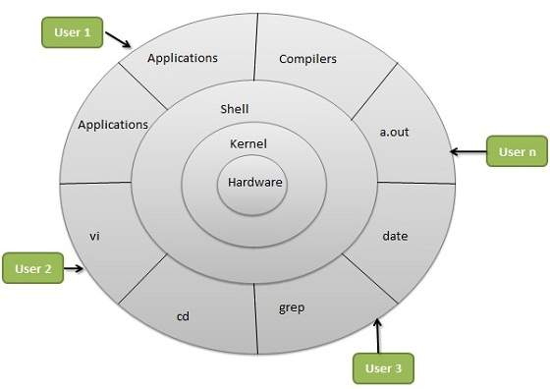
What is Linux?
Linux is an operating system
Portable, open source, built with C
Kernel – does all the hardware interaction
Shell – provides interface for users
Users – control and run various processes (applications)
Notes:
Linux is an operating system. It was conceived as a portable, open source OS modeled after Unix (1969, rewritten in C by Ritchie in 1973), in 1990/91 Linux Tovalds created Linux system kernel, and licensed it under the GNU free software license. Figure thanks to https://www.tutorialspoint.com/operating_system/os_linux.htm

Slide 5
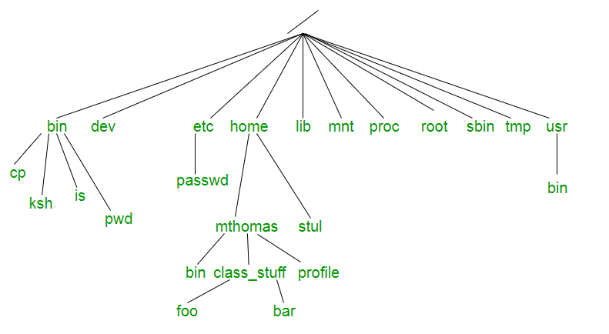
File Systems
Data is stored in files
Files are organized in a file system
File systems are trees
Absolute file address starts from the top (`/`)
Relative file address from current position (`./`) – this directory (`../`) – one directory up
Home directly has short-cut (`~`)
https://tldp.org/LDP/intro-linux/html/sect_03_01.html
- Linux layout, but windows is similar
Demo: whoami, pwd, ls, mkdir, cd, cp, mv, rm, cat

Slide 6
Processes
"On a UNIX system, everything is a file; if something is not a file, it is a process."
Shell essentially runs programs, or processes. Shell *is* a process and has a state.
Usually launch a process and return to shell when done.
Each process has own memory stream and I/O
Stdin (keyboard), stdout (console), stderr
Many processes have options
‘&’ runs process in the background
fg, bg, top, kill
Step through a script with built-in source
Can redirect input and output (‘<’, ‘>’, ‘>>’)
Redirect output, cat, more/less
Notes:
Can run vi and emacs, and put in background. Then fg # will bring one forward or send it back. Ps gives processes, kill ends program, killall –u <username> kills all the processes for that user. More allows you to move around a little, less moves around more. Hitting ‘h’ brings up help.

Slide 7
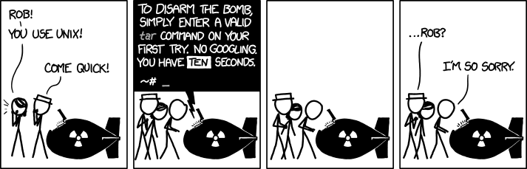
Getting Help
[mh75@calgary ~]$ man date
[mh75@calgary ~]$ date –help
[mh75@calgary ~]$ man –k date
[mh75@calgary ~]$ apropos date
https://tldp.org/LDP/intro-linux/html/sect_02_03.html

Slide 8
Bash as a language
Bash acts as a language interpreter
Commands are subroutines with arguments
Bash interprets the arguments & calls subroutine
Bash also has its own variables and logic

Slide 9
Bash Globbing
Bash applies its own processing ( globbing ) to the I/O
(Input / Output)
Input
Process
Output
[mh75@calgary cse374]$ ls hw0.script
hw0.script

Slide 10
Globbing at work
Bash does redirection, string-expansion, & substitutions
Process only sees the interpreted I/O
Input
Process
Output
Interpreted input
Interpreted output
[mh75@calgary cse374]$ ls *.script
hw0.script hw1.script

Slide 11
Bash Special Characters
Directory Shortcuts
~uname or ~
./ or ../
Wildcards - Globbing
0 or more chars: *
Exactly 1 char: ?
Specified chars: [a-f]
History or `!`
! > < & | * ~ [] “ ‘ ` $ /
\ is escape character
“string”
Glob within the string
‘string’
Use the string as-is
Notes:
https://tldp.org/LDP/abs/html/special-chars.html

Slide 12
Bash Variables
Define variable: i=15
Access variable: $i, ${i}
Undefined variable is empty string
Global scope within environment
See your variables:
printenv
env
set
declare -p
[mh75@calgary ~]$ i=5
[mh75@calgary ~]$ j=
[mh75@calgary ~]$ echo $i
5
[mh75@calgary ~]$ echo $ith
[mh75@calgary ~]$ echo ${i}th
5th
[mh75@calgary ~]$ echo $j

Slide 13
Input-Output (IO) streams
StdIn
StdOut
Process
StdErr
All processes have these three streams
StdIn: keyboard
StdOut = StdErr: terminal output

Slide 14
IO Redirection
Special file: /dev/null
Is EoF if input
Data is discarded if output
>>
Output
file
<
Process
2>
Err file
All processes have these three streams, but, you can redirect
Use ‘<‘ to redirect a file in
Use ‘>’ to redirect out. ‘>>’ appends, ‘2>’ says redirect the second stream, or error
Notes:
https://www.gnu.org/software/bash/manual/html_node/Redirections.html

Slide 15
IO Redirection Syntax
To redirect: | Use this syntax
redirect stdout to a file | command > output
redirect stderr to a file | command 2> output
redirect stdout to stderr | command 1>&2 output
redirect stderr to stdout | command 2>&1 output
redirect stderr and stdout to a file | command &> output

Slide 16
Combining Commands
[mh75@calgary cse374]$ ls | wc
2 2 22
[mh75@calgary cse374]$ wc `ls`
19 99 913 hw0.script
268 1320 32528 hw1.script
287 1419 33441 total
[mh75@calgary cse374]$ wc $(ls)
19 99 913 hw0.script
268 1320 32528 hw1.script
287 1419 33441 total
[mh75@calgary cse374]$ ls hw0.script && wc hw0.script
hw0.script
19 99 913 hw0.script
[mh75@calgary cse374]$ ^hw0.script^hw3.script
ls hw3.script && wc hw0.script
ls: cannot access 'hw3.script': No such file or directory
Can also redirect commands as input to other commands
Cmd1 | cmd2 - pipe output of cmd1 into input of cmd2
Cmd1; cmd2 - do one after another
Cmd1 `cmd2` - use output of cmd2 as argument to cmd1
And do logic with commands
Cmd1 || cmd2 - do cmd2 if cmd1 fails
Cmd1 && cmd2 - do cmd 2 if cmd1 succeeds

Slide 17
Alias
alias
Returns any aliases you have set
Defines a ‘short-cut’ or alias to a command
`unalias`
Aside - .bashrc / .bash_profile
‘preferences’ files that include your personal environment settings
.bash_profile is sourced every time you log-in
.bashrc is sourced every time you open a new interactive shell (usually called by .bash_profile)
Can put aliases or environment variables in .bashrc if you want to always use them.
Notes:
Demo: alias la=‘ls –a’ echo “alias emacs=‘emacs –nw’” >> .bashrc

Slide 18
Shell states & Scripting
Shell has a state
Working directory, aliases, variables, history, streams
Can change your state with command line operations (such as defining a new alias)
Can use `source` to execute all the commands in a file, in your current shell, and change your state.
You can also run commands in a file without changing state – a SCRIPT!
[mh75@calgary cse374]$ echo "alias six='echo 6 7'" >> party
[mh75@calgary cse374]$ six
-bash: six: command not found
[mh75@calgary cse374]$ source party
[mh75@calgary cse374]$ six
6 7

Slide 19
Special Variables
Common variables which set shell state:
$HOME - sets home directory. $HOME=~/CSE374 would reset your home directory to always be CSE374
$PS1 - sets prompt
$PATH - tells shell where to look for things. Often extended: $PATH=$PATH:~/CSE374
Show current state: printenv
Notes:
Demo: PS1=GoNow PS1=“${USER}’s wish: “

Slide 20
Source & Executable
We demonstrated source, but what about running a script?
Want to run in a separate shell
Need to specify what shell / interpreter
#/bin/bash
Need to make the file executable
chmod u+x
CHMOD(1)
NAME
chmod - change file mode bits
SYNOPSIS
chmod [OPTION]... MODE[,MODE]... FILE...
chmod [OPTION]... OCTAL-MODE FILE...
chmod [OPTION]... --reference=RFILE FILE...
[mh75@calgary cse374]$ chmod 744 hello.sh
Notes:
Demo hello.sh

Slide 21
demo
wget https://courses.cs.washington.edu/cse374/26sp/lectures/hello.sh

Slide 22
Happy Weekend
HW 0, start HW1
Practice problems for Lectures 2&3

