Slide 1
CSE 374: Programming Concepts and Tools
Spring 2026
Instructor: Megan Hazen

Slide 2
Today’s Goals
Subject Matter
Memory usage
Profiling Tools
Your Goals
Assessments
  C Basics in-class Monday
  Debugging demo
Keep working on
  HW5 (due Monday)
  HW6 (due May 29)

Slide 3
Memory Hierarchy
Smaller /Faster / Costlier
Larger / Slower / Cheaper
< 1 ns
1 ns
5-10 ns
100 ns
150,ooo ns
1-150 ms
Registers
On-chip L1 cache (SRAM)
Off-chip L2 cache (SRAM)
Main memory (DRAM)
(SSD) Local secondary storage – local disks
Remote secondary storage – remote disks

Slide 4


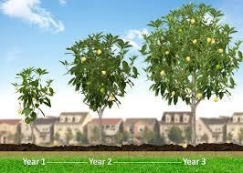
Memory Hierarchy - intuition
Smaller /Faster / Costlier
< 1 ns – 5-10s
1 ns – 20 s
5-10 ns – 1-2 min
100 ns – 15-30 min
150,ooo ns – 31 days
1-150 ms – 1-15 years!
Registers
On-chip L1 cache (SRAM)
Off-chip L2 cache (SRAM)
Main memory (DRAM)
(SSD) Local secondary storage – local disks
Remote secondary storage – remote disks
Larger / Slower / Cheaper
Notes:
If on-chip is cutting up an avocado to eat, going to disk is like going to the store to get an avocado, and going to a remote disk is like waiting for an avocado tree to grow you an avocado!

Slide 5
Processor-Memory Bottleneck
Main
Memory
CPU
REG
CACHE
CPU speed has grown faster than bandwidth for data transfer
Latency every time CPU has to go to the main memory
‘cache’ solution keeps recently accessed memory available
  Loads a ‘block’ of memory at a time
    Block size is architecture dependent. ~4 Kilobytes

Slide 6
Memory Hierarchy - Caches
Smaller /Faster / Costlier
Program sees ‘memory’ but hardware manages transparently
Larger / Slower / Cheaper
Registers: program addresses specifically
Cache L1
Cache L2 ‘Program Memory’
Main Memory
150,ooo ns
10,000,000 ns
1-150 ms
Registers
On-chip L1 cache (SRAM)
Off-chip L2 cache (SRAM)
Main memory (DRAM)
(SSD) Local secondary storage – local disks
Remote secondary storage – remote disks
Notes:
What this means is that processes that access memory don’t scale linearly with bytes. There is a discontinuity if you must go to the main memory instead of a cache.

Slide 7
Cache Mechanics
Cache (smaller, faster, more expensive) holds subset of blocks
Data is copied in block-sized units
Memory (larger, slower, cheaper) can be considered divided into blocks
7
11
3
9
0
1
2
3
4
5
6
7
8
9
10
11
12
13
14

Slide 8
Cache Mechanics - retrieval
If data from a block IN the cache is requested, it is easy to retrieve
Data is sent to CPU
7
11
3
9
0
1
2
3
4
5
6
7
8
9
10
11
12
13
14

Slide 9
Cache Mechanics – retrieve from memory
7
11
3
9
If data from a block NOT IN the cache is requested
Data is first loaded from main memory to the cache
Second it is passed to the CPU
0
1
2
3
4
5
6
7
8
9
10
11
12
13
14

Slide 10
Cache locality
Locality: Programs tend to use data and instructions with addresses near or equal to those they have used recently
Temporal locality:
  Recently referenced items are likely to be referenced again in the near future
Spatial locality:
  Items with nearby addresses tend to be referenced close together in time
Analogy: took a bite of sandwich, probably going to take a bite out of other half of sandwich (as opposed to a new sandwich)
How do caches take advantage of this?

Slide 11
Locality
sum = 0;
for (i = 0; i < n; i++) {
sum += a[i];
}
return sum;
We consider locality in order to increase chances of a hit on the cache for memory retrieval
Temporal locality: sum referenced every iteration
Spatial locality: consecutive elements of array[] accessed
Notes:
Notice that this is iterative.

Slide 12
Locality example (good)
int sum_array_rows(int a[M][N]) {
int i, j, sum = 0;
for (i = 0; i < M; i++)
for (j = 0; j < N; j++)
sum += a[i][j];
return sum;
}
Memory is accessed
a[0][0], a[0][1], …
…
a[3][2], a[3][3]
In other words, spatial locality.
Notes:
Notice that this is iterative.

Slide 13
Locality example (bad)
int sum_array_rows(int a[M][N]) {
int i, j, sum = 0;
for (i = 0; i < N; i++)
for (j = 0; j < M; j++)
sum += a[j][i];
return sum;
}
Memory is accessed
a[0][0], a[1][0], …
…
a[2][3], a[3][3]
NO spatial locality.
Notes:
Notice that this is iterative.

Slide 14
Locality challenge
// Compute y = mx + b for each point
void compute_line(float m, float b, float* points, int n) {
for(int i = 0; i < n; i++) {
points[i] = m * points[i];
}
for(int i = 0; i < n; i++) {
points[i] = b + points[i];
}
}
Can you improve temporal locality?
Notes:
Notice that this is iterative.

Slide 15
Locality challenge solution
// Compute y = mx + b for each point
void compute_line(float m, float b, float* points, int n) {
for(int i = 0; i < n; i++) {
points[i] = m * points[i];
points[i] = b + points[i];
}
}
Can you improve temporal locality?
Notes:
Notice that this is iterative.

Slide 16
Writing Cache friendly code
Write code that has locality!
Spatial: access data contiguously, use small strides
Temporal: make sure access to the same data is not too far apart in time, keep working set reasonably small
How can you achieve locality?
Adjust memory accesses in code (software) to improve miss rate (MR)
  Requires knowledge of both how caches work as well as your system’s parameters
Proper choice of algorithm
Loop transformations

Slide 17
Memory Summary
Memory Hierarchy
Successively higher levels contain “most used” data from lower levels
Accessing the disk is very slow
  This is why we discourage excess I/O in homework assignments!
Exploits temporal and spatial locality
Caches are intermediate storage levels used to optimize data transfers between any system elements with different characteristics
Cache Performance
Ideal case: found in cache (hit)
Bad case: not found in cache (miss), search in next level

Slide 18
Software specifications
How do you know what software is supposed to do?
Software engineering:
  Requirements engineering
  Specification writing & documentation
  Architecture and design
  Programming
  Testing & Debugging
  Deploying, operating, evolving
Effectiveness ?
Does what it is supposed to do
Fails gracefully
Uses memory safely and efficiently
Computes in reasonable time
Notes:
Specifications are the domain of a software engineer – go far beyond just writing code.
Gold text is real software engineering work, but not the topic of today’s discussion. The software engineering work tends to go in a cycle.

Slide 19
Beyond Buglessness
Numerically reliable
Memory safe
Memory efficient
Operations efficient
Scales well

Slide 20
Benchmarks
Compare performance against a standard measure
Compare to industry standards
  How are you doing compared to other solutions?
Compare to previous performance
  Is your implementation getting better?
3DMark (gamers hardware tests)
MMLU (Language understanding)
Frontier Math (AI math ability)
Humanities Last Exam (multi-modal AI benchmark)

Slide 21
Basics
Write Code
Run Test Cases & Benchmarks
Profile code
Run linter for style (python clint.py)

Slide 22
Profiling Tools
Investigate run-time behavior of code at different points
Checks time taken by instructions from machine language to high-level functions
  actual time
  number of calls to the instruction
Flat profiler - computes average call times, does not break down calls
Call graph profiler - shows chains based on called functions
Can use common benchmarks which exercise the code on tricky problems or corner cases
  Goal of benchmark is to provide a standard test
  Goal of profiler is to break down how the code is achieving its results

Slide 23
Insertion v Sampling profilers
Insertion
Sampling
Place specific profiling code in program
Can be used on various platforms
Accurate
Requires recompilation and relinking
Will affect performance
Monitoring or snap-shotting at specific intervals
No modification of code
Less accurate - limited by sampling rate
Very small methods often missed
Not great for memory

Slide 24
$gprof
-----------------------------------------------
0.00 0.06 102/102 main [1]
[2] 100.0 0.00 0.06 102 optimize [2]
0.00 0.04 2040000/2040000 update_pos [4]
0.02 0.00 2040000/2040000 update_vel [5]
0.00 0.00 102/102 initialize_opt [6]
0.00 0.00 51000/51000 update_gb [7]
-----------------------------------------------
0.00 0.00 100/2008449 main [1]
0.00 0.00 4000/2008449 initialize_opt [6]
0.04 0.00 2004349/2008449 update_pos [4]
[3] 66.7 0.04 0.00 2008449 rastrigin [3]
-----------------------------------------------
0.00 0.04 2040000/2040000 optimize [2]
[4] 66.5 0.00 0.04 2040000 update_pos [4]
0.04 0.00 2004349/2008449 rastrigin [3]
0.00 0.00 20085/20126 rosenbrock [8]
0.00 0.00 20085/20126 spherefunc [9]
Gnu profiling tool (insertion)
Compile with $gcc -pg flag
$./mainopt
Creates gmon.out
Run profiler with
$gprof ./mainopt

Slide 25
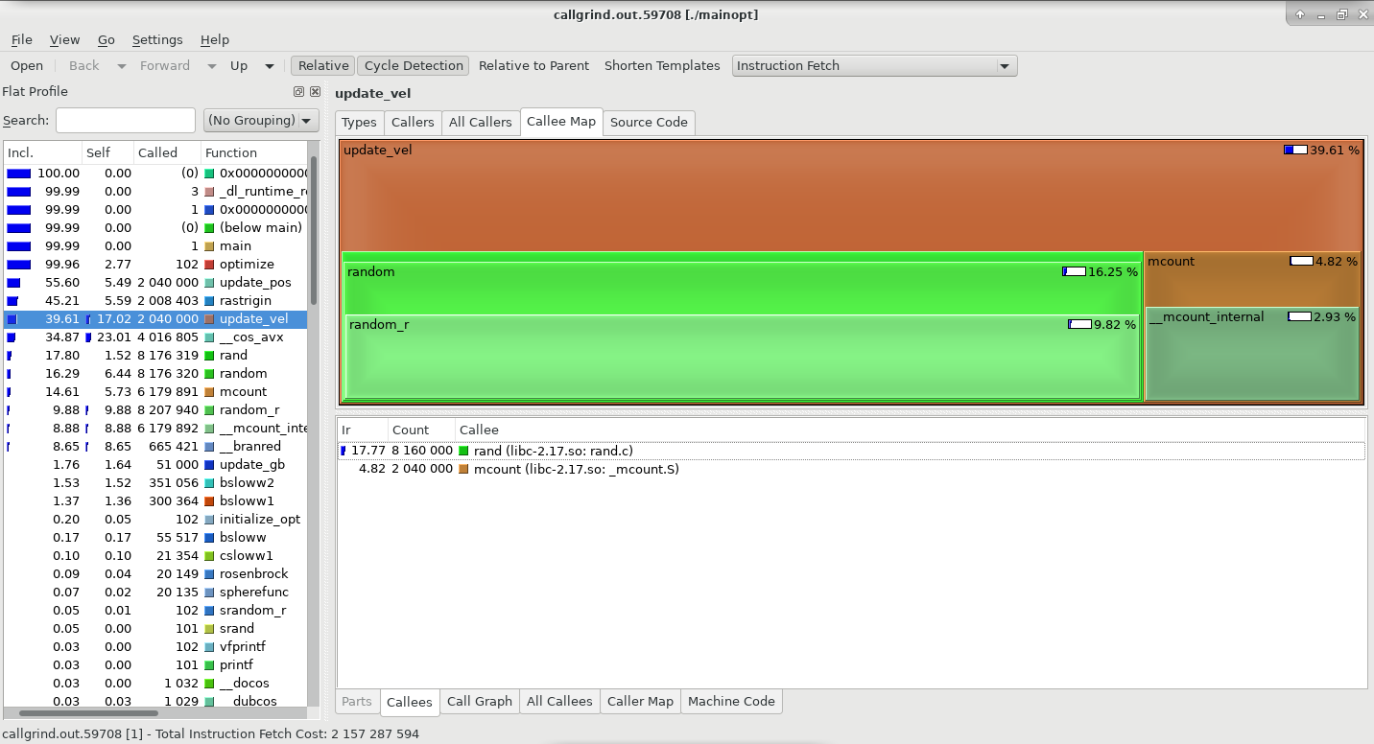
$valgrind –tool=callgrind
$valgrind --tool=callgrind ./mainopt
Creates callgrind.out.X
You can read output file
But its tricky; try:
$kcachegrind callgrind.out.X
(Must install cachegrind / needs graphical interface)

Slide 26
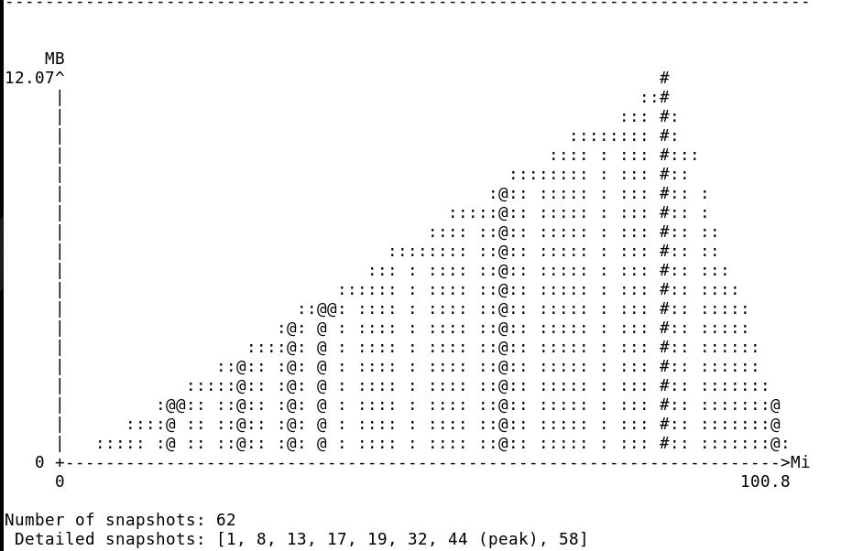
$valgrind –tool=massif
$valgrind --tool=massif ./mainopt
Creates massif.out.X
You can read output file
But its tricky; try:
$ms_print massif.out.X

Slide 27
Demo: Search?
Search has a large number of applications and shows up in many different fields:
Optimize control settings (intelligent control)
Find low energy states (protein structure determination)
Fit functions to data (machine learning)
Train deep neural networks (LLMs)
Minimize a function f0 : R^{n} → R, the objective function, over a specified set C ⊂ R^{n} , the feasible set
Feasibility: x ∈ C
Optimality: a feasible solution such that f0(x*) ≤ f0(x) for all other feasible solutions x

Slide 28
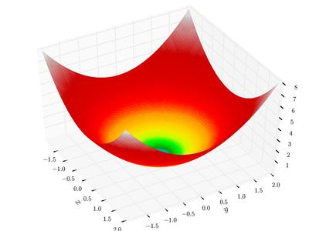
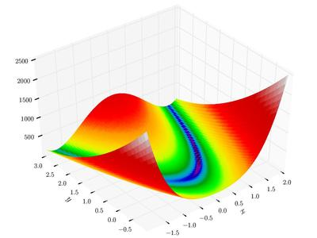
Demo search benchmarks
Benchmark functions represent different complexities, often with different levels of complexity.
  Sphere function nicely behaved convex function
  Rosenbrock quali-convex with poorly behaved slope
  Rastrigin (not pictured) non-convex and highly multi-modal
Can you solve the benchmark?
  How close do you get?
How long does it take?
How much memory?

Slide 29
Demo: Particle Swarm
float* optimize(float (*obj)(float*), float* mins, float* maxs) {
// initialize population
particle* population;
// global best position and global best value
float* gb =(float*) malloc(DIM*sizeof(float));
float gbval;
population = initialize_opt(obj, mins, maxs, gb, &gbval);
// for MAXITS update population and global best
for (int i = 0; i < MAXITS; i++) {
update_gb(population, gb, &gbval);
for (int p = 0; p < POPSIZE; p++) {
update_vel(&population[p], gb);
update_pos(obj, &population[p]);
}
}
free(population);
return gb;
}
Particle swarm optimization (PSO) is a population based stochastic optimization technique developed by Dr. Eberhart and Dr. Kennedy in 1995, inspired by social behavior of bird flocking or fish schooling. ○ Akin to genetic algorithms…
Used to find the global optimum of potentially non-convex functions.
Notes:
Notice that this is iterative.

Slide 30
Extras

Slide 31
Memory Model
Code Globals Heap-> <-Stack
Each byte of memory has an address
Lowest memory stores program instructions, then global variables (static constants, string literals)
‘Heap’ holds dynamically allocated variables (‘new’ or ‘malloc’ variables)
‘Stack’ holds current instructions, each function in a frame
  ‘Stack’ memory implies that a frame is added, and then the last frame added is removed first

Slide 32
Memory (zoomed in) (bkup)
char – 1 byte int – 4 bytes
Each byte of memory has an address
Different data types need different amount of memory to store them
All data types are stored as binary code: each of the 8 bits in a byte is a zero or one.

Slide 33
Memory (zoomed in even more)
0
0
0
0
0
0
0
0
0
0
0
0
0
0
0
0
0
1
1
0
0
0
0
1
0
0
0
0
0
0
0
0
0
1
1
0
0
0
0
1
char – ‘a’ in binary int – 97 in binary
All data types are stored as binary code: each of the 8 bits in a byte is a zero or one.

