Slide 1
CSE 374: Programming Concepts and Tools
Spring 2026
Instructor: Megan Hazen

Slide 2
Today’s Goals
Subject Matter
Computer Model
What is Linux?
What is the Shell?
  What is Bash?
Accessing Calgary
Getting started with Bash
Your Goals
Log onto Calgary
Do first practice problem on Gradescope
HW0
  Find description on webage
  Complete HW0
  Find Gradescope to turn it in

Slide 3
Computer Model
User 1
User 2
Software: Operating system, system software, Applications
Hardware: CPU, RAM, Keyboard

Slide 4
Hardware
Motherboard
Power
CPU – registers to store data & instructions,
logic circuits to execute instructions
GPU - many low powered CPUS in parallel
RAM (Random Access Memory)
Disk drive / solid state drive
Keyboards & Mice
Monitors
Network components
Hardware: CPU, RAM, Keyboard

Slide 5
Users
User 1
User 2
One or more users simultaneously
Run processes (software)
Interact with hardware

Slide 6
Software
Operating system
Hardware abstraction (device drivers)
Networking
Scheduling
File System
Software: Operating system, system software, Applications
System software
System libraries
Application software

Slide 7

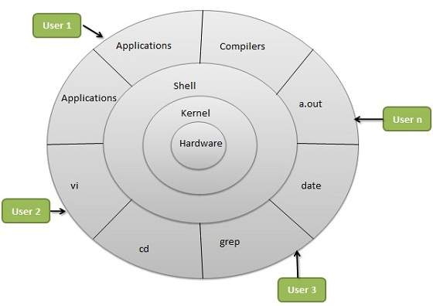
What is Linux?
Linux is an operating system
Portable, open source, built with C
Kernel – does all the hardware interaction
Shell – provides interface for users
Users – control and run various processes (applications)
Notes:
Linux is an operating system. It was conceived as a portable, open source OS modeled after Unix (1969, rewritten in C by Ritchie in 1973), in 1990/91 Linux Tovalds created Linux system kernel, and licensed it under the GNU free software license.
Figure thanks to https://www.tutorialspoint.com/operating_system/os_linux.htm

Slide 8
What operating systems can you name?

Slide 9
Linux variants
Different kernel versions
  For different hardware
  Newer features
  Optimized for different things
Different distributions
  Run on a kernel
  Offer different software on top of the kernel
Calgary runs Rocky Linux (distro) version 10.1, 64-bit address space
[mh75@calgary ~]$ uname -a
Linux calgary.cs.washington.edu 6.12.0-124.40.1.el10_1.x86_64 #1 SMP PREEMPT_DYNAMIC Tue Mar 3 18:15:11 UTC 2026 x86_64 GNU/Linux

Slide 10
What is the shell?
Text is efficient - typing is fast, and there aren’t big image objects to pass around
Scripting makes it easy to automate text-based interfaces
Linux does have a graphical interface
Windows and MacOS do have shell interfaces
Most power users use BOTH
This course uses Calgary, running a Rocky Linux distribution (or flavor?)
You could use any distribution of Linux that is up-to-date, but may have inconsistencies.
There are also ‘flavors’ of shells. We will use Bash for this course.
For most things you can use any terminal interface - MacOS standardly is using Zsh

Slide 11
Log into Calgary
https://courses.cs.washington.edu/courses/cse374/26sp/resources/linux.html
Everyone should have an account on calgary that uses your united log-in - send email to cse374-staff if you can not access yours.
PS C:\Users\mh75> ssh mh75@calgary.cs.washington.edu
Notes:
This is a good time for a demo. Powershell, log in, uname –a, echo $HOSTNAME

Slide 12
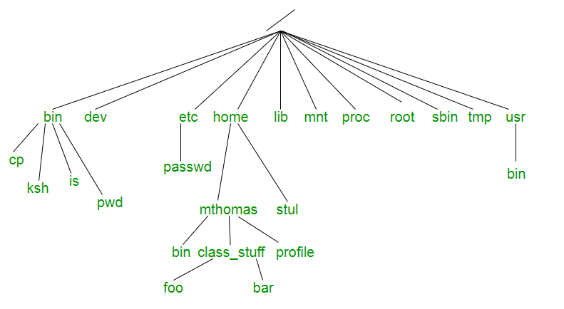
File Systems
Data is stored in files
Files are organized in a file system
File systems are trees
Absolute file address starts from the top
(`/`)
Relative file address from current position
(`./`) – this directory
(`../`) – one directory up
Home directly has short-cut
(`~`)
https://tldp.org/LDP/intro-linux/html/sect_03_01.html
- Linux layout, but windows is similar
Demo: whoami, pwd, ls, mkdir, cd, cp, mv, rm, cat

Slide 13
Processes
"On a UNIX system, everything is a file; if something is not a file, it is a process."
Shell essentially runs programs, or processes. Shell *is* a process and has a state.
Usually launch a process and return to shell when done.
Each process has own memory stream and I/O
Stdin (keyboard), stdout (console), stderr
Many processes have options
‘&’ runs process in the background
fg, bg, top, kill
Step through a script with built-in source
Can redirect input and output (‘<’, ‘>’, ‘>>’)
Redirect output, cat, more/less

Slide 14
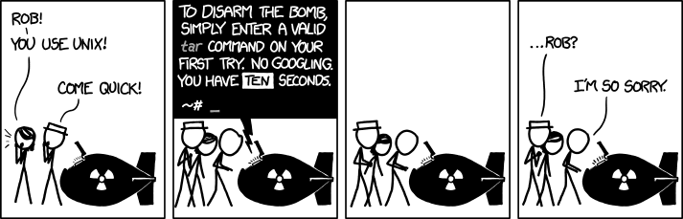
Getting Help
[mh75@calgary ~]$ man date
[mh75@calgary ~]$ date –help
[mh75@calgary ~]$ man –k date
[mh75@calgary ~]$ apropos date
https://tldp.org/LDP/intro-linux/html/sect_02_03.html

Slide 15
Bash as a language
Bash acts as a language interpreter
  Commands are subroutines with arguments
  Bash interprets the arguments & calls subroutine
  Bash also has its own variables and logic

Slide 16
Bash Globbing
Bash applies its own processing ( globbing ) to the I/O
(Input / Output)
Input
Process
Output

Slide 17
Globbing at work
Bash does redirection, string-expansion, & substitutions
Process only sees the interpreted I/O
Input
Process
Output
Interpreted input
Interpreted output

Slide 18
Bash Special Characters
Directory Shortcuts
  ~uname or ~
  ./ or ../
Wildcards - Globbing
  0 or more chars: *
  Exactly 1 char: ?
  Specified chars: [a-f]
History or `!`
! > < & | * ~ [] “ ‘ ` $ /
\ is escape character
“string”
  Glob within the string
‘string’
  Use the string as-is

Slide 19
Office hours today
10:30-11:00 CSE1 462

