Slide 1
CSE 374: Programming Concepts and Tools
Spring 2026
Instructor: Megan Hazen

Slide 2
Today’s Goals
Subject Matter
Linked Lists
Multiple files
Your Goals
Look at info for Assessment 3
Get started on HW4

Slide 3
Struct Tags: typdef - inline
Has type struct person_info
‘Person_info’ is a struct tag, not a type
Can use typedef to rename
typdef struct person_info {
char * name;
int age;
} person_info;
person_info *me;
person_info you;
me->age = 99;
you.age = 25;
Notes:
What seems different from a Java class?

Slide 4
Data Structures
Organization of data that has some internal structure
  Relationship is encoded in the way the data is stored
  Dictates the types of operations that are performed on the data
Arrays (very simple – just adjacent values)
Records (associated values – essentially a struct)
Hash tables (allow look up by value)
Graphs
Lists: stacks / queues
Trees

Slide 5
Data Structures in C
Organization of data that has some internal structure
  Relationship is encoded in the way the data is stored
  Dictates the types of operations that are performed on the data
Arrays (very simple – just adjacent values)
Records (associated values – essentially a struct)
Hash tables (allow look up by value)
Graphs
Lists: stacks / queues
Trees
We build records / nodes
  Define a struct to contain values
We use pointers to associate nodes with other nodes
C is procedural, not objected oriented
  We write functions that act on nodes
  Instead of nodes having methods that act on themselves….

Slide 6
Lists
front
data
next
data
next
data
NULL
// A single list node that stores an integer as data.
typedef struct IntListNode {
int data;
struct IntListNode* next;
} IntListNode;
// Allocates a new node on the heap.
IntListNode* makeNode(int data, IntListNode* next);

Slide 7
List nodes - making
front
data
next
data
next
data
NULL
IntListNode* makeNode(int data, IntListNode* next) {
IntListNode* n = (IntListNode*) malloc(sizeof(IntListNode));
if (n) { // malloc might return null
n->data = data;
n->next = next;
}
return n;
}

Slide 8
Lists - building
front
NULL
IntListNode* fromArray(int* array, int length) {
IntListNode* front = NULL;
for (int i = length - 1; i >= 0; i--) {
front = makeNode(array[i], front);
if (front == NULL) {
return NULL;
}
}
return front;
}

Slide 9
List nodes – building, one node
front
data
NULL
IntListNode* fromArray(int* array, int length) {
IntListNode* front = NULL;
for (int i = length - 1; i >= 0; i--) {
front = makeNode(array[i], front);
if (front == NULL) {
return NULL;
}
}
return front;
}

Slide 10
Data structures – keeping track
List {
node* Head;
node* Tail;
}
data
next
data
NULL
It is important not to lose your pointers
  Create another data structure that always holds these important addresses?

Slide 11
Data structures - freeing
front
data
next
data
next
data
NULL
void freeList(IntListNode* front) {
while (front != NULL) {
IntListNode* next = front->next;
free(front);
front = next;
}
}

Slide 12
Building library modules
lldemo
One set of code to define linked list:
  Linkedlist.h
  Linkedlist.c
Another piece of code uses it:
  Linkedlistclient.c
  #include “linkedlist.h”
Linkedlist.o
Linkedlistclient.o
linkedlist.c
Linkedlistclient.c
Linkedlist.h
Compile with
$gcc -o lldemo linkedlist.c linkedlistclient.c

Slide 13
Challenge
What code goes in linkedlist.h?
What code goes in linkedlist.c?
  What are the includes?
What code goes in linkedlistclient.c?
  What are the includes?

Slide 14
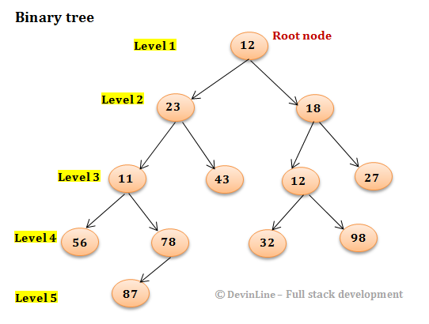
Binary Trees
struct BinaryTreeNode {
int data;
struct BinaryTreeNode* left;
struct BinaryTreeNode* right;
}
struct BinaryTree {
Struct BinaryTreeNode* root;
}

Slide 15
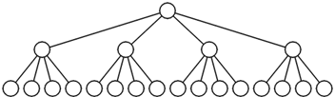
N-ary Trees
struct TrinaryTreeNode {
char* data;
struct TrinaryTreeNode* left;
struct TrinaryTreeNode* middle;
struct TrinaryTreeNode* right;
}
struct QuadTreeNode {
char* data;
struct QuadTreeNode* children[4];
}
Arbitray branching-number
It may work better to have an indexed array of branch pointers, or an extendable and variable length list of branch pointers

Slide 16
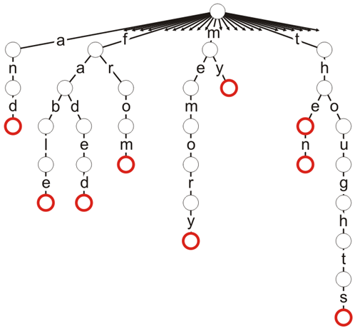
Prefix Trees (Trie)
Compact storage
  Or generative automaton
Key of each node defined entirely by position
Compact data storage
Efficient worst-case searching
Strings often use 26-ary tree
  Predictive text
  Spell check
Notes:
So, we’re introducing a prefix tree. Here, the idea is that each branch is associated with a letter. (So, the english alphabet would have a branching factor of 26.) The nodes are defined by the path that is taken to get to them. For example, the left-most red node is reaching by taking branch a, branch n, and then branch d. This node is associated with a word - ‘and’. Some nodes have words, some nodes don’t. All the leaf nodes have words, and some of the interior ones. (Why would a none-leaf node have a word?).

Slide 17
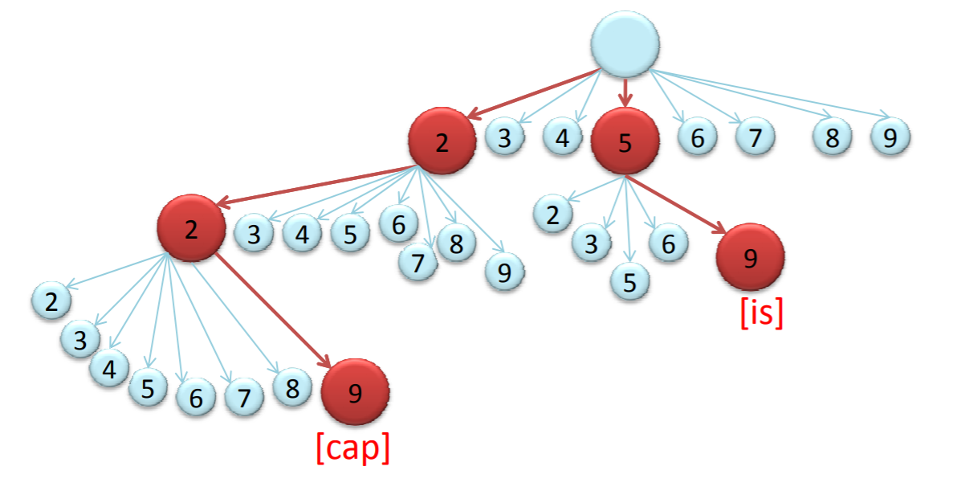
T9 Trie
Number pad buttons associated with letters – could be used to type characters
What is the branching factor?
What does a node contain?
  What data is in a node?
  How might we store the branches?
Keypad | Keypad | kepad
1 | 2 a b c | 3 d e f
4 g h i | 5 j k l | 6 m n o
7 p q r s | 8 t u v | 9 w x y z
* | 0 _ | #

