Slide 1
CSE 374: Programming Concepts and Tools
Spring 2026 Instructor: Megan Hazen

Slide 2

Megan Hazen
PhD Electrical Engineering, UW Machine learning expert Data Science professor
Call me Megan, Dr. Hazen, Professor Hazen, she/they/nerd
Catch me biking to work or reading a book…
Come to my office to talk debugging, eat cookies, or just enjoy the view

Slide 3
Today’s Goals 1
My Job
About this course
Instructional set-up
Assignments
Resources
Course staff
Web page
EdStem
Schedule
Course Standards
Your Job
Find your resources
Read the syllabus
Find the course calendar
Get started with technology
Post on Ed, or attend office hours

Slide 4
What is this course?
CSE 374 is a practical course about
Command line tools and scripts to automate tasks
Linux and a computer model
C programming with explicit memory management
Data storage and manipulation
Programming tool stack & Object Oriented Programming
Software engineering impacts
CSE 374 is also
A chance to learn how to learn
A path to being a power user
Notes:
We cover a lot of specific material, but we also talk about why that material looks the way it does, and what effect it has on what we can do with computers.

Slide 5
Major topics of 374
Command line and scripting tools - Linux, Bash, automation
C programming and memory management – How does a program interface with memory?
Tools for programming - Compilers, debuggers, version control, Makefiles
C++ Programming – Object oriented design and larger software projects
Software development and testing - Software specs, tests, and teamwork
Concurrency & Profiling – Understanding more about memory usage

Slide 6
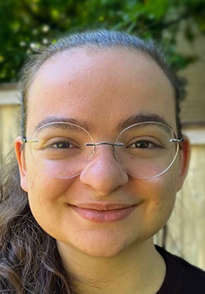


Who we are
Professor Megan Hazen
TAs
Naama Amiel
Perry Chien
Michael Ibrahim
William Tsai
Selina Wang
Contact Us
Course Webpage
Ed Discussion
Email: cse374-staff@cs.Washington.edu
Come to office hours

Slide 7
Who you are
Declared Majors When taking the course
67% ELECTRICAL AND COMP ENGR
11% INFORMATICS
7% ACMS (DISCRETE MATH AL)
3% PRE SCIENCE
2% APPLIED MATH: DATA SCI
2% APPLIED MATHEMATICS
2% ACMS (SCI COM & NUM AL)
Concurrent Courses When taking the course
15% E E-469
13% E E-474
11% E E-398
9% E E-477
8% BIOL-130
8% M E-398
7% CSE-415
7% CSE-416

Slide 8
Today’s Goals 2
My Job
About this course
Instructional set-up
Assignments
Resources
Course staff
Web page
EdStem
Schedule
Course Standards
Your Job
Find your resources
Read the syllabus
Find the course calendar
Get started with technology
Post on Ed, or attend office hours

Slide 9
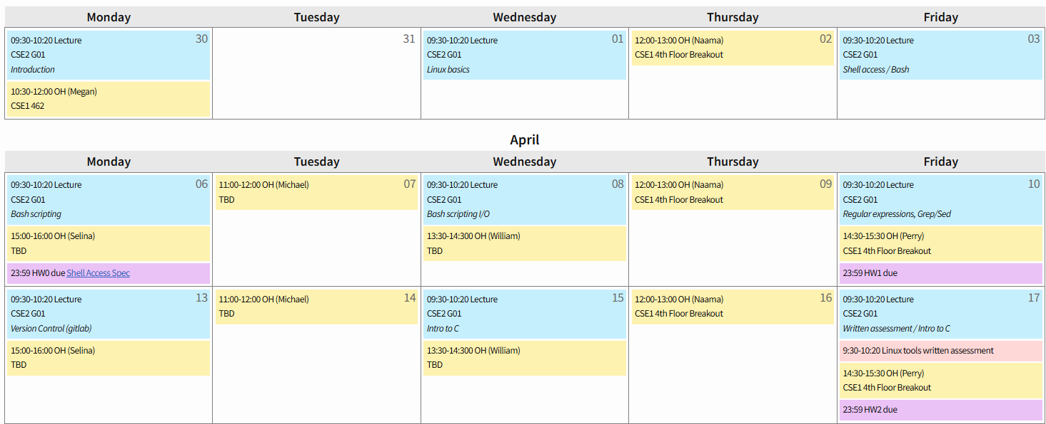
Logistics
Lecture Monday, Wednesday, Friday 9:30-10:20am in CSE2 G01
- Prepare for active learning, feel free to bring a laptop
No section, but office hours (mostly) daily

Slide 10
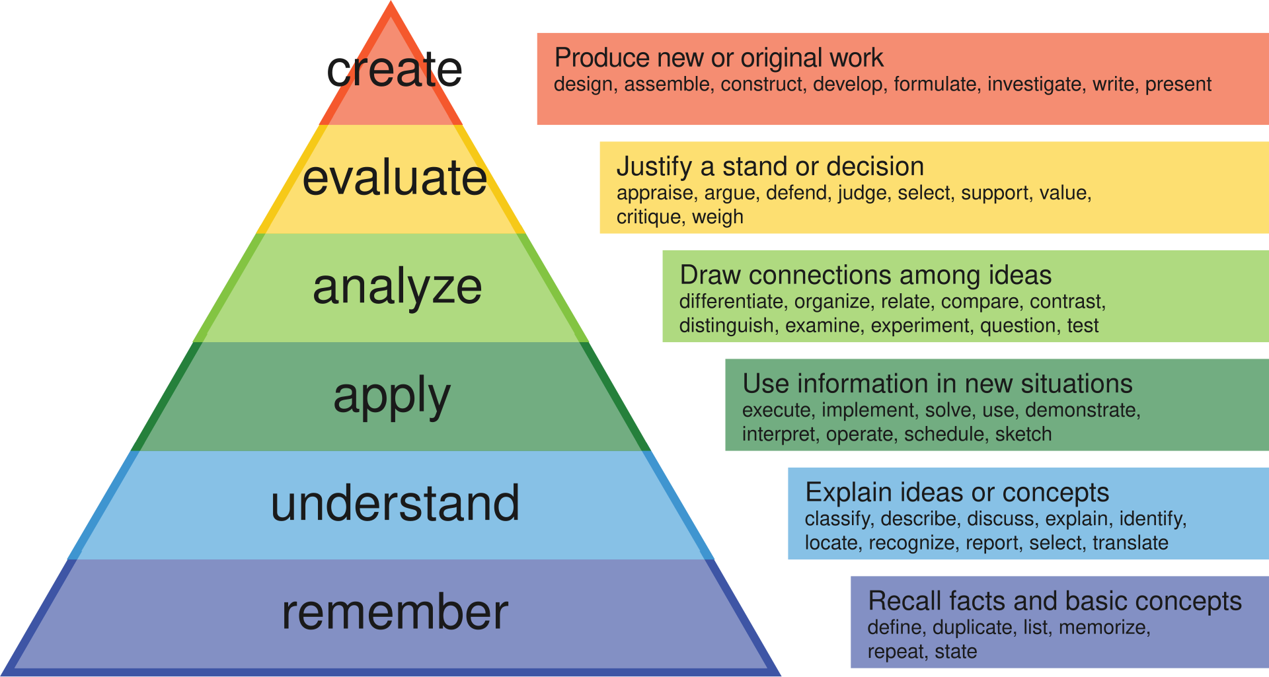

Course work & grading
Practice Problems: Very short credit/no-credit exercises designed for remembering and understanding material.
Homework Projects: Longer form work in which students apply, analyze, and create with course material.
Assessments: Formal evaluations (tests/oral demonstrations) provide information about individual mastery
Bloom, B.S. (1956) Taxonomy of Educational Objectives, Handbook: The Cognitive Domain. David McKay, New York.

Slide 11
Course work & grading details
Work-type | Number Frequency | Grading | Late Policy
Practice Problems: Very short credit/no-credit exercises designed for remembering and understanding material. | 25 ~ every lecture | Credit / no-credit # complete/25 25% of final grade | No late submissions
Homework Projects: Longer form work in which students apply, analyze, and create with course material. | ~ 8 Weekly | Variable points Points_earned/points possible 50% of final grade | Up to 3 late days per assignment, 10 late days per quarter
Assessments: Formal evaluations (tests/oral demonstrations) provide information about individual mastery | 4 | 25 points each Sum of points_earned 25% of final grade | Missed assessments get 0 points

Slide 12
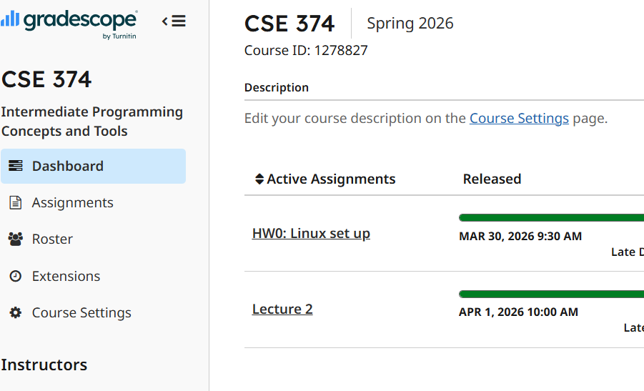
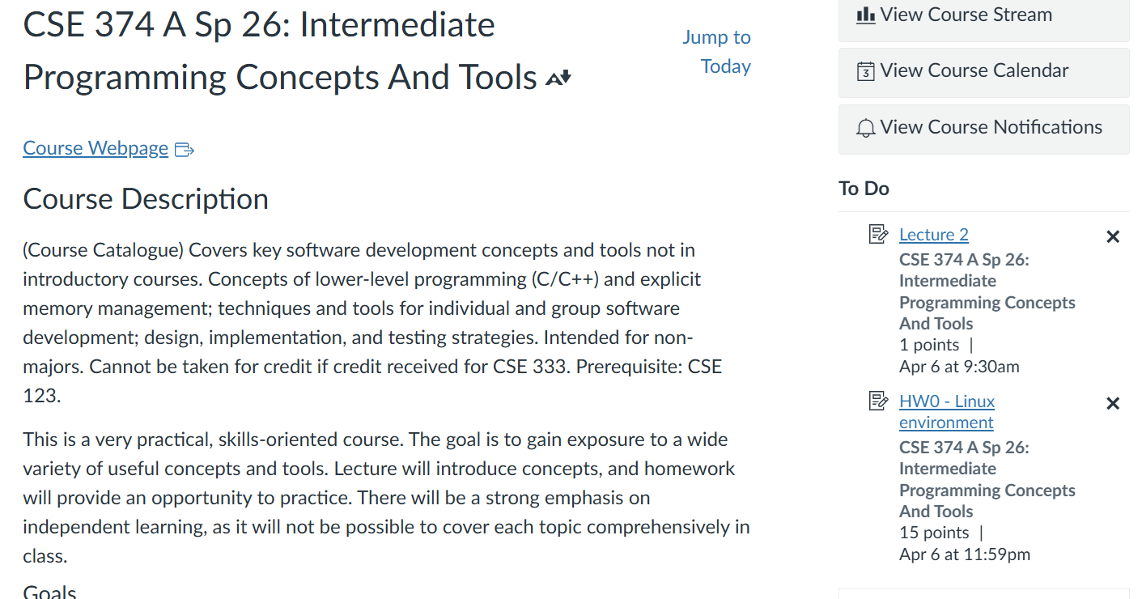
Staying on top of work
Work is turned in via Gradescope
If the interface is new to you, please ask for help
Assignments will show up there as they are published
We will also (later) submit work to Gradescope via Github – instructions will be provided
Grades are tracked via Canvas
As much as possible, Canvas assignment list will also be kept up to date
All materials are tracked on the webpage calendar
Including assessment dates
And links to helpful references

Slide 13
Expectations
You are responsible for material on the webpage
Keep track of the calendar, follow the links
Learning how to learn is part of the plan Look at documentation Search for answers
You are in charge of your own learning You will get out of the course what you put into it

Slide 14
Today’s Goals 3
My Job
About this course
Instructional set-up
Assignments
Resources
Course staff
Web page
EdStem
Schedule
Course Standards
Your Job
Find your resources
Read the syllabus
Find the course calendar
Get started with technology
Post on Ed, or attend office hours

Slide 15
Resources
Instructor and TAs
Ask questions in lecture
Office hours are frequent
We are here to help
Edstem Discussion Group
Email (cse374-staff@cs)
Canvas Page
Course Web page
Resources list on web page
Use web searches / AI as a starting place only
Go to formal references for more info and authoritative answers
Don’t cut-and-paste, do you own work.

Slide 16
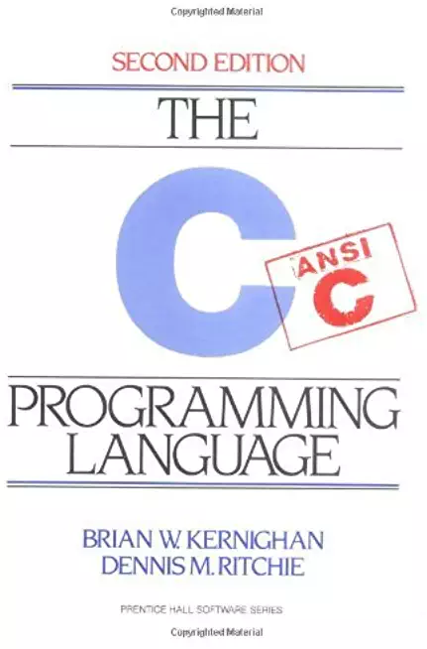

Books
Resources tab on webpage offers a lot of source material
Two books may be helpful – great references with detailed information (check the library!)
Linux Pocket Guide, Barrett, O'Reilly, 3rd ed., 2016 (different editions are ok too)
The C Programming Language, Kernighan & Ritchie, Prentice-Hall, 2nd ed, 1988
May also use web resources and (sparingly) AI

Slide 17
Today’s Goals 5
My Job
About this course
Instructional set-up
Assignments
Resources
Course staff
Web page
EdStem
Schedule
Course Standards
Your Job
Find your resources
Read the syllabus
Find the course calendar
Get started with technology
Post on Ed, or attend office hours

Slide 18
Course Standards
Every student in this course is capable and deserves to thrive with this material
Different life experiences may dictate different needs for learning; we’ll figure it out
Course staff are authorities who are respected by course participants

Slide 19
Integrity
Your integrity is everything
Policy on course webpage & Allen school webpage
Do your own work; be ready to explain it
Unless otherwise specified, all work is independent effort
Do not share code; discuss an approach
Do not copy an answer; ask about an idea
Do not use AI’s solution; ask only small questions of AI

Slide 20
Integrity Again
You must never copy actual code or written answers from another student or AI
Modifying code or other artifacts does not make them your own
You must not look at previous solutions, nor should you share your own
You must cite any help you received, including on-line references or AI responses. #comment in code
You should be prepared to explain any of your submitted work
Your integrity is everything

Slide 21
How to succeed
Show up and be an active learner
Stay on top of assignments
Being an expert requires practice
Ask for help early and often
Don’t be afraid to try something out; play with ideas

Slide 22
Office hours today
10:30-12:00 CSE1 462

Slide 23
Today’s Goals – your job
My Job
About this course
Instructional set-up
Assignments
Resources
Course staff
Web page
EdStem
Schedule
Course Standards
Your Job
Find your resources
Read the syllabus
Find the course calendar
Get started with technology
Post on Ed, or attend office hours

